Slide 1
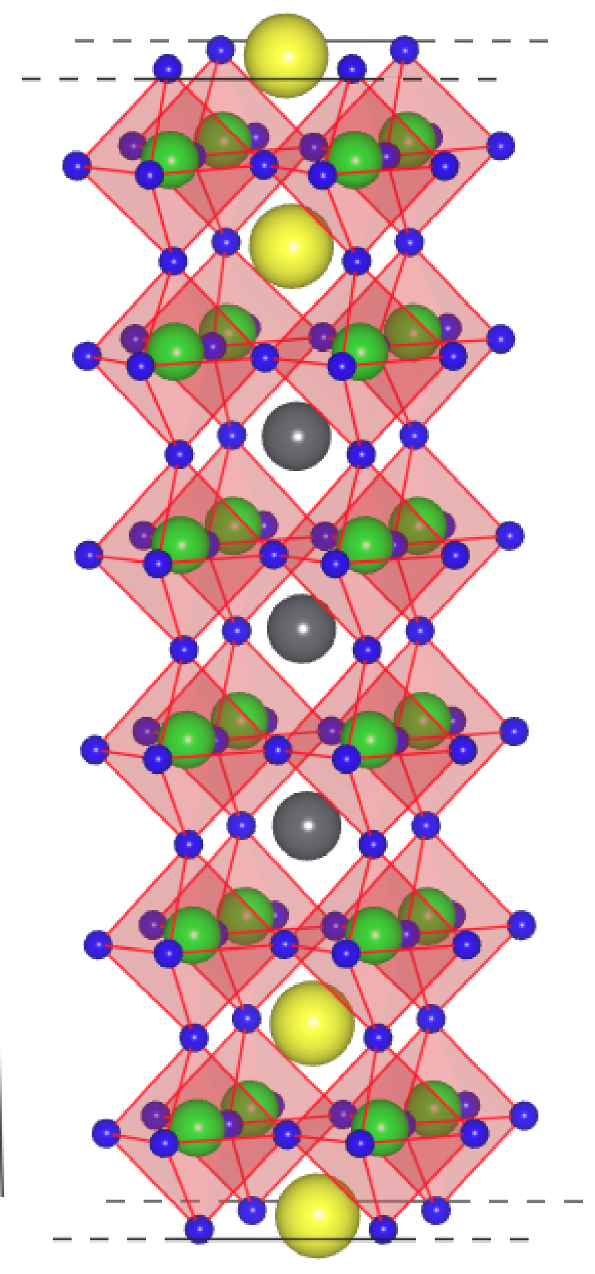
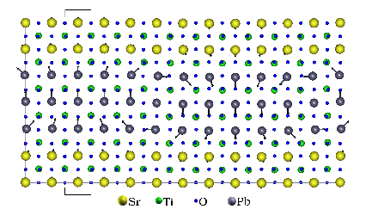


First-principles simulations on
PbTiO₃/SrTiO₃ superlattices
Javier Junquera
Pablo Aguado-Puente
Pablo García-Fernández

Slide 2
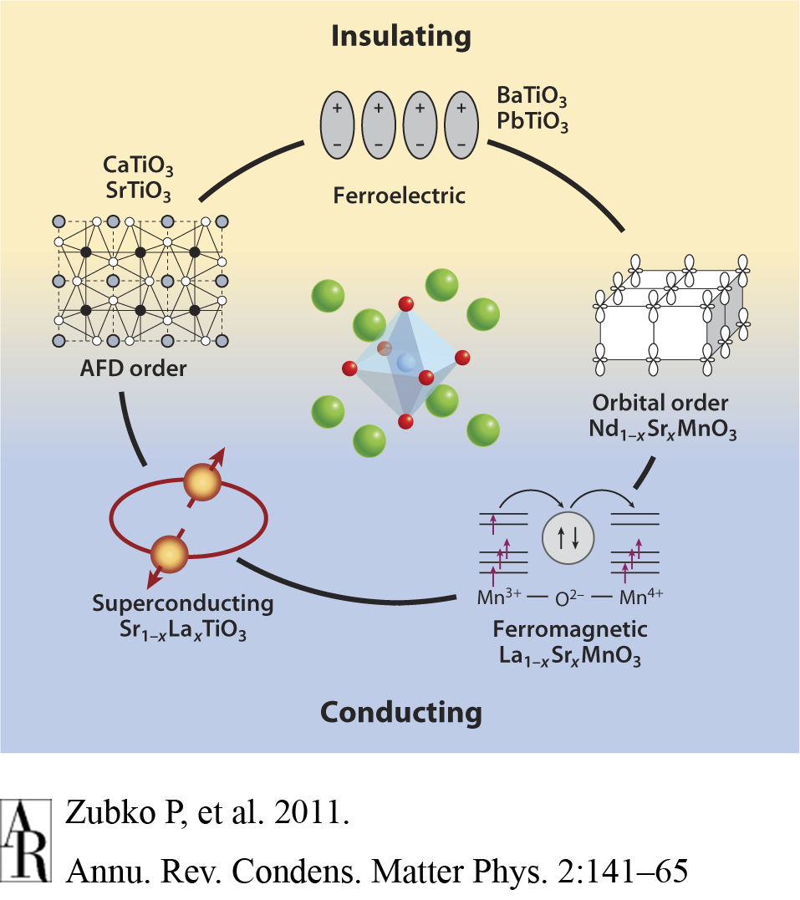
Multitude of fascinating and exotic properties boasted by transition metal oxides
ABO₃ perovskites oxides:
simple structure, wide variety of properties

Slide 3
Some surprises at the interfaces between two oxides
The interface between two good insulators (e.g. LaAlO₃ and SrTiO₃) is metallic
A. Ohtomo and H. Y. Hwang, Nature 427, 423 (2004)
Appearance of improper ferroelectricity in PbTiO₃/SrTiO₃ superlattices
E. Bousquet et al., Nature 452, 732 (2008)

Slide 4
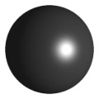

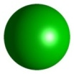
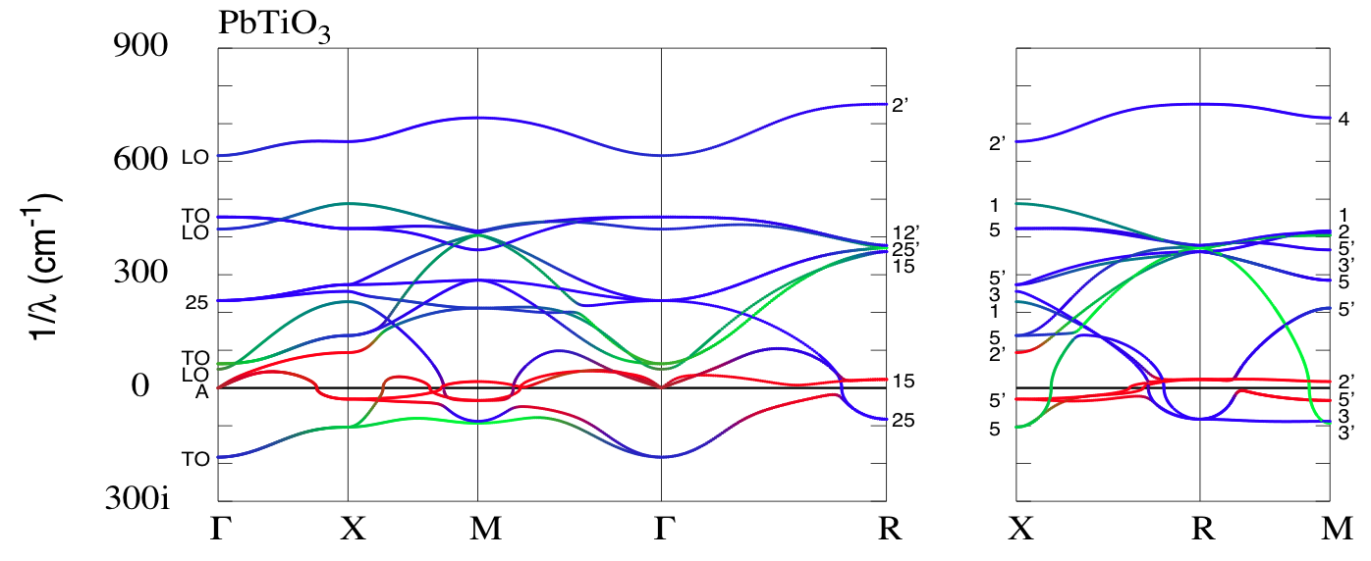
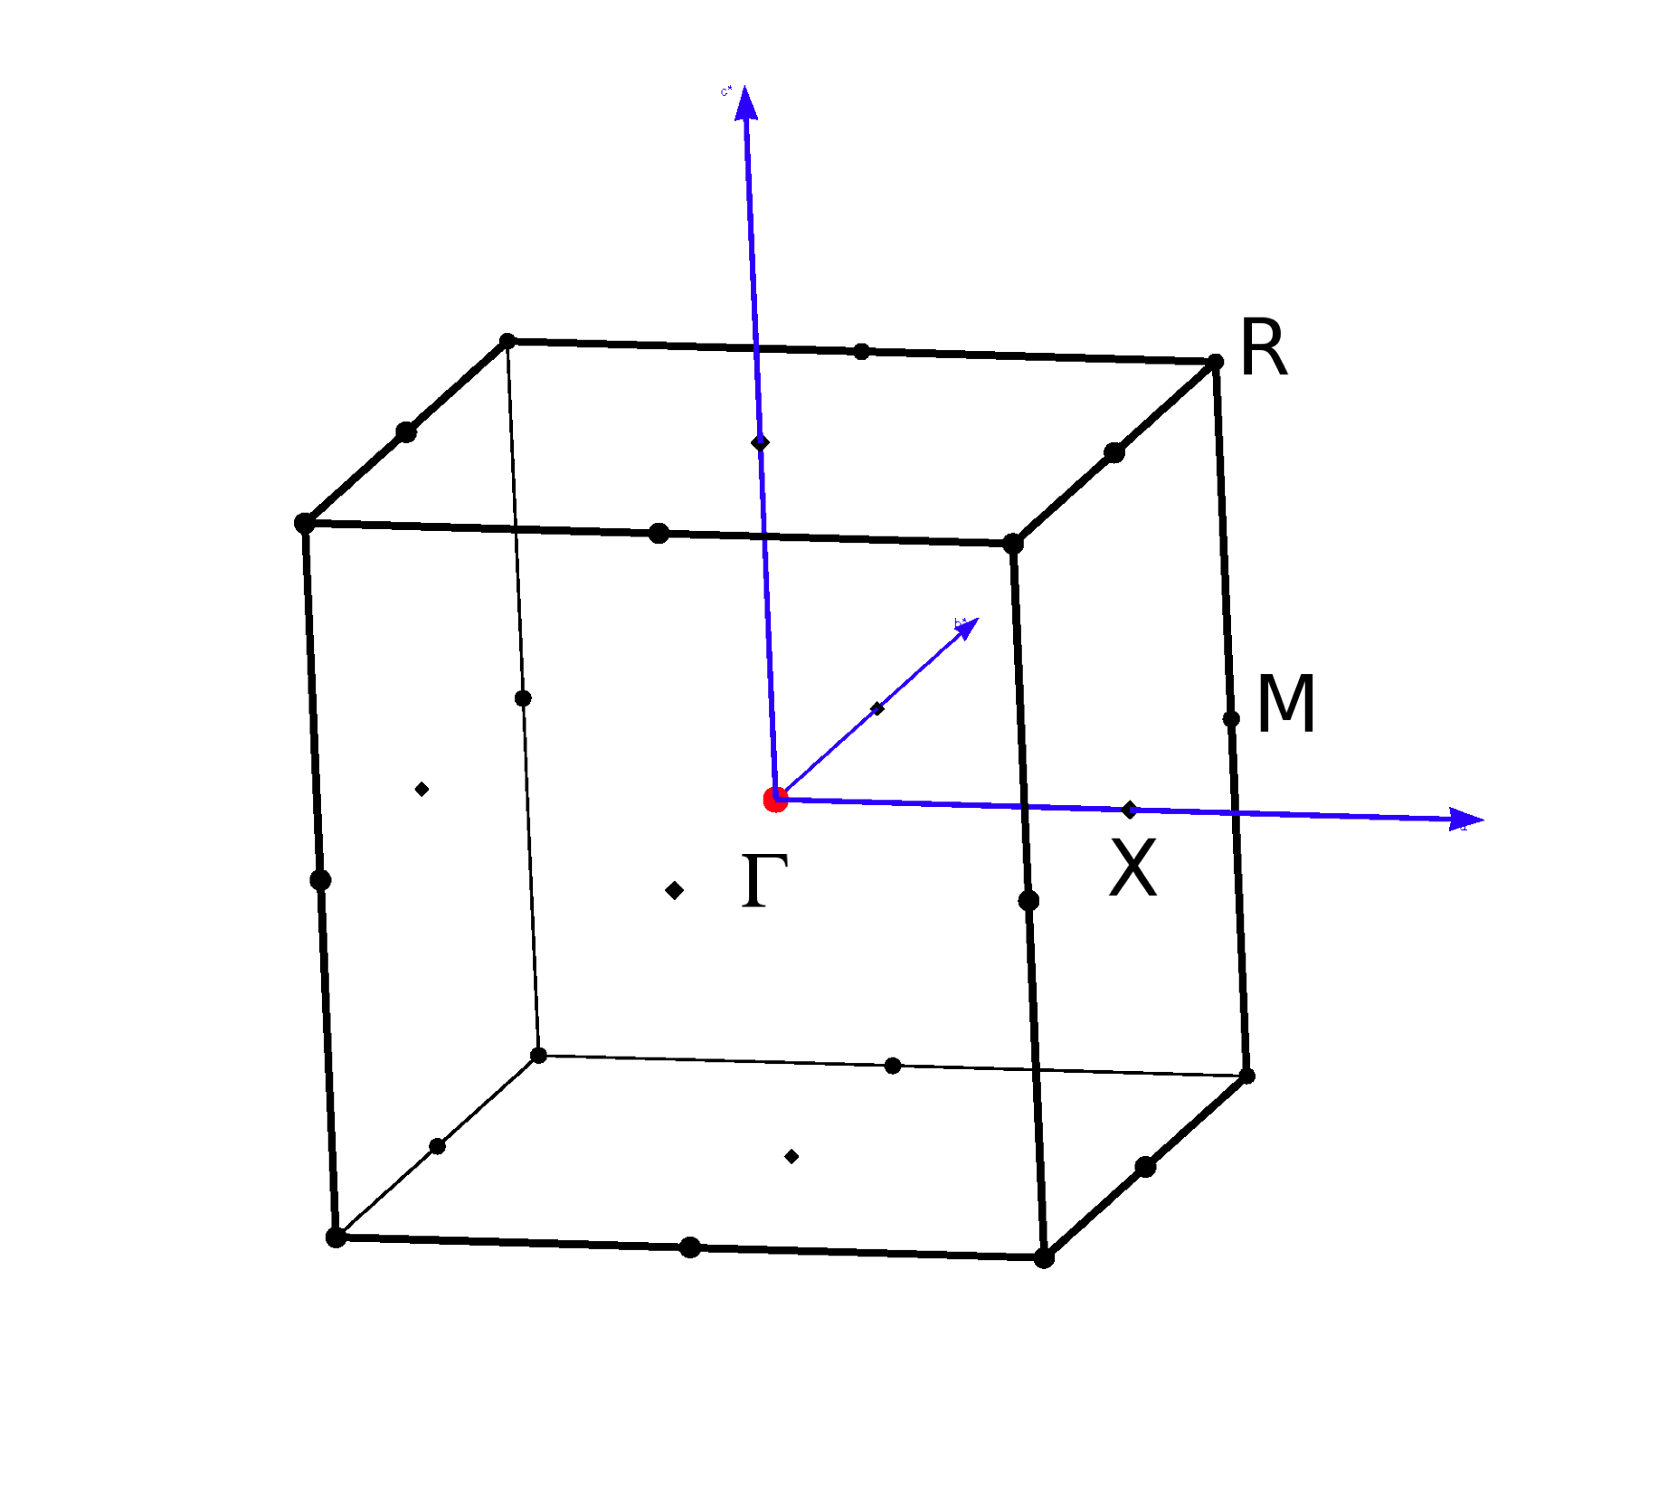
Many instabilities might be present in bulk ABO₃ perovskites: They often compete and tend to suppress each other
“ideal” cubic perovskite structure, taken as the high-symmetry reference configuration
Stable only within a narrow range of ionic radii.
Ph. Ghosez et al., Phys. Rev. B 60, 836 (1999)
Phonon dispersion curves at the bulk cubic experimental lattice constant
Signature of the instability:
a branch in the phonon dispersion curve with imaginary frequency

Slide 5
Γ-point
(0.0, 0.0, 0.0)
Typical crystal instabilities
X-point
(0.5, 0.0, 0.0)
Ph. Ghosez et al., Phys. Rev. B 60, 836 (1999)
Ferroelectric (FE)
Antiferroelectric (AFE)
M-point
(0.5, 0.5, 0.0)
R-point
(0.5, 0.5, 0.5)
PbTiO₃ phonon dispersion curves at the bulk cubic experimental lattice constant
Antiferrodistortive (AFD)
Antiferrodistortive (AFD)

Slide 6
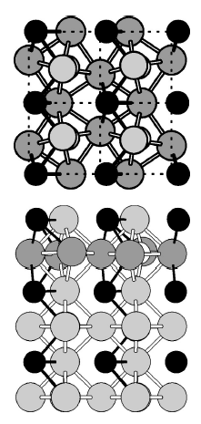
The competition between all the structural instabilities might be altered at surfaces/interfaces
Surface might induced reconstructions to saturate dangling bonds
Top
(001) PbTiO₃
c(2×2) reconstructions in PbO-terminated
  Substantial enhancement of the AFD distorsion
  Driving force: shorter PbO bonds
  ⇓
  Not observed neither in TiO₂ termination nor BaTiO₃ surface
Lateral
A. Munkholm et al., Phys. Rev. Lett. 88, 016101 (2002)
C. Bungaro and K. M. Rabe, Phys. Rev. B 71, 035420 (2005)

Slide 7
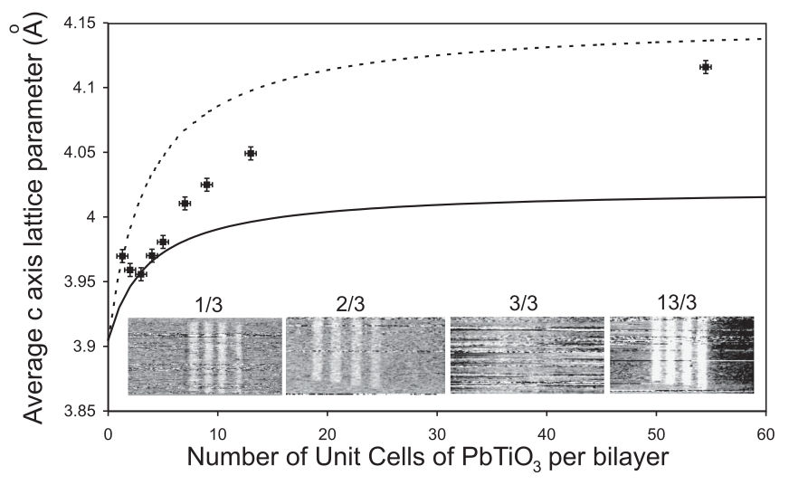
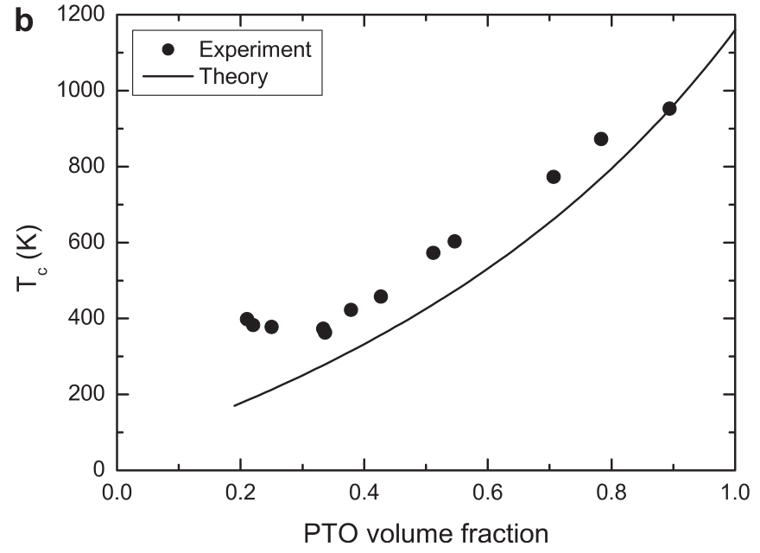
PbTiO₃/SrTiO₃ superlattice: polarization, c/a, and phase transition T can be monitored with PTO volume
Tetragonality
(related with P due to the large polarization-strain coupling in PbTiO₃)
Phase transition temperature
M. Dawber et al., Phys. Rev. Lett. 95, 177601 (2005)
M. Dawber et al., Adv. Mater. 19, 4153 (2007)
In the experiment, the number of layers of SrTiO₃, n_{s}, was fixed to 3
For PbTiO₃ layers thickness larger than 3, n_{p}/n_{s} > 1, the polarization is found to be reduded (depolarizing field effect)
For PbTiO₃ layer thickness smaller than 3, n_{p}/n_{s}<1,unexpected recovery of ferroelectricity that can not be accounted for by simple electrostatic arguments

Slide 8
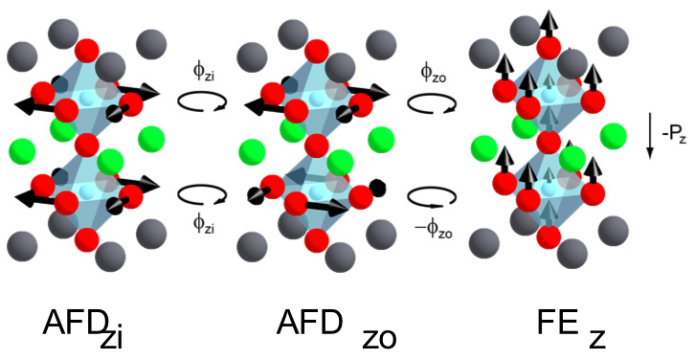
Short-period PbTiO₃/SrTiO₃ superlattices: the GS involves trilinear coupling between two AFD modes and a polar FE mode
Improper ferroelectricity
E. Bousquet et al., Nature 452, 732 (2008)
In-phase AFD rotations of O octahedra
Out-of-phase AFD rotations of O octahedra
Ferroelectric mode

Slide 9
Interesting and useful features of improper ferroelectrics
E. Bousquet et al., Nature 452, 732 (2008)
N. Sai et al., Phys. Rev. Lett. 102, 107601 (2010)
Normal sample
(9/3)
Anomalous sample
(2/3)
Reduced sensitive to depolarizing fields
The instability to a single domain ferroelectric state does not vanish even when depolarizing field remains unscreened
High P_{z} T=0
P_{s} (YMnO₃ thin films) ≈ P_{s}(YMnO₃ bulk)
N. A. Benedek and C. J. Fennie, Phys. Rev. Lett. 106, 107204 (2011)
Promising way of generating novel magnetoelectric couplings
High and T-independent ε
Possible paths for electric-field switching of magnetization in Ca₃Mn₂O₇

Slide 10
First-principles study on PbTiO₃/SrTiO₃ superlattices
Influence of the epitaxial strain
Eventual stabilization of domains

Slide 11
First-principles study on PbTiO₃/SrTiO₃ superlattices
Influence of the epitaxial strain
Eventual stabilization of domains

Slide 12
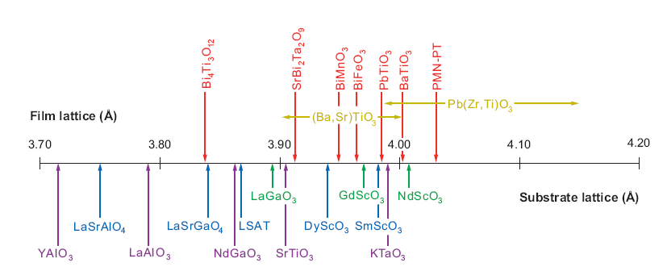
Current interest in functional oxides is largely based on engineered epitaxial thin films
D. G. Schlom et al., Annu. Rev. Mater. Res. 37, 589 (2007)
Many oxides have similar lattice constants allowing for a good match at the interfaces
What would happen if we could mix materials with different properties?
Potential for novel behaviour

Slide 13
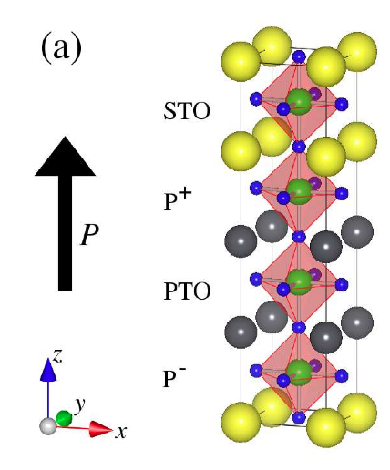
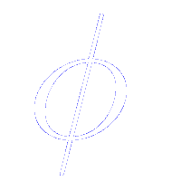
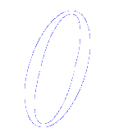
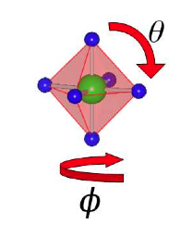
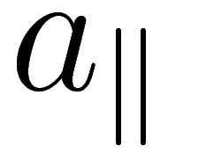
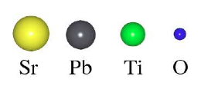
First-principles simulations on monodomain PbTiO₃/SrTiO₃ superlattices
(2/2) superlattice
Local Density Approximation (LDA)
(2 × 2) in-plane periodicity to allow for TiO₆ octahedra rotations and tiltings
Mechanical boundary conditions implicitly treated by fixing the in-plane lattice constant
Short-circuit electrical boundary conditio
Oxygen octahedra labeled according to:
- chemical identity of first two
neighbours layers
- polarization

Slide 14
First-principles atomic relaxations on monodomain PbTiO₃/SrTiO₃ superlattices
(2/2) superlattice
Step 1:
Getting a reference non-polar structure
Relaxation of the atomic position and lattice vectors
BUT
With some constraints to avoid the appearance of a polarization

Slide 15
First-principles atomic relaxations on monodomain PbTiO₃/SrTiO₃ superlattices
(2/2) superlattice
Step 2:
Getting the most stable phases
Starting from the most stable non-polar phase,
SYMMETRY IS BROKEN
A new atomic relaxation is performed

Slide 16
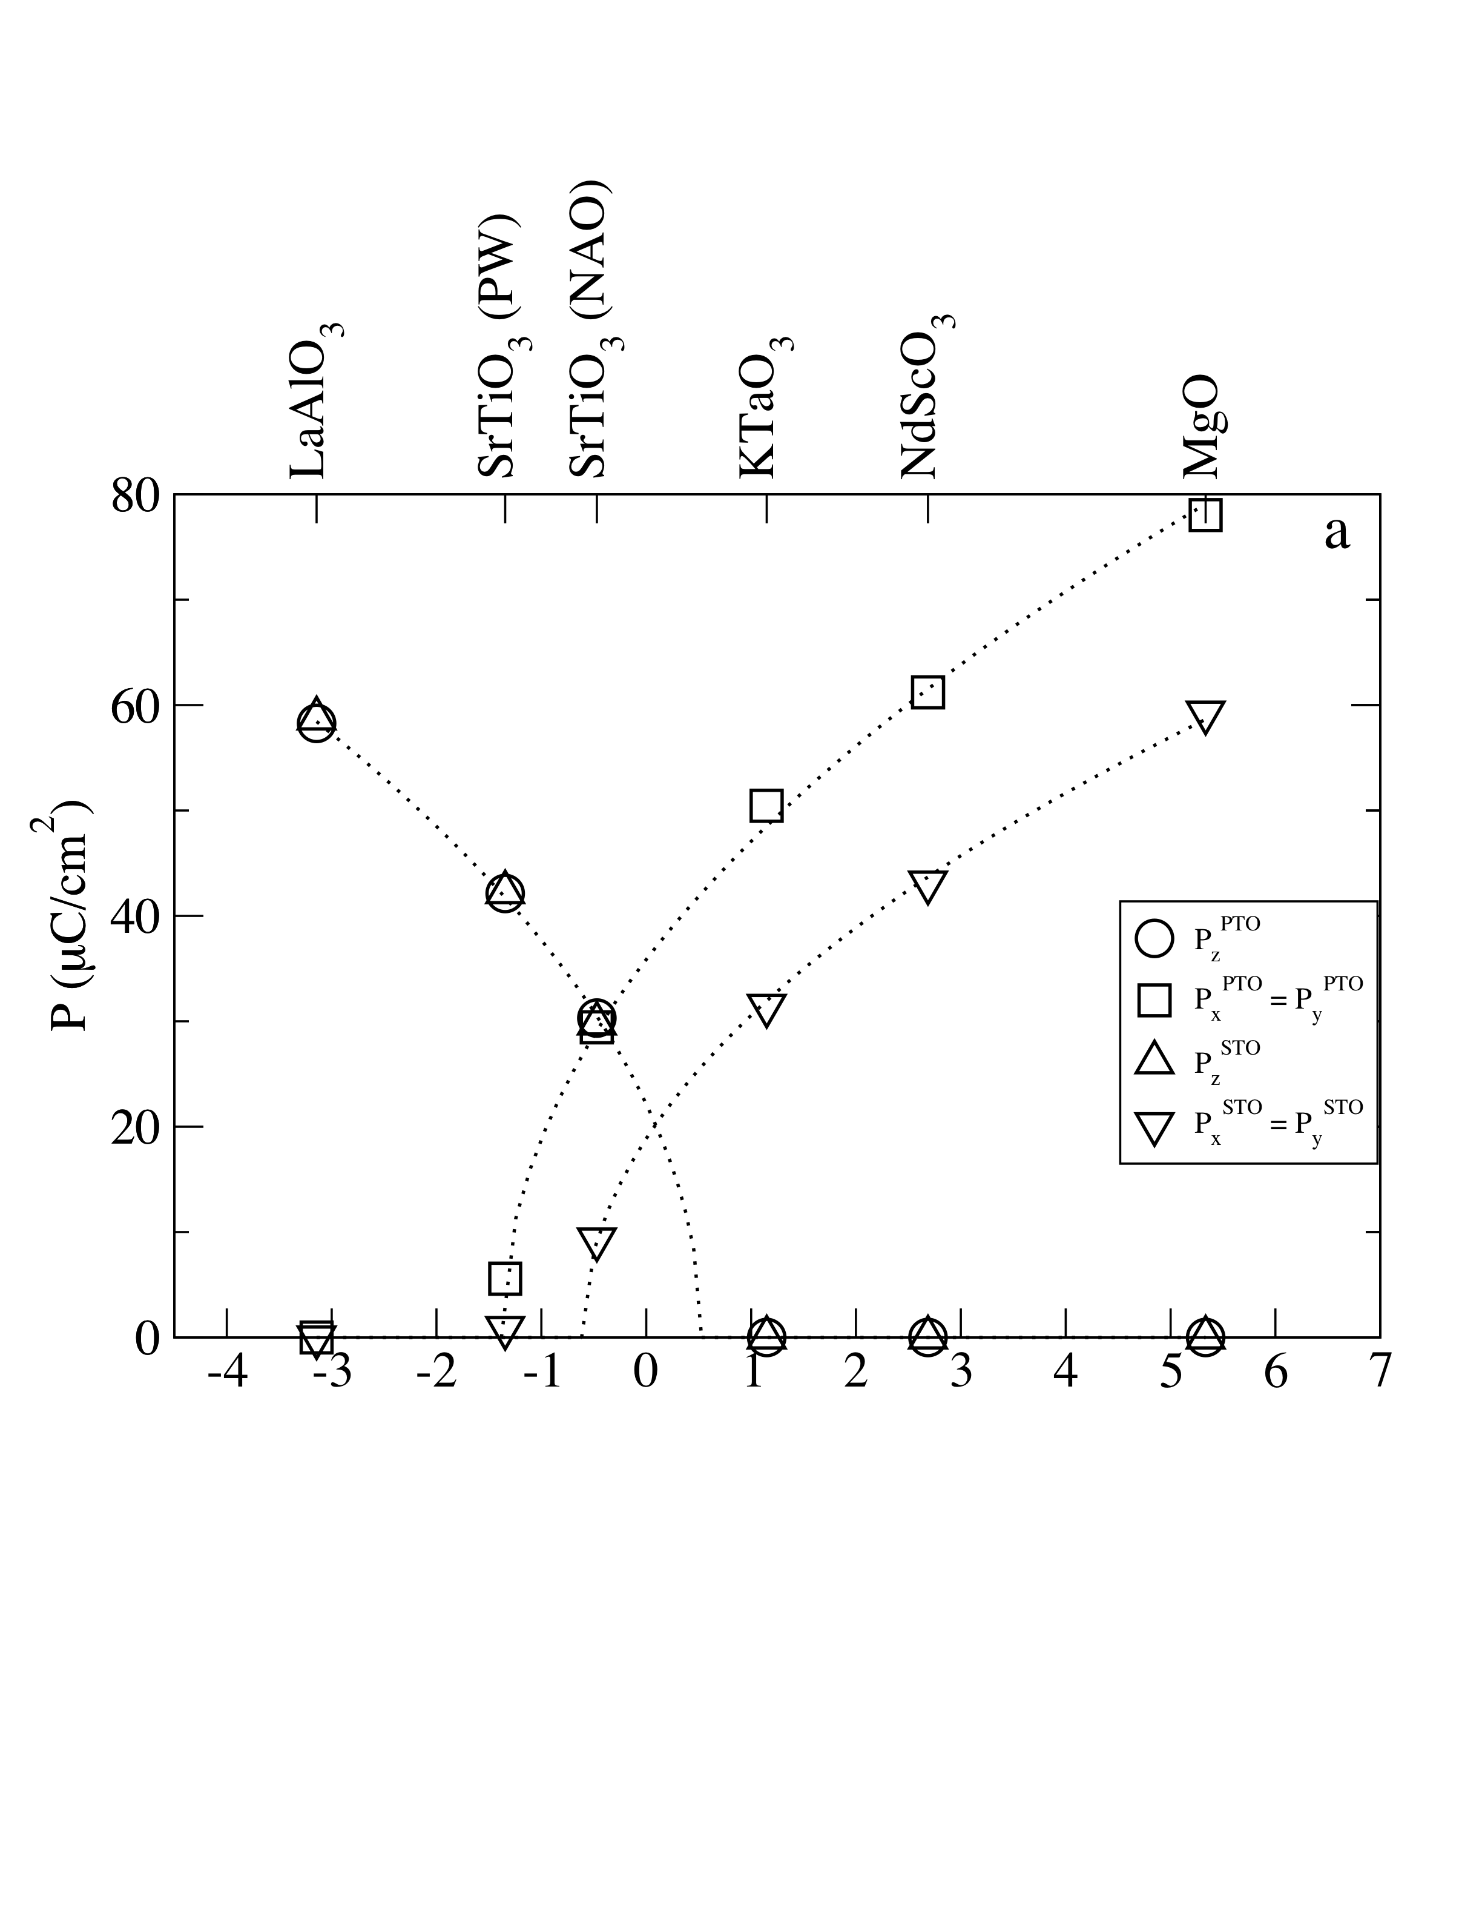
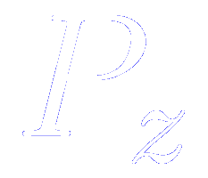
Polarization-strain coupling in monodomain PbTiO₃/SrTiO₃ (2/2) superlattices
Common cubic substrates
For compressive strains:
-homogeneous polarization stabilized along z (c-phase)
preserved at the PbTiO₃/SrTiO₃ interface
(electrostatic restriction)
For tensile strains:
-polarization lies along [110] direction
(aa-phase)
-no electrostatic restriction to keep the in-plane polarization at the same value
Strain (%)
For intermediate regime:
-continuous rotation of polarization
(r-phase)
-second order phase transitions
PW: SrTiO₃ lattice constant using plane wave
3.84 Å
NAO: SrTiO₃ lattice constant using numerical atomic orbitals (3.87 Å)

Slide 17
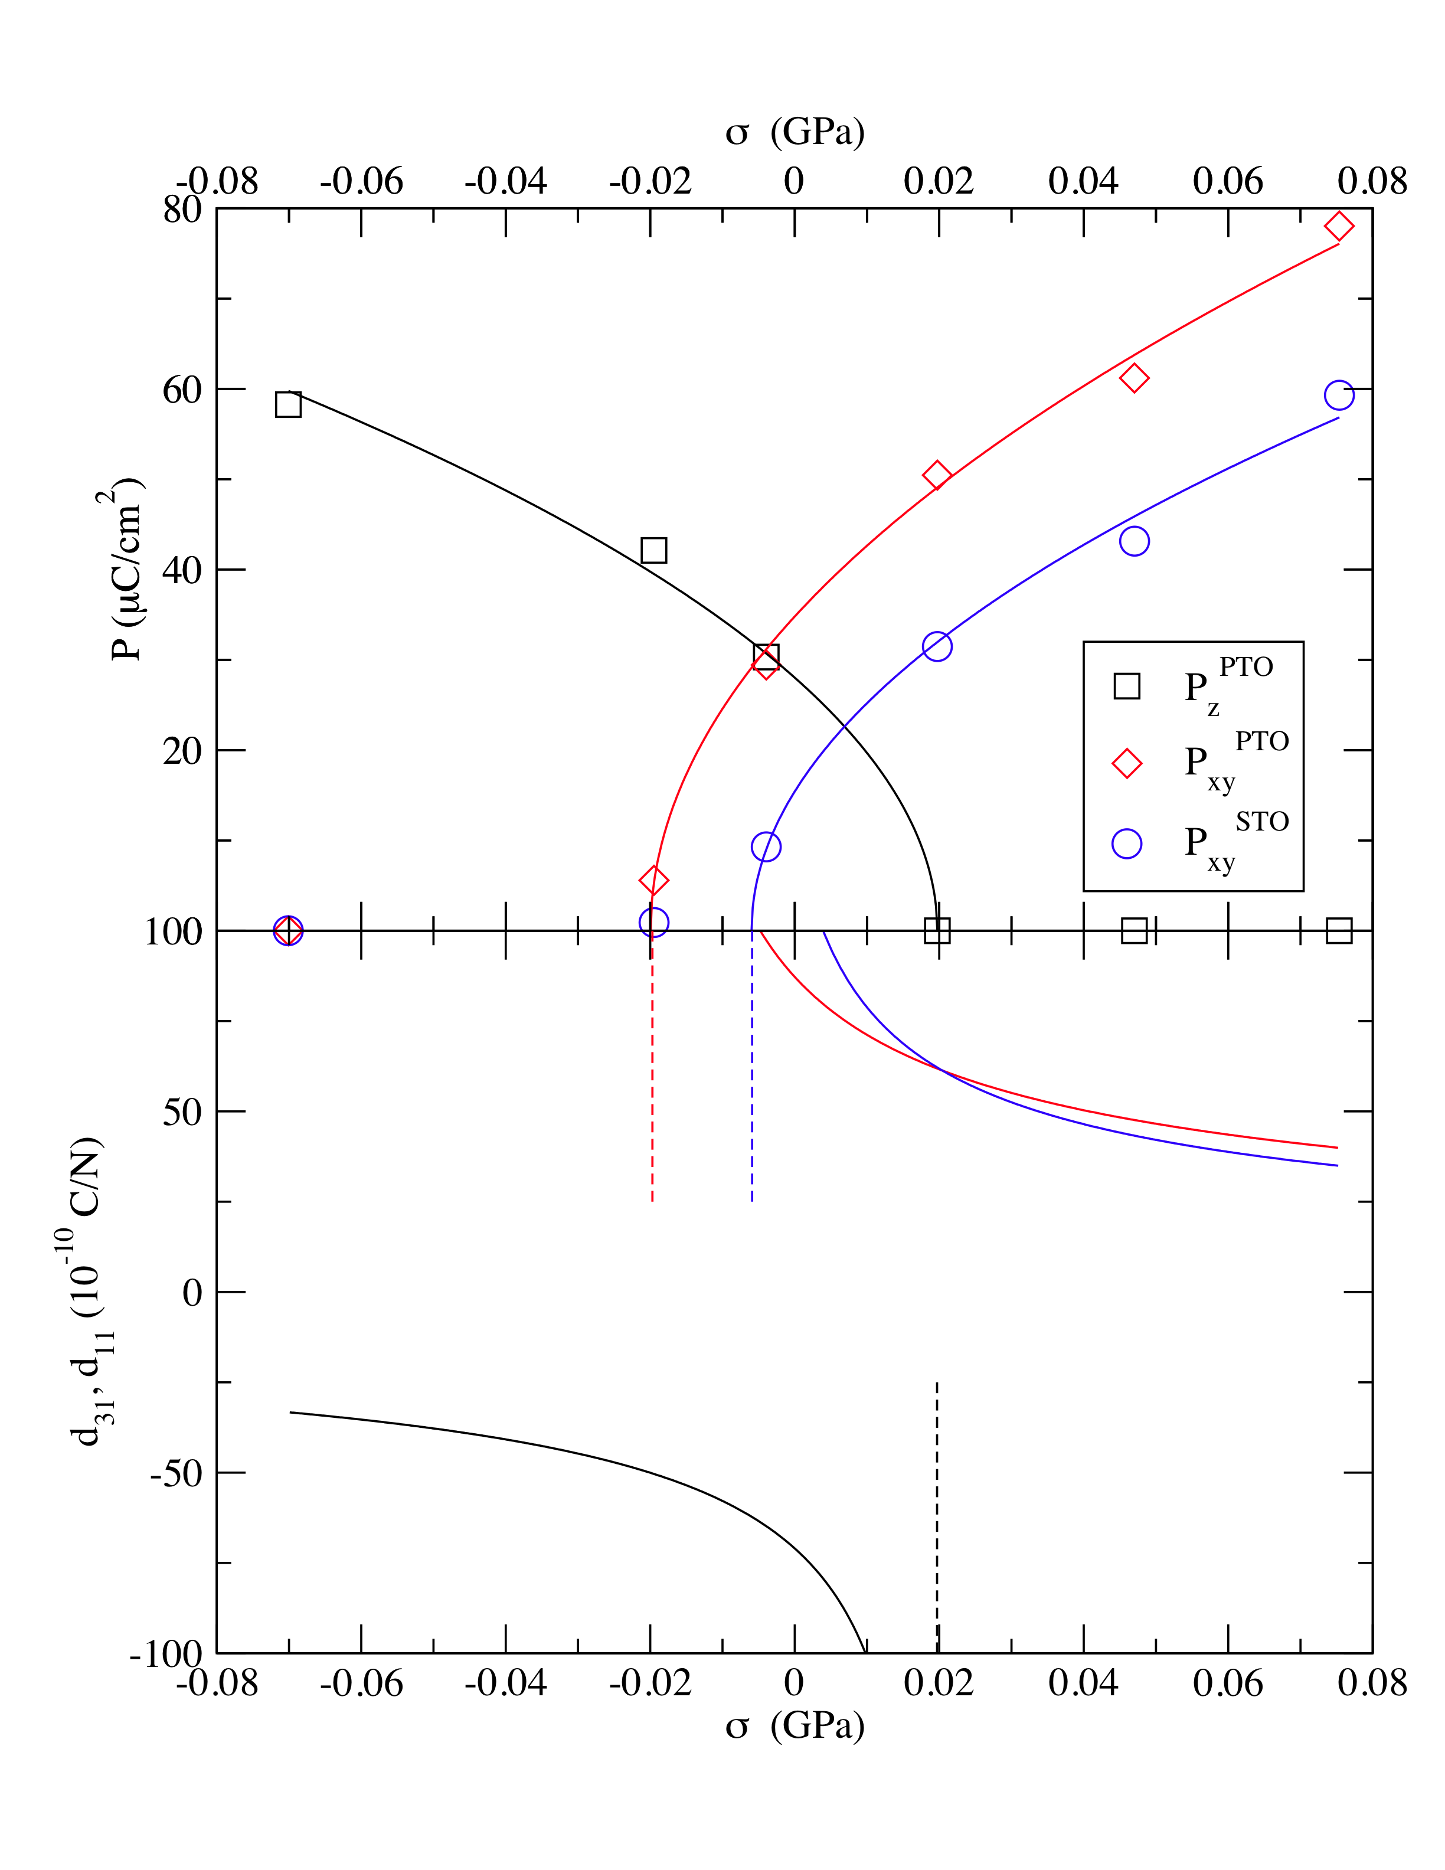
Large electromechanical response in monodomain PbTiO₃/SrTiO₃ (2/2) superlattices
Polarization as a function of stress
d₁₁^{STO}
d₁₁^{PTO}
Piezoelectric components diverge in a region very accesible experimentally, around lattice constant of SrTiO₃
d₁₃

Slide 18
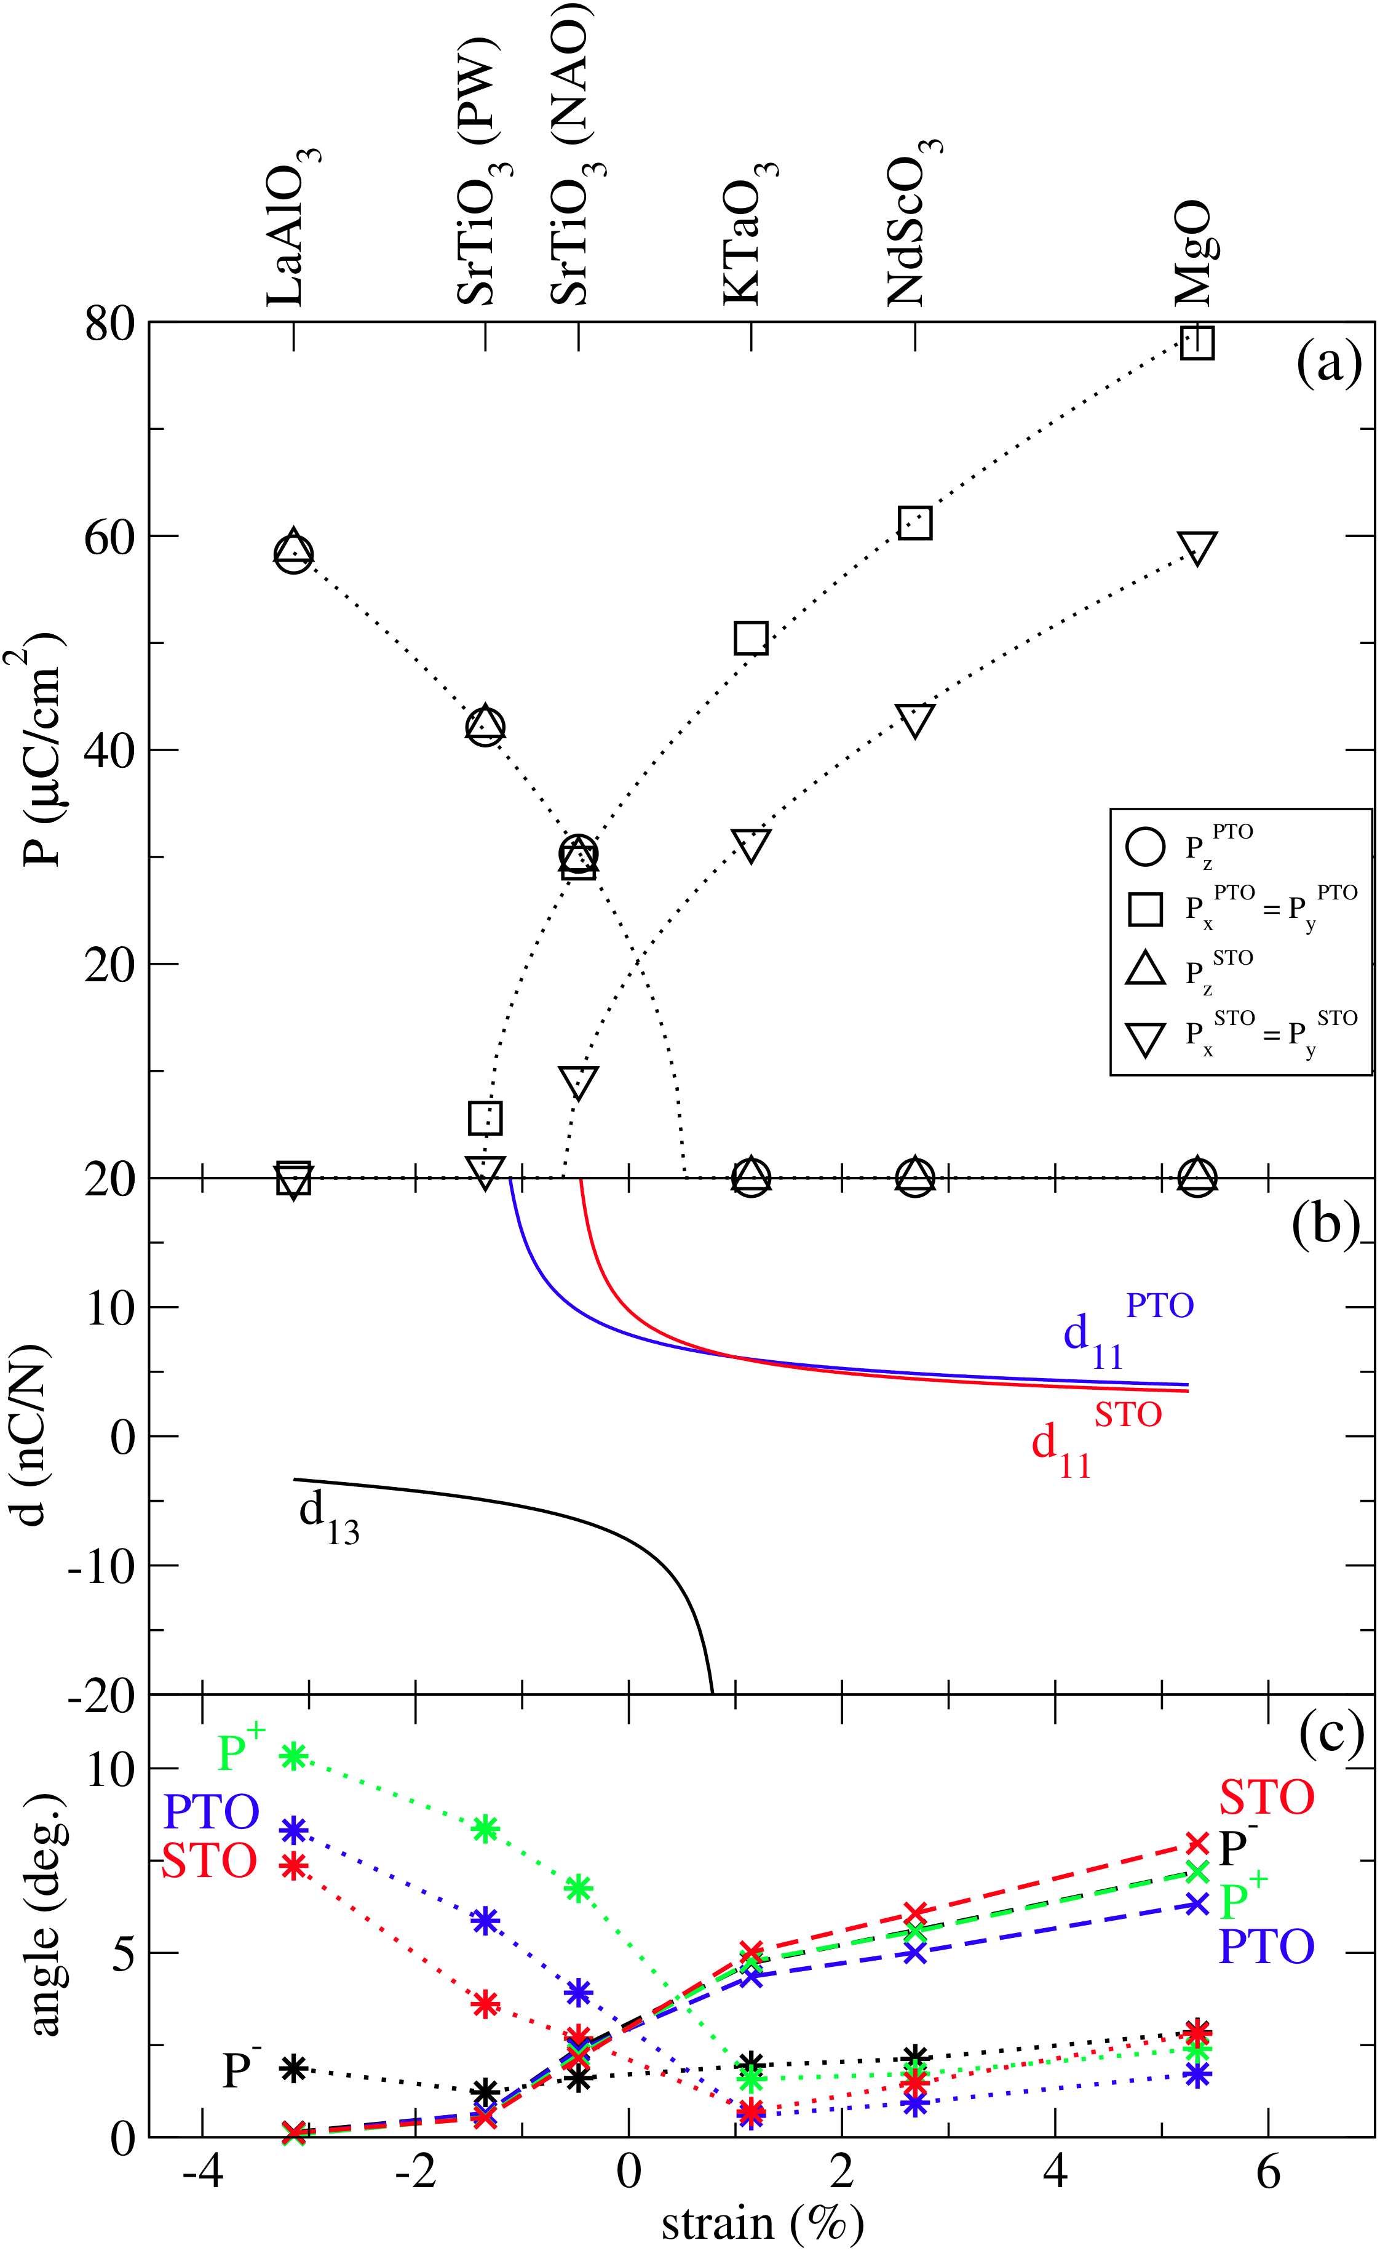
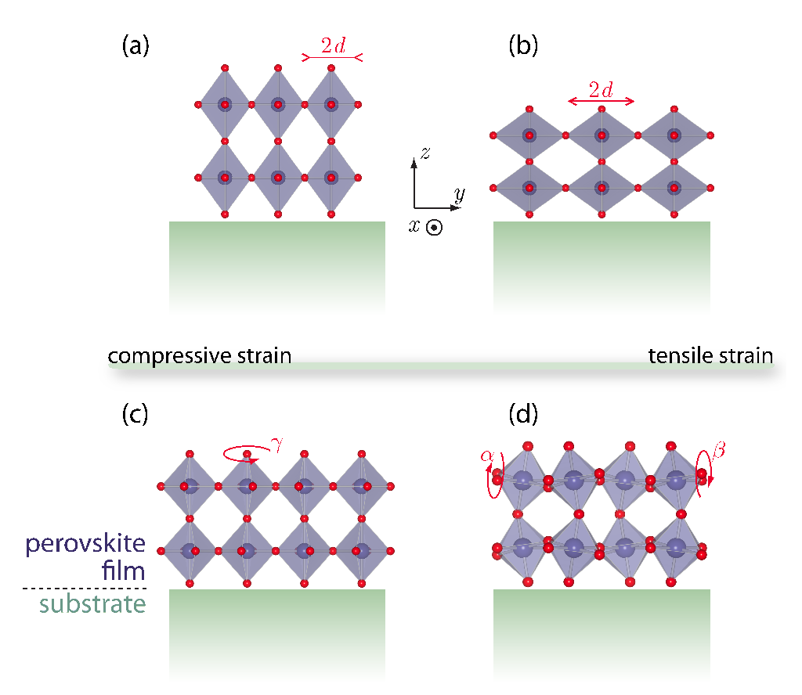
FE-AFD-strain coupling in monodomain PbTiO₃/SrTiO₃ (2/2) superlattices
Common cubic substrates
Compressive strains favour rotation of the TiO₆ octahedra
Tensile strains favour tilting of the TiO₆ octahedra
J. Rondinelli and N. A. Spaldin, cond-mat/1103.4418
* : rotations x : tiltings

Slide 19
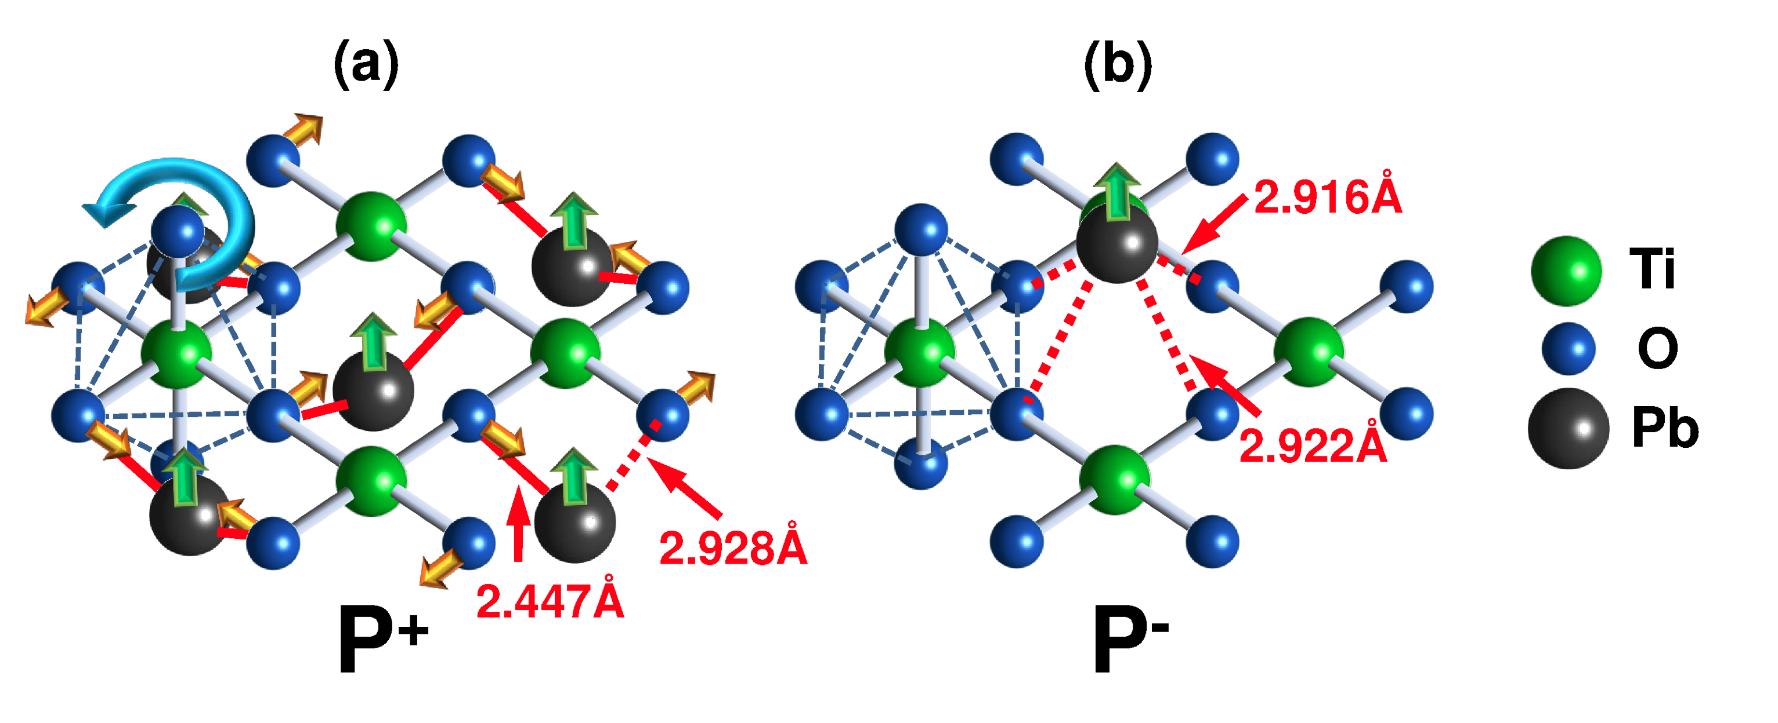
Behaviour of the different TiO₆ octahedra explained by a covalent model
When a large compressive strains are applied, P⁺ rotates more than P⁻.
TiO₂ layer and Pb atoms below
When Pb atom moves up (FE),
O moves towards it to form stronger covalent bonds
Reinforcement of the P⁺ TiO₆ rotation

Slide 20
Behaviour of the different TiO₆ octahedra explained by a covalent model
When a large compressive strains are applied, P⁺ rotates more than P⁻.
TiO₂ layer and Pb atoms below
TiO₂ layer and Pb atom up
When Pb atom moves up (FE),
O moves towards it to form stronger covalent bonds
When Pb atom moves up (FE) all Pb-O bonds are weakened
Reinforcement of the P⁺ TiO₆ rotation
Reduction of the P⁻ TiO₆ rotation
* : rotations x : tiltings

Slide 21

Monodomain PbTiO₃/SrTiO₃ superlattices with different periodicities
In-plane lattice constant: theoretical SrTiO₃ (3.874 Å)
Independently of the periodicity: the ground state
- always in-plane and out-of-plane polarization
(although for n=1, essentially degenerated with the [001] configuration
found in E. Bousquet et al. 452, 732 Nature (2008)
- n ≥ 2, pointing along the diagonal of the perovskite unit cell in PbTiO₃
Reason for the stabilization of the [111] phase:
PbTiO₃ likes rotate more than a monotomic decrease of

Slide 22
First-principles study on PbTiO₃/SrTiO₃ superlattices
Influence of the epitaxial strain
Eventual stabilization of domains

Slide 23
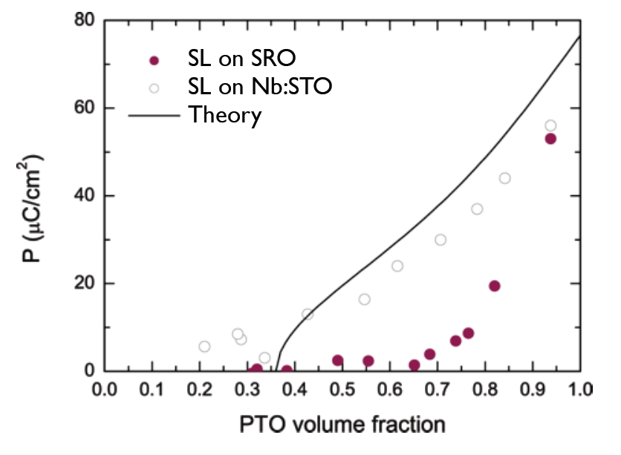
Structural and dielectric properties of PTO/STO superlattices as a function of the periodicity, electrodes and electric fields
Remnant polarization as a function of the PbTiO₃ volume fraction
Nb-doped SrTiO₃/…/PbTiO₃/SrTiO₃/…/Au
Structural parameters almost identical for the two series
Follows DGL theory (assumes mono)
SrRuO₃/…/PbTiO₃/SrTiO₃/…/SrRuO₃
Does not follow DGL theory
Almost 0 remnant polarization except for the highest PbTiO₃ volume fractions
Suggest of a polydomain phase with domain wall motion
P. Zubko et al., Phys. Rev. Lett. 104, 187601 (2010)
Tune properties by changing periodicity, electrodes, …
Close competition between mono and polydomain ground state
Ideal system for the study of nanodomains under applied electric fields using x-ray diffraction
Motivation: study of domains in PbTiO₃/SrTiO₃ superlattices from first-principles

Slide 24
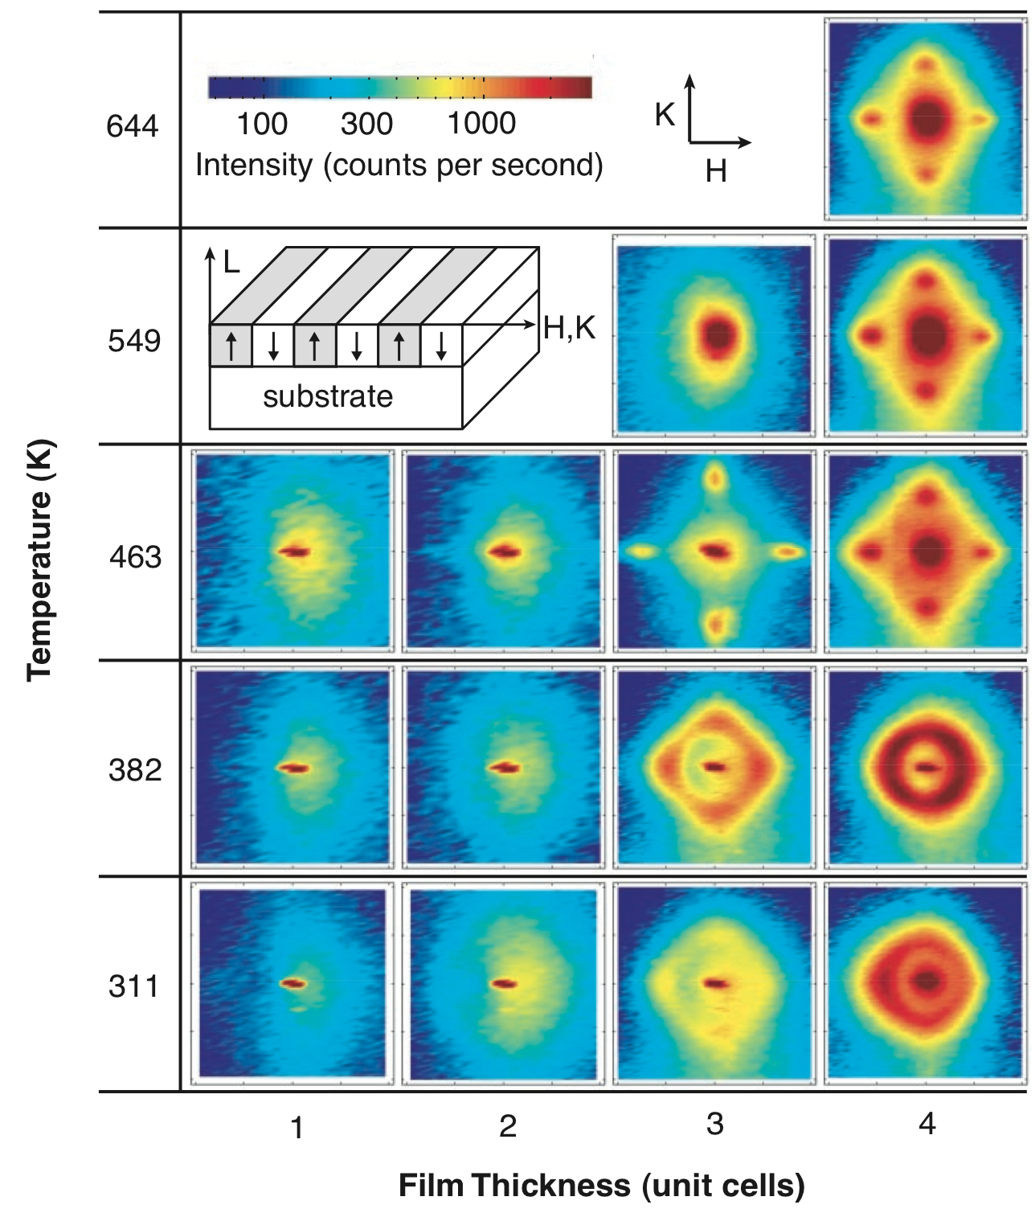
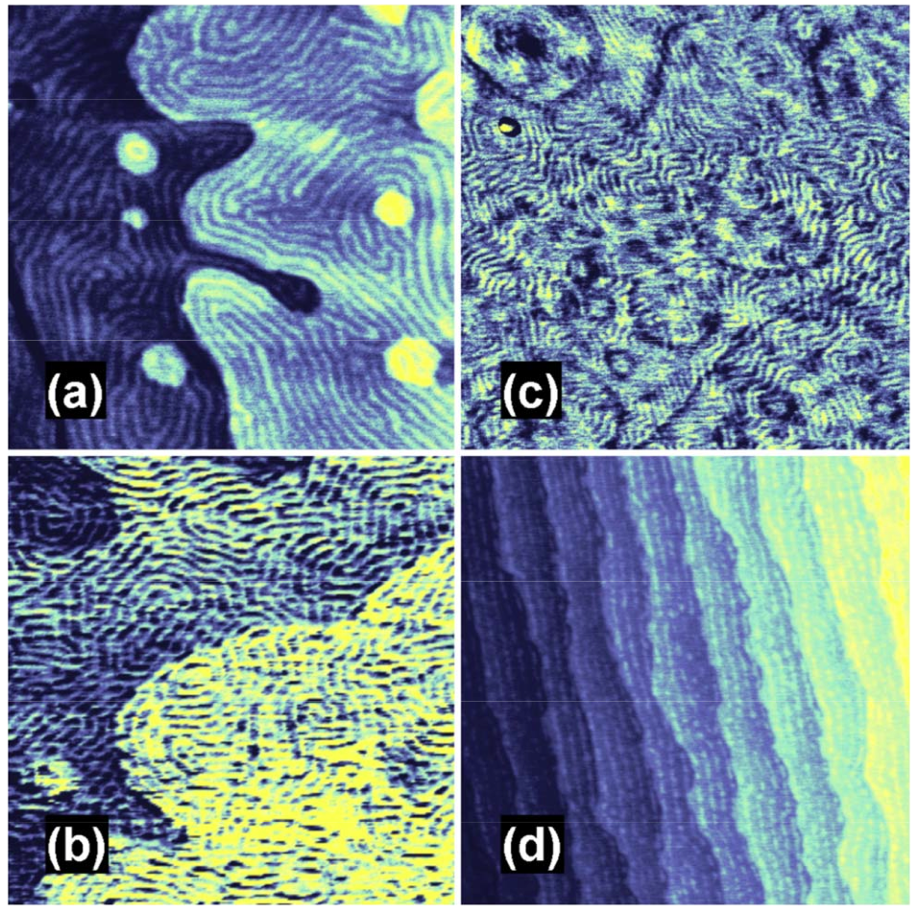
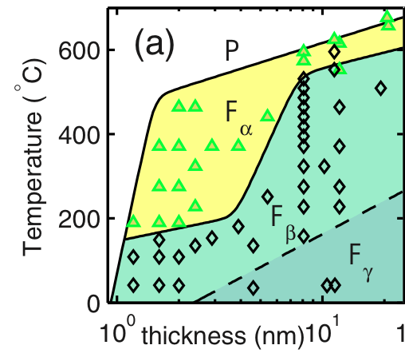
180° domain structures detected and characterized in PbTiO₃ thin films grown on SrTiO₃(001) substrates
Satellites around PbTiO₃ Bragg peaks in synchrotron x-ray
Real space AFM image
Phase diagram
F_{α}, F_{β} : domain phases with different periodicities
F_{γ} : monodomain phase
P : paraelectric
D. D. Fong et al., Science 304, 1650 (2004)
C. Thompson et al., Appl. Phys. Lett. 93, 182901 (2008)

Slide 25
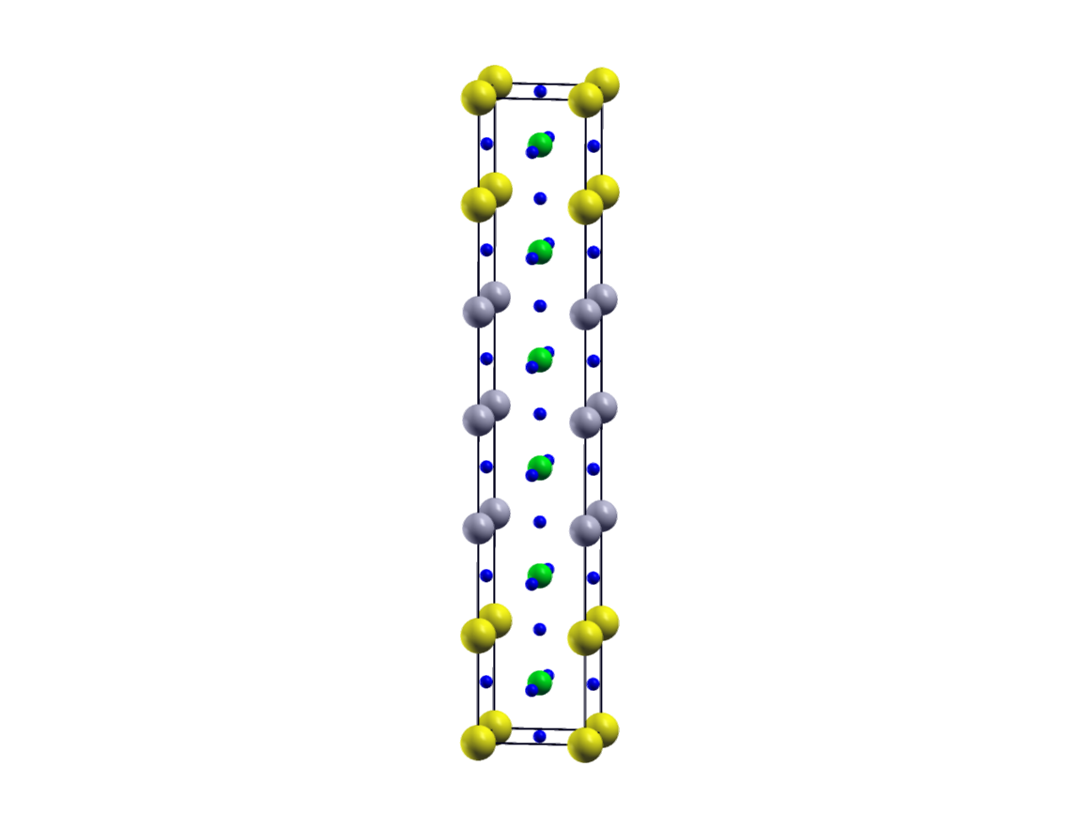
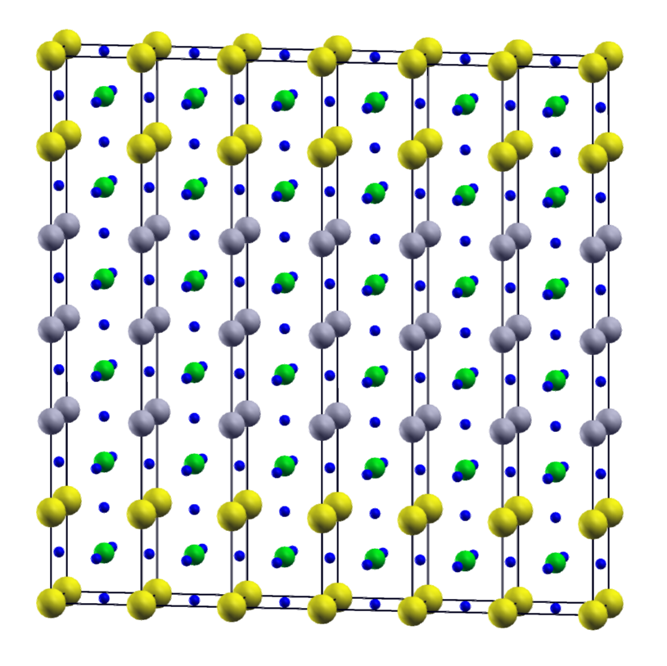
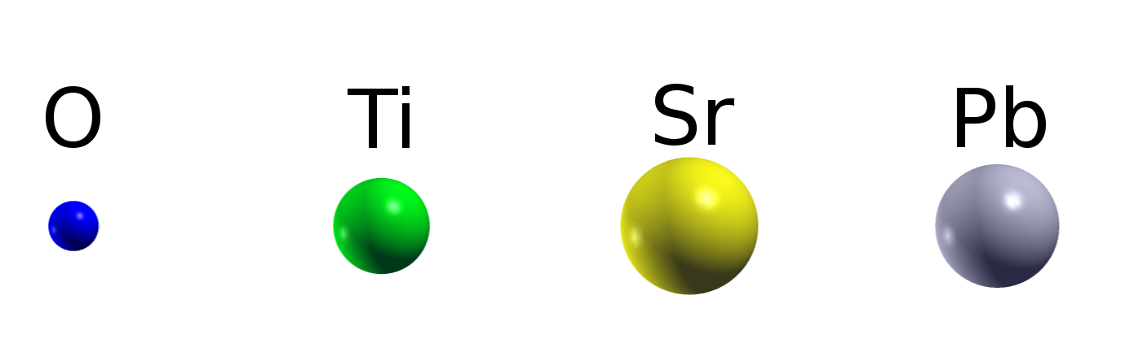
Simulation of domains in PbTiO₃/SrTiO₃ superlattices building of the supercell
(3,3) superlattice → 30 atoms
N_{x} x N_{y} supercell → Impose lateral size of domains
N_{y} allows to switch on (N_{y} =2) and off (N_{y} = 1) Oxygen octahedra rotations
Example: 6x1 supercell

Slide 26
Simulation of domains in PbTiO₃/SrTiO₃ superlattices building of the supercell
(3,3) superlattice → 30 atoms
N_{x} x N_{y} supercell → Impose lateral size of domains
N_{y} allows to switch on (N_{y} =2) and off (N_{y} = 1) Oxygen octahedra rotations
Example: 6x1 supercell

Slide 27
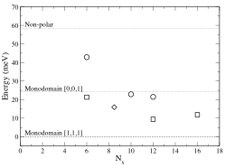
Domains in PbTiO₃/SrTiO₃ (3/3) superlattices: Energetics
The energy of the polydomain structure decreases with the increase of the domain periodicity (minimum found around N_{x} =12)
For a given domain periodicity, the energy is lowered if the AFD distortions are allowed
(Importance of FE-AFD coupling)
22 meV
10 meV
AFD not allowed
AFD allowed
Domain walls along [110]

Slide 28
Domains in PbTiO₃/SrTiO₃ (3/3) superlattices: Energetics
The energy of the polydomain structure decreases with the increase of the domain periodicity (minimum found around N_{x} =12)
For a given domain periodicity, the energy is lowered if the AFD distortions are allowed
(Importance of FE-AFD coupling)
The effect of the domain wall orientation is small
9 meV
The most stable phase: monodomain
BUT
Difference in energy with respect the most stable polydomain phase small.
Both phases might compete.
AFD not allowed
AFD allowed
Domain walls along [110]

Slide 29
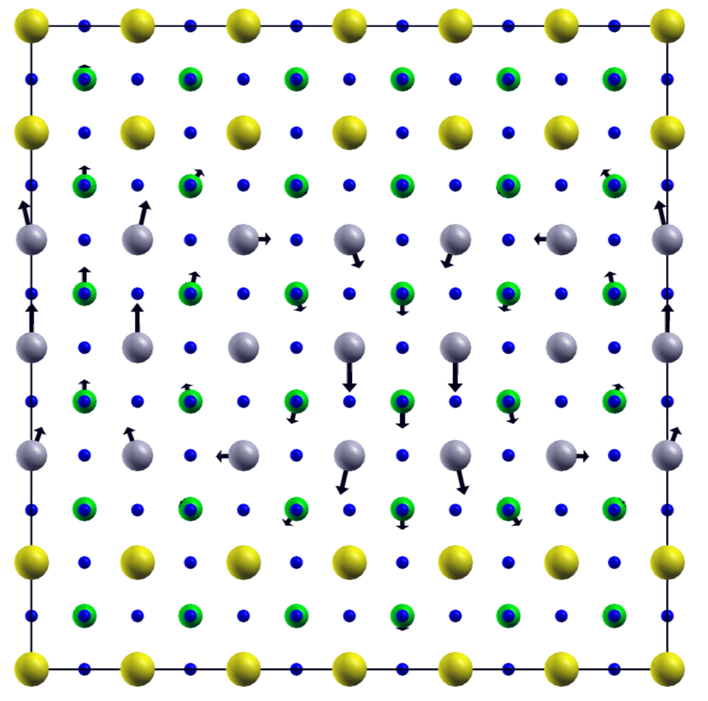
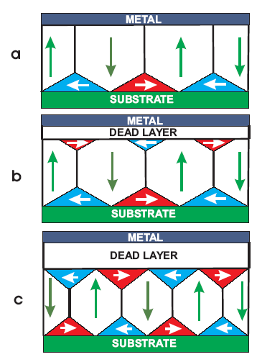
Domains in PbTiO₃/SrTiO₃ superlattices: adopt the clossure-domain structure with vortices
Vortices at DW
Closed by a large in-plane displacement of the Pb atoms
(3,3) superlattice
6 unit cells of domain periodicity
Fully relaxed
S. Prosandeev and L. Bellaiche, Phys. Rev. B 75, 172109 (2007)
P. Aguado-Puente and J. Junquera Phys. Rev. Lett. 100, 177601 (2008)

Slide 30
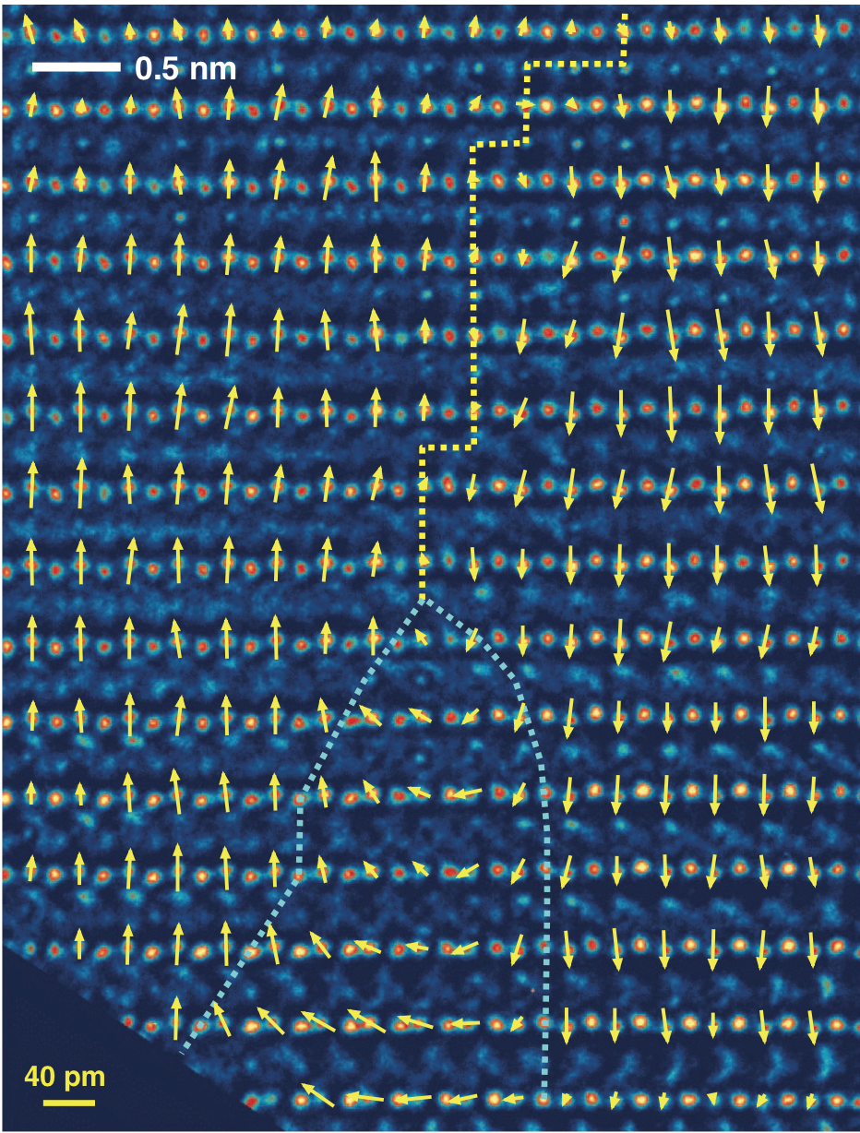
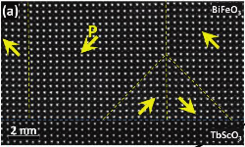
Experimental observarion of domains of closure
Pb(Zr_{0.2}Ti_{0.8})O₃/SrTiO₃
BiFeO₃/TbScO₃
C.-L. Jia et al. Science 331, 1420 (2011)
C. T. Nelson et al. Nano Lett. 11, 828 (2011)

Slide 31
Domains in PbTiO₃/SrTiO₃ (3/3) superlattices: vortices in larger domain periodicities
(3,3) superlattice
12 unit cells of domain periodicity
Fully relaxed
 | w/o AFD | with AFD
P^{PTO} (μC/cm²) | (0, 0, 62) | (0, 2, 55)
P^{STO} (μC/cm²) | (0, 0, 32) | (0, 0, 30)
Large in-plane displacements for the Pb ~ 0.2 Å → TEM experiment?

Slide 32
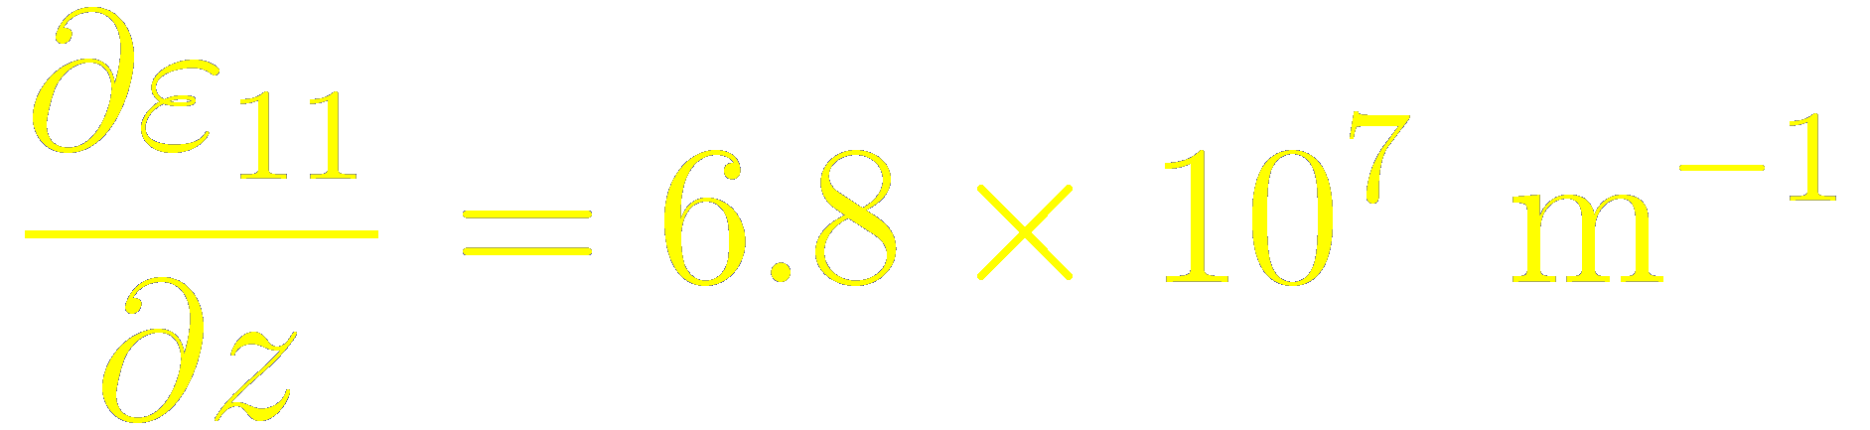
Domains in PbTiO₃/SrTiO₃ superlattices: domain structure induces inhomogeneous strain
(3,3) superlattice
6 unit cells of domain periodicity
Fully relaxed
Polarization domains → good screening
 | w/o AFD | with AFD
P^{PTO} (μC/cm²) | (0, 0, 68) | (0,26,56)
P^{STO} (μC/cm²) | (0, 0, 25) | (0,1,23)
Domains induce large strain gradient
a_{PTO down} = 3.76 Å
Δa = 0.20 Å
a_{PTO up} = 3.97 Å

Slide 33
Conclusions
Mixed ferroelectric-antiferrodistortive-strain coupling in PbTiO₃/SrTiO₃ superlattices
Electrostatic and covalent origin
Large electromechanical response around the strain imposed by a SrTiO₃ lattice constant
Close competition between monodomain and closure-domain structures

Slide 34


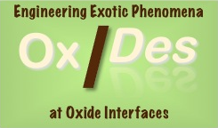

Many thanks to
Pablo García-Fernández
Pablo Aguado-Puente
Finantial support
Computer time

Slide 35
More info …

Slide 36
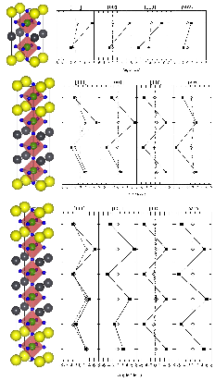
Monodomain PbTiO₃/SrTiO₃ superlattices with different periodicities

Slide 37
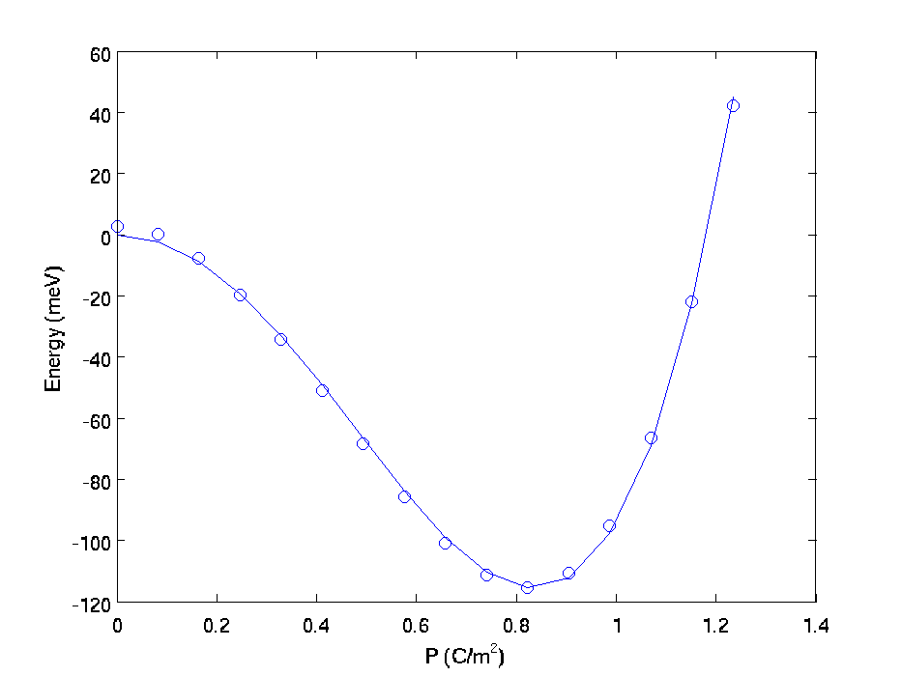
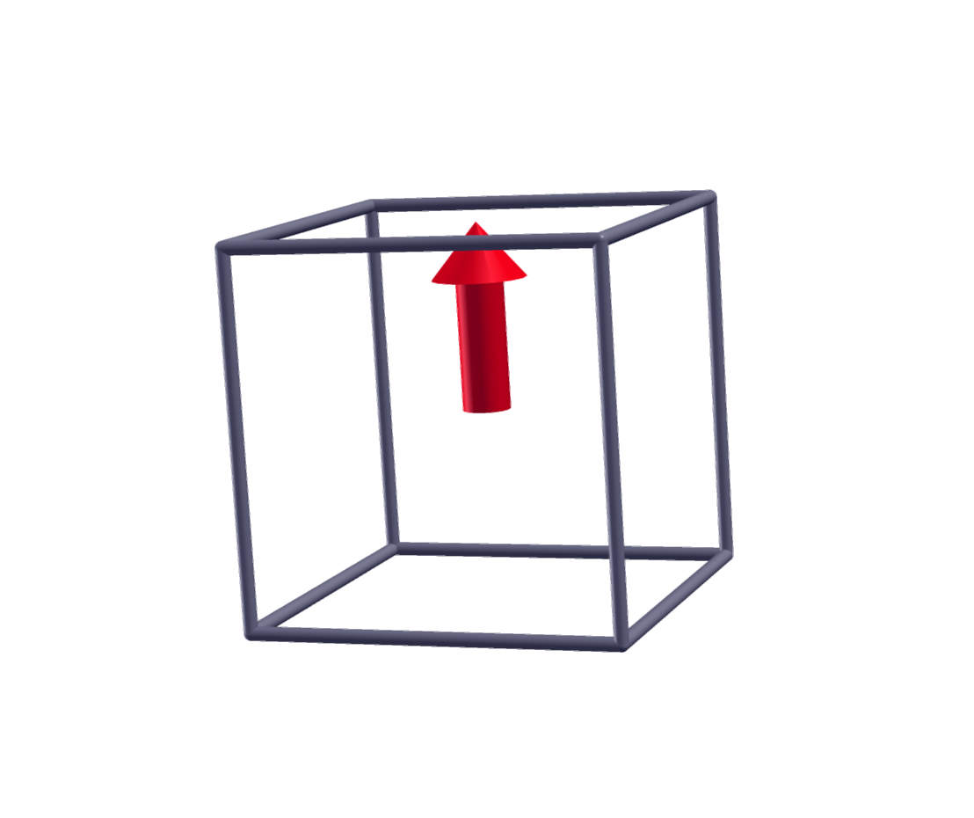
Origin of the r-phase: PbTiO₃ prefers to rotate over a reduction of the out-of-plane-polarization
Double-well curve of bulk tetragonal PbTiO3
~ 80 meV

Slide 38
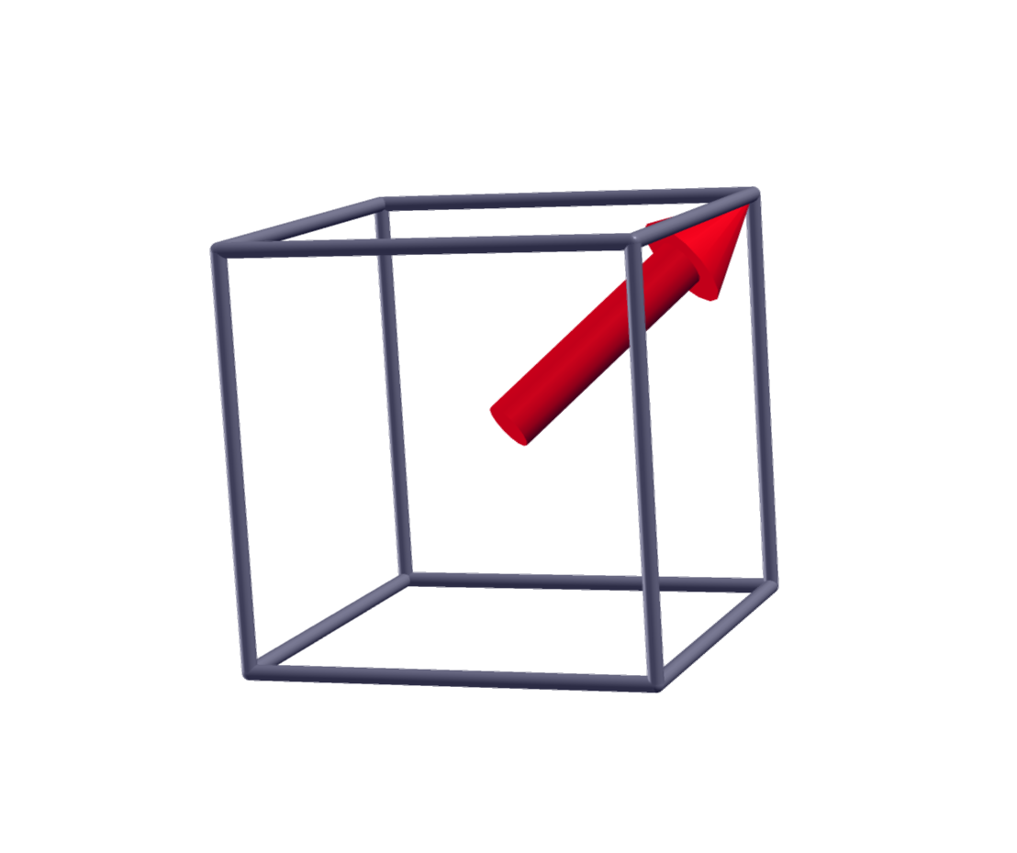
Origin of the r-phase: PbTiO₃ prefers to rotate over a reduction of the out-of-plane-polarization
Double-well curve of bulk tetragonal PbTiO3
~ 80 meV
~ 45 meV
Its actually cheaper to rotate!

Slide 39
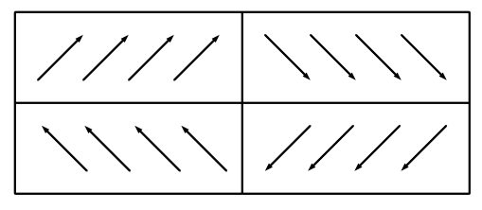
No polarization along x

Slide 40
Elastic vs electrostatic interlayer coupling
Domains induce large strain gradient
Related with flexoelectricity, face where cation move towards expands.
STO is forced to distort the opposite way → elastic cost
Minimization of elastic energy?
Greater electrostatic cost
Minimization of elastic energy?

Slide 41
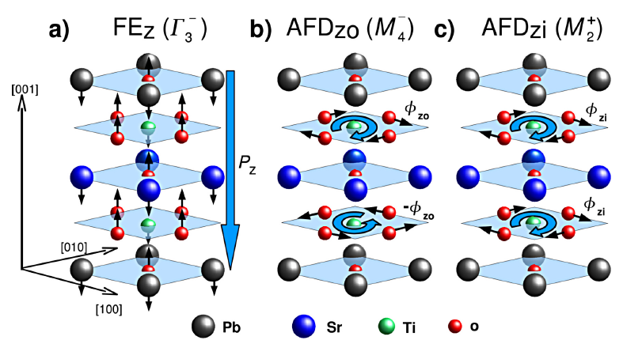
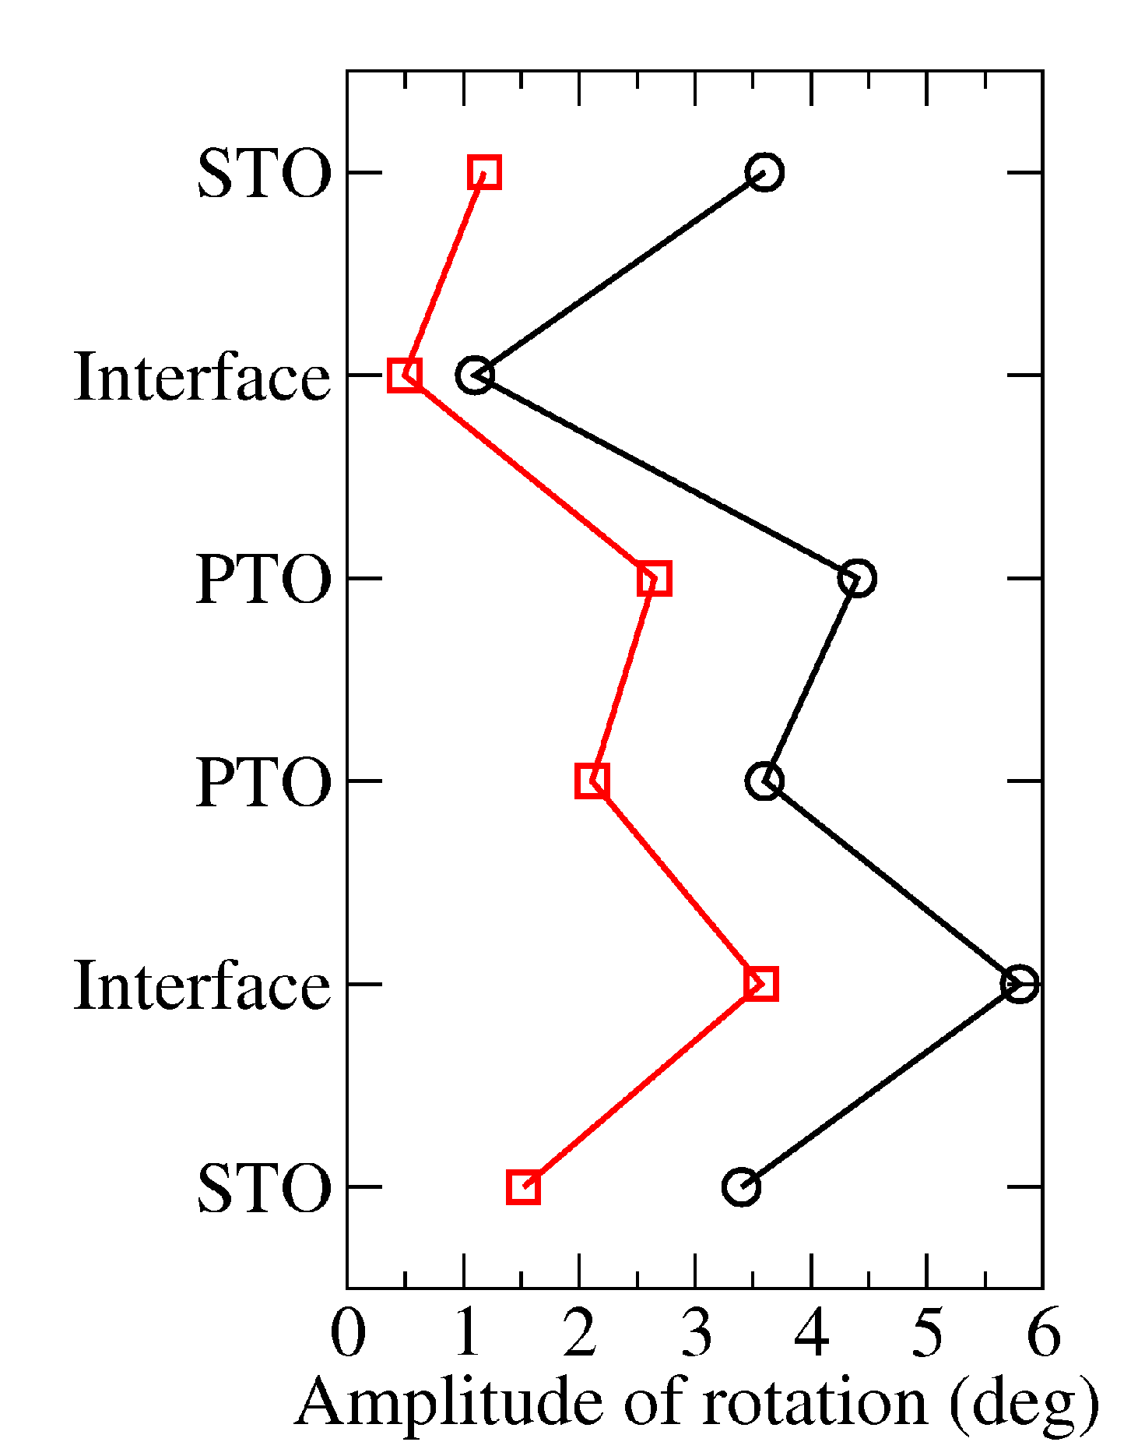
Simulation of monodomain PbTiO₃/SrTiO₃ superlattices
Bousquet et al., Nature 452, 732 (2008)
Monodomain configuration
Strong coupling between FE and AFD modes
Improper FE
Larger periodicities → Interfacial effect
(3,3) superlattices:
Bousquet et al.
Present work

Slide 42
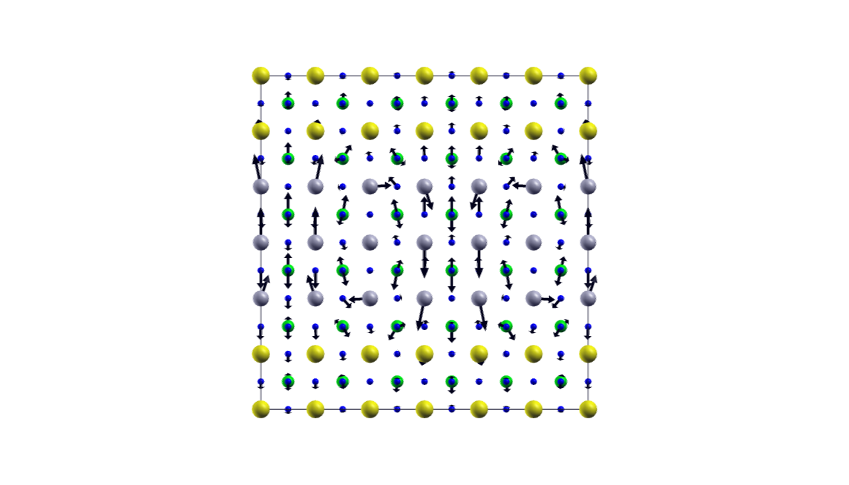
Inhomogeneous distortion in SrTiO₃ /PbTiO₃ superlattices
Domain widths:
a_{STO bulk} = 3.874 Å
w_{STO up} = 11.56 = 3 × 3.85 Å
w_{PTO down} = 11.32 = 3 × 3.77 Å
w_{PTO up} = 11.92 = 3 × 3.97 Å
w_{STO down} = 11.68 = 3 × 3.89 Å
Δw_{STO} = 0.12 Å
Δw_{PTO} = 0.60 Å

Slide 43
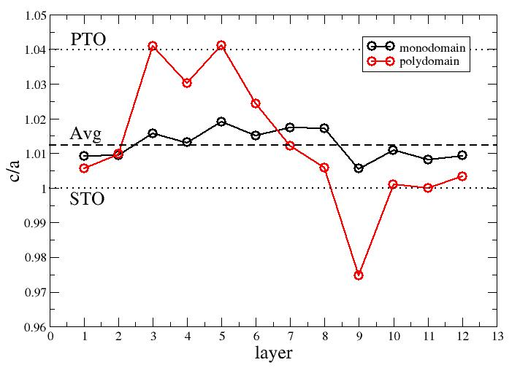
Tetragonality in polydomain SrTiO₃ /PbTiO₃ superlattices
Out of plane lattice parameters:
c_{STO bulk} = 3.874 Å
c_{PTO bulk} = 4.025 Å
12
11
10
9
8
7
6
5
4
3
2
1

Slide 44
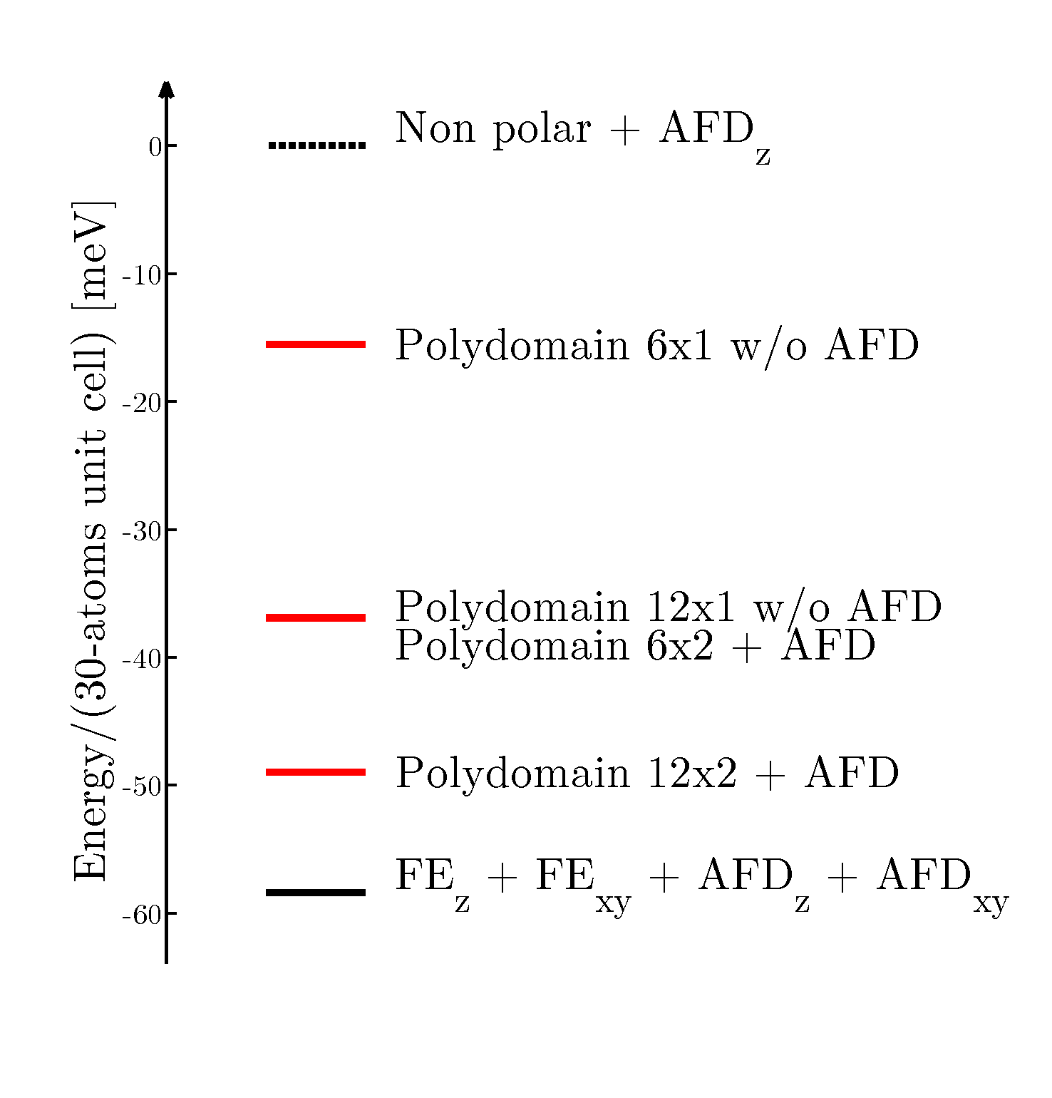
PTO/STO superlattices: relative stability of monodomain and polydomain configurations
AFD instabilities increase stability
Domain periodicity ~ 12 unit cells
(experiment ~ 11 unit cells)
↑N_{x} = -23 meV

Slide 45
Inhomogeneous strain due to domain structure in PTO/STO
Polarization breaks inversion symmetry → different bonding at up and down interfaces and diffetent interfacial distance.
Δz = 3.85 Å
Δz = 3.90 Å
Flexoelectric effect? → unit cell side where cations move towards, expands.
Large flexoelectric effect observed in FE materials.
Spontaeous P induces spontaneous strain gradient.
Ti
O
Bursian et al., Fiz. Tv. Tela 10, 1413 (1968)

Slide 46
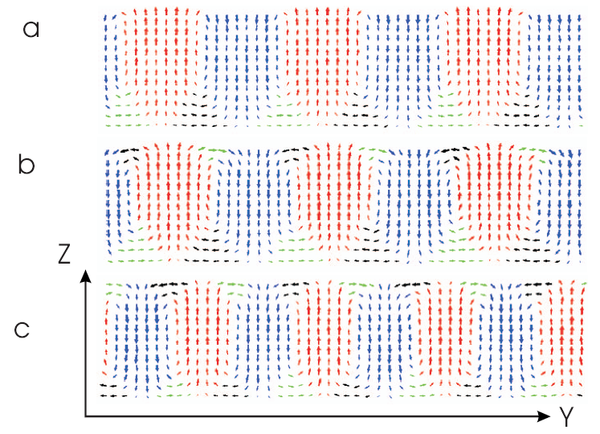
Domains of closure recently predicted using a model hamiltonian approach
48 Å thick PbZr_{0.4}Ti_{0.6}O₃ thin films
sandwiched with a nongrounded metallic plate (top) and a non-conductive substrate (bottom)
d = 0
d = 0.3 a
d = 0.5 a
Dead layer thickness
S. Prosandeev and L. Bellaiche, Phys. Rev. B 75, 172109 (2007)

Slide 47
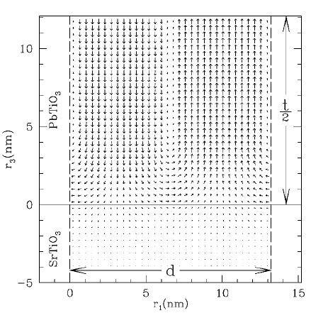

Domains of closure recently predicted using a phenomenological thermodynamic potential
242 Å thick PbTiO₃ thin films sandwiched with a nonconducting SrTiO₃ electrodes @ 700 K stripe period 132 Å
Polarization distribution
Equilibrium field distribution
G. B. Stephenson and K. R. Elder, J. Appl. Phys. 100, 051601 (2006)

Slide 48



ABO₃ perovskite structure exhibits several lattice instabilities. Competition between polar and non polar instabilities.
Antiferrodistortive
Ferroelectric
Antiferroelectric
Balance might be altered in nanostructures
Surface
Defects
(vacancies, misfit dislocations…)
Interfacial chemistry
Electrostatic
Mechanical

Slide 49
Inhomogeneous strain due to domain structure in PbTiO₃/SrTiO₃ superlattices
Polarization breaks inversion symmetry → different bonding at up and down interfaces and diffetent interfacial distance.
Δz = 3.85 Å
Δz = 3.90 Å

Slide 50
Elastic energy associated with inhomogeneous strain play a role in domain structure
Balance:
Elastic energy ↔ Electrostatic energy ↔ Domain wall energy
Domain wall interaction more complex than in bulk/thick films
Need for a model

Slide 51



Common wisdom: epitaxial BaTiO₃ under compressive in-plane strain stabilizes the tetragonal phase, with enhancement of P_{s}
r
c
ac
aa
p
a
Enhancement of the remnant polarization
Enhancement of the transition temperature
BaTiO₃/SrTiO₃
K. J. Choi et al., Science 306, 1005 (2004)
Yoneda et al., J. Appl. Phys. 83, 2458 (1998)
O. Diéguez et al., Phys. Rev. B 69, 212101 (2004)
B. Lai et al., Appl. Phys. Lett. 86, 132904 (2005)

Slide 52

Simulation of monodomain PbTiO₃/SrTiO₃ (3/3) superlattices
Bousquet et al., Nature 452, 732 (2008)
Monodomain configuration
Strong coupling between FE and AFD modes
Improper FE for the short-period superlattices
Larger periodicities → Interfacial effect
[PbTiO₃]₃/[SrTiO₃]₃ = (3,3) superlattices:
 | Bousquet et al. | Present work
Ground state | FE_{z} + AFD_{z} | FE_{z} + FE_{xy} + AFD_{z} + AFD_{xy}
-24 meV

Slide 53
Simulation of monodomain PbTiO₃/SrTiO₃ (3/3) superlattices
Bousquet et al., Nature 452, 732 (2008)
Monodomain configuration
Strong coupling between FE and AFD modes
Improper FE for the short-period superlattices
Larger periodicities → Interfacial effect
[PbTiO₃]₃/[SrTiO₃]₃ = (3,3) superlattices:
 | Bousquet et al. | Present work
Ground state | FE_{z} + AFD_{z} | FE_{z} + FE_{xy} + AFD_{z} + AFD_{xy}
P^{STO} (μC/cm²) | (0, 0, 37.5) | (5, 5, 29)
P^{PTO} (μC/cm²) | (0, 0, 35.8) | (36, 32, 31)

Slide 54
Simulation of monodomain PbTiO₃/SrTiO₃ (3/3) superlattices
Bousquet et al., Nature 452, 732 (2008)
Monodomain configuration
Strong coupling between FE and AFD modes
Improper FE for the short-period superlattices
Larger periodicities → Interfacial effect
[PbTiO₃]₃/[SrTiO₃]₃ = (3,3) superlattices:
 | Bousquet et al. | Present work
Ground state | FE_{z} + AFD_{z} | FE_{z} + FE_{xy} + AFD_{z} + AFD_{xy}
P^{STO} (μC/cm²) | (0, 0, 37.5) | (5, 5, 29)
P^{PTO} (μC/cm²) | (0, 0, 35.8) | (36, 32, 31)
Strain of PTO on STO | -1.2% | -0.5%
FE ↔ AFD coupling is extremely sensitive to strain!

Slide 55
Simulation of monodomain PbTiO₃/SrTiO₃ (3/3) superlattices
[PbTiO₃]₃/[SrTiO₃]₃ = (3,3) superlattices:
 | Present work
Ground state | FE_{z} + FE_{xy} + AFD_{z} + AFD_{xy}
P^{STO} (μC/cm²) | (5, 5, 29)
P^{PTO} (μC/cm²) | (36, 32, 31)
Why PbTiO₃ polarizes in-plane?
Its actually cheaper to rotate!
~ 80 meV
~ 45 meV

Slide 56

Recent discoveries on transition metal oxides: one of the “top tens” scientific breakthroughs of 2007
Science, 318, 1846 (2007)

Slide 57
The field is still in an incipient stage, comparable to that of semiconductors 60 years ago

Slide 58






Polydomain phases in ferrolectric nanocapacitors adopt the form of a “domain of closure”, common in ferromagnets
2-unit-cells thick BaTiO₃ layer in between SrRuO₃ electrodes
N_{x}=4
N_{x}=6
BaO wall
BaO wall
P. Aguado-Puente and J. Junquera Phys. Rev. Lett. 100, 177601 (2008)
TiO₂ wall
TiO₂ wall
Ferromagnetic domains
C. Kittel (1946)

Slide 59

Domains of closure in PbTiO₃/SrRuO₃ capacitors from first-principles
C. Lichtensteiger et al.
“Oxide ultrathin films: science and technology”
Ed. by G. Pacchini and S. Valeri (Wiley, 2011)
Short-circuit
4-unit-cell thick PbTiO₃
6 unit cells of domain periodicity
Fully relaxed
SrRuO₃
PbTiO₃
P = 65 μC/cm² → good screening
Vortices at DW ↔ Domains of closure (but in this case, closed by the displacements of the Pb atoms)
SrRuO₃

Slide 60
Domains in PbTiO₃/SrTiO₃ superlattices: vortices & large polarization
Vortices at DW
(3,3) superlattice
6 unit cells of domain periodicity
Fully relaxed
Polarization domains → good screening
 | w/o AFD | with AFD
P^{PTO} (μC/cm²) | (0, 0, 68)
P^{STO} (μC/cm²) | (0, 0, 25)

Slide 61

Domains in PbTiO₃/SrTiO₃ superlattices: vortices & large polarization
Vortices at DW
(3,3) superlattice
6 unit cells of domain periodicity
Fully relaxed
Polarization domains → good screening
 | w/o AFD | with AFD
P^{PTO} (μC/cm²) | (0, 0, 68) | (0,26,56)
P^{STO} (μC/cm²) | (0, 0, 25) | (0,1,23)
-22 meV

