Slide 1


Solving the Schrödinger equation in simple cases
Javier Junquera
Preschool ASESMA, March 6th 2025

Slide 2

The most important reference followed in this lecture
An EXTREMELY RECOMMENDED textbook for a new comer in the field

Slide 3
Outline:
The free electron gas (plane waves; metals)
The Hydrogen atom (atomic orbitals; pseudopotentials)
Quantum harmonic oscillator in 1D (thermal properties)

Slide 4
Outline:
The free electron gas (plane waves; metals)
The Hydrogen atom (atomic orbitals; pseudopotentials)
Quantum harmonic oscillator in 1D (thermal properties)

Slide 5
The free electron gas confined in a box
Infinite rectangular potential well
A quantum particle is confined to a specified region of space (called the “potential well”) by infinitely strong forces at the edges of that region
Within the well, no force acts on the particle.

Slide 6



The free electron gas in an infinite square well potential (1D)
Goal:
Compute the ground state of a gas of:
N free electrons (no interaction between themselves nor with the lattice)
In 1-dimension
Keeping only the Pauli exclusion principle
One electron of mass m is confined in an infinite square quantum well of length L. The time independent Schrödinger equation is given by
Kinetic energy
Energy levels of one electron in the wave function
Boundary conditions
Normalization conditions
Due to the infinite barrier, the electrons cannot leave the crystal
The electron is somewhere within the potential box

Slide 7
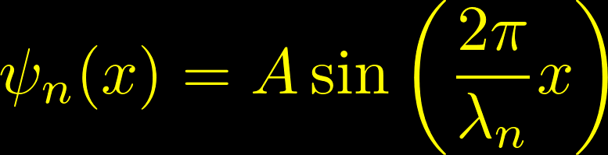
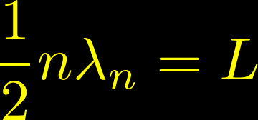
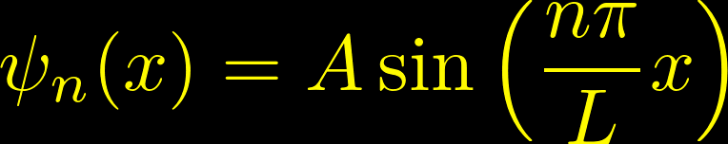
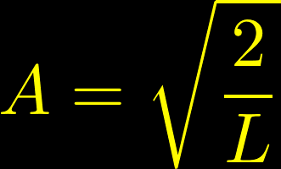
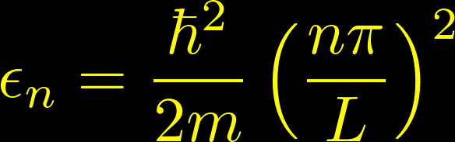
The free electron gas in an infinite square well potential (1D)
Solution: similar to the stationary waves propagating in a string
Normalization constant
One electron energy levels
The energy is a quadratic function of the quantum number n
From Kittel

Slide 8
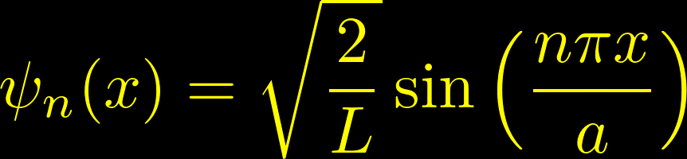
Eigenfunctions and eigenvalues of the TISE for the free electron gas in an infinite square well potential
Eigenfunctions
Eigenvalues
Possible outcomes of energy measurements
The wavenumbers associated with the energy eigenfunctions within the infinite rectangular well are quantized
They have a discrete set of possible values
the energy difference between adjacent wavefunctions increases with increasing n
The wavefunction must have zero amplitude at both edges of the well,
the only allowed wavefunctions are
those with an integer number of half-wavelengths within the well.

Slide 9
Fundamental differences with classical mechanics
Eigenfunctions
Eigenvalues
Possible outcomes of energy measurements
Classical mechanics
All positive values of the energy are allowed
At zero temperature, the lowest energy state has zero energy
Quantum mechanics
The particle can take only certain values
At zero temperature, the lowest energy state has a non zero energy
“zero point energy”

Slide 10
Wave functions in an infinite quantum well
Excited states
Each step up in energy level adds another half-cycle to the wavefunction across the well and another node within the well
The wavefunctions alternate between even and odd parity if the center of the well is taken as the origin
Ground state
Has a node (location of zero amplitude) at each boundary of the well, but no nodes within the well

Slide 11
Relation between shape of the wavefunction and energy

Slide 12



The free electron gas in an infinite square well: filling the one-electron levels with N electrons
Now, we have to accomodate N electrons according to the
Pauli exclusion principle
There cannot be two electrons that have all their quantum numbers identical
Each orbital can be occupied by a maximum of one electron
Quantum numbers for our electrons in a 1D infinite square well
Positive integer
The state with n=0 cannot be normalized over the volumen and must be excluded
States with negative n give no new linearly independent solutions
Magnetic quantum number
According to spin orientation

Slide 13
The free electron gas in an infinite square well: filling the one-electron levels with N electrons
Example:
Filling of the one-energy levels if we have six electrons
Gound state would be
From Kittel

Slide 14

Periodic (Born-von Karman) boundary conditions
We should expect that the bulk properties to be unaffected by the presence of its surface.
A natural choice to emphasize the inconsequence of the surface by disposing of it altogether
Supercell +
Born-von Karman boundary conditions
Each face of the cube is joined to the face opposite to it.
An electron coming to the “surface” is not reflected back in.
It leaves the metal, simultaneously reentering at the corresponding point on the opposite surface

Slide 15
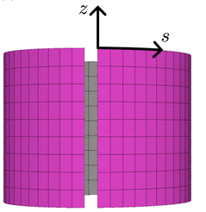
Periodic (Born-von Karman) boundary conditions
Like playing “origami”
Supercell +
Born-von Karman boundary conditions
Each face of the cube is joined to the face opposite to it.
An electron coming to the “surface” is not reflected back in.
It leaves the metal, simultaneously reentering at the corresponding point on the opposite surface

Slide 16


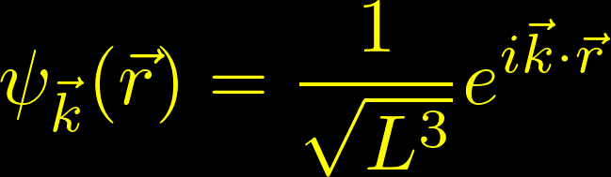


What happens with periodic boundary conditions?
Solution: travelling plane waves
These travelling waves,
in contrast with the stationary waves of the infinite well,
represent better the trasport of electronic charge
They look like plane waves with wave vector
Normalization condition

Slide 17
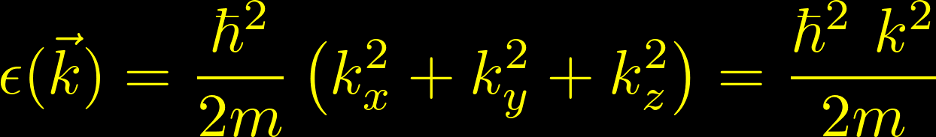
What happens with periodic boundary conditions?
Solution: travelling plane waves
These travelling waves,
in contrast with the stationary waves of the infinite well,
represent better the trasport of electronic charge
They look like plane waves with wave vector
The posible energy states are

Slide 18



Three dimensional plane waves
The plane wave will be constant in any plane perpendicular to and periodic in the direction parallel to with a wave length
The module of the wave vector is related with the wave length
de Broglie’s wave length
A Student’s Guide to the Schrödinger equation
Daniel A. Fleisch
Cambridge University Press, Cambridge, 2020
ISBN:978-1-108-81978-7

Slide 19
Outline:
The free electron gas (plane waves; metals)
The Hydrogen atom (atomic orbitals; pseudopotentials)
Quantum harmonic oscillator in 1D (thermal properties)

Slide 20
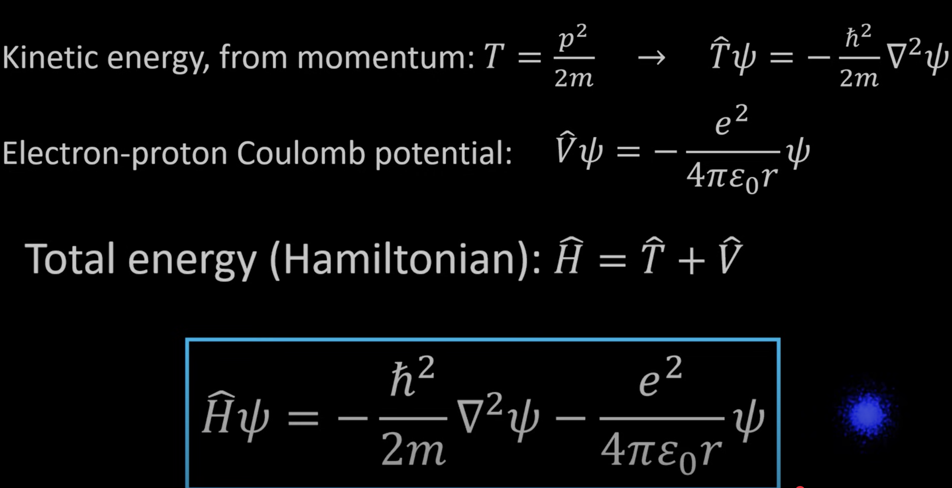
Schrödinger equation for the Hydrogen atom

Slide 21
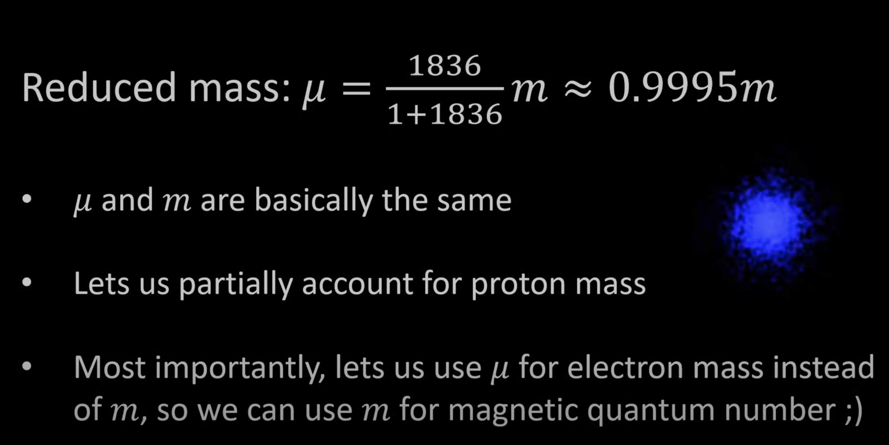
Schrödinger equation for the Hydrogen atom

Slide 22
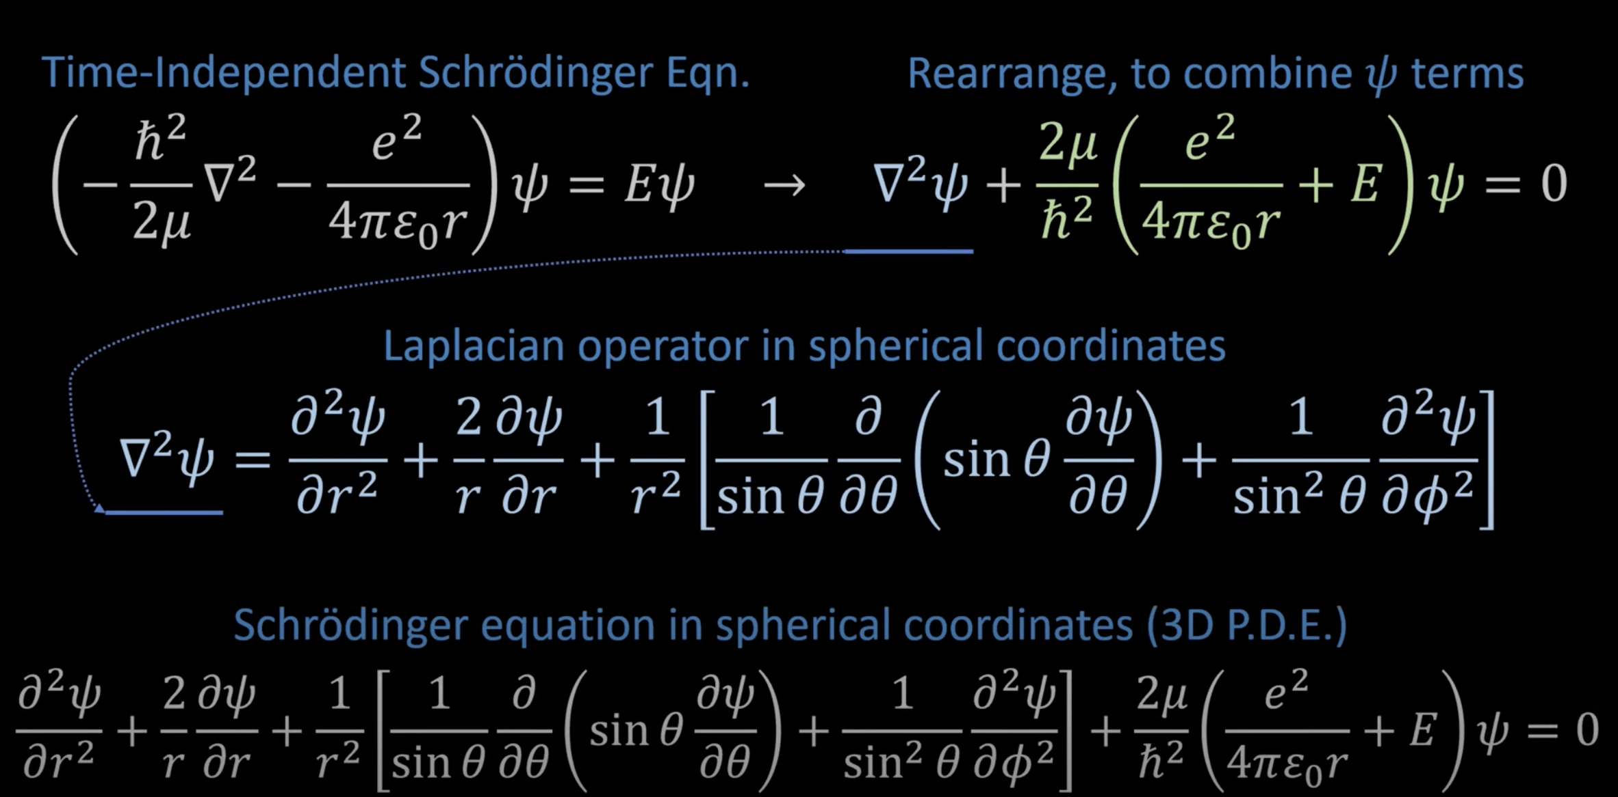
Schrödinger equation for the Hydrogen atom
Due to the symmetry of the problem, we are going to use polar spherical coordinates
This equation can be solved by separation of variables
The wave functions are the product of a radial part times an function that only depends on the angular variables

Slide 23


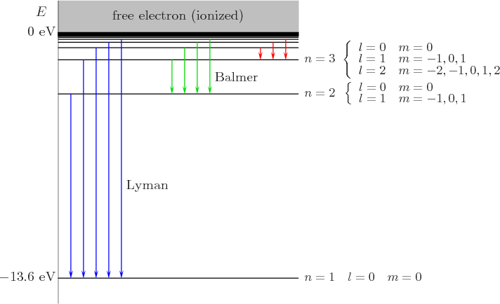
Eigenfunctions and eigenvalues of the Schrödinger equation for the Hydrogen atom
Eigenfunctions
Due to the symmetry of the problem, they are also eigenfunctions of the operators and
Eigenvalues

Slide 24
The atoms are not like this…
A fantastic video by “Quantum fracture”
Los átomos no son así (The atoms are not like this)
And also, the Hydrogen atom, by Richard Behiel
The hydrogen atom

Slide 25
Outline:
The free electron gas (plane waves; metals)
The Hydrogen atom (atomic orbitals; pseudopotentials)
Quantum harmonic oscillator in 1D (thermal properties)

Slide 26
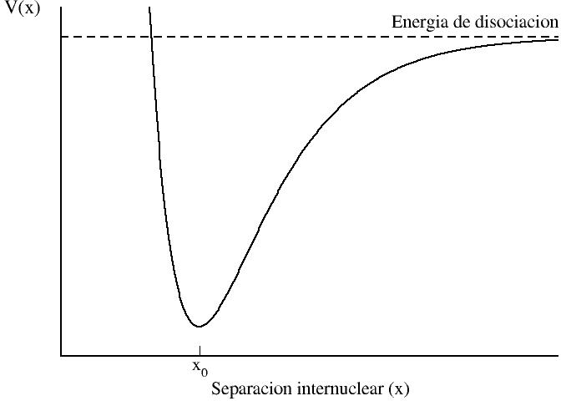
Harmonic approximation: displacements around a minimum of the potential
Consider a potential (whatever) with a minimum at x₀
Example: interaction potential energy between two non polar molecules as a function of distance
Strong repulsion when the molecules are very close together
Atraction when the molecules are more distant
If we are interested only in what happens only around the minimum…
Notes:
Cohen-Tannoudji, Ch. VA, page 484
Feynman, Volume 1, Chapter 12, page 12-6.

Slide 27
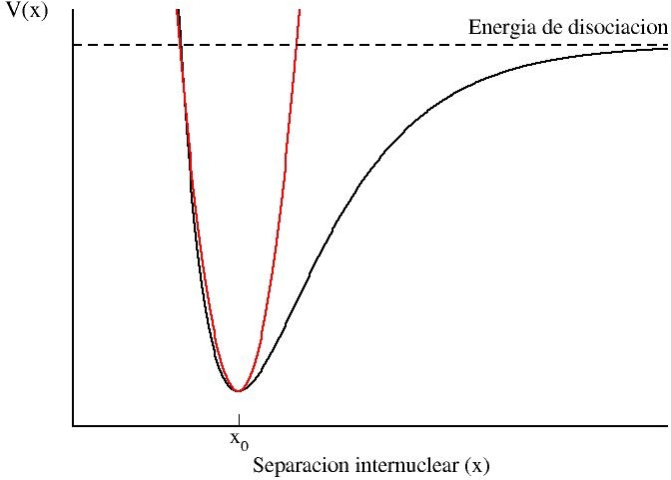

Harmonic approximation: displacements around a minimum of the potential
Around the minimum, we can aproximate the potential by a parabola
If the displacements are not very large, the force is proportional to the displacement
Equation of movement of the harmonic oscillator
Notes:
Cohen-Tannoudji, Ch. VA, page 484
Feynman, Volume 1, Chapter 12, page 12-6.

Slide 28
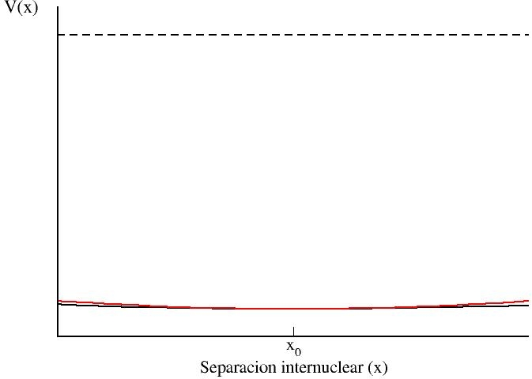
Harmonic approximation: displacements around a minimum of the potential
Around the minimum, we can aproximate the potential by a parabola
If the displacements are not very large, the force is proportional to the displacement
Equation of movement of the harmonic oscillator
Notes:
Cohen-Tannoudji, Ch. VA, page 484
Feynman, Volume 1, Chapter 12, page 12-6.

Slide 29
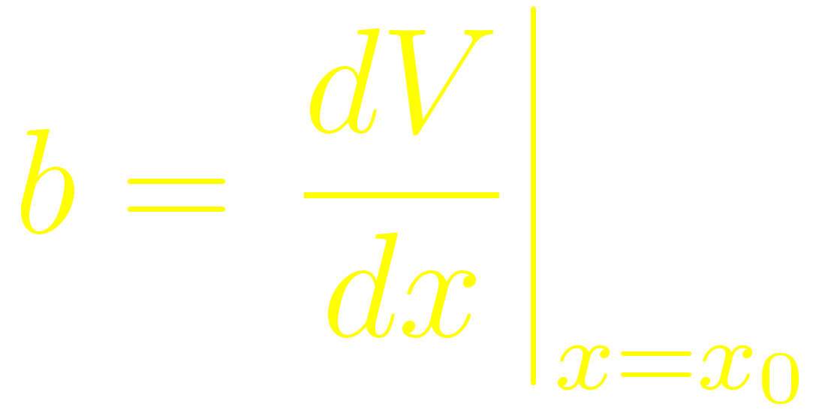
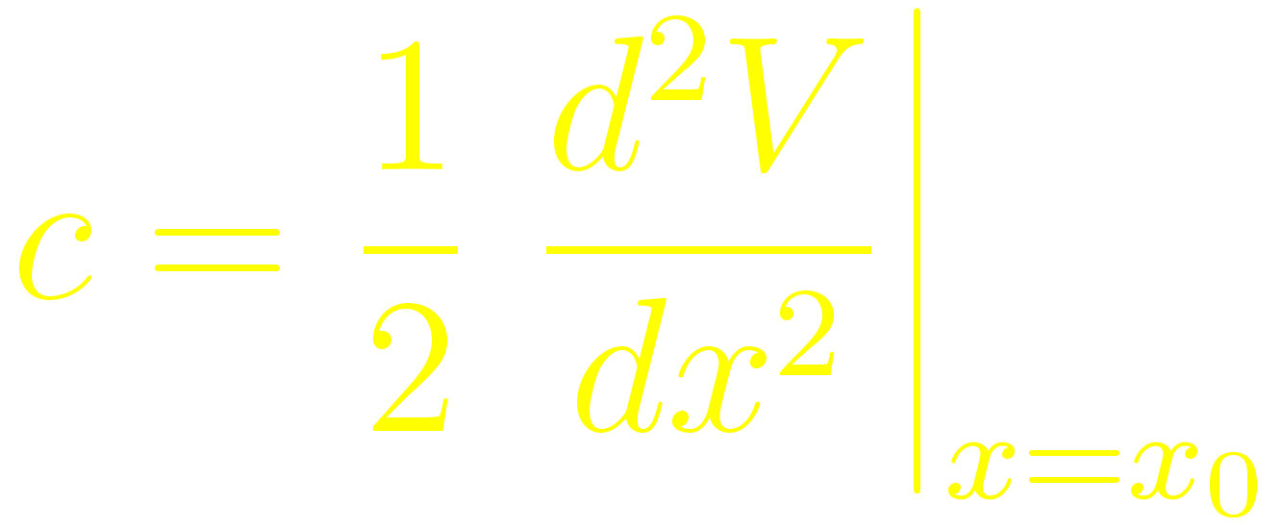
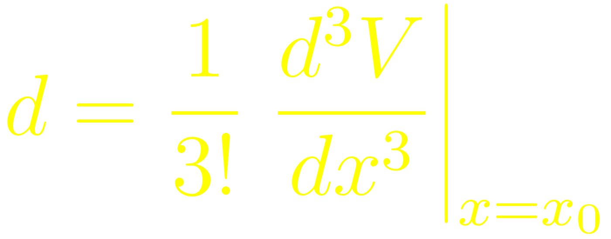
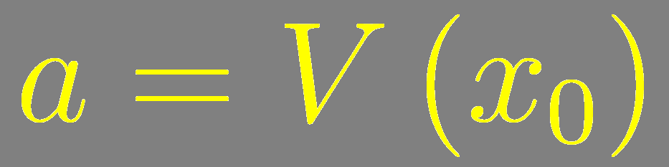
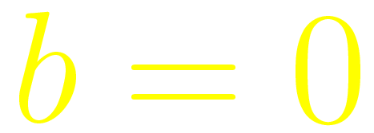

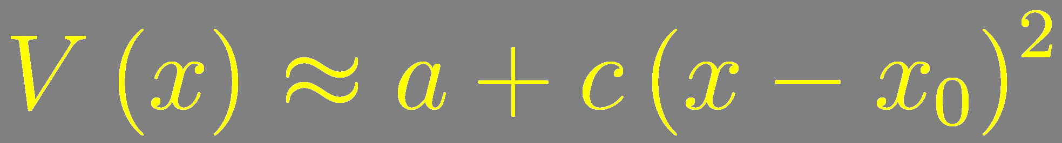
Harmonic approximation: mathematical approach
Taylor expansion of the potential around the minimum
If x₀ is an stable equilibrium position:
If the displacements around x₀ are sufficiently small
Notes:
Cohen-Tannoudji. Chapter VA (pages 481-484)

Slide 30



Quantum harmonic oscillator in 1D
The potential energy is quadratic
where is the distance of the object from the equilibrium position
and is the “spring constant”
(the force on the object per unit distance from the equilibrium position)

Slide 31



Quantum harmonic oscillator in 1D
The potential becomes infinite when
must be zero in regions in which the potential energy is infinite
The “depth of the well” varies continuosly with the position
This provides the boundary conditions for the wave function of the quantum oscilator

Slide 32


The time-independent Schrödinger equation for the quantum harmonic oscillator in 1D
To find the energy levels and wave functions of the quantum harmonic oscillator, we need to solve
Writting the equation in terms of the angular frequency

Slide 33

The time-independent Schrödinger equation for the quantum harmonic oscillator in 1D
How to solve the TISE for the harmonic oscillator in 1D
“Analytical approach”
Use a power series
“Algebraic approach”
Use factorization ans using a type of operator called “ladder operator”

Slide 34
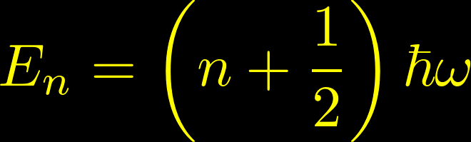
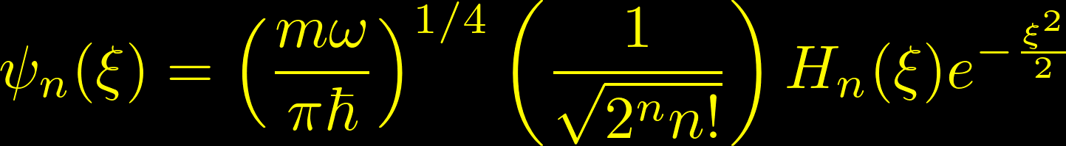



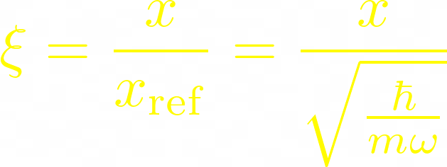



Eigenvalues and eigenfunctions of the TISE for the quantum harmonic oscillator in 1D
Allowed values for the energies
Corresponding eigenfunctions
The ground-state energy
Rescaling the positions to make the solutions easer to find
Hermite polynomials
The spacing between energy levels in the quantum harmonic oscillator is constant.
Each energy level is precisely higher than the adjacent energy level
Complete derivation in the book by Daniel Fleisch

Slide 35
Eigenvalues and eigenfunctions of the TISE for the quantum harmonic oscillator in 1D
Oscillatory on the classical allowed region
Odd
(5 nodes)
In this region, the curvature of the wave functions increases with increasing energy
(more cycles between the classical turning points)
Even
(4 nodes)
Odd
(3 nodes)
Even
(2 nodes)
Odd
(1 node)
Even
(0 nodes)
Exponentially decaying in the classically forbidden region

Slide 36
Probability density of the TISE for the quantum harmonic oscillator in 1D
At low energies, the behaviour of the harmonic oscillator differs significantly from the classical one
Classical mechanics:
The object moves fastest at equilibrium and slowest at the turning points
Measurements of position taken at random times are more likely to yield results near the turning points, because the object spends more time there.
Quantum mechanics:
A measuremnt of the position of a particle in the ground state is more likely to yield a value near x = 0

Slide 37

Probability density of the TISE for the quantum harmonic oscillator in 1D
Higher energies:
An excited state has locations with zero probability on the classially allowed region
As increases, the probability of a position measurement producing a result near the classical turning points increases
The behavior of the quantum harmonic oscillator does begin to resemble that of the classical case at large values of , as required by the Correspondence Principle

Slide 38
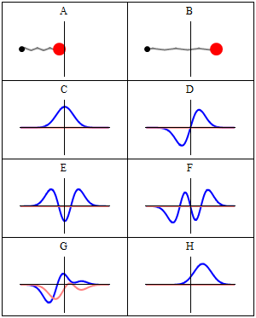
Stationary states of the TISE for the quantum harmonic oscillator in 1D
Classical solutions
Real part
Imaginary part
of the wavefunction of some energy eigenstates
Real part
Imaginary part
of the wavefunction of some states that are not eigenstates
(H is a coherent states)
From Wikipedia

