Slide 1
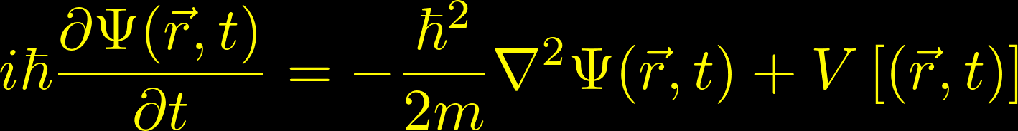



An introduction to the Schrödinger equation
Javier Junquera
Preschool ASESMA, February 27th 2025

Slide 2
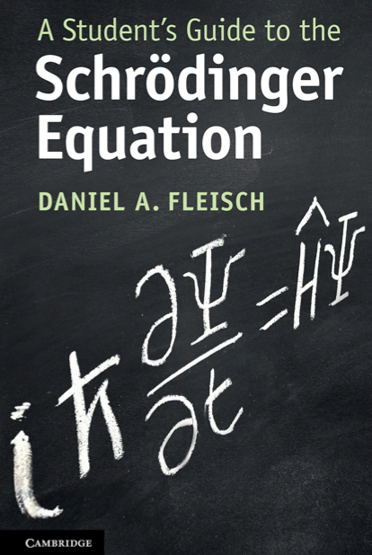
The most important reference followed in this lecture
An EXTREMELY RECOMMENDED textbook for a new comer in the field

Slide 3
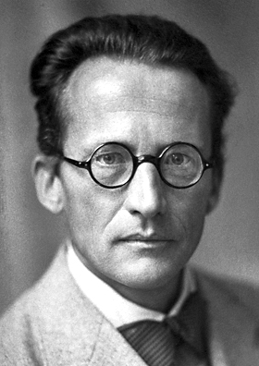
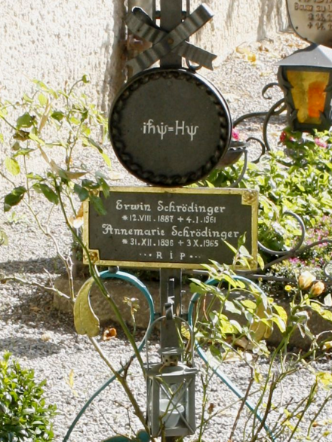
A little bit of history
Erwin Schrödinger
(1887-1961)
Paper published in 1926

Slide 4
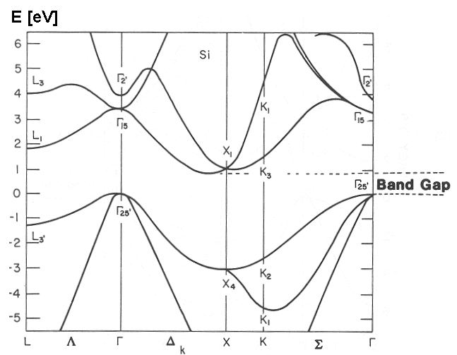
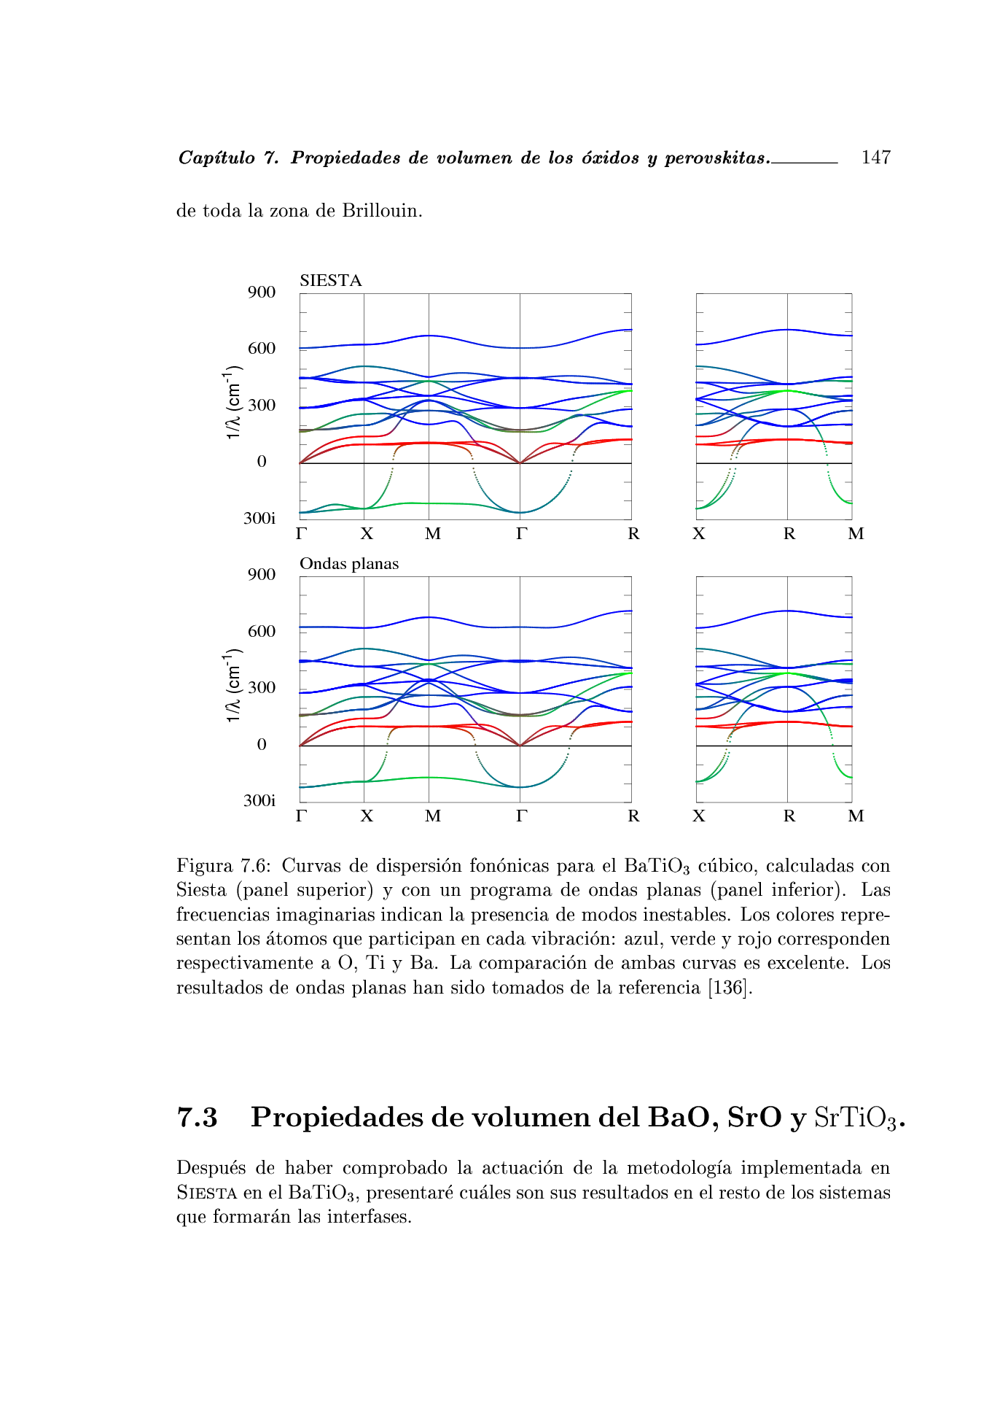

Goal: Describe properties of matter from theoretical methods firmly rooted in fundamental equations
structural
electronic
PROPERTIES
magnetic
vibrational
optical

Slide 5
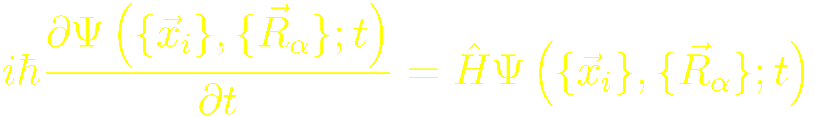
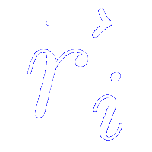
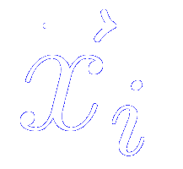
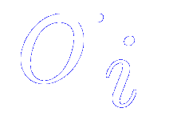

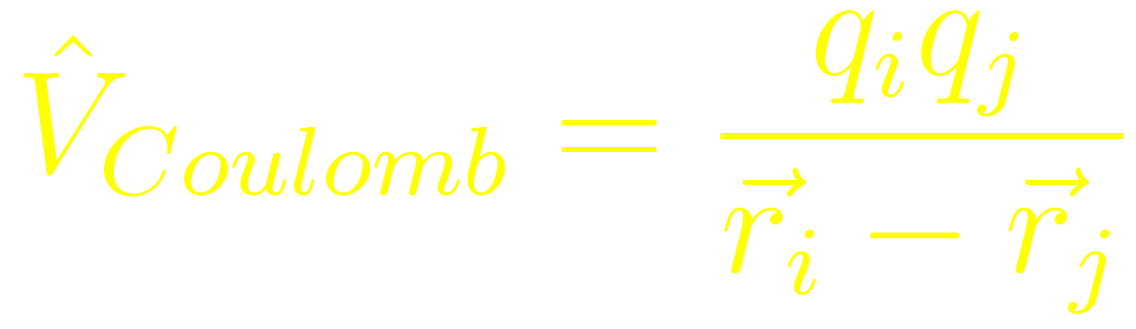
Goal: Describe properties of matter from theoretical methods firmly rooted in fundamental equations
Quantum Mechanics: Schrödinger equation (assuming no relativistic)
Space coordinates
Coordinates of electron i comprise
Spin coordinates
Electromagnetism: Coulomb’s law
For a pair of charged particles
Notes:
Any problem in the electronic structure of matter is covered by Schrodinger equation including the time. In most cases, however, one is concerned with atoms and molecules without time dependent interactions, so we may focus on the time-independent Schrodinger equation.
For an isolated N-electron atomic or molecular system in the Born-Oppenheimer nonrelativistic approximation, it is given by H \Psi = E \Psi.

Slide 6
This hamiltonian can not be solved exactly: practical and fundamental problems
Fundamental problem:
Schrödinger’s equation is exactly solvable for
- Harmonic oscillator (analytically)
- Two particles (analytically)
- Very few particles (numerically)
The complexity wall is the treatment of the electron-electron interaction
Practical problem:
The number of electrons and nuclei in a pebble is of the order of 10²³
The computational cost grows exponentially with the number of electrons

Slide 7

ASESMA school in Ghana
9th-20th June 2025
https://www.asesma.org/home

Slide 8
Outline:
What the Schrödinger equation means
Characteristics of the Schrödinger equation
Time independent Schrödinger equation in 1D
Schrödinger equation in 3D
What does the electronic wavefunction represents.
Principles of Copenhagen interpretation

Slide 9
Outline:
What the Schrödinger equation means
Characteristics of the Schrödinger equation
Time independent Schrödinger equation in 1D
Schrödinger equation in 3D
What does the electronic wavefunction represents.
Principles of Copenhagen interpretation

Slide 10
What the Schrödinger equation means
Time dependent Schrödinger equation in one-dimension

Slide 11
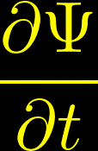




Partial derivative of the wave function with respect to time
The quantum wavefunction is a function of both the spatial position and time
Represents the change of the wave function over time only (it is a partial derivative)
In a graph of the wavefunction at a given location as a function of time, this term is the slope of the graph
Units (in one dimension and in the international system)
s = seconds
m = meters

Slide 12

numerical value of the imaginary unit (adimensional)
Multiplication by has the effect of causing a 90∘ rotation in the complex plane
It moves numbers from the positive real axis to the positive imaginary axis, ot from the positive imaginary axis to the negative real axis
Its presence means that the quantum wavefunction solutions might be complex
(this has a significant impact on the results of combining two wave functions)

Slide 13





the modified Planck constant
s = seconds
J = Joules
It is the constant of proporciontality between the energy and the angular frequency
It is the constant of proporciontality between the momentum and the wave number
Linear dependency here because it appears linearly in the energy expression
Quadratic dependency here because it appears linearly in the momentum expresión and the kinetic energy is quadratic to the momentum

Slide 14

mass of the particle or system associated with the quantum wavefunction
It is a measure of inertia
(resistance to acceleration)
Units in kg in the international system

Slide 15
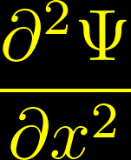



curvature of the wavefunction over space
Change of wavefunction over space
(the slope of the wave function plotted against x)
Change in the slope of the wavefunction over space
(curvature of the wavefunction)
Units on the international system
m = meters

Slide 16





potential energy of the system
may vary over space and time
In quantum mechanics, the particle’s total energy may be less than the potential energy in some regions
Classically “unallowed regions”
Evanescent solutions
Classically “allowed regions”
Oscillating solutions
Units on the international system: Joules
m = meters
s = seconds
kg = kilograms

Slide 17
Outline:
What the Schrödinger equation means
Characteristics of the Schrödinger equation
Time independent Schrödinger equation in 1D
Schrödinger equation in 3D
What does the electronic wavefunction represents.
Principles of Copenhagen interpretation

Slide 18
Characteristics of the Schrödinger equation
Differential: involves the change of the wavefunction over space and time
Partial: because the wavefunction depends on both space and time
Second-order: because the highest-order in the equation is a second derivative
Parabolic: because the combination of a first-order differential term in time and a second-order differential term in space is analogous to the combination of a first-order algebraic term and a second-order algebraic term in a parabola

Slide 19
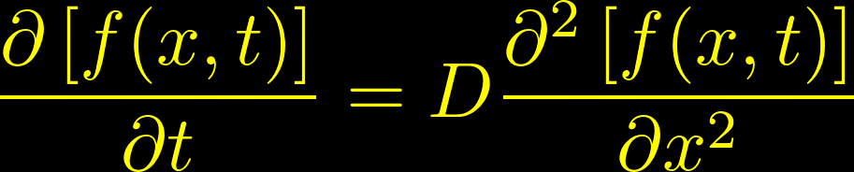

Relationship with difussion equation

Slide 20


Relationship with difussion equation
Consider a function at that might represent, for instance,
the initial temperature distribution of a fluid with a warm spot at the origin
The curvature is the change in the slope
(second derivative of the function)
How this temperature will evolve over time?
From the diffusion equation, we should consider the curvature of the function in various regions

Slide 21
Relationship with difussion equation
Since the difussion equation tells that the time rate of change of the function is proportional to the curvature of the function,
the function will evolve as…
The temperature increases in regions of positive curvature
The temperature decreases in regions of negative curvature
(the energy from the initially warm regions diffuses into the cooler neighboring regions)

Slide 22
Would all the quantum particles and systems diffuse or spread out in space as time passes?
Sometimes, but no always
The difference between the Schrödinger equation and the difussion equation is a factor of “i” in the former
The wavefunctions might be complex
They may exhibit oscillatory behaviour rather than diffusing under some circumstances

Slide 23

Interpretation of the wavefunction as a probability amplitude
Due to Max Born (1926)
The module squared of a particle’s position wavefunction
gives the particle’s position probability density function
In the one-dimensional case this is the probability per unit length
The integral of the probability density function over any spatial interval gives the probability of finding the particle within that interval
When the wavefunction oscillates or diffuses,
it is the probability’s distribution that is changing

Slide 24
The wavefunctions that satisfy the Schrödinger eq. represent “all you can ever know” about the state of a particle of system
The time derivative is first order
The first-order tells you how fast the wavefunction itself is changing over time
If we integrate once, only one constant of integration is required
The knowledge of the wavefunction at some instant in time completely specifies the state if the particle or system at all future times
This is at odds with the classical wave equation, where both the time and spatial derivatives are second order

Slide 25
Outline:
What the Schrödinger equation means
Characteristics of the Schrödinger equation
Time independent Schrödinger equation in 1D
Schrödinger equation in 3D
What does the electronic wavefunction represents.
Principles of Copenhagen interpretation

Slide 26



Time-independent Schrödinger equation
Assumption: separation of variables
The solution can be written as the product of two separate functions:
One depending only on the spatial coordinates ( )
Another depending only on
There is no a-priori reason why this approach should work.
But it often does.
In any situation in which the potential energy varies only over space
(and not over time), you can use separtation of variables to solve the Schrödinger equation

Slide 27



Time-independent Schrödinger equation
Inserting this into the Schrödinger equation
Since does not depend on time,
and does not depend on position,
they can be taken out from the partial derivatives
Now the partial derivatives have become total derivatives

Slide 28
Time-independent Schrödinger equation
Dividing both sides of the equation by
This side of the equation only depends on time
If the potential does not depend on time, this side of the equation
only depends on space
For that to be true, each side must be constant

Slide 29




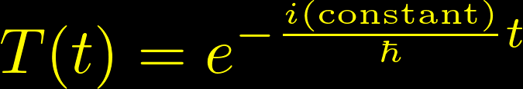
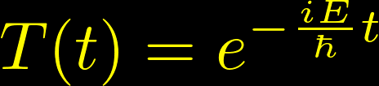
Time-independent Schrödinger equation: time part
Taking a look to the left hand side
Integrating both sides over time
Calling the constant of integration E

Slide 30

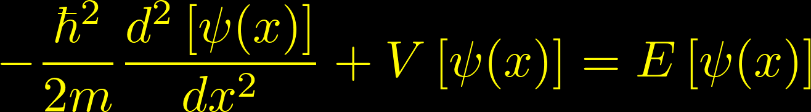
Time-independent Schrödinger equation: spatial part
Taking a look to the right hand side
The same as in the time equation
Multiplying both sides by we arrive to the
time-independent Schrödinger equation
Its solutions describe only the spatial behaviour of the quantum wavefun.
They depend on the behaviour of the potential in the region of interest

Slide 31


Time-independent Schrödinger equation: spatial part
It is an eigenvalue equation
Consider the operator
Then, the TISE can be written as
Eigenvalue
Eigenfunction

Slide 32

Time-independent Schrödinger equation: stationary states
The wave function depends both on time and space
It changes over time
So, what is the meaning of stationary?
Stationary means that the wave function
may be separated into spatial and temporal functions,
And quantities such as the probability density and expectation values do not vary over time

Slide 33

Time-independent Schrödinger equation: stationary states
Stationary means that the wave function
may be separated into spatial and temporal functions,
And quantities such as the probability density and expectation values do not vary over time
Compute the inner product of such a separable wavefunction with itself
The time dependence has disappeared
Any quantity involving will not change over time (it will be “stationary”) if the wave function is separable

Slide 34
Outline:
What the Schrödinger equation means
Characteristics of the Schrödinger equation
Time independent Schrödinger equation in 1D
Schrödinger equation in 3D
What does the electronic wavefunction represents.
Principles of Copenhagen interpretation

Slide 35



Three-dimensional Schrödinger equation
Now the wavefunction must be written as
To specify positions in 3D requires a position vector with three components
In Cartesian coordinates
The second spatial derivatives will be replaced by the Laplacian operator

Slide 36
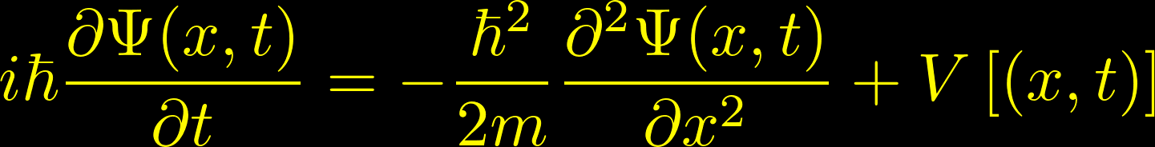

Three-dimensional Schrödinger equation
Applying these changes

Slide 37




Time independent Schrödinger equation in three-dimensions
Using a similar approach (separation of variables) to that used in the one-dimensional case
Spatial part
Temporal part
The 3D Hamiltonian now takes the shape

Slide 38
Outline:
What the Schrödinger equation means
Characteristics of the Schrödinger equation
Time independent Schrödinger equation in 1D
Schrödinger equation in 3D
What does the electronic wavefunction represents.
Principles of Copenhagen interpretation

Slide 39



What does the electronic wave function represents?
Schrödinger interpretation (wrong):
the wavefunction of a charged particle might be related to the spatial distribution of electric charge
Max Born
Grandfather of
Olivia Newton John
1954
Born’s rule (1926):
the wavefunction represents a “probability amplitude” whose magnitude squared determines the probability that a certain result will be obtained when an observation is made

Slide 40
What does the electronic wave function represents?
The wavefunction is not a measurable disturbance in a physical medium
The wavefunction can be used to determine the possible results of measurements of quantum observables and to calculate the probabilities of those results

Slide 41
Principles of the Copenhagen interpretation (I)
Information content
The quantum state includes all possible information about a quantum system – there are no “hidden variables” with additional information.
Time evolution
Overtime, quantum states evolve smoothly in accordance with the Schrödinger equation unless a measurement is made.
Wavefunction collapse
Whenever an measurement of a quantum state is made, the state “collapses” to an eigenstate of the operator associated with the observable being measured.
Measurement results
The value measured for an observable is the eigenvalue of the eigenstate to which the original quantum state has collapsed.

Slide 42
Principles of the Copenhagen interpretation (II)
Uncertainty principle
Certain “incompatible” observables (such as position and momentum) may not be simultaneously known with arbitrarily great precisión
Born rule
The probability that a quantum state will collapse to a given eigenstate upon measurement is determined by the square of the amount of that eigenstate present in the original state (the wavefunction)
Correspondence principle
In the limit of very large quantum numbers, the results of measurements of quantum observables must match the results of classical physics.
Complementarity
Every quantum system includes complementary wave-like and particle-like aspects; whether the system behaves like a wave or like a particle when measured is determined by the nature of the measurement.

Slide 43





Physical meaning of the wave function
The wave function ( ) in quantum mechanics is a fundamental mathematical entity that contains all the information about a quantum system.
While its square ( ) represents the probability density,
the wave function itself has deeper physical implications
Encodes All Observable Properties:
The wave function contains information about a system’s position, momentum, energy, and other observable properties.
By applying the corresponding quantum mechanical operators
(e.g., position , momentum Hamiltonian ),
we can extract expectation values and probabilities for these quantities

Slide 44
Physical meaning of the wave function
The wave function ( ) in quantum mechanics is a fundamental mathematical entity that contains all the information about a quantum system.
While its square ( ) represents the probability density,
the wave function itself has deeper physical implications
Superposition Principle:
The Schrödinger equation is linear and homogeneous.
Therefore, the solutions can be superposed linearly
The wave function allows for quantum superposition,
meaning a system can exist in multiple states simultaneously until measured. This leads to interference effects seen in phenomena like the double-slit experiment.

Slide 45
Physical meaning of the wave function
The wave function ( ) in quantum mechanics is a fundamental mathematical entity that contains all the information about a quantum system.
While its square ( ) represents the probability density,
the wave function itself has deeper physical implications
Phase and Interference Effects:
The phase of the wave function plays a crucial role in quantum interference.
Even if two wave functions have the same probability distribution,
their relative phases can change how they combine
(constructive or destructive interference).

Slide 46
Physical meaning of the wave function
The wave function ( ) in quantum mechanics is a fundamental mathematical entity that contains all the information about a quantum system.
While its square ( ) represents the probability density,
the wave function itself has deeper physical implications
Quantum Evolution and Determinism:
The wave function evolves deterministically according to the Schrödinger equation, meaning that while measurement introduces probabilities, the evolution of itself is completely determined by the system’s Hamiltonian.

Slide 47
Physical meaning of the wave function
The wave function ( ) in quantum mechanics is a fundamental mathematical entity that contains all the information about a quantum system.
While its square ( ) represents the probability density,
the wave function itself has deeper physical implications
Collapse and Measurement:
Upon measurement, the wave function “collapses” to a specific eigenstate of the measured observable, leading to the probabilistic nature of quantum mechanics.

Slide 48
Physical meaning of the wave function
While the wave function itself is not directly observable, it serves as the core mathematical and conceptual tool for understanding quantum phenomena.
the Copenhagen interpretation treats it as a tool for predicting measurement outcomes.

