Slide 1
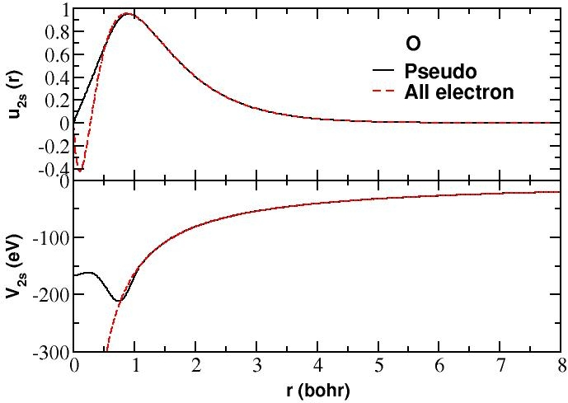


Norm-conserving pseudopotentials in electronic structure calculations
Javier Junquera
Alberto García

Slide 2
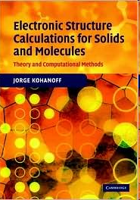
Bibliography used in the present lecture

Slide 3
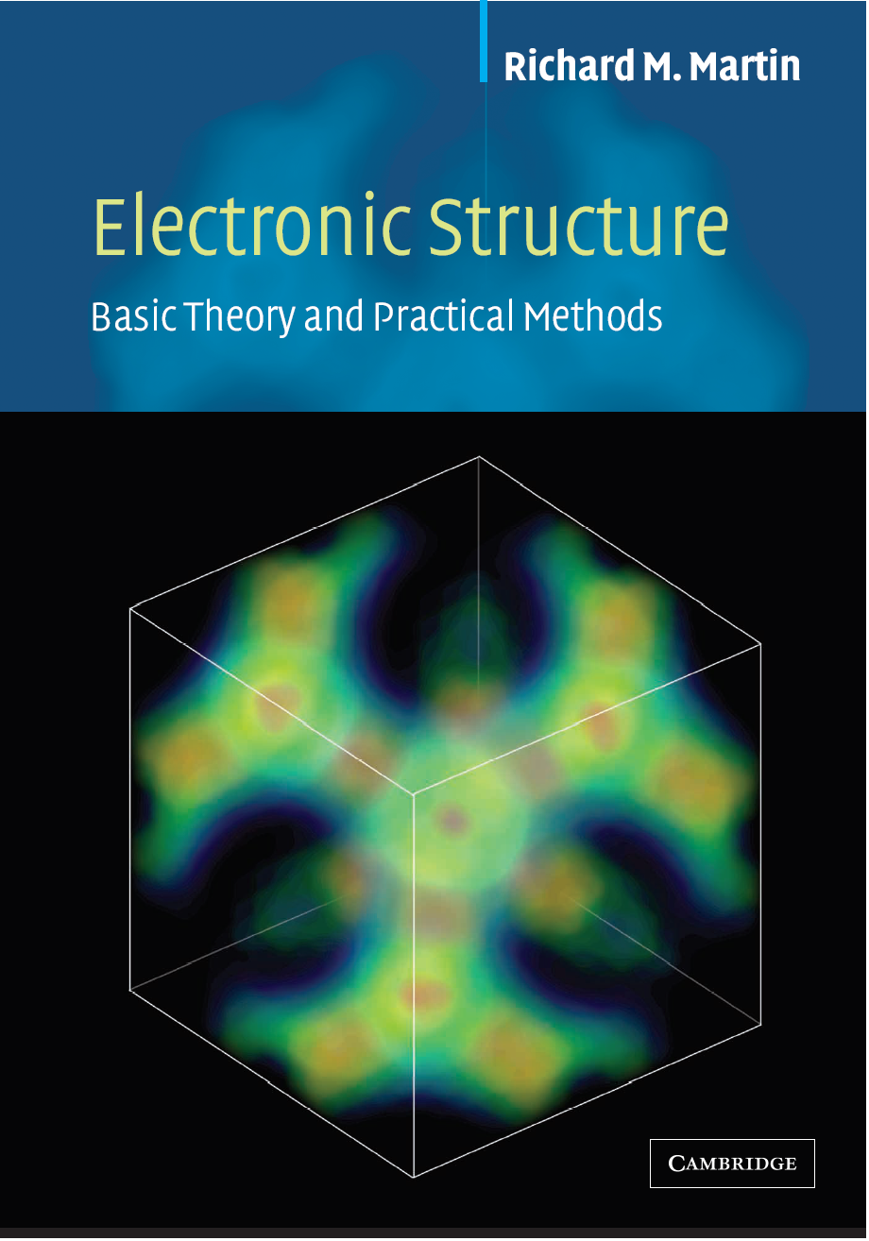
Bibliography used in the present lecture

Slide 4
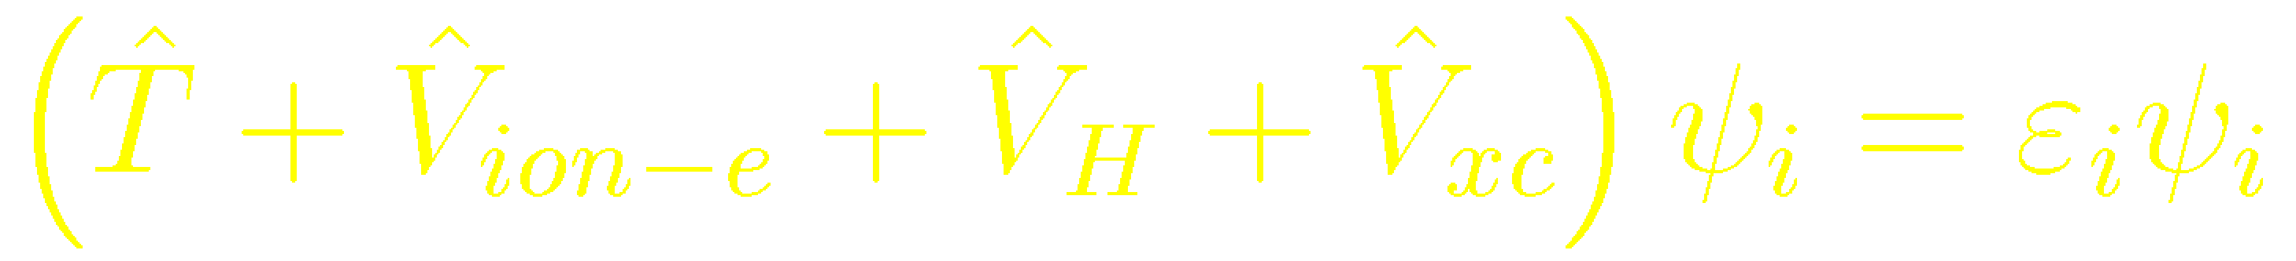
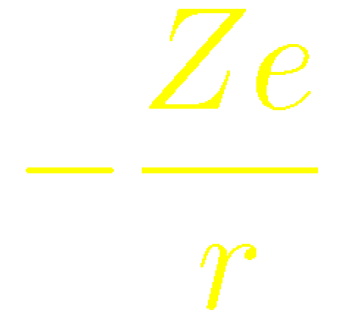
Atomic calculation using DFT:
Solving the Schrodinger-like equation
One particle Kohn-Sham equations
Notes:
The difficulty in general is to deal accurately with the electrons both near the nucleus and in the smoother bonding regions. (Martin, page 7).
In solving the Schrodinger equation for condensed aggregates of atoms, space can be divided into two regions with quite different properties.
The region near the nuclei, the “core regions” are composed primarily of tightly bound core electrons which respond very little to the presence of neighboring atoms.
While the remaining volume contains the valence electron density which is involved in the bonding together of the atoms.

Slide 5
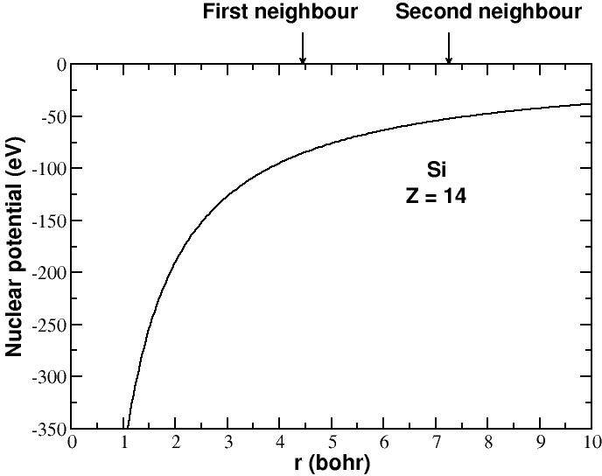
Difficulty: how to deal accurately with both the core and valence electrons
CORE
Notes:
The difficulty in general is to deal accurately with the electrons both near the nucleus and in the smoother bonding regions. (Martin, page 7).
In solving the Schrodinger equation for condensed aggregates of atoms, space can be divided into two regions with quite different properties.
The region near the nuclei, the “core regions” are composed primarily of tightly bound core electrons which respond very little to the presence of neighboring atoms.
While the remaining volume contains the valence electron density which is involved in the bonding together of the atoms.

Slide 6
Difficulty: how to deal accurately with both the core and valence electrons
VALENCE
CORE
Notes:
The difficulty in general is to deal accurately with the electrons both near the nucleus and in the smoother bonding regions. (Martin, page 7).
In solving the Schrodinger equation for condensed aggregates of atoms, space can be divided into two regions with quite different properties.
The region near the nuclei, the “core regions” are composed primarily of tightly bound core electrons which respond very little to the presence of neighboring atoms.
While the remaining volume contains the valence electron density which is involved in the bonding together of the atoms.

Slide 7
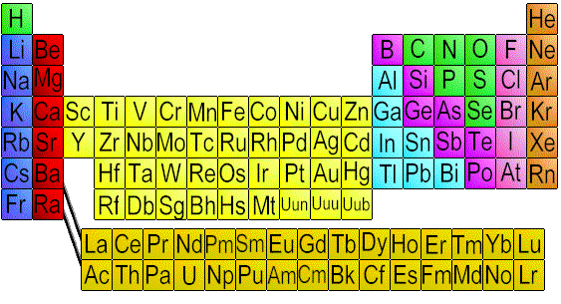
Si atomic configuration: 1s² 2s² 2p⁶ 3s² 3p²
core
valence

Slide 8
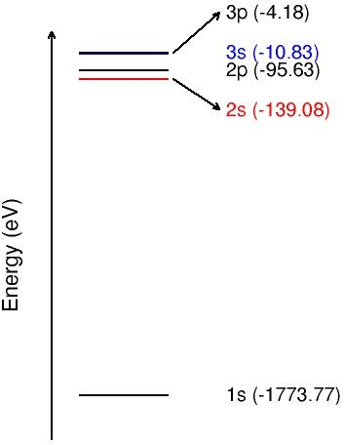
Core eigenvalues are much deeper than valence eigenvalues
Valence
Core
Atomic Si

Slide 9
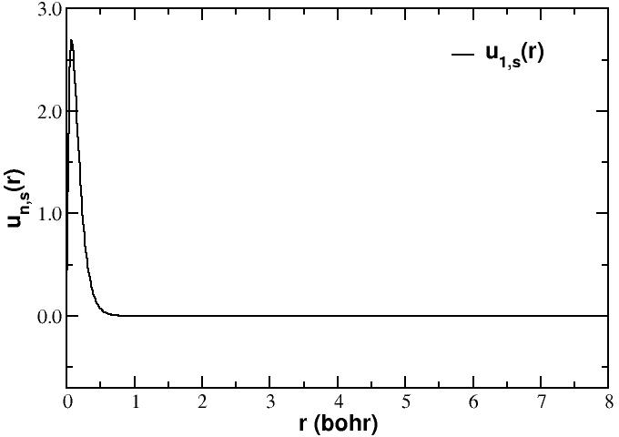
Core wavefunctions are very localized around the nuclei
Atomic Si

Slide 10
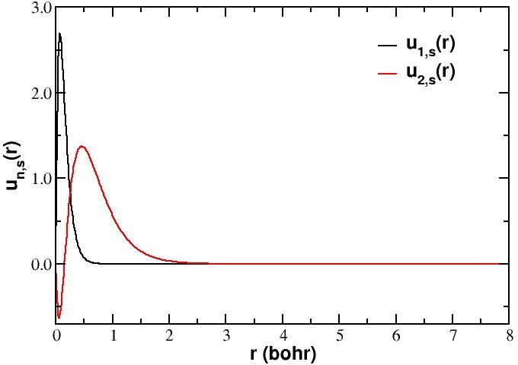
Core wavefunctions are very localized around the nuclei
Core electrons…
highly localized
very depth energy
… are chemically inert
Atomic Si

Slide 11
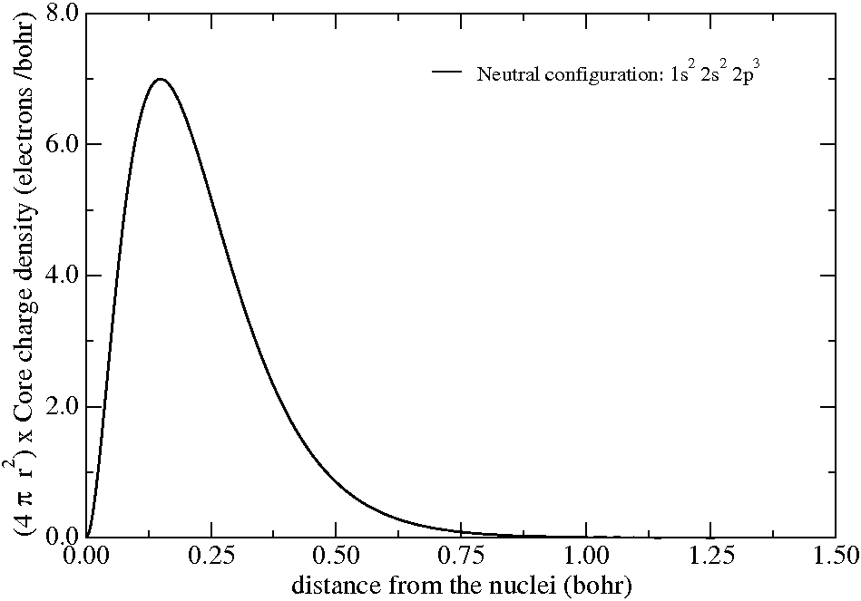
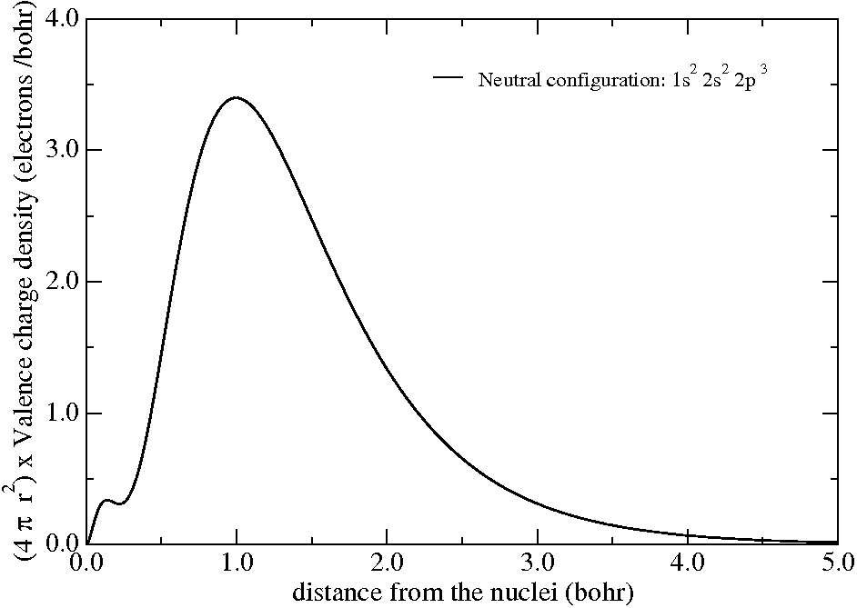
Core electrons are chemically inert
All electron calculation for an isolated N atom
Core charge density
Valence charge density

Slide 12
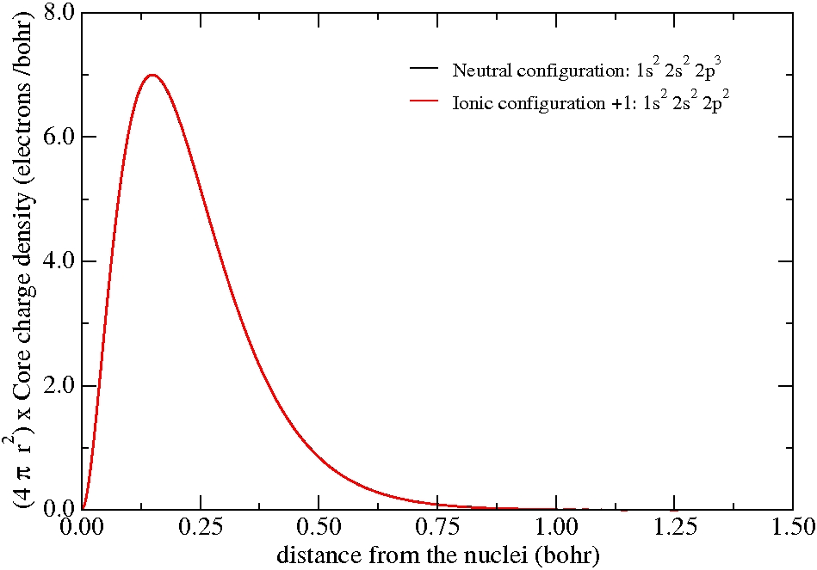
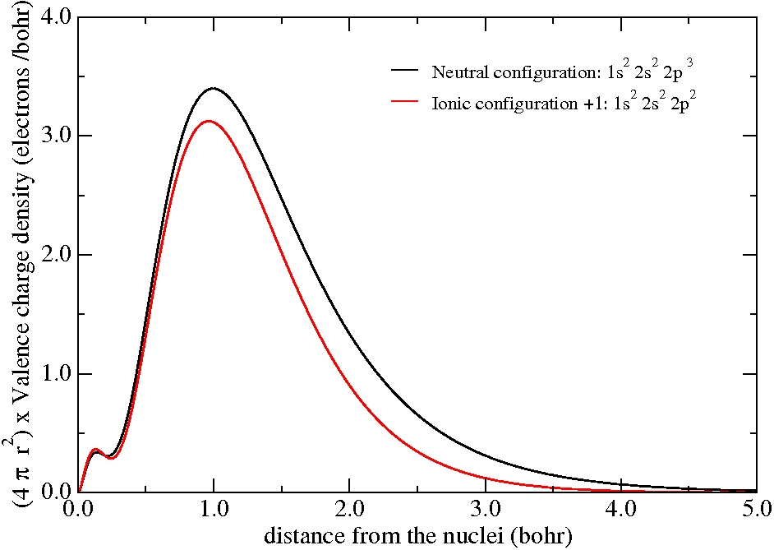
Core electrons are chemically inert
All electron calculation for an isolated N atom
Core charge density
Valence charge density

Slide 13
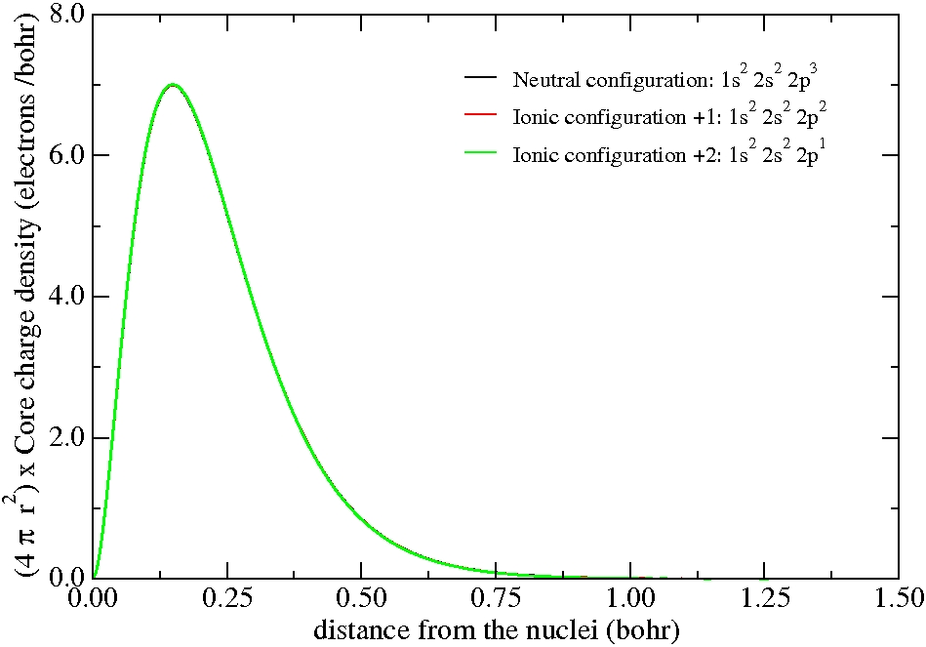
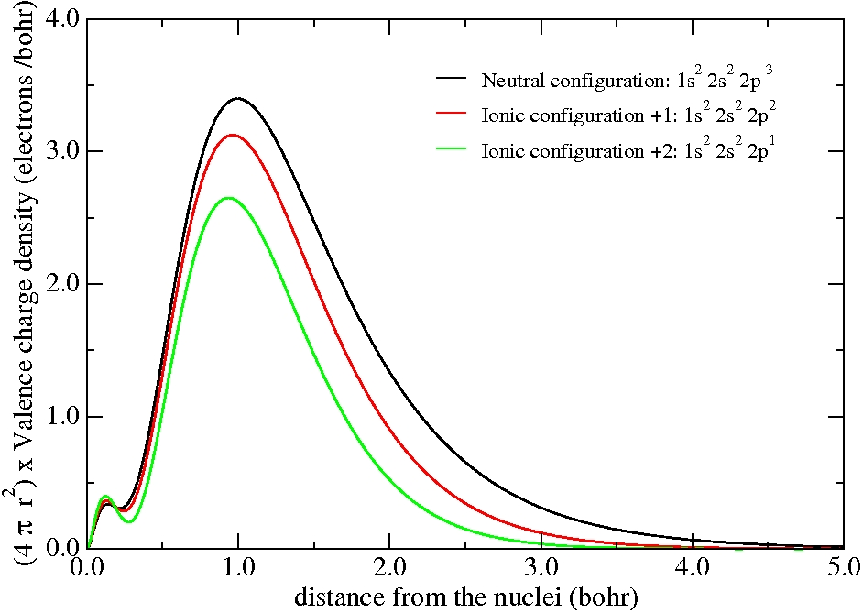
Core electrons are chemically inert
All electron calculation for an isolated N atom
Core charge density
Valence charge density

Slide 14
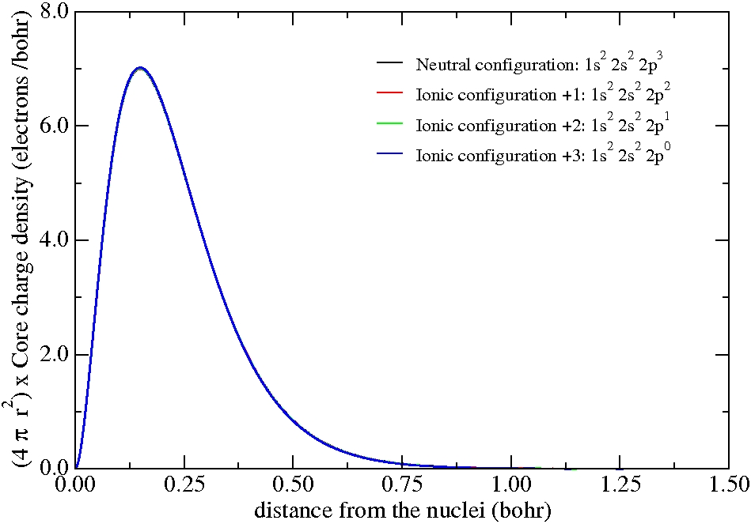
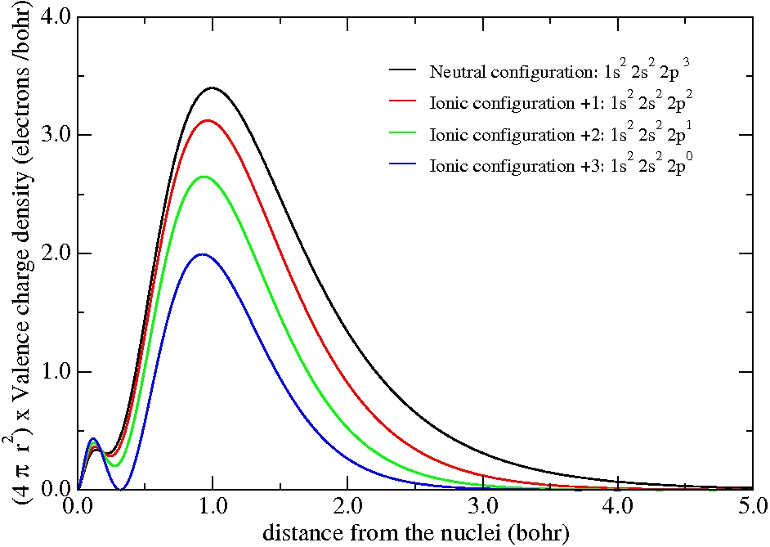
Core electrons are chemically inert
All electron calculation for an isolated N atom
Core charge density
Valence charge density
The core charge density remains unperturbed
Although there are drastic modifications in the valence charge density
Peak due to the 2s all-electron orbitals of N, (they have a node to be ortogonal with the 1s)

Slide 15
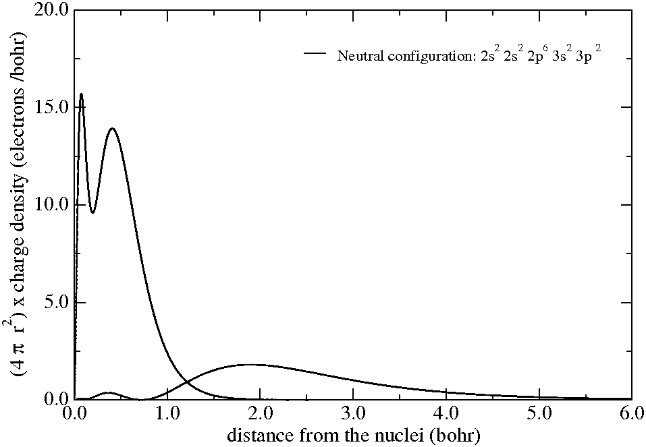
Core electrons are chemically inert
All electron calculation for an isolated Si atom
Angularly integrated core and valence charge densities

Slide 16
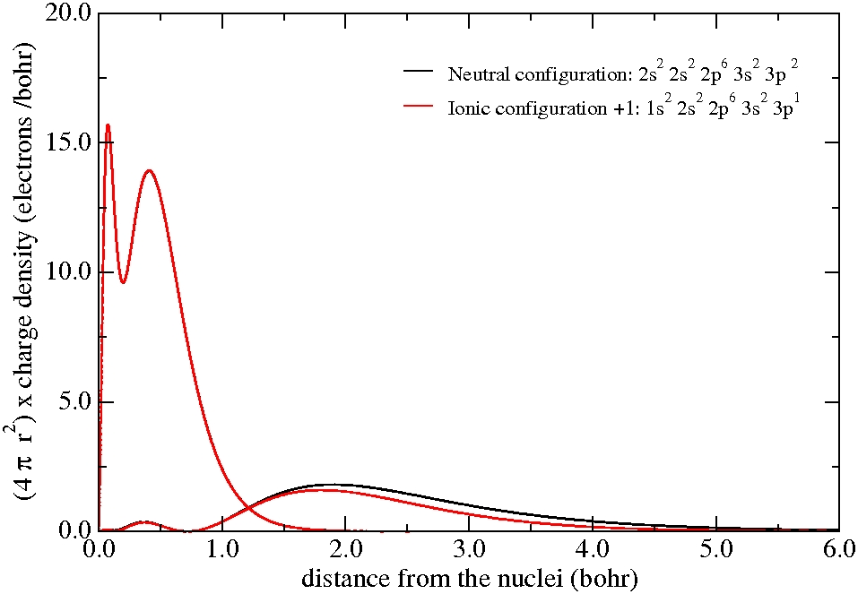
Core electrons are chemically inert
All electron calculation for an isolated Si atom
Angularly integrated core and valence charge densities

Slide 17
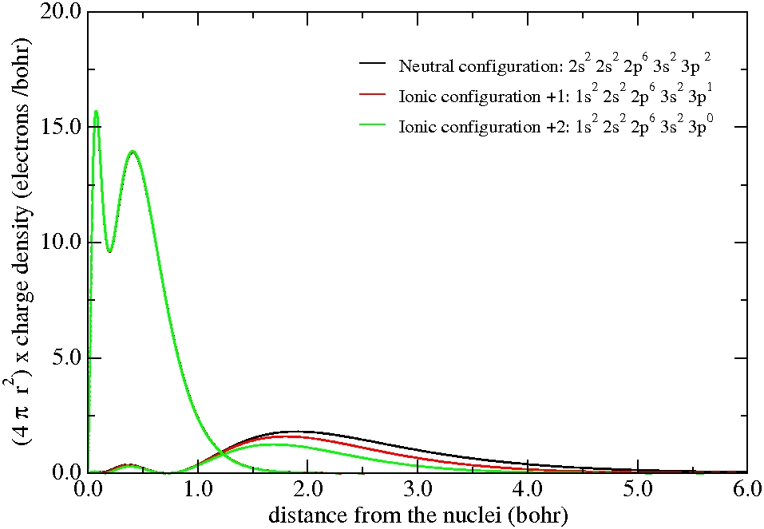
Core electrons are chemically inert
All electron calculation for an isolated Si atom
Angularly integrated core and valence charge densities

Slide 18
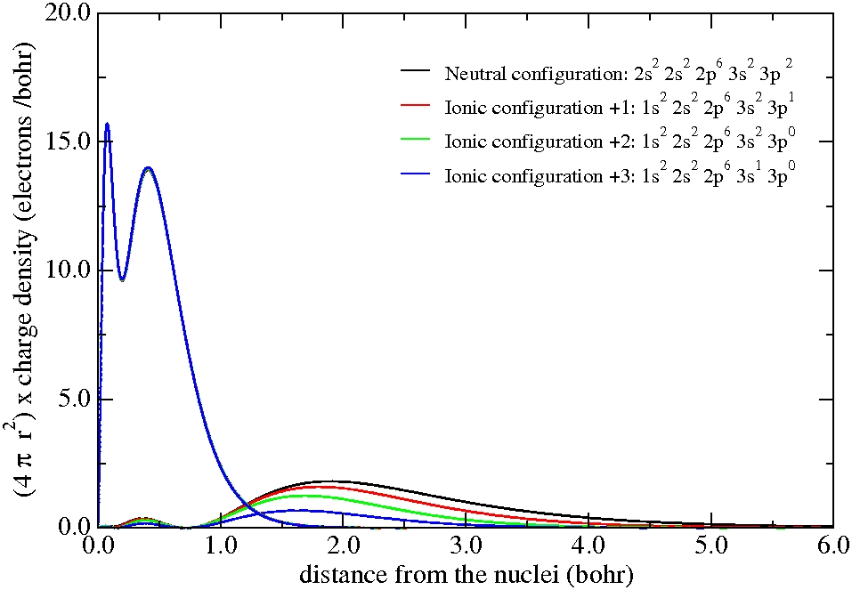
Core electrons are chemically inert
All electron calculation for an isolated Si atom
Angularly integrated core and valence charge densities

Slide 19
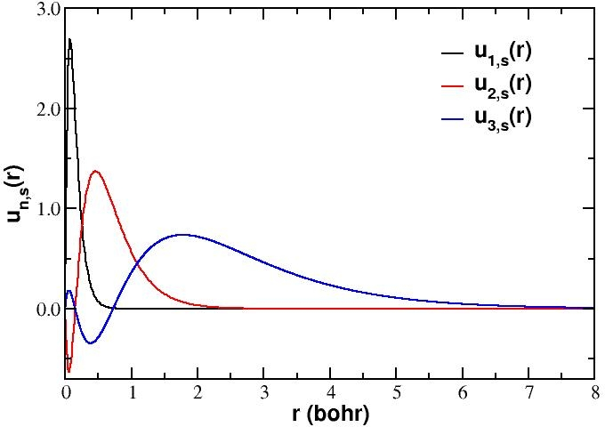
Valence wave functions must be orthogonal to the core wave functions
Core electrons…
highly localized
very depth energy
… are chemically inert
Atomic Si

Slide 20
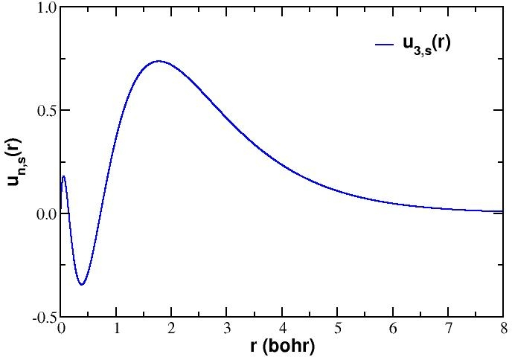
Fourier expansion of a valence wave function has a great contribution of short-wave length
To get a good approximation we would have to use a large number of plane waves.

Slide 21
Pseudopotential idea:
Core electrons are chemically inert
(only valence electrons involved in bonding)
Core electrons make the calculation more expensive
more electrons to deal with
orthogonality with valence ⇒ poor convergence in PW
Core electrons main effect: screen nuclear potential
Idea:
Ignore the dynamics of the core electrons (freeze them)
And replace their effects by an effective potential

Slide 22
The nodes are imposed by orthogonality to the core states
core region

Slide 23
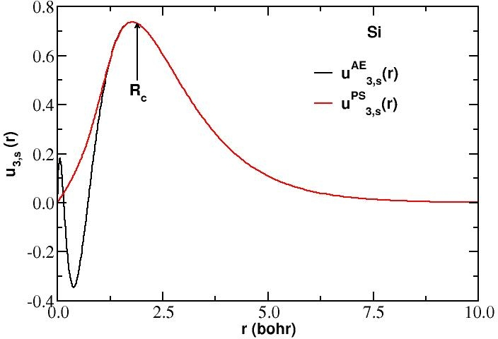
Idea, eliminate the core electrons by ironing out the nodes
The construction of a pseudopotential is an inverse problem:
Given a nodeless pseudo-wave function that
Beyond some distance decays exactly as the all-electron wave-function
is an eigenstate of a pseudo-Hamiltonian with the same eigenvalue as the all-electron wave function
The pseudopotential is obtained by inverting the radial Schrödinger equation for that pseudo-wave function

Slide 24




Construction of a first-principles pseudopotential:
The radial Schrödinger equation
An “atomic DFT program” will be used
(only considers an isolated atom for the rest of the universe)
The wave functions, eigenstates of the Hamiltonian, angular momentum and can be written as the product of a radial part times a spherical harmonic
The radial Schrödinger equation is given by
It will be solved in a radial (typically logarithmic) grid

Slide 25






The radial logarithmic derivative
Second-order linear differential equation
It requires two integration constants to be solved
Once has been fixed (not necessarily to an eigenvalue),
its solution is uniquely determined by the value of the wave function and its derivative at any given point
These two conditions can be equally realized by specifying the value of the (dimensionless) radial logarithmic derivative of the wave function at
together with the normalization condition

Slide 26





The first-principles pseudopotencial construction idea
Given
Same for
Invent
If the all-electron potential and the pseudopotential are the same outside some radius (the cutoff or core radius),
then
The all-electron and pseudo-wave functions are proportional if the corresponding logarithmic derivatives are the same
The proportionality becomes an equality only when the pseudo-wave function is farther required to preserve the norm inside the cutoff radius

Slide 27








First-principles pseudopotential construction
Beyond
Also

Slide 28
Relationship between the logarithmic derivative and the scattering properties
L. I. Schiff, Quantum Mechanics.
Chapter V (page 106)

Slide 29
First-principles pseudopotential construction
By construction, the pseudopotential has the correct eigenvalues
- Scattering properties are correct at the reference eigenvalues
- Find the solution of the Schrödinger equation that is regular at the origin at this energy
Also want:
- Norm conservation
- Scattering conservation remain pretty good for nearby eigenvalues
Surprising result of Hamann, Schlüter and Chang:
- These two properties come together
- Norm conserving pseudopotentials have good scattering properties

Slide 30



Checking the transferability through the scattering properties
For separated all-electron and a pseudopotential calculations:
- Choose a given angular momentum channel and an energy
- Find the solution of the Schrödinger equation that is regular at the origin at this energy
- Compare the solution beyond
- If they match good scattering properties
(Used for construction)
(Used for testing)

Slide 31



Scattering properties:
How to quantify the “logarithmic derivatives”
Diagnostic radius
Correct by construction at
Logarithmic derivative
Energy (Ry)

Slide 32


Norm conservation
At
(used for construction)
Charge contained in this region is the same (AE vs. PS)

Slide 33

Relationship between norm conservation and scattering properties
Fundamental advance of Hamann, Schlüter and Chang Phys. Rev. Lett. (1979)
If norm conservation is imposed,
then the pseudo-logarithmic derivative
matches
the all-electron logarithmic derivative to second order in
The slopes automatically matches at the reference energies
Color: all electron
Black: pseudopotential
Arrows: bound energies
Courtesy of Andrea del Corso

Slide 34
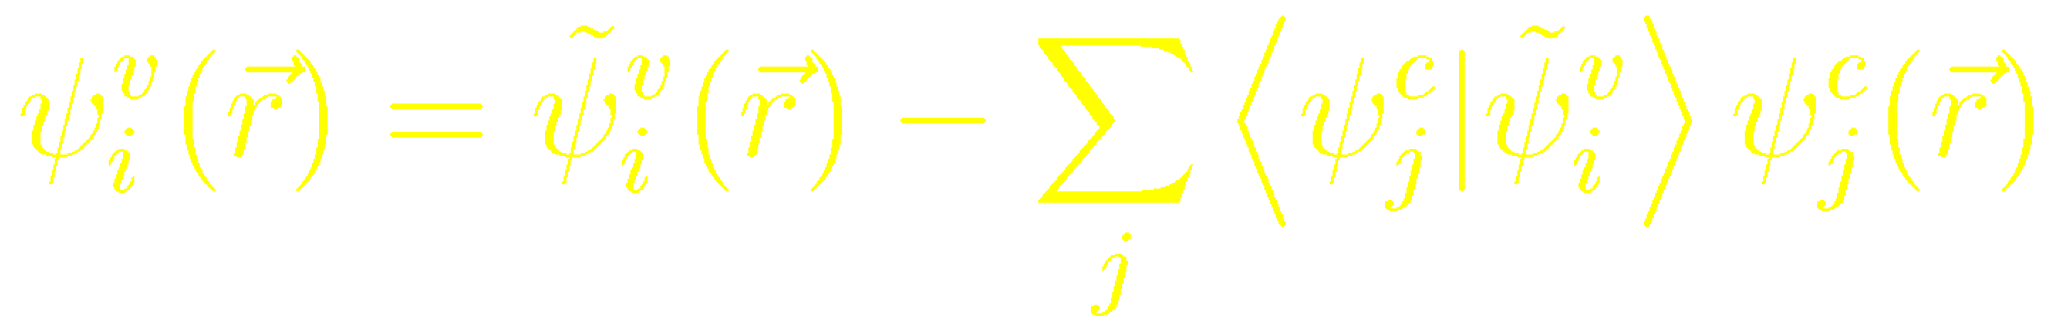
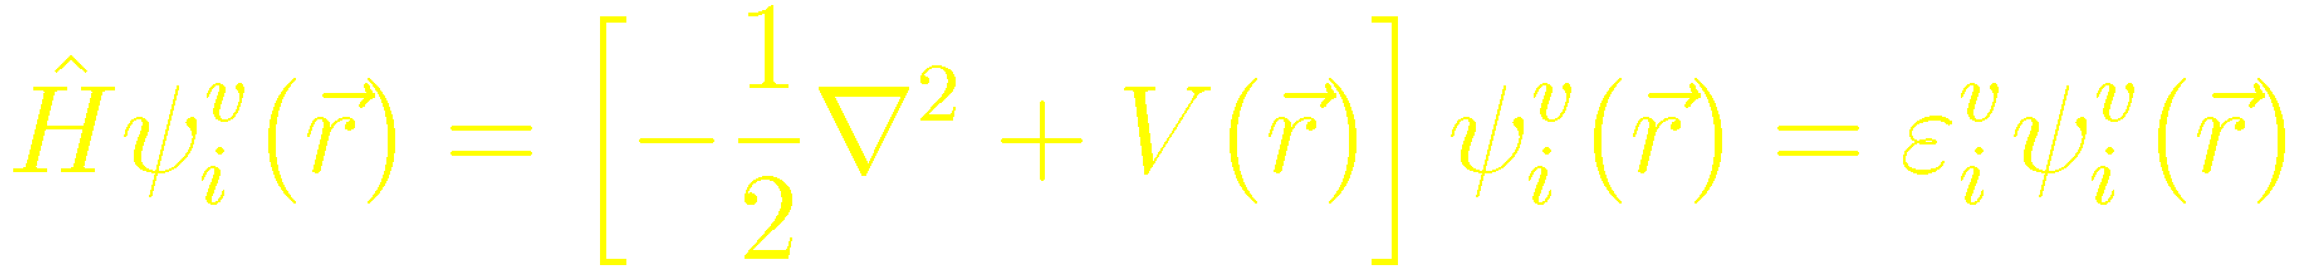
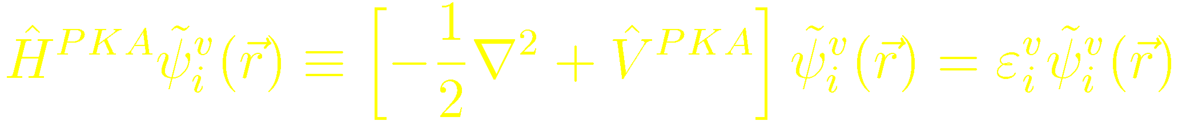
The pseudopotential transformation:
Seeking for the wave equation of the “smooth”
J. C. Phillips and L. Kleinman, Phys. Rev. 116, 287 (1959)
Replace the OPW form of the wave function into the Schrödinger equation
⇓
Equation for the smooth part, with a non local operator
Notes:
The OPW can be recasted in the form of a equation for the valence states only that involves a weaker non local pseudopotential.

Slide 35
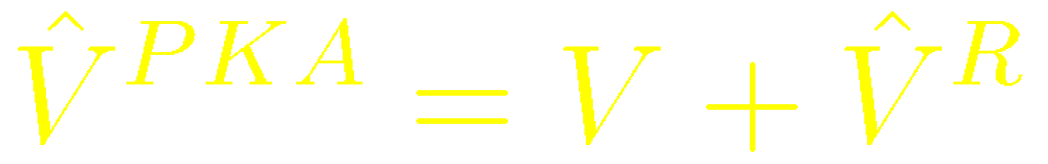
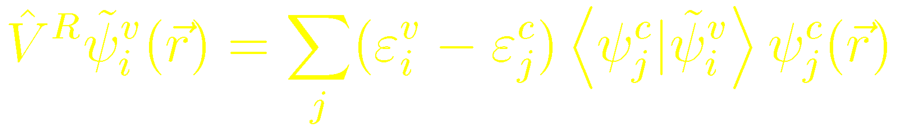
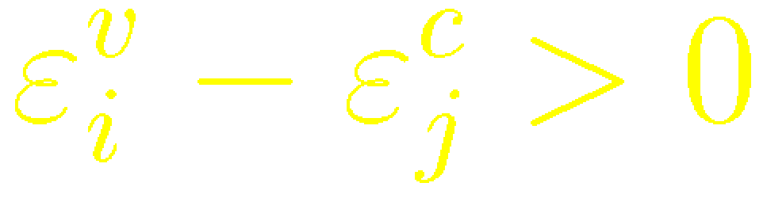
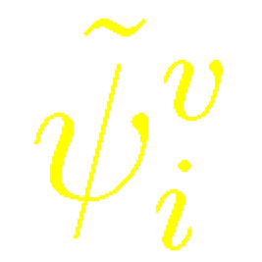
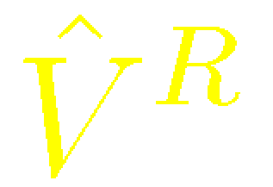
The original potential is replaced by a weaker non-local pseudopotential
J. C. Phillips and L. Kleinman, Phys. Rev. 116, 287 (1959)
Advantages
Disadvantages
Repulsive
⇓
V^{PKA} is much weaker than the original potential V(r)
Non-local operator
are not orthonormal
is not smooth
Spatially localized
vanishes where ψ_{j}^{c} = 0
l-dependent
Notes:
Cite cancellation theorem.
Cite number of Fourier components required to reproduce the pseudo.

Slide 36
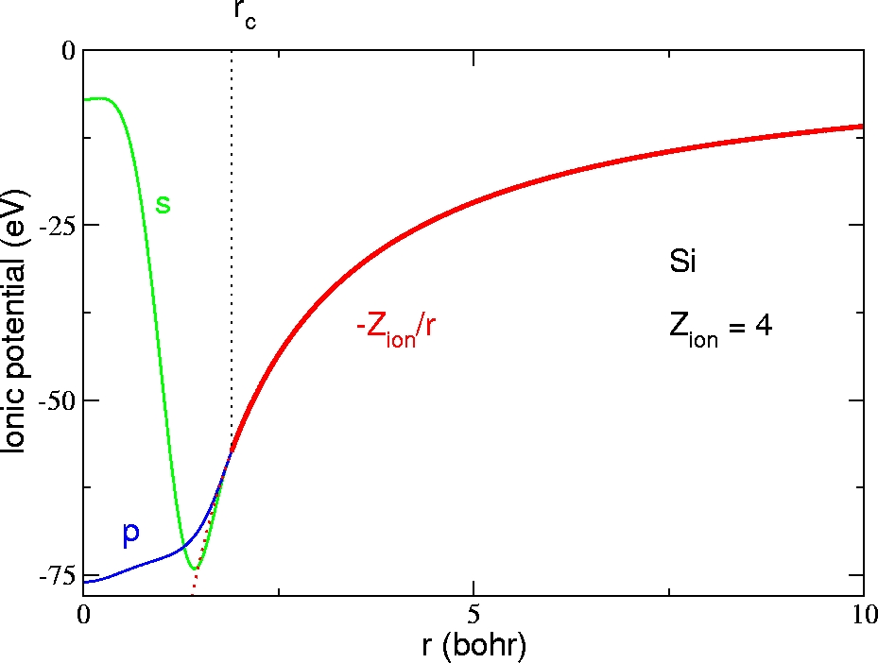
Ab-initio pseudopotential method: fit the valence properties calculated from the atom

Slide 37
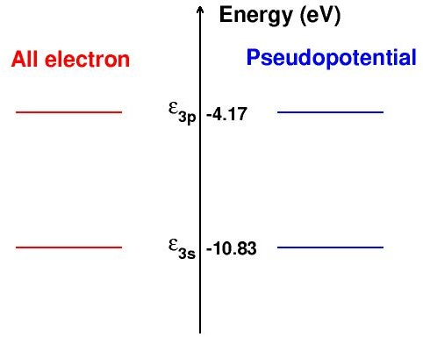
List of requirements for a good norm-conserving pseudopotential:
D. R. Hamann et al., Phys. Rev. Lett. 43, 1494 (1979)
Choose an atomic reference configuration Si: 1s² 2s² 2p⁶ 3s² 3p²
core
valence
1. All electron and pseudo valence eigenvalues agree for the chosen reference configuration

Slide 38
List of requirements for a good norm-conserving pseudopotential:
D. R. Hamann et al., Phys. Rev. Lett. 43, 1494 (1979)
Choose an atomic reference configuration Si: 1s² 2s² 2p⁶ 3s² 3p²
core
valence
2. All electron and pseudo valence wavefunctions agree beyond a chosen cutoff radius R_{c} (might be different for each shell)

Slide 39
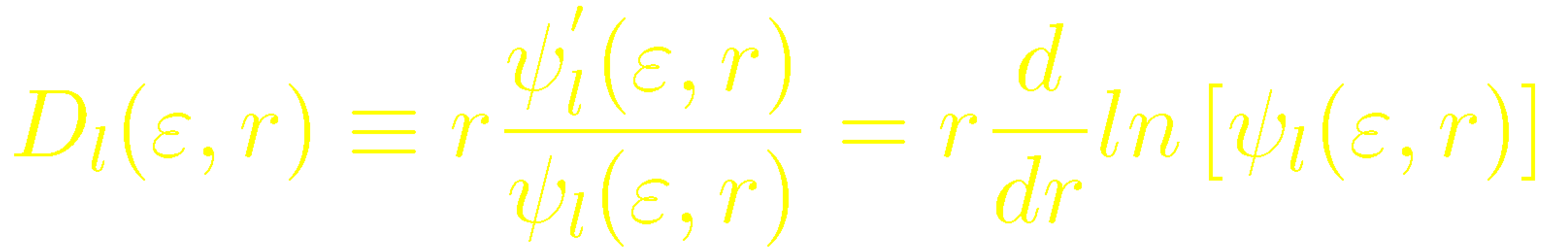
List of requirements for a good norm-conserving pseudopotential:
D. R. Hamann et al., Phys. Rev. Lett. 43, 1494 (1979)
Choose an atomic reference configuration Si: 1s² 2s² 2p⁶ 3s² 3p²
core
valence
3. The logarithmic derivatives of the all-electron and pseudowave functions agree at R_{c}

Slide 40
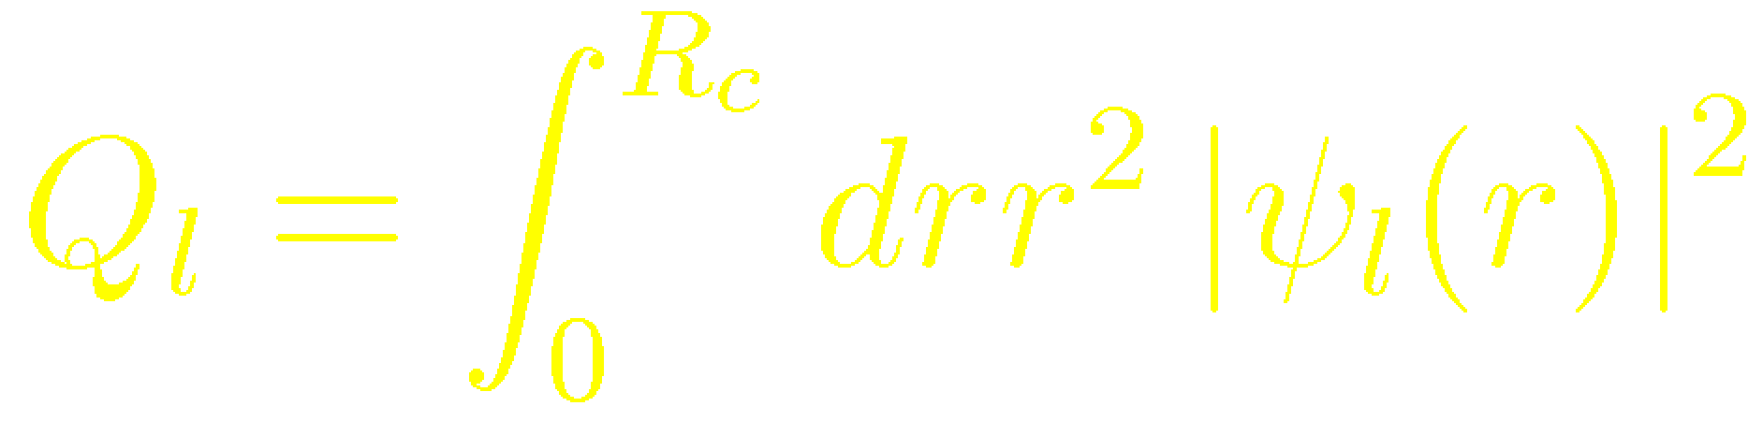
List of requirements for a good norm-conserving pseudopotential:
D. R. Hamann et al., Phys. Rev. Lett. 43, 1494 (1979)
Choose an atomic reference configuration Si: 1s² 2s² 2p⁶ 3s² 3p²
core
valence
4. The integrals from 0 to r of the real and pseudo charge densities agree for r > R_{c} for each valence state
Q_{l} is the same for ψ_{l}^{PS} as for the all electron radial orbital ψ_{l}
⇓
Total charge in the core region is correct
Normalized pseudoorbital is equal to the true orbital outside of R_{c}

Slide 41
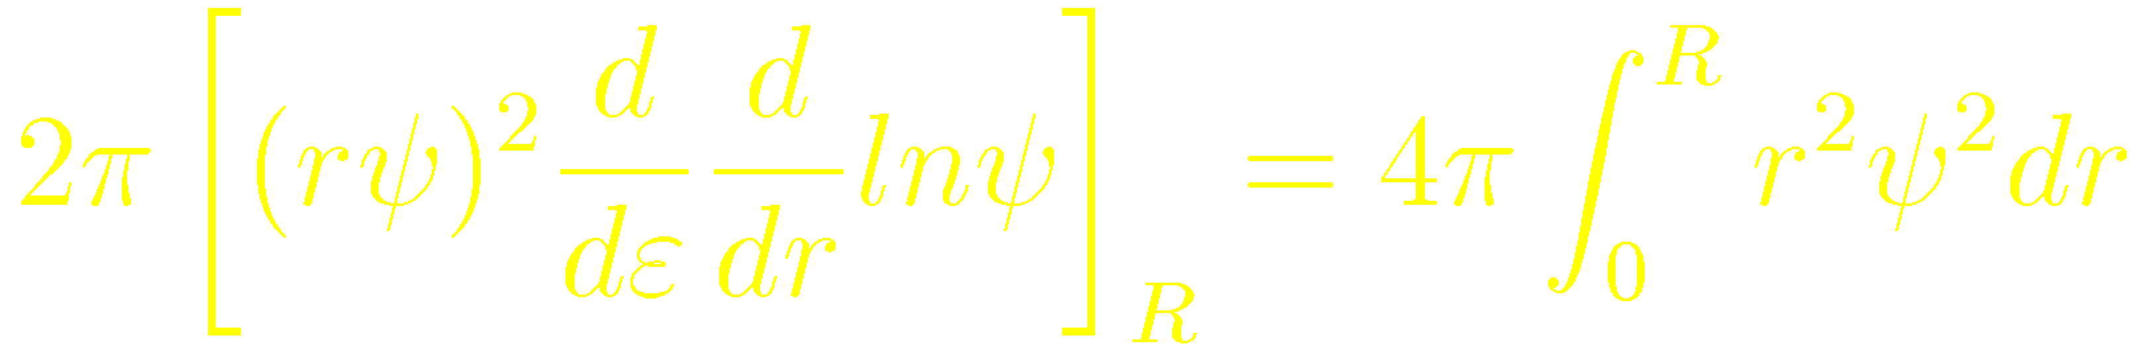
List of requirements for a good norm-conserving pseudopotential:
D. R. Hamann et al., Phys. Rev. Lett. 43, 1494 (1979)
Choose an atomic reference configuration Si: 1s² 2s² 2p⁶ 3s² 3p²
core
valence
5. The first energy derivative of the logarithmic derivatives of the all-electron and pseudo wave functions agrees at R_{c}
Central point due to Hamann, Schlüter and Chiang:
Norm conservation [(4)] ⇒ (5)
Notes:
This is a crucial step toward the goal of constructing a “good” pseudopotential: one that can be generated in a simple environment like a spherical atom and then used in a more complex environment.
In a molecule or solid, the wavefunctions and eigenvalues change and a pseudopotential that satisfies this point will reproduce the change in the eigenvalues to linear order in the change in the self consistent potential.
The scattering properties of the real ion cores are reproduced with minimum error as bonding or banding shifts eigenenergies away from the atomic levels.

Slide 42
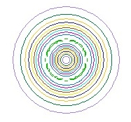
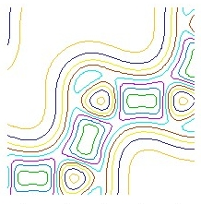
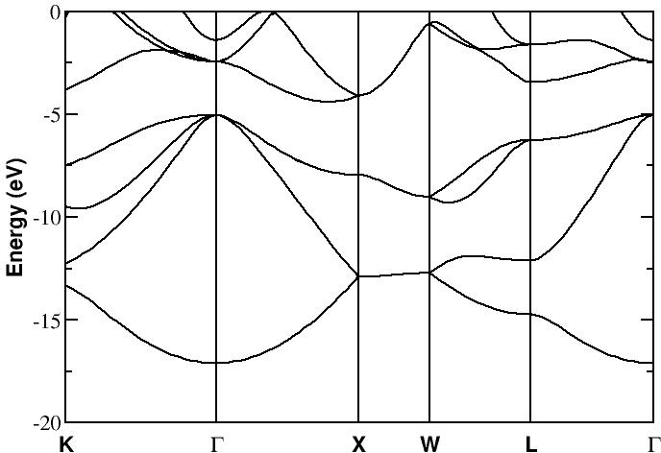
Equality of AE and PS energy derivatives of the logarithmic derivatives essential for transferability
Atomic Si
Bulk Si
If condition 5 is satisfied, the change in the eigenvalues to linear order in the change in the potential is reproduced
Notes:
This is a crucial step toward the goal of constructing a “good” pseudopotential: one that can be generated in a simple environment like a spherical atom and then used in a more complex environment.
In a molecule or solid, the wavefunctions and eigenvalues change and a pseudopotential that satisfies this point will reproduce the change in the eigenvalues to linear order in the change in the self consistent potential.
The scattering properties of the real ion cores are reproduced with minimum error as bonding or banding shifts eigenenergies away from the atomic levels.

Slide 43
Generation of l-dependent norm-conserving pseudopotential
Choose an atomic reference configuration, i.e., a given distribution of electrons in the atomic energy levels (degree of freedom)

Slide 44
Generation of l-dependent norm-conserving pseudo: Step 1, choosing the reference configuration
Question: how to choose the electronic configuration of the isolated atom
(the reference atomic configuration)
so that the pseudopotential remains useful in molecular systems and solids
(the target system)
The reference configuration is arbitrary, the user has a degree of freedom here
If the pseudopotential is transferable enough, the choice is not so critical, but transferability tests are mandatory
Transferability is expected to work best for electronic configurations close to the reference one, but it is not obvious for rather different configurations (would a pseudopotential generated for neutral K work well in K⁺?)

Slide 45
Generation of l-dependent norm-conserving pseudo: Step 1, choosing the reference configuration
Standard first choice: ground state configuration of the neutral isolated atom
However, states of angular momenta that are unoccupied in the neutral atom hibridize with the occupied states in the presence of a different environment, becoming partially occupied.
In these cases, it is necessary to include these angular momenta as non-local components of the pseudopotential

Slide 46
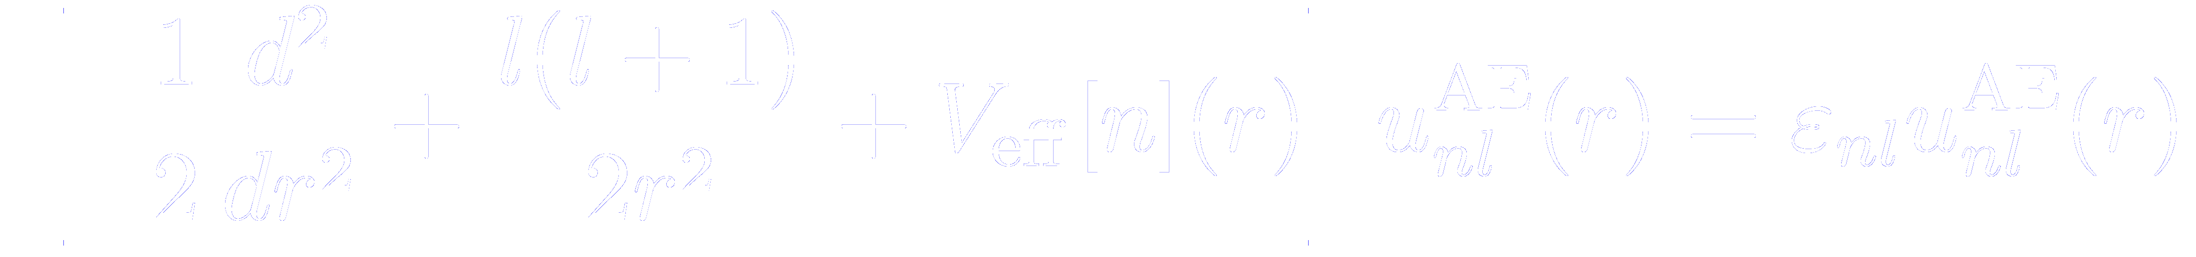
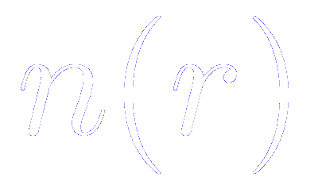
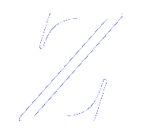
Generation of l-dependent norm-conserving pseudopotential
Choose an atomic reference configuration, i.e., a given distribution of electrons in the atomic energy levels (degree of freedom)
Solve the all-electron radial Schrödinger equation for the chosen atomic reference configuration
≡ sum of electronic charges for occupied states
≡bare nuclear charge
Notes:
This is a crucial step toward the goal of constructing a “good” pseudopotential: one that can be generated in a simple environment like a spherical atom and then used in a more complex environment.
In a molecule or solid, the wavefunctions and eigenvalues change and a pseudopotential that satisfies this point will reproduce the change in the eigenvalues to linear order in the change in the self consistent potential.
The scattering properties of the real ion cores are reproduced with minimum error as bonding or banding shifts eigenenergies away from the atomic levels.

Slide 47
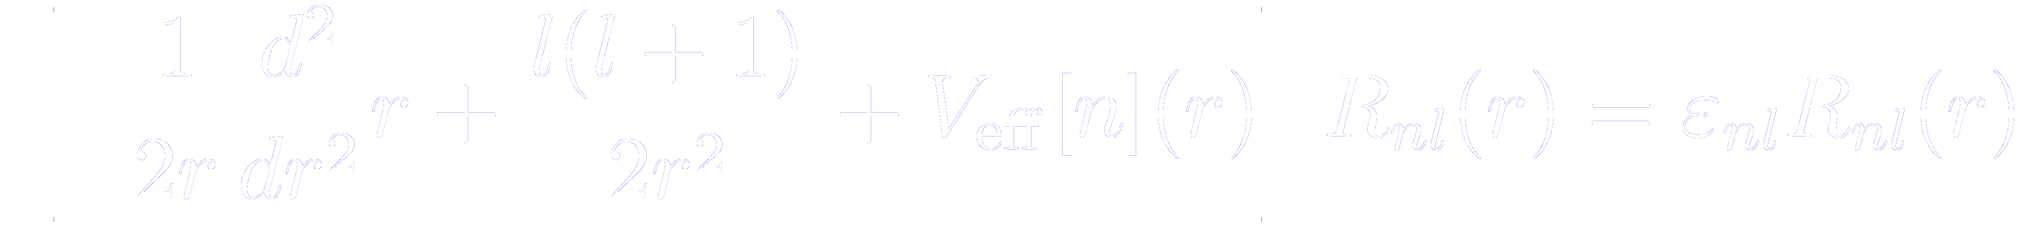
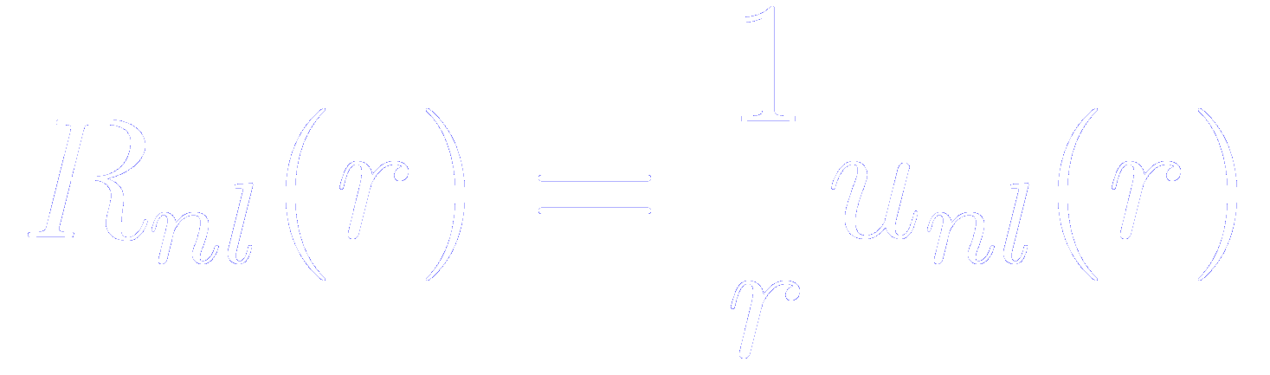
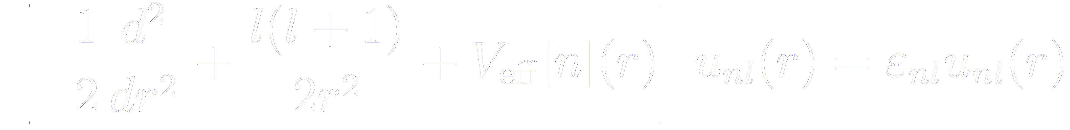
Generation of l-dependent norm-conserving pseudo: Step 2, solving the radial wave function
Since, in the isolated atom, the potential is spherically symmetric, the one electron wave functions can be decoupled as the product of a radial part times an spherical harmonic
The radial equation (in atomic units) reads
If, as in many textbooks, we redefine the radial part of the wave function, to simplify the differential operator

Slide 48
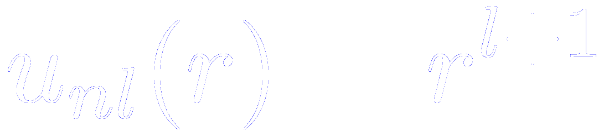
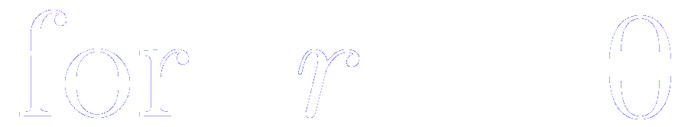
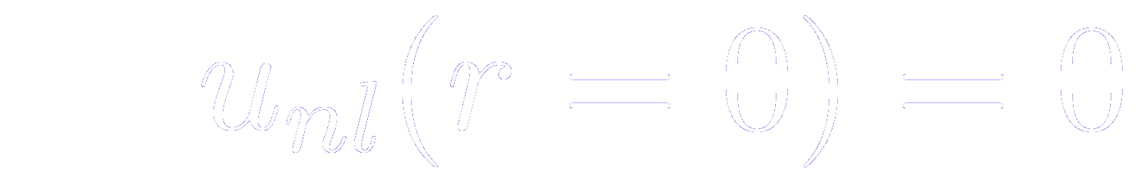



Generation of l-dependent norm-conserving pseudo: Step 2, solving the radial wave function
The equation has to be solved subject to the following boundary conditions
And the radial part of the wave function has to be normalized as

Slide 49

Generation of l-dependent norm-conserving pseudopotential
Choose an atomic reference configuration, i.e., a given distribution of electrons in the atomic energy levels (degree of freedom)
Solve the all-electron radial Schrödinger equation for the chosen atomic reference configuration
≡ sum of electronic charges for occupied states
≡bare nuclear charge
Parametrization of the pseudo-wave functions for according to any of the available prescriptions (degree of freedom)
Notes:
This is a crucial step toward the goal of constructing a “good” pseudopotential: one that can be generated in a simple environment like a spherical atom and then used in a more complex environment.
In a molecule or solid, the wavefunctions and eigenvalues change and a pseudopotential that satisfies this point will reproduce the change in the eigenvalues to linear order in the change in the self consistent potential.
The scattering properties of the real ion cores are reproduced with minimum error as bonding or banding shifts eigenenergies away from the atomic levels.

Slide 50
Generation of l-dependent norm-conserving pseudo: Step 3, parametrization of the pseudowave functions
Independently of the method, two conditions usually imposed:
Smooth matching between the all electron and the pseudo wave function at the cutoff radius R_{c}
Conservation of the norm of the pseudo wave function.
Degree of freedom in the choice of the flavour of the pseudopotential and R_{c}
Several schemes available in the literature for norm-conserving pseudopotentials
Hamann, Schlüter, and Chiang [D. R. Hamann et al., Phys. Rev. Lett. 43, 1494 (1979)]
Kerker [G. P. Kerker, J. Phys. C 13, L189 (1980)]
Troullier-Martins [N. Troullier and J. L. Martins, Phys. Rev. B 43, 1993 (1991)]
Rappe-Rabe-Kaxiras-Joannopoulos [A. M. Rappe et. al., Phys. Rev. B 41, 1227 (1990)]

Slide 51

Different methods to generate norm-conserving pseudopotential
Haman-Schlüter-Chiang
Troullier-Martins
Kerker
Vanderbilt
C
s-state
p-state
R. M. Martin, Electronic structure, Basic Theory and Practical Methods, Cambridge University Press, Cambridge, 2004
Notes:
This is a crucial step toward the goal of constructing a “good” pseudopotential: one that can be generated in a simple environment like a spherical atom and then used in a more complex environment.
In a molecule or solid, the wavefunctions and eigenvalues change and a pseudopotential that satisfies this point will reproduce the change in the eigenvalues to linear order in the change in the self consistent potential.
The scattering properties of the real ion cores are reproduced with minimum error as bonding or banding shifts eigenenergies away from the atomic levels.

Slide 52
Generation of l-dependent norm-conserving pseudopotential
Choose an atomic reference configuration, i.e., a given distribution of electrons in the atomic energy levels (degree of freedom)
Solve the all-electron radial Schrödinger equation for the chosen atomic reference configuration
≡ sum of electronic charges for occupied states
≡bare nuclear charge
Parametrization of the pseudo-wave functions for according to any of the available prescriptions (degree of freedom)
Invert the radial Schrödinger equation for the screened pseudopotential
Notes:
This is a crucial step toward the goal of constructing a “good” pseudopotential: one that can be generated in a simple environment like a spherical atom and then used in a more complex environment.
In a molecule or solid, the wavefunctions and eigenvalues change and a pseudopotential that satisfies this point will reproduce the change in the eigenvalues to linear order in the change in the self consistent potential.
The scattering properties of the real ion cores are reproduced with minimum error as bonding or banding shifts eigenenergies away from the atomic levels.

Slide 53



Generation of l-dependent norm-conserving pseudo: Step 4, inversion of the radial Schrödinger equation
Search for the Schrödinger-like equation that would satisfy the pseudo-orbital

Slide 54
Generation of l-dependent norm-conserving pseudo: Step 4, inversion of the radial Schrödinger equation
Search for the Schrödinger-like equation that would satisfy the pseudo-orbital
The inversion can always be done because of the nodeless condition
Note that the principal quantum number has droped, because the pseudization is done for the lowest-lying valence state of each angular momentum
Higher lying valence states of the same angular momentum correspond to excited states of the pseudopotential

Slide 55
Generation of l-dependent norm-conserving pseudopotential
Choose an atomic reference configuration, i.e., a given distribution of electrons in the atomic energy levels (degree of freedom)
Solve the all-electron radial Schrödinger equation for the chosen atomic reference configuration
≡ sum of electronic charges for occupied states
≡bare nuclear charge
Parametrization of the pseudo-wave functions for according to any of the available prescriptions (degree of freedom)
Invert the radial Schrödinger equation for the screened pseudopotential
Subtract (unscreen) the Hartree and exchange-correlation potentials
Notes:
This is a crucial step toward the goal of constructing a “good” pseudopotential: one that can be generated in a simple environment like a spherical atom and then used in a more complex environment.
In a molecule or solid, the wavefunctions and eigenvalues change and a pseudopotential that satisfies this point will reproduce the change in the eigenvalues to linear order in the change in the self consistent potential.
The scattering properties of the real ion cores are reproduced with minimum error as bonding or banding shifts eigenenergies away from the atomic levels.

Slide 56

Generation of l-dependent norm-conserving pseudo: Step 5, unscreening of the pseudopotential
The pseudo-wave function obeys
Where the effective potential is computed in the atom
Bare nuclei-valence interaction
Computed with an atomic charge density
Hartree interacion
includes
Exchange-correlation interacion
Blind to the chemical environment
Extremely dependent on the chemical environment
In the molecular system or condensed phase, we have to screen the (ion+core)-valence interaction with the valence charge density computed in the targeted sytem

Slide 57


Generation of l-dependent norm-conserving pseudo: Step 5, unscreening of the pseudopotential
In the molecular system or condensed phase, we have to screen the (ion+core)-valence interaction with the valence charge density computed in the targeted sytem
So, the pseudopotential is finally obtained by subtracting (unscreening) the Hartree and exchange and correlation potential calculated only for the valence electrons (with the valence pseudo-wave function)
Where the pseudo-valence charge density is computed as
Exchange-correlation functional in the DFT all-electron calculation used to construct the pseudopotential has to be the same as in the target calculation

Slide 58
When there is a significant overlap of core and valence charge densities: problem with unscreening
The exchange and correlation potential and energy are not linear functions of the density
In cases where the core and valence charge density overlap significantly:
- In systems with few valence electrons (alkali atoms)
- In systems with extended core states
- In transition metals, where the valence d bands overlap spatially with the code s and p electrons
the unscreening procedure as explained before is not fully justified.
xc potential that appears in the unscreened potential
Since xc is not linear, if core and valence overlap, the contribution from valence is not fully canceled
xc potential that is removed in the unscreening procedure
Then, the screening pseudopotential are dependent on the valence configuration, a feature highly undesirable since it reduces the transferability of the potential.

Slide 59
When there is a significant overlap of core and valence charge densities: non-linear core correction
Solution 1: Include explicitly the extended core orbitals in the valence (semicore in valence)
Expensive since:
- We have to include explicitly more electrons in the simulation
-The semicore orbitals tend to be very localized and hard, in the sense that high Fourier components are required

Slide 60



When there is a significant overlap of core and valence charge densities: non-linear core correction
Solution 2: Include non-linear core corrections (NLCC)
S. Louie et al., Phys. Rev. B 26, 1738 (1982)
Step 1: Replace the previous unscreening expression by
Step 2: In the actual electronic structure calculations performed with this pseudopotential, the exchange and correlation distribution is computed from the full electronic charge, , instead of the usual valence charge. The frozen core charge density of isolated atoms is used for
Step 3: The full core density, with its very high Fourier components, is impractical to use. However, the core charge has significant effect only where the core and valence charge densities are of similar magnitude. We can therefore, replace the full core charge density with a partial core charge density

Slide 61


When there is a significant overlap of core and valence charge densities: non-linear core correction
Solution 2: Include non-linear core corrections (NLCC)
Models for the partial core
1. Original one proposed by S. Louie et al. (in ATOM, the default for LDA)
Parameters a and b determined by the continuity of the partial core and its first derivative at r_{pc}
2. New one that fixes some problems in the generation of GGA pseudos
Parameters a, b and c determined by the continuity of the partial core and its first and second derivatives at r_{pc}
r_{pc} has to be chosen such that the valence charge density is negligeable compared to the core one for r < r_{pc}.
Tests show that it might be located where the core charge density is from 1 to 2 times larger than the valence charge density

Slide 62
When there is a significant overlap of core and valence charge densities: non-linear core correction
Bulk NaCl (rocksalt structure)
Without core corrections for Na:
Semi metal
With core corrections for Na:
Insulator
J. Hebenstreit and M. Scheffler, Phys. Rev. B 46, 10134 (1992)

Slide 63
The screened potential depends on the angular momentum of the valence electron: is l-dependent
Reason for the l-dependency: different orthogonality conditions
For instance, in the Si atom
The 3s valence state has to be orthogonal with the 2s and 1s core states
The 3p valence state does not feel the orthogonality constraint with the 2s and 1s core states, because they have different angular momentum quantum numbers
Within the core region, these electrons feel different potentials from the ionic core.
At large distances (beyond R_{c}) the potential is –Z_{ion}/r, independently of l, because the ionic core is seen as a point charge of magnitude equal to the valence charge Z_{ion}

Slide 64




General form of a l-dependent pseudopotential
Where is a projector operator onto the l-th angular momentum subspace
is spherically symmetric
Meaning of the previous expression:
When the pseudopotential operator acts on an electronic wave function, the projector operator selects the different angular momentum components of the wave function, which are then multiplied by the corresponding pseudopotential.
The contributions of all the angular momentums are finally added up to form the total pseudopotential contribution to the Hamiltonian matrix elements that enter Schrödinger equation.

Slide 65





General form of a l-dependent pseudopotential
Where is a projector operator onto the l-th angular momentum subspace
is spherically symmetric
This pseudopotential form is semilocal:
It is local in but non-local in
If we want to know the result of applying this operator to a function in a point
We need to know the value of at all the points

Slide 66




It is useful to separate the ionic pseudopotentials into a local (l-independent) part and non-local terms
The local part of the pseudo is in principle arbitrary, but it must join the semilocal potentials , which by construccion, all become equal to the ionic all electron potential beyond the pseupotential core radius R_{c}
Thus, the non-local part is short range
All the long-range effects of the Coulomb potential are included in the local part of the pseudopotential

Slide 67




It is useful to separate the ionic pseudopotentials into a local (l-independent) part and non-local terms
Normally, only a few low angular momenta core states are occupied.
For values the ionic core is seen in the same way by all the component of the wave function
Identity operator

Slide 68



Computing matrix elements of the pseudopotential operator
Matrix elements of the pseudopotential in some basis
Where due to the semilocal character of the pseudopotential, a factor is understood

Slide 69



The pseudopotential operator in the semilocal form: local in radial variable, non-local in the angular variable
The most common basis functions:
- floating (plane waves)
- atom-centered (product of radial function and spherical harmonics)
In either case, the above integral factorizes into two angular-dependent parts that can be integrated separately, and a radial integral of the form
Local integral in the radial variable
Radial part of the basis function (for AO) or the spherical Bessel functions (for PW)

Slide 70





Computational scaling in the computation of semilocal potentials
Local integral in the radial variable
Radial part of the basis function (for AO) or the spherical Bessel functions (for PW)
The computation of these integrals is very expensive.
It scales as
Number of basis functions
Number of atoms in the system (for every atom changes)
Since also scales with the number of atoms, the scaling of the previous operation is
Bottleneck for electronic structure simulations

Slide 71


Replacing the semi-local operator by a fully non-local form separable in the radial variables
Replacing the semi-local operator with a fully non-local form separable in the radial variables, allows a factorization of the problem
with
Now, the non-local part can be cheaply and accurately computed as two-center intergrals

Slide 72


It is useful to separate the ionic pseudopotentials into a local (l-independent) part and non-local terms
In Siesta, the local pseudopotential is optimized for smoothness, because it is represented in the real space grid
It is defined as the potential generated by a positive charge distribution of the form
a and b are chosen to provide simultaneously optimal real-space localization and reciprocal-space convergence

Slide 73






General expression for a separable non-local potential of the Kleinman-Bylander form
where are the atomic, reference pseudo-wave function
The only relevant aspect is to reproduce the all-electron calculation for the reference configuration
The reference pseudowave-function should be an eigenstate of the pseudo-Hamiltonian with (all electron and pseudo) eigenvalue
Thus, to reproduce the all-electron scattering properties and energy derivatives at the reference energy, the projection function can be constructed as

Slide 74



Kleinman-Bylander fully non-local separable form
L. Kleinman and D. M. Bylander, Phys. Rev. Lett. 48, 1425 (1982)
Request: the action of the fully non-local separable pseudopotential on the reference pseudo-wave function is the same as that of the original semi-local form
For that, they proposed
so that

Slide 75


Kleinman-Bylander fully non-local separable form
L. Kleinman and D. M. Bylander, Phys. Rev. Lett. 48, 1425 (1982)
The Kleinman–Bylander projector is then written as
Where the normalized projection functions are given by

Slide 76

Kleinman-Bylander fully non-local separable form
L. Kleinman and D. M. Bylander, Phys. Rev. Lett. 48, 1425 (1982)
The strength of the non-locality is determined by

Slide 77

Balance between softness and transferability controlled by R_{c}
Representability by a resonable small number of PW
R_{c}
Accuracy in varying environments
TRANSFERABILITY
SOFTNESS
Larger R_{c}: softer pseudo
First guess: last peak of the all electron wave function
Si
Shorter R_{c}: harder pseudo
Notes:
This is a crucial step toward the goal of constructing a “good” pseudopotential: one that can be generated in a simple environment like a spherical atom and then used in a more complex environment.
In a molecule or solid, the wavefunctions and eigenvalues change and a pseudopotential that satisfies this point will reproduce the change in the eigenvalues to linear order in the change in the self consistent potential.
The scattering properties of the real ion cores are reproduced with minimum error as bonding or banding shifts eigenenergies away from the atomic levels.

Slide 78







A transferable pseudo will reproduce the AE energy levels and wave functions in arbitrary environments
Compute the energy of two different configurations
Compute the difference in energy
For the pseudopotential to be transferible:
3s² 3p² (reference)
3s² 3p¹ 3d¹
3s¹ 3p³
3s¹ 3p² 3d¹
3s⁰ 3p³ 3d¹
Notes:
This is a crucial step toward the goal of constructing a “good” pseudopotential: one that can be generated in a simple environment like a spherical atom and then used in a more complex environment.
In a molecule or solid, the wavefunctions and eigenvalues change and a pseudopotential that satisfies this point will reproduce the change in the eigenvalues to linear order in the change in the self consistent potential.
The scattering properties of the real ion cores are reproduced with minimum error as bonding or banding shifts eigenenergies away from the atomic levels.

Slide 79

Problematic cases: first row elements
2p and 3d elements
O: 1s² 2s² 2p⁴
core
valence
No nodes because there are no p states to be orthogonal to
pseudopotential is hard
Notes:
This is a crucial step toward the goal of constructing a “good” pseudopotential: one that can be generated in a simple environment like a spherical atom and then used in a more complex environment.
In a molecule or solid, the wavefunctions and eigenvalues change and a pseudopotential that satisfies this point will reproduce the change in the eigenvalues to linear order in the change in the self consistent potential.
The scattering properties of the real ion cores are reproduced with minimum error as bonding or banding shifts eigenenergies away from the atomic levels.

Slide 80
Conclusions
Core electrons…
highly localized and very depth energy
… are chemically inert
Pseudopotential idea
Ignore the dynamics of the core electrons (freeze them)
And replace their effects by an effective potential
Pseudopotentials are not unique
there might be many “best choices”
Two overall competing factors: transferability vs hardness
Norm conservation helps transferability
Always test the pseudopotential in well-known situations
Notes:
This is a crucial step toward the goal of constructing a “good” pseudopotential: one that can be generated in a simple environment like a spherical atom and then used in a more complex environment.
In a molecule or solid, the wavefunctions and eigenvalues change and a pseudopotential that satisfies this point will reproduce the change in the eigenvalues to linear order in the change in the self consistent potential.
The scattering properties of the real ion cores are reproduced with minimum error as bonding or banding shifts eigenenergies away from the atomic levels.

Slide 81

Howto: input file to generate the pseudopotential

Slide 82


Slide 83


Slide 84


Slide 85


Slide 86


Slide 87

Core electrons are chemically inert

Slide 88

Core electrons are chemically inert

Slide 89

Generation of l-dependent norm-conserving pseudopotential
All electron self consistent atomic calculation
Each state l,m treated independently
Identify the valence states
Freedom (different approaches)
Generate the pseudopotential V_{l,total}(r) and pseudoorbitals ψ_{l}^{PS}(r)
V_{l,total} (r) screened pseudopotential acting on valence electrons
“Unscreened” by substracting from the total potential V_{Hxc}^{PS}(r)
Notes:
This is a crucial step toward the goal of constructing a “good” pseudopotential: one that can be generated in a simple environment like a spherical atom and then used in a more complex environment.
In a molecule or solid, the wavefunctions and eigenvalues change and a pseudopotential that satisfies this point will reproduce the change in the eigenvalues to linear order in the change in the self consistent potential.
The scattering properties of the real ion cores are reproduced with minimum error as bonding or banding shifts eigenenergies away from the atomic levels.

Slide 90


The pseudopotential operator in the semilocal form: local in radial variable, non-local in the angular variable
Matrix elements of the pseudopotential in some basis assume the form
Where due to the semilocal character of the pseudopotential, a factor is understood

Slide 91
The pseudopotential operator in the semilocal form: local in radial variable, non-local in the angular variable
The most common basis functions:
- floating (plane waves)
- atom-centered (product of radial function and spherical harmonics)
In either case, the above integral factorizes into two angular-dependent parts that can be integrated separately, and a radial integral of the form
Local integral in the radial variable
Radial part of the basis function (for AO) or the spherical Bessel functions (for PW)

