Slide 1


The nearly free electron approximation
Javier Junquera

Slide 2
Basic references, where most of the information is taken from
Charles Kittel
“Introduction to Solid-State Physics”
John-Wiley & Sons, New York, 1996
ISBN 0-471-11181-3
Chapter 9
Harald Ibach and Hans Lüth
“Solid-State Physics”
Springer-Verlag, Berlin, 1993
ISBN 3-540-56841-7
Chapter 7
N. W. Ashcroft and N. D. Mermin
“Solid State Physics”
Saunders College Publishers, Fort Worth, 1976
ISBN 0-03-083993-9
Chapter 3 and 8

Slide 3
Proos of the free electron model
Free electron model succesfully accounts for a wide range of metallic properties
Stricking deficiencies of Drude’s model (due to the use of classical statistics):
Thermoelectric fields
Heat capacities
Wiedemann-Franz law
(hundreths of times too large even at room temperature)
(fortuitous compensation of errors)
Fermi-Dirac statistics eliminated this class of difficulties

Slide 4
Inedequacies of the free electron model
The Hall coefficient
The magnetoresistance
The thermoelectric field
The Wiedemann-Franz law
Temperature dependence of the DC electrical conductivity
Directional dependence of the DC electric conductivity
AC conductivity
Optical properties (Sharp resonance-like structures observed in the optical spectra of solids)

Slide 5
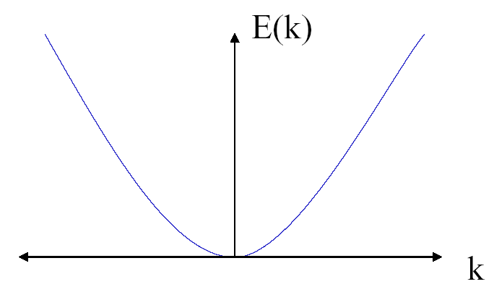
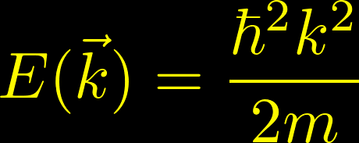
Failures of the free electron model
Too simple model to explain the difference between insulator, semiconductors and metals
Independent of the material!
All the energies are allowed

Slide 6
Reviews of basic assumptions
Free electron approximation
The metallic ions play a very minor role
Independent electron approximation
The interaction of electrons with one another are ignored
Relaxation time approximation
The outcome of a collision is assumed not to depend on the configuration of the electrons at the moment of collision
Supersimplifications to be abandoned if we want to obtain an accurate model of the solid

Slide 7
Next approximation: abandon the free electron approximation
Significant progress can be made by maintaining (2) and (3), concentrating on revising the free electron approximation (1)

Slide 8

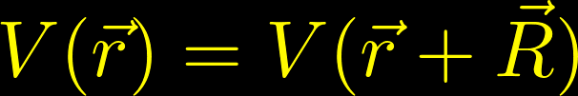
One step forward: consideration of a periodic potential
All the physics of the system can be described from its Hamiltonian
Kinetic energy of the electrons
Captures the electron-electron interaction
Coulomb-like
Repulsive
Captures the electron-lattice (or electron-phonon) interaction
Coulomb-like
Attractive
We will enrich the physical phenomenology of the crystal considering that the electrons move in the periodic potential resulting from a distribution of positive particles located in the static positions of the Bravais lattice.
The electrons will move within a potential that will fulfill

Slide 9
“This chapter is not the easiest one in the book, but is the most important”
Ch. Kittel
Starting sentence of chapter 9

Slide 10
Electron in a potential with the periodicity of the underlying Bravais lattice
Deviations of perfect periodicity (defects, lattice vibrations,…) will be neglected
Assumption of an infinitely extended potential means the neglect all surface effects
The periodicity of the potential is of the order of 10⁻¹⁰ m
( ≈ de Broglie’s wave length in the Sommerfeld’s free electron model)
A quantum formalism is still required
New concepts:
Energy bands
Band gaps
Fermi surfaces
Effective masses
Electrons within the Fermi surface will occupy energy levels distributed in bands separated by gaps of forbidden energy
From Kittel

Slide 11



From the free electron model to the energy bands
On the free electron model the allowed energy values are distributed continuosly from zero to infinity
For periodic boundary conditions over a cube of side L
The free electron wave functions are of the form
Free electron model

Slide 12
From the free electron model to the energy bands
On the free electron model the allowed energy values are distributed continuosly from zero to infinity
For periodic boundary conditions over a cube of side L
The free electron wave functions are of the form
Free electron model
Nearly free electron model

Slide 13
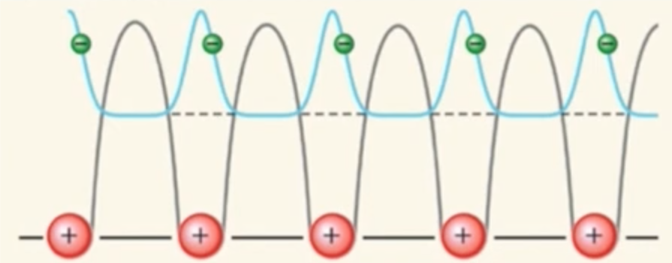
Two different aspects to analyze
General symmetry properties
What kind of symmetry properties will impose the periodic potential on the electronic wave function
The Bloch theorem
2. Interaction with a weak periodic potential
The nearly free electron model
Energy bands

Slide 14



The infinitely extended solid is described using Born-von-Karman boundary conditions
Unit cell
are the primitive vectors of the Bravais lattice

Slide 15



The infinitely extended solid is described using Born-von-Karman boundary conditions
We build a supercell that contains unit cells
We repeat the unit cell times along the direction of the Bravais lattice vector
Unit cell
This is the Born-von-Karman supercell
For the electronic states, we apply the periodic boundary conditions within the Born-von-Karman supercell
(the bulk properties of the solid will not depend on the choice of the boundary conditions, wich can be dictated by analytical convenience)

Slide 16







Allowed values of points
Let us search for plane waves compatible with the periodic boundary conditions
Where the wave vectors are given in a basis of the reciprocal lattice vectors
are the reciprocal lattice vectors
Consequently, we must have
There will be
Allowed wave vectors in the first Brillouin zone
The general form for allowed wave vectors is

Slide 17





General symmetry properties
The periodic potential
Time independent Schrödinger equation with a finite and periodic potential
where
Since the potential has the same periodicity as the lattice,
it can be expanded in the following Fourier series
where is a reciprocal lattice vector
Besides, we will take into account the Born von Karman boundary conditions

Slide 18


General symmetry properties
The electronic wave function
We can expand a wave function that obeys the Born-von-Karman boundary conditions as plane wave expansion
where is a point in the reciprocal space that is compatible with the periodic boundary conditions

Slide 19




General symmetry properties
The time independent Schrödinger equation (TISE)
Kinetic energy
Potential energy
TISE
Renaming the summation indices

Slide 20






General symmetry properties
The time independent Schrödinger equation (TISE)
This condition is valid for every position vector
The expression in brackets, independent of the position, must vanish for every point
This expression couples only expansion coefficients of whose value of differ only from one another by a reciprocal lattice vector
The original problem separates into problems
( = number of unit cells in the Born-von-Karman supercell)
Each of them corresponds to a vector in the unit cell of the reciprocal lattice

Slide 21
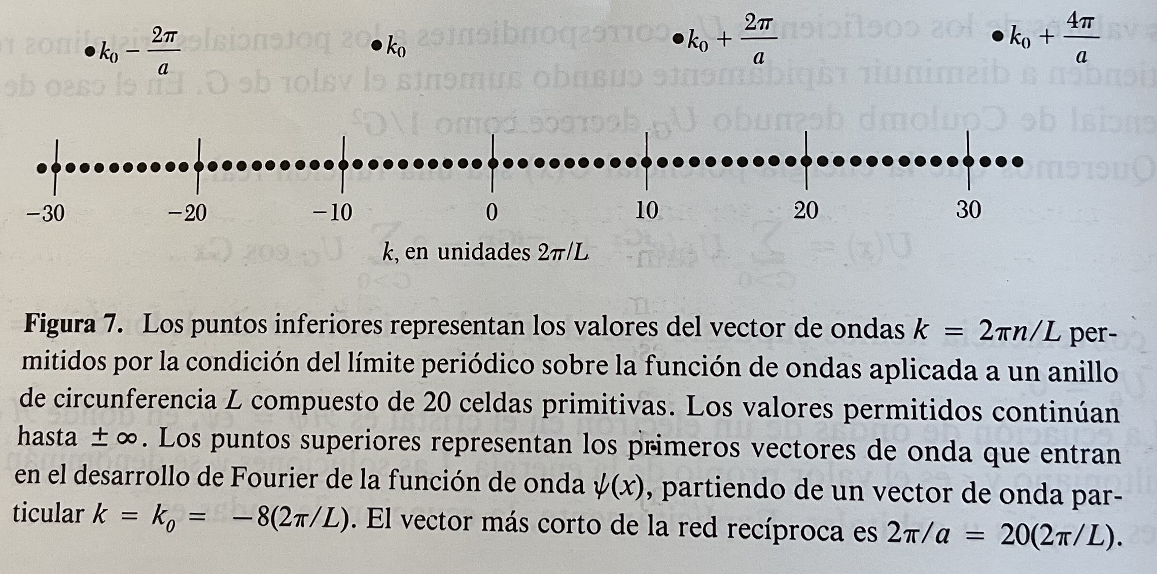
Decoupling of the equations in reciprocal space
From Kittel

Slide 22

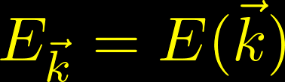
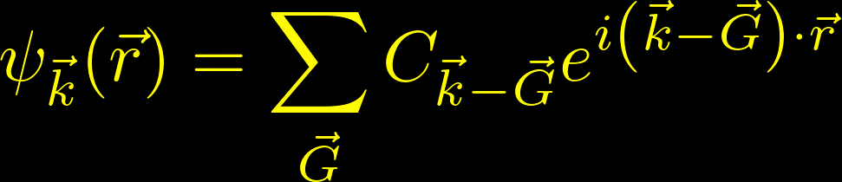

General symmetry properties
The time independent Schrödinger equation (TISE)
Each of the system of equations yields a solution that can be represented as a superposition of plane waves whose wave vectors differ by reciprocal lattice vectors
The eigenvalue of the Schrödinger equation can be indexed according to
And the wave functions belonging to
Fourier series over reciprocal lattice vector and thus has the periodicity of the lattice

Slide 23




General symmetry properties
Quantization of the wave vector
The wave vector for periodic boundary conditions can take the values
is the macroscopic dimension of the crystal
yields the correct quantum numbers
according to which the energy eigenvalues and quantum states may be indexed

Slide 24
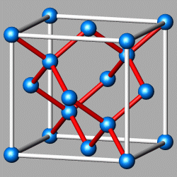
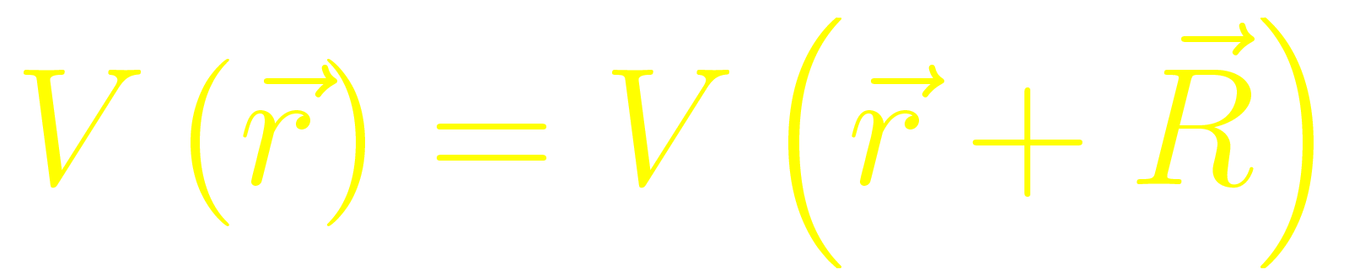
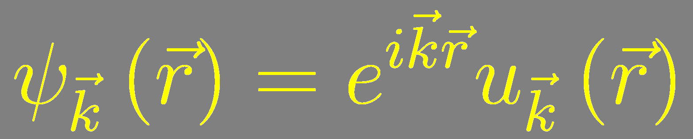
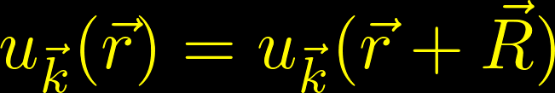
Summary of the Bloch theorem
Periodic solid
Bloch's Theorem:
The wave function of an electron within a mean periodic potential can be written as the product of a plane wave times a periodic function with the periodicity of the lattice
The wave functions are called Bloch states or Bloch waves

Slide 25
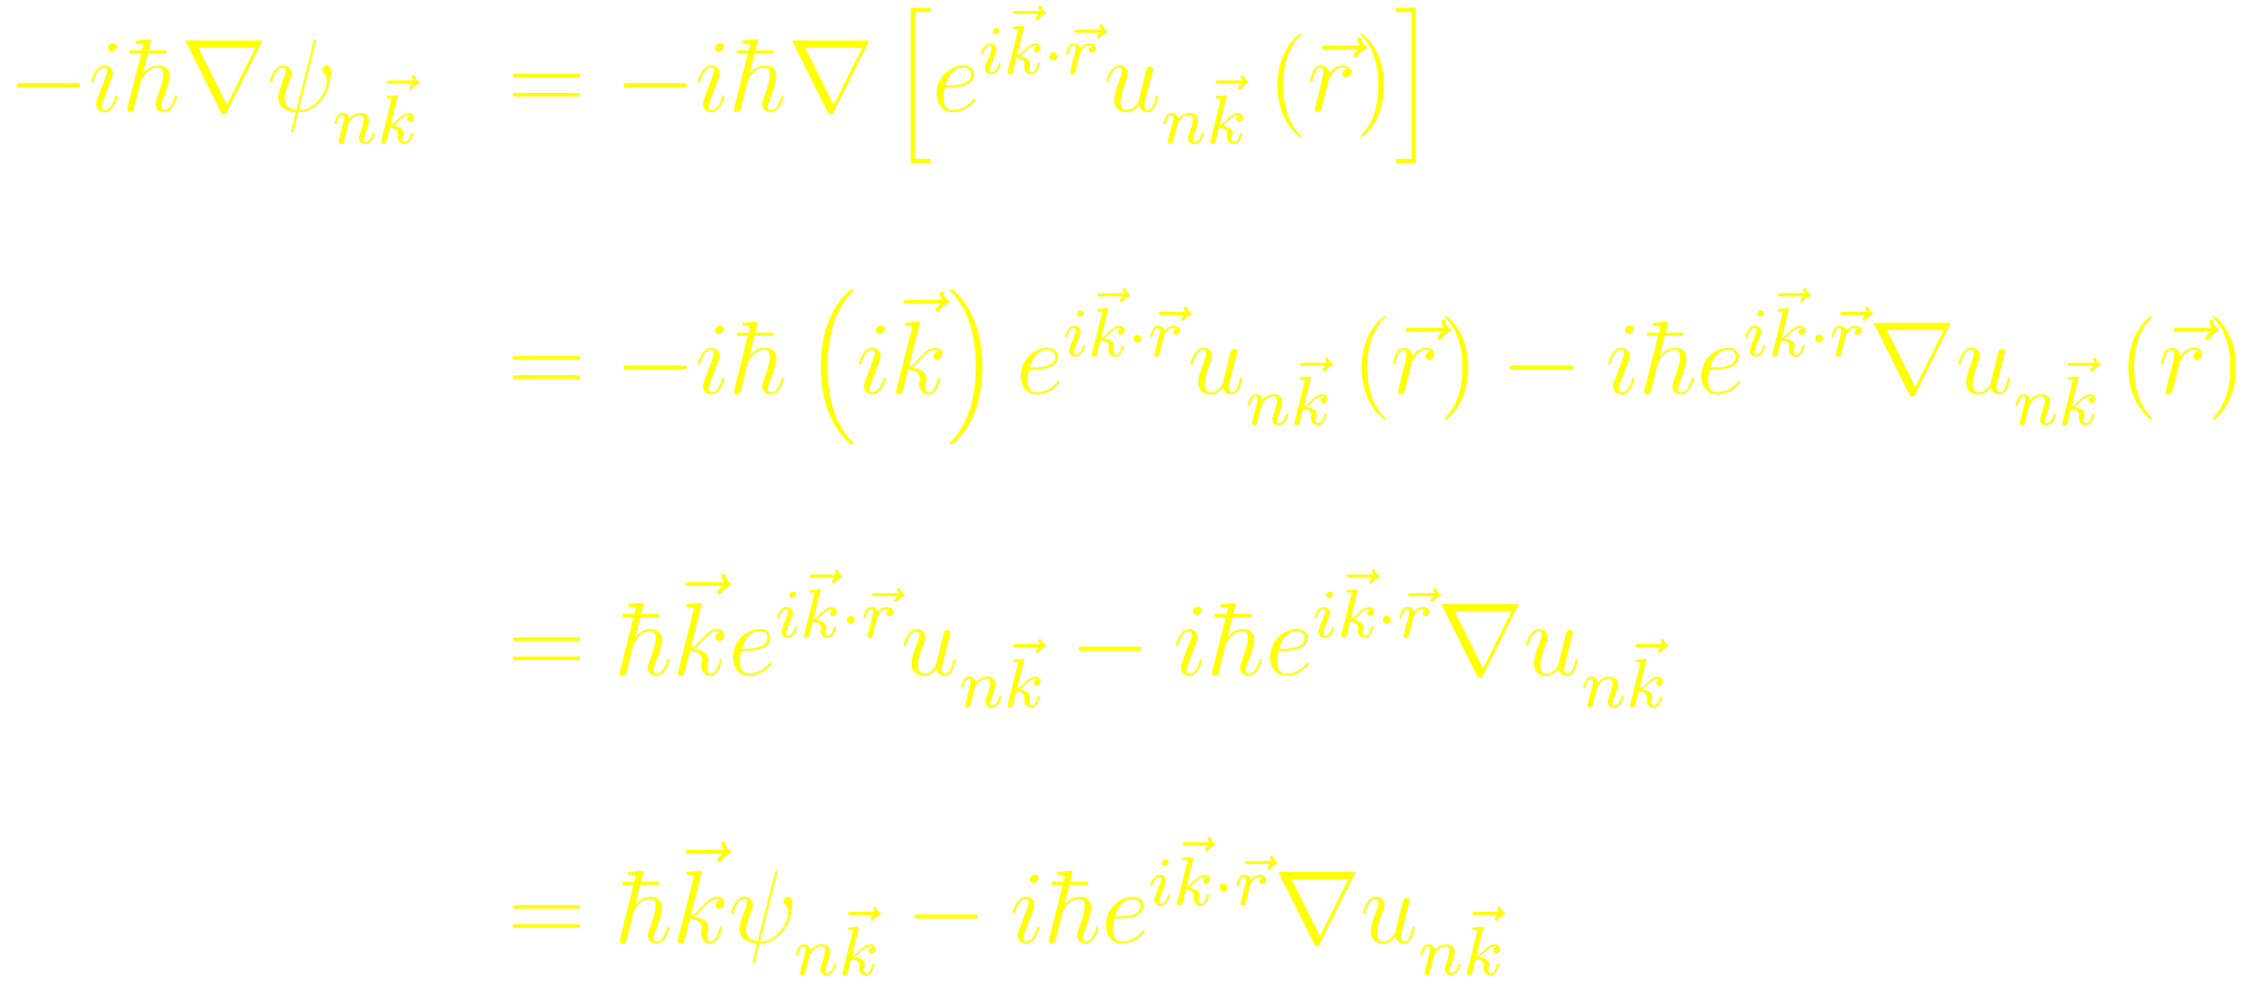


The Bloch wave functions are not eigenstates of the momentum operator
Bloch’s theorem introduces a wave vector which play a similar role to that of the free electron wave vector plays in the Sommerfeld theorem
However, in the periodic potential case
is not proportional to the electronic momentum
The Bloch wave function is not an eigenstate of the mometum operator
is known as the crystal momentum
(a natural extension of to the case of a periodic potential)

Slide 26

For a given there are many solutions to the Schrödinger equation, labeled by the band index
Look for all the solutions to the Schrödinger equation that have the Bloch form

Slide 27
For a given there are many solutions to the Schrödinger equation, labeled by the band index

Slide 28
For a given there are many solutions to the Schrödinger equation, labeled by the band index

Slide 29
For a given there are many solutions to the Schrödinger equation, labeled by the band index

Slide 30


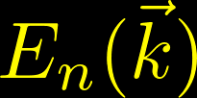
For a given there are many solutions to the Schrödinger equation, labeled by the band index
Hermititian eigenvalue problem restricted to a single primitive cell (fixed finite volume)
Infinite family of solutions with discretely spaced eigenvalues, that will be labelled with the band index
The wave vector appears as a parameter in the Hamiltonian
We expect each of the energy levels for a given to vary continuously as varies
We arrive at the description of the levels of an electron in a periodic potential in terms of a family of continuous functions
(ENERGY BANDS)

Slide 31

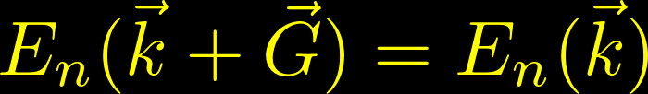


Both the Bloch wave functions and the eigenvalues are periodic functions in reciprocal space
The wave vector appearing in Bloch’s theorem can always be confined to the first Brillouin zone
Any vector not in the first Brillouin zone can be written as
where is a reciprocal lattice vector and lie in the first Brillouin zone

Slide 32







The energy eigenfunctions are periodic functions of the wave vectors of the Bloch waves
Demonstration

Slide 33



The energy eigenvalues are periodic functions of the wave vectors of the Bloch waves
Demonstration
But since
So, finally, comparing the first equation with this last one

Slide 34

Upper and lower bounds in the band structure
Since the bands are periodic in and continuous,
they have an upper and lower bound,
so that all the levels lie in the band of energies lying between these limits

Slide 35
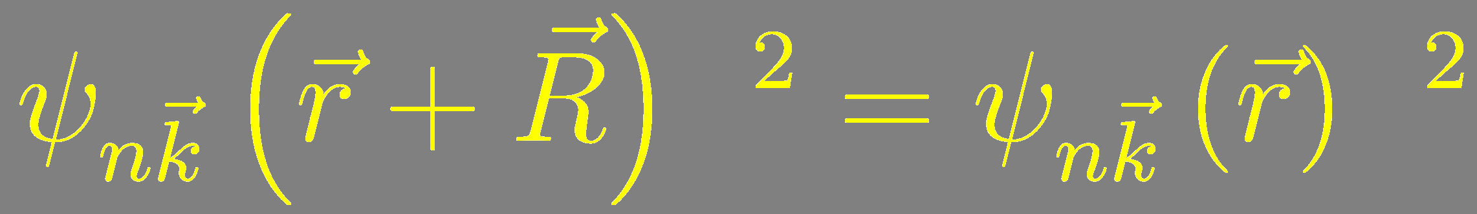
Bloch functions are not periodic in real space
Bloch functions are not periodic in real space
Its square (associated with the probability of finding an electron in a given position) is periodic

Slide 36


Electron velocity
An electron in a level specified by a band index and a wave vector has a non-vanishing mean velocity
There are stationary (time independent) levels of an electron in a periodic potential in which, in spite of the interaction of the electrons with the fixed lattice, it moves forever without any degradation of its mean velocity
Contrast with Drude’s model:
Collisions were simply encounters between the electrons and the statis ions

Slide 37

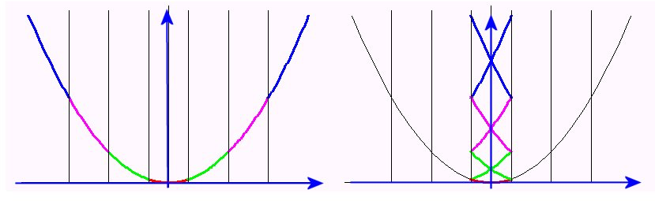



The nearly-free-electron approximation
We shall consider the case of a vanishingly small periodic potential
We shall imagine that the periodic potential starts at zero and is gradually “switched on”
What happens then to the energy states of the free electrons?
We shall start with the energy states of free electrons in the square-well potential
Extended zone scheme
Reduced zone scheme

Slide 38





Extended zone scheme
Only one band plotted for all the kpoints
(including those outside the first Brillouin zone)
Let us take a k-point outside the first Brillouin zone, ,
with an associated eigenvalue

Slide 39



From the extended zone scheme to the reduced zone scheme
Extended zone scheme
Reduced zone scheme
Then, this k-point can be written as
It follows than any energy for wave vector outside the first-Brillouin zone is equal to an eigenvalue in the first-Brillouin zone
(might be with other band index)
In the example above, there is one red band and one green band below our translated band
We need solve for the energy only in the first Brillouin zone for each band

Slide 40

From the reduced zone scheme to the periodic zone scheme
Extended zone scheme
Reduced zone scheme
Sometimes it is helpful to repeat the first Brillouin zone periodically through all the reciprocal space.
Periodic zone scheme
If we can translate the contents of other zones into the first zone, then we can translate the first zone into any or every other zone

Slide 41


The nearly-free-electron approximation
We shall consider the case of a vanishingly small periodic potential
We shall imagine that the periodic potential starts at zero and is gradually “switched on”
What happens then to the energy states of the free electrons?
We shall start with the energy states of free electrons in the square-well potential
In the extreme case, where the potential is still zero ( )
one must consider the symmetry requirements of the periodicity
The possible electron states are not restricted to a single parabola in space but can be found equally well on parabolas shifted by any vector
From Ibach & Lüth

Slide 42



Reduction to the first Brillouin zone
Since the behaviour of is periodic in space,
it is sufficient to represent this in the first Brilloun zone only
From Ibach & Lüth
There is a degeneracy of the energy values at the edges of the
first Brillouin zone, and ,
where two parabolas intersect
The description of the state of an electron with these values is necessarily a superposition of at least two corresponding plane waves

Slide 43

The nearly-free-electron approximation: solutions at the Brillouin zone border
For a vanishing potential (zero order approximation) these waves are
and
The approximate expressions for a perturbation calculation of the influence of a small potential are of the form
These are standing waves possessing zeros at fixed position in space
They can be represented as a superposition of an
incoming wave and
a counter-propagating “Bragg-reflected” wave

Slide 44


The nearly-free-electron approximation: solutions at the Brillouin zone boundary (density)
The corresponding probability densities are
From Ibach & Lüth

Slide 45



The nearly-free-electron approximation: solutions at the Brillouin zone boundary (energy)
has lower total energy (particularly potential energy) than that of a free electron
has higher total energy (particularly potential energy) than that of a free electron
From Ibach & Lüth
This increase and decrease in the energy of the electron of the states at the zone boundary represents a deviation from the free-electron energy parabola
A gap is opened at where a is determined by the lattice

Slide 46



The nearly-free-electron approximation: quantitative solution
The solution can be considered from a
perturbation of the eigenstates at zero potencial
Trivially verifies the Bloch theorem.
The function with the periodicity of the lattice is
The associated eigenvalue is

Slide 47








Fourier transform of a weak periodic potential
Let us assume that is a weak periodic potential with the periodicity of the lattice
Therefore, it can be expanded in a basis of plane waves with wave vectors that are vectors of the reciprocal lattice
The Fourier components are related with by
Integral over the primitive cell of volume
Since we are at liberty to change the potential energy by an additive constant, we fix this constant by requiring that the spatial average of the potential over a primitive cell vanishes
Since the potential is real
In a weak periodic potential

Slide 48


Electronic wave function in a weak periodic potential
A function that complies with the Bloch theorem
If the potential is weak, we expect that the wave functions differ only slightly from the unperturbed wave functions
In other words, we expect that

Slide 49
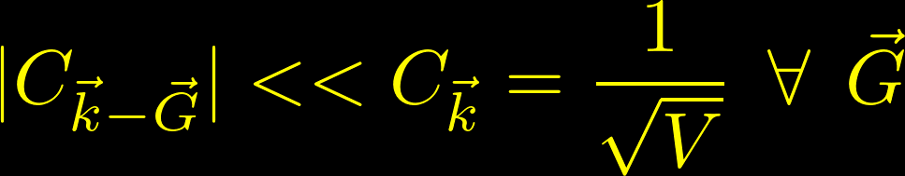








Consequences of
Starting from the general representation of the Schrödinger equation in reciprocal space
Where is the eigenvalue of
And translating by a reciprocal lattice vector
In the sum, the only relevant term will be the one with , i.e. with
Solving for

Slide 50


Consequences of
For small perturbations, a first approximation of
Can be made by setting the true eigenvalue we are seeking equal to the energy of the free electron
Remember that the Fourier coefficients are small
In a weak periodic potential
So will be small…
When this happens, we expect the wave function of the electrons for a given in a weak periodic potential to be well described by the component of the plane wave .
Those electrons are essentially plane waves.

Slide 51




Behaviour under the Bragg condition
For small perturbations, a first approximation of
Can be made by setting the true eigenvalue we are seeking equal to the energy of the free electron
Remember that the Fourier coefficients are small
In a weak periodic potential
So will be small…
…unless the demonitator will be also small. When
This happens at the edges of the Brillouin zone
The right term can be arbitrarily large and cannot be ignored
Both and appear in the expansión of the wave function

Slide 52






Behaviour under the Bragg condition
In such a case, we need to know both the coefficient of and
Starting from
From here, we get the equation for
Making we get the equation for
We thus obtain the secular equation for the energy value

Slide 53






Value of the gap at the zone boundary
We thus obtain the secular equation for the energy value
The two solutions of this secular equation might be written as
Where we have defined
At the zone boundary, where the contributions of the two waves with and are equal
and

Slide 54
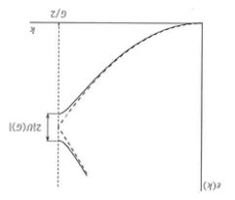
Dispersion relation for the nearly-free electron model

Slide 55
The nearly-free-electron approximation: formal calculation of the band splitting
From Ibach & Lüth

Slide 56
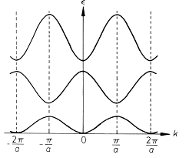
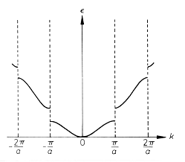
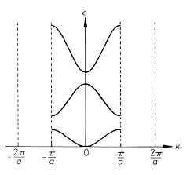
Band structure in the three schemas
Periodic zone
Reduced zone
Extended zone

