Slide 1


The free electron approximation
The Sommerfeld model
Javier Junquera

Slide 2
Basic references, where most of the information is taken from
Charles Kittel
“Introduction to Solid-State Physics”
John-Wiley & Sons, New York, 1996
ISBN 0-471-11181-3
Chapter 6 (7th Edition)
Chapter 7 (in other Editions)
Harald Ibach and Hans Lüth
“Solid-State Physics”
Springer-Verlag, Berlin, 1993
ISBN 3-540-56841-7
Chapter 6
N. W. Ashcroft and N. D. Mermin
“Solid State Physics”
Saunders College Publishers, Fort Worth, 1976
ISBN 0-03-083993-9
Chapter 2

Slide 3

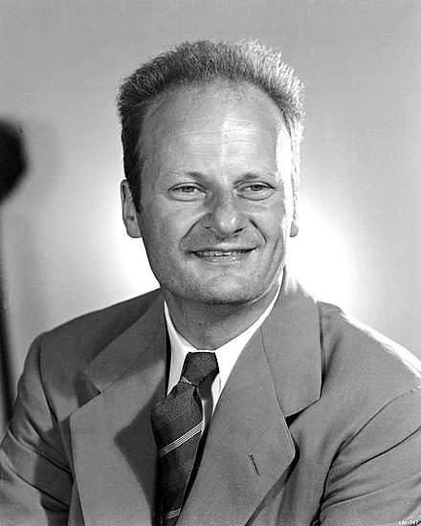
The free electron approximation
(Sommerfeld and Bethe 1933)
Sommerfeld
(1868-1951)
H. Bethe
(1906-2005)
One extra approximation, beyond the one-particle approximation
The periodic potential will be replaced by a constant potential
Approximated crystal potential
Actual crystal potential
The electrons do not interact neither between themselves nor with the nuclei
The electrons confined within the boundaries of the solid, behave as an ideal gas
(we shall consider only the Pauli exclusion principle)

Slide 4
The free electron gas in an infinite square well potential
Model
A metal crystal is modeled as a cube of side L,
described by a three-dimensional potential box with an infinite barrier at the surface
Within this model, an electron is unable to leave the cristal
(oversimplification: the work functions are finite, of the order of 5 eV)

Slide 5



The free electron gas in an infinite square well potential (1D)
Goal:
Compute the ground state of a gas of:
N free electrons (no interaction between themselves nor with the lattice)
In 1-dimension
Keeping only the Pauli exclusion principle
One electron of mass m is confined in an infinite square quantum well of length L. The time independent Schrödinger equation is given by
Kinetic energy
Energy levels of one electron in the wave function
Boundary conditions
Normalization conditions
Due to the infinite barrier, the electrons cannot leave the crystal
The electron is somewhere within the potential box

Slide 6
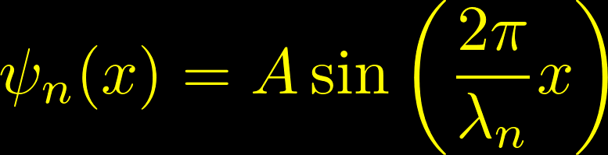
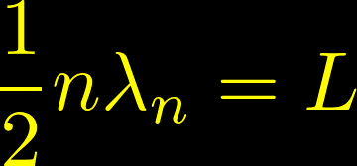
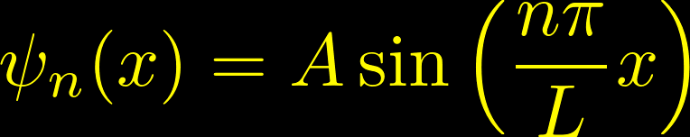
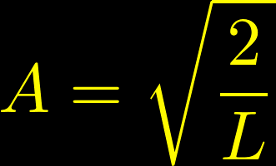
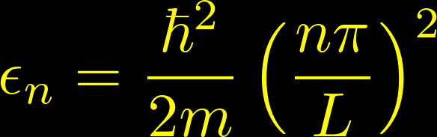
The free electron gas in an infinite square well potential (1D)
Solution: similar to the stationary waves propagating in a string
Normalization constant
One electron energy levels
The energy is a quadratic function of the quantum number n
From Kittel

Slide 7
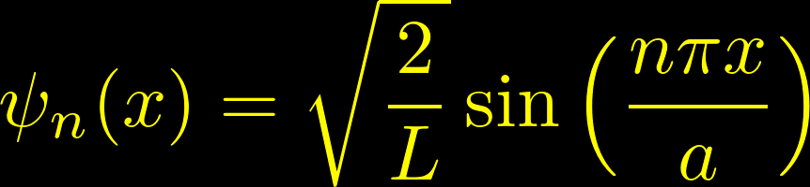
Eigenfunctions and eigenvalues of the TISE for the free electron gas in an infinite square well potential
Eigenfunctions
Eigenvalues
Possible outcomes of energy measurements
The wavenumbers associated with the energy eigenfunctions within the infinite rectangular well are quantized
They have a discrete set of possible values
the energy difference between adjacent wavefunctions increases with increasing n
The wavefunction must have zero amplitude at both edges of the well,
the only allowed wavefunctions are
those with an integer number of half-wavelengths within the well.

Slide 8
Fundamental differences with classical mechanics
Eigenfunctions
Eigenvalues
Possible outcomes of energy measurements
Classical mechanics
All positive values of the energy are allowed
At zero temperature, the lowest energy state has zero energy
Quantum mechanics
The particle can take only certain values
At zero temperature, the lowest energy state has a non zero energy
“zero point energy”

Slide 9
Wave functions in an infinite quantum well
Excited states
Each step up in energy level adds another half-cycle to the wavefunction across the well and another node within the well
The wavefunctions alternate between even and odd parity if the center of the well is taken as the origin
Ground state
Has a node (location of zero amplitude) at each boundary of the well, but no nodes within the well

Slide 10
Relation between shape of the wavefunction and energy

Slide 11



The free electron gas in an infinite square well: filling the one-electron levels with N electrons
Now, we have to accomodate N electrons according to the Pauli exclusion principle
There cannot be two electrons that have all their quantum numbers identical
Each orbital can be occupied by a maximum of one electron
Quantum numbers for our electrons in a 1D infinite square well
Positive integer
The state with n=0 cannot be normalized over the volumen and must be excluded
States with negative n give no new linearly independent solutions
Magnetic quantum number
According to spin orientation

Slide 12
The free electron gas in an infinite square well: filling the one-electron levels with N electrons
Example:
Filling of the one-energy levels if we have six electrons
Gound state would be
From Kittel

Slide 13






Important magnitudes in the free electron gas:
The Fermi level energy and Fermi energy
Fermi level ( ): the highest occupied energy level
Since N is usually an extremely large number,
we can assume without major consequences that it is an even number
The condition determines
Fermi energy ( ): the energy of the Fermi level
(the energy of the uppermost filled energy level of the ground state of the system with N electrons)
Order of magnitude in metallic systems: 1-10 eV
Relatively high: at room temperature ≈ 0.025 eV
Degeneracy: number of orbitals with the same energy

Slide 14



Important magnitudes in the free electron gas:
The total energy
The total energy can be estimated summing over all the orbital energies, upto the Fermi level
For the one-dimensional problem, the average kinetic energy in the ground state is one third of the Fermi energy

Slide 15


The free electron gas in an infinite square well potential (3D)
Goal:
Generalization of the previous reasoning to a three dimensional case
Boundary conditions
Normalization conditions
The electron is somewhere within the potential box

Slide 16



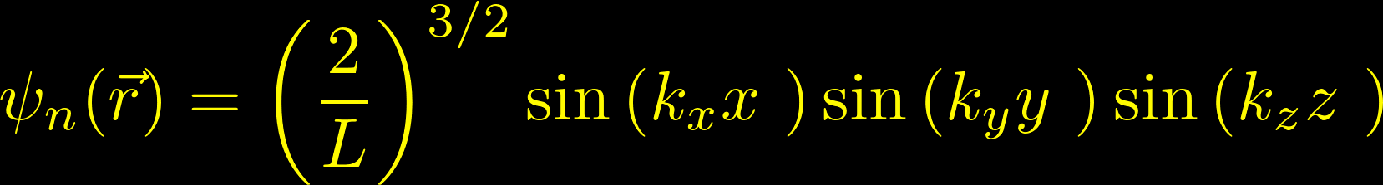
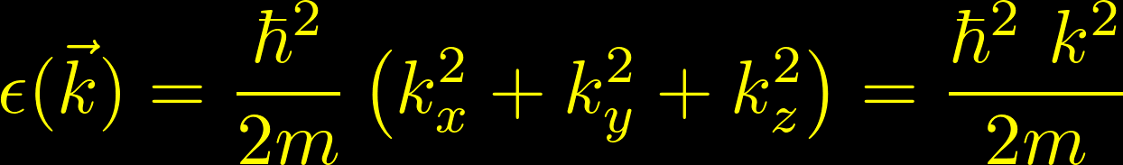
The free electron gas in an infinite square well potential (3D)
Solution
With positive integers
The origin is located at a vertex of the cube
Defining
The posible states of an electron in a three-dimensional infinite square well of side L and volume L³ can be listed according to their quantum numbers
The posible energy states are

Slide 17

In the ground state of a system of N free electrons with fixed boundary conditions, the occupied orbitals occupy an octant
From Ibach-Lüth
For the fixed boundary conditions, the possible values are confined to the positive octant of the sphere

Slide 18


The choice of the boundary conditions
Problem: represent the confinement of the electron
(by the attraction of the ions)
to the volume by a boundary condition
In problems where we are not explicitly concerned by the effect of metallic surfaces
If the metal is sufficiently large we should expect its bulk properties to be unaffected by the detailed configuration of its surface
Then, the choice of the boundary conditions is at one’s disposal
The boundary conditions can be determined by mathematical convenience. We first select the shape of the metal to suit our analytic convenience
Standard one: a cube of side
with periodic boundary conditions
(this illustrates the inconsecuence of the surface by disposing of it altogether)

Slide 19

Periodic (Born-von Karman) boundary conditions
We should expect that the bulk properties to be unaffected by the presence of its surface.
A natural choice to emphasize the inconsequence of the surface by disposing of it altogether
Supercell +
Born-von Karman boundary conditions
Each face of the cube is joined to the face opposite to it.
An electron coming to the “surface” is not reflected back in.
It leaves the metal, simultaneously reentering at the corresponding point on the opposite surface

Slide 20
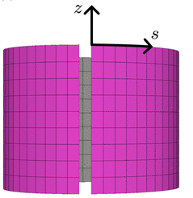
Periodic (Born-von Karman) boundary conditions
Like playing “origami”
Supercell +
Born-von Karman boundary conditions
Each face of the cube is joined to the face opposite to it.
An electron coming to the “surface” is not reflected back in.
It leaves the metal, simultaneously reentering at the corresponding point on the opposite surface

Slide 21


What happens with periodic boundary conditions?
Goal:
Solve again the three dimensional time independent Schrödinger equation
Boundary conditions (Born-von Karman)
Normalization conditions
The electron is somewhere within the potential box

Slide 22

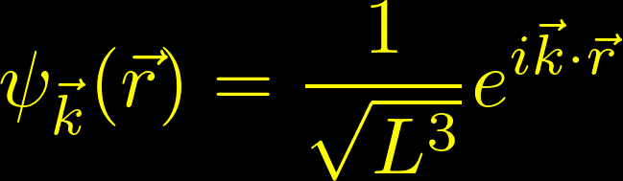

What happens with periodic boundary conditions?
Solution: travelling plane waves
These travelling waves,
in contrast with the stationary waves of the infinite well,
represent better the trasport of electronic charge
They look like plane waves with wave vector
Normalization condition

Slide 23
What happens with periodic boundary conditions?
Solution: travelling plane waves
These travelling waves,
in contrast with the stationary waves of the infinite well,
represent better the trasport of electronic charge
They look like plane waves with wave vector
The posible energy states are

Slide 24





The momentum operator
The wave vector adquires an special significance
The travelling plane waves are also eigenstates of the linear momentum operator with eigenvalue
Related observables
The electron will have a momentum
…a velocity
…and an energy

Slide 25



Three dimensional plane waves
The plane wave will be constant in any plane perpendicular to and periodic in the direction parallel to with a wave length
The module of the wave vector is related with the wave length
de Broglie’s wave length
A Student’s Guide to the Schrödinger equation
Daniel A. Fleisch
Cambridge University Press, Cambridge, 2020
ISBN:978-1-108-81978-7

Slide 26




Quantization of the wave vector
To accomplish with the periodic boundary conditions, not all the values of are allowed
They are quantized
The same for the y and z directions
Any component of the wave vector with the form
with n a positive or negative integer
Proof
The components of the wave vector, together with the magnetic quantum number , are the quantum numbers of the system

Slide 27







The space
We define a 3D space with Cartesian coordinates ,
where we represent the allowed wave vectors,
which are those with coordinates along the three axes that are multiples of
In 2D
k_{y}
Due to the quantization conditions for the allowed wave vectors,
there is one allowed wave vector
(one with a distinct triplet of quantum numbers )
for the volume element of -space
2π/L
k_{x}
One arbitrary region of volume in the space contains a number of points equal to
space density:
number of states per unit volume

Slide 28

In the ground state of a system of N free electrons, the occupied orbitals of the system fill a sphere
From Kittel
A representation of the allowed values in a three-dimensional wave-vector
space yields constant energy surfaces that are spherical

Slide 29





Important magnitudes in the free electron gas:
The Fermi wave vector, sphere, surface and energy
In the ground state of a system with N free electrons the occupied states may be represented as points inside a sphere in space
When N is very large, the volume of the region of occupied states in space is a sphere
The energy at the surface of the sphere is the Fermi energy
Fermi wave vector
radius of the sphere of states with
Fermi sphere
Sphere of radius
Fermi surface
Surface of the Fermi sphere

Slide 30



Important magnitudes in the free electron gas:
The Fermi momentum and velocity
In the ground state of a system with N free electrons the occupied states may be represented as points inside a sphere in space
When N is very large, the volume of the region of occupied states in space is a sphere
Fermi momentum
Fermi velocity
≈10⁸ cm/s (1% of speed of light)
As important as the thermal velocity in a classical gas

Slide 31




Fermi energy as a function of the electron density
In the Fermi sphere of volume
The total allowed number of states is
spin
Below the Fermi energy, all the states are occupied,
so the number of states is the same as the number of electrons.
Then

Slide 32
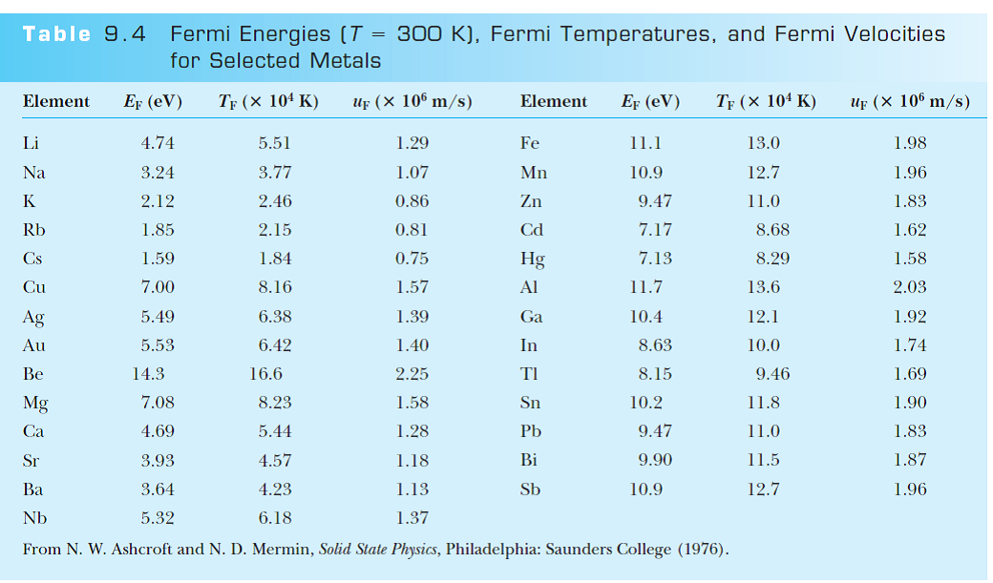
Orders of magnitude of all the Fermi magnitudes

Slide 33



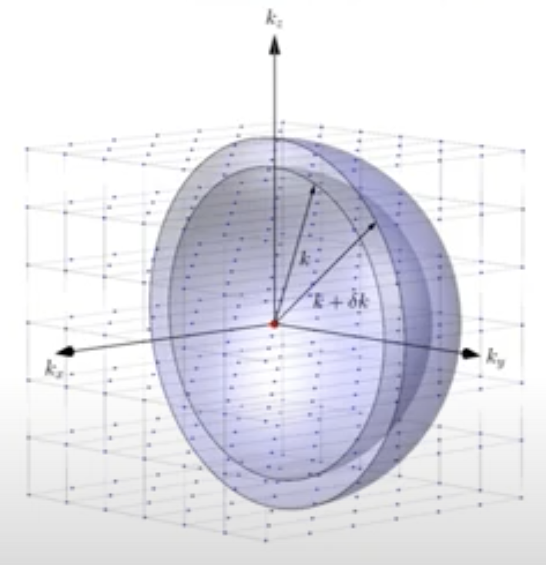




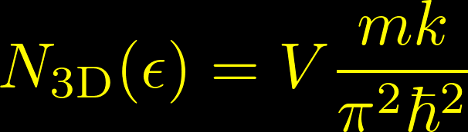
Density of states per unit volumen in 3D
We build multielectron states by filling available energy levels one at a time, considering two spin orientations per level.
Let us consider two energy surfaces (spheres) of radii and , corresponding to the energies and
Number of allowed wave vectors between the two spheres?
First, compute the volume of the spherical crust
Second, divide by the volume per allowed point
Then, the number of electrons with energies between and
spin

Slide 34
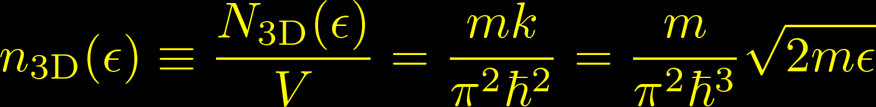
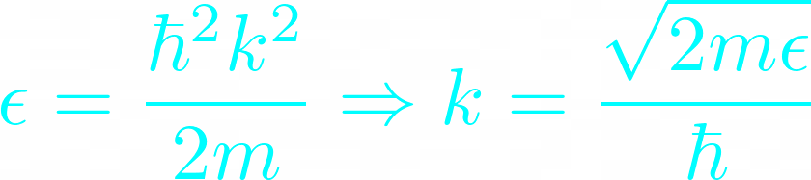


Density of states per unit volumen in 3D
spin
To define the density of states
(number of states per unit volume with energy between and )
A dimensionally more transparent way of writing it
so

Slide 35
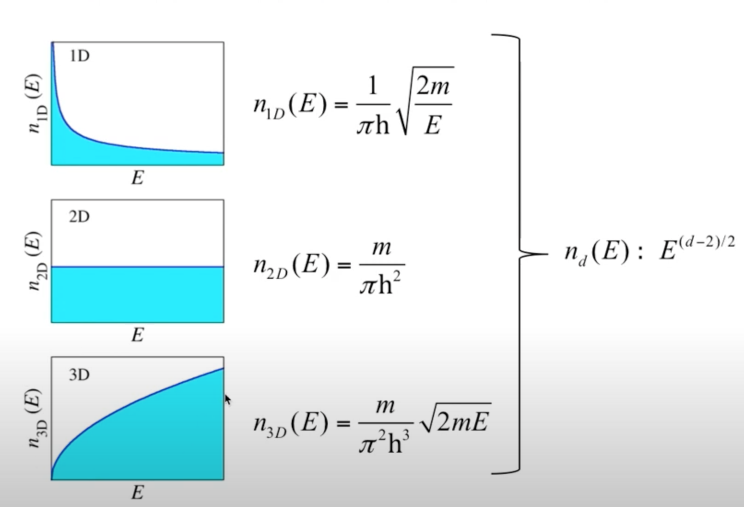
Density of states in different dimensions

Slide 36




Computing the energy density of the electron gas
To calculate the ground-state energy of N electrons in a volume V we must add the energies of all the one-electron levels inside the Fermi sphere
We can multiply and divide by the volume allowed per point
Now, we take the macroscopic limit of the side of the cube

Slide 37


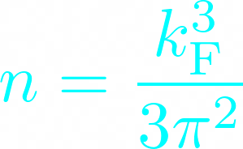
Computing the energy density of the electron gas
Performing the integral in polar variables
The angular part is trivial. The remaining radial part takes the form
From this, we can compute the energy per electron
Interesting consequence of the Pauli exclusion principle:
A Fermi gas of free particles, in contrast to a classical gas,
has a non-vanishing internal energy at T=0 K

Slide 38

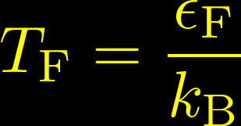

The Fermi temperature
Where we have introduced the Fermi temperature as
In contrast to this, the energy per electron in a classical gas amounts to
and vanishes at zero temperature
In the classical gas, to get a value as large as the one in the quantum gas, we need temperatures of the order of 10⁴ K

Slide 39




Pressure and the bulk module
Once we know the ground state energy,
one can calculate the pressure exerted by the electron gas
Expressing the energy as a function of the volume
Taking the partial derivative
The bulk module is defined as

Slide 40
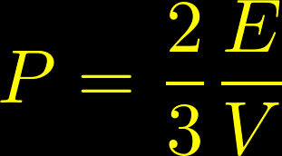
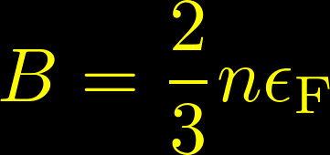
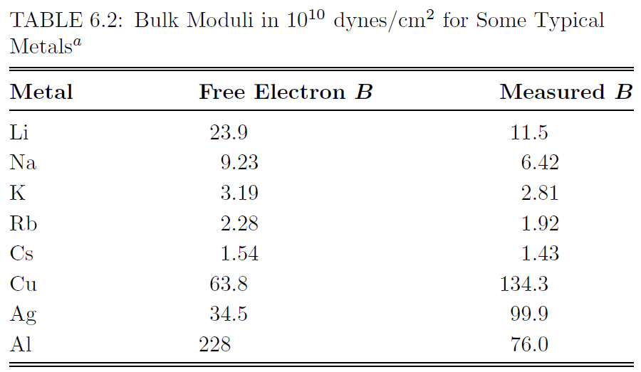
Pressure and the bulk module
From Ashcroft and Mermin

Slide 41

The Fermi-Dirac distribution at 0 K
The ground state is the state of the system at absolute zero temperature
At the time of filling the energy levels with our N electrons:
all the levels below the Fermi energy were filled,
all the levels above the Fermi energy were empty
Let us define a probability function that a state at a given energy will be occupied in an ideal electron gas in thermal equilibrium
(the probability that a state is occupied by an electron is the average number of electrons in the state)
At 0 K, the probability function will take the form of a step function
What does happen at finite temperature?

Slide 42
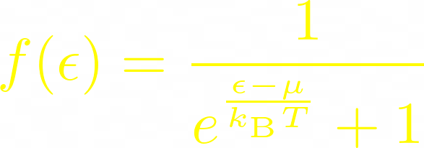





The Fermi-Dirac distribution at finite temperature
As temperature increases:
some energy levels are occupied which were vacant at absolute zero
some levels are vacant which were occupied at absolute zero
This is described by the Fermi-Dirac distribution function
is called the chemical potential
It is temperature dependent
Must be chosen in such a way that the total number of particles in the system comes out correctly
At zero temperature,
At all finite temperatures,
The two curves differ only in a region of the order of about

Slide 43
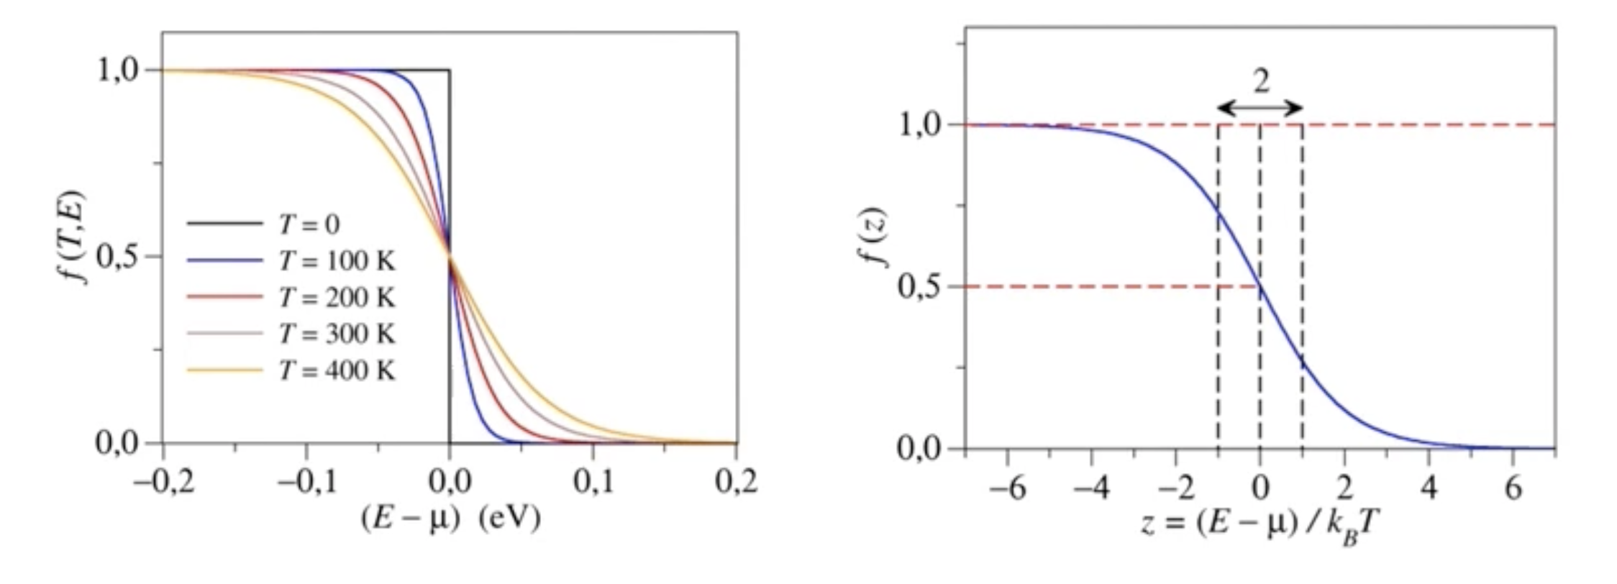

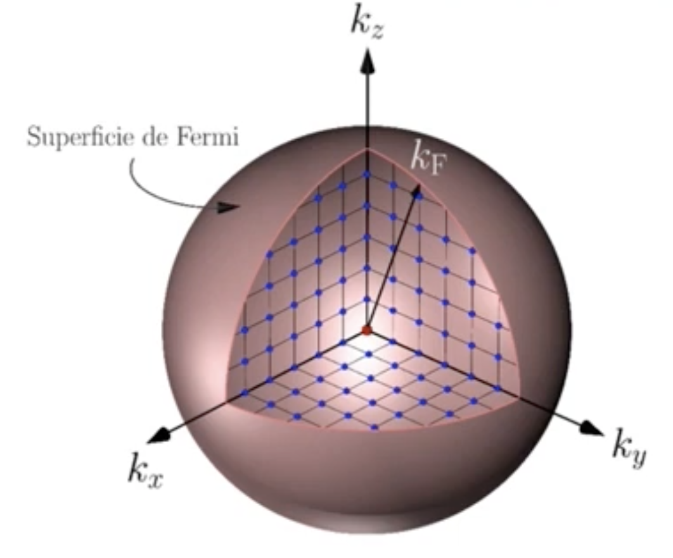
The Fermi-Dirac distribution at finite temperature
The width increases when T increases
Only the electrons close to the Fermi energy are able to promote
(there are empty states close in energy)

Slide 44


Fermi-Dirac versus Boltzmann distribution
The high-energy tail of the distribution
That is essentially the Boltzmann distribution

Slide 45


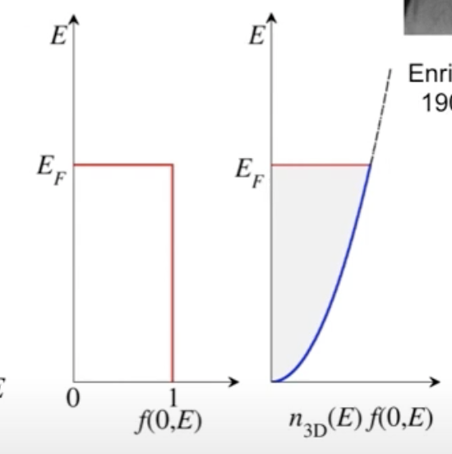


Computing the density of particles as a product of density of states and Fermi distribution
Probability of occupation
Number of levels per volume with energies between and
From the previous equation
So, the Fermi energy will take the value
Since

Slide 46




Computing the energy density as a product of density of states and Fermi distribution
Probability of occupation
Energy
Number of levels per volume with energies between and
The density of states is defined as
So the integral can be extended between and

Slide 47






Dependence of the chemical potential with temperature
The density of particles does not change with temperature
Replacing the shape of the density of states in 3D
Change the variables to make the integrals adimensional

Slide 48



Dependence of the chemical potential with temperature
To get this, follow the next two slides

Slide 49




Solution of
Multiplying the two terms by 3/2
Taking the power of 2/3
The previous approach is valid, since the chemical potential is much larger than the thermal energy
Then

Slide 50

Solution of
From the previous slide…
Simplifying the expression
Solve the equation for x
Taking again the approximation for the power a binomial
Only the positive solution has physical meaning
(the other one gives a non-sense negative value for x)

Slide 51



Dependence of the chemical potential with temperature
Undoing the change of variables
Simplifying the expression

Slide 52




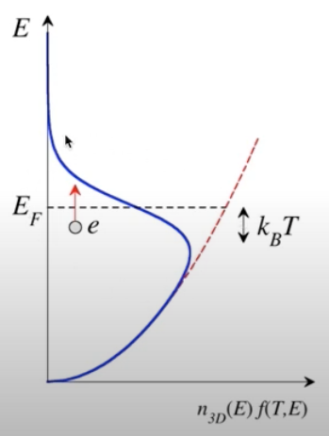


Number of electrons that can be excited at low temperature
The number of particles in excited states at temperature T can be obtained integrating the corresponding interval around the Fermi energy
Assuming
Then we can compute
Fraction of electrons thermally excited at finite temperatures beyond the Fermi energy

Slide 53


The specific heat capacity of electrons in metals
Due to the Pauli exclusion principle, only a fraction of the electrons of the order of can absorb thermal energy
The energy absorbed per electron is of the order of .
Therefore, the increase in the energy density due to the thermally excited electrons is
Linearly dependent on the temperature
Since the Fermi temperature is very large, the electronic contribution to the specific heat of the solid will be very small compared with the lattice contribution

Slide 54




The specific heat capacity of electrons in metals (more accurate calculation)
The change in the total energy of the system of N electrons on heating from 0 to T
We can multiply the following identity…
… by the Fermi energy
Then

Slide 55
The specific heat capacity of electrons in metals (more accurate calculation)
The change in the total energy of the system of N electrons on heating from 0 to T

Slide 56

The specific heat capacity of
electrons in metals (more accurate calculation)
The electronic heat capacity (at constant volumen) is defined as
Taking into account that the only term that depends on Temperature is the Fermi-Dirac distribution

Slide 57



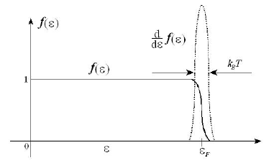
The specific heat capacity of
electrons in metals (more accurate calculation)
The electronic heat capacity (at constant volumen) is defined as
Taking into account that the only term that depends on Temperature is the Fermi-Dirac distribution
At low temperatures ( ) of interest the derivative is large only at energies near the Fermi energy.

Slide 58

The specific heat capacity of
electrons in metals (more accurate calculation)
The electronic heat capacity (at constant volumen) is defined as
Taking into account that the only term that depends on Temperature is the Fermi-Dirac distribution
At low temperatures ( ) of interest the derivative is large only at energies near the Fermi energy.
We can take the density of states evaluated at the Fermi energy
outside of the integral

Slide 59
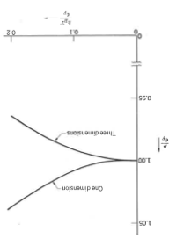

The specific heat capacity of electrons in metals (more accurate calculation)
Assuming that, to first order in temperature the chemical potential does not depend on T, we can replace in the expression of the Fermi-Dirac distribution the chemical potential by the Fermi energy
From Kittel

Slide 60
The specific heat capacity of electrons in metals (more accurate calculation)
Assuming that, to first order in temperature the chemical potential does not depend on T, we can replace in the expression of the Fermi-Dirac distribution the chemical potential by the Fermi energy
Then, taking the derivative of the Fermi-Dirac distribution

Slide 61

The specific heat capacity of electrons in metals (more accurate calculation)

Slide 62


The specific heat capacity of electrons in metals (more accurate calculation)
Assuming that, to first order in temperature the chemical potential does not depend on T, we can replace in the expression of the Fermi-Dirac distribution the chemical potential by the Fermi energy
Then, taking the derivative of the Fermi-Dirac distribution
Setting

Slide 63




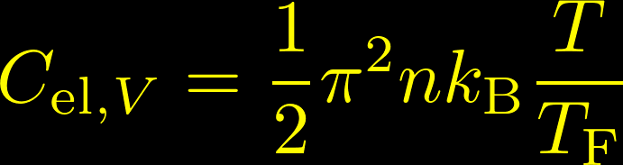
The specific heat capacity of electrons in metals (more accurate calculation)
Because the factor in the integrand is negligible at we may replace the lower limit by
Since
Since we have proved before that
Essentially the same expression as in the previous rough estimate

Slide 64

Experimental heat capacity of metals
Phonon contribution to the specific heat (Debye contribution)
From Ibach-Lüth

Slide 65
Experimental heat capacity of metals
Phonon contribution to the specific heat (Debye contribution)
From Ibach-Lüth
For transition metals the determined values of the electronic contribution to the specific heat bear little resemblance to those calculated from the electron gas

Slide 66
Experimental heat capacity of metals
From Ibach-Lüth
For transition metals the determined values of the electronic contribution to the specific heat bear little resemblance to those calculated from the electron gas
Fe, Co, Ni: d-electron shell is partially occupied.
The d-bands lie at the Fermi energy
The d-electrons are strongly localized around the atoms, and the overlap of their wave functions is small

Slide 67
Supporting slides

Slide 68

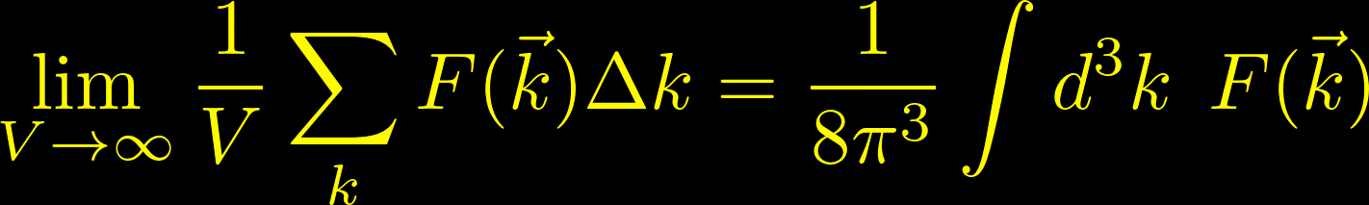
Computing the energy density of the electron gas
To calculate the ground-state energy of N electrons in a volume V we must add the energies of all the one-electron levels inside the Fermi sphere
We can multiply and divide by the volume allowed per point
Now, we take the macroscopic limit of the side of the cube

