Slide 1
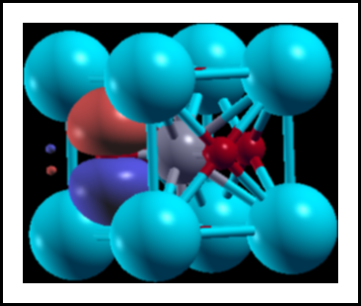
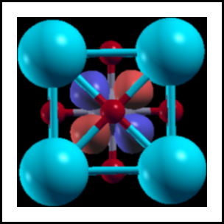

How to run wannier90
directly from siesta
Javier Junquera

Slide 2
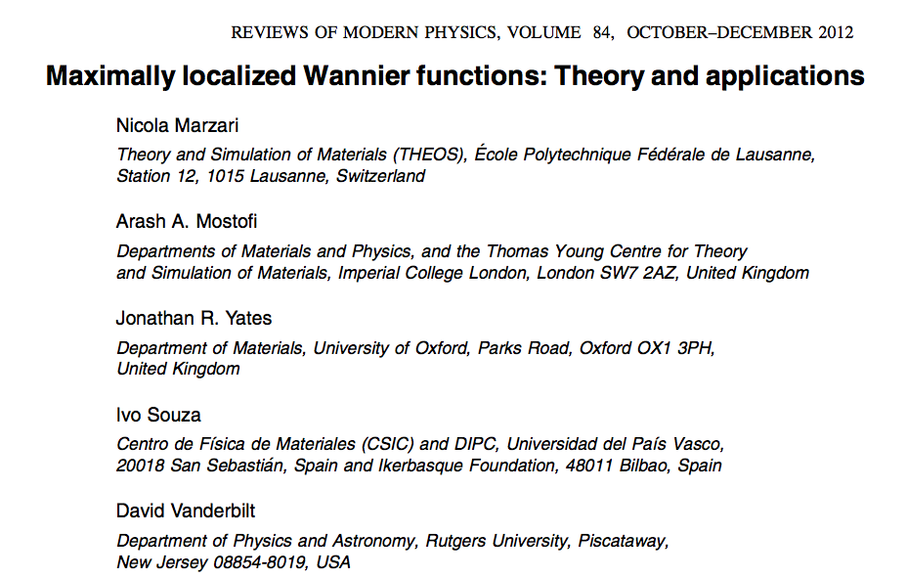
Important bibliography:
For a review on Maximally Localized Wannier functions:

Slide 3
Important bibliography:
The user guide of the wannier90 code
Freely available from:
http://www.wannier.org

Slide 4
wannier90 code directly called from siesta
wannier90 code (version 3.0.0) has been compiled in library mode and called directly from siesta
That means that we can run all the functionalities of
wannier90 directly from siesta
Advantages
No need to prepare two different input files
No need to run wannier90 in pre-processing mode
We can use the basis set of siesta (numerical atomic orbitals) as the initial guess for the projections
Wannierization of different manifolds can be done in the same run of siesta
The unitary matrices connecting the Bloch and Wannier representations are available in siesta.
  New functionalities can follow (initial guesses for order-N simulations)
Interface with other codes will be much easier:
scale-up (second-principles)
DMFTwDFT (DMFT code by Aldo Romero’s group)

Slide 5
wannier90 code directly called from siesta
Practical examples:
Bulk SrTiO₃ in the cubic phase
Graphene

Slide 6
After running siesta and compute the PDOS, we can analyze the character of the different bands
Which atoms contribute more to the bands at a particular energy window

Slide 7
We can analyze the character of the different bands
Which atoms contribute more to the bands at a particular energy window
Zoom around the top of the valence bands and bottom of conduction bands
Bottom of conduction bands: mostly Ti t_{2g} character
Top of valence bands: mostly O 2p character
We can project on particular atomic orbitals within an atom to further define the character.

Slide 8
Choose the Bloch states that will be used to compute the Wannier functions
In this particular example, we are interested in the wannierization of three different manifolds
Manifold number 1:
Top of valence bands: mostly O 2p character
That means:
- 3 O p bands (p_{x}, p_{y}, p_{z})
× 3 O atoms
9 bands to wannierize

Slide 9
Choose the Bloch states that will be used to compute the Wannier functions
In this particular example, we are interested in the wannierization of three different manifolds
Manifold number 2:
Bottom of conduction bands: mostly Ti t_{2g} character
That means:
-3 Ti t_{2g} bands (d_{xy}, d_{yz}, d_{xz})
3 bands to wannierize

Slide 10
Choose the Bloch states that will be used to compute the Wannier functions
In this particular example, we are interested in the wannierization of three different manifolds
Manifold number 3:
Bottom of conduction bands: mostly Ti t_{2g} character
Top of valence bands: mostly O 2p character
That means:
- 3 O p bands (p_{x}, p_{y}, p_{z})
× 3 O atoms
- 3 Ti t_{2g} bands (d_{xy}, d_{yz}, d_{xz})
12 bands to wannierize

Slide 11
siesta variables related with the wannierization
Number of manifolds to wannierize
As many lines in the block as manifolds will be wannierized
A nickname is given to each manifold

Slide 12
siesta variables related with the wannierization
Information for every manifold
As many WannierManifolds blocks as manifolds considered for wannierization
The nickname of every manifold is appended here to the keyword WannierManifold

Slide 13
siesta variables related with the wannierization

Slide 14
siesta variables related with the wannierization

Slide 15
siesta variables related with the wannierization
A good initial guess to project the bands of the top of the valence band are the O-2p orbitals
Take a look to the SystemLabel.ORB_INDX file
p-orbitals of the first O atom
p-orbitals of the second O atom
p-orbitals of the third O atom

Slide 16
siesta variables related with the wannierization
Number of iterations for the minimization of the localization functional
If zero, then the procedure is the same as a Löwdin orthonormalization
The resulting Wannier functions will keep the symmetry of the projection function, but it will not be maximally localized

Slide 17
siesta variables related with the wannierization
Instruction to plot the Wannier functions
The integer refers to the size of the supercell for plotting the Wannier functions

Slide 18
siesta variables related with the wannierization
Flag to determine whether the Fermi Surface is computed or not

Slide 19
siesta variables related with the wannierization
Flag to determine whether the Hamiltonian in real space in a basis of Wannier functions is written
SystemLabel.manifold.X_hr.dat
X is the nickname of the manifold

Slide 20
siesta variables related with the wannierization
Flag to determine whether the lattice vectors, Hamiltonian in real space and position operator in a basis of Wannier functions are written
SystemLabel.manifold.X_tb.dat
X is the nickname of the manifold

Slide 21
siesta variables related with the wannierization
Number of k-points used in the Wannierization

Slide 22
Succesful output of siesta

Slide 23
Succesful output of siesta
The output is exactly the same as the wannier90 code
9 WF centered on the three O
The spread of the Wannier functions (in Å) is three and six fold degenerated

Slide 24
How to plot the Wannier functions
First of all, siesta has to write the periodic part of the Bloch functions in a 3D grid. The number of points in the grid along the three lattice vectors are given by
seedname.fdf file
(input of siesta)
This produces many files with the name UNKXXXXX.Y where
XXXXX is the number of the k-point, from 1 to the number of points included in seedname.win file
Y refers to the spin compoment (1 or 2)

Slide 25
How to plot the Wannier functions
Wannier90 produces files with the name:
SystemLabel.manifold.X_0000Y.xsf that can be directly plotted with xcrysden
Once XCrySDen starts, click on
File → Open structure (Select your xsf file)
Tools → Data Grid
Click on OK
Then, select:
Degree of triCubic Spline: 3
Click on Render+/- isovalue
Select the desired isovalue (in this example 0.1)
Submit
SrTiO3.manifold.first_00001.xsf

Slide 26
wannier90 code directly called from siesta
Practical examples:
Bulk SrTiO₃ in the cubic phase
Graphene

Slide 27
Graphene, including bond centered Hydrogen ghost atoms

Slide 28
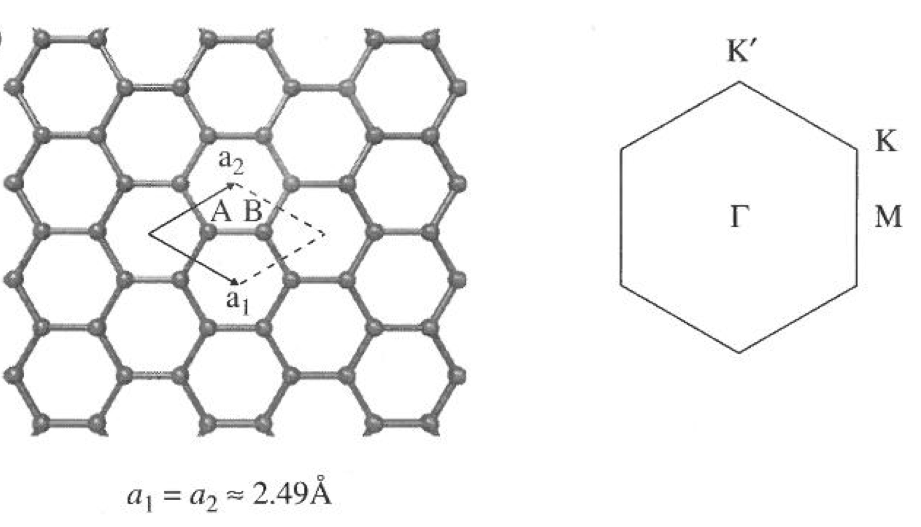
Graphene: atomic structure in siesta

Slide 29
Graphene: plotting the band-structure in siesta

Slide 30
wannier90 code directly available from siesta
We have eight bands in the outer energy window
We are interested in project over the wannierization over the three sp² orbitals and the manifold
(five Wannier functions in total)

Slide 31
wannier90 code directly available from siesta
Some Bloch states are forced to be preserved identically in the projected manifold; those are referred to as belonging to a frozen “inner” window
Frozen energy window
We are interested in project over the wannierization over the three sp² orbitals and the manifold (five Wannier functions in total)

Slide 32
Output of a succesful run
Three sp₂ type-Wanniers
The manifold

Slide 33
How to plot the Wannier functions
Wannier90 produces files with the name:
SystemLabel.manifold.X_0000Y.xsf that can be directly plotted with xcrysden
Once XCrySDen starts, click on
File → Open structure (Select your xsf file)
Modify → Number of units drawn 2 (along x) 2 (along y) 1 (along z)
Tools → Data Grid
Click on OK
Then, select:
Degree of triCubic Spline: 3
Click on Render+/- isovalue
Select the desired isovalue (in this example 0.1)
Submit
graphene.manifold.first_00004.xsf
Lateral view
Top view

Slide 34


Funding
SPANISH INITIATIVE FOR ELECTRONIC SIMULATIONS WITH THOUSANDS OF ATOMS:
CÓDIGO ABIERTO CON GARANTÍA Y SOPORTE PROFESIONAL: SIESTA-PRO
Proyecto financiado por el Ministerio de Economía, Industria y Competitividad,
y cofinanciado con Fondos Estructurales de la Unión Europea
Referencia: RTC-2016-5681-7
Objetivo Temático del Programa Operativo:
"Promover el desarrollo tecnológico, la innovación y una investigación de calidad"

