Slide 1
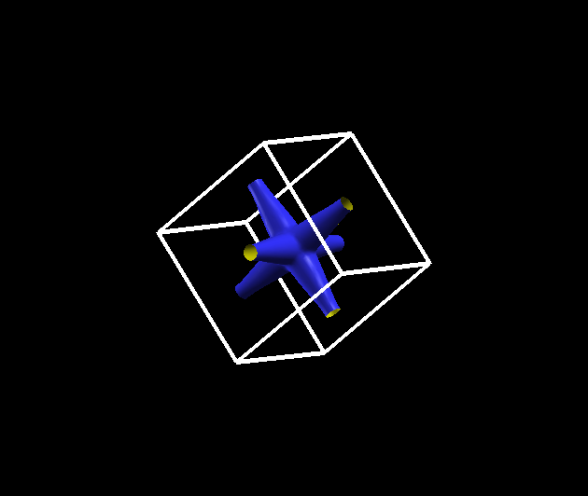
How to plot the Fermi surface using siesta and wannier90
Javier Junquera

Slide 2
We are going to plot the Fermi surface of electron-doped bulk SrTiO₃
To charge slightly the bulk unit cell of SrTiO₃, introduce the following line in the input file
NetCharge -0.10
Then, follow step by step all the process described in the exercise about the Wannier functions

Slide 3
How to plot the Fermi surface
wannier90 has produced a file called seedname.bxsf
xcrysden --bxsf SrTiO3.manifold.first.bxsf
Specify the Fermi energy in the dialog box
(it Will take directly the Fermi energy computed in siesta)
and type OK
Select the bands that cross the Fermi energy
(they cross an horizontal dashed line in the BARGraph).
In this example, they are the bands 10, 11, and 12

Slide 4
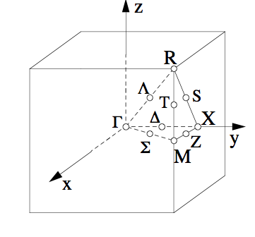
Fermi surface of electron doped SrTiO₃
The part of the conduction band that is occupied is along the ΓX line, as reflected by the Fermi surface

Slide 5
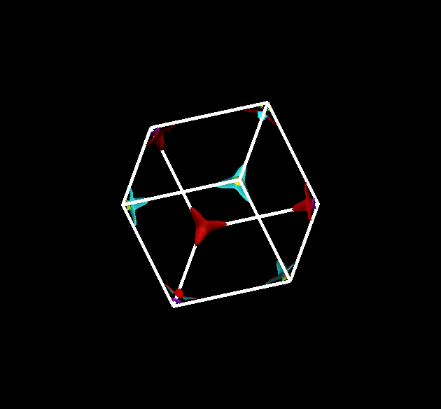
Repeat the exercise for a hole-doped system
The part of the valence band that is desoccupied is at the R point, as reflected by the Fermi surface

