Slide 1
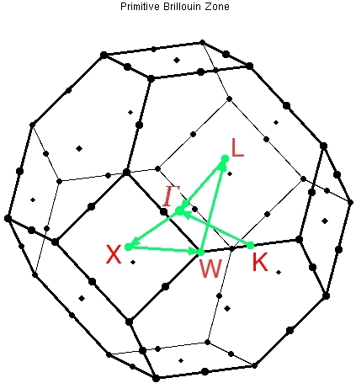

K-point sampling, smearing, metals
Javier Junquera
Shobhana Narasimhan
JNCASR, Bangalore, India
8th African School on Electronic Structure Methods and Applications
ASESMA 2025, Accra (Ghana), June 10th 2025

Slide 2

Bibliography used in the present lecture

Slide 3

Bibliography used in the present lecture

Slide 4
Periodic systems are idealizations of real systems
Conceptual problems
NO exactly periodic systems in Nature
(periodicity broken at the boundary)
BUT
- Condensed systems (solids, liquids, amorphous) and systems of lower dimensionalities (surfaces, wires, dots) are macroscopic objects constituted by a huge number of atoms (N_{A}=6×10²³). In fact they can be treated as infinity
- The great majority of the physical quantities are unaffected by the existence of a border. In other words, they are independent of the truncation of the sample’s surface. We should expect that the bulk properties to be unaffected by the presence of its surface.

Slide 5
Crystalline solids: an ordered state of matter in which the position of the nuclei are repeated periodically in space
Periodic repetition of a given unit
Rules that describe the repetition (translations)
Single atoms
Groups of atoms
Molecules
Ions
Specified by the types and positions of the nuclei in one repeated unit cell
Crystal structure = Bravais lattice + basis
(Ordered state of matter)
Notes:
A crystal is an ordered state of matter in which the position of the nuclei (and consequently all properties) are repeated periodically in space. It is completely specified by the types and the positions of the nuclei in one repeated unit (primitive unit cell), and the riles that describe the repetition (translations).
The positions and types of the atoms in the primitive cell are called the basis. The set of translations, which generates the entire periodic crystal by repeating the basis, is a lattice of points in space called the Bravais lattice. Specification of the crystal can be summarized as:
Crystal structure = Bravais lattice + basis.

Slide 6
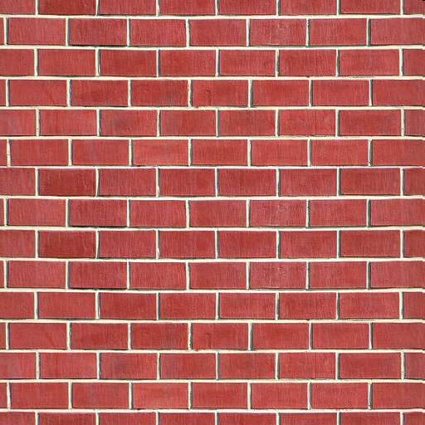
Crystalline solids: an ordered state of matter in which the position of the nuclei are repeated periodically in space
Periodic repetition of a given unit
Single atom
Groups of atoms
Molecules
Ions
Bravais lattice
Notes:
A crystal is an ordered state of matter in which the position of the nuclei (and consequently all properties are periodically repeated in space). It is completely specified by the types and the positions of the nuclei in one repeated unit (primitive unit cell), and the riles that describe the repetition (translations).
The positions and types of the atoms in the primitive cell are called the basis. The set of translations, which generates the entire periodic crystal by repeating the basis, is a lattice of points in space called the Bravais lattice. Specification of the crystal can be summarized as:
Crystal structure = Bravais lattice + basis.

Slide 7
There are infinitely many ways of characterizing a crystalline solid
Periodic repetition of a given unit
Infinite number of choices for the primitive translation vectors
Notes:
The cell is not unique, since there are an infinite number of possible choices for the primitive translation vectors.
Sometimes, it is convenient to describe the solid in terms of a cell containing more atoms than the unit cell (the conventional cell) in order to simplify the description of the symmetry properties, e.g., so that the lattice vectors are orthogonal.

Slide 8
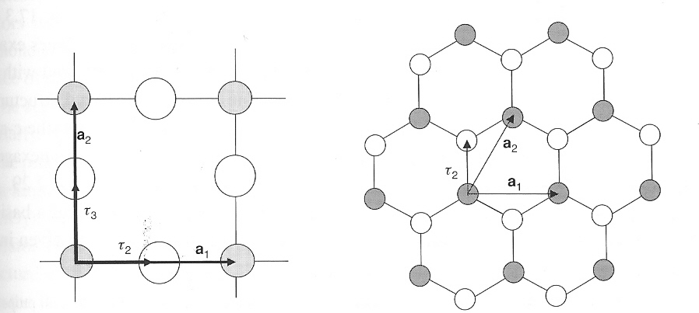
Examples of two dimensional periodic systems: square and triangular lattices
CuO₂ planes
Graphene
(Single plane of graphite)
Square lattice
Three atoms per unit cell
Triangular lattice
Two atoms per unit cell
Notes:
Square lattice for CuO2 planes common to the cuprate high-temperature superconductors: there are three atoms per primitive cell. Right: honeycomb lattice for a single plane of graphite in hexagonal BN: the lattice is triangular and there are two atoms per primitive cell

Slide 9

How can we simulate an infinite periodic solid? Periodic (Born-von Karman) boundary conditions
We should expect that the bulk properties to be unaffected by the presence of its surface.
A natural choice to emphasize the inconsequence of the surface by disposing of it altogether
Supercell +
Born-von Karman boundary conditions

Slide 10
Periodic systems are idealizations of real systems
Computational problems
In a periodic solid:
Number of atoms
Number and electrons
⇓
∞ Number of wave functions ??
2. Wave function will be extended over the entire solid
Bloch theorem will rescue us!!

Slide 11
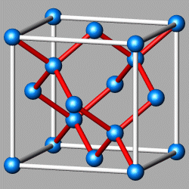
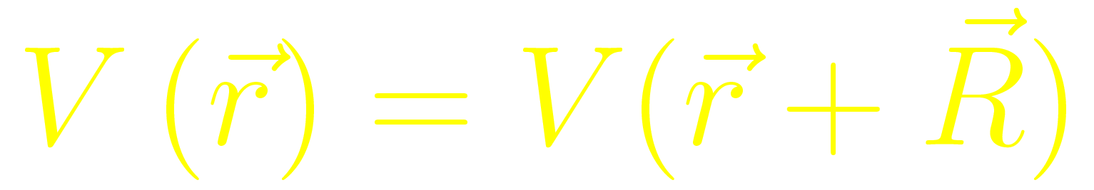
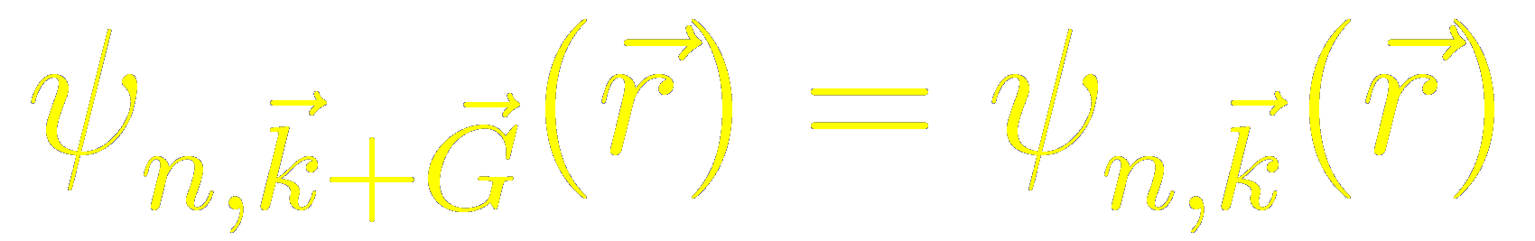
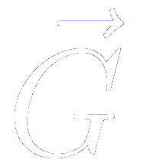
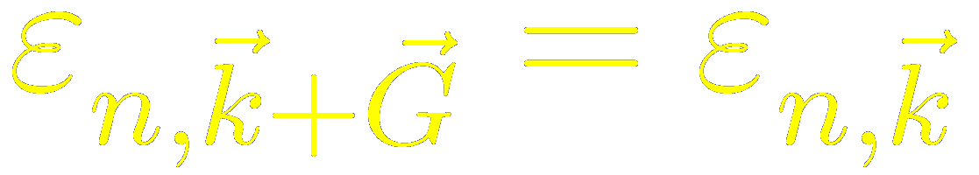
A periodic potential commensurate with the lattice. The Bloch theorem
Bloch Theorem: The eigenstates of the one-electron Hamiltonian in a periodic potential can be chosen to have the form of a plane wave times a function with the periodicity of the Bravais lattice.
Periodicity in reciprocal space
≡Reciprocal lattice vector

Slide 12


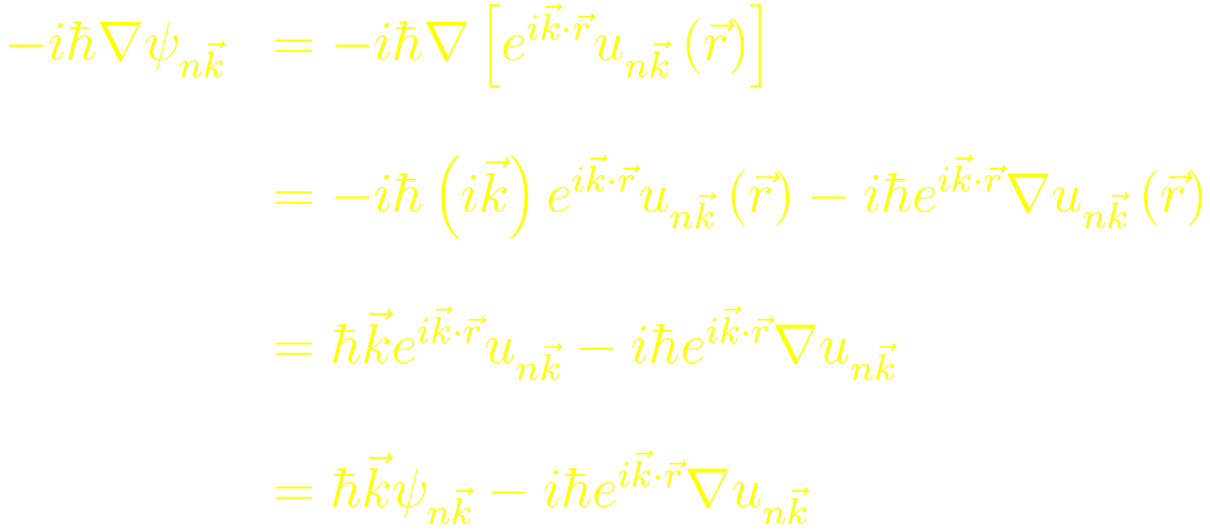


The Bloch wave functions are not eigenstates of the momentum operator
Bloch’s theorem introduces a wave vector which play a similar role to that of the free electron wave vector plays in the Sommerfeld theorem
However, in the periodic potential case
is not proportional to the electronic momentum
The Bloch wave function is not an eigenstate of the mometum operator
is known as the crystal momentum
(a natural extension of to the case of a periodic potential)

Slide 13

For a given there are many solutions to the Schrödinger equation, labeled by the band index
Look for all the solutions to the Schrödinger equation that have the Bloch form

Slide 14
For a given there are many solutions to the Schrödinger equation, labeled by the band index

Slide 15
For a given there are many solutions to the Schrödinger equation, labeled by the band index

Slide 16
For a given there are many solutions to the Schrödinger equation, labeled by the band index

Slide 17
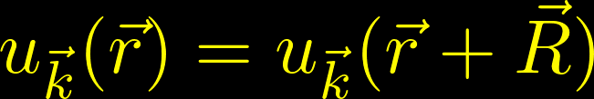

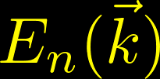
For a given there are many solutions to the Schrödinger equation, labeled by the band index
Hermititian eigenvalue problem restricted to a single primitive cell (fixed finite volume)
Infinite family of solutions with discretely spaced eigenvalues, that will be labelled with the band index
The wave vector appears as a parameter in the Hamiltonian
We expect each of the energy levels for a given to vary continuously as varies
We arrive at the description of the levels of an electron in a periodic potential in terms of a family of continuous functions
(ENERGY BANDS)

Slide 18

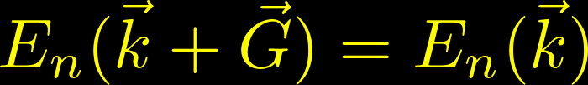



Both the Bloch wave functions and the eigenvalues are periodic functions in reciprocal space
The wave vector appearing in Bloch’s theorem can always be confined to the first Brillouin zone
Any vector not in the first Brillouin zone can be written as
where is a reciprocal lattice vector and lie in the first Brillouin zone

Slide 19
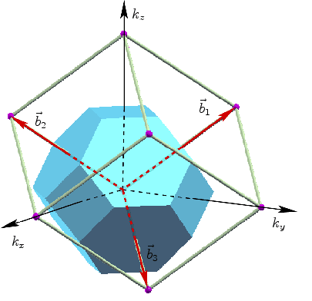
Concept of Brillouin zone
Wigner-Seitz cell in reciprocal space.
(Or could choose to use parallelepiped defined by b₁, b₂, b₃)
e.g., 1st BZ for FCC
lattice →
(www.iue.tuwien.ac.at)

Slide 20







The energy eigenfunctions are periodic functions of the wave vectors of the Bloch waves
Demonstration

Slide 21



The energy eigenvalues are periodic functions of the wave vectors of the Bloch waves
Demonstration
But since
So, finally, comparing the first equation with this last one

Slide 22

Upper and lower bounds in the band structure
Since the bands are periodic in and continuous,
they have an upper and lower bound,
so that all the levels lie in the band of energyes lying between these limits

Slide 23
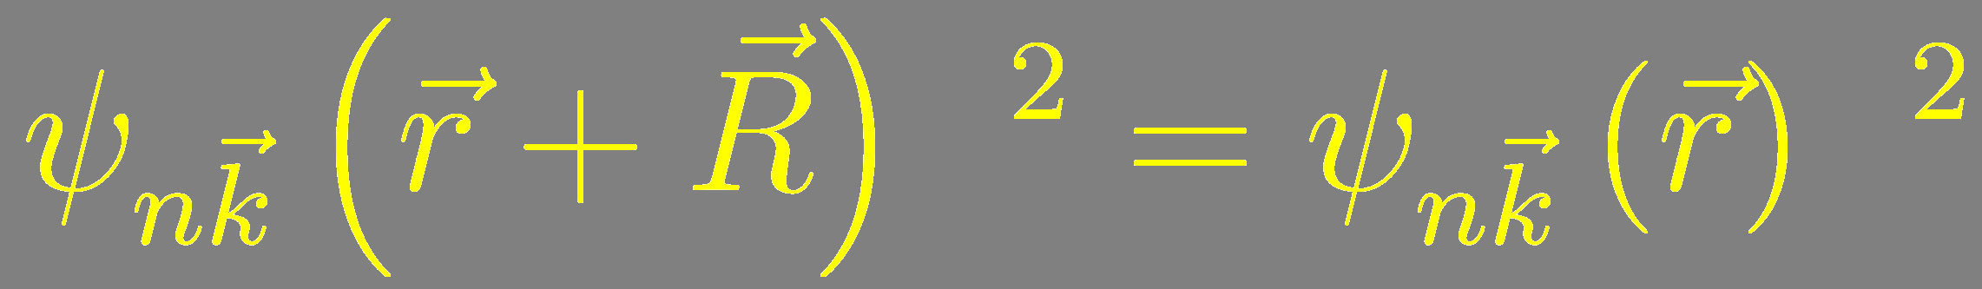
Bloch functions are not periodic in real space
Bloch functions are not periodic in real space
Its square (associated with the probability of finding an electron in a given position) is periodic

Slide 24
The wave vector k and the band index n allow us to label each electron (good quantum numbers)
The Bloch theorem changes the problem
Instead of computing an infinite number of electronic wave functions
Finite number of wave functions at an infinite number of k-points in the 1BZ

Slide 25
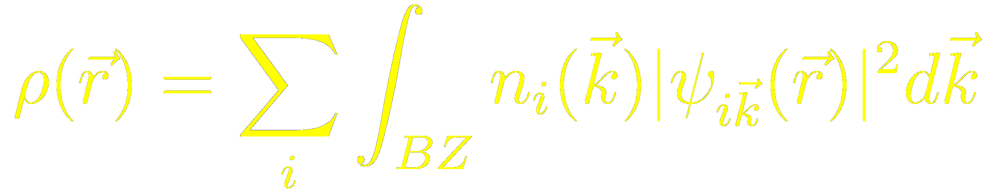
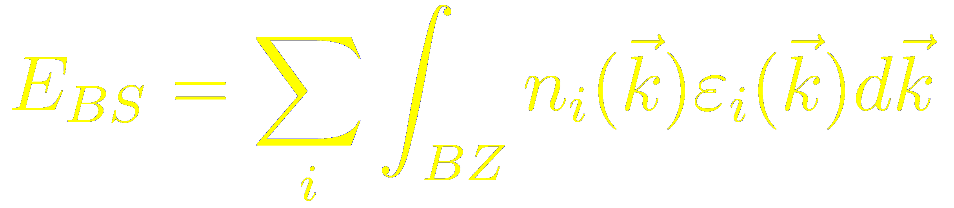
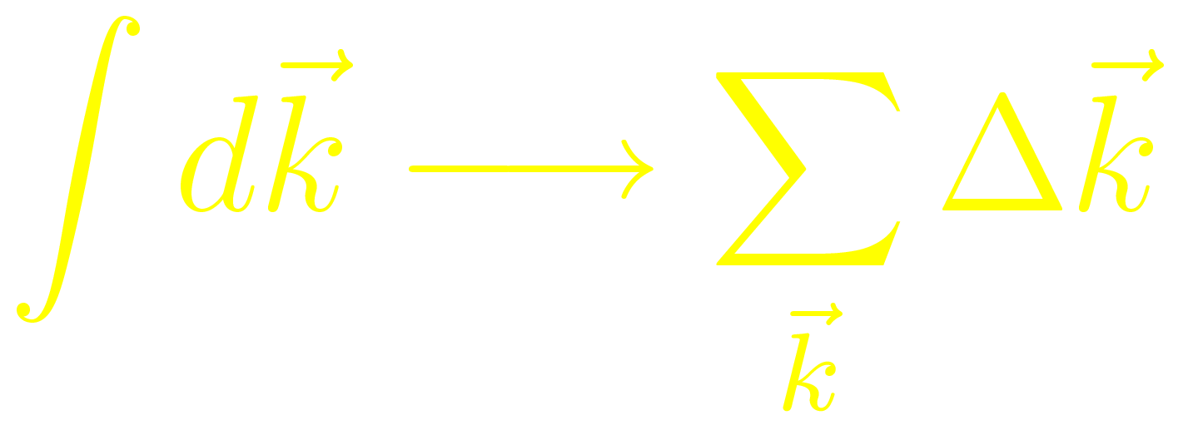
Many magnitudes require integration of Bloch functions over Brillouin zone (1BZ)
Charge density
Band structure energy
In principle: we should know the eigenvalues and/or eigenvectors at all the k-points in the first BZ
In practice: electronic wave functions at k-points that are very close together will be almost identical ⇒
It is possible to represent electronic wave functions over a region of k-space by the wave function at a single k-point.
Brillouin zone sampling

Slide 26
Brillouin zone sampling
In practice, sum over a finite number: BZ “sampling”
For computational reasons, we want the number of k’s to be small
Number needed depends on band structure
Need to test convergence with respect to the k-point sampling

Slide 27
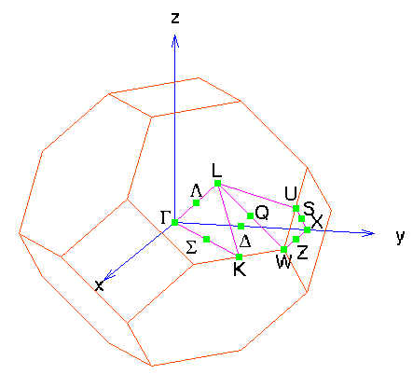
Irreducible Brillouin zone
Smallest wedge of the 1st BZ such that any wave-vector k in the 1st BZ can be obtained from a wave-vector k in the IBZ by performing symmetry operations of the crystal structure.
k
This wedge is the
Irreducible Brillouin zone.
e.g., for FCC
lattice
k
k
cst-www.nrl.navy.mil

Slide 28
Using the Irreducible BZ:
Weights
Need not sum over k’s in entire BZ;
can restrict to Irreducible BZ, with appropriate weights
e.g., for FCC
k
Count this 8 x ½ = 4 times.
Count this only once.
k
k
Count this 48 times.
cst-www.nrl.navy.mil

Slide 29
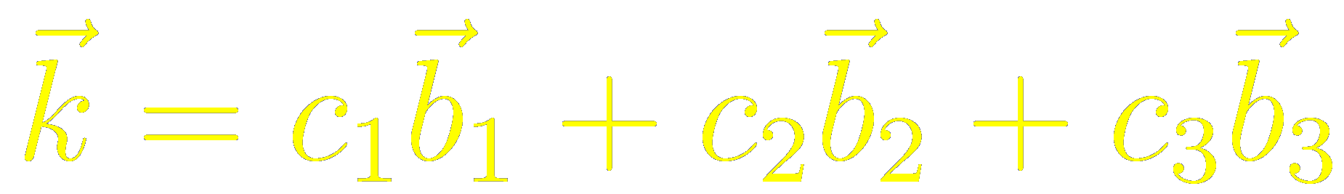
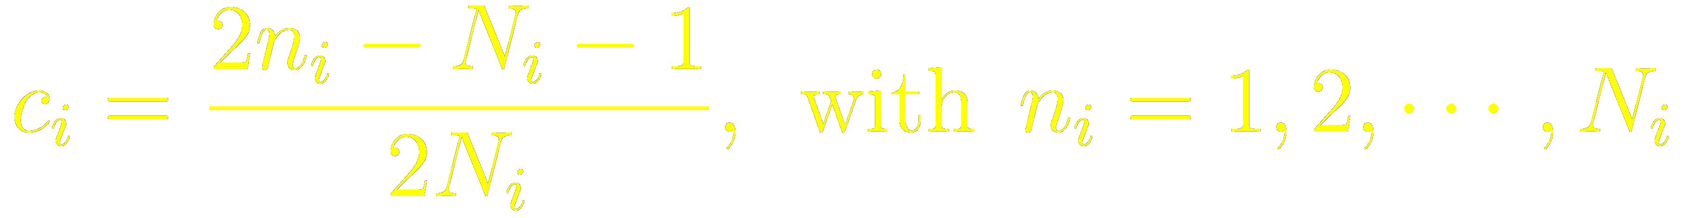
Recipes to compute sets of spetial k-points for the different symmetries to accelate the convergence of BZ integrations
Using just one k-point
Baldereschi and the “mean value point”
Phys. Rev. B 7 5212 (1973)
A few k-points chosen to give optimally fast convergence
Chadi and Cohen
Phys. Rev. B 8 5747 (1973)
Monkhorst-Pack
Phys. Rev. B 13 5188 (1976)
The magnitude of the error introduced by sampling the Brillouin zone with a finite number of k-points can always be reduced by using a denser set of points

Slide 30
Monkhorst-Pack k-points
Uniformly spaced grid of nk1 × nk2 × nk3 points in 1st BZ
nk1=nk2=3
nk1=nk2=4
b₂
b₂
b₁
b₁
Note: This is slightly different from way grid defined in original paper
[Phys. Rev. B 13 5188 (1976)]
where odd/even grids include/don’t include the zone center Γ

Slide 31
Unshifted & Shifted Grids
Can choose to shift grid so that it is not centered at Γ
Can get comparable accuracy with fewer k-points in IBZ
For some Bravais lattice types, shifted grid may not hav full symmetry
b₂
b₂
unshifted
shifted
b₁
b₁

Slide 32
Why it might be better to use a shifted grid
Unshifted
10 pts in IBZ
Shifted
6 pts in IBZ

Slide 33

The number of citations allow us to gauge the importance of the works on DFT
11 papers published in APS journals since 1893 with >1000 citations in APS journals (~5 times as many references in all science journals)
From Physics Today, June, 2005

Slide 34
Choosing grid divisions
Space grid in a way (approximately) commensurate with length of primitive reciprocal lattice vectors b’s.
Remember that dimensions in reciprocal space are the inverse of the dimensions in real space!
y
k_{y}
x
k_{x}

Slide 35
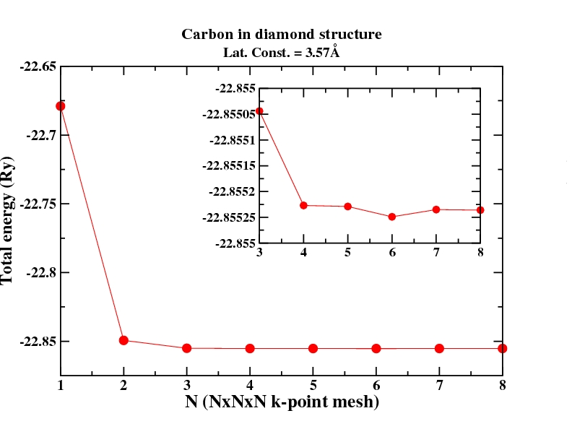
Convergence with respect to BZ sampling
Madhura Marathe
Note: Differences in energy usually converge faster than absolute value of total energy because of error cancellation (if supercells & k-points are identical or commensurate).

Slide 36
Comparing energies of structures having different symmetries: take care of BZ samplings
The BZ sampling of all the structures must be sampled with the same accuracy
Since for unit cells of different shapes it is not possible to choose exactly the same k-point sampling, a usual strategy is to try and maintain the same density of k-points

Slide 37
Convergence with respect to BZ sampling
Adsorption energy of CO on Ir(100):
Ghosh, Narasimhan, Jenkins, and King, J. Chem. Phys. 126 244701 (2007).

Slide 38
When the sampling in k is essential?
Small systems
Metals
Magnetic systems
Good description of the Bloch states at the Fermi level
Real space ↔Reciprocal space
Even in same insulators:
Perovskite oxides

Slide 39
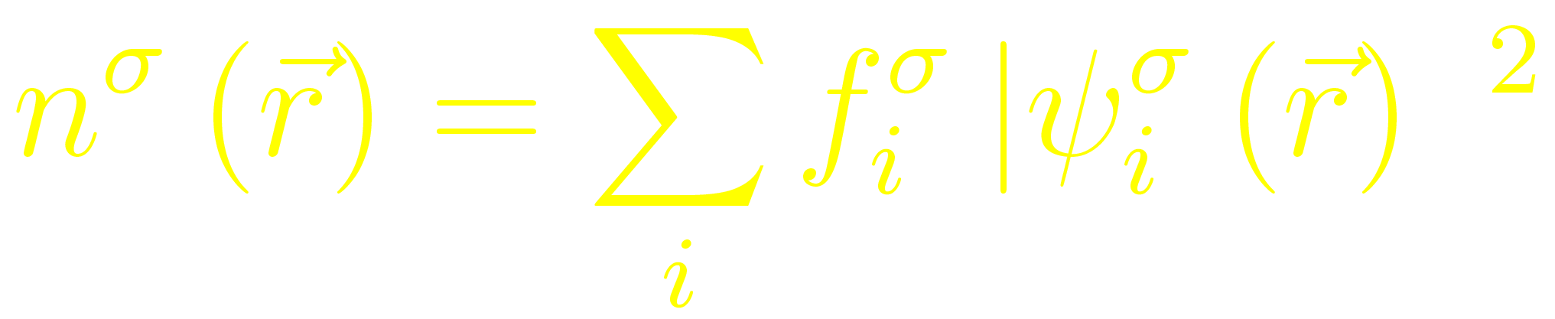

The one-particle eigenstates are filled following the “Aufbau” principle: from lower to higher energies
Occupation numbers
The ground state has one (or two if spin independent) in each of the orbitals with the lowest eigenvalues

Slide 40
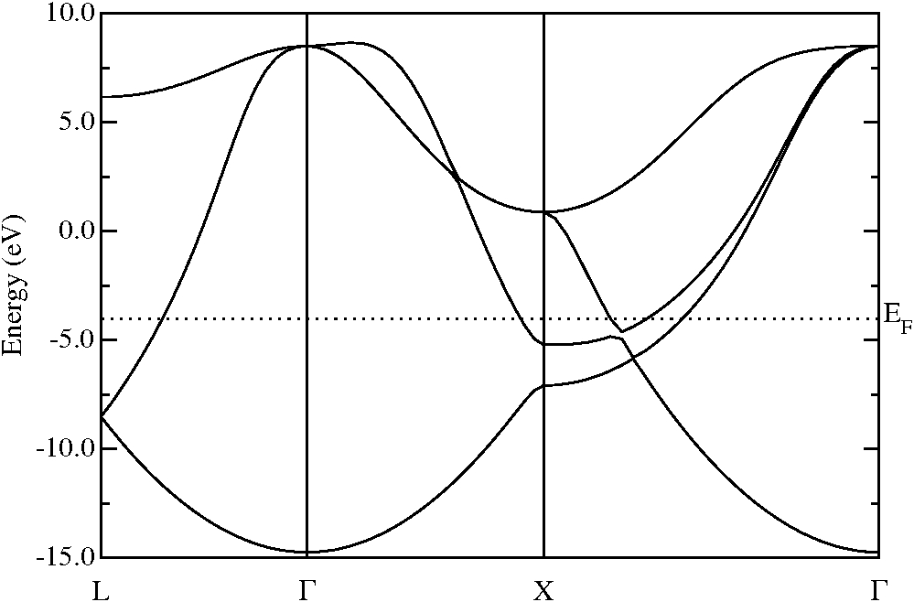
Fermi surface sampling for metallic systems
The determination of the Fermi level might be delicate for metallic systems
Band structure of bulk Al
For this k-point, three bands are occupied
For this k-point, two bands are occupied
For this k-point, one band is occupied
Slightly different choices of k-points can lead to bands entering or exiting the sum, depending if a given eigenvalue is above or below the Fermi level.
For a sufficiently dense Brillouin zone sampling, this should not be a problem

Slide 41
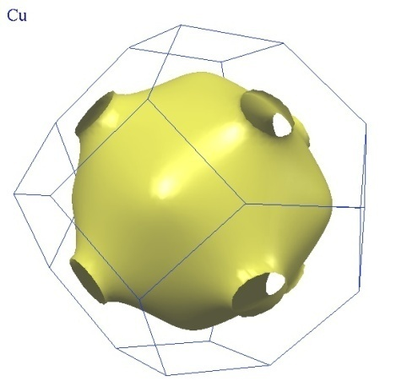
Problems with metals
Recall:
For metals, at T=0, this corresponds to (for highest band) an integral over all wave-vectors contained within the Fermi surface, i.e., for highest band, sharp discontinuity in k-space between occupied and unoccupied states…need many k-points to reproduce this accurately.
Fermi Surface of Cu
iramis.cea.fr

Slide 42

Problems with metals
The basic problem is that anything with sharp edges or features can’t be reproduced well if it is sampled coarsely…
…So smear out the quantity we are sampling into something that can be sampled coarsely…
but of course…
the procedure of smearing out may lead to errors…

Slide 43
The Free Energy
When occupying with a finite T distribution, what is variational (minimal) w.r.t. wavefunctions and occupations is not E but F=E-TS
What we actually want is Ε (σ→0)
E(σ→0) = ½ (F+E) (deviation O(T³))
Mermin, Phys. Rev. 137 A1441 (1965).
Gillan, J. Phys. Condens. Matter 1 689 (1989).

Slide 44
Difficulties in the convergence of the self-consistence procedure with metals: smearing the Fermi surface
For the k-points close to the Fermi surface, the highest occupied bands can enter or exit the sums from one iterative step to the next, just because the adjustement of the Fermi energy
⇓
Instability of the self-consistent procedure
Solution 1: Use small self-consistent mixing coefficients
Solution 2: Smear the Fermi surface introducing a distribution of occupation number The occupations are not any longer 1 (if below E_{F}) or 0 (if above E_{F})

Slide 45

A Smear Campaign!
Problems arise because of sharp discontinuity at Fermi surface / Fermi energy.
“Smear” this out using a smooth operator!
Will now converge faster w.r.t. number of k-points (but not necessarily to the right answer!)
The larger the smearing, the quicker the convergence w.r.t. number of k-points, but the greater the error introduced.
PhD Comics

Slide 46
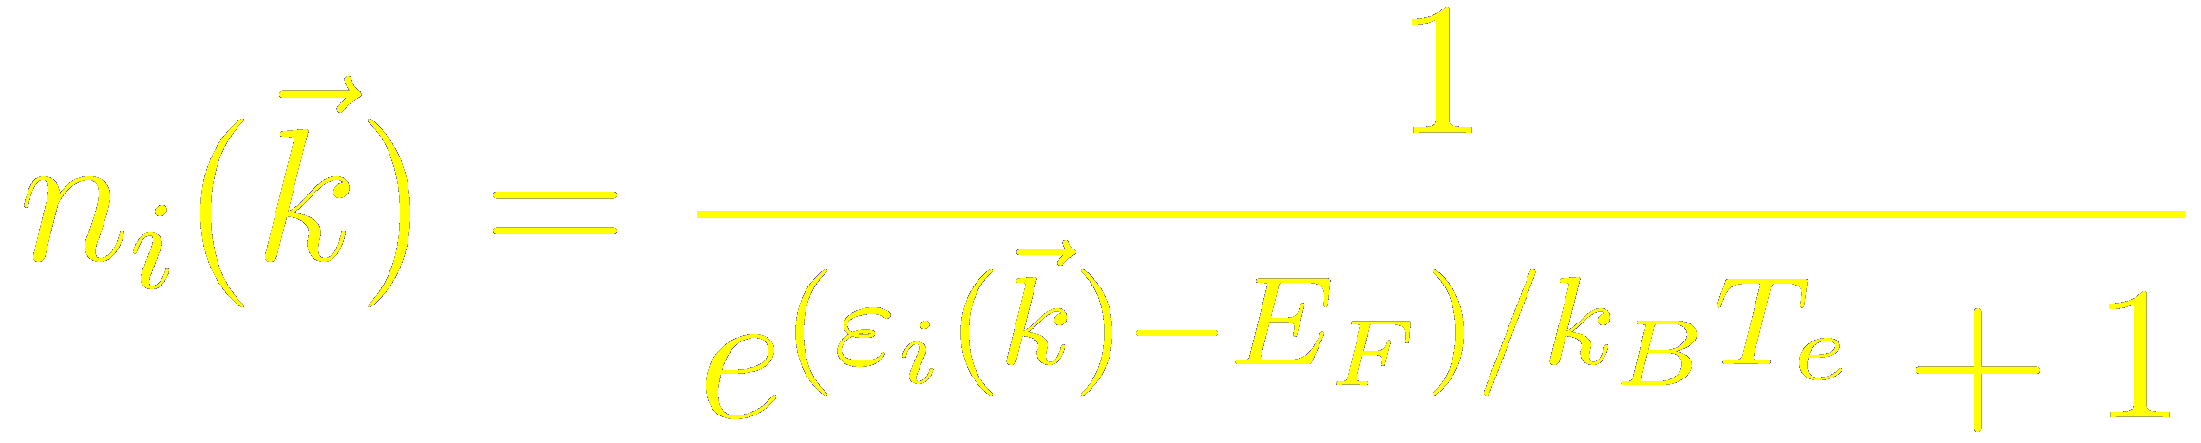
Difficulties in the convergence of the self-consistence procedure with metals: smearing the Fermi surface
For the k-points close to the Fermi surface, the highest occupied bands can enter or exit the sums from one iterative step to the next, just because the adjustement of the Fermi energy
⇓
Instability of the self-consistent procedure
Solution 1: Use small self-consistent mixing coefficients
Solution 2: Smear the Fermi surface introducing a distribution of occupation number The occupations are not any longer 1 (if below E_{F}) or 0 (if above E_{F})
Gaussians
C. –L. Fu and K. –M. Ho, Phys. Rev. B 28, 5480 (1989)
Fermi functions

Slide 47
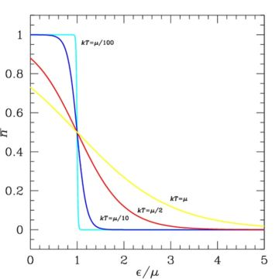
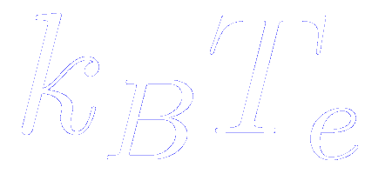
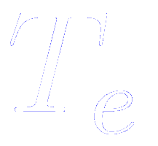
Smearing the Fermi surface: the Electronic Temperature
is a broadening energy parameter that is adjusted to avoid instabilities in the convergence of the self-consistent procedure. It is a technical issue. Due to its analogy with the Fermi distribution, this parameter is called the Electronic Temperature
For a finite , the BZ integrals converge faster but to incorrect values. After self-consistency has been obtained for a relatively large value of , this has to be reduced until the energy becomes independent of it.

Slide 48
Gaussian Smearing
Think of the step function as an integral of δ-fn.
Replace sharp δ-fn. by smooth gaussian….
(this is what you get if you integrate a Gaussian)
Now have a generalized free energy …E-TS,
where S is a generalized entropy term.
Converges faster (w.r.t. k-mesh) than Fermi-Dirac.
Problem: need not converge to the right value, can get errors in forces.
Want: fast convergence w.r.t. k-mesh to right answer!

Slide 49
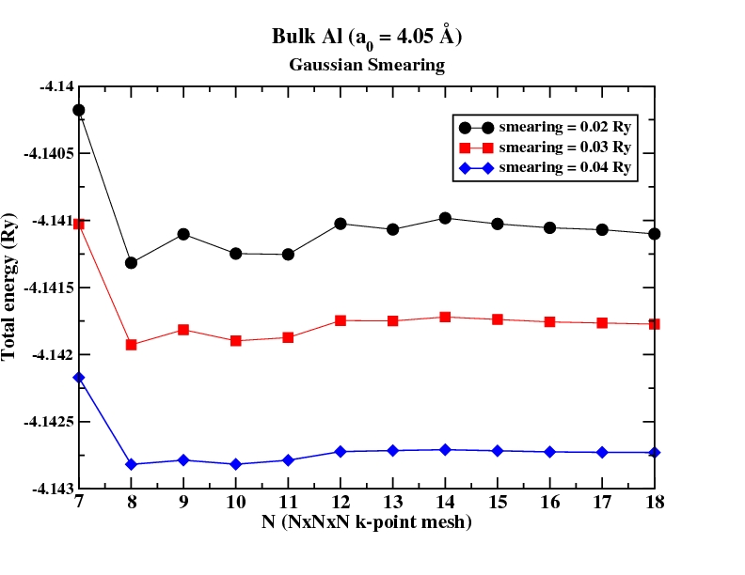
Convergence with respect to grid and smearing
Gaussian smearing
Madhura Marathe

Slide 50
Better Smearing Functions
Methfessel & Paxton:
Methfessel & Paxton, Phys. Rev. B 40 3616 (1989)
Can have a successive series of better (but smooth) approximations to the step function.
E converges fast [with respect to σ] to Ε (σ→0)
Marzari & Vanderbilt:
Marzari & Vanderbilt, Phys Rev. Lett. 82, 3296 (1999).
Unlike Methfessel-Paxton, don’t have negative occupancies.

Slide 51
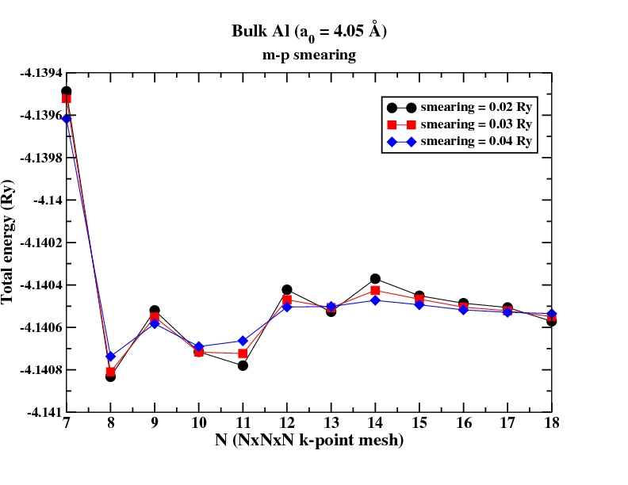
Convergence wrt grid & smearing
Gaussian
Methfessel-Paxton:
represents an energy difference of 1 mRy
Madhura Marathe

Slide 52
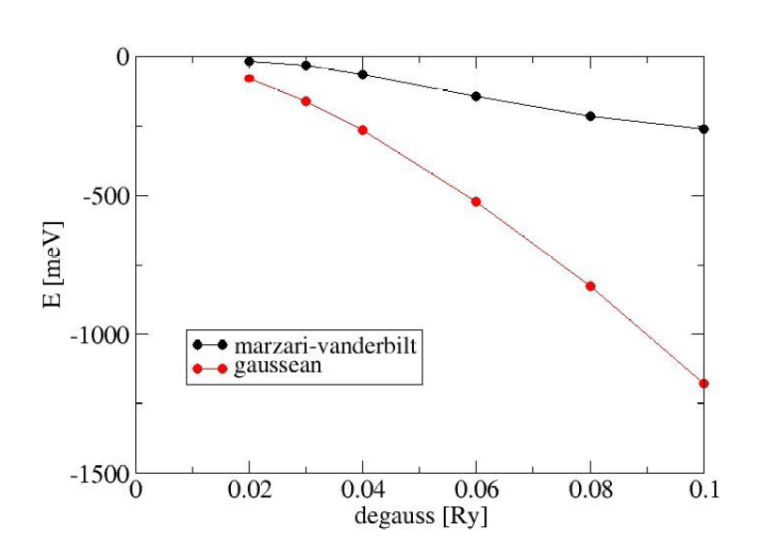
Convergence with respect to k-points and smearing width
e.g., for bcc Fe, using 14 ×14 × 14 grid:
R. Gebauer

Slide 53
Smearing for molecules
Consider a molecule where HOMO is multiply degenerate and only partially occupied.
If we don’t permit fractional occupancies…the code will occupy only one (or some) of the degenerate states, resulting in wrong symmetry.
Smearing will fix this problem.

Slide 54
Intrinsically aperiodic systems simulated with periodic boundary conditions: the supercell approach
How can we simulate systems where the periodicity is broken?
- Defects:
Point defects (interstitials, vacancies,…)
Extended defects (surfaces, edges, steps,…)
- Molecules or clusters
Solution:
Supercell approach + periodic boundary conditions
Make sure that the physical and chemical properties are converged with respect to the size of the supercell

Slide 55
The supercell approach for molecules or clusters
Introduce a vacuum region that should be large enough that periodic images corresponding to adjacent replicas of the supercell do not interact significantly
Make sure that the physical and chemical properties are converged with respect to the size of the supercell
M. C. Payne et al., Rev. Mod. Phys. 64, 1045 (1992)
Sometimes convergence is difficult to achieve
Charged molecules: the electrostatic energy of an infinitely periodically replicated charged system diverges.
Typical solution: compensate the charge with a uniformly spread of background charge of opposite sign (a jellium)
In Siesta, use the input variable NetCharge (for SC, FCC, BCC)

Slide 56
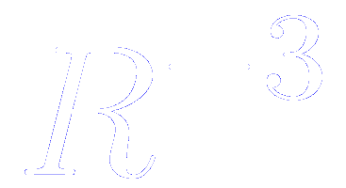

The supercell approach for molecules or clusters
Introduce a vacuum region that should be large enough that periodic images corresponding to adjacent replicas of the supercell do not interact significantly
Make sure that the physical and chemical properties are converged with respect to the size of the supercell
M. C. Payne et al., Rev. Mod. Phys. 64, 1045 (1992)
Sometimes convergence is difficult to achieve
Neutral polar molecules: the electrostatic interaction between dipoles decays as and the quadropole-quadropole interaction decays as
Mechanism to eliminate the undesired inter-cell interactions can be devised modifying the Poisson equation that determines the electrostatic potential.
G. Makov and M. C. Payne, Phys. Rev. B 51, 4014 (1995)

Slide 57
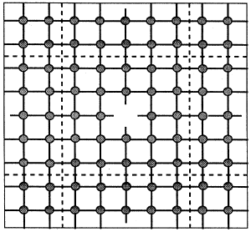
The supercell approach for point defects
Introduce a piece of bulk. The amount of bulk should be large enough that the periodic images of the defect do not interact significantly
Charged defects present the same problems of convergence as charged molecules
M. C. Payne et al., Rev. Mod. Phys. 64, 1045 (1992)

Slide 58
The supercell approach for surfaces: the slab geometry
The semi-infinite bulk is represented by a slab with two surfaces
The slab has to be large enough that the two surfaces do not interact with each other
The vacuum between periodic replicas has also to be large enough, specially in charged or polarized slabs
M. C. Payne et al., Rev. Mod. Phys. 64, 1045 (1992)
Usually, semiconductor and insulators require larger supercells than metals

Slide 59
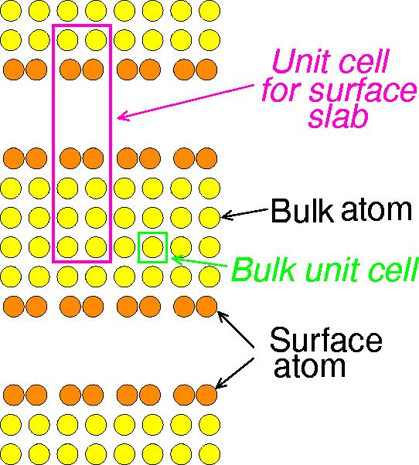
Choosing grid divisions
For artificially periodic supercells, choose only 1 division along the dimensions that have been extended (in real space) by introducing vacuum region.
k_{z}
z
k_{x}
x

Slide 60
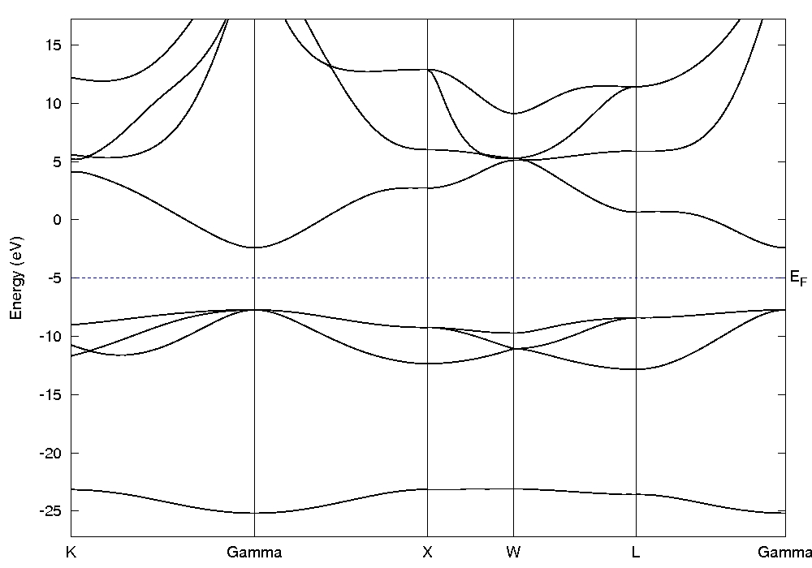
Once SCF has been achieved, we compute the bands along the high symmetry points in the First-Brillouin zone
The Fermi energy lies in a gap ⇒ insulator
Theo. direct gap = 5.3 eV
Expt. Gap = 7.8 eV
(LDA band gap understimation)
MgO band structure

Slide 61
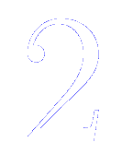

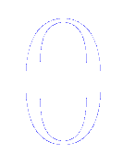
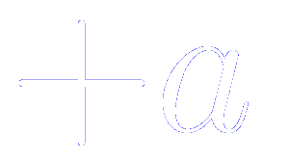
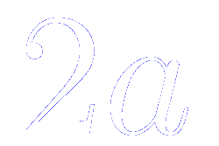

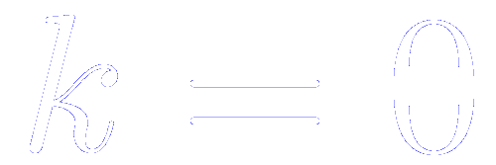
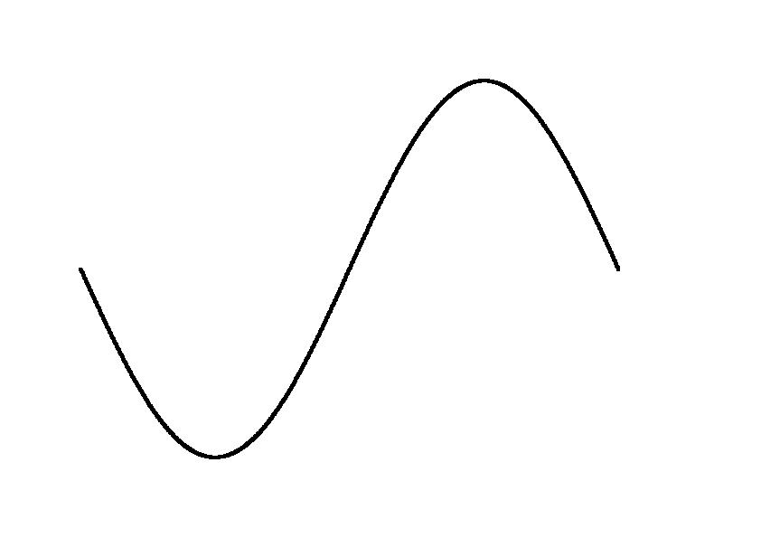
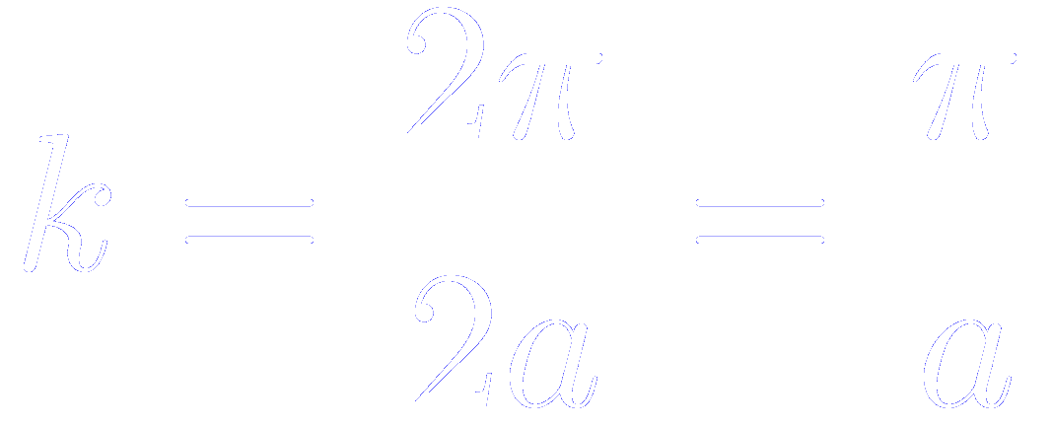
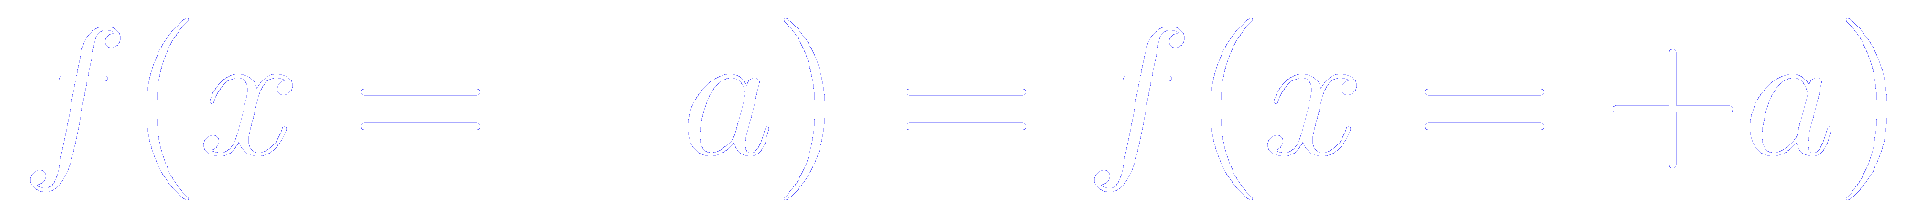
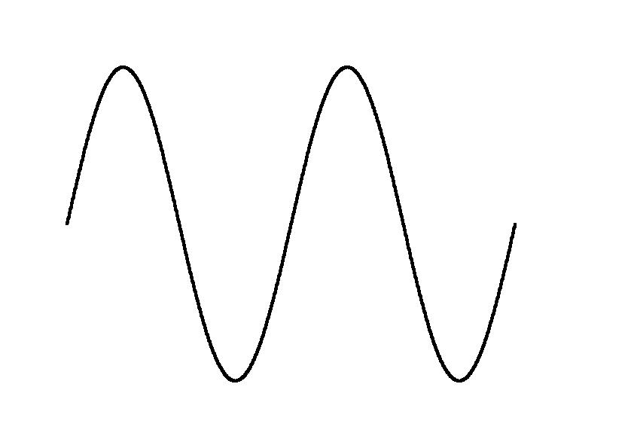
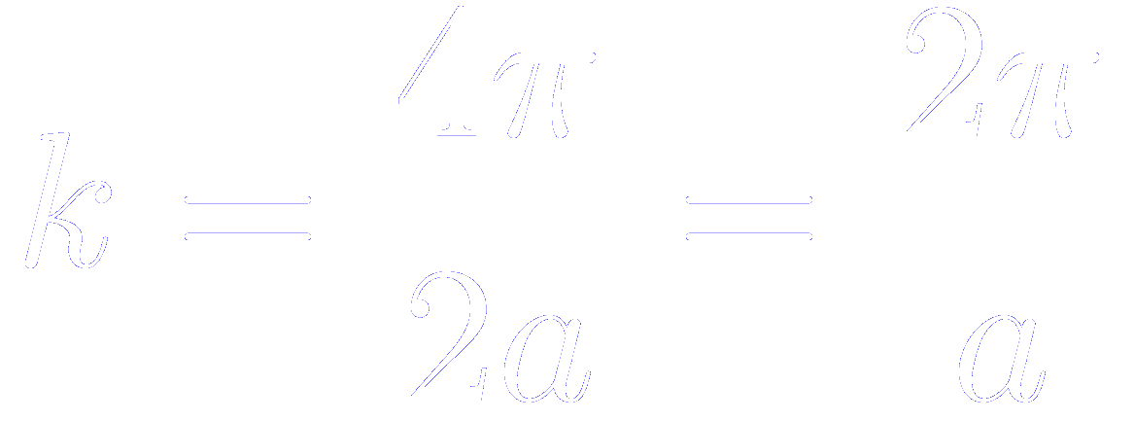
The Born-von Karman boundary condition allows the expansion of physical quantities in Fourier series
Let us assume that our supercell is made of the repetition of unit cells along x
Within the Born-von Karman approximation, every physical quantity at the left and the right border has to be equal
Thanks to this periodicity, we can represent the physical quantity in a Fourier series, in the set of all the plane waves that satisfy the boundary condition

Slide 62
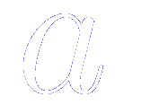
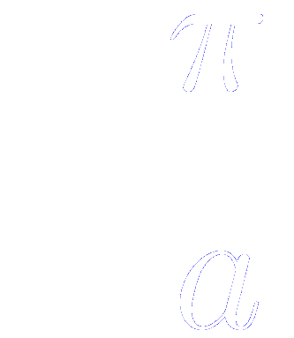
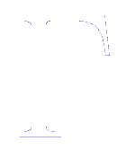
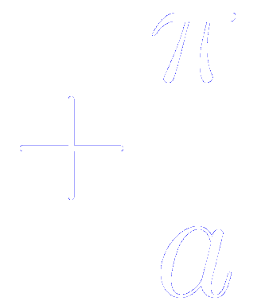
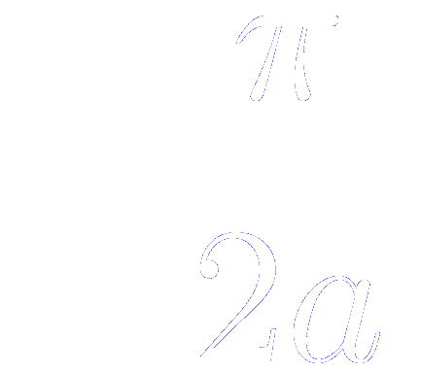



Relations between unit cell and supercells in real and reciprocal space
Let us assume that our supercell is made of the repetition of unit cells along x
Unit cell
Supercell
Real space
First Brillouin zone of the unit cell
First Brillouin zone of the supercell
Reciprocal space
Reciprocal lattice vectors

Slide 63


The larger BZ of the unit cell can be reproduced by repeating the smaller BZ of the supercell using the reciprocal vectors
Let us assume that our supercell is made of the repetition of unit cells along x
First Brillouin zone of the unit cell
First Brillouin zone of the supercell
Reciprocal space
Reciprocal lattice vectors
Repeating this process for all the points in the first BZ of the supercell, we can reproduce the BZ of the unitcell

Slide 64
The choice of a larger supercell is equivalent to considering the unit cell, but with a finer sampling of its BZ
Let us assume that our supercell is made of the repetition of unit cells along x
Unit cell
Supercell
The Γ point of the supercell refolds onto two k-points of the BZ of the unit cell
Suppose that the supercell was sampled with the Γ point only

Slide 65


Taking the thermodyncamic limit (infinitely large supercell)
Let us assume that our supercell is made of the repetition of unit cells along x
Unit cell
Supercell
Its repetition implies a uniform and infinitely fine sampling of the BZ of the unit cell
The BZ becomes a single point, the Γ point only

Slide 66


Reciprocity of Supercells in real space and BZ Sampling
Increase supercell in real space by a factor N_{i} along a_{i}
EXACTLY same results obtained by reducing number of divisions in k mesh (in the new smaller BZ) by factor N_{i} .
E
y
x
k_{y}
k_{x}
k_{x}

Slide 67
Advantages and disadvantages of the supercell approach to simulate a solid
Advantages
Disadvantages
The supercell approach is useful when atomic rearrangements beyond the size of the unit cell are expected.
The equivalent k-points in the unit cell can not be chosen at will. They are univocally determined by the shape of the supercell.
The symmetry of the unit cell, that allows the use of irreducible wedges of the BZ, may not be necessarily exploited.
A large supercell implies a larger number of electrons and basis functions (more expensive calculations), that does not compensate for the smaller number of k-points required in the BZ sampling.

Slide 68


When choosing a supercell, try to preserve the symmetry0f the underlying unit cell.
Real Space
Reciprocal Space
b
b*
a
a*
Hexagonal lattice
Reciprocal lattice vectors

Slide 69
When choosing a supercell, try to preserve the symmetry0f the underlying unit cell.
Real Space
Reciprocal Space
b
b*
a
a*
Monkhorst-Pack SuperCell
Reciprocal Space

Slide 70
When choosing a supercell, try to preserve the symmetry0f the underlying unit cell.
Real Space
Reciprocal Space
b
b*
a
a*
Monkhorst-Pack SuperCell
Reciprocal Space
4 k-points in 1BZ
Symmetry is kept

Slide 71

When choosing a supercell, try to preserve the symmetry0f the underlying unit cell.
Otherwise, the refolded images of the k-points explicitly included will break the symmetry, inducing spurious geometrical distortions
Monkhorst-Pack SuperCell

Slide 72
When choosing a supercell, try to preserve the symmetry0f the underlying unit cell.
Otherwise, the refolded images of the k-points explicitly included will break the symmetry, inducing spurious geometrical distortions
Monkhorst-Pack SuperCell
4 k-points in 1BZ
Symmetry is broken

Slide 73
Summary
For extended systems, need to sum over BZ
Smaller the cell in real space, larger # k-points needed
Always need to test for convergence with respect to k-points
More k-points needed for metals than insulators
Problems with metals can be aided by “smearing”
All of this is true for all DFT codes (not special for plane waves & pseudopotentials)

Slide 74
How to set up the k-point sampling in Siesta
Spetial set of k-points: Accurate results for a small number of k-points
  Monkhorst-Pack
Variables that control the fineness of the grid
kgrid_cutoff
      kgrid_cutoff 10.0 Ang
kgrid_Monkhorst_Pack
      %block kgrid_Monkhorst_Pack
      4 0 0 0.5
        0 4 0 0.5
        0 0 4 0.5
      %endblock kgrid_Monkhorst_Pack
A real-space radius that plays a role equivalent to the plane-wave cutoff in real space grids
(Moreno and Soler 92)
The origin of the k-grid might be displaced to reduce the number of inequivalent k-points

Slide 75
Once SCF has been achieved, we compute the bands along the high symmetry points in the First-Brillouin zone
First-Brillouin zone of a FCC , with the high symmetry points
New variables to plot the band structure

