Slide 1

Molecular dynamics in the microcanonical (NVE) ensemble: the Verlet algorithm
Javier Junquera

Slide 2
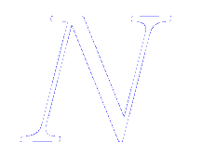


Equations of motion for atomic systems in cartesian coordinates
Classical equation of motion for a system of molecules interacting via a potential
This equation also aplies to the center of mass motion of a molecule, with the force begin the total external force acting on it

Slide 3
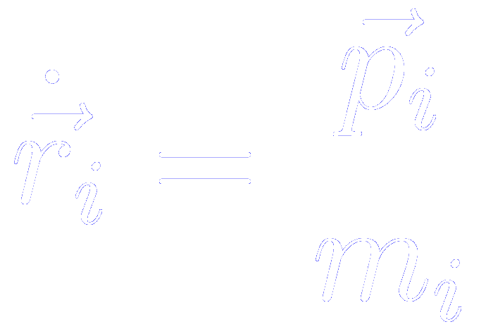
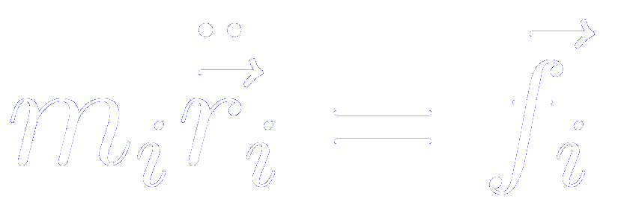
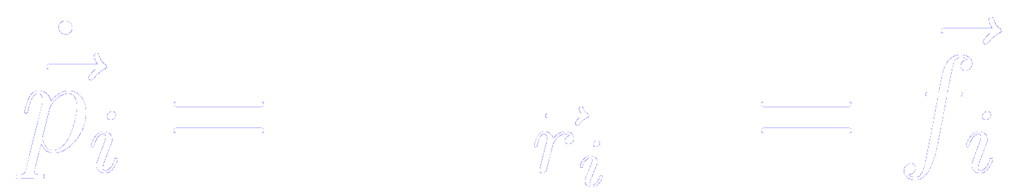
Hamilton or Lagrange equations of motion
Lagrange’s equation
Hamilton’s equations
To compute the center of mass trajectories involves solving…
A system of 3N second order differential equations
Or an equivalent set of 6N first-order differential equations

Slide 4
Hamilton or Lagrange equations of motion
Lagrange’s equation
Hamilton’s equations
To compute the center of mass trajectories involves solving…
A system of 3N second order differential equations
Or an equivalent set of 6N first-order differential equations

Slide 5

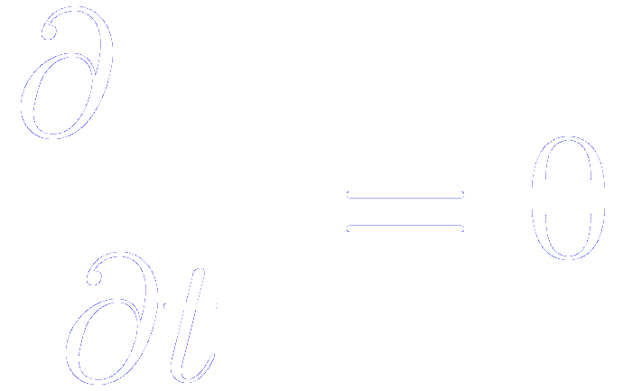
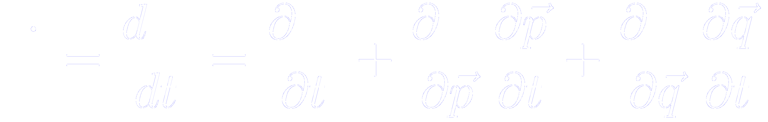
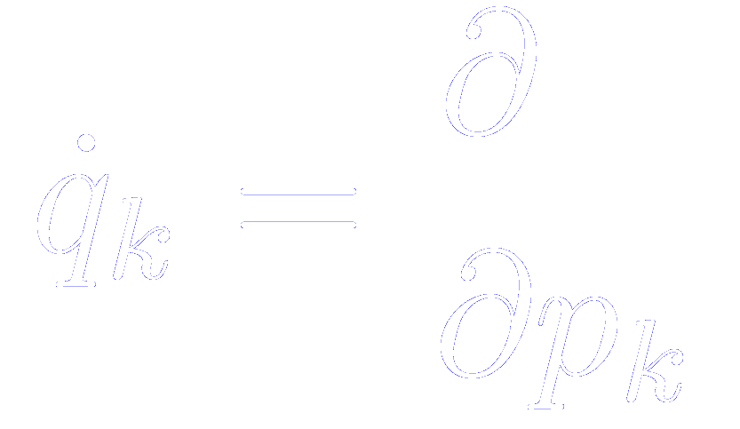
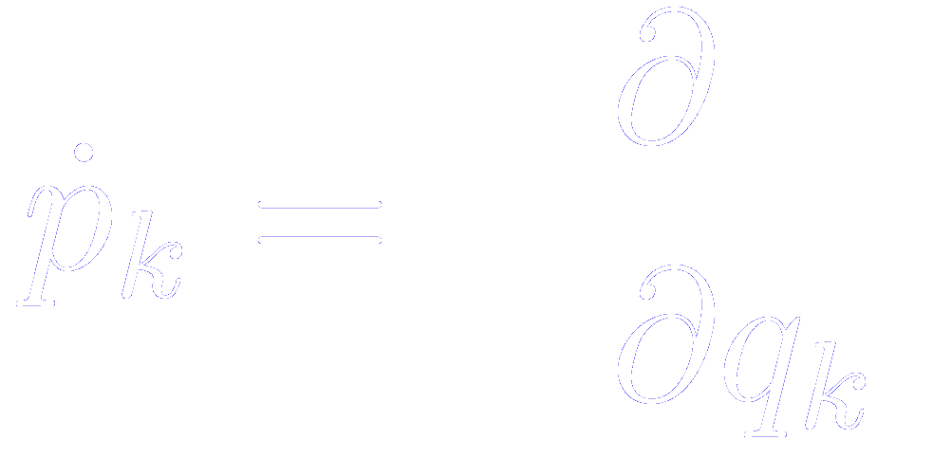
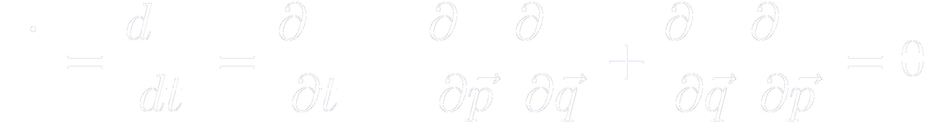
Conservation laws
Assuming that and do not depend explicitly on time, so that
Essential condition:
No explicitly time dependent or velocity dependent force acting
Then, the total derivative of the Hamiltonian with respect to time
From the Hamilton’s equation of motion
The Hamiltonian is a constant of motion
Independent of the existence of an external potential

Slide 6
The equations are time reversible
By changing the signs of all the velocities and momenta, we will cause the molecules to retrace their trajectories.
If the equations of motion are solved correctly, the computer-generated trajectories will also have this property

Slide 7
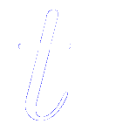
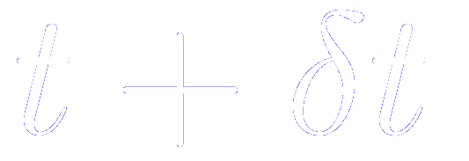
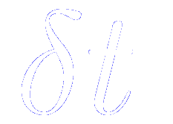
Standard method to solve ordinary differential equations: the finite difference approach
Given molecular positions, velocities, and other dynamic information at a time
We attempt to obtain the position, velocities, etc. at a later time , to a sufficient degree of accuracy
h=δt
t₀
t₁
t₂
t_{n-1}
t_{n}
t_{n+1}
t_{N}
Notes:
The equations are solved on a step by step basis
The choice of the time interval will depend on the method of solution, but will be significantly smaller than the typical time taken for a molecule to travel its own length

Slide 8
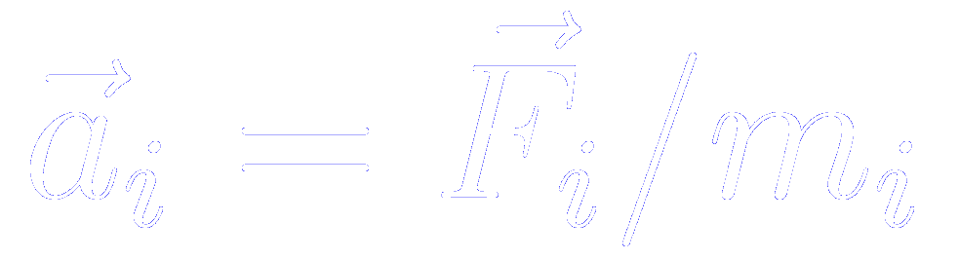
General step of a stepwise Molecular Dynamics simulation
Predict the positions, velocities, accelerations, etc. at a time , using the current values of these quantities
Evaluate the forces, and hence the accelerations from the new positions
Correct the predicted positions, velocities, accelerations, etc. using the new accelerations
Calculate any variable of interest, such as the energy, virial, order parameters, ready for the accumulation of time averages, before returning to the first point for the next step

Slide 9
Desirable qualities for a successful simulation algorithm
It should be fast and require little memory
Since the most time consuming part is the evaluation of the force, the raw speed of the integration algorithm is not so important
It should permit the use of long time step
Far more important to employ a long time step. In this way, a given period of simulation time can be covered in a modest number of steps
It should duplicate the classical trajectory as closely as possible
It should satisfy the known conservation laws for energy and momentum, and be time reversible
It should be simple in form and easy to program
Involve the storage of only a few coordinates, velocitites,…

Slide 10
Desirable qualities for a successful simulation algorithm
It should be fast and require little memory
Since the most time consuming part is the evaluation of the force, the raw speed of the integration algorithm is not so important
It should permit the use of long time step
Far more important to employ a long time step. In this way, a given period of simulation time can be covered in a modest number of steps
It should duplicate the classical trajectory as closely as possible
It should satisfy the known conservation laws for energy and momentum, and be time reversible
It should be simple in form and easy to program
Involve the storage of only a few coordinates, velocitites,…

Slide 11
Energy conservation is degraded as time step is increased
All simulations involve a trade-off between
ECONOMY
ACCURACY
A good algorithm permits a large time step to be used while preserving acceptable energy conservation

Slide 12

Parameters that determine the size of
Shape of the potential energy curves
Typical particle velocities
Shorter time steps are used at high-temperatures, for light molecules, and for rapidly varying potential functions

Slide 13
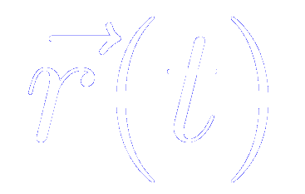
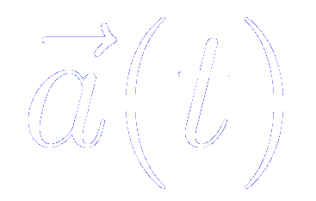
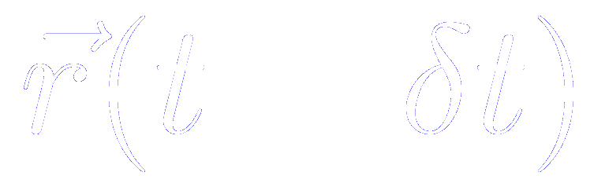
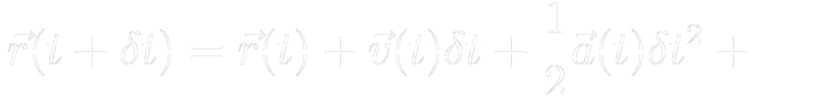
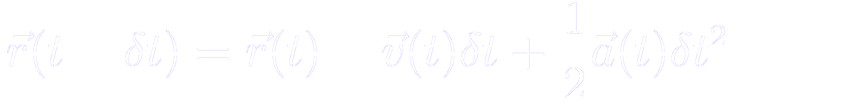
The Verlet algorithm method of integrating the equations of motion: description of the algorithm
Direct solution of the second-order equations
Method based on:
- the positions
- the accelerations
- the positions from the previous step
A Taylor expansion of the positions around t
Adding the two equations

Slide 14
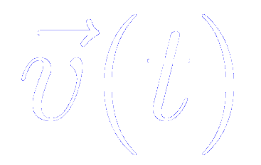
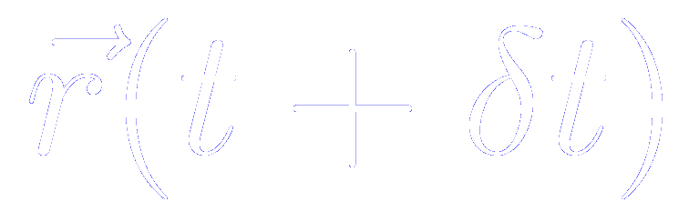
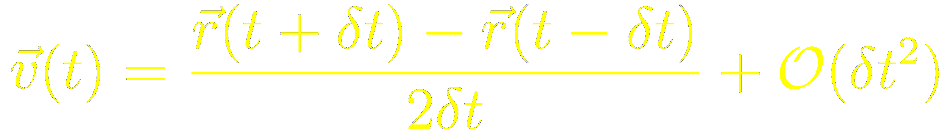
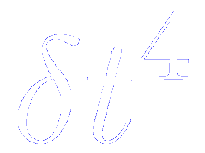
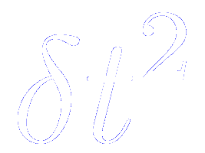
The Verlet algorithm method of integrating the equations of motion: some remarks
Remark 1
The velocities are not needed to compute the trajectories, but they are useful for estimating the kinetic energy (and the total energy).
They can be computed a posteriori using [ can only be computed once is known]
Remark 2
Whereas the errors to compute the positions are of the order of
The velocities are subject to errors of the order of

Slide 15
The Verlet algorithm method of integrating the equations of motion: some remarks
Remark 3
The Verlet algorithm is properly centered: and play symmetrical roles.
The Verlet algorithm is time reversible
Remark 4
The advancement of positions takes place all in one go,
rather than in two stages as in the predictor-corrector algorithm.

Slide 16
The Verlet algorithm method of integrating the equations of motion: overall scheme
Known the positions at t, we compute the forces (and therefore the accelerations at t)
Then, we apply the Verlet algorithm equations to compute the new positions
…and we repeat the process computing the forces (and therefore the accelerations at )

Slide 17
Molecular Dynamics
Timestep must be small enough to accurately sample highest frequency motion
Typical timestep is 1 fs (1 x 10⁻¹⁵ s)
Typical simulation length: Depends on the system of study!!
(the more complex the PES the longer the simulation time)
Is this timescale relevant to your process?
Simulation has two parts
  equilibration – when properties do not depend on time
  production (record data)
Results:
  diffusion coefficients
  Structural information (RDF’s,)
  Free energies / phase transformations (very hard!)
Is your result statistically significant?

Slide 18
How to run a Molecular Dynamic in Siesta: the Verlet algorithm (NVE-microcanonical ensemble)

Slide 19
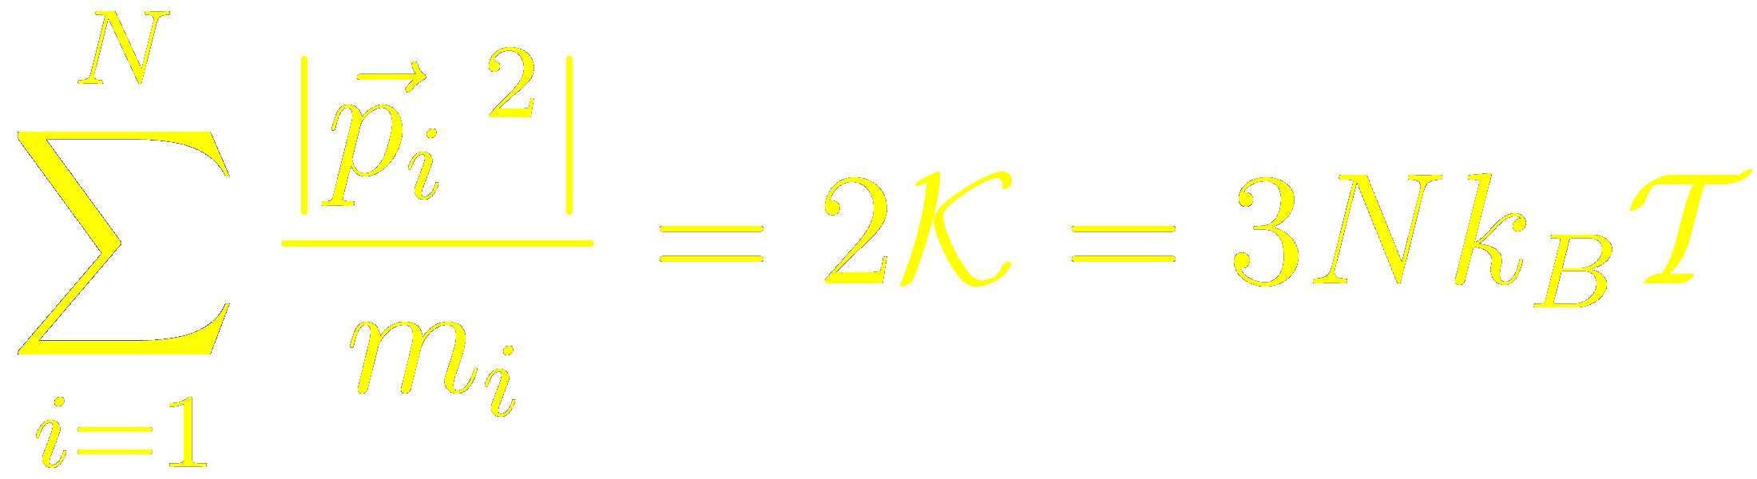
Computing the instantaneous temperature, kinetic energy and total energy

Slide 20
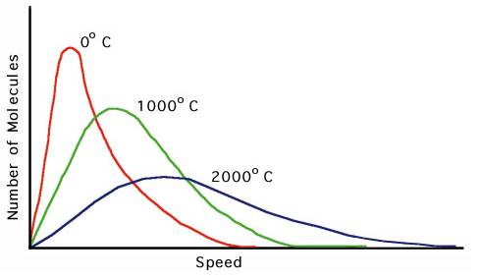
How to run a Molecular Dynamic in Siesta: the Verlet algorithm (NVE-microcanonical ensemble)
Maxwell-Boltzmann

Slide 21
Output of a Molecular Dynamic in Siesta: the Verlet algorithm (NVE-microcanonical ensemble)
Conserved quantity
SystemLabel.MDE
Example for MgCoO₃ in the rhombohedral structure

Slide 22
Output of a Molecular Dynamic in Siesta:
SystemLabel.MD Atomic coordinates and velocities
(and lattice vectors and their time derivatives if the
dynamics implies variable cell).
(unformatted; post-process with iomd.F)
SystemLabel.MDE shorter description of the run, with energy, temperature, etc. per time step
SystemLabel.ANI (contains the coordinates of every Molecular Dynamics step in xyz format)
These files are accumulative even for different runs.
Remember to delete previous ones if you are not interested on them

Slide 23
Check conservation of energy
Length of time step: 3 fs
$ gnuplot
$ gnuplot> plot "md_verlet.MDE" using 1:3 with lines, "md_verlet.MDE" using 1:4 with lines
Compare:
Total energy
with
KS energy
$ gnuplot> set terminal postscript color
$ gnuplot> set output “energy.ps”
$ gnuplot> replot

Slide 24
Check conservation of energy
Length of time step: 1 fs
$ gnuplot
$ gnuplot> plot "md_verlet.MDE" using 1:3 with lines, "md_verlet.MDE" using 1:4 with lines
Compare:
Total energy
with
KS energy
$ gnuplot> set terminal postscript color
$ gnuplot> set output “energy.ps”
$ gnuplot> replot

Slide 25
Check conservation of energy
Length of time step: 0.5 fs
$ gnuplot
$ gnuplot> plot "md_verlet.MDE" using 1:3 with lines, "md_verlet.MDE" using 1:4 with lines
Compare:
Total energy
with
KS energy
$ gnuplot> set terminal postscript color
$ gnuplot> set output “energy.ps”
$ gnuplot> replot

Slide 26
Check conservation of energy
Length of time step: 0.1 fs
$ gnuplot
$ gnuplot> plot "md_verlet.MDE" using 1:3 with lines, "md_verlet.MDE" using 1:4 with lines
Compare:
Total energy
with
KS energy
$ gnuplot> set terminal postscript color
$ gnuplot> set output “energy.ps”
$ gnuplot> replot

Slide 27
Check conservation of energy

Slide 28
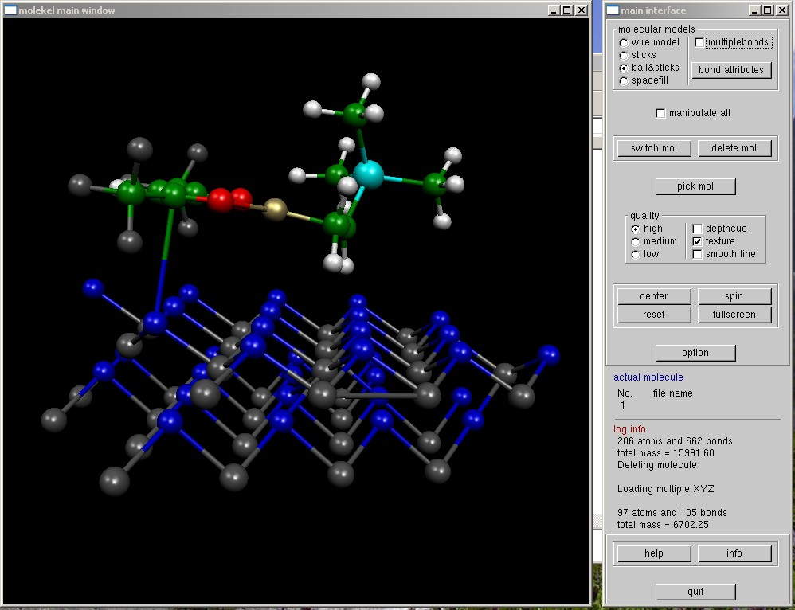
Visualisation and Analysis
Molekel
http://www.cscs.ch/molekel
XCRYSDEN
http://www.xcrysden.org/
GDIS
http://gdis.seul.org/

