Slide 1


Exercises on basis set generation
Increasing the angular flexibility: polarization orbitals
Javier Junquera

Slide 2
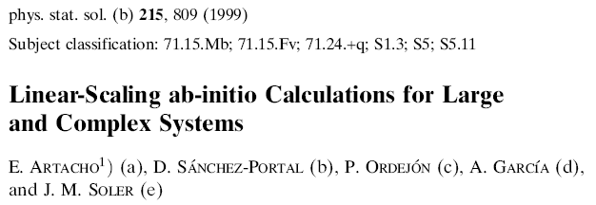
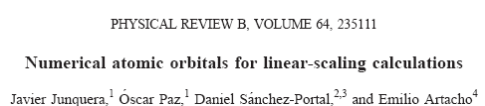
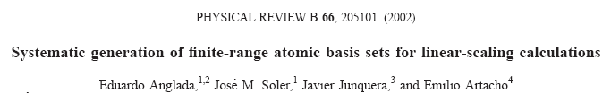
Most important reference followed in this lecture

Slide 3
Converging the basis size: from quick and dirty to highly converged calculations
  Single-ζ (minimal or SZ)
  One single radial function per angular
  momentum shell occupied in the free–atom
Improving the quality
  Radial flexibilization:
  Add more than one radial function within the same angular momentum than SZ
  Multiple-ζ
  Angular flexibilization:
  Add shells of different atomic symmetry (different l)
  Polarization

Slide 4
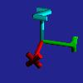
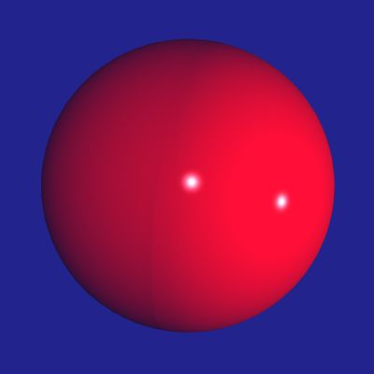
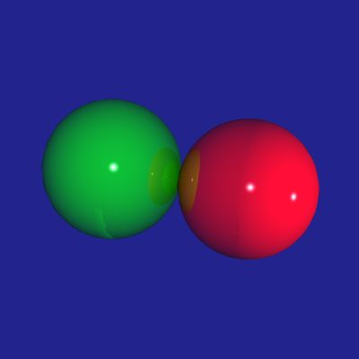
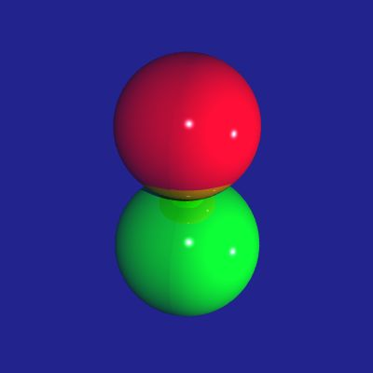
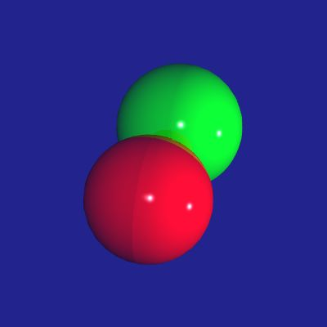
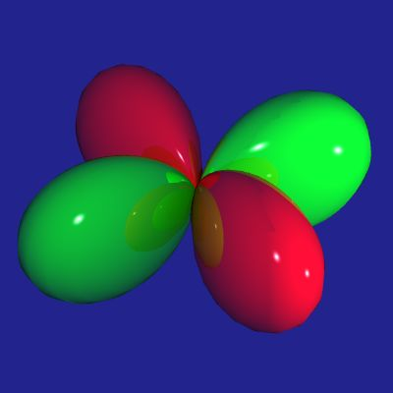
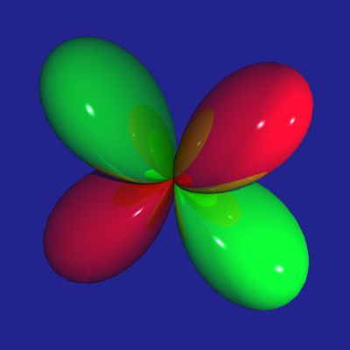
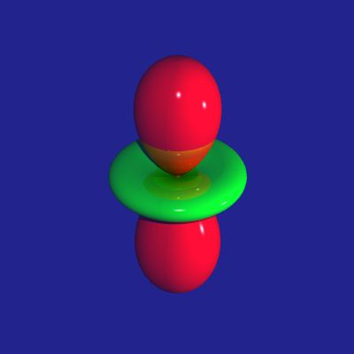
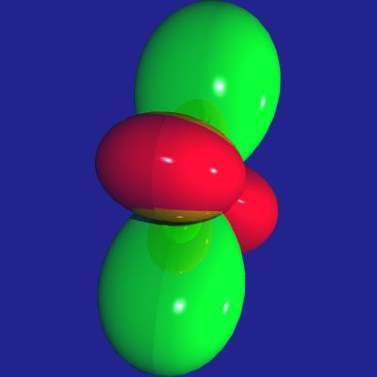
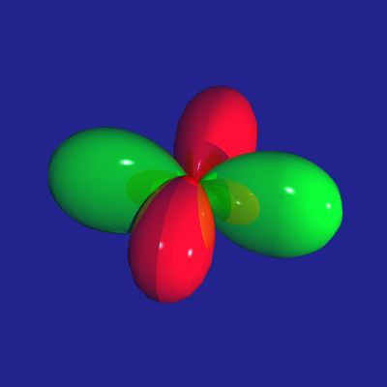
Example of adding angular flexibility to an atom
Polarizing the Si basis set
Si atomic configuration: 1s² 2s² 2p⁶ 3s² 3p²
core
valence
l = 0 (s)
l = 1 (p)
m = 0
m = -1
m = 0
m = +1
Polarize: add l = 2 (d) shell
m = -2
m = -1
m = 0
m = +1
m = +2
New orbitals directed in different directions with respect the original basis

Slide 5
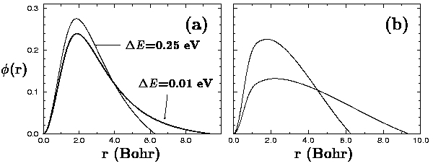
Two different ways of generate polarization orbitals
Perturbative polarization
Apply a small electric field to the orbital we want to polarize
Elegant and parameter free solution
E
s
s+p
Si 3d
orbitals
E. Artacho et al., Phys. Stat. Sol. (b), 215, 809 (1999)

Slide 6
Bulk Al, a metal that crystallizes in the fcc structure
Go to the directory with the exercise on the energy-shift
More information at the Siesta web page http://www.icmab.es/siesta and follow the link Documentations, Manual
Inspect the input file, Al.per-pol.fdf
As starting point, we assume the theoretical lattice constant of bulk Al
FCC lattice
Sampling in k in the first Brillouin zone to achieve self-consistency

Slide 7
For each basis set, a relaxation of the unit cell is performed
Variables to control the Conjugate Gradient minimization
Two constraints in the minimization:
- the position of the atom in the unit cell (fixed at the origin)
- the shear stresses are nullified to fix the angles between the unit cell lattice vectors to 60°, typical of a fcc lattice

Slide 8
Perturbative polarization:
They can be included adding a “P” after the standard basis size
Or using the PAO.Basis block (see next lecture of the tutorial)

Slide 9
Perturbative polarization:
Polarize the p-orbital means add a shell of d-orbital L=2
The extent of the polarization orbital is degined by that of the orbitals they polarize

Slide 10
Search for the free energy
Edit the output file and search for:
We are interested in this number
Compare the free energy with a DZP basis set with that obtained in previous lectures for SZ and DZ basis sets

Slide 11
Search for the relaxed lattice constant
Edit the output file and search for:
The lattice constant in this particular case would be
2.005748 Å × 2 = 4.011496 Å
Experimental lattice constant: 4.05 Å
When we improve the quality of the basis set, we make the corresponding deviations smaller.
The most important source of deviations are then the pseudopotential and the functional (the LDA tends to underestimate the lattice constant by 1-3 %)

Slide 12
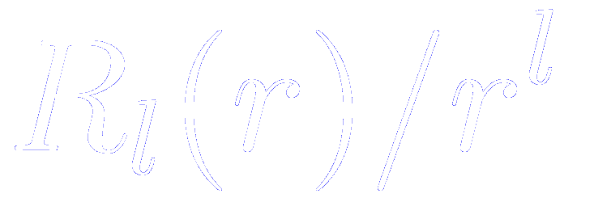
Perturbative polarization: How to plot the radial part of the atomic orbital
Follow the instructions given in the Tutorial
How to plot the radial part of the atomic orbital
Remember that in the ORB file we store .
For Al, the polarization orbital is a d-shell (l=2)
$ gnuplot
gnuplot> plot "ORB.S3.1.Al" u 1:($2 * $1**2) w l
gnuplot> set terminal postscript
gnuplot> set output "perturbative-polarization.ps"
gnuplot> replot

Slide 13
Two different ways of generate polarization orbitals
Perturbative polarization
Atomic polarization
Apply a small electric field to the orbital we want to polarize
Solve Schrödinger equation for higher angular momentum (Unoccupied atomic shells of higher l)
E
unbound in the free atom ⇒
require short cut offs (agressive confinement)
s
s+p
Si 3d
orbitals
E. Artacho et al., Phys. Stat. Sol. (b), 215, 809 (1999)

Slide 14
Atomic polarization:
They must be included using the PAO.Basis block
(see the corresponding lecture of the tutorial)
We can include shells of any angular momenta
The cutoff radii might be different from that of the orbitals that are polarized

Slide 15
Atomic polarization:
Polarize the p-orbital means add a shell of d-orbital L=2
The polarization d-orbitals are computed as the rest of the shells
(solving the Schrödinger equation of the isolated atom for the corresponding component of the pseudopotential)

Slide 16
Search for the free energy
Edit the output file and search for:
We are interested in this number
The atomic confinement usually performs variationaly better than the atomic polarization

Slide 17
Search for the relaxed lattice constant
Edit the output file and search for:
The lattice constant in this particular case would be
1.993001 Å × 2 = 3.986002 Å
Experimental lattice constant: 4.05 Å
When we improve the quality of the basis set, we make the corresponding deviations smaller.
The most important source of deviations are then the pseudopotential and the functional (the LDA tends to underestimate the lattice constant by 1-3 %)

Slide 18
Perturbative polarization: How to plot the radial part of the atomic orbital
Follow the instructions given in the Tutorial
How to plot the radial part of the atomic orbital
Remember that in the ORB file we store .
For Al, the polarization orbital is a d-shell (l=2)
$ gnuplot
gnuplot> plot "ORB.S3.1.Al" u 1:($2 * $1**2) w l
gnuplot> set terminal postscript
gnuplot> set output ”atomic-polarization.ps"
gnuplot> replot

