Slide 1
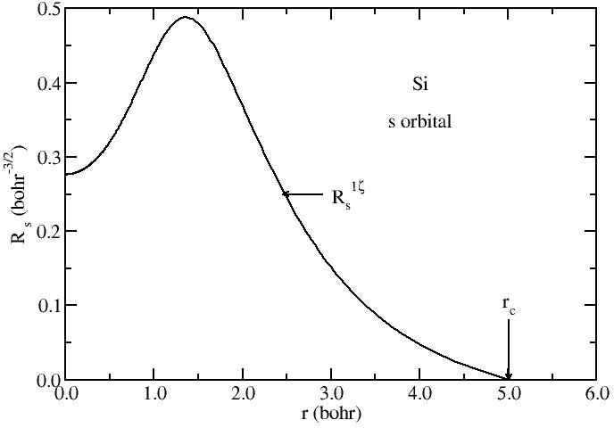
Exercises on basis set generation
1. The default basis set
Javier Junquera

Slide 2
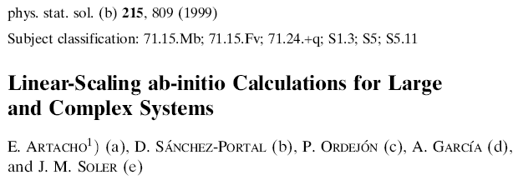
Most important reference followed in this lecture

Slide 3
Bulk Si, a semiconductor that crystallizes in the diamond structure
Go to the directory with the exercise on the default basis set
Inspect the input file, Si.default.fdf
More information at the Siesta web page http://www.icmab.es/siesta and follow the link Documentations, Manual
No input on the basis set is given
As starting point, we assume the theoretical lattice constant of bulk Si
FCC lattice
Two atoms in the basis
Sampling in k in the first Brillouin zone to achieve self-consistency

Slide 4
How to introduce the basis set in SIESTA Effort on defining a systematic with minimum parameters
If nothing is specified: default
Default value
Basis size: PAO.BasisSize DZP
Range of first-zeta: PAO.EnergyShift 0.02 Ry
Second-zeta: PAO.BasisType Split
Range of second-zeta: PAO.SplitNorm 0.15
Confinement: Hard well
Good basis set in terms of accuracy versus efficiency

Slide 5
For each basis set, a relaxation of the unit cell is performed
Variables to control the Conjugate Gradient minimization
Two constraints in the minimization:
- the position of the atoms in the unit cell
- the shear stresses are nullified to fix the angles between the unit cell lattice vectors to 60°, typical of a fcc lattice

Slide 6
Relax the lattice constant and compute the energy for the default basis set
Run the code for bulk Si with the default basis set
siesta < Si.default.fdf > Si.default.out
The name of the output file is free, but since we are running bulk Si with the default basis set, this is a sensible choice
The numbers in this exercise have been obtained with siesta-3.0-b, compiled with the g95 compiler and double precision in the grid.
Numbers might change slightly depending on the platform, compiler and compilation flags

Slide 7
How to introduce the basis set in SIESTA Effort on defining a systematic with minimum parameters
If nothing is specified: default
Inspect the output files and search for
The PAO.Basis block
For Si, we include two shells
3s, with two radial functions
Cutoff radii of the two func. (in bohrs)
Same for the 3p shell
The 3p ( l = 1) orbitals are polarized:
A shell with angular momentum l+1 (3d orbitals is added)
The cutoff of the polarization orbital will be the same as the first-ζ of the orbital that polarizes (in this case, the 3p)

Slide 8
Study the structural and energetic properties with the default basis set
Inspect the output files and search for
the relaxed structure
After relaxation, the system remains in a fcc lattice with a lattice constant of 2 × 2.705266 = 5.410532 Å

Slide 9
Study the structural and energetic properties with the default basis set
Inspect the output files and search for
the converged Kohn-Sham energy for the relaxed structure
We are interested in this number

