Slide 1



Introduction to atomistic simulation methods in condensed matter
Javier Junquera
Pablo Ordejón
Alberto García

Slide 2
Outline of the talk:
What is an atomistic simulation
How to compute material properties from first-principles.
Overview of approximations
Examples of realistic simulations

Slide 3
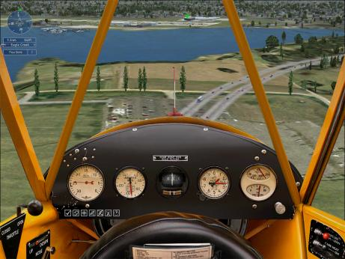

What is a Computer Simulation?
By “computer simulation” we understand the use of a computer to “solve” numerically the equations that govern a certain process.
Simulations are present in every branch of science, and even increasingly in every day life
Weather forecast
Flight simulations
Finances

Slide 4
What is a Computer Simulation?
By “computer simulation” we understand the use of a computer to “solve” numerically the equations that govern a certain process.
Simulations are present in every branch of science, and even increasingly in every day life
Simulations in materials: study the way in which the blocks that build the material interact with one another and with the environment, and determine the internal structure, the dynamic processes and the response to external factors (pressure, temperature, radiation, etc.)

Slide 5
Why are simulations interesting?
Simulations are the only general method to solve models describing many particles interacting among themselves.
Experiments are sometimes limited (control of conditions, data acquisition, interpretation,…) and generally expensive
Simulations scale up with the increase of computer power (that roughly doubles every year!!)

Slide 6
Why are simulations interesting?
Alternative to approximate solutions for models (traditional theory)
Complement and alternative to experimental research
First-principles simulations
The Torii metaphore
(Prof. H. Nakamura)
Theory
Experiment

Slide 7

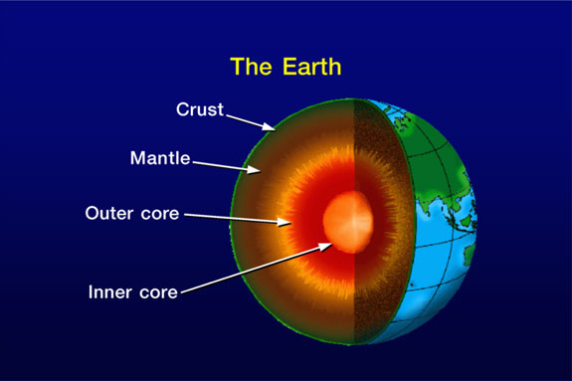
Why are simulations interesting?
Alternative to approximate solutions for models (traditional theory)
Complement and alternative to experimental research
Increasing scope and power with improving computers and codes
Level of accuracy “Computer experiments”
Model of materials under circumstances far away from the conditions achievable in a lab., under extreme conditions

Slide 8
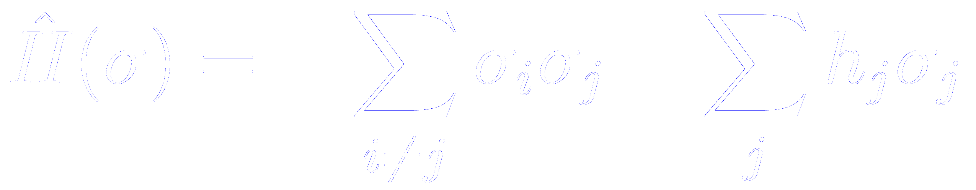
Components of a simulation
1. A model of the interactions between the blocks that build the material
Ising model:
A mathematical model of ferromagnetism in statistical physics.
Atomistic models
Wave function methods
DFT
Spins are treated as discrete variables that can be in one of two states.
Spins are arranged in a lattice or graph, and each spin interacts at most with its nearest neighbors.

Slide 9
Components of a simulation
1. A model of the interactions between the blocks that build the material
2. A simulation algorithm: the numerical solution to the equations that describe the model.
For the same model, there might be many different implementations, many availables codes
3. A set of tools for the analysis of the results of the simulations
Ising model + Monte Carlo simulations phase transitions
Results:
Emergent properties not evident just looking at the equations
Use of computer essential for the exploration of the model

Slide 10

Challenge of simulation of materials
Physical and mathematical foundations
What approximations come in?
The simulation is only as good as the model being solved
Systems with many particles and long-time scales are problematic
Computed time is limited: relatively small number of atoms for relatively short times
Space-time is 4D
How we do estimate errors? (Statistical and systematic)
How do we manage ever more complex codes?

Slide 11
Challenge of simulation of materials
Multiple scales
Length scales:
1 cm – 1 Å (10⁻¹⁰ m)
Time scales:
1 year – 1 fs(10⁻¹⁵s)

Slide 12
Challenge of simulation of materials
Multiple scales
Macro and mesoscopic thermodynamic properties
Atomic structure and dynamics
Electronic states chemical bonds and reactions, excitations…

Slide 13
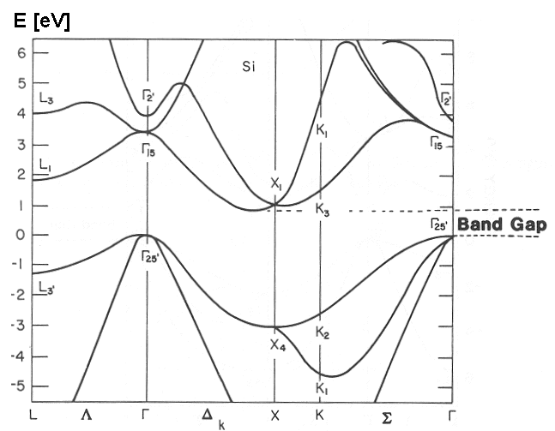
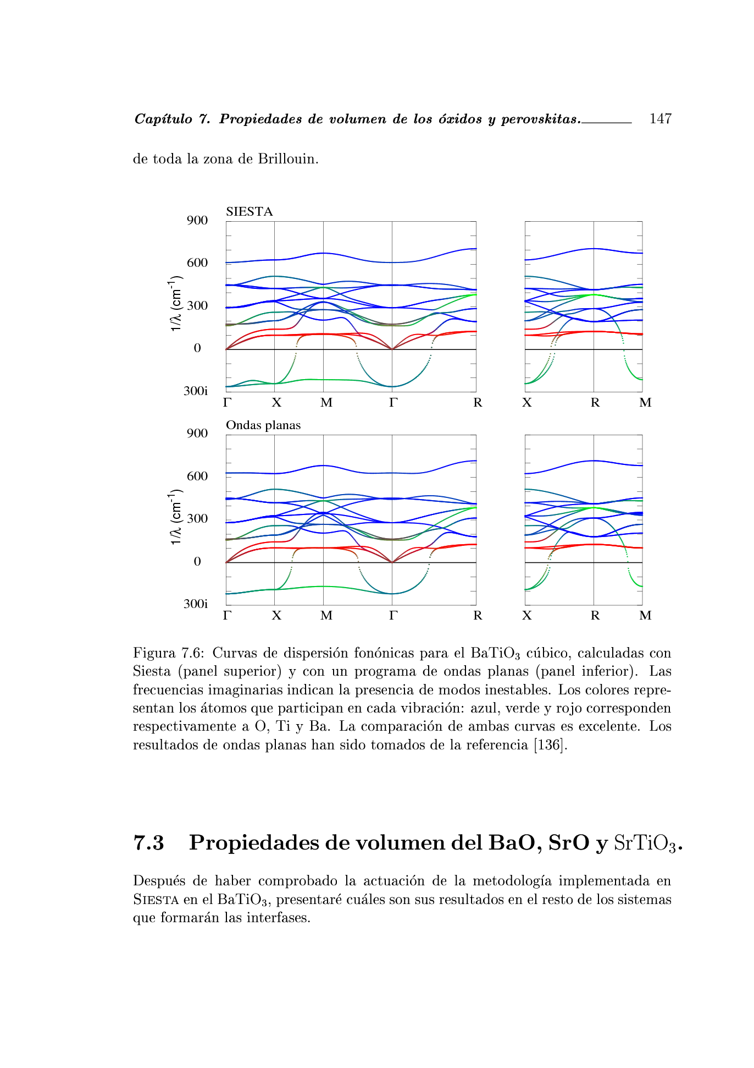

Goal: Describe properties of matter from theoretical methods firmly rooted in fundamental equations
structural
electronic
PROPERTIES
magnetic
vibrational
optical

Slide 14
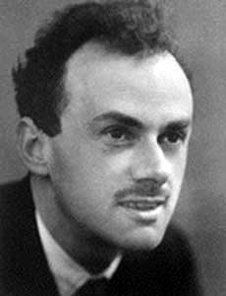
Modern atomic simulations follow Dirac’s intructions (1929)
“The general theory of quantum mechanics is now almost complete. The underlying physical laws necessary for the mathematical theory of a large part of physics and the whole of chemistry are thus completely known, and the difficulty is only that the exact application of these laws leads to equations much too complicated to be soluble.”
“…It therefore becomes desirable that approximate practical methods of applying quantum mechanics should be developed, which can lead to an explanation of the main features of complex atomic systems without too much computation.”
Goal of modern atomic simulations: implement that dream

Slide 15
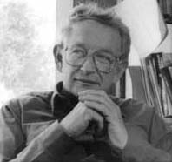
The most important point: analysis and modelization of the results
In a first-principles simulations, what we have is the ultimate modeling of materials, whose solution requires the use of computers
“A simple model can shed more light on Nature’s workings than a series of “ab-initio” calculations of individual cases, which,even if correct, are so-detailed that they hide reality instead of revealing it… A perfect computation simply reproduces Nature, it does not explain it.”
Philip W. Anderson

