Slide 1


Random numbers and the central limit theorem
Alberto García
Javier Junquera

Slide 2
Bibliography
Cambridge University Press, Cambridge, 2002
ISBN 0 521 65314 2

Slide 3
Physical processes with probabilistic character
Certain physical processes do have a probabilistic character
Desintegration of atomic nuclei:
The dynamic (based on Quantum Mechanics) is strictly probabilistic
Brownian movement of a particle in a liquid:
We do not know in detail the dynamical variables of all the particles involved in the problem
We need to base our knowledge in new laws that do not rely on dynamical variables with determined values, but with
probabilistic distributions
Starting from the probabilistic distribution, it is possible to obtain well defined averages of physical magnitudes, especially if we deal with very large number of particles

Slide 4

The stochastic oracle
Computers are (or at least should be) totally predictible
Given some data and a program to operate with them, the results could be exactly reproduced
But imagine, that we couple our code with a special module that generates randomness
^{program randomness}
^{real :: x}
^{do}
^{call random_number(x)}
^{print "(f10.6)" , x}
^{enddo}
^{end program randomness}
$<your compiler> -o randomness.x randomness.f90
$./randomness
The output of the subroutine randomness is a real number, uniformly distributed in the interval
"Anyone who considers arithmetical methods of producing random digits is, of course, in a state of sin.” (John von Neumann)

Slide 5
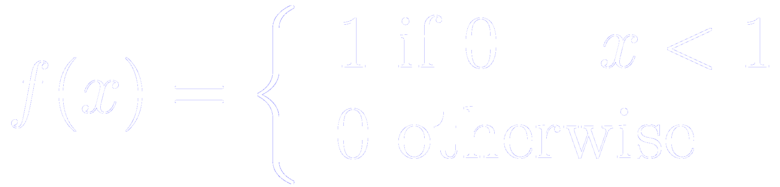
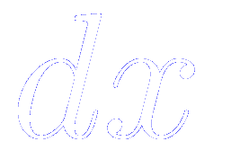
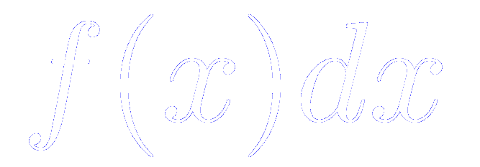
Probability distribution
The subroutine “random number” generates a uniform distribution of real numbers in
The probability of occurrence is given by
This is a continuous probability distribution.
It has to be used as a “density”, i.e.,
The probability of having a number in is
The probability of obtaining a predefined exact number is 0

Slide 6
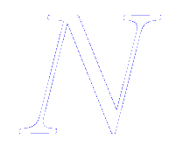
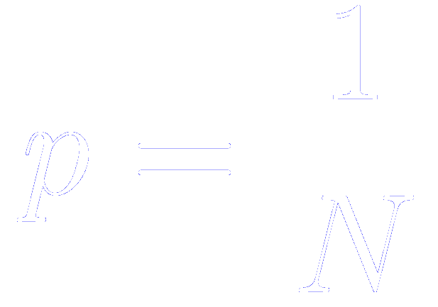
Other probability distributions
Discrete distribution
Some probability for a set of discrete numbers
The probability of occurrence of a given number is given by
Poison distribution
Gaussian distribution
Important because the central limit theorem

Slide 7
Reproduced with permission of Cedric Weber, from King’s College London
http://nms.kcl.ac.uk/cedric.weber/index.html

Slide 8
Reproduced with permission of Cedric Weber, from King’s College London
http://nms.kcl.ac.uk/cedric.weber/index.html

Slide 9
Reproduced with permission of Cedric Weber, from King’s College London
http://nms.kcl.ac.uk/cedric.weber/index.html

Slide 10
Reproduced with permission of Cedric Weber, from King’s College London
http://nms.kcl.ac.uk/cedric.weber/index.html

Slide 11
Reproduced with permission of Cedric Weber, from King’s College London
http://nms.kcl.ac.uk/cedric.weber/index.html

Slide 12
Reproduced with permission of Cedric Weber, from King’s College London
http://nms.kcl.ac.uk/cedric.weber/index.html

Slide 13
Reproduced with permission of Cedric Weber, from King’s College London
http://nms.kcl.ac.uk/cedric.weber/index.html

Slide 14
Reproduced with permission of Cedric Weber, from King’s College London
http://nms.kcl.ac.uk/cedric.weber/index.html

Slide 15
Reproduced with permission of Cedric Weber, from King’s College London
http://nms.kcl.ac.uk/cedric.weber/index.html

Slide 16
Reproduced with permission of Cedric Weber, from King’s College London
http://nms.kcl.ac.uk/cedric.weber/index.html

Slide 17
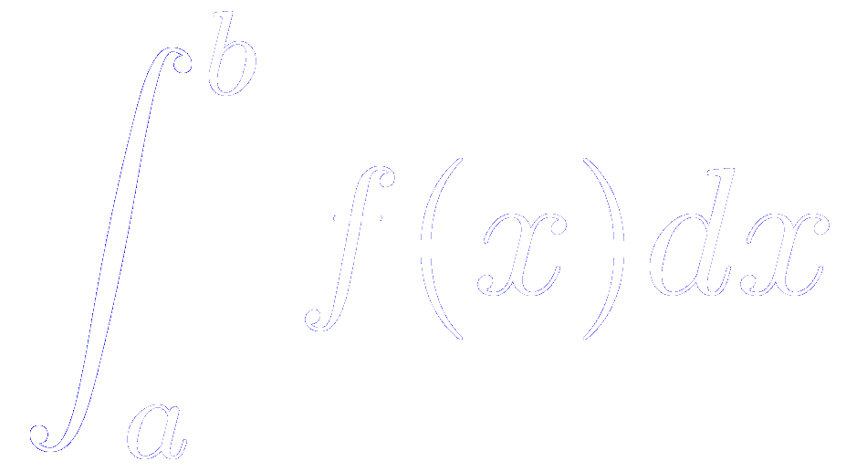
Integration of functions
Standard example of the use of stocastic methods in Applied Mathematics
Problem: compute

Slide 18
Integration of functions
Reproduced with permission of Cedric Weber, from King’s College London
http://nms.kcl.ac.uk/cedric.weber/index.html

Slide 19
Integration of functions
Reproduced with permission of Cedric Weber, from King’s College London
http://nms.kcl.ac.uk/cedric.weber/index.html

Slide 20
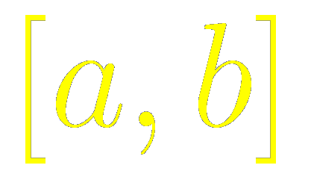
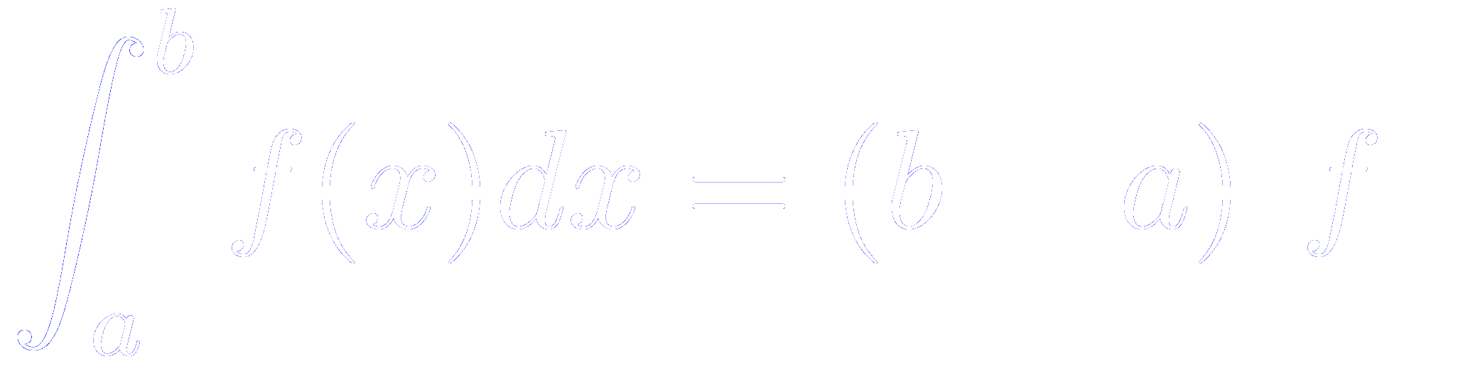


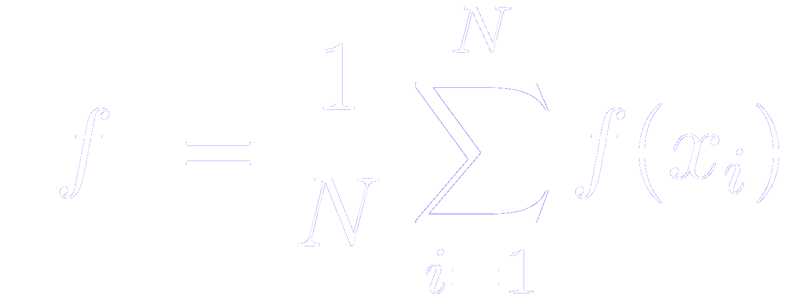

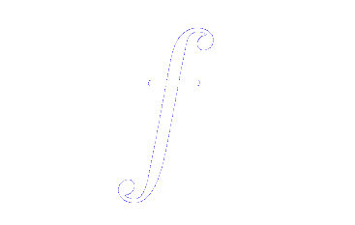
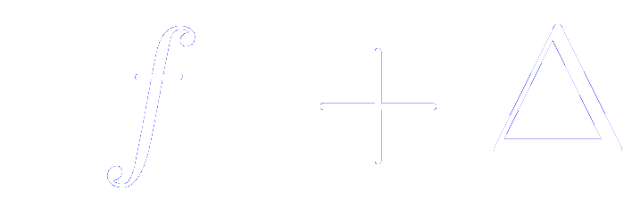
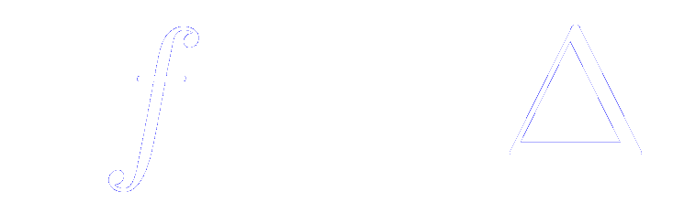
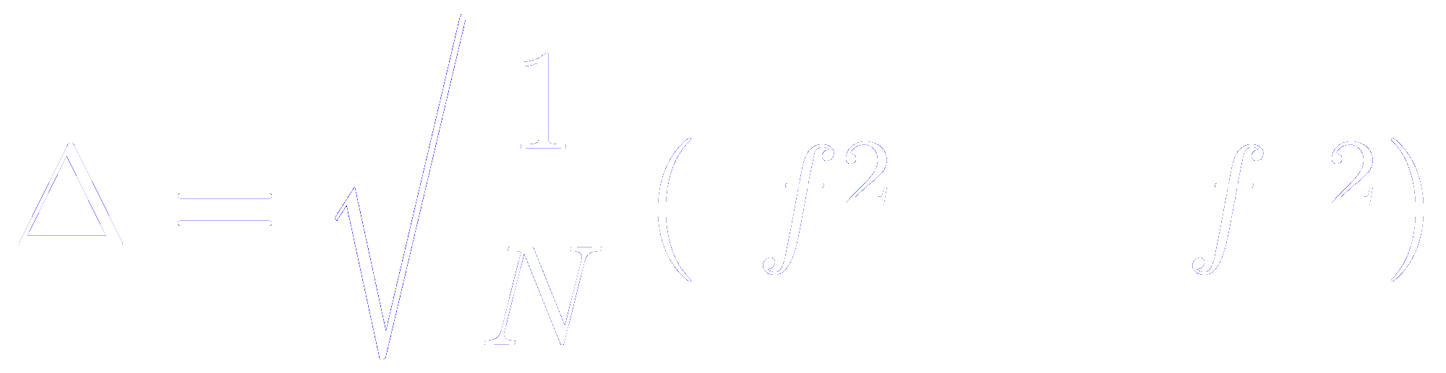
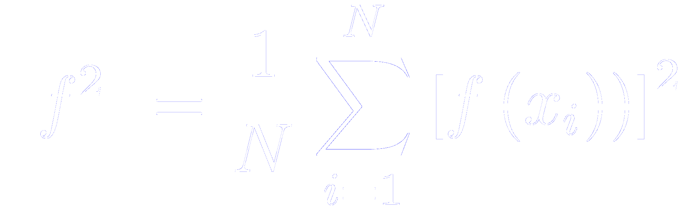
Integration of functions
Method 3: estimation from the average of the function between
Assume that we choose points randomly distributed between , then
The larger the number of points, the better the estimation.
The typical error in , in the sense that 63% of the estimations of will be between and
where

Slide 21
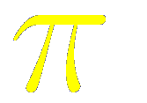
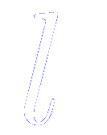
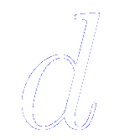

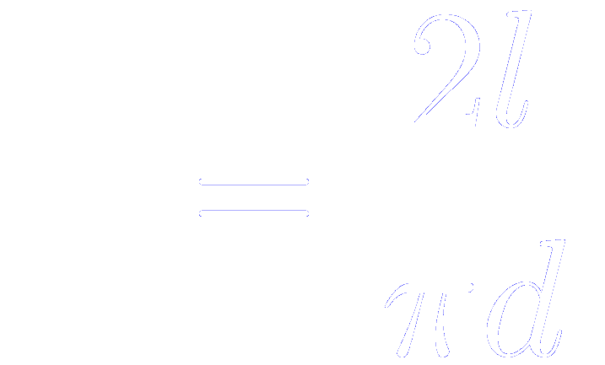
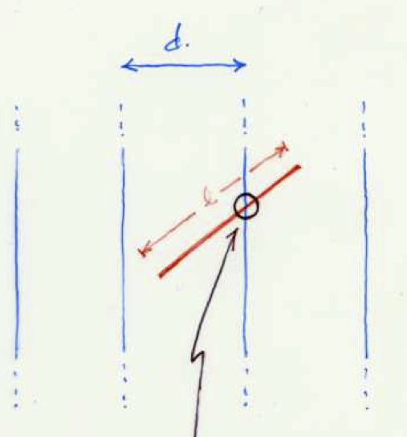
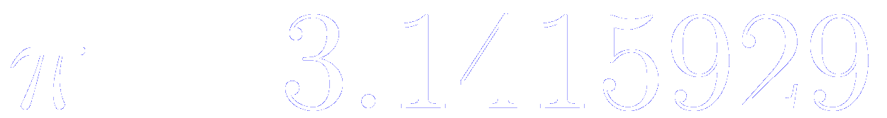
Example of integration: How to estimate with a needle
Buffon’s experiment
If a needle of length is thrown at random onto a set of equally spaced parallel lines, apart (where ), the probability of the needle crossing a line is
Lazzerini (1901):
Spinning round and dropping a needle 3407 times:

Slide 22
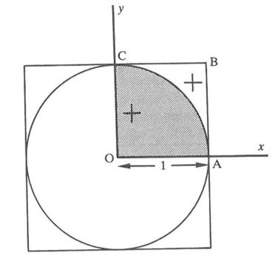

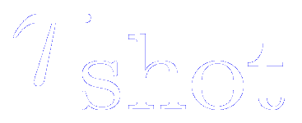
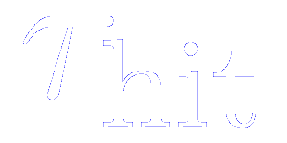

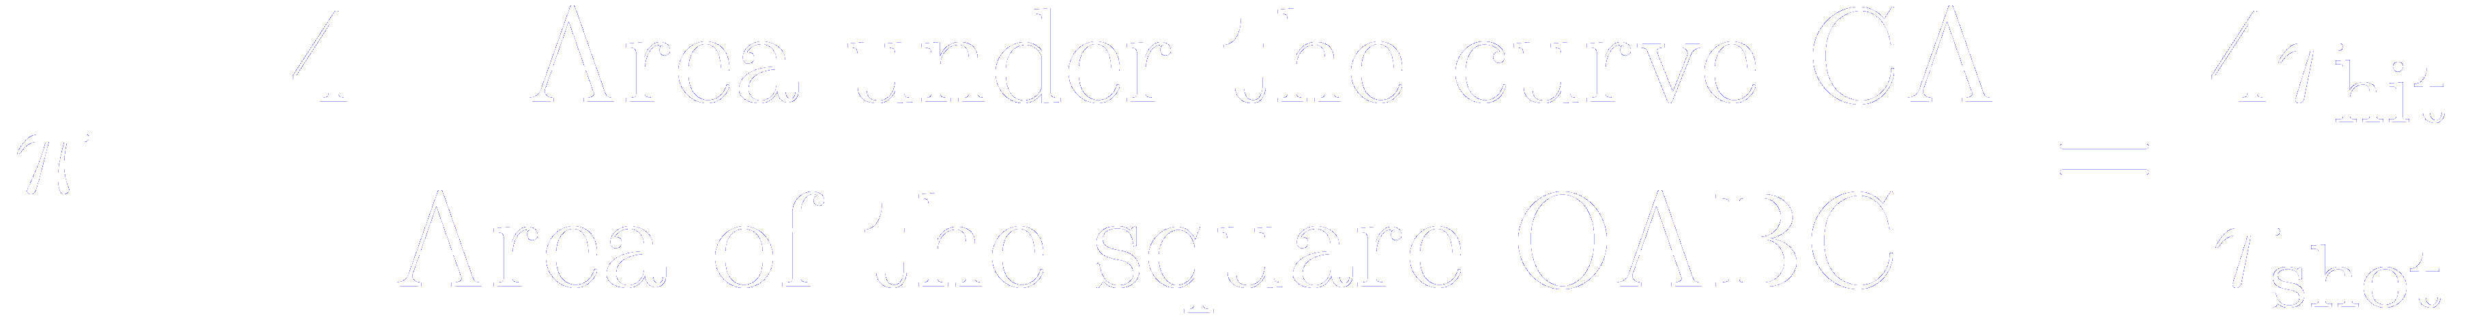
Example of integration: How to estimate in a rainy day
Let us rephrase the problem:
how to estimate the area of a circle of radius 1
A circle centred at the origin and inscribed in a square
A number of trial shots are generated in the square OABC
At each trial two independent random numbers are chosen from a uniform distribution on
These numbers are taken as the coordinates of a point
(marked as + in the figure)
The distance from the random point to the origin is calculated
If the distance is less or equal to one, the shot has landed in the shaded region and a hit is scored
If a total of are fired and hits scored, then

Slide 23


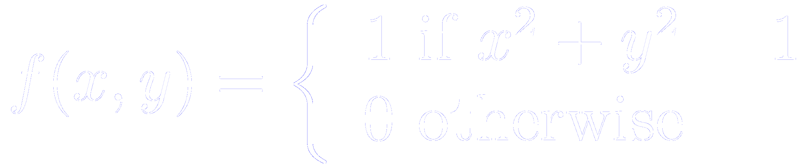
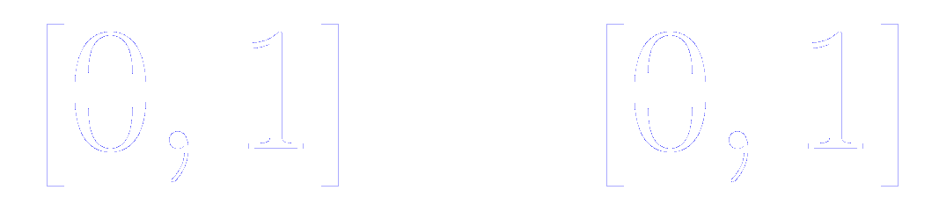
Example of integration: How to estimate in a rainy day
In mathematical words, we have estimated the integral
where the function is
In the two-dimensional interval

Slide 24
Example of integration: How to estimate from the hit and miss method

Slide 25
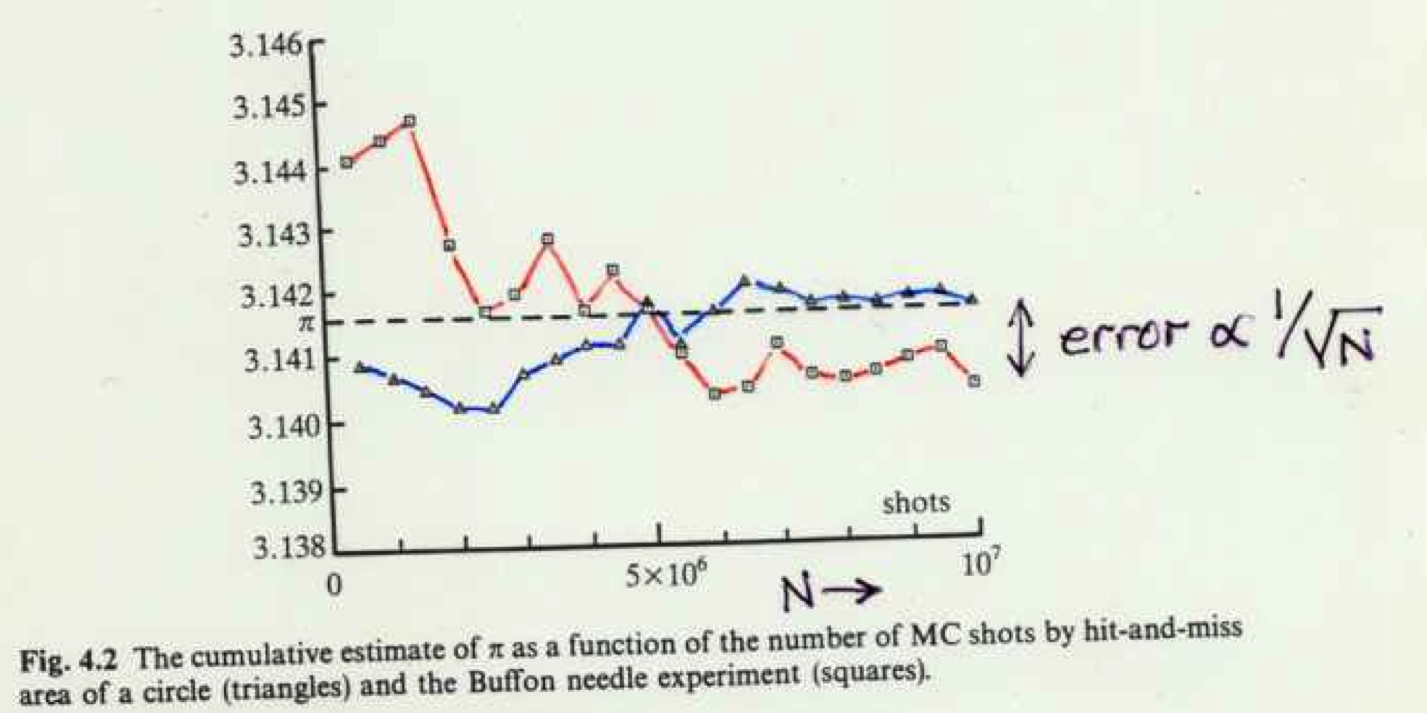
Example of integration: How to estimate in a rainy day or with a needle
To gain one significative figure (i.e. to reduce the typical error by one order of magnitude) we should to increase the number of integration points by 100

Slide 27
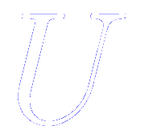
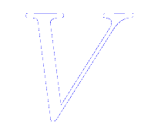
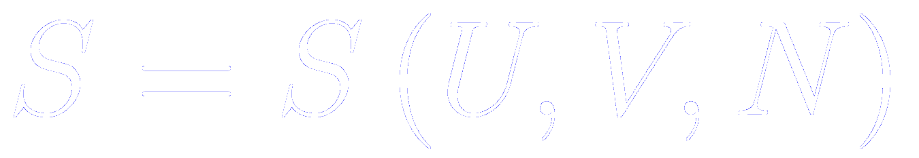
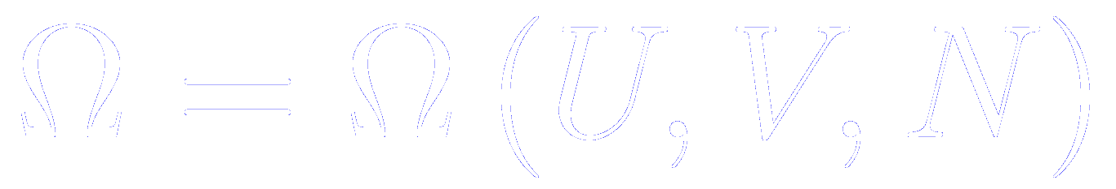
Applications to Statistical Mechanics
Fundamental postulate of Statistical Physics:
All the microstates of a closed system in equilibrium are equally probable
Closed means that the total energy , the number of particles , and the volume are constant
In thermodynamics, these are the natural variables in the entropic representation
The fundamental connection between Statistical Mechanics and Thermodynamics
The entropy can be computed from the total number of microstates of a system

Slide 28
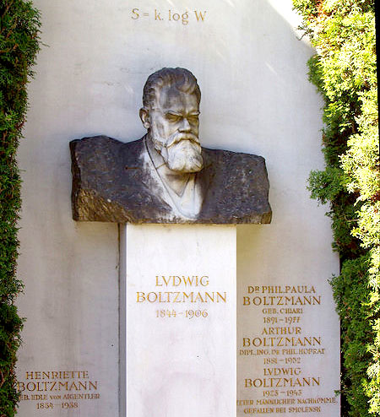
Applications to Statistical Mechanics
Boltzmann's grave in the Zentralfriedhof, Vienna, with bust and entropy formula

Slide 29
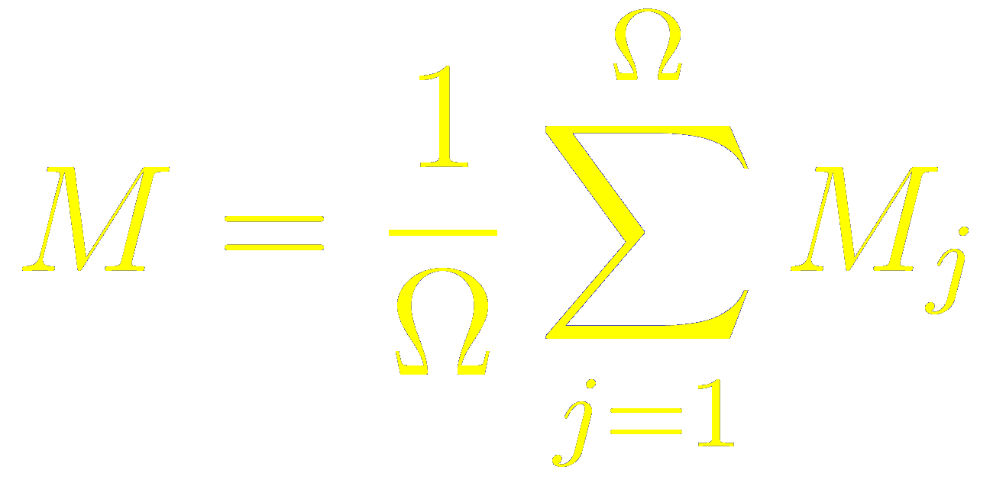
Any macroscopic physical quantity can be computed as an statistical average over accesible microstates
Therefore, to study the properties of any closed macroscopic system in equilibrium, it should be enough (in principle) to determine all the microscopic states and evaluate the corresponding averages taking only those microstates compatible with the thermodynamic variables
, , and
In practice, it is impossible to find all the microscopic states available

Slide 30
Any macroscopic physical quantity can be computed as an statistical average over accesible microstates
Therefore, to study the properties of any closed macroscopic system in equilibrium, it should be enough (in principle) to determine all the microscopic states and evaluate the corresponding averages taking only those microstates compatible with the thermodynamic variables
, , and
In practice, it is impossible to find all the microscopic states available

Slide 31
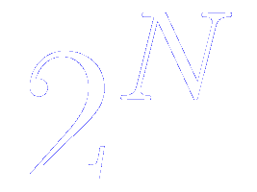
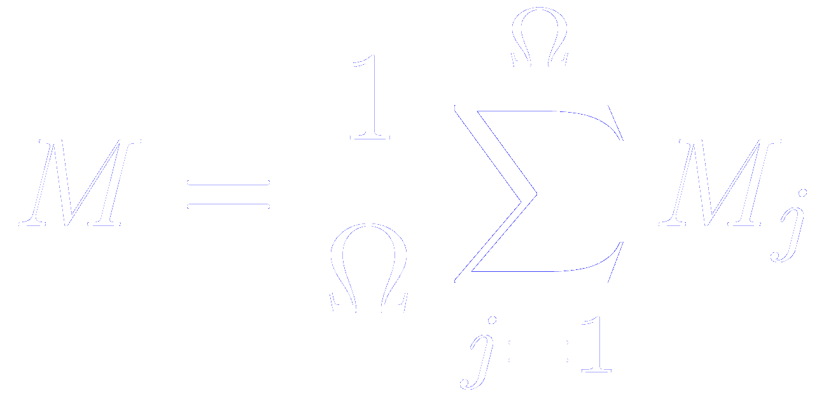
Number of possible microstates might be inconceivable large
Let us imagine a system of spins with two possible states (up or down). How many microstates are possible?
With a few dozens of particles, this number might be very, very large
It is impossible to compute these averages, , exactly
But we can estimate them by a partial sampling of all the possible microstates, in the same way as sociologist prepare the poll.
We should employ a non-bias method to sample the configuration space

Slide 32
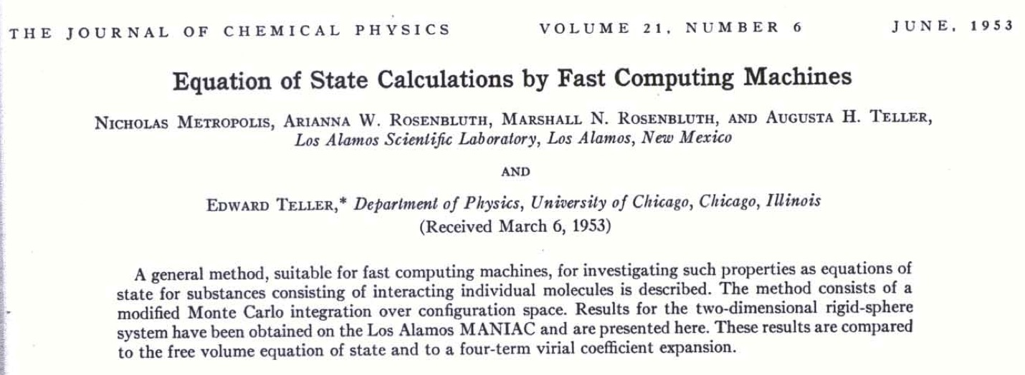
The Metropolis algorithm

Slide 33
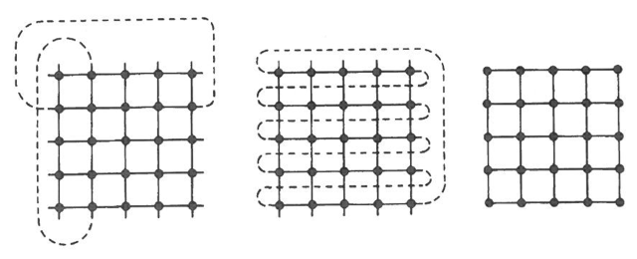
Boundary conditions
Typical boundary conditions for the two-dimensional Ising model
Periodic boundary contsitions
Screw periodic
Free edges

