Slide 1
Introduction to Heisenberg model
Javier Junquera

Slide 2
Most important reference followed in this lecture
Magnetism in Condensed Matter Physics
Stephen Blundell
Oxford Master Series in Condensed Matter Physics

Slide 3
Exchange interactions
If relativistic effects are not considered, then
the electric interaction between particles does not depend on their spins
In the absence of a magnetic field, the Hamiltonian of a system of particles in electric interaction does not contain spin operators

Slide 4
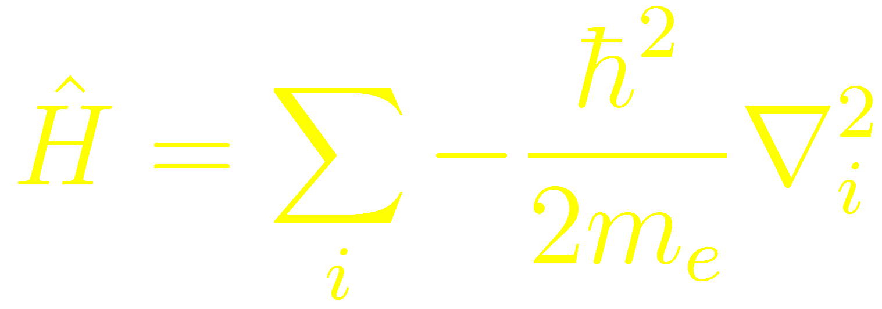
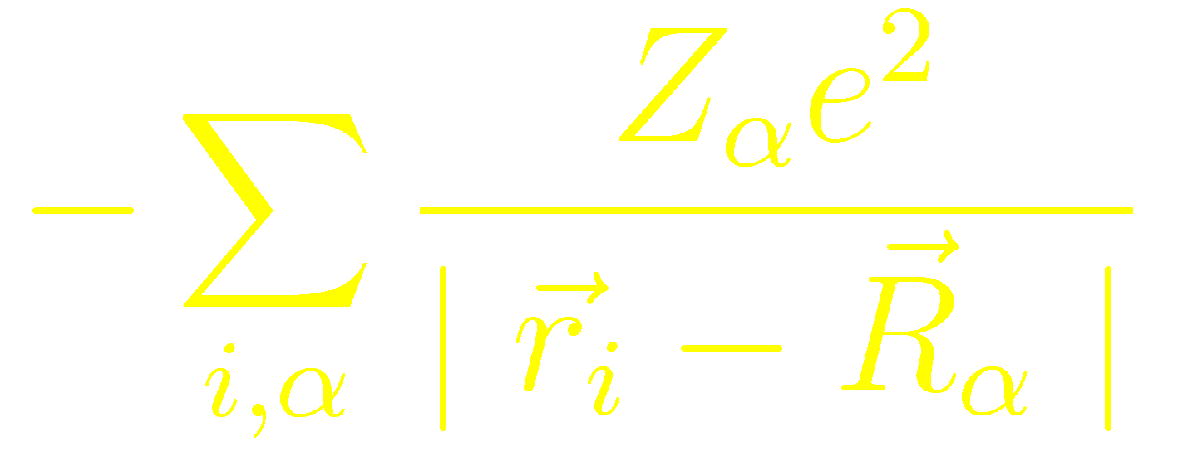
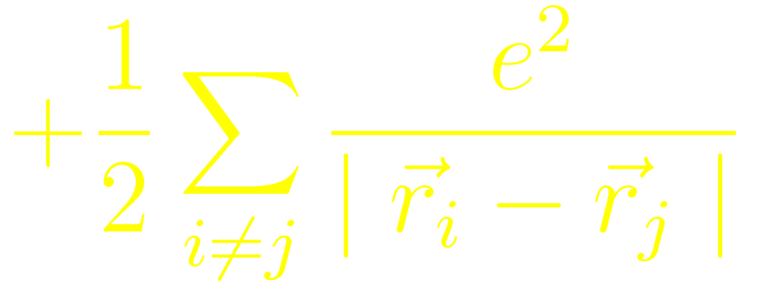
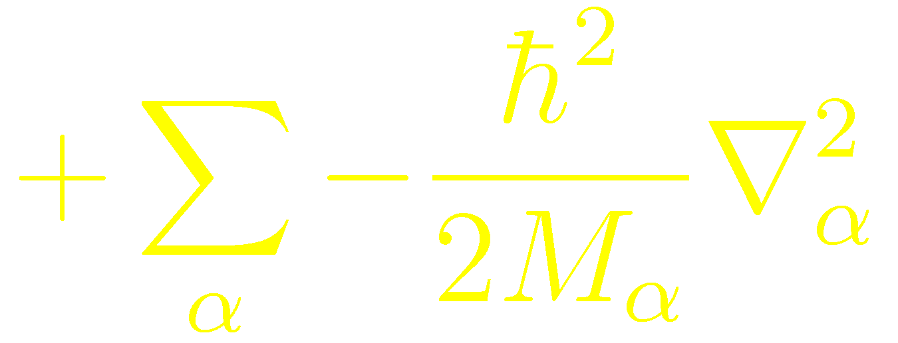
A look to the hamiltonian: a difficult interacting many-body system.
Kinetic energy operator for the electrons
Potential acting on the electrons due to the nuclei
Electron-electron interaction
Kinetic energy operator for the nuclei
Nucleus-nucleus interaction

Slide 5
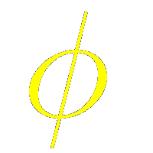
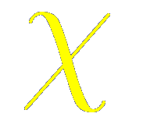
Exchange interactions
If relativistic effects are not considered, then
the electric interaction between particles does not depend on their spins
In the absence of a magnetic field, the Hamiltonian of a system of particles in electric interaction does not contain spin operators
When it is applied to a wavefunction, it does not affect the spinoidal variables
The wave function of a system of particles can be written as a product
It depends only on the spin variables
It depends only on the spatial coordinates of the particles
The Schrödinger equation determines only , leaving arbitrary

Slide 6
The indistinguisibility of the particles leads to symmetry conditions on the wave function
Despite the fact that the electric interaction is spin-independent, there is a dependendency of the energy of the system with respect the total spin
Let us consider a system of two identical particles.
After solving the Schrödinger equation, we find a set of energy levels, each of which are associated with a spatial wavefunction
Since the particles are identical, the Hamiltonian of the system has to be invariant with respect the permutation of the particles
has to be symmetric or antisymmetric

Slide 7
The possible values of the energy of a system of identical particles depend on the total spin system
Let us assume now that the particles have spin 1/2
The total wave function (product of a spatial coordinate wave function and the spinorial wave function) has to be antisymmetric with respect the permutation of the two particles
symmetric
antisymmetric
Total spin = 0 (spins aligned antiparallel one to the other)
The energy only depends on , that is determined by the total spin
antisymmetric
symmetric
Total spin = 1 (spins aligned parallel one to the other)

Slide 8
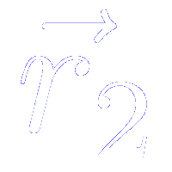
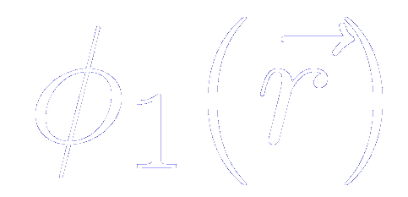
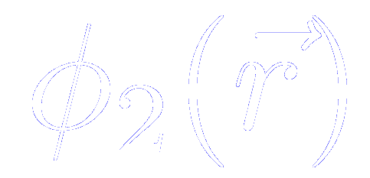
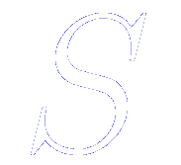
The possible values of the energy of a system of identical particles depend on the total spin system
Let us assume now that the particles have spin 1/2
Consider two electrons which have spatial coordinates and
Let us assume that the two particles, without considering their mutual interaction, are in states that can be represented by single electron coordinate wavefunctions and
The overall wave function of the system for a state with total spin
Singlet ( )
Triplet ( )

Slide 9
The possible values of the energy of a system of identical particles depend on the total spin system
The energies of the two possible states are
We assume that the spin part of the wave function is normalized
The overall wave function of the system for a state with total spin
Singlet ( )
Triplet ( )

Slide 10
Mean value of the energy in the singlet and triplet states
The energies of the single state is
We assume that the spin part of the wave function is normalized

Slide 11
Mean value of the energy in the singlet and triplet states
The energies of the triplet state is
We assume that the spin part of the wave function is normalized

Slide 12
Mean value of the energy in the singlet and triplet states
The difference in energies between the singlet and the triplet state is
(to obtain this expression remembers that the Hamiltonian operator is self-adjoint)
The difference between single and triplet states can be parametrized by

Slide 13
Explanation of this mapping: The coupling of two spins
Consider two spin-1/2 particles coupled by an interaction given by the Hamiltonian
Operator for the spin of particle a
Operator for the spin of particle b
Considered as a joint entity, the total spin can be represented by the operator
so that

Slide 14
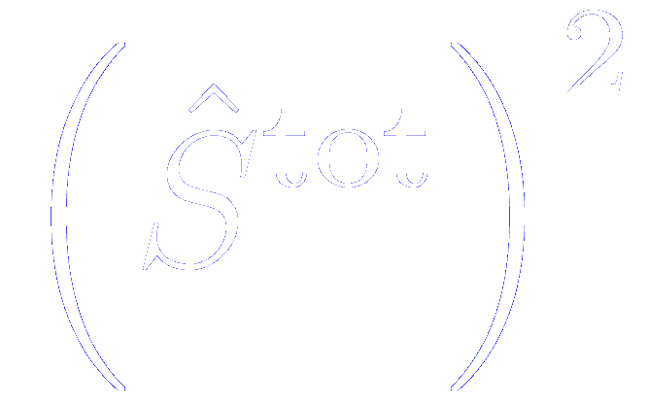
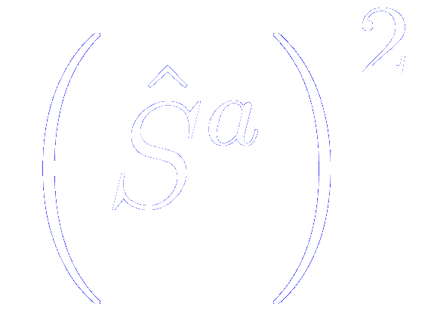
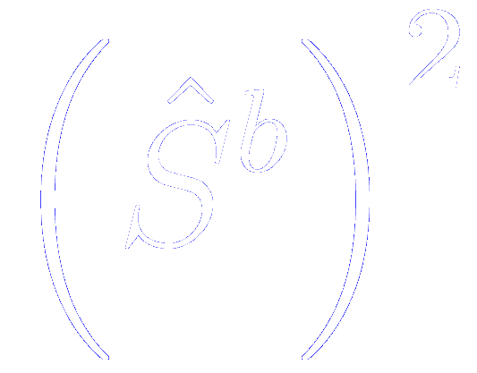
The coupling of two spins: eigenvalue of different operators
Combining two spin-1/2 particles results in a joint entity with spin quantum number
The eigenvalue of is
The eigenvalue of and
are 3/4
Since
Since

Slide 15
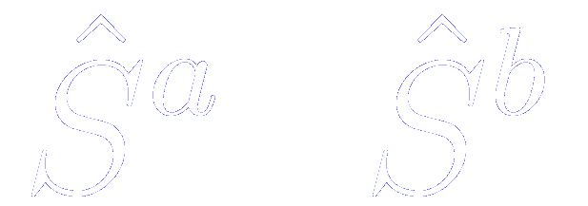
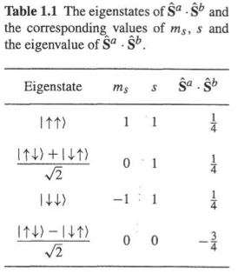
The coupling of two spins: eigenstates of different operators
Let us consider the following basis
First arrow: z-component of the spin labelled as a
Second arrow: z-component of the spin labelled as b
The eigenstates of are linear combination of these basis states
The degeneracy of each state of each state is given by
Triplet
Singlet

Slide 16
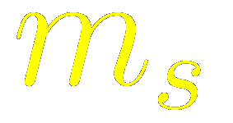
The coupling of two spins: eigenstates of different operators
Let us consider the following basis
First arrow: z-component of the spin labelled as a
Second arrow: z-component of the spin labelled as b
The eigenstates of are linear combination of these basis states
The z component of the spin of the state,
Is the sum of the z components of the individual spins
Because eigenstates are mixtures of states in the original basis, it is not possible in general to know both the z-component of the original spins and the total spin of the resultant entity
Triplet
Singlet

Slide 17
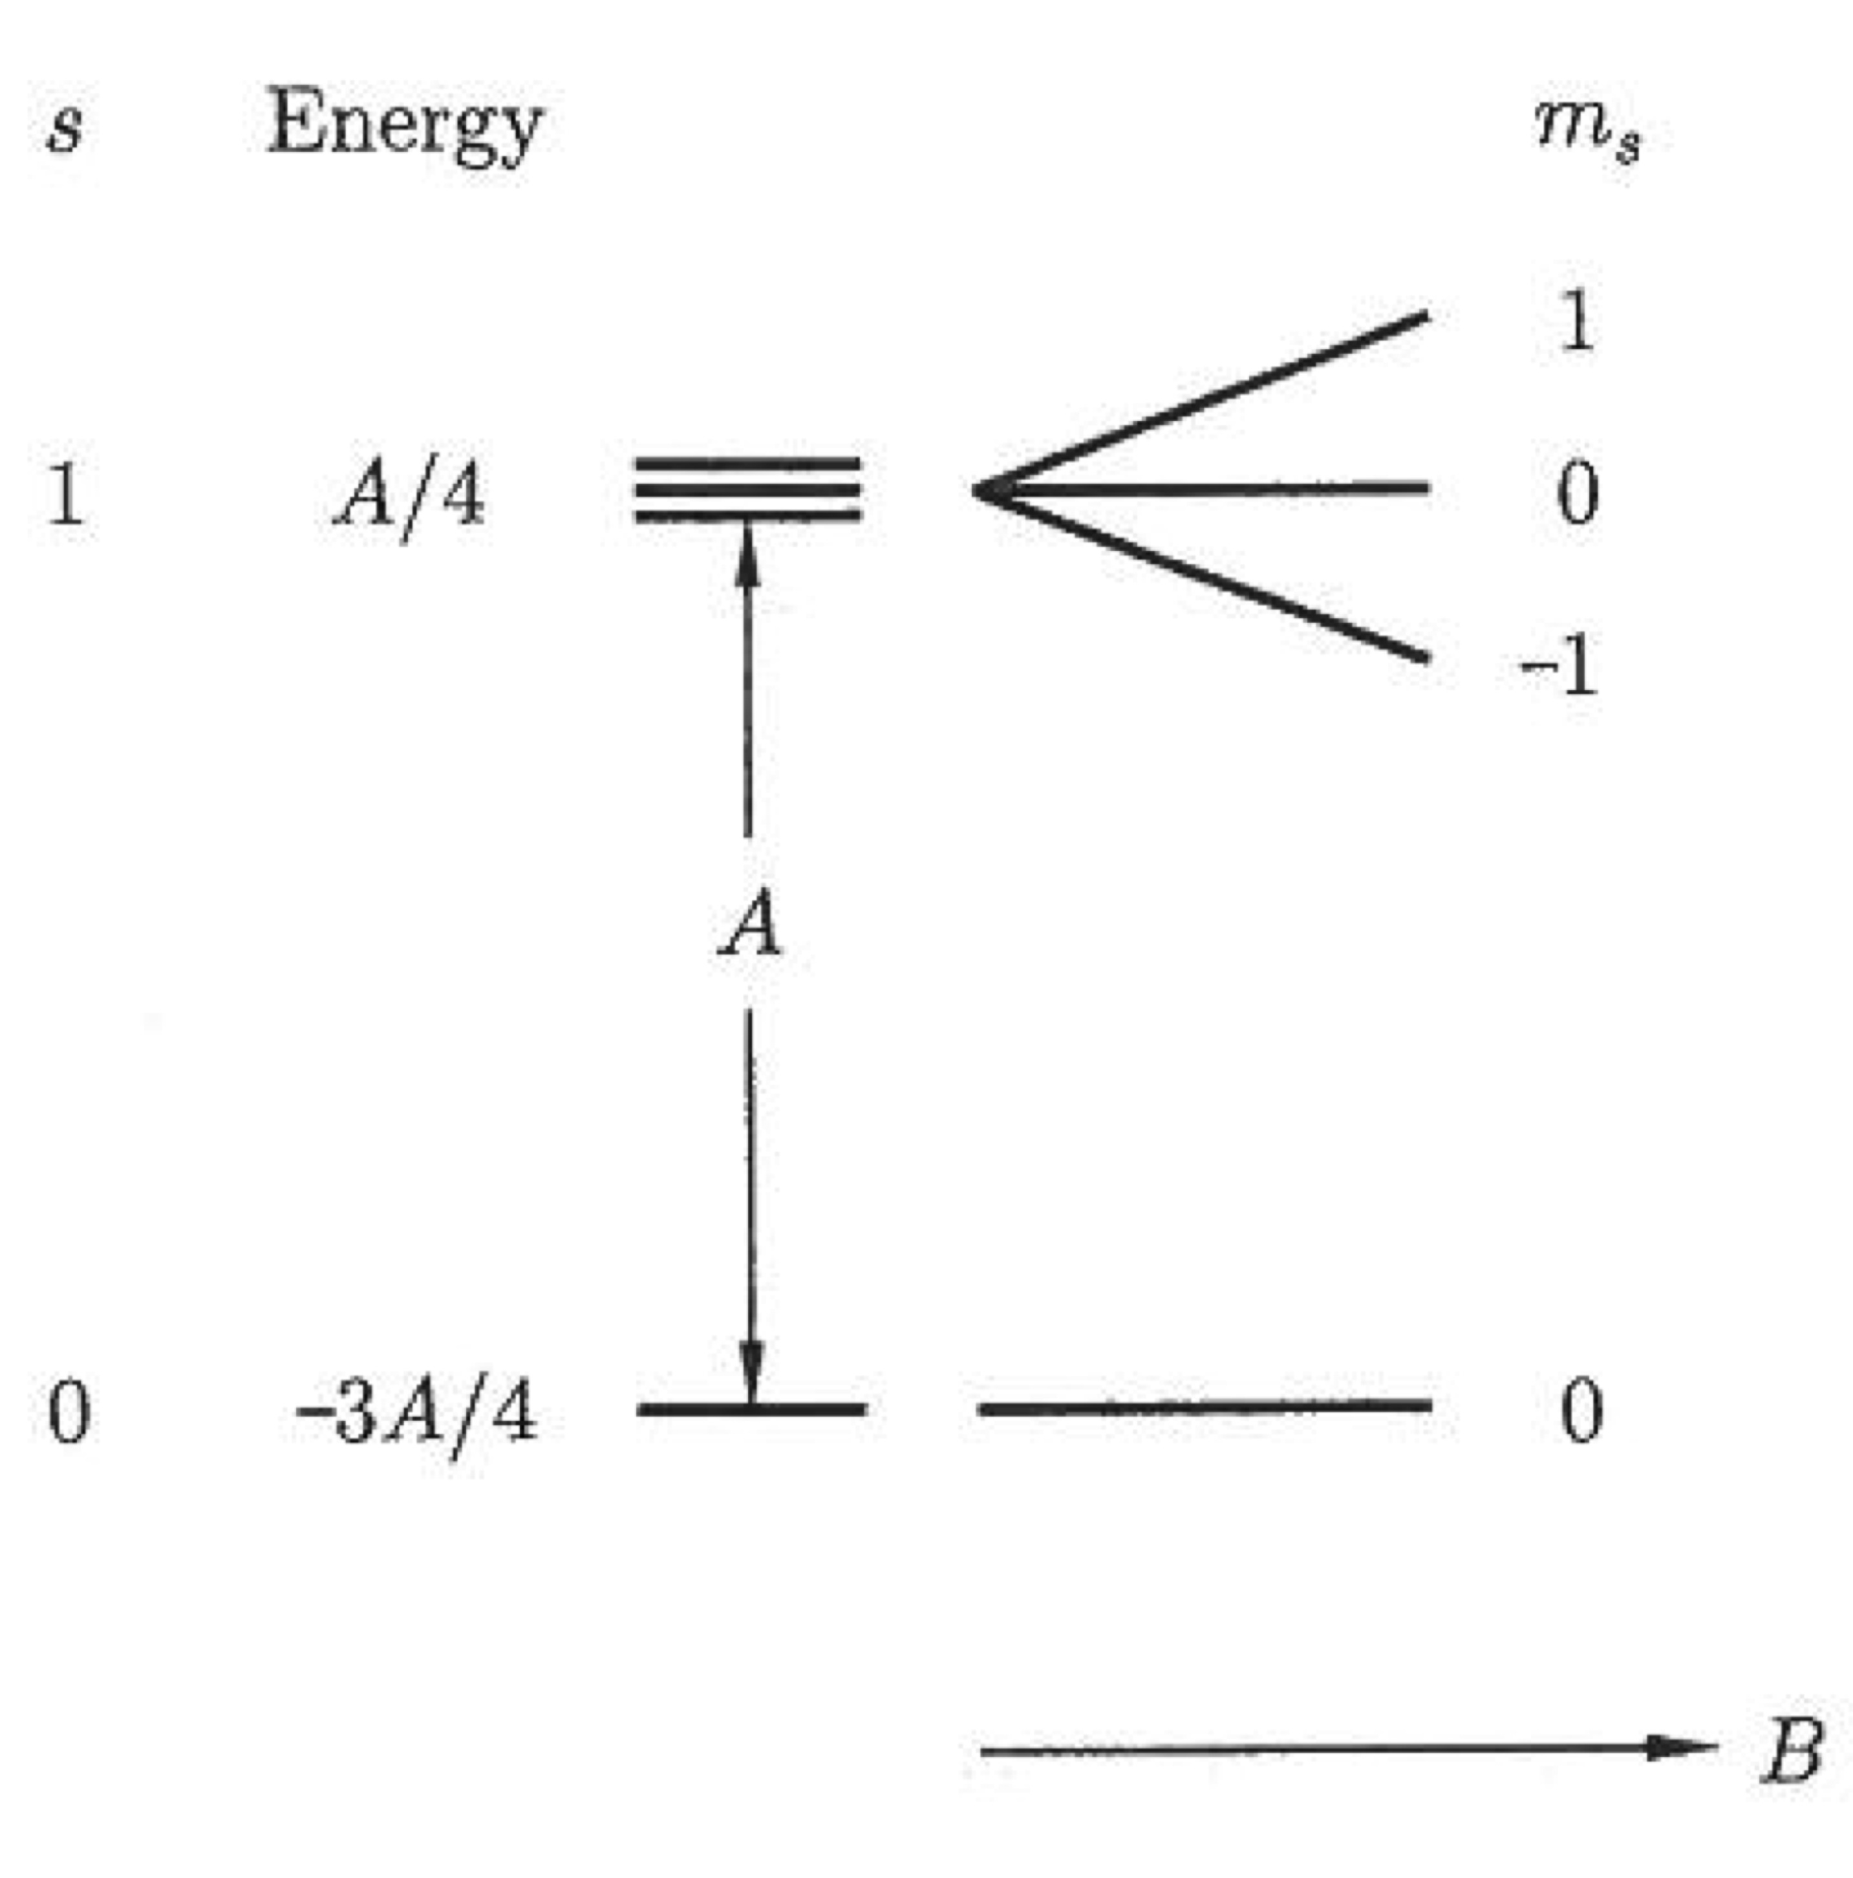
The coupling of two spins: Summary
A assumed to be positive in the diagram

Slide 18
Mean value of the energy in the singlet and triplet states
The difference in energies between the singlet and the triplet state is
(to obtain this expression remembers that the Hamiltonian operator is self-adjoint)
The difference between single and triplet states can be parametrized by
For a singlet state
For a triplet state
The Hamiltonian can be written in the form of an effective Hamiltonian

Slide 19
Effective Hamiltonian to describe singlet and triplet states
The Hamiltonian can be written in the form of an effective Hamiltonian
Constant term:
Can be absorbed into other constant energy-terms
Spin-dependent term:
Since
We can define the exchange constant (or exchange integral) as
And hence, the spin dependent term in the model Hamiltonian can be written as

Slide 20
Effective Hamiltonian to describe singlet and triplet states
And hence, the spin dependent term in the model Hamiltonian can be written as

Slide 21
Generalization for more than two electrons
The spin dependent term in the model Hamiltonian can be written as
Generalizing to a many-body system is far from trivial
Since the early days of Quantum Mechanics, it was recognized that interactions such as the previous one probably apply between all neighboring atoms
This motivates the Hamiltonian of the Heisenberg model
The factor of 2 is omitted because the summation includes each pair of spins twice
The factor of 2 appears because the summation on i >j avoids the double counting

Slide 22
General features respect the (complicate) calculation of exchange integrals
If the two electrons are on the same atom the exchange integral is usually positive
Antisymmetric spatial state
Minimizes the Coulomb repulsion between the two electrons by keeping them apart
Good agreement with Hund’s first rule

Slide 23
General features respect the (complicate) calculation of exchange integrals
If the two electrons are on neighboring atoms
Any joint state will be a combination of a state centered on one atom and a state centered on the other
The correct states to consider are molecular orbitals that can be:
- Bonding (spatially symmetric) (asymmetric spin state)
- Antibonding (spatially asymmetric) (symmetric spin state)
Antisymmetric state usually more energetic
(more curvature that implies larger kinetic energy),
and the system tends to be in the bonding state

Slide 24
Aditional information

Slide 25
Direct exchange
If the electrons in neighboring magnetic atoms interact via an exchange interaction, this is known as direct exchange
The exchange interaction proceeds directly without the need for an intermediary.
Physical situation is rarely that simple:
Very often, direct exchange cannot be an important mechanism in controlling the magnetic properties because there is insufficient direct orbital between neighboring magnetic orbitals
4f electrons in rare earths are strongly localized
3d transition metals, extremely difficult to justify magnetic properties from direct exchange. Some of these materials (Fe, Co, Ni) are metals, and conduction (delocalized) electrons should not ne neglected.

Slide 26
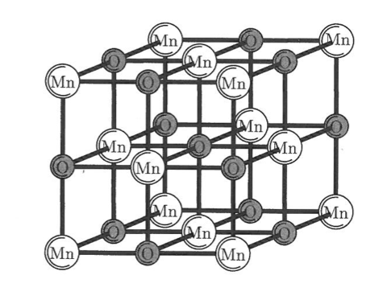
Indirect exchange in ionic solids: superexchange
Superexchange is defined as an indirect exchange interaction between non-neighboring magnetic ions which is mediated by a non-magnetic ion which is placed in between the magnetic ion
Imagine two transition metal ions separated by an oxygen atom
(for instance Mn²⁺ manganese ions connected via O²⁻ oxygen ions in MgO)
For simplicity, we assume that the magnetic moment on the transition metal ion is due to a single unpaired electron
In the perfectly ionic picture, each metal ion would have a single unpaired electron in a d-orbital and the oxygen would have two p-electrons in its outermost occupied state

Slide 27
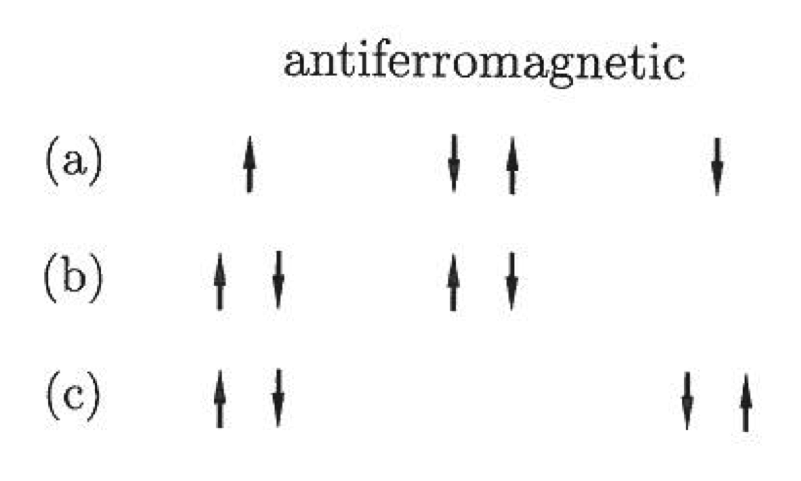
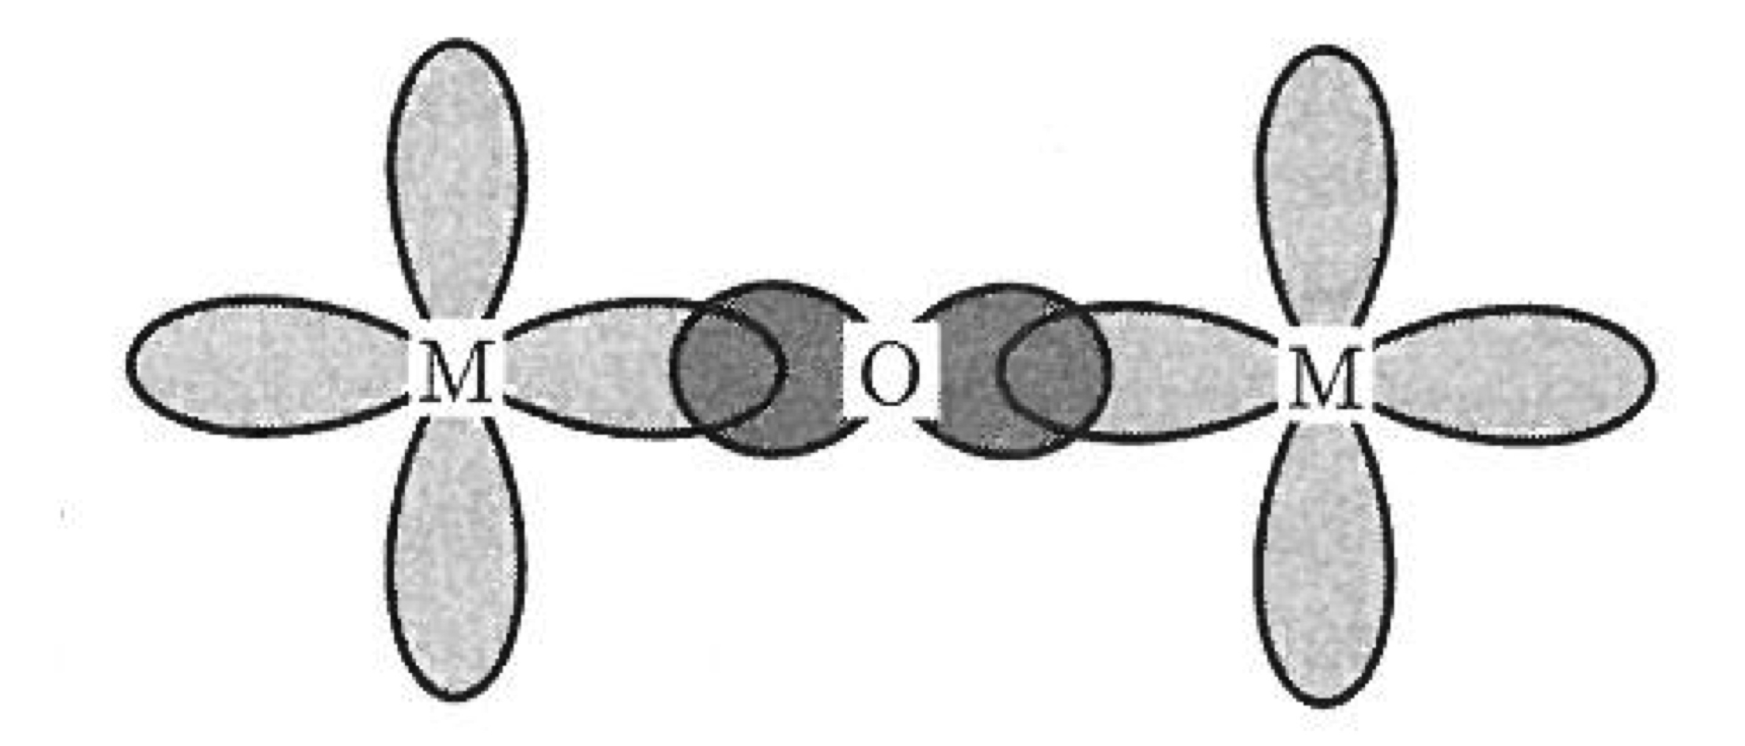
Indirect exchange in ionic solids: superexchange
Superexchange is defined as an indirect exchange interaction between non-neighboring magnetic ions which is mediated by a non-magnetic ion which is placed in between the magnetic ion
In the perfectly ionic picture, each metal ion would have a single unpaired electron in a d-orbital and the oxygen would have two p-electrons in its outermost occupied state
In the antiferromagnetic configuration, two electrons with spin up and two electrons with spin down
The ground state configuration is (a)
But the excited states (b) and (c) are also possible
Therefore (a) can mix with the excited states (b) and (c) and the magnetic electrons can be delocalized over the M-O-M unit, lowering the kinetic energy

Slide 28
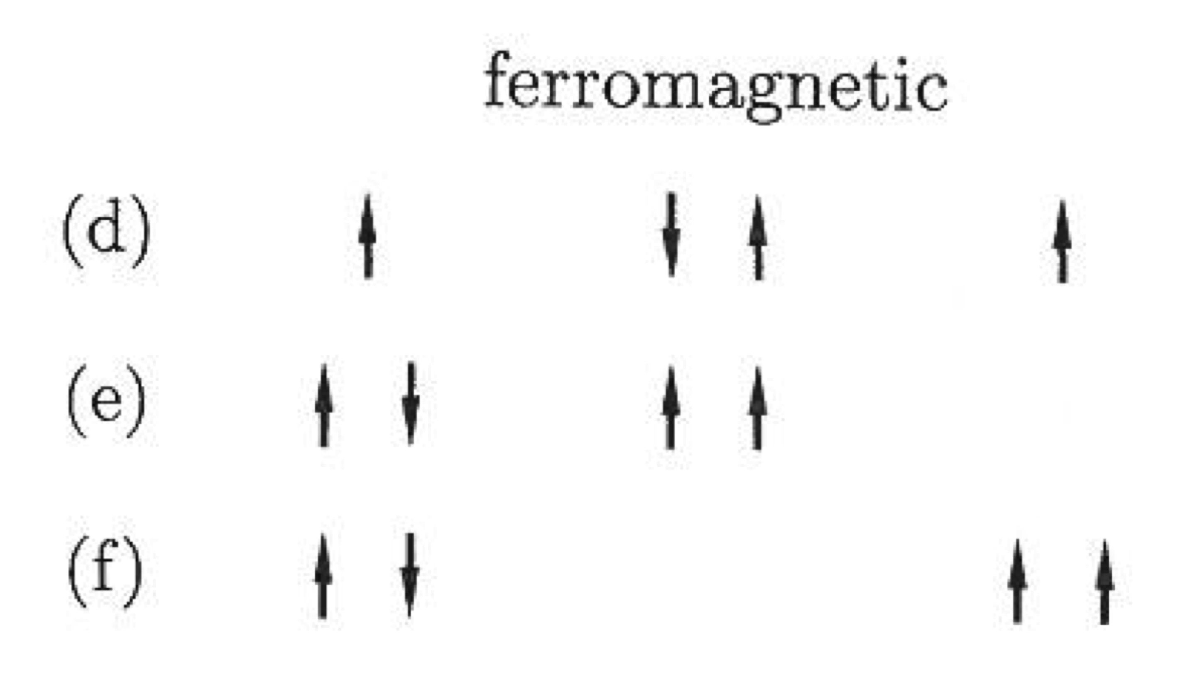
Indirect exchange in ionic solids: superexchange
Superexchange is defined as an indirect exchange interaction between non-neighboring magnetic ions which is mediated by a non-magnetic ion which is placed in between the magnetic ion
In the perfectly ionic picture, each metal ion would have a single unpaired electron in a d-orbital and the oxygen would have two p-electrons in its outermost occupied state
In the ferromagnetic configuration, three electrons with spin up and one electron with spin down
The ground state configuration is (a)
The excited states (b) and (c) are not possible due to exclusion principle
Therefore (a) cannot mix with the excited states (b) and (c). The ferromagnetic state is more localized and costs more energy.

Slide 29
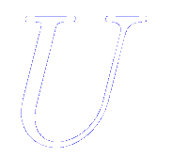
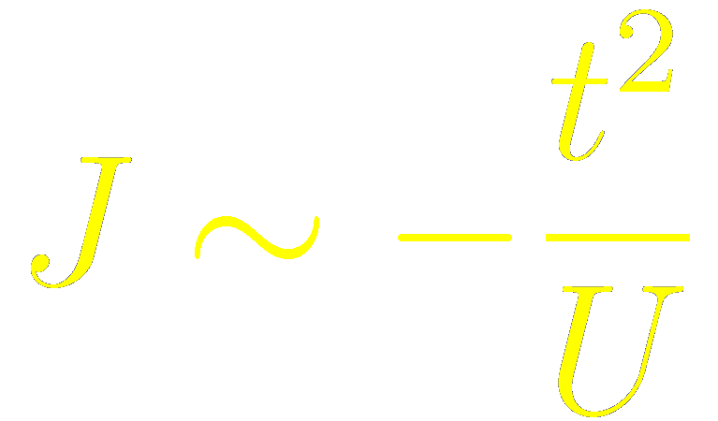
Indirect exchange in ionic solids: superexchange
Superexchange is a second order process and is derived from second order perturbation theory
The energy involved is:
Directly proportional to the square of the matrix element of the transition
Inversely proportional to the to the energy cost of making the transition state
Related with the width of the conduction band in a simple tight-binding approach
Related with the Coulomb energy

Slide 30
Indirect exchange in ionic solids: superexchange
The exchange integral consists of two parts
Potential exchange term
Kinetic exchange term
Represents the electron repulsion.
Favours ferromagnetic state.
Small when the atoms are well separated
Favours delocalization of the electrons.
Dominates when the atoms are well separated.
Strongly dependent upon the angle of the M-O-M bond.

Slide 31
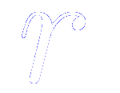
Indirect exchange in metals: RKKY interaction
In metals, the exchange interaction between magnetic ions can be mediated by the conduction electrons
A localized magnetic moment spin polarizes the conduction electrons
This polarization, in turn, couples to a neighbouring localized magnetic moment a distance away
The magnetic interaction is indirect because it does not involve direct coupling between magnetic moments.
Ruderman, Kittel, Kasuya and Yoshida interaction
The interaction is long range
It might be ferro or antiferro depending on the distance
Oscillatory coupling, with wave length because sharpness of Fermi surface

Slide 32
Double exchange
A ferromagnetic exchange interaction which occurs because the magnetic ion can show mixed valency, i.e. that it can exist in more than one oxidation state
Examples: compounds containing the Mn ion which can exist in oxidation state 3 or 4 (Mn³⁺ or Mn⁴⁺)
La_{1-x}Sr_{x}MnO₃
Sr is divalent (Sr⁺²) a fraction x of the Mn ions are Mn⁴⁺
La is trivalent (La⁺³) a fraction (1-x) of the Mn ions are Mn³⁺
The end members of the series are both antiferromagnetic insulators (as expected for an oxide material in which magnetism is mediated by superexchange through the oxygen
When LaMnO₃ is doped with Sr up to x = 0.175, the Jahn-Teller distortion vanishes and the system becomes ferromagnetic with a Curie temperature around room temperature, below which the system is metallic

Slide 33
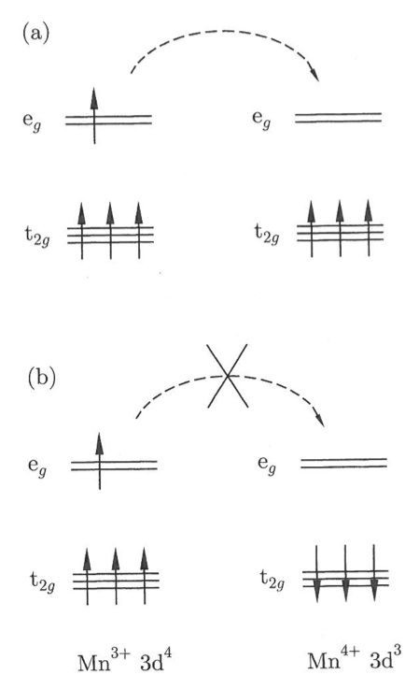
Double exchange
A ferromagnetic exchange interaction which occurs because the magnetic ion can show mixed valency, i.e. that it can exist in more than one oxidation state
La_{1-x}Sr_{x}MnO₃
The e_{g} electron of a Mn³⁺ ion can hop to the neighboring site only if there is a vacancy there with the same spin
(hopping proceeds without spin flip of the hopping electron)
If the neighboring atom is a Mn⁴⁺
(no electrons in its e_{g} shell),
this should present no problem
However, there is a strong single-center exchange interaction between the e_{g} electron and the t_{2g} level, which wants to keep them all aligned
Ferromagnetic alignement of neighboring ions is therefore required to maintain the high-spin alignment on the donating and receiving ion

Slide 34
The Pauli spin matrices
Any two by two matrix can be written in terms of them (they are a basis of the Hilbert space of the (2×2) matrices
Any matrix that can be written has four numbers in it
It can be written as a linear combination of four matrices
One special way of doing this is to choose the Pauli spin matrices as the basis
Are complex numbers

Slide 35
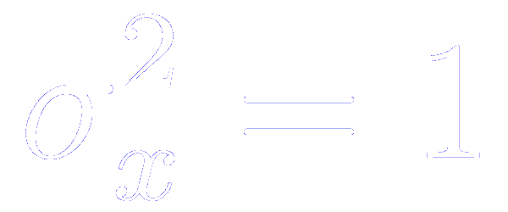
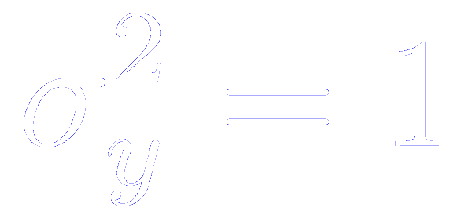
Products of the Pauli spin matrices

Slide 36
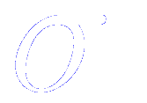
Pauli spin matrices as components of a vector of matrices
You can use in different coordinate systems as though it is a vector

Slide 37
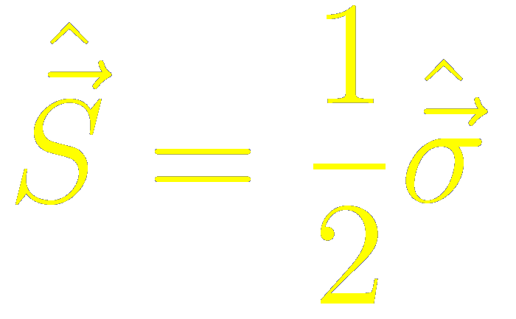
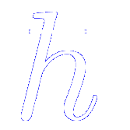
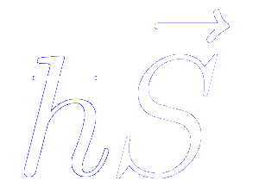
Definition of the spin angular momentum operator
We define the spin angular momentum operator by
Or, in components
We are using the convention that the angular momentum is measured in units of
The angular momentum associated with an electron is

Slide 38
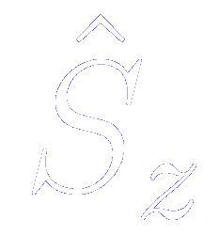
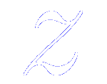
Definition of the spin angular momentum operator
We define the spin angular momentum operator by
Or, in components
Only the operator is diagonal.
If the electron spin points along the representation is particularly simple

Slide 39
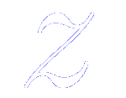
Representation of the spin operator along -direction
Eigenstates of
Eigenvalues of
Spin pointing parallel to the -axis
Spin pointing antiparallel to the -axis

Slide 40
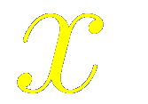
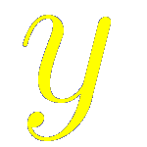
Eigenstates corresponding to the spin pointing parallel or antiparallel to the and axis
axis
axis
These eigenstates are normalized
All of them have the same magnitude of the eigenvalue: ½
positive if pointing parallel to the axis
negative if pointing antiparallel

Slide 41
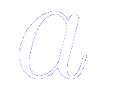
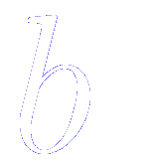
Spinor representation: the two-component representation of the spin wave function
Where and are complex numbers and it is conventional to normalize the state

Slide 42
Total spin angular momentum operator
The spin square operator is given by
Since the eigenvalues of are always
So we have the result that for any spin state,

Slide 43
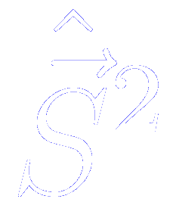
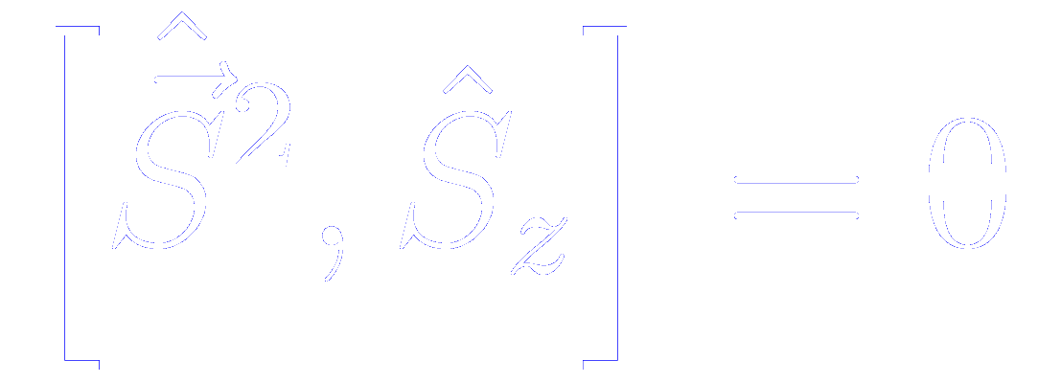
Commutation relations between the spin operators
From the commutation relations of the Pauli matrices, it follows immediatly than
And cyclic permutations thereof.
Besides, each of these components commute with
Thus, it is possible to know simultaneously the total spin and one of the components, but it is impossible to know more than one component simultaneously

Slide 44
Raising and lowering operator
Raising operator
Lowering operator
They are not Hermitian operators (not observables)

Slide 45
Raising and lowering operator effect on spin states
The raising operator will raise the component of the spin angular momentum by
The lowering operator will lower the component of the spin angular momentum by
If the component of the spin angular momentum is already at its maximum (minimum) level, the raising (lowering) operator will annihilate the state

