Slide 1

Molecular dynamics in different ensembles
Javier Junquera

Slide 2
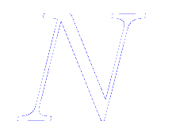

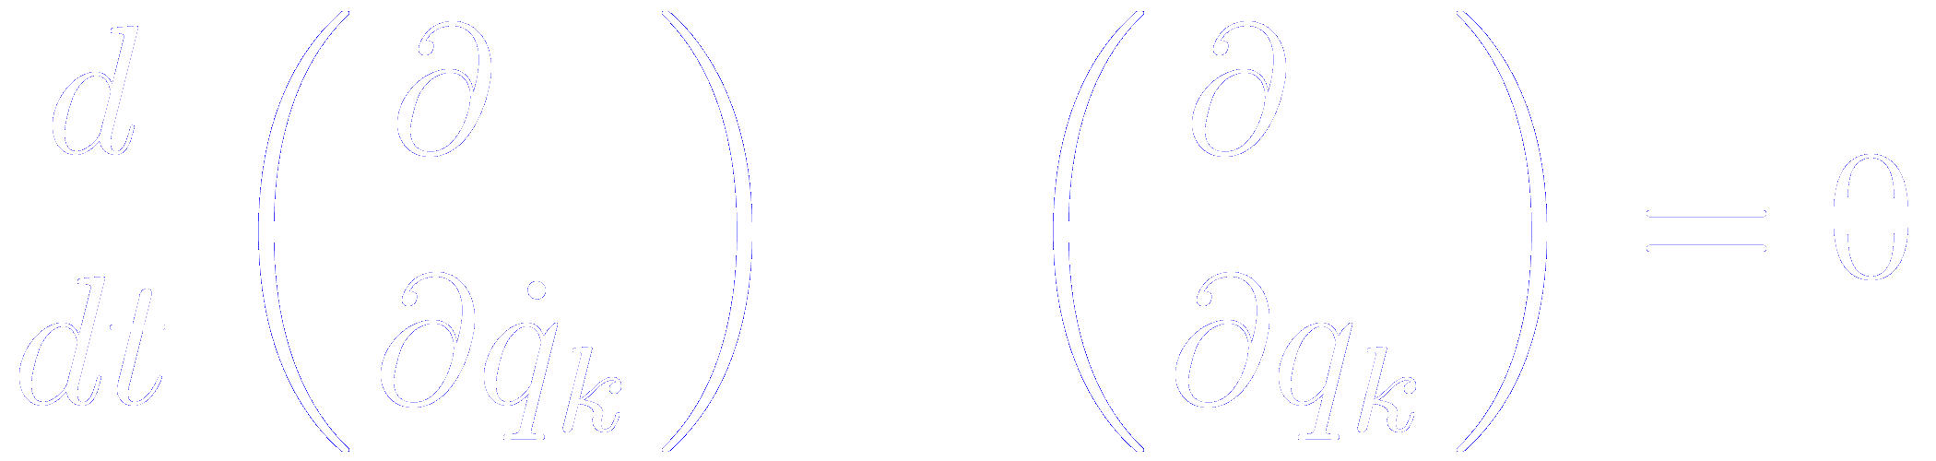
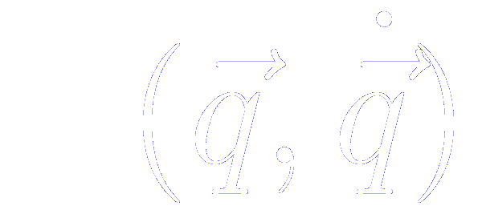
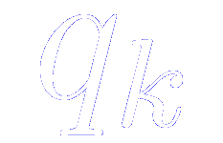
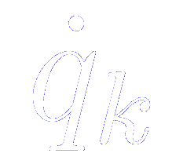

Equations of motion for atomic systems
Classical equation of motion for a system of molecules interacting via a potential
The most fundamental form: the Lagrangian equation of motion
Where the Lagrangian function is defined in terms of the kinetic and potential energies, and is considered to be a function of the generalized coordinates and their time derivatives

Slide 3
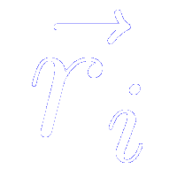
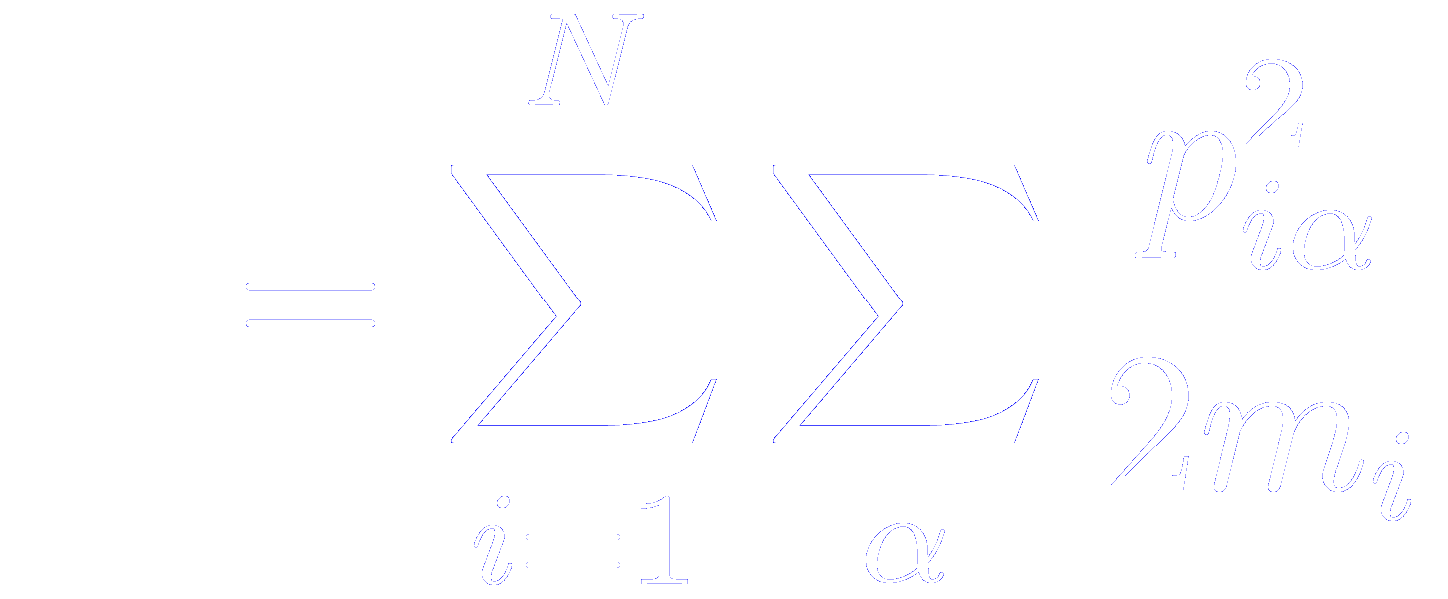
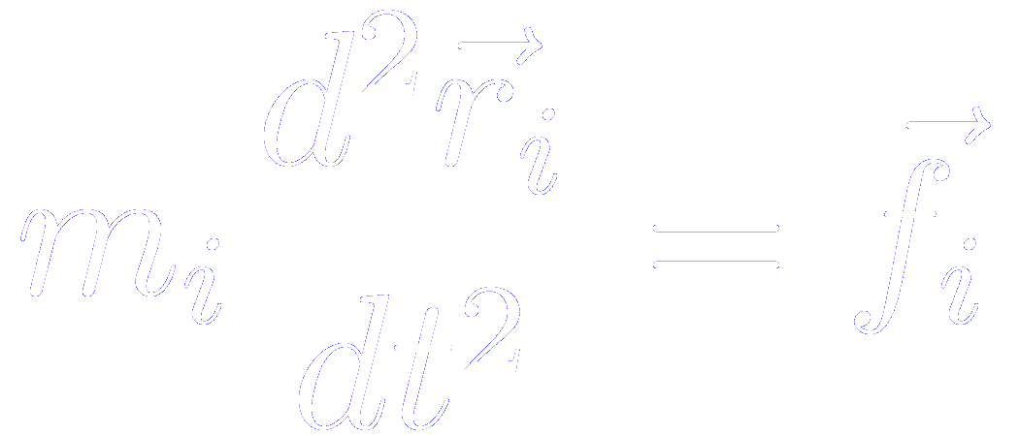
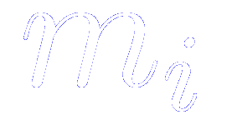
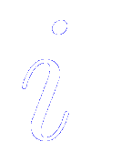
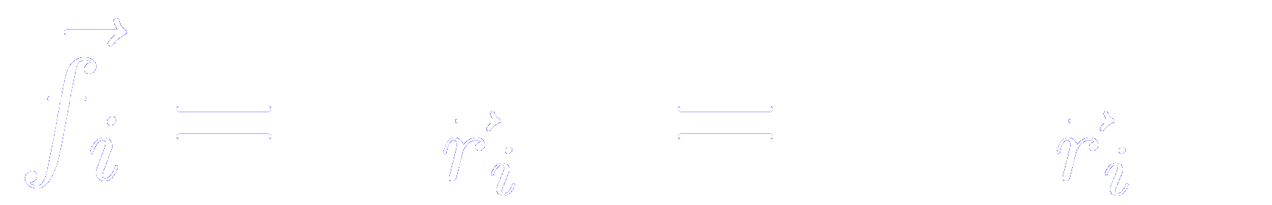
Equations of motion for atomic systems in cartesian coordinates
Classical equation of motion for a system of molecules interacting via a potential
If we consider a system of atoms with Cartesian coordinates , and the usual definitions of the kinetic and potential energies
Then, the equation of motion transforms into
where is the mass of atom and the force on that atom is given by

Slide 4
Equations of motion for atomic systems in cartesian coordinates
Classical equation of motion for a system of molecules interacting via a potential
This equation also aplies to the center of mass motion of a molecule, with the force begin the total external force acting on it

Slide 5
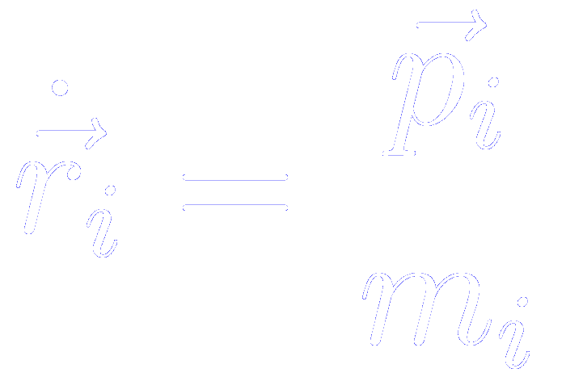
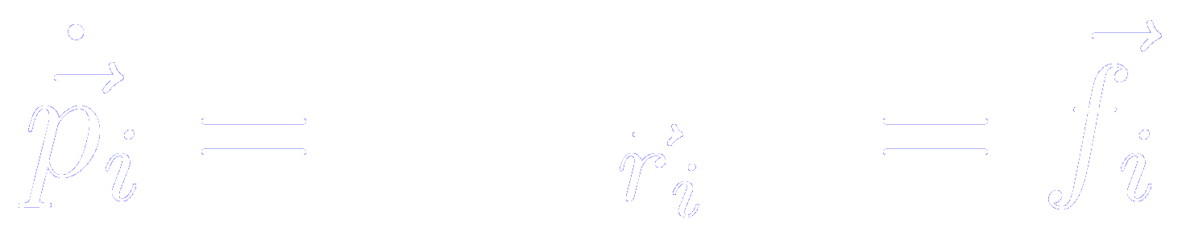
Hamilton’s equation of motion in cartesian coordinates
For a derivation of these expressions, read Goldstein, Chapter 8

Slide 6
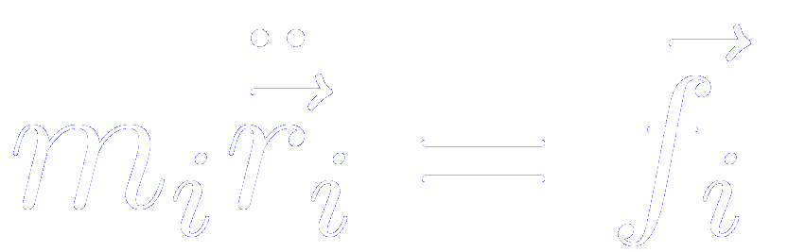
Hamilton or Lagrange equations of motion
Lagrange’s equation
Hamilton’s equations
To compute the center of mass trajectories involves solving…
A system of 3N second order differential equations
Or an equivalent set of 6N first-order differential equations

Slide 7
Hamilton or Lagrange equations of motion
Lagrange’s equation
Hamilton’s equations
To compute the center of mass trajectories involves solving…
A system of 3N second order differential equations
Or an equivalent set of 6N first-order differential equations

Slide 8

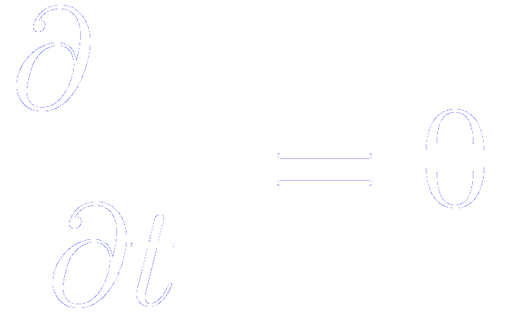
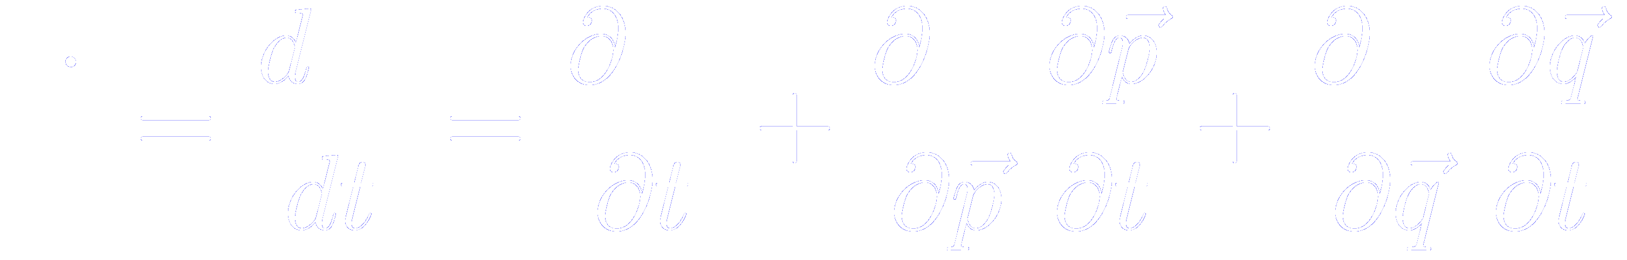
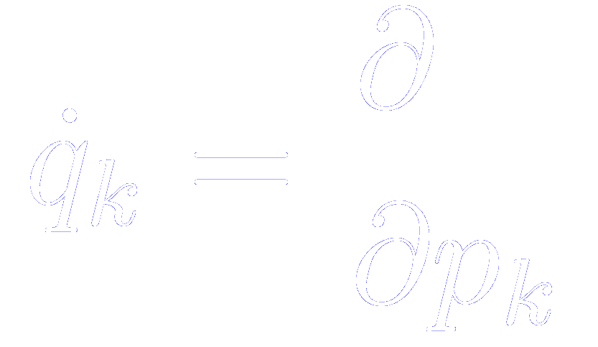
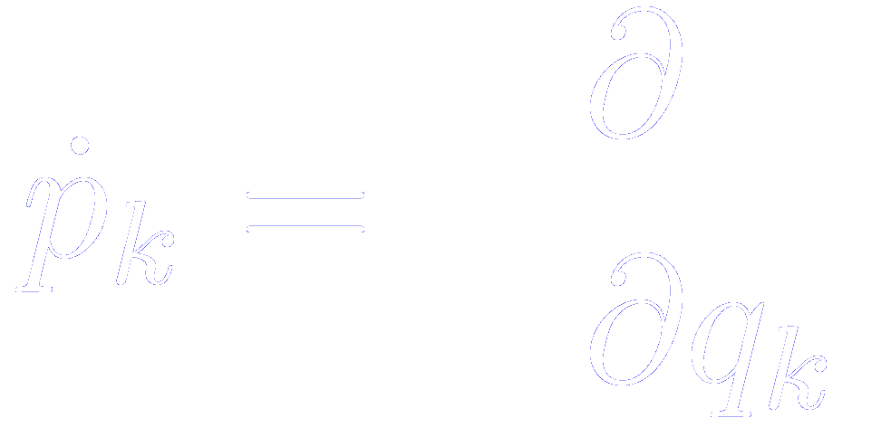
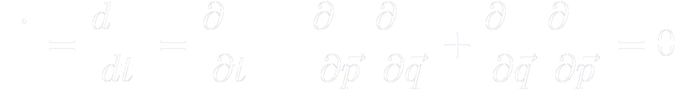
Conservation laws
Assuming that and do not depend explicitly on time, so that
Essential condition:
No explicitly time dependent or velocity dependent force acting
Then, the total derivative of the Hamiltonian with respect to time
From the Hamilton’s equation of motion
The Hamiltonian is a constant of motion
Independent of the existence of an external potential

Slide 9
The equations are time reversible
By changing the signs of all the velocities and momenta, we will cause the molecules to retrace their trajectories.
If the equations of motion are solved correctly, the computer-generated trajectories will also have this property

Slide 10
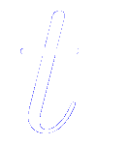
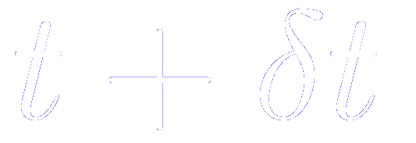
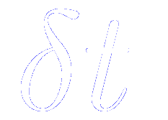
Standard method to solve ordinary differential equations: the finite difference approach
Given molecular positions, velocities, and other dynamic information at a time
We attempt to obtain the position, velocities, etc. at a later time , to a sufficient degree of accuracy
Notes:
The equations are solved on a step by step basis
The choice of the time interval will depend on the method of solution, but will be significantly smaller than the typical time taken for a molecule to travel its own length

Slide 11
Many different algorithms within the finite different methodology
Predictor-corrector algorithm

Slide 12
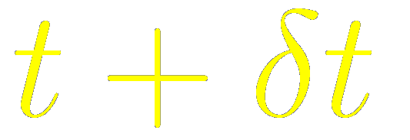

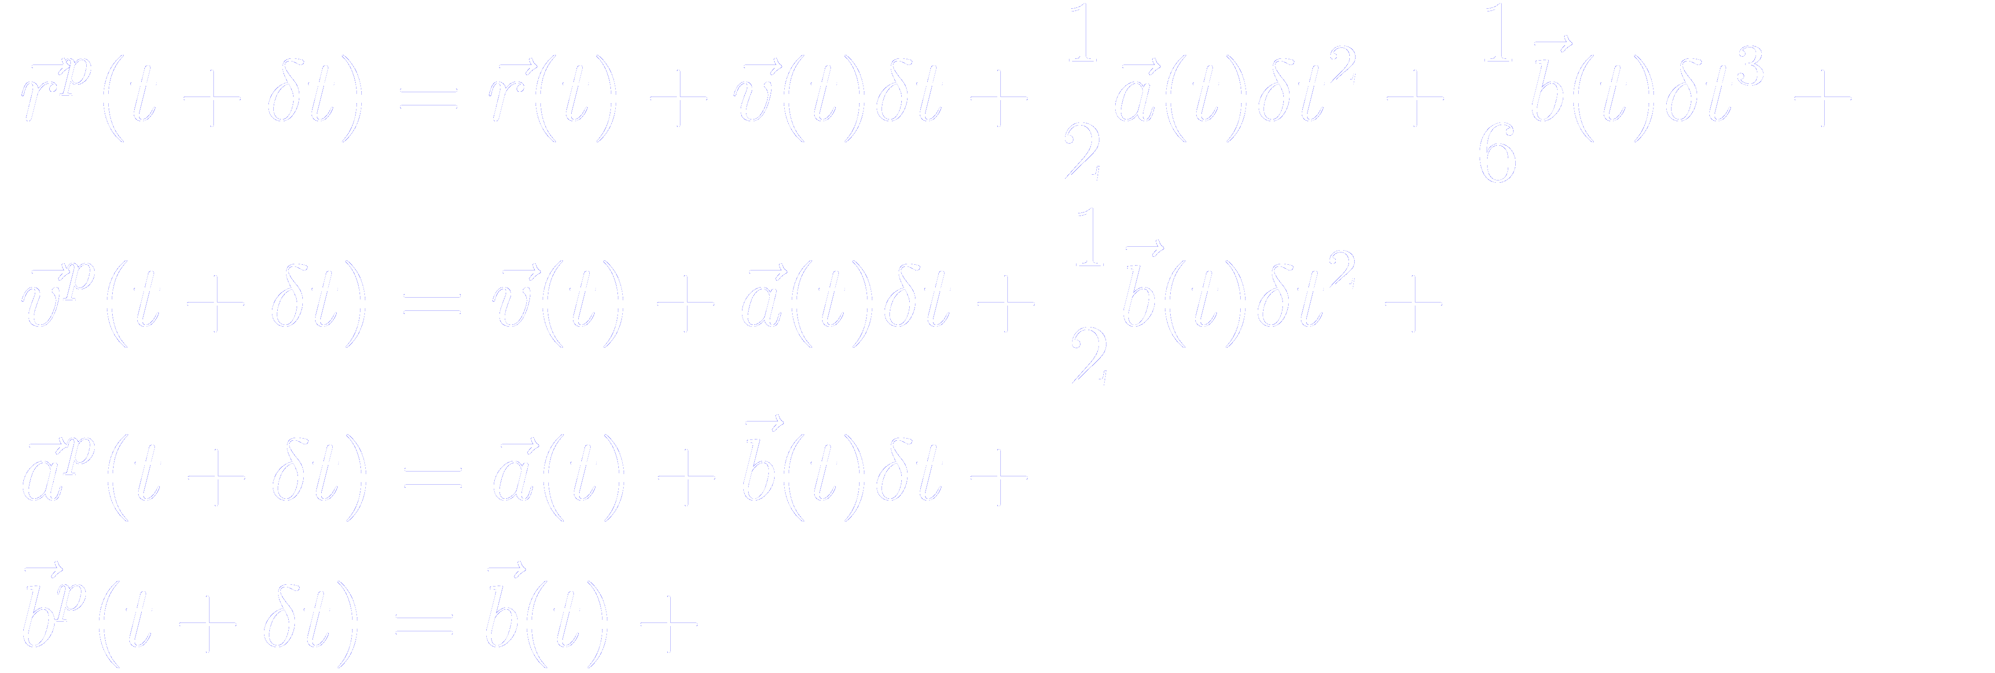

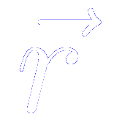
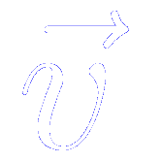
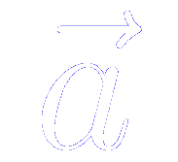
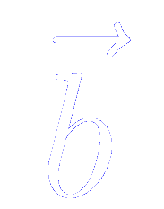
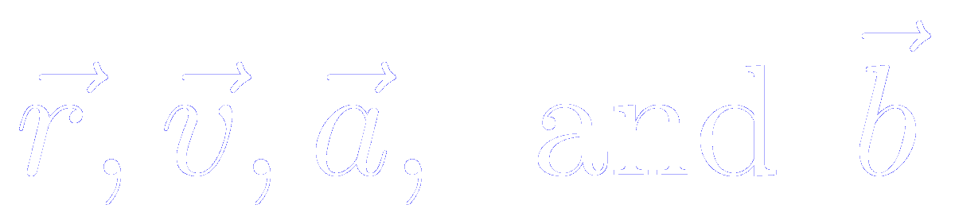
If the classical trajectory is continuous, then an estimate of the positions, velocities, accelerations at can be obtained by a Taylor expansion about time
stands for “predicted”
stands for the complete set of positions
stands for the complete set of velocities
stands for the complete set of accelerations
stands for the complete set of third derivatives of the position
We store four “vectors” per atom:

Slide 13
If the classical trajectory is continuous, then an estimate of the positions, velocities, accelerations at can be obtained by a Taylor expansion about time
stands for “predicted”
If we truncate the expansion retaining the terms given above
We have achieved our goal of approximately advancing the values of the dynamical quantites from one time step to the next
We will not generate correct trajectories as time advances because we have not introduced the equations of motion

Slide 14
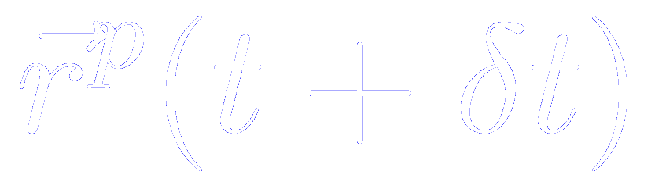
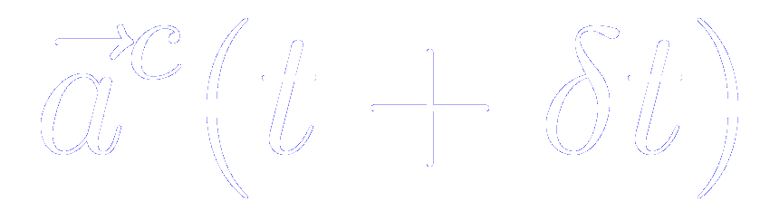
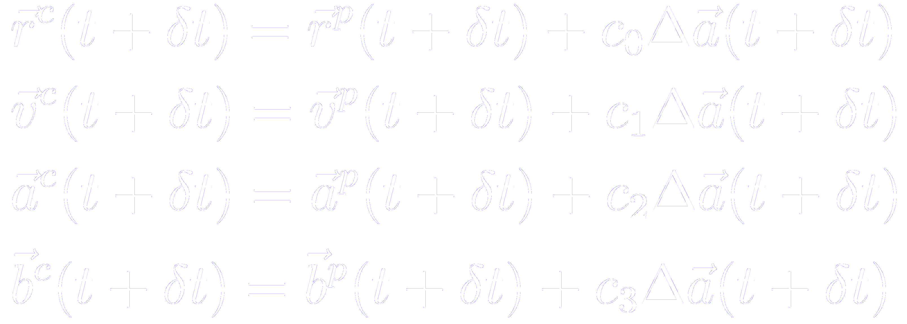
The equations of motion are introduced through the correction step
From the new predicted positions we can compute the forces at time , and hence correct accelerations
The correct accelerations can be compared with the predicted accelerations to estimate the size of the error in the prediction step
This errors, and the results of the predictor step, are fed into the corrector step
These positions, velocities, etc. are better approximations to the true positions, velocities, etc.

Slide 15

“Best choices” (leading to optimum stability and accuracy of the trajectories) for the coefficients discussed by Gear
Different values of the coefficients are required if we include more (or fewer) position derivatives in our scheme
The coefficients also depend upon the order of the differential equation being solved (second order in our case)
If the positions, velocities, accelerations, etc. are unscaled, factors involving the time scaled are required (see algorithm below)

Slide 16
Implementation of Gear’s predictor-corrector algorithm
The predictor part

Slide 17
Implementation of Gear’s predictor-corrector algorithm
The corrector part

Slide 18
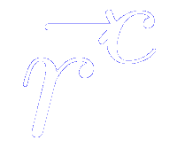
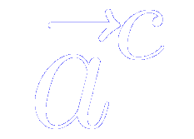
The corrector step might be iterated till convergence
New correct accelerations are computed from the positions and compared with the current values of , so as to further refine the positions, velocities, etc.
In many applications this iteration is key to obtaining an accurate solution
However, each iteration requires a computation of the forces from particle positions (the most time-consuming part of the simulation)
⇒ A large number of corrector iterations would be very expensive. Normally one (occasionally two) corrector steps are carried out

Slide 19
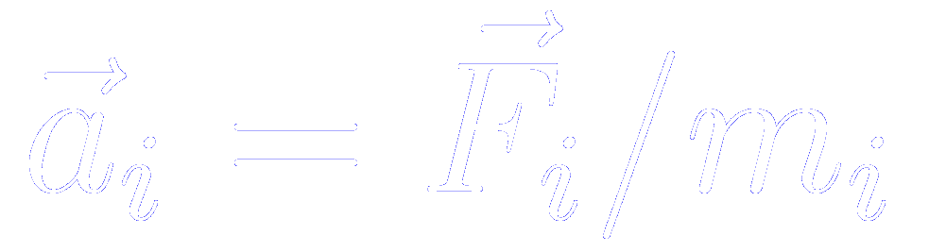
General step of a stepwise Molecular Dynamics simulation
Predict the positions, velocities, accelerations, etc. at a time , using the current values of these quantities
Evaluate the forces, and hence the accelerations from the new positions
Correct the predicted positions, velocities, accelerations, etc. using the new accelerations
Calculate any variable of interest, such as the energy, virial, order parameters, ready for the accumulation of time averages, before returning to the first point for the next step

Slide 20
Desirable qualities for a successful simulation algorithm
It should be fast and require little memory
Since the most time consuming part is the evaluation of the force, the raw speed of the integration algorithm is not so important
It should permit the use of long time step
Far more important to employ a long time step. In this way, a given period of simulation time can be covered in a modest number of steps
It should duplicate the classical trajectory as closely as possible
It should satisfy the known conservation laws for energy and momentum, and be time reversible
It should be simple in form and easy to program
Involve the storage of only a few coordinates, velocitites,…

Slide 21
Desirable qualities for a successful simulation algorithm
It should be fast and require little memory
Since the most time consuming part is the evaluation of the force, the raw speed of the integration algorithm is not so important
It should permit the use of long time step
Far more important to employ a long time step. In this way, a given period of simulation time can be covered in a modest number of steps
It should duplicate the classical trajectory as closely as possible
It should satisfy the known conservation laws for energy and momentum, and be time reversible
It should be simple in form and easy to program
Involve the storage of only a few coordinates, velocitites,…

Slide 22
The accuracy and stability of a simulation algorithm may be tested comparing the result with analytical simple models (Harmonic oscillator, for instance)
Any approximate method of solution will dutifully follow the classical trajectory indefinetely
Small differences in the initial conditions
Small numerical errors
Any two trajectories which are initially very close will eventually diverge from one another exponentially with time
Any small perturbation, even the tiny error associated with finite precision arithmetic, will tend to cause a computer-generated trajectory to diverge from the true classical trajectory with which it is initially coincident

Slide 23
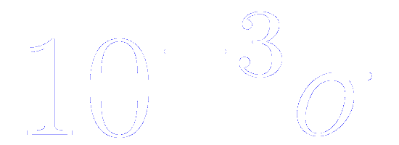
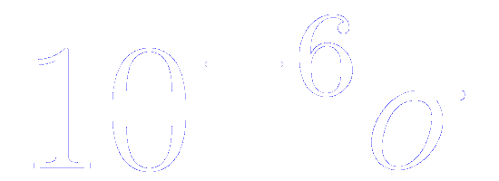
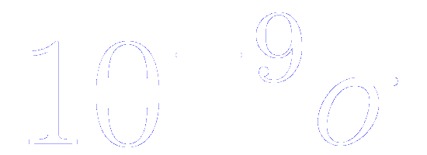
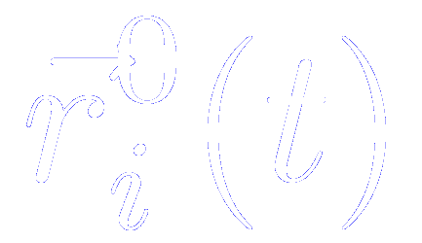
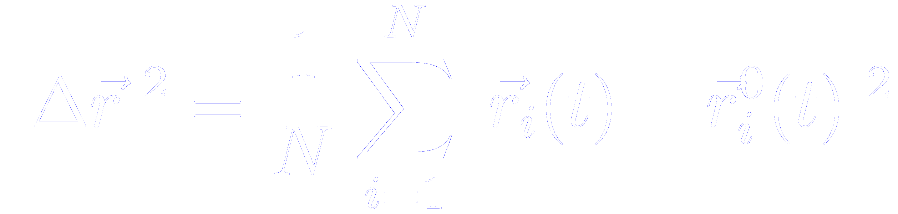
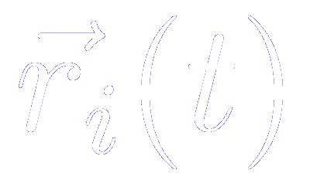
The accuracy and stability of a simulation algorithm may be tested comparing the result with analytical simple models (Harmonic oscillator, for instance)
Any approximate method of solution will dutifully follow the classical trajectory indefinetely
Divergence of trajectories in molecular dynamics
As the time proceeds, other mechanical quantites become statistically uncorrelated
Molecules perturbed from the initial positions at t=0 by
Small differences in the initial conditions
Any two trajectories which are initially very close will eventually diverge from one another exponentially with time
Reference simulation
Perturbed simulation

Slide 24
The accuracy and stability of a simulation algorithm may be tested comparing the result with analytical simple models (Harmonic oscillator, for instance)
Any approximate method of solution will dutifully follow the classical trajectory indefinetely
No integration algorithm will provide an essentially exact solution for a very long time
But this is not really required… What we need are:
Exact solutions of the equations of motion for times comparable with the correlation times of interest, so we can calculate time correlation functions
The method has to generate states sampled from the microcanonical ensemble. The emphasis has to be given to the energy conservation.
The particles trajectories must stay on the appropriate constant-energy hypersurfaces in phase space to generate correct ensemble averages

Slide 25
Energy conservation is degraded as time step is increased
All simulations involve a trade-off between
ECONOMY
ACCURACY
A good algorithm permits a large time step to be used while preserving acceptable energy conservation

Slide 26

Parameters that determine the size of
Shape of the potential energy curves
Typical particle velocities
Shorter time steps are used at high-temperatures, for light molecules, and for rapidly varying potential functions

Slide 27
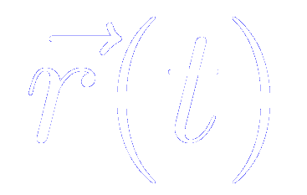
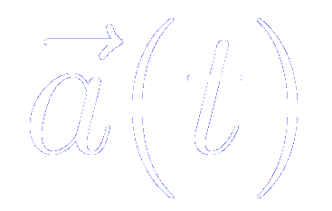
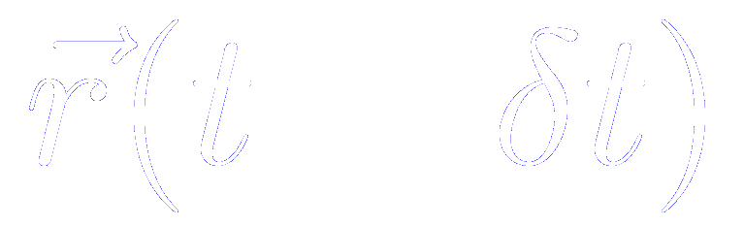
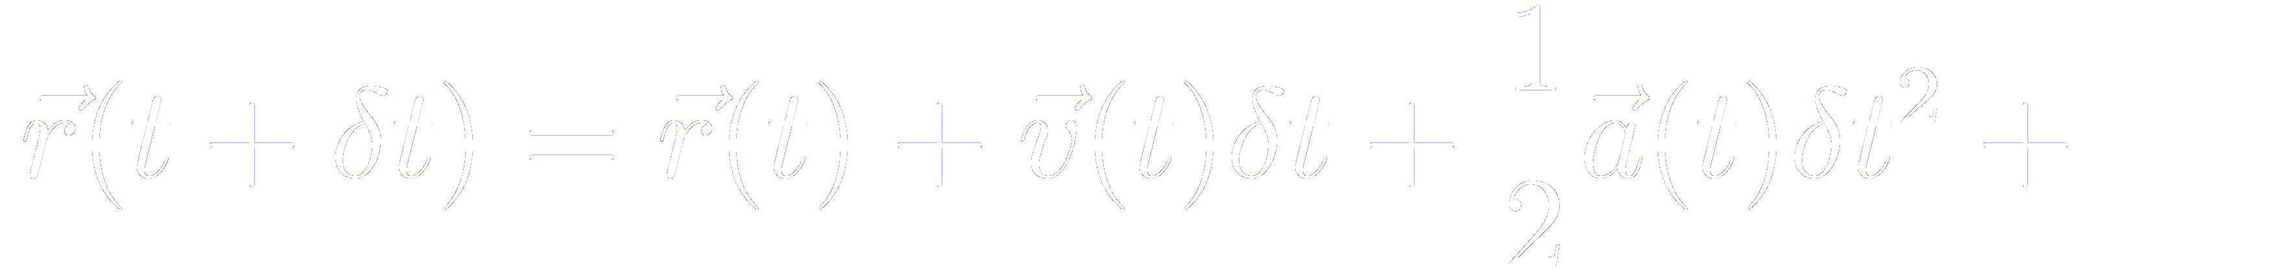
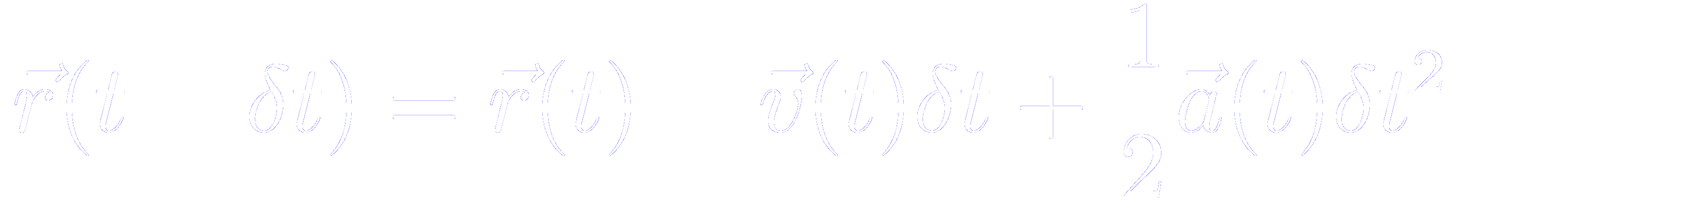
The Verlet algorithm method of integrating the equations of motion: description of the algorithm
Direct solution of the second-order equations
Method based on:
- the positions
- the accelerations
- the positions from the previous step
A Taylor expansion of the positions around t
Adding the two equations

Slide 28
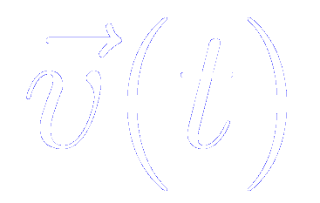
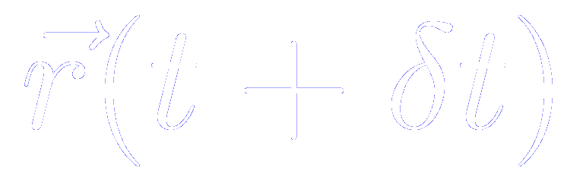
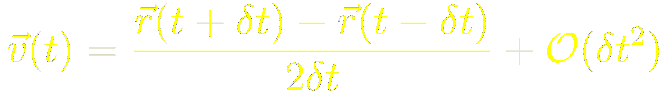
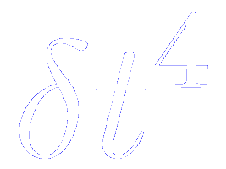

The Verlet algorithm method of integrating the equations of motion: some remarks
Remark 1
The velocities are not needed to compute the trajectories, but they are useful for estimating the kinetic energy (and the total energy).
They can be computed a posteriori using [ can only be computed once is known]
Remark 2
Whereas the errors to compute the positions are of the order of
The velocities are subject to errors of the order of

Slide 29
The Verlet algorithm method of integrating the equations of motion: some remarks
Remark 3
The Verlet algorithm is properly centered: and play symmetrical roles.
The Verlet algorithm is time reversible
Remark 4
The advancement of positions takes place all in one go,
rather than in two stages as in the predictor-corrector algorithm.

Slide 30
The Verlet algorithm method of integrating the equations of motion: some remarks
Let us assume that we have available current (RX) and old (RXOLD).
The current accelerations (AX) are evaluated in the force loop as usual.
Then, the coordinates are advanced in the following way

Slide 31
The Verlet algorithm method of integrating the equations of motion: some remarks
Let us assume that we have available current (RX) and old (RXOLD).
The current accelerations (AX) are evaluated in the force loop as usual.
Then, the coordinates are advanced in the following way
Use of temporary variables (RXNEWI) to store the new positions.
This is necessary because the current values must be transferred to the “old” positions before being overwritten with the new variables.
The calculation of kinetic energy (SUMVSQ) and the total linear momentum (SUMVX) is included in the loop, since this is the only moment at which and are known.

Slide 32
The Verlet algorithm method of integrating the equations of motion: overall scheme
Known the positions at t, we compute the forces (and therefore the accelerations at t)
Then, we apply the Verlet algorithm equations to compute the new positions
…and we repeat the process computing the forces (and therefore the accelerations at )

Slide 33
The Verlet algorithm method of integrating the equations of motion: advantages
The Verlet algorithm requires 9N words of storage (RX, RXOLD, AX, and the corresponding for the y and z coordinates)
The algorithm is exactly reversible in time, and, given conservative forces, is guaranteed to conserve linear momentum and energy
The method has been shown to have excellent energy conserving properties even in long time steps

Slide 34


The Verlet algorithm method of integrating the equations of motion: drawbacks
The handling of velocities is rather awkward
It may introduce some numerical imprecision
A small term of order …
…is added to a difference of large terms, of order

Slide 35

The half-step “leap-frog” scheme tackles the deficiencies of the Verlet algorithm
Method based on:
- the positions
- the accelerations
- the mid-step velocities
Algorithm

Slide 36

Scheme of the half-step “leap-frog” algorithm
The velocity equation is implemented first, and the velocities leap over the coordinates
Then, we apply the leap-frog algorithm to compute the new positions
Known the new positions, we compute the forces and therefore the accelerations…
…and we repeat the process computing the new velocities at
At a given t, we can compute the velocities, required to calculate the total energy

Slide 37
The half-step “leap-frog” scheme: advantages and disadvantages
Advantages
Elimination of velocities from the leap-frog equations, the method is algebraically equivalent to Verlet’s algorithm
At no stage do we take the difference of two large quantities to obtain a small value, minimizing loss of precision on a computer
Disadvantages
Still do not handle the velocities in a complete satisfactory way

Slide 38


The velocity Verlet algorithm: algorithm and advantages
Algorithm
Advantages
Stores the positions, velocities, and accelerations at the same time t
Minimizes rounds-off errors
The Verlet algorithm can be recovered by eliminating the velocities

Slide 39


Scheme of the velocity Verlet algorithm
Known the positions, velocities and accelerations at t, we compute the new positions at
At this point the kinetic energy is available
The velocities at mid step are computed using
The potential energy has been evaluated in the force loop
Known the new positions, we compute the forces and therefore the accelerations at time
The velocity move is completed

Slide 40
The velocity Verlet algorithm: advantages
The method uses 9N words of storage
Numerically stable
Very simple

Slide 41
The velocity Verlet algorithm:

Slide 42
The velocity Verlet algorithm:

Slide 43


Is the code working?: First check: the conservation laws are properly obeyed
The energy should be “constant”
In fact, small changes in energy will occur.
For simple Lennard-Jones system, fluctuations of 1 part in 10⁴ are generally considered to be acceptable
Energy fluctuations might be reduced by decreasing the time step
Suggestion to check accuracy:
Several short runs should be undertaken, each starting from the same initial configuration and covering the same total time
Each run should employ a different time step (different number of steps )
The root mean square fluctuations for each run should be calculated

Slide 44
Is the code working?: First check: the conservation laws are properly obeyed
Suggestion to check accuracy:
Several short runs should be undertaken, each starting from the same initial configuration and covering the same total time
Each run should employ a different time step (different number of steps )
The root mean square fluctuations for each run should be calculated
If the program is functioning correctly, the Verlet algorithm should give RMS fluctuations that are accurately proportional to

