Slide 1


Advanced Computing
Starting-up:
How to setup the initial conditions for a Molecular Dynamic Simulation
Javier Junquera

Slide 2
The initial configuration
In molecular dynamic simulations it is necessary to design a starting configuration for the first simulation
Initial molecular positions and orientations
Initial velocities and angular velocities
For the first run, it is important to choose a configuration that can relax quickly to the structure and velocity distribution appropriate to the fluid
This period of equilibration must be monitored carefully, since the disapperance of the initial structure might be quite slow

Slide 3
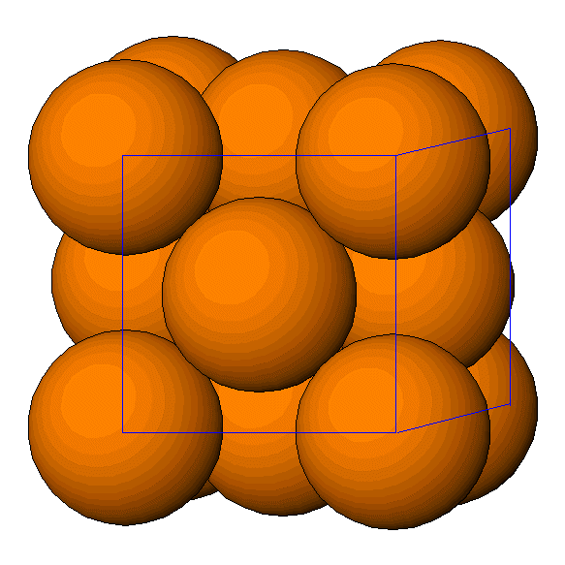
The initial configuration: more usual approach, start from a lattice
Almost any lattice is suitable.
Historically, the face-centered cubic structure has been the starting configuration
The lattice spacing is chosen so the appropriate liquid state density is obtained
During the course of the simulation, the lattice structure will disappear, to be replaced by a typical liquid structure
This process of “melting” can be enhanced by giving each molecule a small random displacement from its initial lattice point

Slide 4
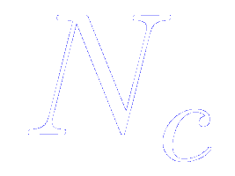
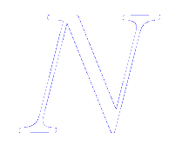
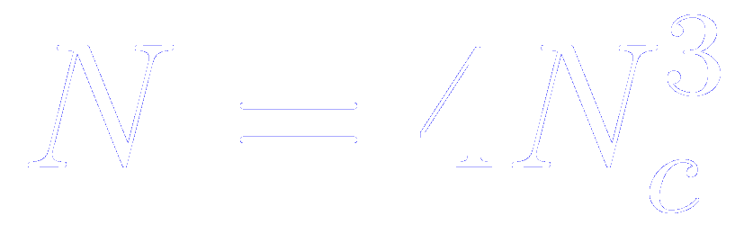
The initial configuration: more usual approach, start from a lattice
Almost any lattice is suitable.
Historically, the face-centered cubic structure has been the starting configuration
A supercell is constructed repeating the conventional cubic unit cell of the FCC lattice times along each direction
The number of atoms in the simulation box, , is an integer of the form , where is the number of FCC unit cells in each direction

Slide 5
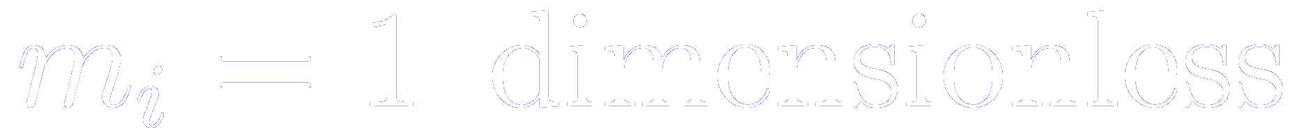

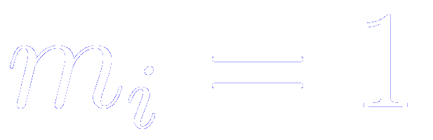
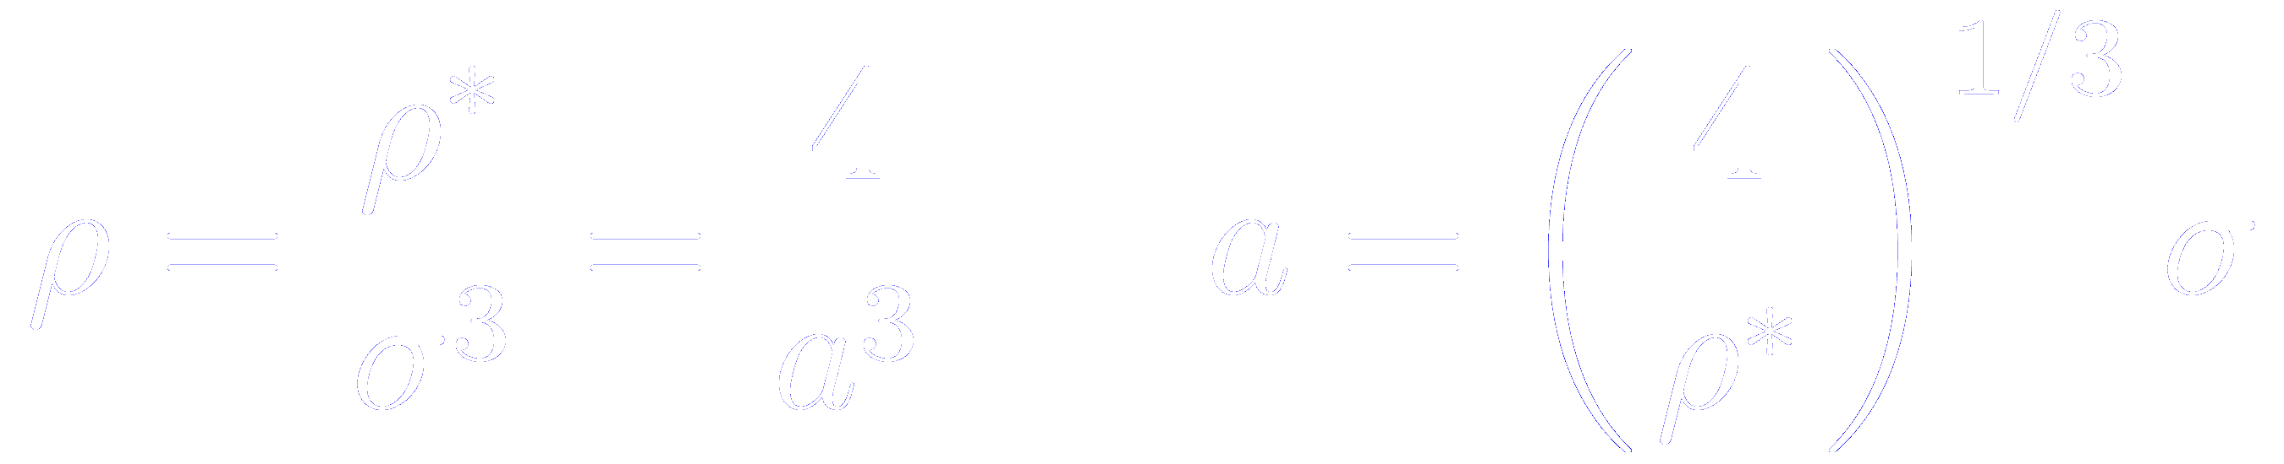
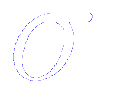
Units for the density
For systems consisting of just one type of atom or molecule, it is sensible to use the mass of the molecule as a fundamental unit
With this convention:
Particle momenta and velocities become numerically identical
Forces and accelerations become numerically identical
In systems interacting via a Lennard-Jones potential, the density is oftenly quoted in reduced units
Assuming an FCC lattice (4 atoms in the conventional cubic), and , then we can compute the lattice constant from the reduced density
And then, the lattice constant will come in the same units as the ones used to determine

Slide 6
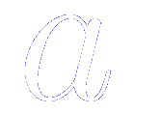
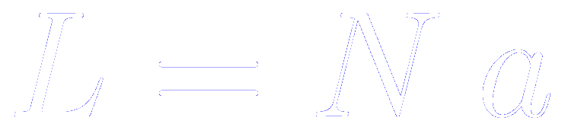
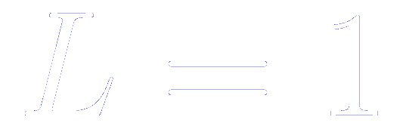
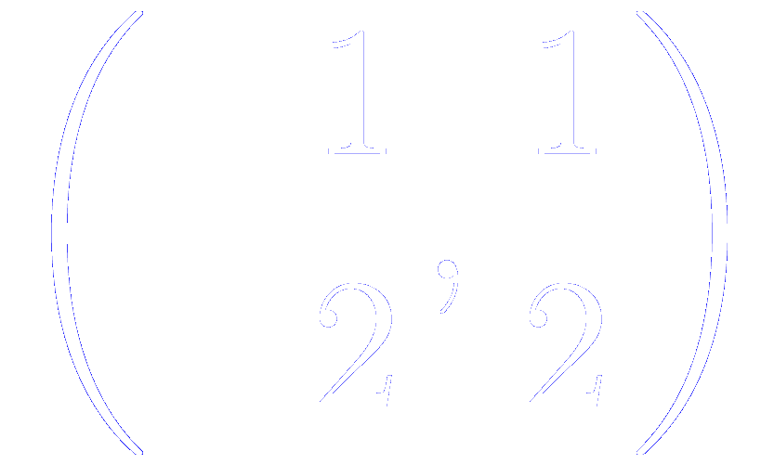
Units for the length of the supercell
If the lattice constant of the conventional cubic unit cell of an FCC lattice is , then the length of the side of the supercell is
However, the implementation of the periodic boundary conditions and the calculation of minimum image distances is simplified by the use of reduced units: the length of the box is taken to define the fundamental unit of length of the simulation,
In particular, the atomic coordinates can be defined using this unit of length, so nominally they will be in the range

Slide 7
Implementation of a fcc lattice
The simulation box is a unit cube centred at the origin
The number of atoms in the simulation box, is an integer of the form , where is the number of FCC unit cells in each direction

Slide 8
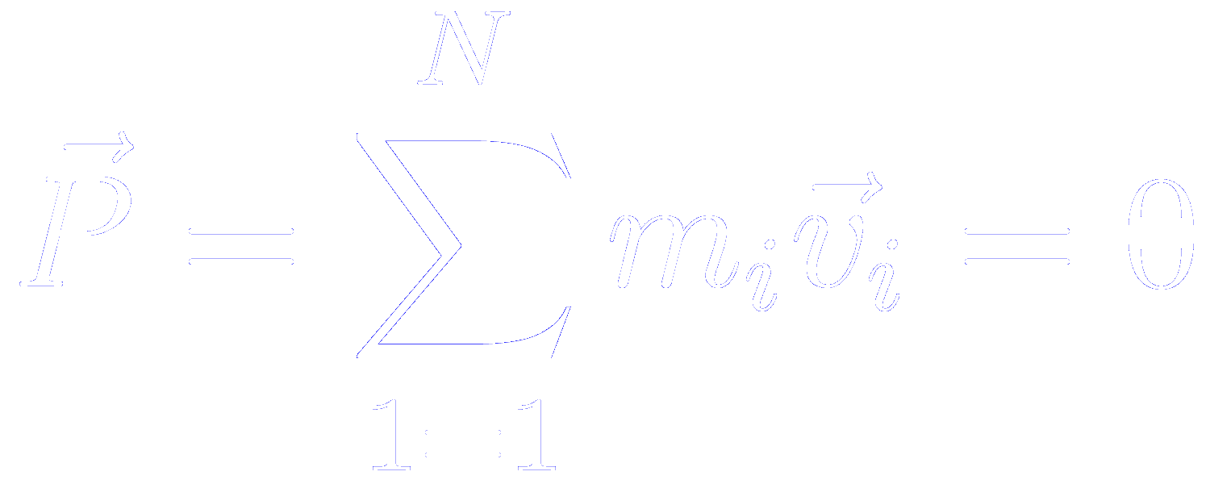
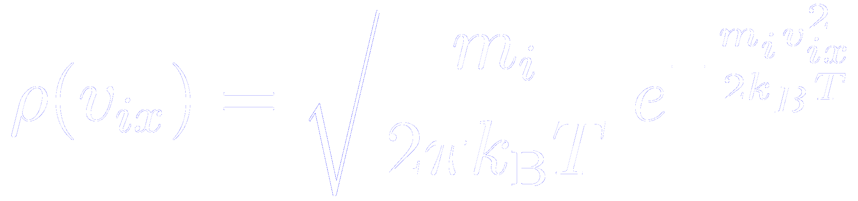
Initial velocities
For a molecular dynamic simulation, the initial velocities of all the molecules must be specified
It is usual to choose random velocities, with magnitudes conforming to the required temperature, corrected so that there is no overall momentum
The distribution of molecular speeds is given by
Probability density for velocity component
For a derivation of this expression, read Feynman lectures on Physics, Volume 1, Chapter 40-4
Similar equations apply for the y and z velocities

Slide 9
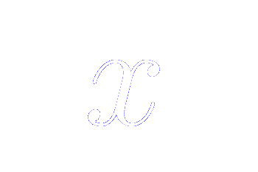
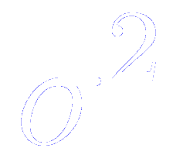
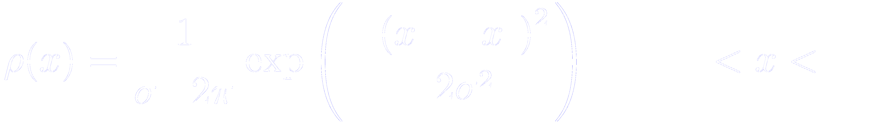
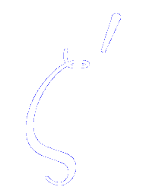
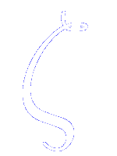
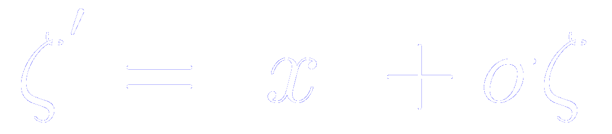
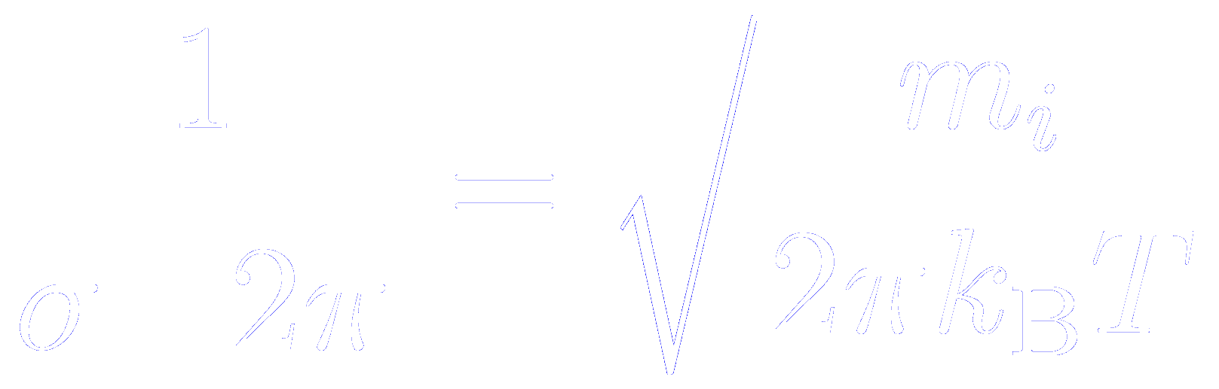
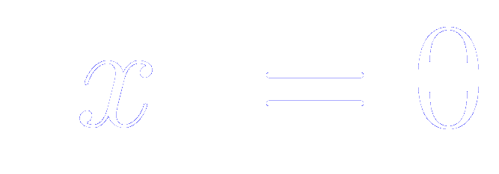
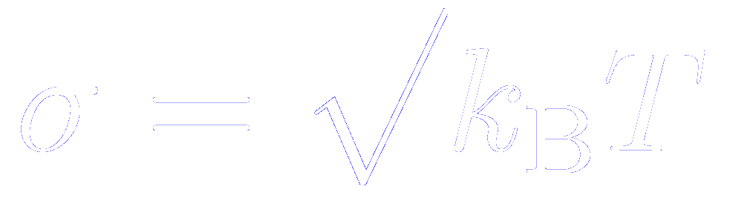
Normal distributions
The normal distribution with mean and variance is defined as
A random number generated from this distribution is related to a number generated from the normal distribution with zero mean and unit variance by
The Maxwell-Boltzmann distribution is a normal distribution with
If we take the mass of the atoms or molecules as

Slide 10
Flowchart in the generation of random numbers
Generate a random number distribution uniformly between [0 and 1]

Slide 11
Implementation of random numbers uniformly distributed between 0 and 1

Slide 12
Flowchart in the generation of random numbers
Generate a random number distribution uniformly between [0 and 1]
From this, generate random numers following a normal (Gaussian) distribution with zero mean and unit variance

Slide 13
Implementation of random numbers following a Gaussian distribution

Slide 14
Flowchart in the generation of random numbers
Generate a random number distribution uniformly between [0 and 1]
From this, generate random numers following a normal (Gaussian) distribution with zero mean and unit variance
A random number generated from this distribution is related to a number generated from the normal distribution with zero mean and unit variance by
The Maxwell-Boltzmann distribution is a normal distribution with
If we take the mass of the atoms or molecules as

Slide 15
Implementation of the initial velocities

Slide 16
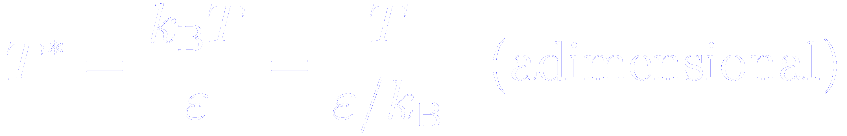
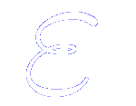
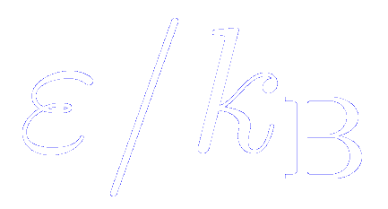
Units of temperature and velocity
The temperature is usually given in reduced units
(remember that is usually tabulated as , in K)
In this system of units, the velocities are given in units of square root of the temperature

Slide 17
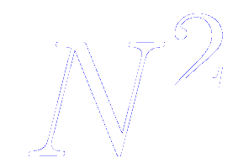
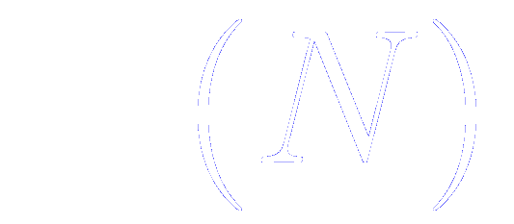
Typical system sizes
The size of the system is limited by the:
- available storage on the host computer
- speed of execution of the program
The double loop used to evaluate the forces or the potential energy is proportional to
Special techniques may reduce this dependency to ,
but the force /energy loop almost inevitably dictates the overall speed.

Slide 18
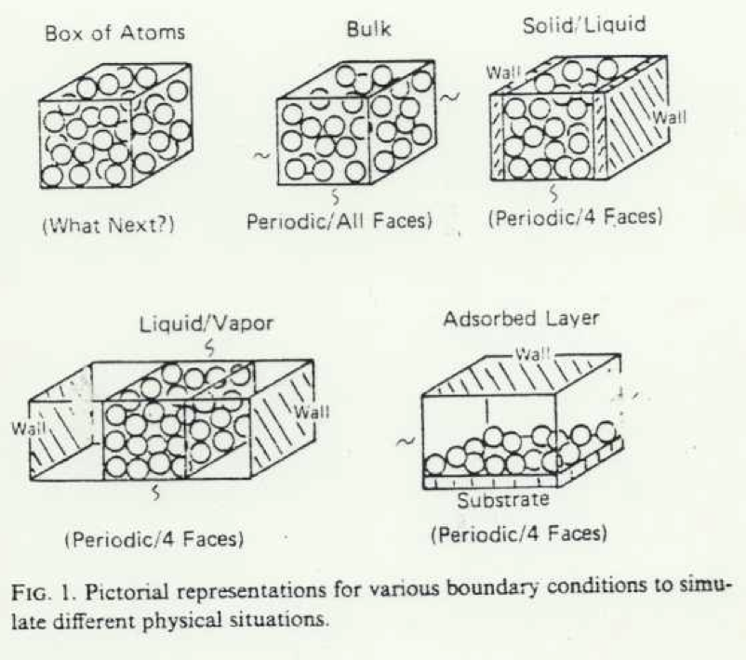
Boundary conditions

Slide 19

How can we simulate an infinite periodic solid? Periodic (Born-von Karman) boundary conditions
We should expect that the bulk properties to be unaffected by the presence of its surface.
A natural choice to emphasize the inconsequence of the surface by disposing of it altogether
Supercell +
Born-von Karman boundary conditions

Slide 20
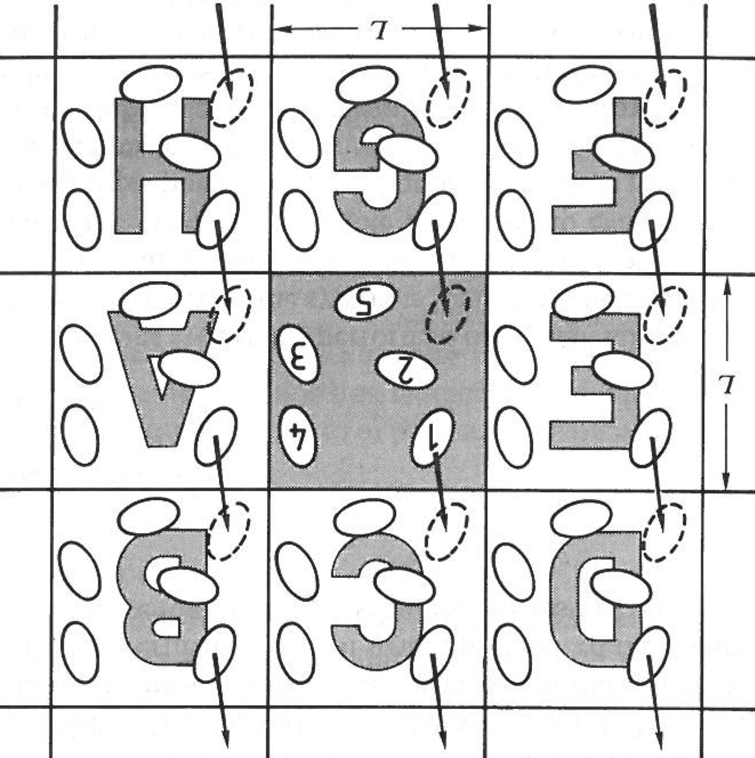
Periodic (Born-von Karman) boundary conditions
The box is replicated throughout space to form an infinite lattice
In the course of the simulation, as a molecule moves in the original box, its periodic image in each of the neighboring boxes moves in exactly the same way
Thus, as a molecule leaves the central box, one of its images will enter through the opposite face
There are no walls at the boundary of the central box, and no surface molecules. This box simply forms a convenient axis system for measuring the coordinates of the molecules
The density in the central box is conserved
It is not necessary to store the coordinates of all the images in a simulation, just the molecules in the central box

Slide 21
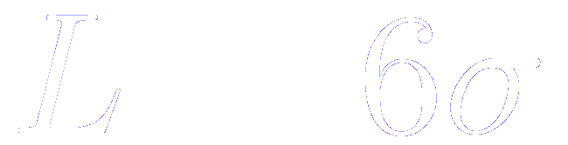
Periodic (Born-von Karman) boundary conditions: influence on the properties
It is important to ask if the properties of a small, infinitely periodic, system and the macroscopic system which it represents are the same
For a fluid of Lennard-Jones atoms, it should be possible to perform a simulation in a cubic box of side
without a particle being able to “sense” the symmetry of the periodic lattice

Slide 22
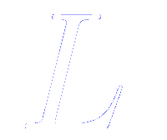
Periodic (Born-von Karman) boundary conditions: drawbacks and benefits
Drawbacks
Benefits
Inhibits the occurrence of long-wave length fluctuations. For a cube of side , the periodicity will suppress any density wave with a wave length greater than .
Be careful in the simulation of phase transitions where the range of critical fluctuations is macroscopic, and of phonons in solids.
Common experience in simulation work is that periodic boundary conditions have little effect on the equilibrium of thermodynamic properties and structures of fluids:
- away from phase transitions
- where the interactions are short-range
If the resources are available, it is always sensible to increase the number of molecules (and the box size, so as to maintain constant density) and rerun the simulations

Slide 23
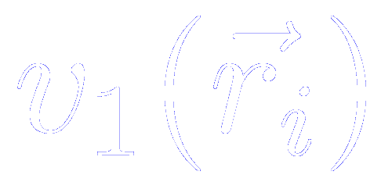
Periodic (Born-von Karman) boundary conditions and external potentials
Up to now, we have assumed that there is no external potential (i.e. no term in the expansion of the potential energy)
If such a potential is present:
- it must have the same periodicity as the simulation box
or
- the periodic boundary conditions must be abandoned

Slide 24
Periodic (Born-von Karman) boundary conditions in 2D and 1D
In some cases, it is not appropriate to employ periodic boundary conditions in each of the three coordinate directions
In the study of surfaces (2D)
In the study of wires or tubes (1D)
The system is periodic only in the planes parallel to the surface layer
The system is periodic only along the direction of the wire or tube

Slide 25
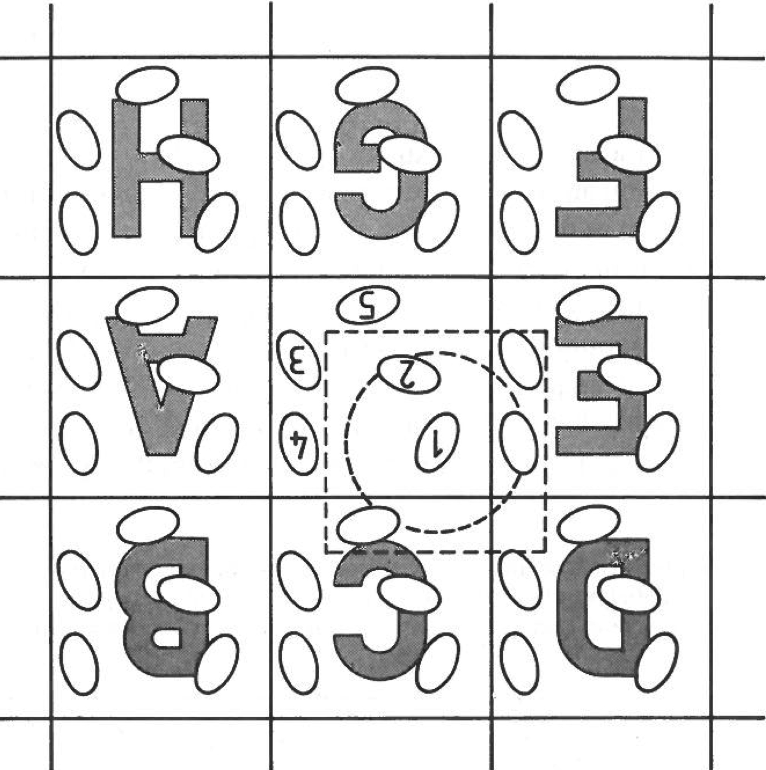
Calculating properties of systems subject to periodic boundary conditions
Heart of a Molecular Dynamic or Monte Carlo program:
- calculation of the potential energy of a particular configuration
- in Molecular Dynamics, compute the forces acting on all molecules
How would we compute these for molecule 1
We must include interactions between molecule 1 and every other molecule (or periodic image)
This is an infinite number of terms!!
Impossible to calculate in practice!!
For a short-range potential energy function, we must restrict this summation by making an approximation

Slide 26
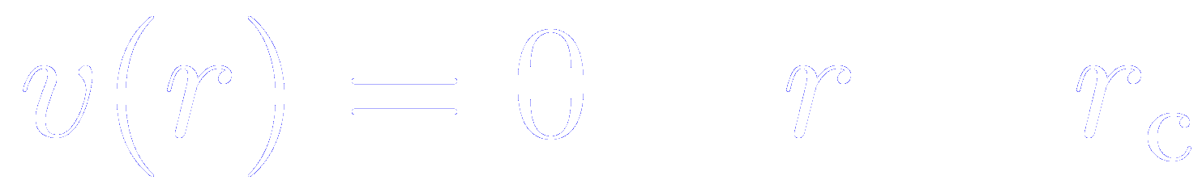
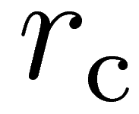
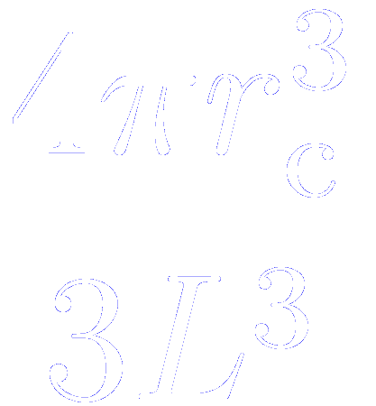
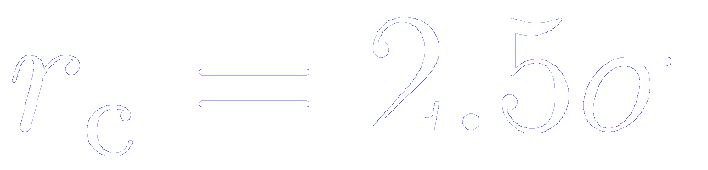
Cutting the interactions beyond a given radius to compute the potential energy and forces
The largest contribution to the potential and forces comes from neighbours close to the molecule of interest, and for short-range forces we normally apply a spherical cutoff
That means:
Molecules 2 and 4_{E} contribute to the force on 1, since their centers lie inside the cutoff
Molecules 3_{E} and 5_{F} do not contribute
In a cubic simulation box of side , the number of neighbours explicitly considered is reduced by a factor of approximately
The introduction of a spherical cutoff should be a small perturbation, and the cutoff distance should be sufficiently large to ensure this.
Typical distance in a Lennard-Jones system:

Slide 27
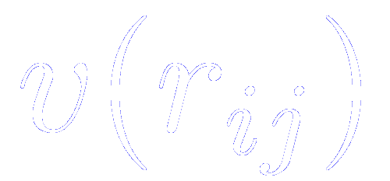
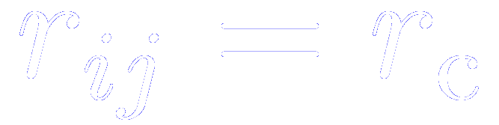
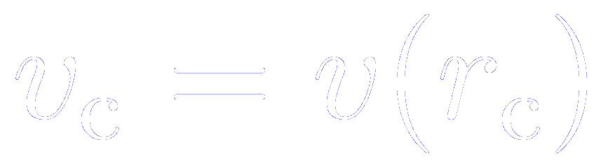
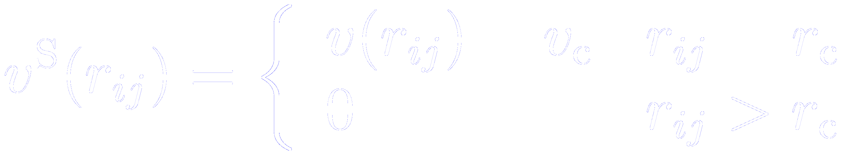
Difficulties in defining a consistent POTENTIAL in MD method with the truncation of the interatomic pot
The function used in a simulation contains a discontinuity at :
Whenever a pair of molecules crosses this boundary, the total energy will not be conserved
We can avoid this by shifting the potential function by an amount
The small addition term is constant for any pair interaction, and does not affect the forces
However, its contribution to the total energy varies from time step to time step, since the total number of pairs within cutoff range varies

Slide 28
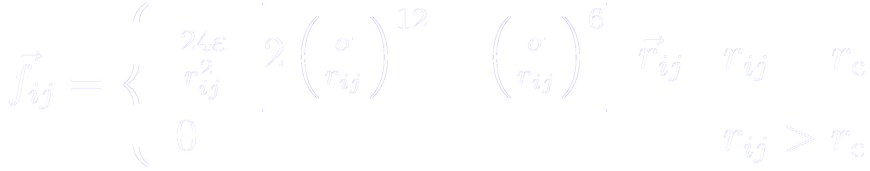
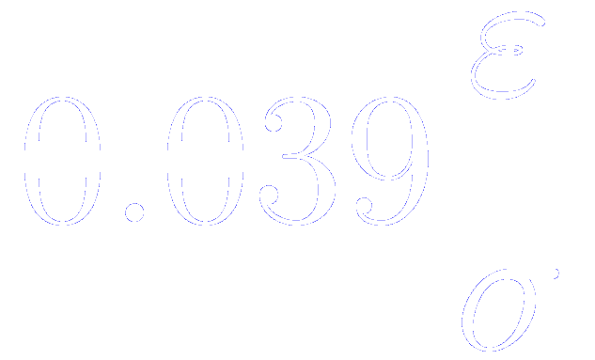
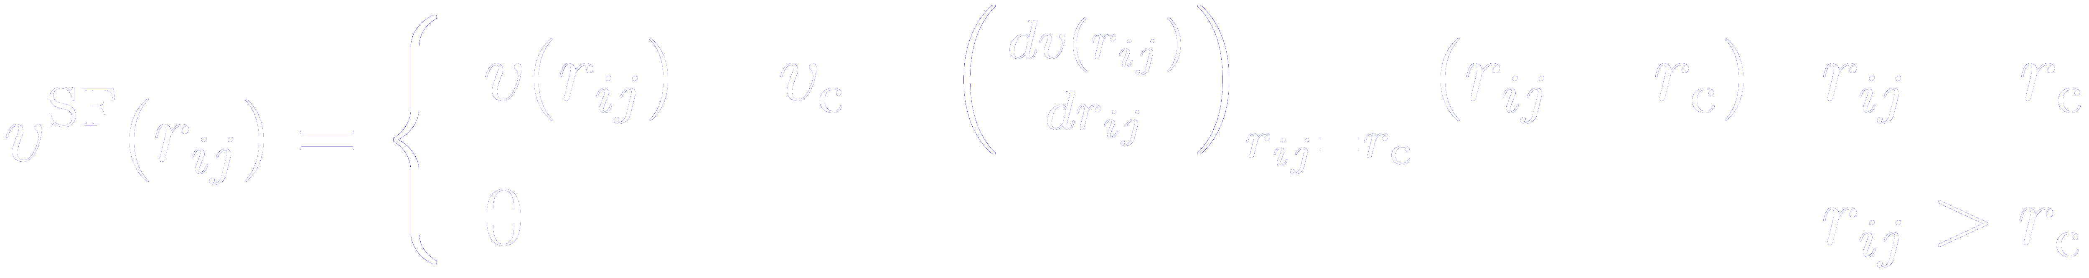
Difficulties in defining a consistent FORCE in the MD method with the truncation of the interatomic potent
The force between a pair of molecules is still discontinuous at
For a Lennard-Jones case, the force is given by
And the magnitude of the discontinuity is for
It can cause instability in the numerical solution of the differential equations. To avoid this difficulty, a “shifted force potential” has been introduced
The discontinuity now appears in the gradient of the force, not in the force itself

Slide 29
Difficulties in defining a consistent FORCE in the MD method with the truncation of the interatomic potent
The difference between the shifted-force potential and the original one means that the simulation no longer corresponds to the desired model liquid
However, the thermodynamic properties with the unshifted potential can be recovered using a simple perturbation scheme

Slide 30
Computer code for periodic boundaries
Let us assume that, initially, the molecules in the simulation lie within a cubic box of side , with the origin at its centre.
As the simulation proceeds, these molecules move about the infinite periodic system.
When a molecule leaves the box by crossing one of the boundaries, it is usual to switch the attention to the image molecule entering the box, simply adding or subtracting from the appropriate coordinate

Slide 31
Computer code for periodic boundaries

Slide 32
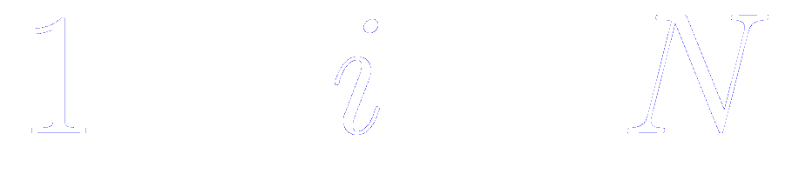
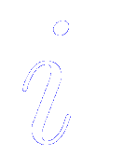
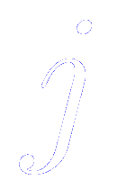
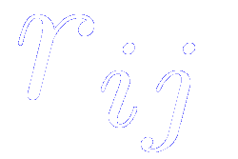
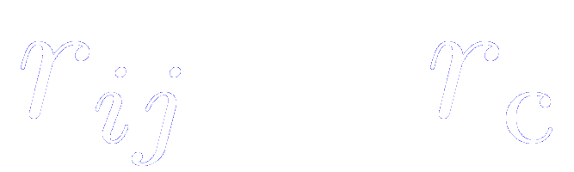


Loops in Molecular Dynamic (MD) and Monte Carlo (MC) programs
Loop on all the molecules (from )
For a given molecule , loop over all molecules to calculate the minimum image separation
If molecules are separated by distances smaller than the potential cutoff
Compute potential energy and forces
If molecules are separated by distances greater than the potential cutoff
Skip to the end of the inner loop, avoiding expensive calculations
Time required to examine all pair separations is proportional to

Slide 33

Neighbour lists: improving the speed of a program
Inner loops of the MD and MC programs scale proportional to
Verlet: maintain a list of the neighbours of a particular molecule, which is updated at intervals
Between updates, the program does not check through all the molecules, but just those appearing on the list
The number of pais separations explicitly considered is reduced.
This saves time in:
Looping through
Minimum imaging,
Calculating
Checking against the cutoff

Slide 34




The Verlet neighbour list
The potential cutoff sphere, of radius , around a particular molecule is surrounded by a “skin”, to give a larger sphere of radius
At first step, a list is constructed of all the neighbours of each molecule, for which the pair separation is within
These neighbours are stored in a large one-dimensional array, LIST
The dimension of LIST is roughly
At the same time, a second indexing array of size , POINT, is constructed:
POINT (I) points to the position in the array LIST where the first neighbour of molecule I can be found.
Since POINT(I+1) points to the first neighbour of molecule I+1, then POINT(I+1)-1 points to the last neighbour of molecule I.
Thus, using POINT, we can readily identify the part of the last LIST array which contains neighbours of I.

Slide 35
The Verlet neighbour list
Over the next few steps, the list is used in force/energy evaluation routine
For each molecule I, the program identifies the neighbours J, by running over LIST from point to POINT(I) to POINT(I+1)-1
It is essential to check that POINT(I+1) is actually greater then POINT(I). If it is not the case, then molecule I has no neighbours
From time to time, the neighbour list is reconstructed and the cycle is repeated.

Slide 36
The Verlet neighbour list
Over the next few steps, the list is used in force/energy evaluation routine
For each molecule I, the program identifies the neighbours J, by running over LIST from point to POINT(I) to POINT(I+1)-1
It is essential to check that POINT(I+1) is actually greater then POINT(I). If it is not the case, then molecule I has no neighbours
From time to time, the neighbour list is reconstructed and the cycle is repeated.

Slide 37
The Verlet neighbour list
The algorithm is successful if the skin around is chosen to be thick enough so that between reconstructions:
A molecule, such as 7, which is not on the list of molecule 1, cannot penetrate through the skin into the important sphere
Molecules, such as 3 and 4 can move in and out of this sphere, but since they are on the list of molecule 1, they are always considered until the list is next updated.

Slide 38

Parameters of the Verlet neighbour list: the interval between updates
Often fixed at the beginning of the program
Intervals of 10-20 steps are quite common
An important refinement: allow the program to update the list automatically:
- When the list is constructed, a vector for each molecule is set to zero
- At subsequent steps, the vector is incremented with the displacement of each molecule.
- Thus, it stores, the displacement of each molecule since the last update
- When the sum of the magnitudes of the two largest displacements exceeds , the neighbour list should be updated again

Slide 39
Parameters of the Verlet neighbour list: the list sphere radius
Is a parameter that we are free to choose
As is increased, the frequency of updates of the neighbour list will decrease
However, with a large list, the efficiency of the non-updated steps will decrease
The larger the system,
the more dramatic the improvement

Slide 40
Algorithm to compute the Verlet neighbour list

Slide 41
Algorithm to check whether the update of the list is required

Slide 42
Algorithm to save the list for future checkings

Slide 43
Algorithm of the inner loop to compute forces and potential energy

Slide 44






Long range forces
By definition, a long range force is defined as one in which the spatial interaction falls off no faster than where is the dimensionality of the system
Charge-charge interaction between ions
Dipole-dipole interaction between molecules
Their range is greater than half the box length for a typical simulation
Brute force solution: increase the length of the central box to hundrehts of nanometers, so that the screening by neighbours would diminish the effective range of the potentials
Impractical
Computational cost scales as , i.e. as

Slide 45









Statement of the problem when dealing with long-range forces
Ion 1 interacts with ions 2, 2_{A}, 2_{B}, and all the other images of 2
and are the charges
For simplicity, we are ommiting all the factors
The sum over is the sum over all simple cubic lattice points, with integers
The prime indicates that we omit for

Slide 46
Statement of the problem when dealing with long-range forces
Ion 1 interacts with ions 2, 2_{A}, 2_{B}, and all the other images of 2
For long-range potentials, this sum is conditionally convergent, i. e. the results depends on the order in which we add up terms
As we shall see below, the Ewald method evaluate this energy by transforming it into summations that converges not only rapidly but also absolutely

Slide 47



The infinite sum is conditionally convergent
For long-range potentials, this sum is conditionally convergent, i. e. the results depends on the order in which we add up terms
Natural choice:
Take boxes in order of their proximity to the central box
First term
Second term
As we add further terms to the sum, we are building up our infinite system in roughly spherical layers
In vacuum, the sphere has a dipolar layer on its surface, and there would be a jump in the potential energy

Slide 48



The infinite sum is conditionally convergent
We must specify the nature of the medium surrounding the sphere, in particular, its dieletric permittivity (the dielectric constant)
Good conductor (perfect metal)
For a sphere in a conductor, there is no such layer (al the surface charges are screened)

Slide 49





The infinite sum is conditionally convergent
We must specify the nature of the medium surrounding the sphere, in particular, its dieletric permittivity (the dielectric constant)
Vacuum
In vacuum, the sphere has a dipolar layer on its surface
For a sphere, the depolarization factor
And the associated energy

Slide 50

The infinite sum is conditionally convergent
We must specify the nature of the medium surrounding the sphere, in particular, its dieletric permittivity (the dielectric constant)
Good conductor (perfect metal)
Vacuum
For a sphere in a conductor, there is no such layer (al the surface charges are screened)
In vacuum, the sphere has a dipolar layer on its surface
Equation applies in the limit of very large sphere boxes

Slide 51






Splitting the charge distribution
In the original problem, the charge distributions are described by delta functions.
We can split it into two terms, adding a subtracting a Gaussian distribution
Determines the width of the distribution
Position relative to the center of the dist
In what we call
Each point charge is surrounded by a charge distribution of equal magnitude and opposite sign, which spreads out radially from the charge.

Slide 52
The screened charge density produces a short-range singular potential that can be summed in real space
Each point charge is surrounded by a charge distribution of equal magnitude and opposite sign, which spreads out radially from the charge.
The distribution is conveniently taken to be Gaussian
Determines the width of the distribution
Position relative to the center of the dist
This distribution acts like an ionic atmosphere to screen the interaction between neighboring charges, that are now short ranged and singular
The total screened potential is calculated by summing over all the molecules in the central cube and all their images in the real space lattice of image boxes

Slide 53


The cancelling distribution produces a long-range no-singular potential that can be summed in reciprocal space
A charge distribution of the same sign as the original charge, and the same shape distribution is also added
This cancelling distribution reduces the overall potential to that due to the original set of charges
The contribution from this cancelling charges is summed in reciprocal space

Slide 54





The Ewald sum: a technique for efficiently summing the interaction between an ion an all it periodic images
The final potential energy will contain a sum in real space plus a reciprocal space sum minus a self-energy term plus the surface term
A complete derivation can be found in the excellent notes by H. Lee and W. Cai
http://micro.stanford.edu/mediawiki/images/4/46/Ewald_notes.pdf
Is the complementary error function
Falls to zero with increasing
If is chosen to be large enough, the only terms which contributes to the sum in real space is that with
(the first term reduces to the minimum image)

Slide 55


The Ewald sum: a technique for efficiently summing the interaction between an ion an all it periodic images
The final potential energy will contain a sum in real space plus a reciprocal space sum minus a self-energy term plus the surface term
Sum over reciprocal lattice vectors
A large value of corresponds to a shape distribution of charge, so we need to include many terms in the point summation to model it.

Slide 56








Extension of the Ewald sum to dipolar system
is replaced by
Sum on and are for dipoles in the central box
Factor is omitted

