Slide 1


Synthetic Traffic Model of the Graph500 Communications
P. Fuentes, E. Vallejo, J.L. Bosque, R. Beivide,
A. Anghel, G. Rodríguez, M. Gusat and C. Minkenberg
University of Cantabria, IBM Zürich Research Lab & Rockley Photonics
International Conference on Algorithms and Architectures for Parallel Processing (ICA3PP’16)
Granada, 14th December 2016

Slide 2
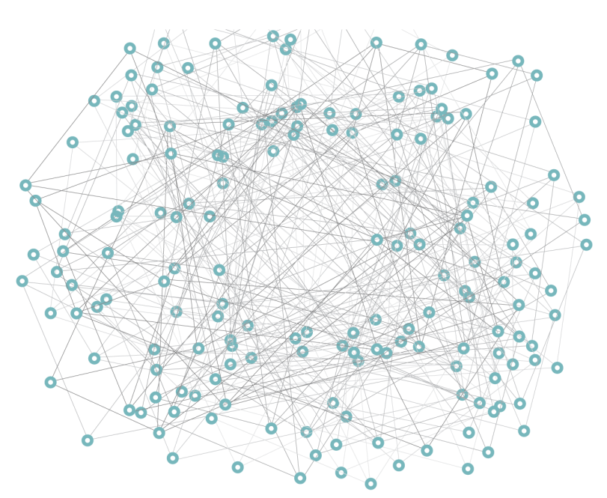
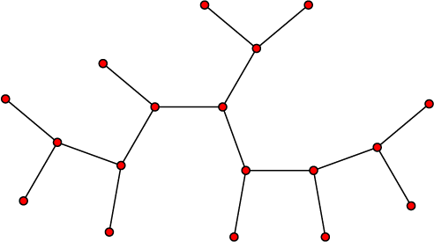
Graph500
A data-intensive benchmark for graph operations
  Used to rank computers on data-intensive operations.
  It stresses the system network (much more than HPL!).
It performs Bread-First Searches (BFS) on a large undirected graph
  Graph nodes are distributed between computing nodes
  Exploration is performed per phases (tree levels)
  Notification messages for newly reached vertices in each phase
Notes:
Graph size is set by scale (log2 of number of vertices) and edgefactor (avg. # edges per vertex)

Slide 3
Simulation of Graph500
Network simulations are based on:
  Full-system: unaffordable
    Skeletons: the amount of computation per element is irrelevant (no savings)
  Traces:
    Large amount of traffic (huge traces!)
    Most of the communications are asynchronous (replaying a trace under different conditions imposes unrealistic dependencies between messages).
  Synthetic traffic
Our approach:
  Deploy a synthetic traffic model for traffic of Graph500.
  Generate a number of messages per phase (tree level) following the temporal and spatial distribution in the original benchmark.
  Feed a network simulator with traffic from the model.
Notes:
Analysis and design of networks uses simulation
Complex to simulate
No real interdependencies between consecutive asynchronous messages

Slide 4
Analysis of the benchmark communications
It performs Bread-First Searches (BFS) on a large graph
  Communications are composed of batches of messages
  Number of newly visited vertices is broadcasted through an All-reduce
Notes:
When a neighbor vertex to visit is in different process -> query -> message
The allreduce acts as a synchronization point
Bulk of communications is done through point-to-point messages

Slide 5
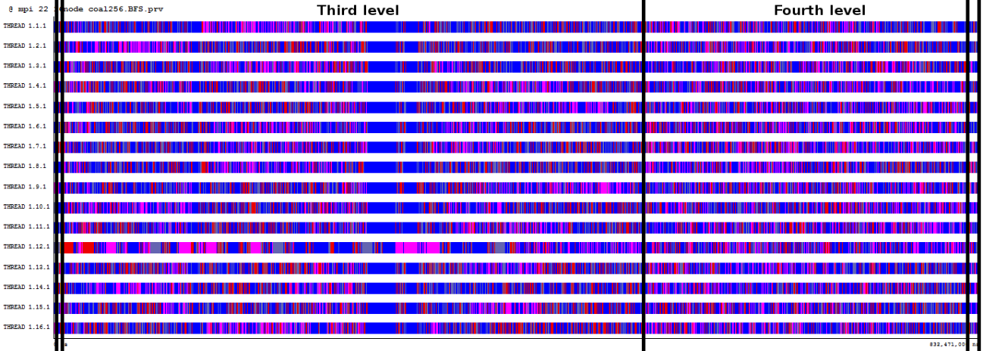
Analysis of the benchmark communications
End of phase notifications and all-reduce are independent of graph size
Messages depend on number of explored vertices per process and tree level
  Uniform spatial distribution
  (Almost) Uniform temporal distribution (within levels)
  High variability between levels.
We need to predict the number of requests per tree level
Notes:
Requests are newly explored vertices in a neighbor process/node

Slide 6
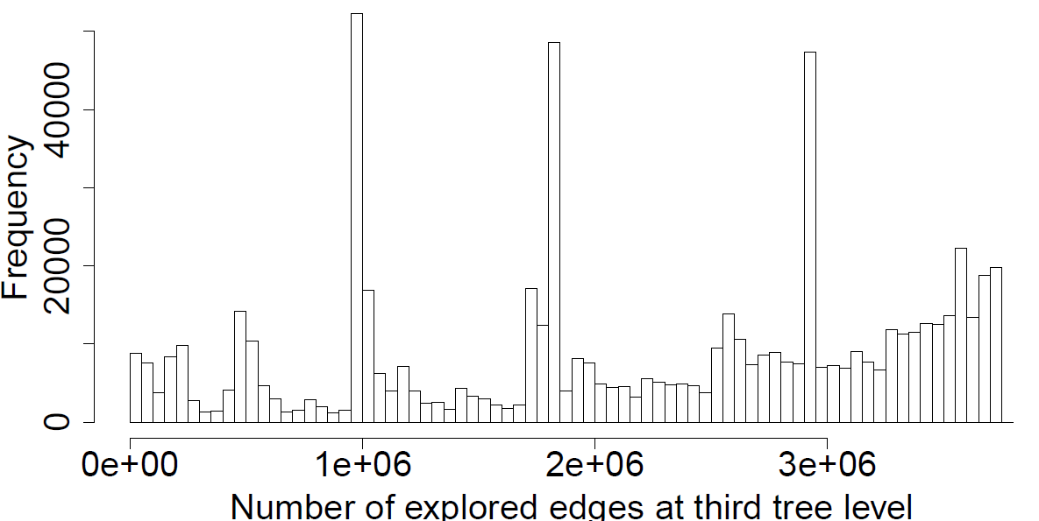
Traffic model
Number of requests generated per node for the third level of the tree traversal: multi-modal distribution

Slide 7
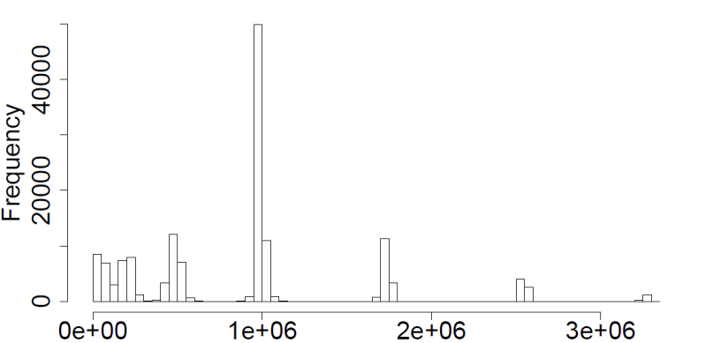
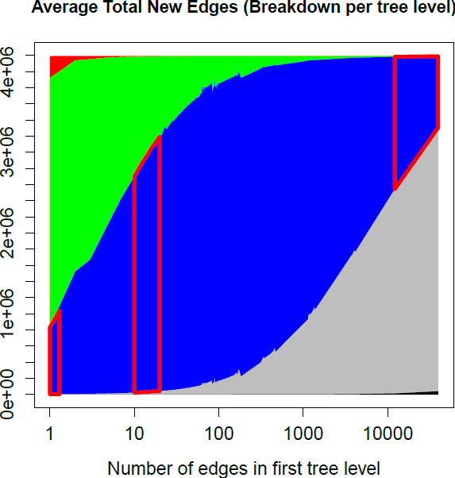
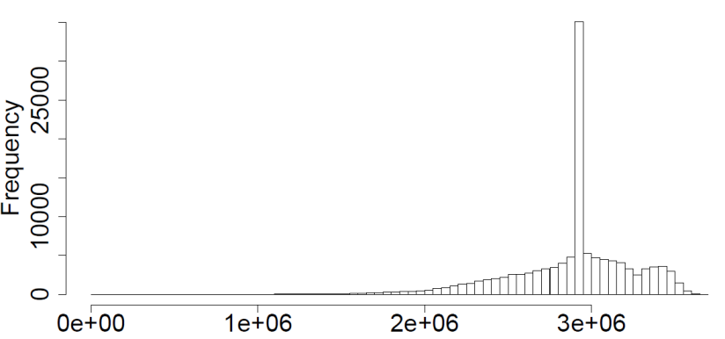
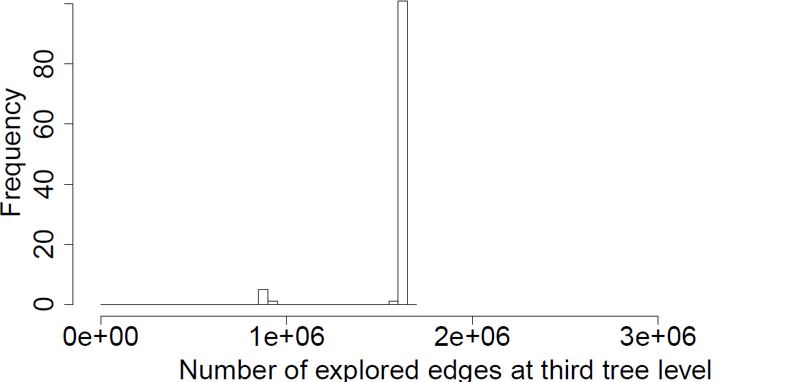
Traffic model
Key observation: root connectivity determines the amount of traffic per level

Slide 8
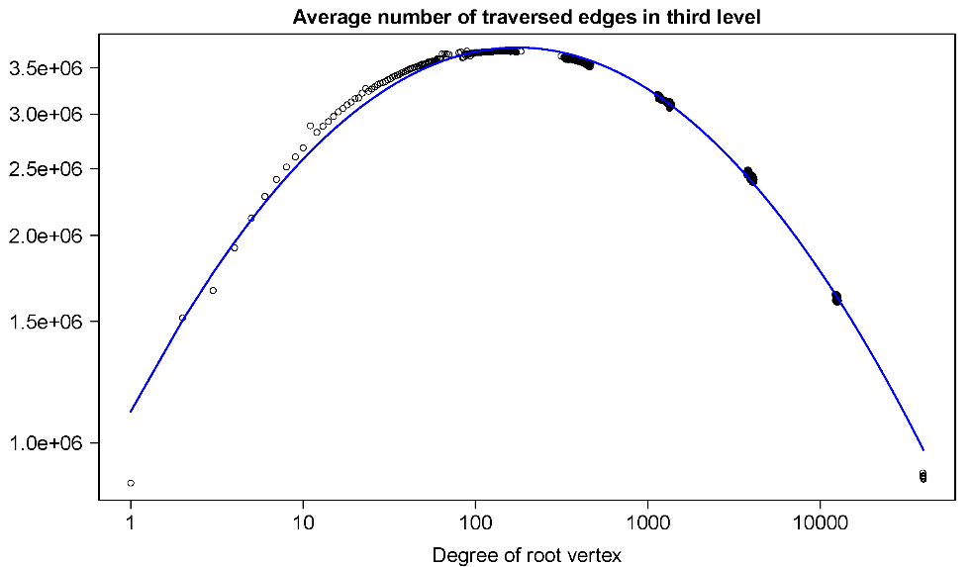
Traffic model
Our strategy:
  Execute multiple runs of Graph500, each with all possible nodes chosen as root.
    Different graph sizes (scale and edgefactor)
  Characterize the distribution of requests with the root connectivity for each case.
  Approximate some equations for average and standard deviation of the number of newly visited edges for each level and root connectivity, for different graph size (scale) and connectivity (edgefactor).
Notes:
The paper only defines the avg. We have also determined the stdev, in a work submitted to the journal extension.
Model predictions of the # edges are calculated through a Gaussian following the eqs for avg. and stddev. Low-demanding computer-wise

Slide 9

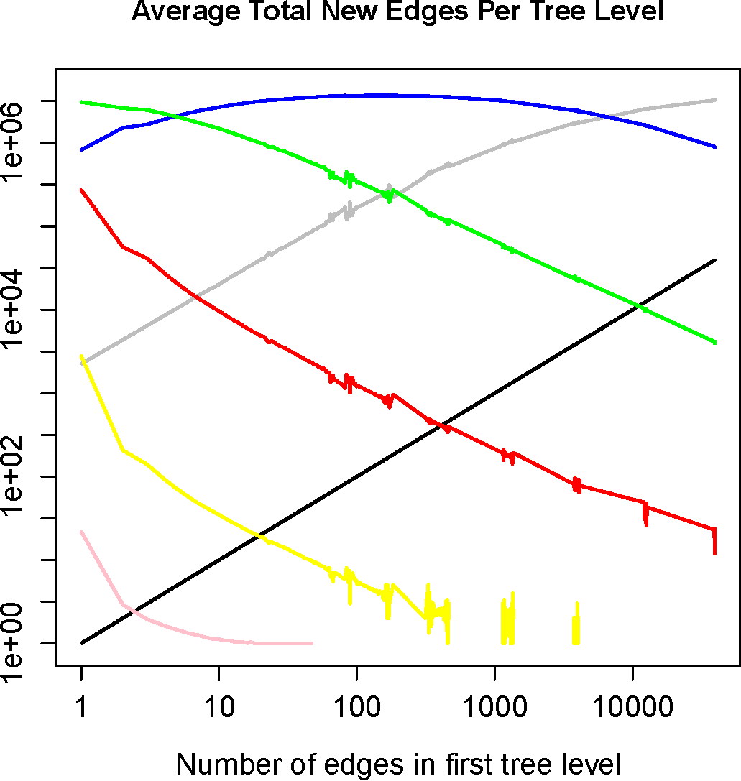
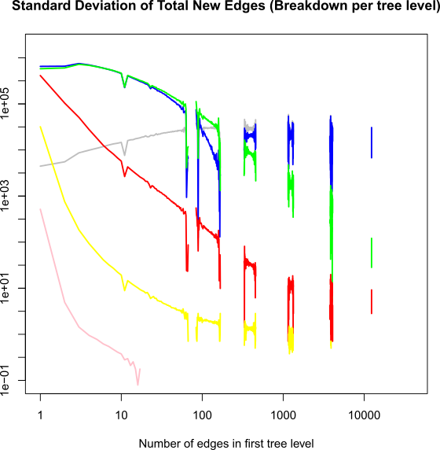
Traffic model
Average is defined by an exponential of a logarithmic polynomial of the root degree.
Standard deviation is defined by an exponential of a log polynomial and an exponential of an inverse function

Slide 10
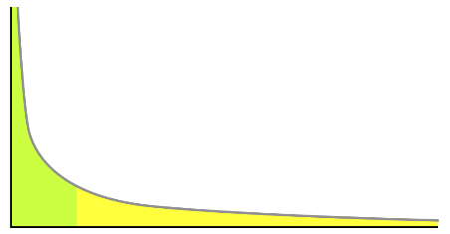
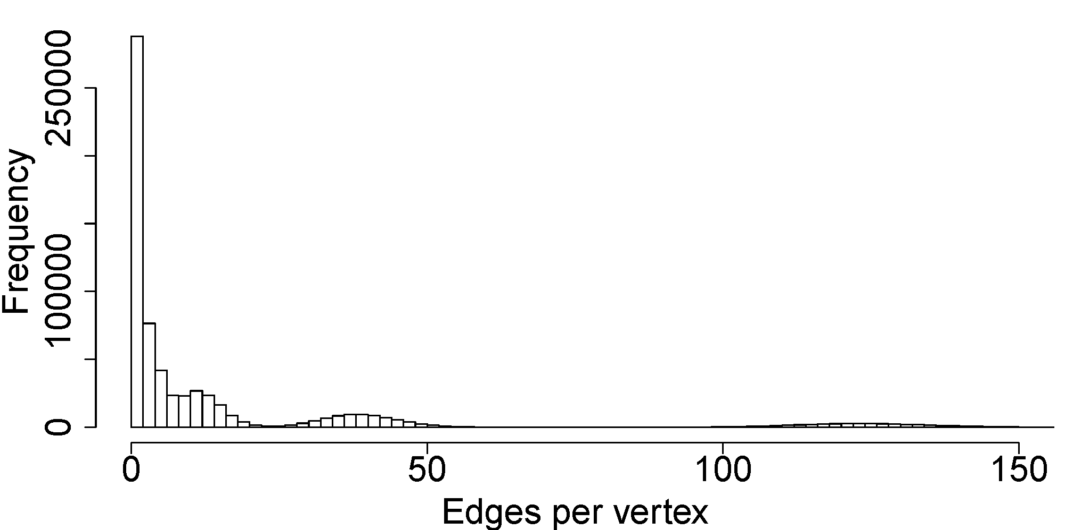
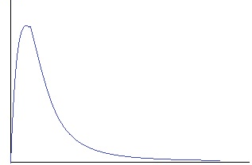
Traffic model
The distribution of the root degree is driven by the graph nature
  Graph generators based on Kronecker-matrix product have a characteristic distribution
Notes:
They emulate nature of little-world phenomena -> frequent low values with isolated peaks at high values (most individuals have low connections, and a few are highly related)
Sample for a graph scale 17 edgef 16
Which distrib? Depends on who you ask
-Lognormal
-Power law
-A series from normal distribs
-Lognormal + exp tail distrib
Lognormal is reasonably accurate, and Kim and Leskovec provide an eq in their works. This can be easily replaced.

Slide 11
Validation of our traffic model
Our approach:
  Validate the equations with more runs of the Graph500 benchmark.
Notes:
We run again the characterization of Graph500 with different sets of parameters (not used for training)
Figures correspond to scale 22 and edgef 16
Note that X- and Y-axis are in log scale
Points correspond to measured values, lines to prediction
Values are stacked up. Max value adding all levels is bounded and truncates prediction from second level onwards
Dynamic range of observations very large for log nature; deviations in prediction incur in large absolute errors.
Relative error for 2nd tree level <18% in more than 90% of the cases.
3rd tree level (most relevant) average relative error of 12.5%

Slide 12
Validation of our traffic model
Our approach:
  Validate the equations with more runs of the Graph500 benchmark.
Notes:
Stddev
Larger deviation; high dispersion for large root degree values (they are less frequent in the graph)
Model still captures trend and adjusts (reasonably) well for lower root degrees
Similar analysis with graphs of different scales and edgefactors -> analogous results

Slide 13
Model implementation
We implement our traffic model in the FOGSim* network simulator
Message injection rate is determined by the node computation capabilities
Node | t_{q}
Altamira supercomputer - IBM iDataplex dx360m4, Intel Xeon E5-2670 @2.6GHz, 64GB RAM @1.6GHz | 1.5ns
Intel Core i5-5200U @2.2GHz, 8 GB RAM @1.6GHz | 2.25ns
Intel Xeon E5-2620 @2GHz | 2.4ns
Mont-Blanc prototype [22] - Samsung Exynos 5, ARM Cortex A15 @ 1.7GHz | 15ns
* Available at http://fuentesp.github.io/fogsim/
Notes:
FOGSim is a publicly available open-source network simulator
We expect to publish our model implementation soon

Slide 14
Simulation results
Graph500 application performance (execution time) for different network performance and configurations
Notes:
Here I want to give you a preview of the results we have obtained by running our synthetic traffic model in a Dragonfly network

Slide 15
Simulation results
Network usage under Graph500

Slide 16
Conclusions
Current evaluations of BigData workloads consist of full-system simulations or are trace-based.
  Unfeasible for large networks simulations
We develop (and implement!) a synthetic traffic model of the Graph500 communications
  We model point-to-point messages through a Gaussian distribution
  Mean and standard deviation are function of graph size and root degree
  Root degree is calculated through a log-normal distribution
We validate our model against a characterization of benchmark executions with a different set of parameters
Simulation results with the traffic model prove a significant impact of the network on the execution time.
Notes:
Graph500 is a well-known benchmark for BigData applications

Slide 17
Thanks for your attention
Questions?

