Slide 1
PARAMETER ESTIMATION FOR ODES USING A CROSS-ENTROPY APPROACH
Wayne Enright
Bo Wang
University of Toronto

Slide 2
Beyond Newton Algorithm?
Machine Learning
Numerical Analysis
Cross Entropy Algorithms
Parameter Estimation for ODEs
Yes!

Slide 3
Outline
Introduction
Main Algorithms
Modification
Numerical Experiments

Slide 4
Introduction
Challenges associated with parameter estimation in ODEs:
* sensitivity of parameters to noise in the measurements
* Avoiding local minima
* Nonlinearity of the most relevant ODE models
* Jacobian matrix is often ill-conditioned and can be
discontinuous
* Often only crude initial guesses may be known
* The curse of dimensionality

Slide 5
Introduction
We develop and justify:
* a cross-entropy (CE) method to determine the optimal (best fit) parameters
* Two coding schemes are developed for our CE method

Slide 6
Problem Description
A standard ODE system:
We try to estimate
Often we have noisy observations:
Our goal is to minimize:

Slide 7
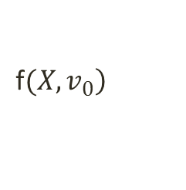
Overview of CE method
Define an initial MV normal distribution, (to generate samples in a “feasible” region of parameter space)
For r=1,2,…
- Generate N samples $X_{i}$ in $ℝ^{s}$ from $\left.f(X,v_{r}\right)$ and compute the values $\left.S(X_{i}\right)$.
- Order the $X_{i}$ by their respective values $\left.S(X_{i}\right)$, and identify the “elites” to be those in the $\left(1−ρ\right)$ quantile
- Approximate the distribution of these elites by a “nearby” normal distribution $\left.f(X,v_{r}\right)$
- Halt this iteration when the smallest elite value doesn’t change much.
End
$$\left.\text{f}(X,v_{0}\right)$$

Slide 8
Key Step in CE
We use an iterative method to estimate
On each iteration the elites are identified by the
threshold value:

Slide 9
Key Steps in CE
Updating of
1. Let
2. Define
where
3. This is equivalent to solve a linear system of equations

Slide 10
Modified Cross Entropy Algorithm
General Cross-entropy method only uses “elites”
Shift “bad” (other) samples towards best-so-far sample
Modified rule updating

Slide 11
Two Coding Schemes
1. Continuous CE Method
2. Discrete CE Method

Slide 12
Continuous CE
The distribution is assumed to be MV Gaussian
Update rule is

Slide 13
Discrete CE
The distribution is assumed to be MV Bernoulli
X_i is represented by an M-digit binary vector,
x_0,x_1…x_M (where M=s(K+L+1) )
The update rule is

Slide 14
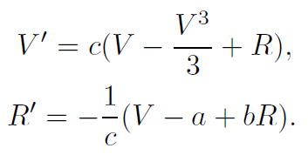
Experiments
FitzHugh-Nagumo Problem
Mathematical Model:
Modeling the behavior of spike potentials in the giant axon of squid neurons

Slide 15
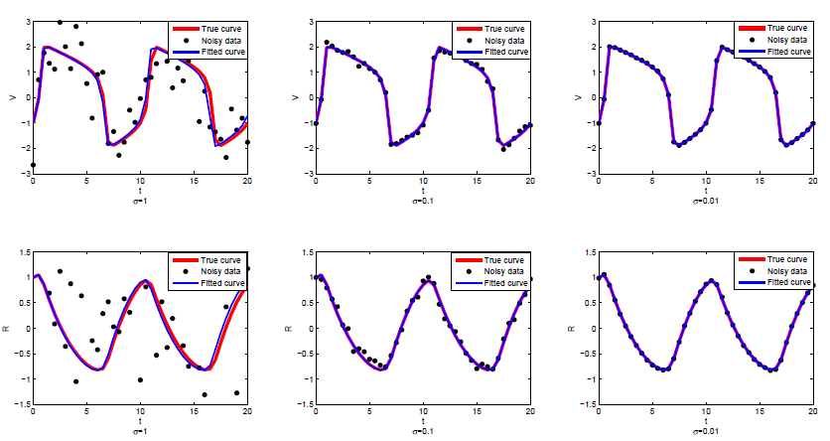
Fitted Curves
Only 50 observations are given
Different scales of Gaussian noise is added

Slide 16
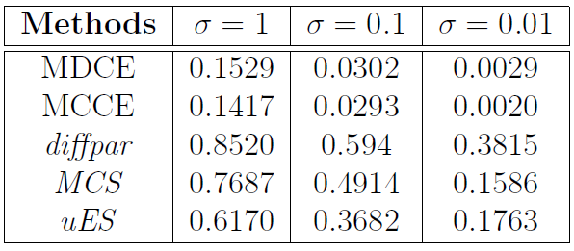
Results
Deviation from “True” Trajectories for FitzHugh-Nagumo Problem with 50 observations

Slide 17
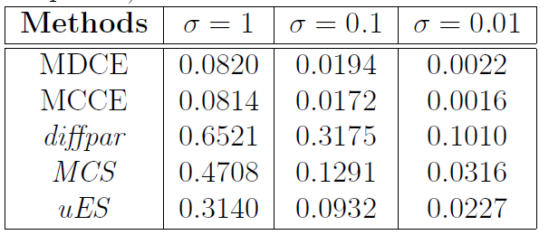
Results
Deviation from “True” Trajectories for FitzHugh-Nagumo Problem with 200 observations

Slide 18
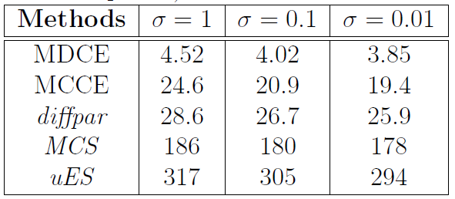
Results
CPU time for FitzHugh-Nagumo Problem with 200 observations

Slide 19
Application on DDEs
Modeling an infectious disease with periodic outbreak

Slide 20
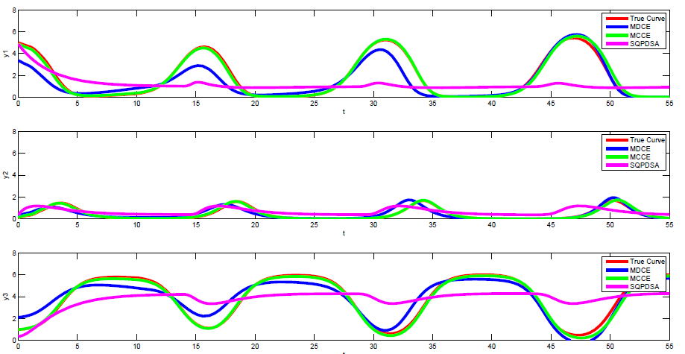
Fitted Curve

Slide 21
Conclusions
1. Modified Cross-Entropy can achieve rapid convergence for a modest number of parameters.
2. Both schemes are insensitive to initial guesses. The discrete CE is less sensitive.
3. Continuous Coding is robust to noise and more accurate but slower to converge.
4. Both schemes are effective as the number of parameters increases but the cost per iteration becomes very expensive.

Slide 22
Thank you for your attention

