Slide 1
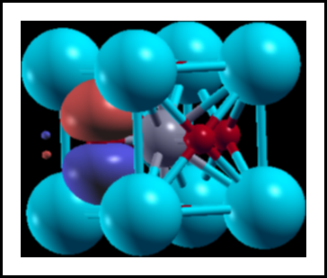
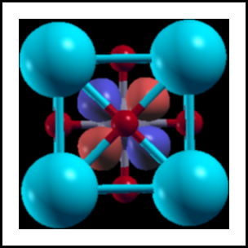

How to run wannier90
directly from siesta
Javier Junquera

Slide 2
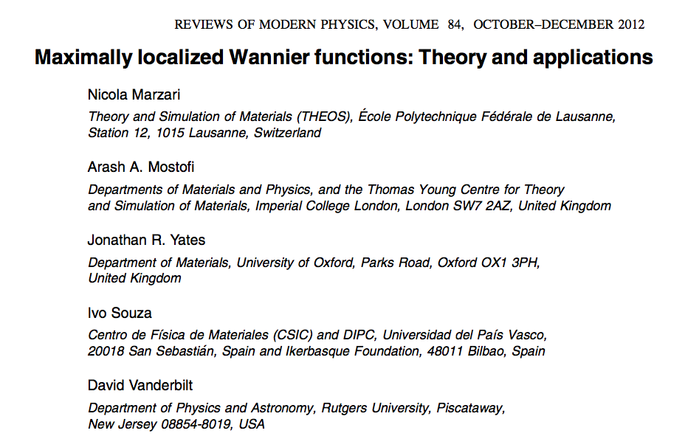
Important bibliography:
For a review on Maximally Localized Wannier functions:

Slide 3
Important bibliography:
The user guide of the wannier90 code
Freely available from:
http://www.wannier.org

Slide 4
wannier90 code directly called from siesta
wannier90 code (version 3.0.0) has been compiled in library mode and called directly from siesta
That means that we can run all the functionalities of
wannier90 directly from siesta
Advantages
No need to prepare two different input files
No need to run wannier90 in pre-processing mode
We can use the basis set of siesta (numerical atomic orbitals) as the initial guess for the projections
Wannierization of different manifolds can be done in the same run of siesta
The unitary matrices connecting the Bloch and Wannier representations are available in siesta.
  New functionalities can follow (initial guesses for order-N simulations)
Interface with other codes will be much easier:
scale-up (second-principles)
DMFTwDFT (DMFT code by Aldo Romero’s group)

Slide 5
Apply the patch to wannier90 to be called from siesta
Download an official release tarball from the wannier90 website
http://www.wannier.org/download/
The version to download must correspond exactly to the version of the patch you want to apply.
For instance, if the patch is called "wannier90-3.0.0-siesta.patch",
you have to download the 3.0.0 version of wannier90.
Uncompress the source code of wannier90 and go to its top directory
$ tar xvzf wannier90-3.0.0.tar.gz
$ cd wannier90-3.0.0
From there, you can apply the patch from siesta
$ patch -p1 < /path/to/siesta/Util/Wannier90/wannier90-3.0.0-siesta.patch
where you replace /path/to/siesta/Util/Wannier90 by the directory path containing the patch file.

Slide 6
Compile wannier90 to be run in serial from siesta
Edit the make.inc file
$ vi make.inc
Choose your Fortran compiler
Select the location of BLAS and LAPACK libraries
$ make veryclean
$ make
$ make lib

Slide 7
Compile siesta in serial to be run with wannier90
Include or modify the following lines in the arch.make
$ vi arch.make
Point to the wannier90 directory
$ make

Slide 8
Compile wannier90 to be run in parallel from siesta
Edit the make.inc file
$ vi make.inc
Choose your Fortran compiler (now parallel)
Extremely important to include this -DMPI
Select the location of BLAS and LAPACK libraries
$ make veryclean
$ make
$ make lib

Slide 9
Compile siesta in parallel to be run with wannier90
Include or modify the following lines in the arch.make
$ vi arch.make
Point to the wannier90 directory
Point to both objects directory
$ make

Slide 10
wannier90 code directly called from siesta
Practical examples:
Bulk SrTiO₃ in the cubic phase
Graphene

Slide 11
After running siesta and compute the PDOS, we can analyze the character of the different bands
Which atoms contribute more to the bands at a particular energy window

Slide 12
We can analyze the character of the different bands
Which atoms contribute more to the bands at a particular energy window
Zoom around the top of the valence bands and bottom of conduction bands
Bottom of conduction bands: mostly Ti t_{2g} character
Top of valence bands: mostly O 2p character
We can project on particular atomic orbitals within an atom to further define the character.

Slide 13
Choose the Bloch states that will be used to compute the Wannier functions
In this particular example, we are interested in the wannierization of three different manifolds
Manifold number 1:
Top of valence bands: mostly O 2p character
That means:
- 3 O p bands (p_{x}, p_{y}, p_{z})
× 3 O atoms
9 bands to wannierize

Slide 14
Choose the Bloch states that will be used to compute the Wannier functions
In this particular example, we are interested in the wannierization of three different manifolds
Manifold number 2:
Bottom of conduction bands: mostly Ti t_{2g} character
That means:
-3 Ti t_{2g} bands (d_{xy}, d_{yz}, d_{xz})
3 bands to wannierize

Slide 15
Choose the Bloch states that will be used to compute the Wannier functions
In this particular example, we are interested in the wannierization of three different manifolds
Manifold number 3:
Bottom of conduction bands: mostly Ti t_{2g} character
Top of valence bands: mostly O 2p character
That means:
- 3 O p bands (p_{x}, p_{y}, p_{z})
× 3 O atoms
- 3 Ti t_{2g} bands (d_{xy}, d_{yz}, d_{xz})
12 bands to wannierize

Slide 16
siesta variables related with the wannierization
Number of manifolds to wannierize
Data related with Manifold 1
Data related with Manifold 2
Data related with Manifold 3
Dimensions of the Monkhorst-Pack grid of k-points for wannierization

Slide 17
siesta variables related with the wannierization

Slide 18
siesta variables related with the wannierization
Number of Wannier functions:
This number is equal to the number of bands in the manifold in we are dealing with isolated group of bands
But if the desired bands lie within a limited energy range but overlap and hybridize with other bands which extend further in energy, then the number of wannier functions might be different from the number of bands in the manifolds
A disentanglement procedure is required
(see the graphene example below)

Slide 19
siesta variables related with the wannierization
A good initial guess to project the bands of the top of the valence band are the O-2p orbitals
Take a look to the SystemLabel.ORB_INDX file
p-orbitals of the first O atom
p-orbitals of the second O atom
p-orbitals of the third O atom

Slide 20
siesta variables related with the wannierization
Number of iterations for the minimization of the localization functional
If zero, then the procedure is the same as a Löwdin orthonormalization
The resulting Wannier functions will keep the symmetry of the projection function, but it will not be maximally localized

Slide 21
siesta variables related with the wannierization
Instruction to plot the Wannier functions
The integer refers to the size of the supercell for plotting the Wannier functions

Slide 22
siesta variables related with the wannierization
Instruction to plot the Fermi surface

Slide 23
siesta variables related with the wannierization
Instruction to write the Hamiltonian in real space in a basis of Wannier functions

Slide 24
siesta variables related with the wannierization
Instruction to write the lattice vectors, Hamiltonian in real space and position operator in a basis of Wannier functions

Slide 25
Succesful output of siesta

Slide 26
Succesful output of siesta
The output is exactly the same as the wannier90 code
9 WF centered on the three O
The spread of the Wannier functions (in Å) is three and six fold degenerated

Slide 27
Succesful output of siesta
The output is exactly the same as the wannier90 code

Slide 28
How to plot the Wannier functions
First of all, siesta has to write the periodic part of the Bloch functions in a 3D grid. The number of points in the grid along the three lattice vectors are given by
seedname.fdf file
(input of siesta)
This produces many files with the name UNKXXXXX.Y where
XXXXX is the number of the k-point, from 1 to the number of points included in seedname.win file
Y refers to the spin compoment (1 or 2)

Slide 29
How to plot the Wannier functions
Wannier90 produces files with the name:
SystemLabel.manifold.X_0000Y.xsf that can be directly plotted with xcrysden
Once XCrySDen starts, click on
File → Open structure (Select your xsf file)
Tools → Data Grid
Click on OK
Then, select:
Degree of triCubic Spline: 3
Click on Render+/- isovalue
Select the desired isovalue (in this example 0.1)
Submit
SrTiO3.manifold.1_00001.xsf

Slide 30
wannier90 code directly called from siesta
Practical examples:
Bulk SrTiO₃ in the cubic phase
Graphene

Slide 31
Graphene, including bond centered Hydrogen ghost atoms

Slide 32
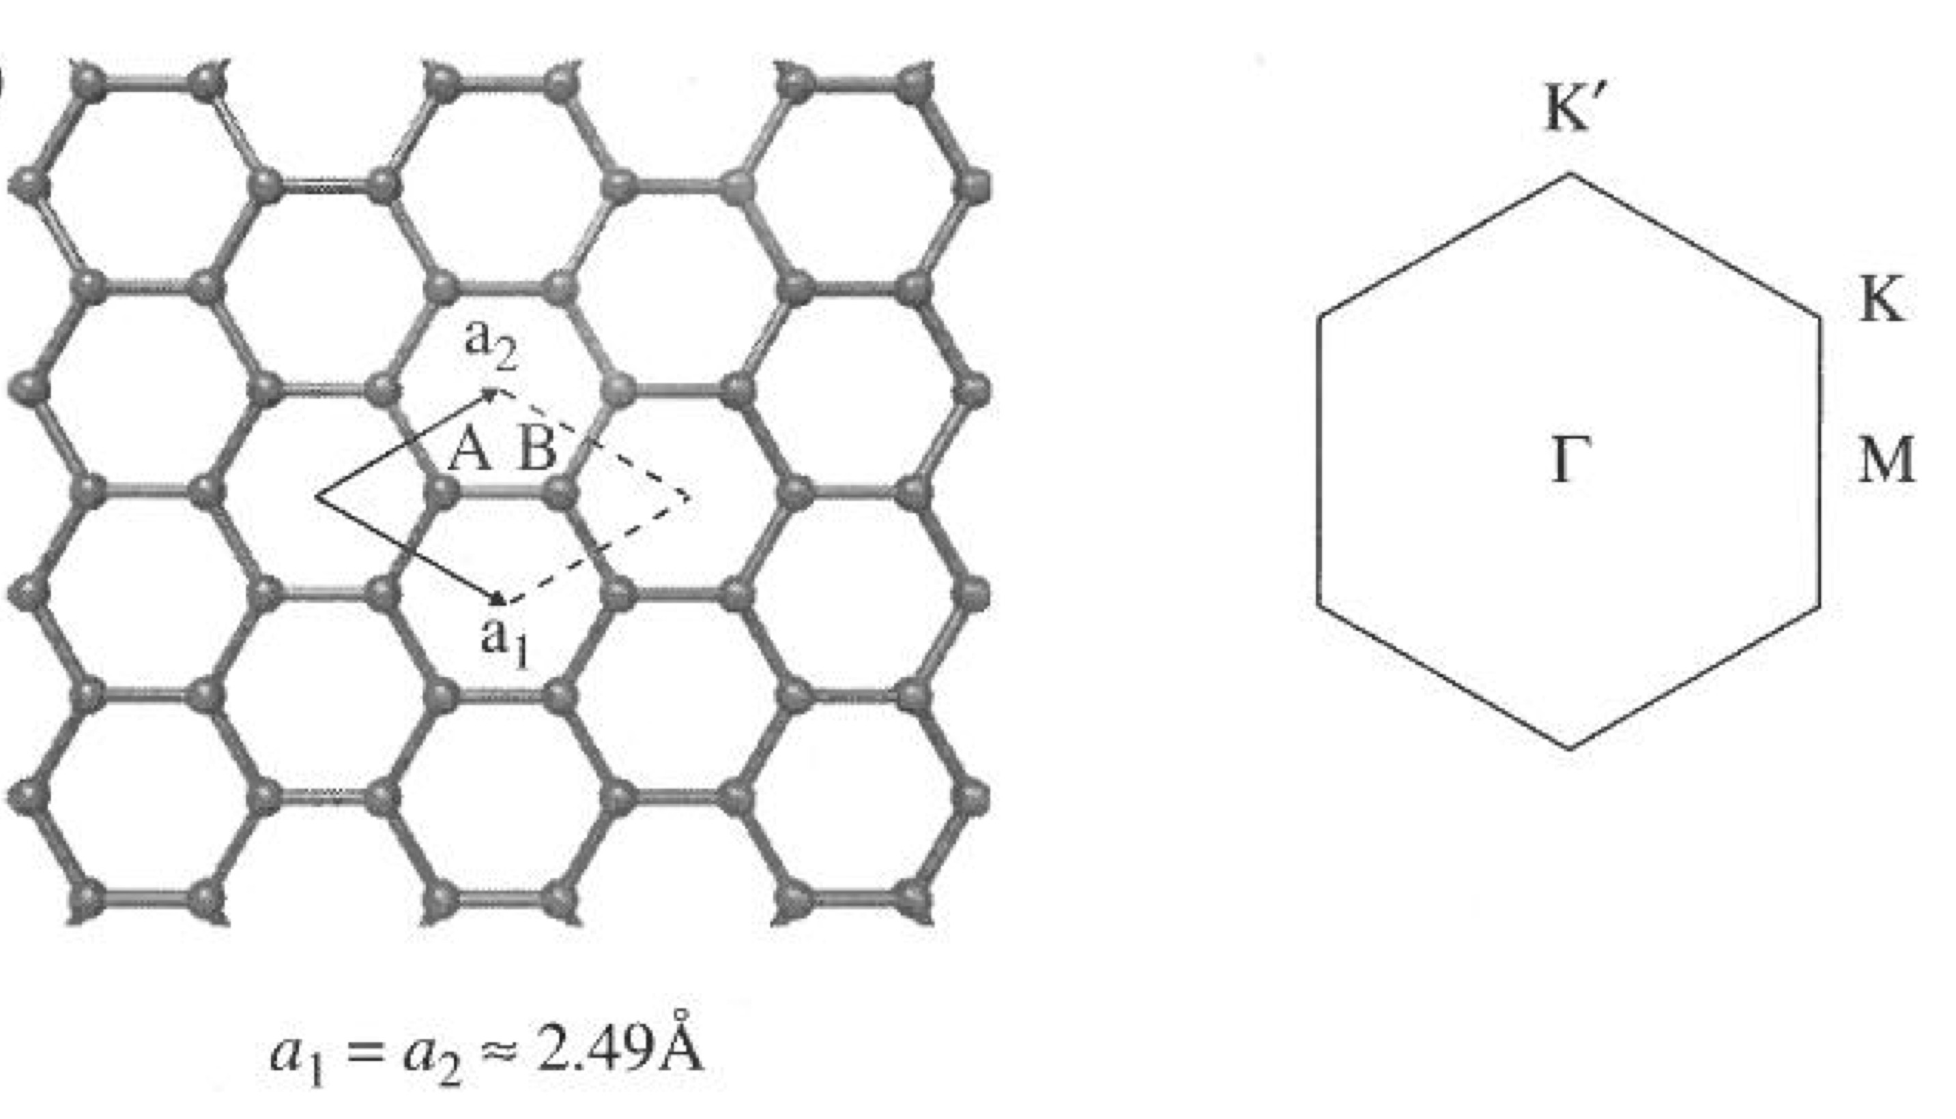
Graphene: atomic structure in siesta

Slide 33
Graphene: plotting the band-structure in siesta

Slide 34
wannier90 code directly available from siesta
We have eight bands in the outer energy window
We are interested in project over the wannierization over the three sp² orbitals and the manifold
(five Wannier functions in total)

Slide 35
wannier90 code directly available from siesta
Some Bloch states are forced to be preserved identically in the projected manifold; those are referred to as belonging to a frozen “inner” window
Frozen energy window
We are interested in project over the wannierization over the three sp² orbitals and the manifold (five Wannier functions in total)

Slide 36
Output of a succesful run
Three sp₂ type-Wanniers
The manifold

Slide 37
How to plot the Wannier functions
Wannier90 produces files with the name:
SystemLabel.manifold.X_0000Y.xsf that can be directly plotted with xcrysden
Once XCrySDen starts, click on
File → Open structure (Select your xsf file)
Modify → Number of units drawn 2 (along x) 2 (along y) 1 (along z)
Tools → Data Grid
Click on OK
Then, select:
Degree of triCubic Spline: 3
Click on Render+/- isovalue
Select the desired isovalue (in this example 0.1)
Submit
graphene.manifold.1_00004.xsf
Lateral view
Top view

Slide 38


Funding
SPANISH INITIATIVE FOR ELECTRONIC SIMULATIONS WITH THOUSANDS OF ATOMS:
CÓDIGO ABIERTO CON GARANTÍA Y SOPORTE PROFESIONAL: SIESTA-PRO
Proyecto financiado por el Ministerio de Economía, Industria y Competitividad,
y cofinanciado con Fondos Estructurales de la Unión Europea
Referencia: RTC-2016-5681-7
Objetivo Temático del Programa Operativo:
"Promover el desarrollo tecnológico, la innovación y una investigación de calidad"

