Slide 1
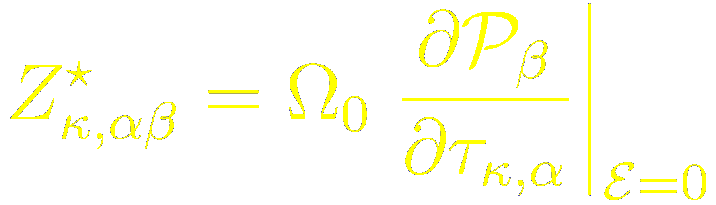

How to compute the
Born effective charge tensor
Javier Junquera

Slide 2
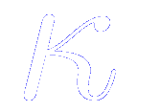
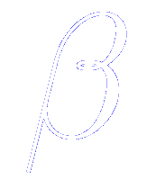
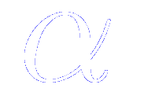
Definition of the Born effective charges, also known as dynamical charges
For periodic solids, the Born effective charge of atom is a tensor defined as the coefficient of proportionality at the linear order and under the condition of zero macroscopic electric field, between the macroscopic polarization per unit cell created in direction and a cooperative displacements of atoms in direction
Units: electron charges
Read pages 106 and following of Philippe Ghosez’s PhD thesis
http://www.phythema.ulg.ac.be/webroot/misc/books/PhD-Ph.Ghosez.pdf

Slide 3
In siesta computed from finite differences of the bulk spontaneous polarization
SrTiO₃ in the centrosymmetric bulk cubic structure
To compute the phonons, the atomic masses are introduced in this block
We are going to displace all the atoms in the unit cell 0.01 Bohrs along the x, y, and z direction
For each atomic configuration, we compute the macroscopic polarization with this Polarization Grid in reciprocal space

Slide 4
Born effective charges dumped into a file: SystemLabel.BC

Slide 5
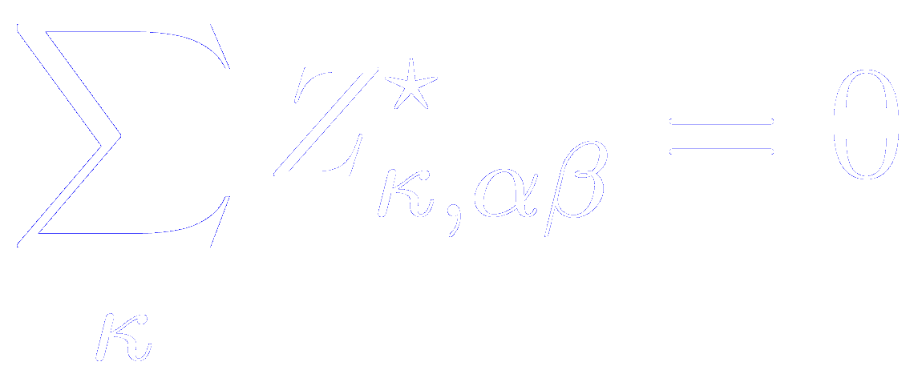
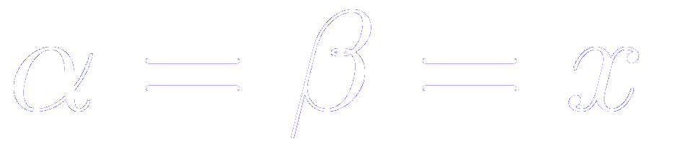
Acoustic sum rule
It is important that the acoustic sum rule is preserved by the Born effective charges
(if we displace the whole solid rigidly, no polarization should be generated)
In our simulation, taking , and rounding to the third significant digit
To fulfill the acoustic sum rule, we divide the sum by the number of atoms
Substracting this same amount to all the atoms

Slide 6
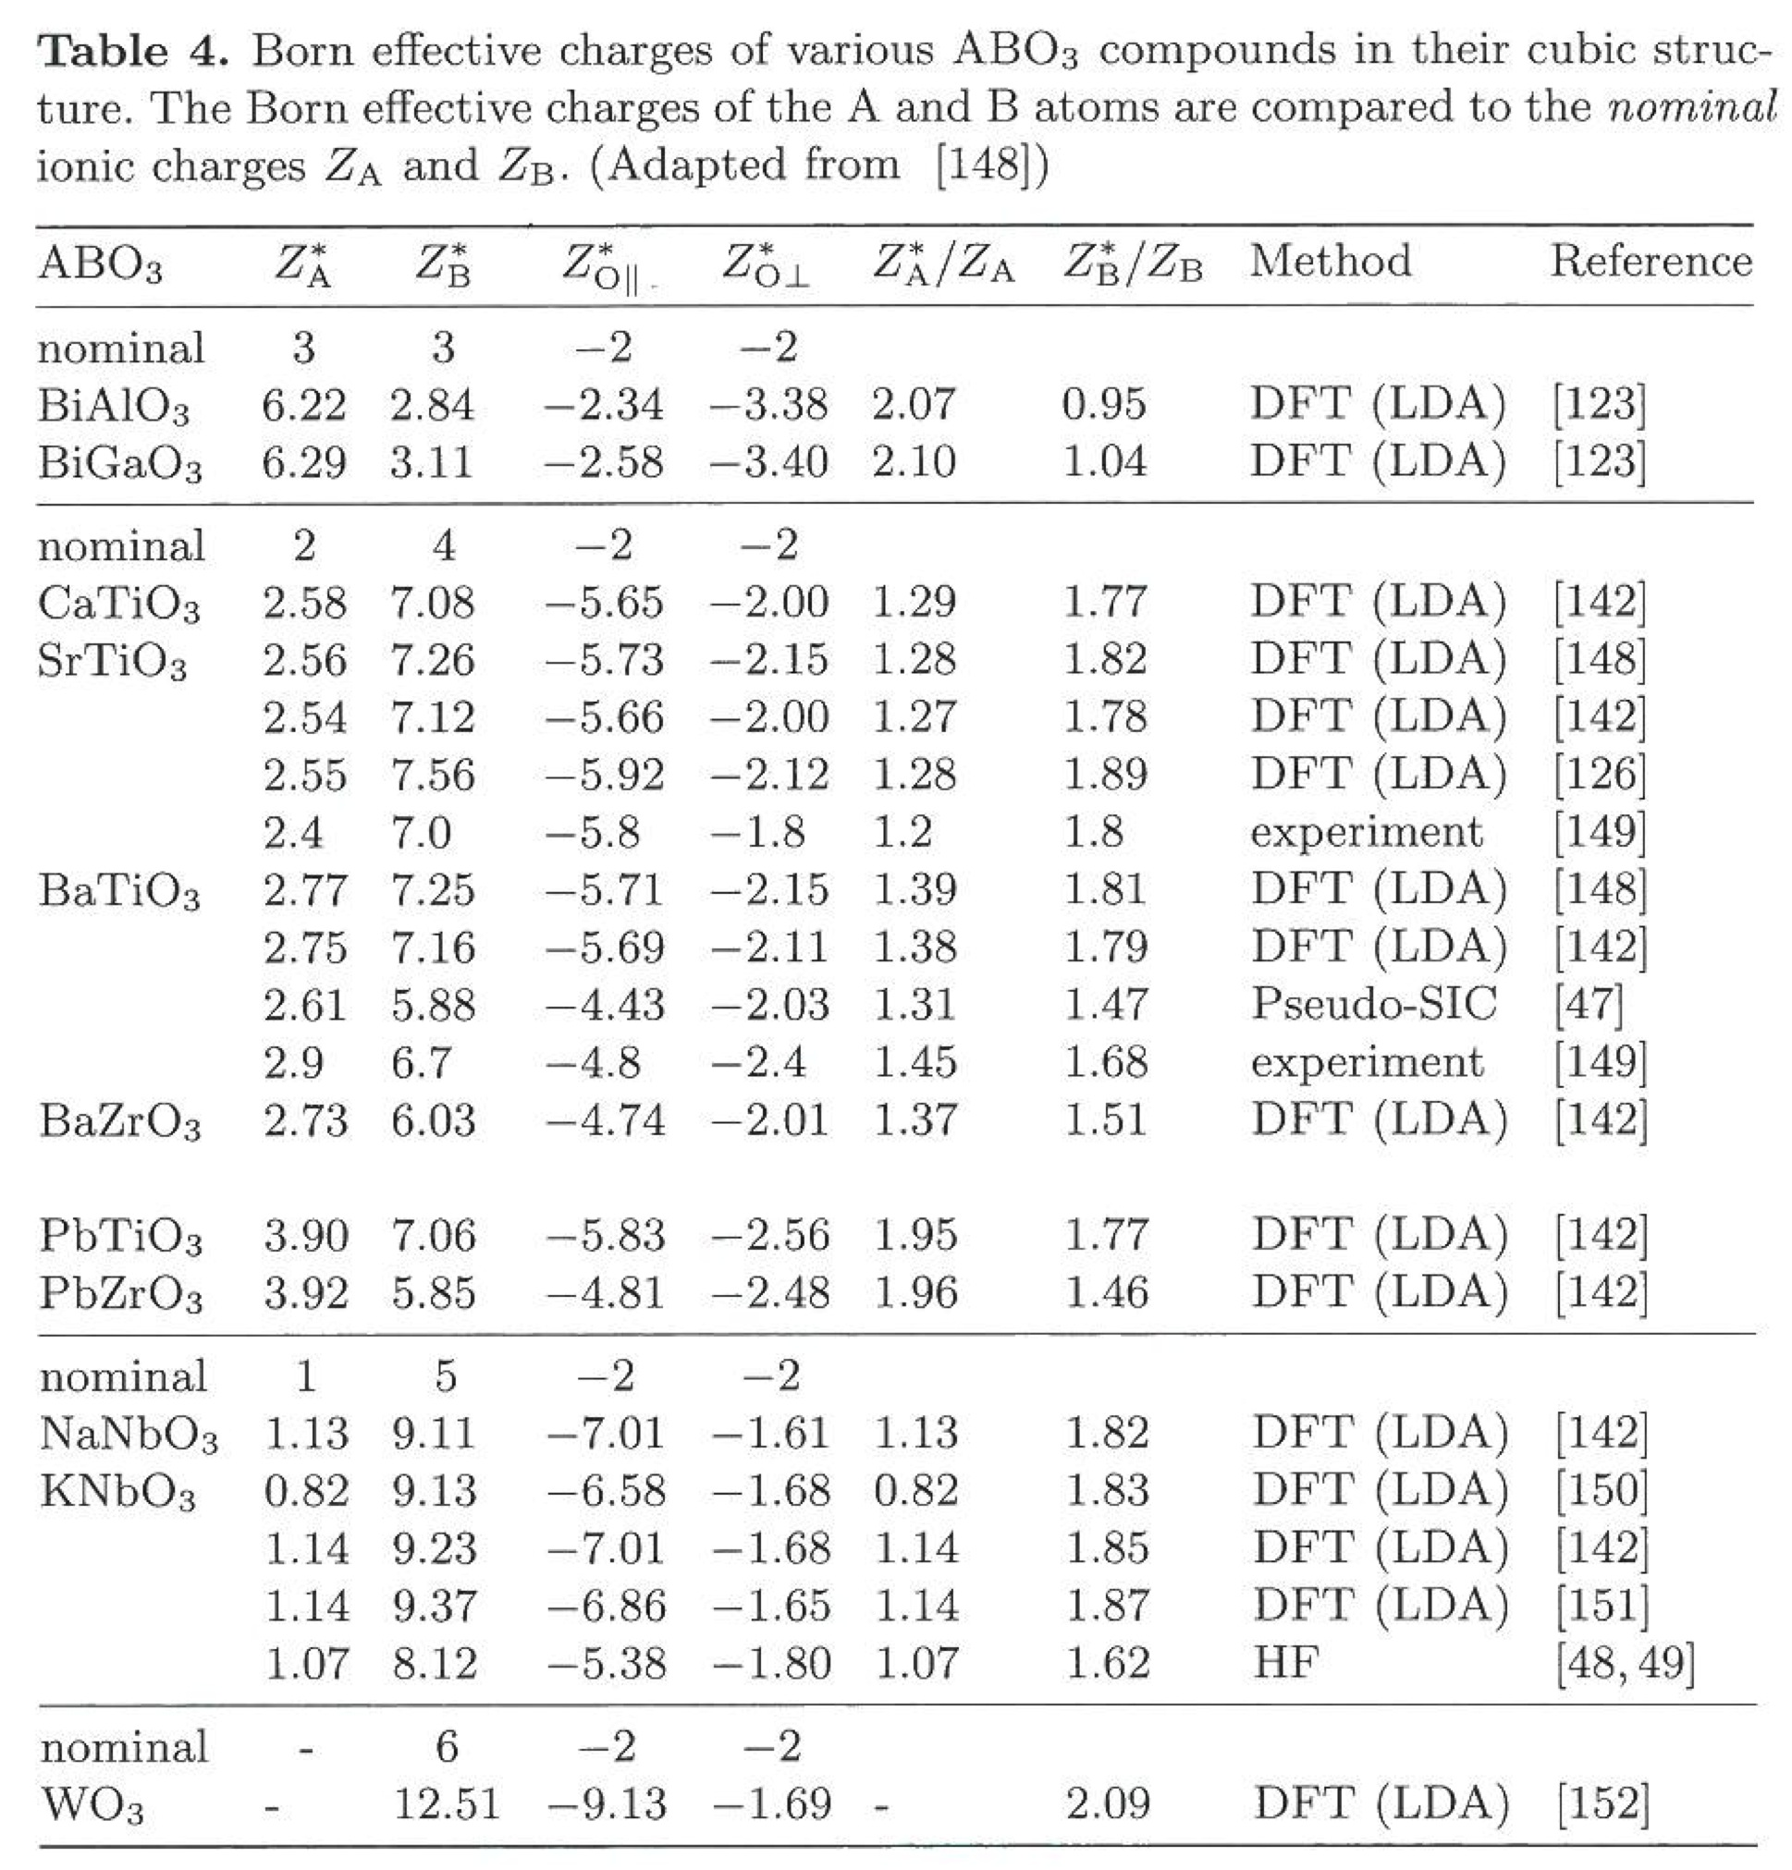
Comparison with previous results
Adapted from
Ph. Ghosez et al. ,
Phys. Rev. B 58, 6224 (1998)
First-principles studies of ferroelectric oxides
K. M. Rabe and Ph. Ghosez, included in
Physics of Ferroelectrics. A Modern Perspective.
Topics in Applied Physics
K. Rabe, Ch. Ahn, and J. –M. Triscone (Editors)
Springer-Verlag, Heidelberg (2007)

Slide 7
Phonon frequencies and eigenvectors at the Γ-point
- Go to the directory
$cd <your_siesta_path>/Util/Vibra/Src
To compile the vibra suite with the same arch.make as in siesta, type
$make
Go back to the directory where you are running the exercise and type
$ <your_siesta_path>/Util/Vibra/Src/vibrator < SrTiO3.fdf
You get the file SrTiO3.bands with the eigenvalues
and SrTiO3.vectors with the eigenvectors
Three frequencies are zero,
They correspond to translational modes

