Slide 1

LDA+U
How to run a simulation within LDA+U framework in siesta
Javier Junquera
Daniel Sánchez-Portal

Slide 2
Transition metal monoxides are prototypes of highly correlated materials
Paradigmatic example: NiO
Above the Néel temperature of is a paramagnetic insulator with the rocksalt structure
Below it is a type-II antiferromagnetic insulator
Ground state:
Type-II AntiFerroMagnetic:
ferromagnetic alignment of the Ni atoms within the (111) planes and the antiferromagnetic alignment of those planes
O
Ni
NiO crystallizes in the rocksalt structure with rhombohedral symmetry induced by the type-II AFM order
M. Cococcioni and S. de Gironcoli, Phys. Rev. B 71, 035105 (2005)

Slide 3
Transition metal monoxides are prototypes of highly correlated materials
Paradigmatic example: NiO
Above the Néel temperature of is a paramagnetic insulator with the rocksalt structure
Below it is a type-II antiferromagnetic insulator
Calculations carried out in the undistorted unit cell at the experimental lattice constant
O
Ni
NiO crystallizes in the rocksalt structure with rhombohedral symmetry induced by the type-II AFM order
M. Cococcioni and S. de Gironcoli, Phys. Rev. B 71, 035105 (2005)

Slide 4
Band structure of NiO within the generalized grandient approximation
We plot the band structure using the Utility program gnubands, and following the recipe given in the tutorial
Band structure of an ionic solid: the case of MgO
Introduce the path in k-space in the siesta input file
Run siesta, run gnubands and plot the results
Edit the file where the bands along the high-symmetry lines are dumped and identify the top of the valence band eigenvalue.
In this example, it amounts to -5.7677 eV

Slide 5
Band structure of NiO within the generalized grandient approximation
Run gnubands and plot the results
We shift rigidly the bands to set the zero of energy with the top of the valence band

Slide 6
Band structure of NiO within the generalized grandient approximation
Run gnubands and plot the results
This work
M. Cococcioni and S. de Gironcoli, Phys. Rev. B 71, 035105 (2005)
GGA gap is too small for NiO

Slide 7
Projected Density of States of NiO within the generalized grandient approximation
We plot the PDOS using the Utility program fmpdos, and following the recipe given in the tutorial
Density of States and Projected Density of States: the case of SrTiO₃
Take a look at the fdf input file and study the meaning of the following blocks

Slide 8
Projected Density of States of NiO within the generalized grandient approximation
Project on the 4s orbitals of the Ni atom
Project on the 3d orbitals of the Ni atom
Project on the 2p orbitals of the O atom

Slide 9
Projected Density of States of NiO within the generalized grandient approximation
This work
M. Cococcioni and S. de Gironcoli, Phys. Rev. B 71, 035105 (2005)

Slide 10
How to introduce the U

Slide 11
LDA+U method
LDA (or GGA) is supplemented with a Hubbard-like term in order to have a better description of the effect of electron-electron interactions in a localized atomic shell of a particular atom in the solid, i.e. 3d shell of Ni in NiO
In particular this reduces the problem of Self-Interaction
with
Double counting term
(cancels the electron-electron interaction in the localized shell in LDA)

Slide 12
LDA+U method

Slide 13
Rotationally invariant formulation
Dudarev et al., Phys. Rev. B 57, 1505 (1998)

Slide 14
Populations are calculated using localized projectors
Two different ways of define the projectors, selected with the keyword
LDAU.ProjectorGenerationMethod
Method 1: Generated in the same way as a simple-𝞯 orbital, with a larger Energy Shift
Method 2: Cut the exact solution of the pseudoatomic problem with a Fermi function

Slide 15
Method 1: Generated in the same way as a simple-𝞯 orbital, with a larger Energy Shift
The Schrödinger equation for the isolated atom might be solved with a confinement potential, in the same way as it is done for the basis atomic orbitals
We are going to generate two projectors for a Mn atom
The first one, for the 3d shell
(we can specify both n and l quantum numbers)
The second one, for the 4s shell
(here we only specify the l quantum number)
(might be quite unphysical… only shown here as an example to tell how the projectors are introduced)

Slide 16
Method 1: Generated in the same way as a simple-𝞯 orbital, with a larger Energy Shift
The cutoff radius of the LDA+U projector, , can be explicitly introduced in the block LDAU.Proj.
If it appears as zero in the block, the value introduced in the LDAU.EnergyShift label is used
(Default value 0.05 Ry)
LDAU.EnergyShift is the same as the parameter PAO.EnergyShift: the energy increase used to define the localization radius of the LDA+U projector

Slide 17
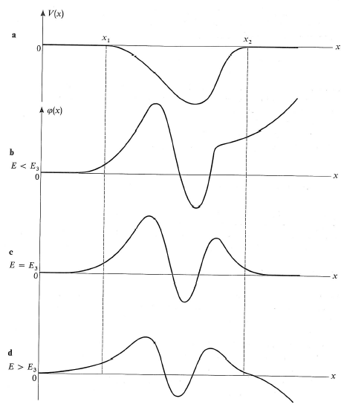
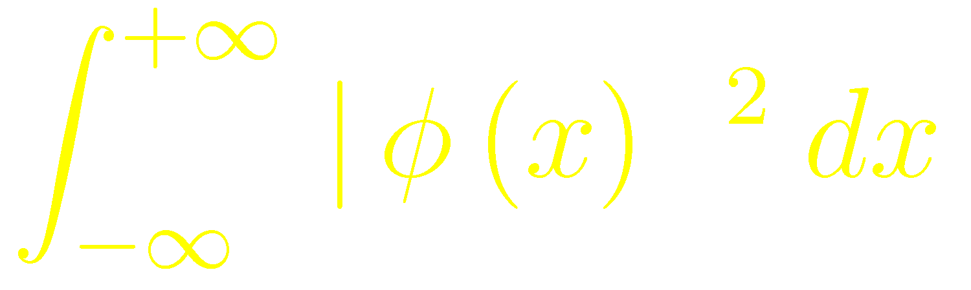
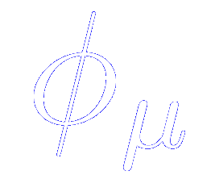
How to control the range of the orbitals in a balanced way: the energy shift
Particle in a confinement potential:
Imposing a finite
+
Continuous function and first derivative
⇓
E is quantized (not all values allowed)
Increasing E ⇒ has a node and tends to -∞ when x→ + ∞
Complement M III “Quantum Mechanics”,
C. Cohen-Tannoudji et al.

Slide 18
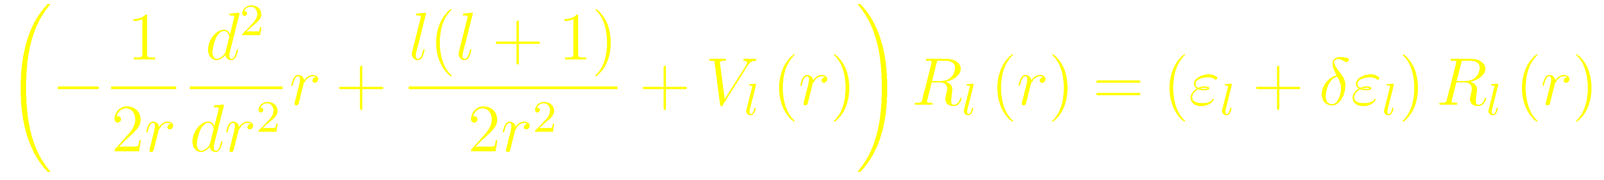
How to control de range of the orbitals in a balanced way: the energy shift
Energy increase ≡ Energy shift
LDAU.EnergyShift (energy)
Cutoff radius, , = position where each orbital has the node
A single parameter for all cutoff radii
The larger the Energy shift, the shorter the ’s
Typical values for generating basis sets: 100-200 meV
LDA+U projectors should be rather localized, therefore larger EnergyShifts are expected
E. Artacho et al. Phys. Stat. Solidi (b) 215, 809 (1999)

Slide 19
Method 1: Generated in the same way as a simple-𝞯 orbital, with a larger Energy Shift
If the label WriteIonPlotFiles is set to .true. Then the radial part pf the projectors is written in the file LDA+U.LX.Y.AtomicSymbol
X = Angular momentum
Y= number of projector for this angular momentum
What is represented is the radial part divided by

Slide 20
Method 2: Cut the exact solution of the pseudoatomic problem with a Fermi function
Solve the Schrödinger equation for the isolated atom with a large cutoff
Multiply the long wave function by a Fermi function

Slide 21
Method 2: Cut the exact solution of the pseudoatomic problem with a Fermi function
The Schrödinger equation for the isolated atom might be solved with a confinement potential, in the same way as it is done for the basis atomic orbitals
(although, since we need a long wave function, it is recommended not to confine them)
We are going to generate two projectors for a Mn atom
The first one, for the 3d shell
(we can specify both n and l quantum numbers)
The second one, for the 4s shell
(here we only specify the l quantum number)
(might be quite unphysical… only shown here as an example to tell how the projectors are introduced)

Slide 22
Method 2: Cut the exact solution of the pseudoatomic problem with a Fermi function
How to determine the parameters of the Fermi function
The cutoff radius of the Fermi function, , equivalent to the Fermi energy, can be explicitly introduced in the block LDAU.Proj.
If it appears as zero in the block, the value introduced in the LDAU.CutoffNorm label is used
(Default value 0.90)
LDAU.CutoffNorm is the norm of the original pseudoatomic orbital contained in a sphere of radius equal to

Slide 23
Method 2: Cut the exact solution of the pseudoatomic problem with a Fermi function
How to determine the parameters of the Fermi function
The width of the Fermi function, , is controlled by the parameters included in the block LDAU.Proj.
If it appears as zero in the block, a default value of 0.05 will be used

Slide 24
Method 2: Cut the exact solution of the pseudoatomic problem with a Fermi function
If the label WriteIonPlotFiles is set to .true. Then the radial part pf the projectors is written in the file LDA+U.LX.Y.AtomicSymbol
X = Angular momentum
Y= number of projector for this angular momentum
What is represented is the radial part divided by

Slide 25
Populations are calculated using localized projectors
In the NiO example, we have used the LDAU.ProjectorGenerationMethod 2
The equivalent to the Fermi energy of the Fermi function is chosen using the LDAU.CutoffNorm parameter
And for the width we rely on the default value

Slide 26
Main keywords related with the U parameter

Slide 27
Main keywords related with the LDA+U self-consistency
LDAU.FirstIteration
If true, local populations are calculated and Hubbard-like term is switch on in the first iteration. Useful if restarting a calculation reading a converged or an almost converged density matrix from file.
LDAU.ThresholdTol
Local populations only calculated and/or updated if the change in the density matrix elements (dDmax) is lower than LDAU.ThresholdTol.
LDAU.PopTol
Convergence criterium for the LDA+U local populations. In the current implementation the Hubbard-like term of the Hamiltonian is only updated (except for the last iteration) if the variations of the local populations are larger than this value.

Slide 28
Band structure of NiO within the generalized grandient approximation + U
Run siesta, and then run gnubands and plot the results
We shift rigidly the bands to set the zero of energy with the top of the valence band

Slide 29
Band structure of NiO within the generalized grandient approximation + U
Run gnubands and plot the results
GGA
GGA+U
This work
M. Cococcioni and S. de Gironcoli, Phys. Rev. B 71, 035105 (2005)

Slide 30
Projected Density of States of NiO within the generalized grandient approximation + U
Project on the 4s orbitals of the Ni atom
Project on the 3d orbitals of the Ni atom
Project on the 2p orbitals of the O atom

Slide 31
Projected Density of States of NiO within the generalized grandient approximation + U
GGA
GGA+U qualitatively modifies the nature of the states at the top of the valence band, and hence the nature of the band gap
GGA + U
GGA: Ni d states
GGA+U: O p states
The bottom of the conduction band is of Ni d character, so the predicted band-gap is of charge-transfer type within GGA+U, in good agreement with experiment.
This work
M. Cococcioni and S. de Gironcoli, Phys. Rev. B 71, 035105 (2005)

Slide 32
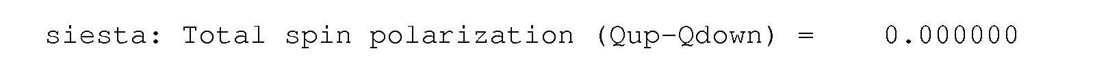
Magnetic moment in bulk NiO
WriteMullikenPop 1
O
GGA +U
Ni
NiO crystallizes in the rocksalt structure with rhombohedral symmetry induced by the type-II AFM order
Well within the experimental ranges of values (from 1.64 to 1.9)
M. Cococcioni and S. de Gironcoli, Phys. Rev. B 71, 035105 (2005)
GGA

Slide 33


Funding
SPANISH INITIATIVE FOR ELECTRONIC SIMULATIONS WITH THOUSANDS OF ATOMS:
CÓDIGO ABIERTO CON GARANTÍA Y SOPORTE PROFESIONAL: SIESTA-PRO
Proyecto financiado por el Ministerio de Economía, Industria y Competitividad,
y cofinanciado con Fondos Estructurales de la Unión Europea
Referencia: RTC-2016-5681-7
Objetivo Temático del Programa Operativo:
"Promover el desarrollo tecnológico, la innovación y una investigación de calidad"

