Slide 1


Simulations of a ferroelectric slab under constrained electric displacement
vacuum
BaTiO₃
vacuum
Ba(O_{(1-x)}N_{x})
Ba(O_{(1-x)}F_{x})
Javier Junquera

Slide 2
Most important reference followed in this lecture
Nature Physics 5, 304 (2009)
Section III C

Slide 3
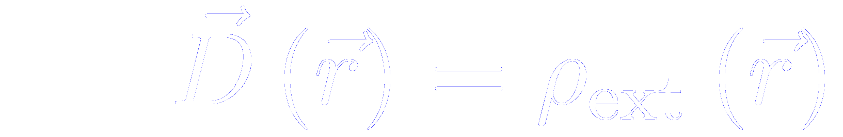
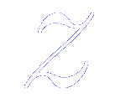
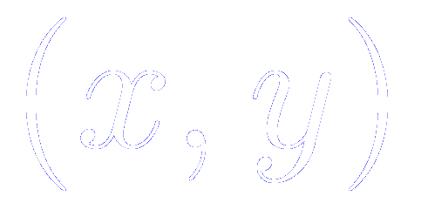
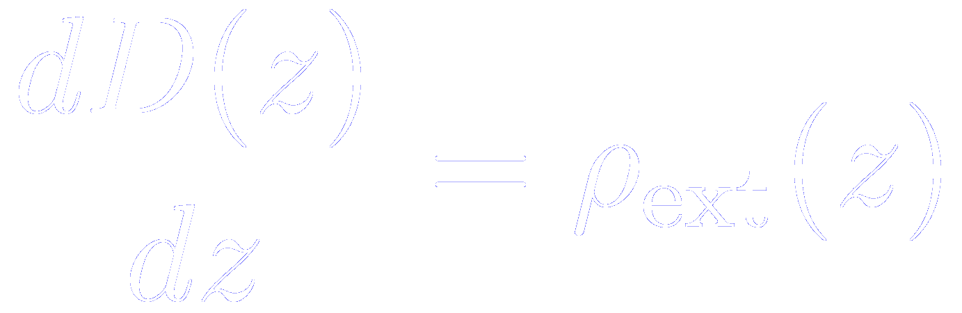
Macroscopic Maxwell equations in materials
From basic electrostatic, the macroscopic Maxwell equation in materials
Encompasses all bound-charged effects that can be referred to the properties of periodically repeated primitive bulk unit
Contains all the rest:
Delta-doping layers
Metallic free charges
Charged adsorbates
Variations in local stoichiometry
…
If we assume that the interface is oriented along the axis,
and each material is periodic in the plane parallel to the interface

Slide 4
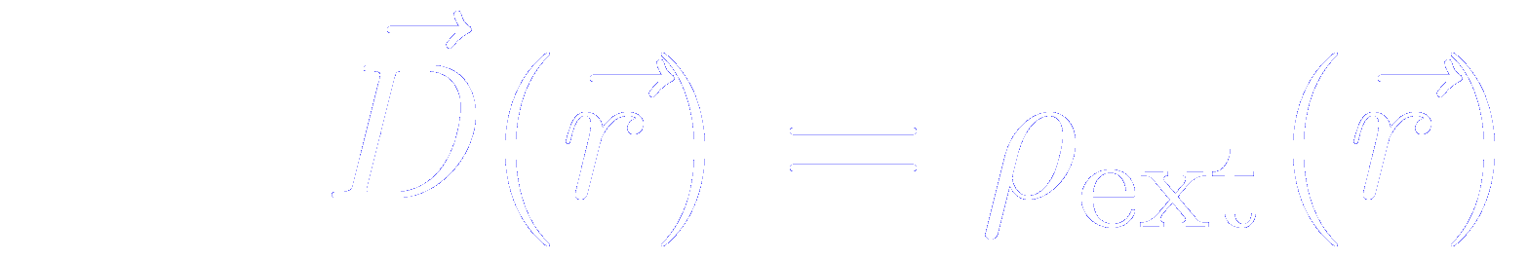
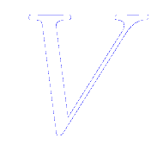

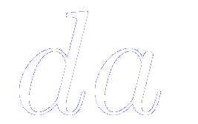
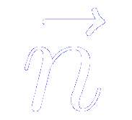
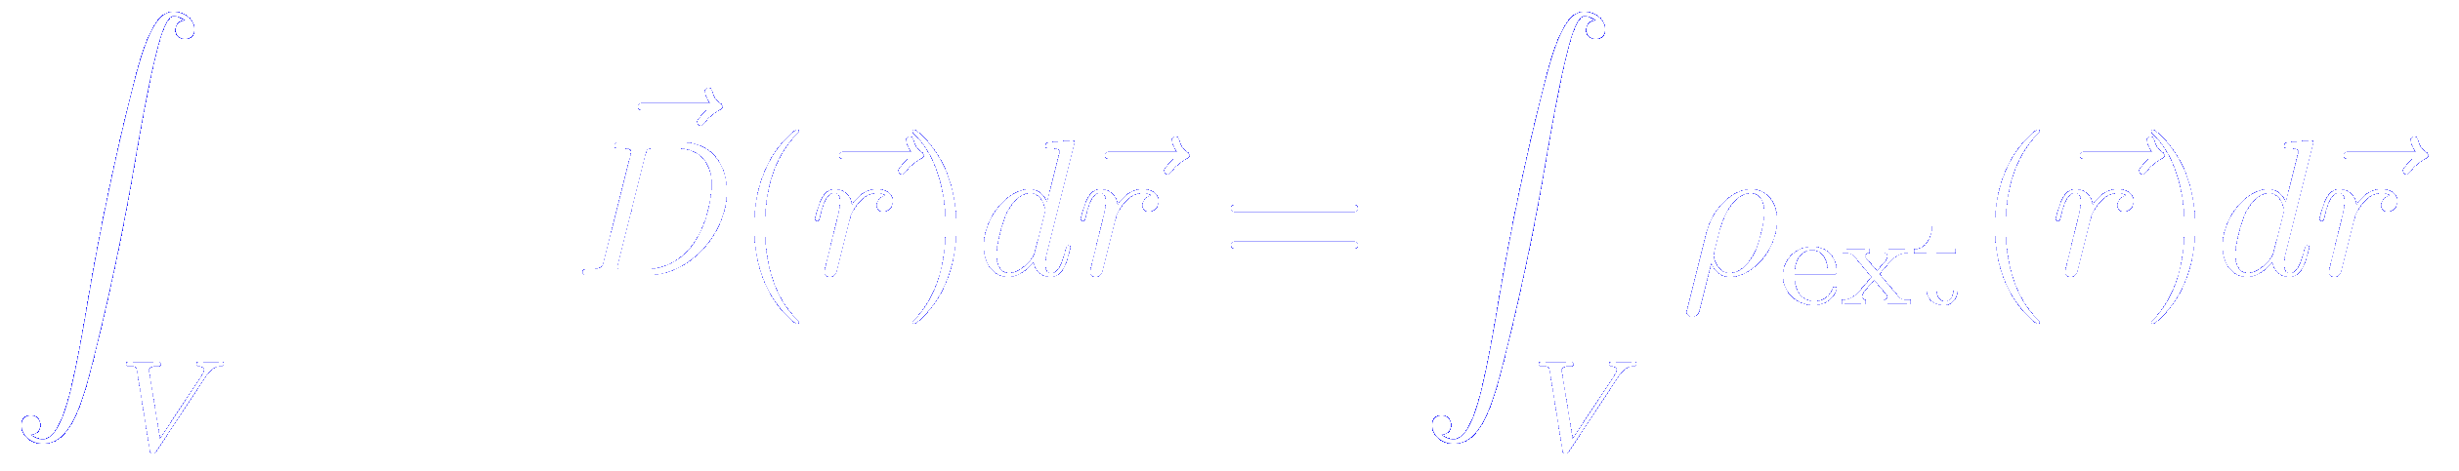
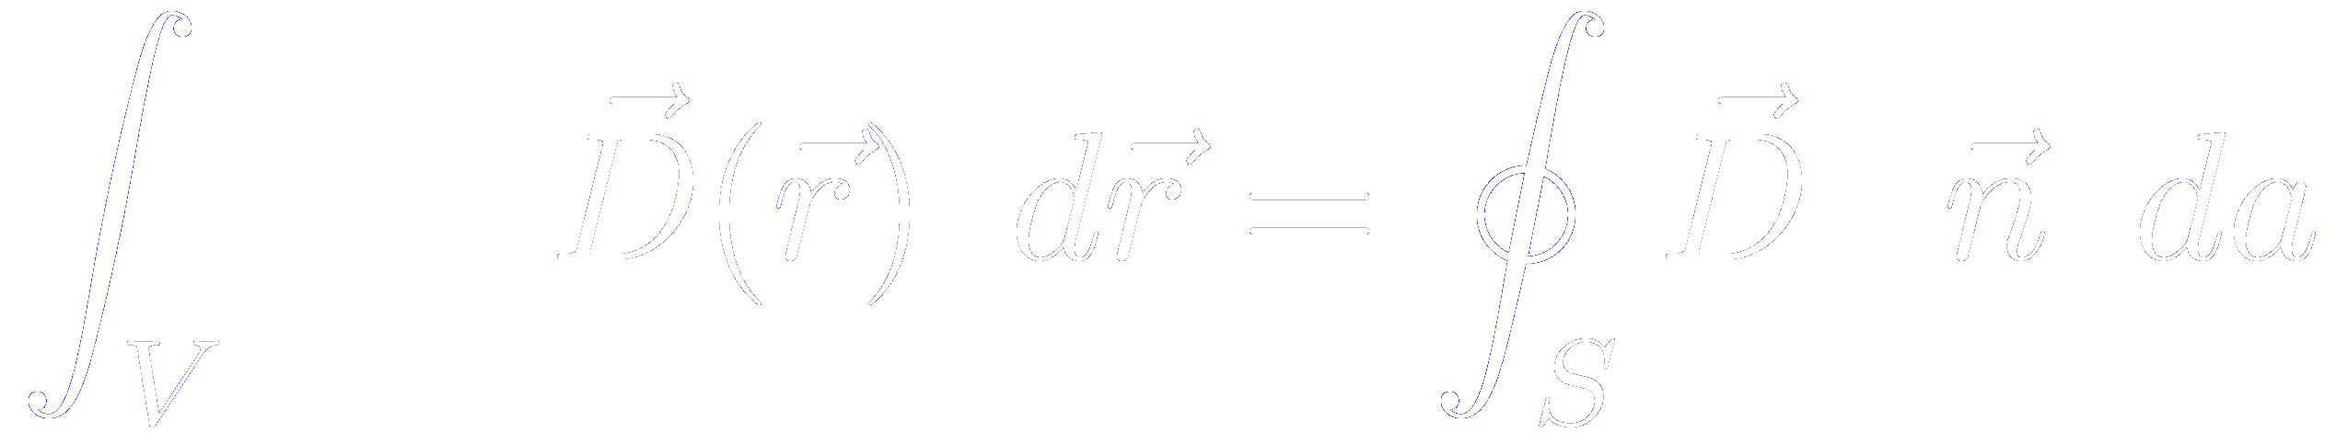
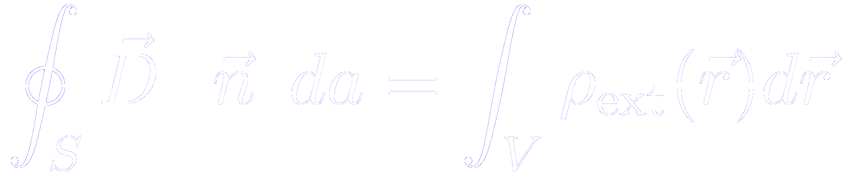
Relation between the normal component of the displacement field at the interface of different media
We start from the Maxwell equation in macroscopic media
SI units
Let be a finite volume in space, the closed surface bounding it, an element of area on the surface, and a unit normal to the surface at pointing outward from the enclosed volume
Integrating the Maxwell equation over the volume
Then, we apply the divergence theorem

Slide 5
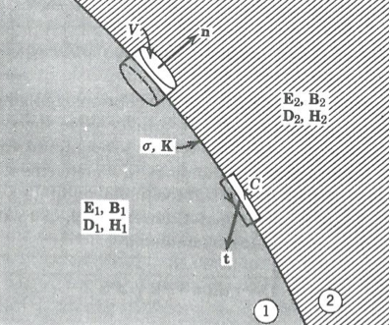
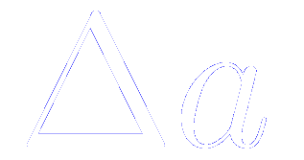
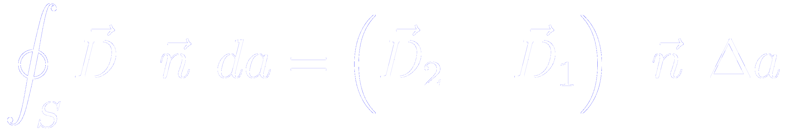
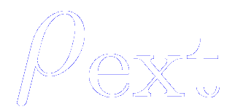
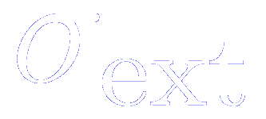
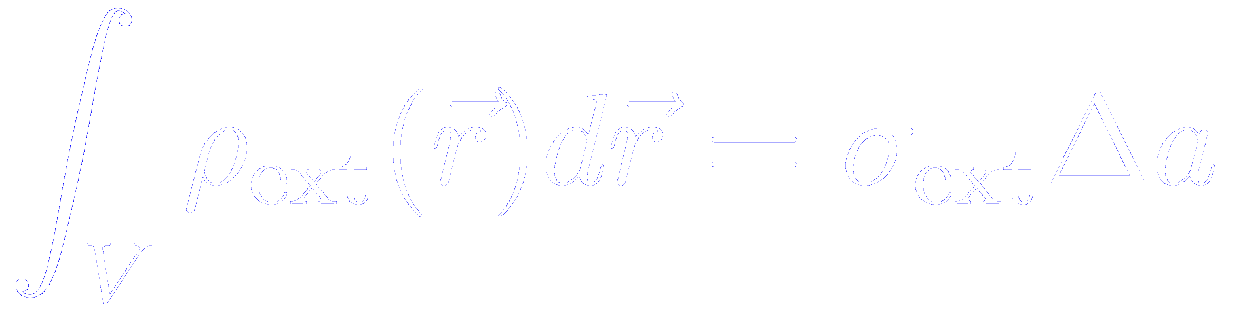
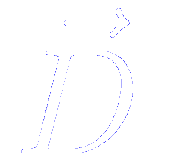
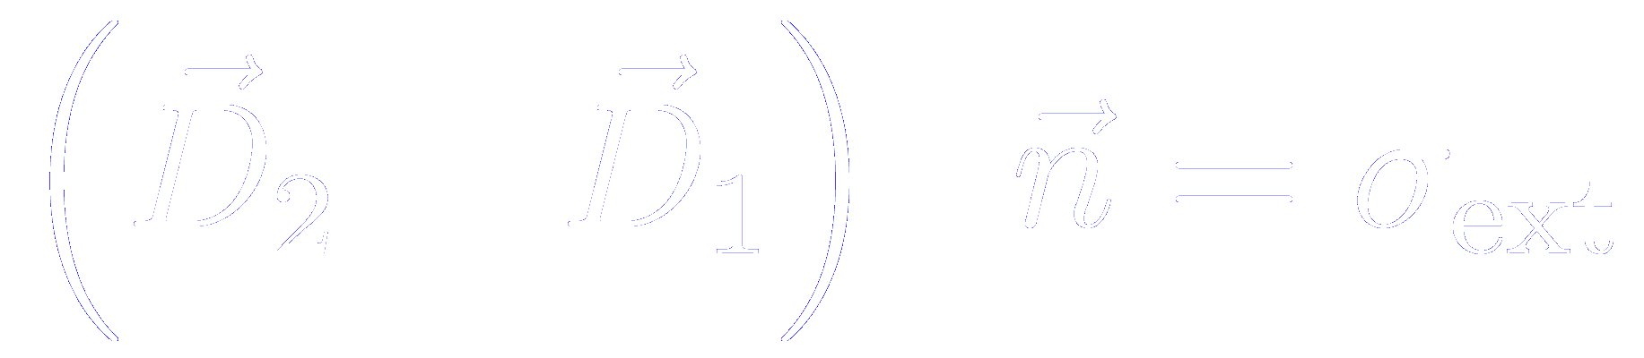

Relation between the normal component of the displacement field at the interface of different media
An infinitesimal Gaussian pillbox straddles the boundary surface between two media
In the limit of a very shallow pillbox, the side surfaces do not contribute to the integral
If the top and bottom are parallel, tangent to the surface, and of area , then
If the charge density is singular at the interface so as to produce an idealized surface charge density
J. D. Jackson
Classical Electrodynamics, John Wiley and sons
Second Edition
So the normal component of on either side of the boundary surface is related according to
The discontinuity of the normal component of at any point is equal to the surface charge density at that point

Slide 6




“Constrained- ” method
Adopt a vacuum/insulator/vacuum geometry
vacuum
BaTiO₃
vacuum
Ba(O_{(1-x)}N_{x})
Pseudos generated with the virtual crystal approximation
Ba(O_{(1-x)}F_{x})
Replace the O by a fictitious atom of fractional atomic charge
Replace the O by a fictitious atom of fractional atomic charge
If the “fictitious atom” is oxygen at both surfaces
Nominal net charge at the left surface = 0
Nominal net charge at the right surface = 0

Slide 7

“Constrained- ” method
Adopt a vacuum/insulator/vacuum geometry
vacuum
BaTiO₃
vacuum
Ba(O_{(1-x)}N_{x})
Pseudos generated with the virtual crystal approximation
Ba(O_{(1-x)}F_{x})
Replace the O by a fictitious atom of fractional atomic charge
Replace the O by a fictitious atom of fractional atomic charge
If the “fictitious atom” is Nitrogen at the left and Fluorine at the right surface
Nominal net charge at the left surface = -1
Nominal net charge at the right surface = +1

Slide 8



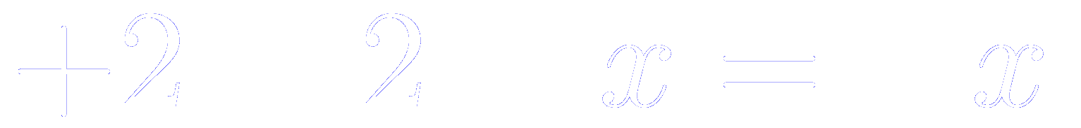
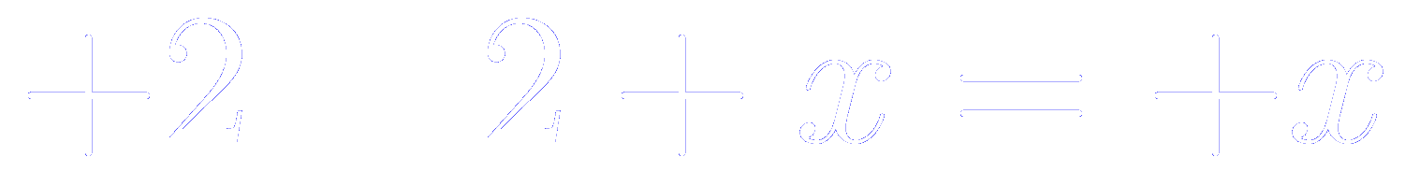
“Constrained- ” method
Adopt a vacuum/insulator/vacuum geometry
vacuum
BaTiO₃
vacuum
Ba(O_{(1-x)}N_{x})
Pseudos generated with the virtual crystal approximation
Ba(O_{(1-x)}F_{x})
Replace the O by a fictitious atom of fractional atomic charge
Replace the O by a fictitious atom of fractional atomic charge
For fractional values of ,
Nominal charge of the “fictitious atom”:
Nominal charge of the “fictitious atom”:
Nominal net charge at the left surface
Nominal net charge at the right surface
Negative
Positive

Slide 9
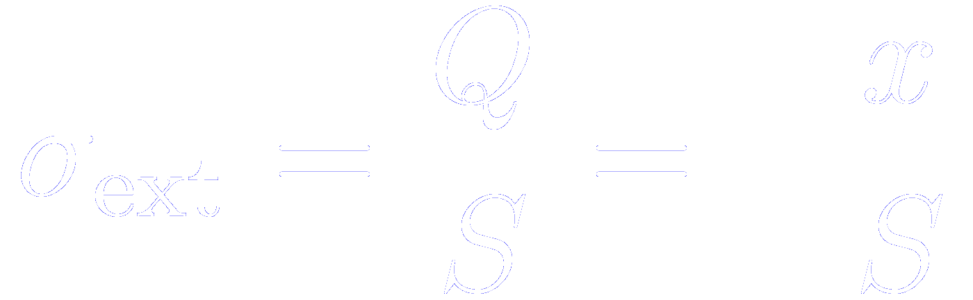
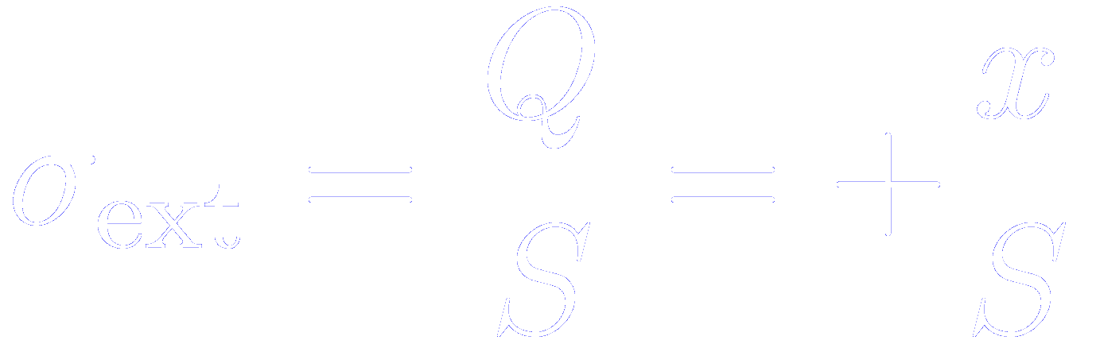
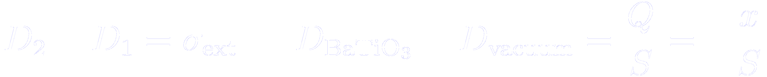
“Constrained- ” method
Adopt a vacuum/insulator/vacuum geometry
vacuum
BaTiO₃
vacuum
Ba(O_{(1-x)}N_{x})
Pseudos generated with the virtual crystal approximation
Ba(O_{(1-x)}F_{x})
Therefore, the surface charge density at each termination amounts to
As we have seen previously
If we particularize this for the left surface (1 = vacuum; 2 = BaTiO₃)

Slide 10

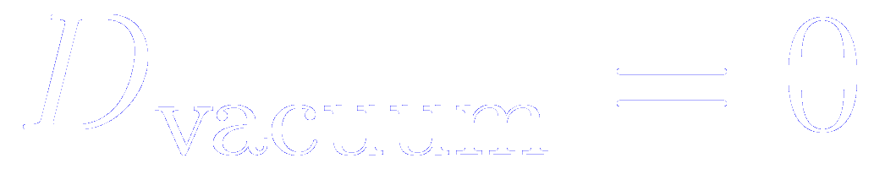
The dipole correction in the vacuum region is required to ensure that in the vacuum side
B. Meyer and D. Vanderbilt
Phys. Rev. B 63, 205426 (2001)
That is what we are looking for.
Zero electric field in the vacuum region
If there is no electric field in vacuum, then

Slide 11
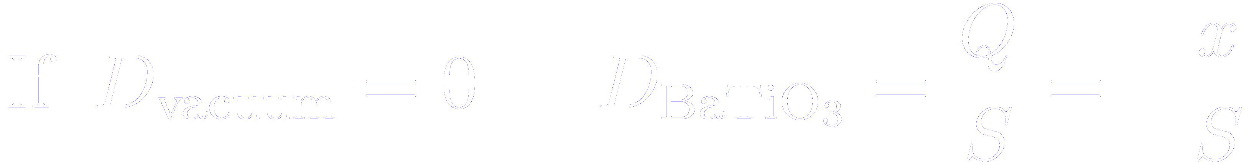
“Constrained- ” method
Adopt a vacuum/insulator/vacuum geometry
vacuum
BaTiO₃
vacuum
Ba(O_{(1-x)}N_{x})
Pseudos generated with the virtual crystal approximation
Ba(O_{(1-x)}F_{x})
Therefore, the surface charge density at each termination amounts to

Slide 12
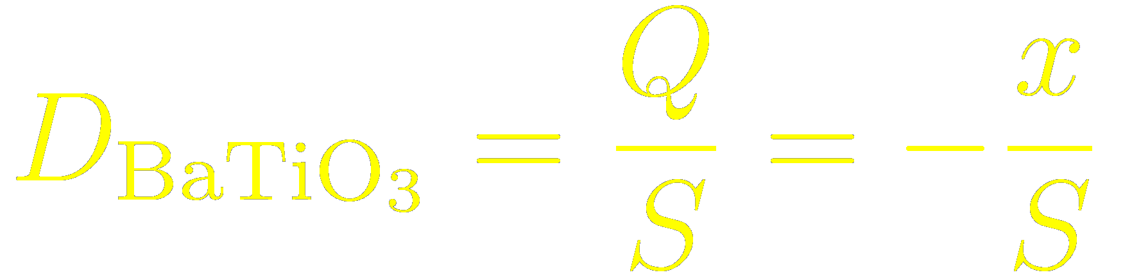


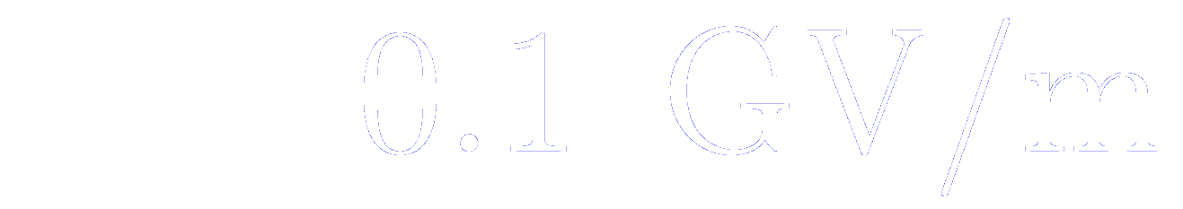
“Constrained- ” method
Adopt a vacuum/insulator/vacuum geometry
vacuum
BaTiO₃
vacuum
Ba(O_{(1-x)}N_{x})
Pseudos generated with the virtual crystal approximation
Ba(O_{(1-x)}F_{x})
We can monitor the value of the displacement field with an external parameter
In many ferroelectric materials, we can assume that , with errors of 1%
Largest electric field that can be applied without dielectric breakdown

Slide 13
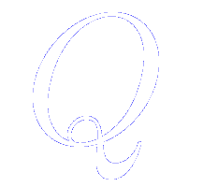
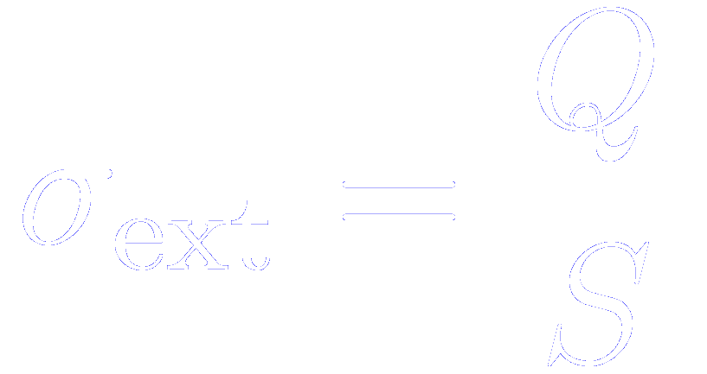
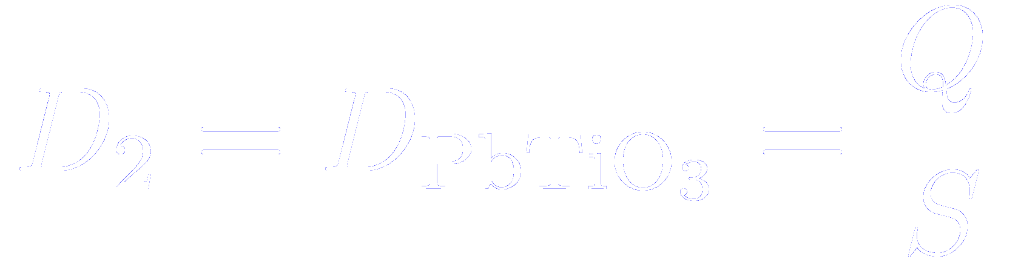

“Constrained- ” method in capacitors
Adopt a vacuum/insulator/metal/vacuum geometry
Induce a layer of bound charges at its free surface
( per surface unit cell )
If the surface region remains locally insulating

Slide 14
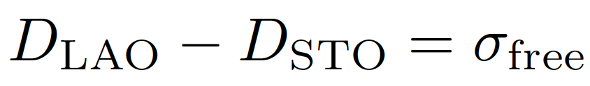
Comparison of the “constrained-σ” method with the existing methods based on applied fields
Useful alternative to the already existing “constrained-D” method
M. Stengel, N. A. Spaldin and D. Vanderbilt, Nature Physics 5, 304 (2009)
Advantages:
  No need for a specialized code
  Practical for interfaces (esp. metal/insulator)
  Can constrain D to two different values at the opposite boundaries of the slab
M. Stengel, Phys. Rev. Lett. 106, 136803 (2011)
Disadvantages:
  Cumbersome for bulk calculations

Slide 15
How to apply the constrained- method in siesta
(easily transferable to any other code)
1. Generate pseudopotential and basis set for alchemical atoms
2. Check that the free surface remains locally insulating
3. Relax the structure and check (at least one time) how the displacement vector within the slab is the same as the one enforced by the external charge

Slide 16
Generate pseudopotentials for alchemy atoms
Follow the instructions given in the lecture
How to generate a mixed pseudopotential.
The Virtual Crystal Approximation in siesta
You can download it from:
http://personales.unican.es/junqueraj/JavierJunquera_files/Metodos/Pseudos/Pseudos.html

Slide 17
For each pseudoatom, a new species has to be defined
Each pseudoatom has to be included as a new Chemical Specie.
The chemical specie number should start at 201 and then numbered consecutively
The name of the chemical specie of the pseudoatom should be that provided by the VCA util
Then, a new block is required for the pseudoatoms.
It should contain the information contained in the name.synth file provided by the VCS util.
Remember to change the integer in the first line to point to the right specie in the ChemicalSpeciesLabel block

Slide 18
Basis set for the pseudoatoms
Since the pseudoatoms are close to O, we chose as the basis set for the pseudoatoms the same basis as for O.
The blocks have to be included in the PAO.Basis block, but changing the line to point to the corresponding chemical specie

Slide 19
The additional charge density is introduced by replacing oxygens at the surface by fictitious atoms
Oxygen atoms at surfaces are replaced by
An atom of fractional charge 5.95
This layer will have a formal charge of -0.05
This layer will have a formal charge of +0.05
An atom of fractional charge 6.05

Slide 20
Check that the free surface remains locally insulating
See below the lecture
How to compute the projected density of states (PDOS)
No states at the Fermi energy: insulating surface
E_{F}

Slide 21

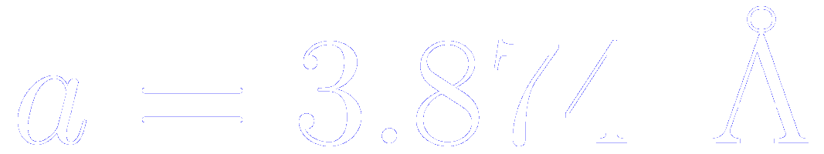
Check that the displacement vector within the slab is the same as the one enforced by the external charge
vacuum
BaTiO₃
vacuum
Ba(O_{(1-x)}N_{x})
Pseudos generated with the virtual crystal approximation
Ba(O_{(1-x)}F_{x})
In our example, x = 0.05, and the in-plane lattice constant is the theoretical one of an hypothetical SrTiO₃ substrate ( )

Slide 22
Check that the displacement vector within the slab is the same as the one enforced by the external charge
We compute the macroscopic internal electric field within BaTiO₃ slab (see the tutorial “how to compute the internal electric field” below)

Slide 23
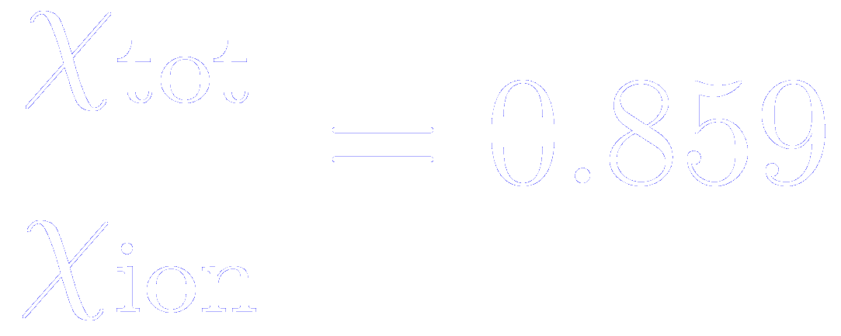
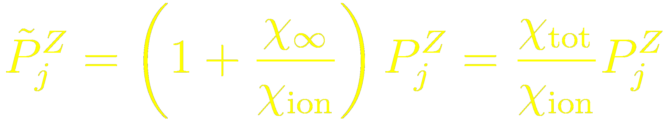
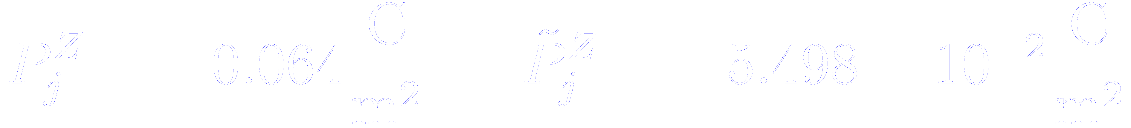
Check that the displacement vector within the slab is the same as the one enforced by the external charge
We compute the local polarization within BaTiO₃ slab
(see the tutorial “how to compute the local polarization” below)
In siesta,
Taking a value around the center of the slab

Slide 24
Check that the displacement vector within the slab is the same as the one enforced by the external charge
Compare the value enforced by the external charge
With the value obtained from the macroscopic field and the local polarization

Slide 25
How to compute the
projected density of states (PDOS)
E_{F}
Javier Junquera

Slide 26
To check that the interface is insulating, compute the layer by layer projected density of states
A separate set of k-points, usually on a finer grid than the one used to achieve self-consistency.
Same format as the Monkhorst-Pack grid.

Slide 27
How to compute the DOS and PDOS
%block ProjectedDensityOfStates
-70.0 5.0 0.150 3000 eV
%endblock ProjectedDensityOfStates
-70.0 5.0 : Energy window where the DOS and PDOS will be computed (relative to the program’s zero, i.e. the same as the eigenvalues printed by the program)

Slide 28
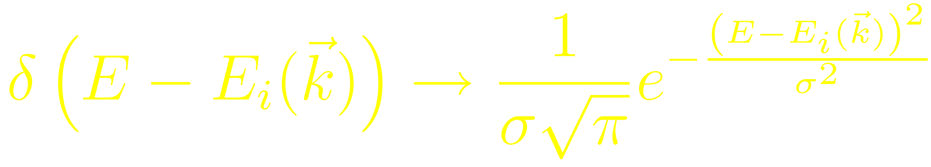
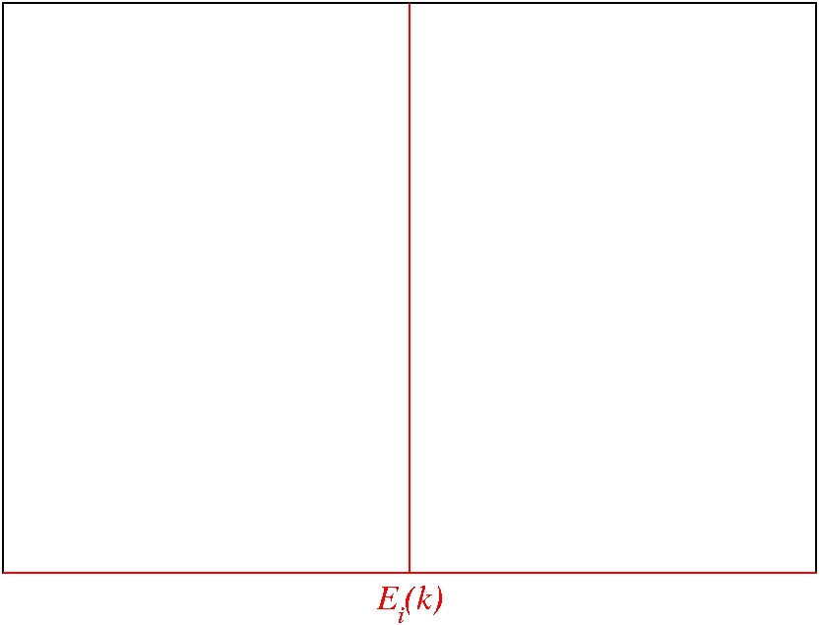
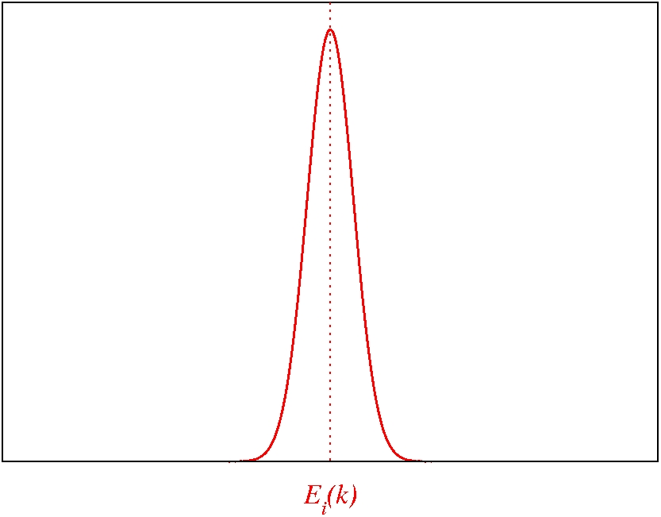
The eigenvalues are broadening by a gaussian to smooth the shape of the DOS and PDOS
σ related with the FWHM

Slide 29
How to compute the DOS and PDOS
%block ProjectedDensityOfStates
-70.0 5.0 0.150 3000 eV
%endblock ProjectedDensityOfStates
-70.0 5.0 : Energy window where the DOS and PDOS will be computed (relative to the program’s zero, i.e. the same as the eigenvalues printed by the program)
0.150 : Peak width of the gaussian used to broad the eigenvalues (energy)
It should be twice as large as the fictitious electronic temperature used during self-consistency
(see Appendix B of M. Stengel et al. Phys. Rev. B 83, 235112 (2011)

Slide 30
How to compute the DOS and PDOS
%block ProjectedDensityOfStates
-70.0 5.0 0.150 3000 eV
%endblock ProjectedDensityOfStates
-70.0 5.0 : Energy window where the DOS and PDOS will be computed (relative to the program’s zero, i.e. the same as the eigenvalues printed by the program)
0.150 : Peak width of the gaussian used to broad the eigenvalues (energy)
It should be twice as large as the fictitious electronic temperature used during self-consistency
(see Appendix B of M. Stengel et al. Phys. Rev. B 83, 235112 (2011)
3000 : Number of points in the histogram

Slide 31
How to compute the DOS and PDOS
%block ProjectedDensityOfStates
-70.0 5.0 0.150 3000 eV
%endblock ProjectedDensityOfStates
-70.0 5.0 : Energy window where the DOS and PDOS will be computed (relative to the program’s zero, i.e. the same as the eigenvalues printed by the program)
0.150 : Peak width of the gaussian used to broad the eigenvalues (energy)
It should be twice as large as the fictitious electronic temperature used during self-consistency
(see Appendix B of M. Stengel et al. Phys. Rev. B 83, 235112 (2011)
3000 : Number of points in the histogram
eV : Units in which the previous energies are introduced

Slide 32
Output for the Density Of States
SystemLabel.DOS
Format
Energy (eV)
DOS Spin Up (eV⁻¹)
DOS Spin Down (eV⁻¹)

Slide 33
Output for the Projected Density Of States
SystemLabel.PDOS
Written in XML
Energy Window
One element <orbital> for every atomic orbital in the basis set

Slide 34
How to digest the SystemLabel.PDOS file
fmpdos (by Andrei Postnikov)
Go to the directory Util/Contrib/Apostnikov, or download from
http://www.home.uni-osnabrueck.de/apostnik/download.html
Compile the code (in the Util directory, simply type $ make)
Execute fmpdos and follow the instructions at run-time
Repeat this for all the atoms you might be interested in, spetially those at the surface layers

Slide 35
How to digest the SystemLabel.PDOS file
Plot the layer by layer Projected Density of States
For the bottom interface
(repeat the same for the top interface)
Plot the PDOS for the atoms of the three first layers starting from the bottom
No states at the Fermi energy: insulating surface
Plot an interval of energies around the Fermi energy, that can be found in the following lines of the output file
E_{F}

Slide 36
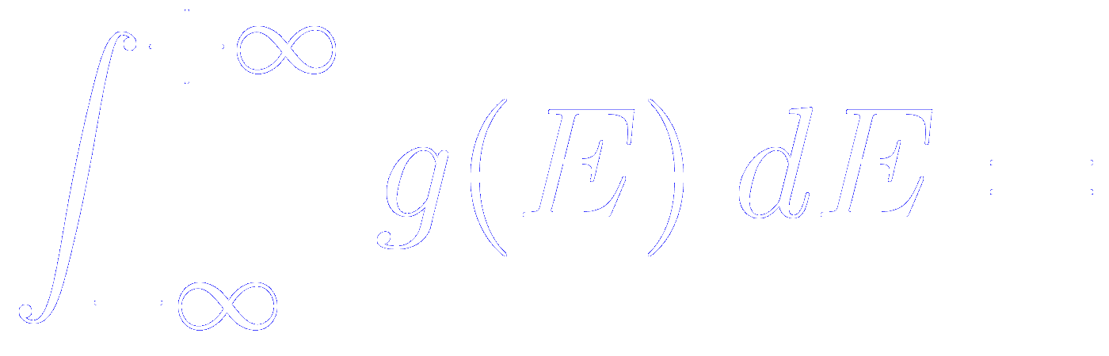

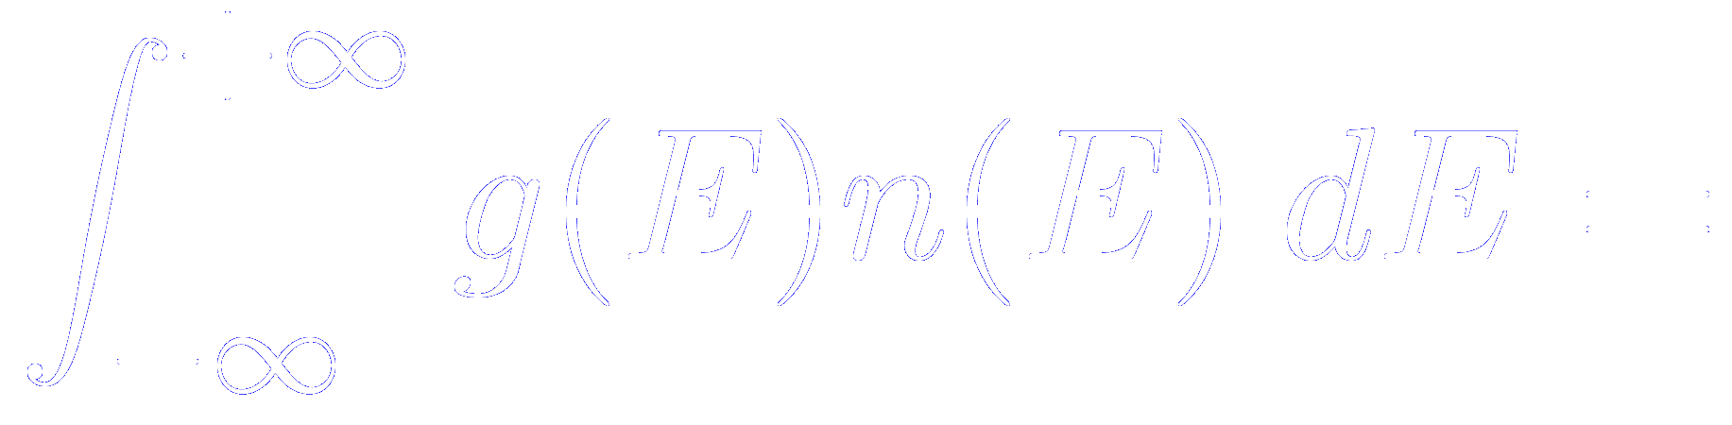
Normalization of the DOS and PDOS
Number of bands per k-point
Number of atomic orbitals in the unit cell
Number of electrons in the unit cell
Occupation factor at energy E

Slide 37
How to compute the macroscopic electric field within the slab
Javier Junquera

Slide 38
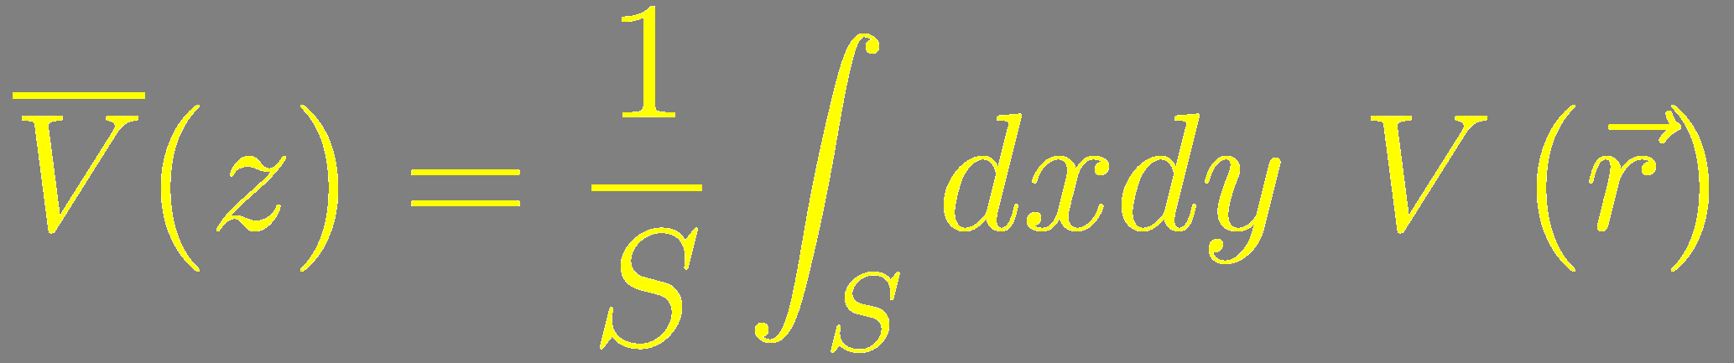
First step: average in the plane
vacuum
BaTiO₃
vacuum

Slide 39
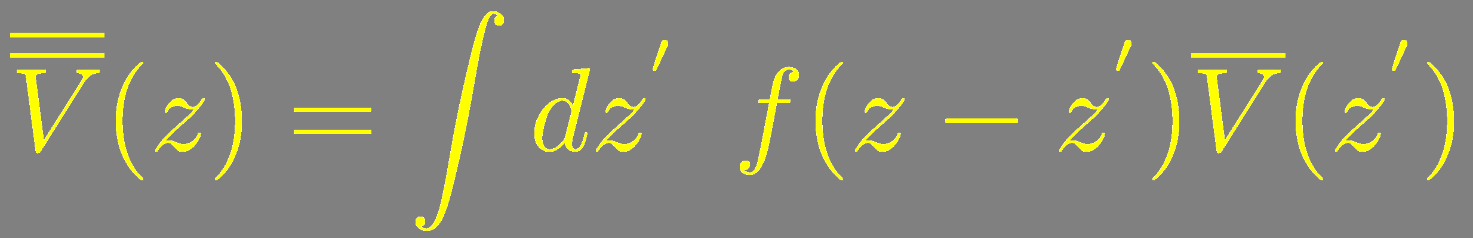
Second step: nanosmooth the planar average on the z-direction
vacuum
BaTiO₃
vacuum

Slide 40
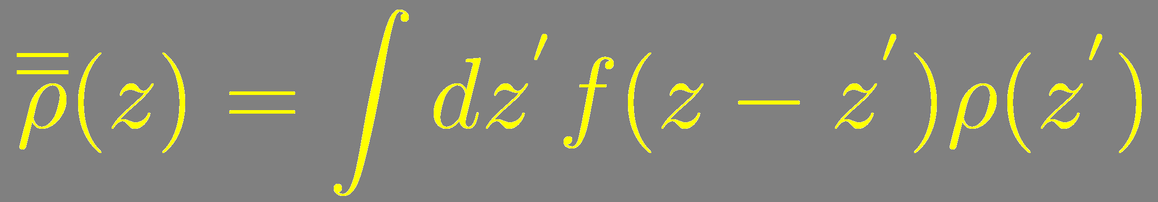
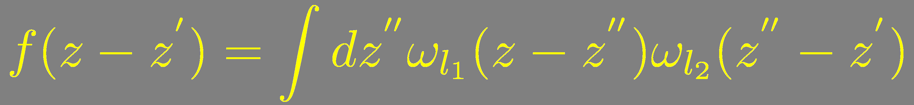
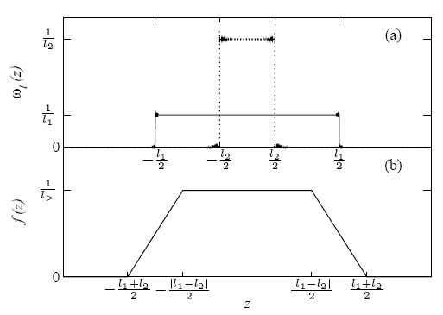
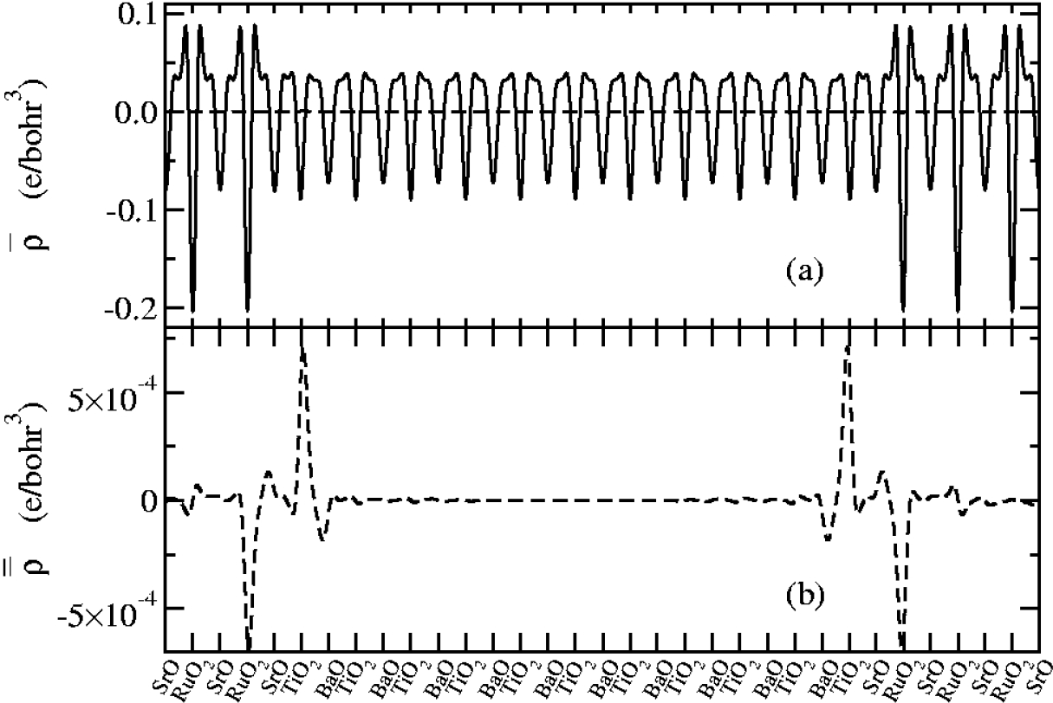
Atomic scale fluctuations are washed out by filtering the magnitudes via convolution with smooth functions

Slide 41
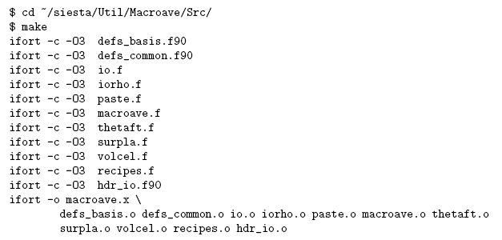

How to compile macroave…
Automaticallu uses the same arch.make file as for the compilation of siesta
…and where to find the User’s Guide and some Examples

Slide 42
How to run MACROAVE
siesta
SaveRho .true.
SaveTotalCharge .true.
SaveIonicCharge .true.
SaveDeltaRho .true.
SaveElectrostaticPotential .true.
SaveTotalPotential .true.
Depending on what you want to nanosmooth
Output of siesta required by macroave
SystemLabel.RHO
SystemLabel.TOCH
SystemLabel.IOCH
SystemLabel.DRHO
SystemLabel.VH
SystemLabel.VT
macroave
Prepare the input file macroave.in
$ ~/siesta/Util/Macroave/Src/macroave.x
You do not need to rerun siesta to run macroave as many times as you want

Slide 43
Input of macroave: macroave.in
The same code with the same input runs with information provided by
siesta
or
abinit
(indeed it should be quite straight forward to generalize to any other code)

Slide 44
Input of macroave: macroave.in
Name of the magnitude that will be nanosmoothed
Potential: SystemLabel.VH
Charge: SystemLabel.RHO
TotalCharge: SystemLabel.TOCH

Slide 45
Input of macroave: macroave.in
SystemLabel

Slide 46
Input of macroave: macroave.in
Number of square filter functions used for nanosmoothing
1 Surfaces
2 Interfaces and superlattices

Slide 47
Input of macroave: macroave.in
Length of the different square filter functions (in Bohrs)

Slide 48
Input of macroave: macroave.in
Total number of electrons
(used only to renormalize if we nanosmooth the electronic charge)

Slide 49
Input of macroave: macroave.in
Type of interpolation from the siesta mesh to a FFT mesh
Spline
or
Linear

Slide 50
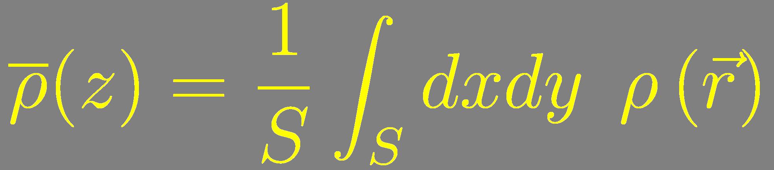
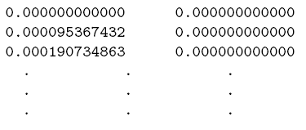
Output of macroave
Planar average
Nanosmoothed
SystemLabel.PAV
SystemLabel.MAV
Format
Units
Coordinates: Bohr Potential: eV Charge density: electrons/Bohr³

Slide 51


To compute the electric field, plot the nanosmoothed pot. and perform a linear regression at the center of the slab
Note how the electric field in vacuum is zero, as impoosed by the slab dipole correction
In our example, for

Slide 52


To learn more on nanosmoothing and how to compute work functions and band offsets with siesta

Slide 53
How to compute the layer by layer polarization
Javier Junquera

Slide 54



How to compute the local value of the “effective polarization”
Ubiquous formula to compute the dipole density of layer :
Surface cell area
Position of atom along
Bulk Born effective charges associated with atom
Note that:
- we sum only over all the atoms that belong to that particular layer
- we assume a one-dimensional problem (the atoms are allowed to move only along the direction, so we do not need to consider off- diagonal terms in the Born effective charges.

Slide 55


How to compute the local value of the “effective polarization”
Ubiquous formula to compute the dipole density of layer :
This formula is typically ill-defined
Since the acoustic sum rule is usually not satisfied by individual layers
Then the formula is origin dependent
To circumvent this problem:
perform an average with the neigboring layers (so the acoustic sum rule is satisfied when summing the weighted effective charges in all these layers)
For instance, in perovskites
[valid for II-IV (PbTiO₃ or BaTiO₃), I-V (KNbO₃), and III-III (LaAlO₃)]

Slide 56


How to compute the local value of the “effective polarization”
Ubiquous formula to compute the dipole density of layer :
The approximate local polarization immediately follows
Here we assume that every individual layer occupies only half the cell
Average out-of-plane lattice parameter
Exact estimate:
In the linear limit (the dipole density is only linear in the positions)
This assumes small polar distortions
- Under short-circuit electrical boundary conditions (assuming that the electric field vanishes throughout the structural transformations). Remember that the Born effective charges assume zero electric-field

Slide 57
How to compute the local value of the “effective polarization”
The approximate local polarization immediately follows
Exact estimate:
In the linear limit (the dipole density is only linear in the positions)
This assumes small polar distortions
Polar distortions in ferroelectric capacitors are generally large (close to the spontaneous polarization of the ferroelectric insulator)
- Under short-circuit electrical boundary conditions (assuming that the electric field vanishes throughout the structural transformations). Remember that the Born effective charges assume zero electric-field
There is generally an imperfect screening regime, with a macroscopic “depolarizing field”

Slide 58
How to compute the local value of the “effective polarization”
A corrected formula for the local polarization
Electronic susceptibility
Ionic susceptibility
See Appendix A in
M. Stengel et al. Phys. Rev. B 83, 235112 (2011)

Slide 59

“Effective” layer-by-layer polarization in the BaTiO₃ slab
The acoustic sum rule is verified

Slide 60
Supporting slides

Slide 61



Relation between the normal component of the displacement field at the interface of different media
We start from the Maxwell equation in macroscopic media
SI units
atomic units
Let be a finite volume in space, the closed surface bounding it, an element of area on the surface, and a unit normal to the surface at pointing outward from the enclosed volume
Integrating the Maxwell equation over the volume
Then, we apply the divergence theorem

Slide 62


Relation between the normal component of the displacement field at the interface of different media
An infinitesimal Gaussian pillbox straddles the boundary surface between two media
In the limit of a very shallow pillbox, the side surfaces do not contribute to the integral
If the top and bottom are parallel, tangent to the surface, and of area , then
If the charge density is singular at the interface so as to produce an idealized surface charge density
So the normal component of on either side of the boundary surface is related according to
The normal component of at any point is equal to the surface charge density at that point

Slide 63


“Constrained-σ” method
Adopt a vacuum/insulator/metal/vacuum geometry
Induce a layer of bound charges at its free surface
( per surface unit cell )
If the surface region remains locally insulating
In this example

