Slide 1

Thermodynamics and statistical mechanics
Javier Junquera

Slide 2
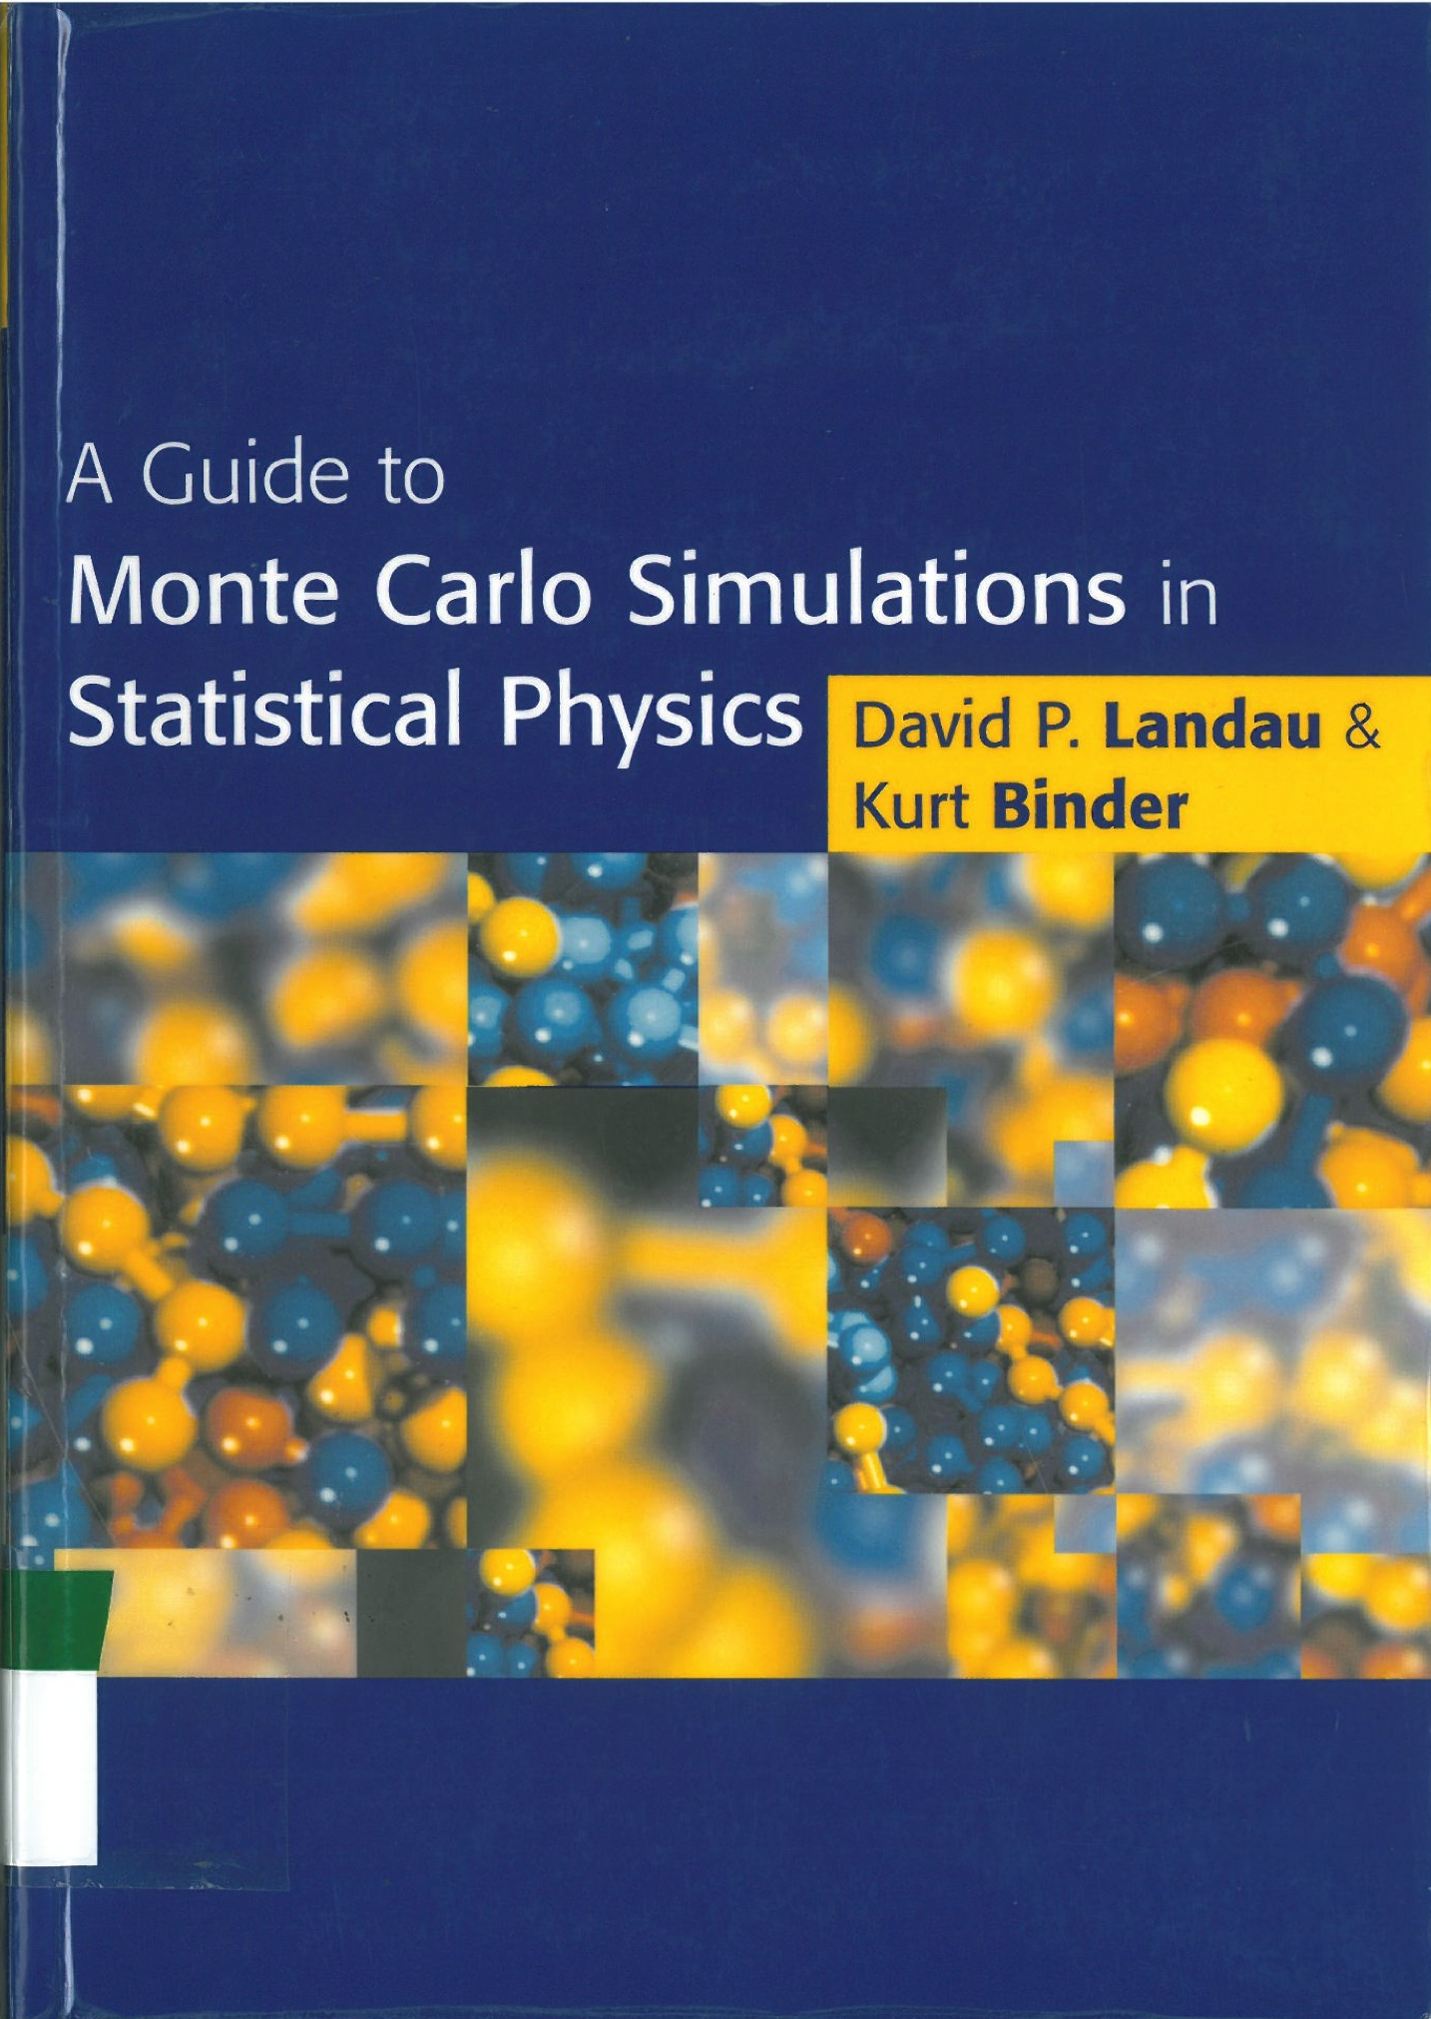
Bibliography
Cambridge University Press, Cambridge, 2002
ISBN 0 521 65314 2

Slide 3

The Boltzmann factor
Let us imagine a quantum mechanical sample, that might be, for instance:
a single atom,
a molecule
a box of a perfect gas
…
This quantum mechanical system is in thermal contact with a large body of matter (a temperature bath) at temperature
It has some probability of being found in any of its possible quantum states. Let us call any single microscopic state , and its energy
This energy might involve:
Kinetic energy
Rotational energy
Internal vibrational energy
Magnetic energy
Electronic excited energy
…
What is the probability of finding the sample in state

Slide 4
The Boltzmann factor
First, let us imagine the sample and the bath together to constitute an isolated system from the rest of the Universe, with total energy
In equilibrium, the system has possible states and entropy
is the product of possible states of the sample, , and the number of possible states of the bath when the system is in equilibrium with total energy
In equilibrium, and with a total energy , the quantum sample might be in different quantum states with different energies

Slide 5
The Boltzmann factor
Now, instead of being in equilibrium, let us instead specify that the sample is in state with energy .
The bath is always internally in equilibrium,
In this case with an energy
The number of possible states for the bath when the sample is in state is
Since the sample is in state , its number of possible states is
Therefore
The probability of finding the sample in state , , is simply the number of states of the system in which the sample happens to be in state divided by the total number of states in equilibrium
(ratio of the favourable cases to the whole number of cases possible)

Slide 6
The Boltzmann factor
The probability plays a crucial role in statistical physics
The sample is always in some state, so
If a quantity, say , has a definite value in each quantum state of the sample, then its average or thermodynamic value is given by
In particular, might be the energy of the sample.
Then, the thermodynamic or average energy is

Slide 7
The Boltzmann factor
The probability plays a crucial role in statistical physics
When the sample is in the definite state , the bath has an entropy
Substracting this energy from the equilibrium entropy of the system
We have therefore

Slide 8
The Boltzmann factor
Assumption:
The entropy of the bath only depends on its energy
Since is much smaller than , we can expand in a Taylor series
But

Slide 9
The Boltzmann factor
Replacing the second equation into the first one
where
that is independent of the microstate
Since
In fact,
, where
is the partition factor

Slide 10
The Boltzmann factor
The probability plays a crucial role in statistical physics
The probability of finding the sample in state with energy at temperature is given by
is called the Boltzman factor

Slide 11
First question about the Boltzmann factor
We started with the assumption that all possible states are equally likely
However, the previous expression shows how the lowest energy states are more likely than the highest energy states…
How is it possible?
All possible quantum states of an isolated system are equally likely
The system is divided in two parts:
- the sample (very small compared with the rest)
- the bath (the rest)
For all the possible quantum states of the system as a whole, the lower the energy of the sample, the larger the energy available to the bath
Since the bath is much bigger than the sample, it has many more ways to use up the extra energy than the sample would, i. e.
The more quantum states are available for the systema as a whole, the therefore, the more probable the situation is

Slide 12
Second question about the Boltzmann factor
The ground state (i.e. The lowest energy state) is always the most probable state
Why do not commonly find macroscopic samples in their ground states?
How is it possible?
A macroscopic sample has just one, unique ground state.
At any higher energy, the sample may have many possible quantum states with the same energy.
Then, the sample will generally have many possible states at nearly the same energy
Each of these states is less probable than the ground state,
But there are so many of them that the sample is more likely to be found in one of those that it is to be found in the ground state.

Slide 13
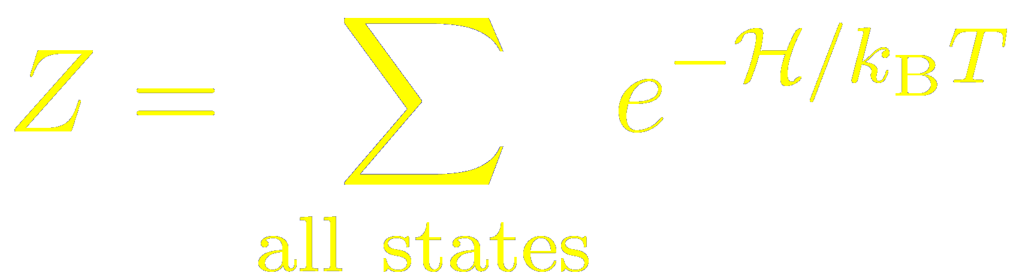


Partition function
Equilibrium statistical mechanics is based on the idea that the there is a partition function which contains all of the essential information about the system under consideration
is the Hamiltonian of the system
is the Temperature
is the Boltzmann constant
The sum is over all possible states of the system, that depends upon its size and the number of particles
In general, the partition function cannot be evaluated exactly

Slide 14



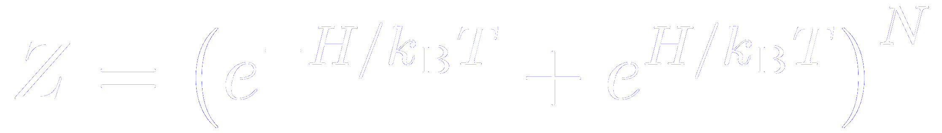
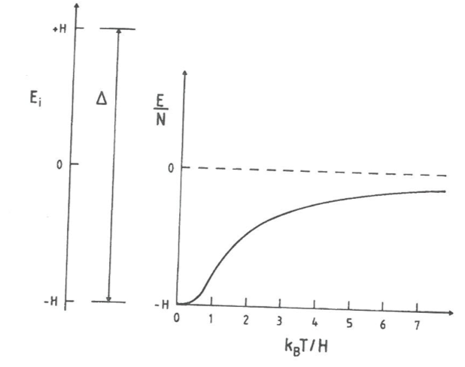
Exact evaluation of a partition function: a particular example
A system of particles
Each of which has only two states (i.e. a non-interacting Ising model in an external magnetic field)
Energies of the states and the temperature dependence of the internal energy in this case

Slide 15
Exploring all the possible states: an impossible mission
A system with one-spin: 2¹ = 2 possible configurations
A system with two-spin: 2² = 4 possible configurations
A system with three-spin: 2³ = 8 possible configurations
A system with 10000-spin: 2¹⁰⁰⁰⁰ possible configurations
(and this is only for a very small fraction of Avogadro’s number and only for two possible states per particle!)

Slide 16

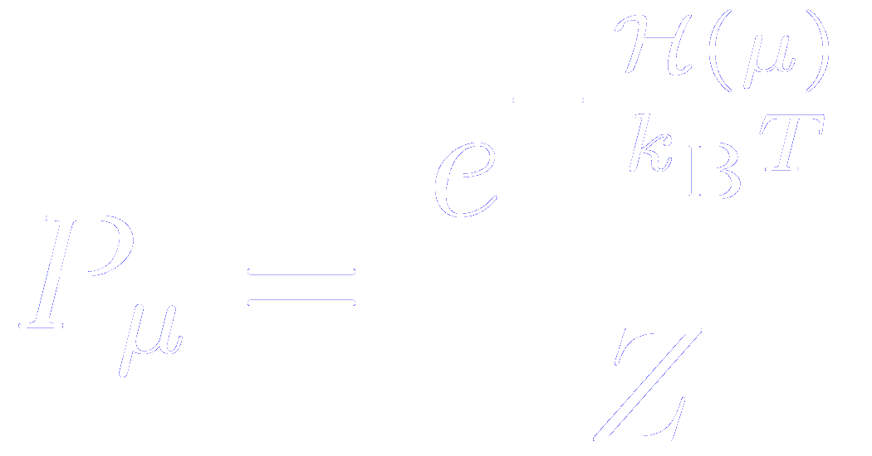

Probability of finding the system in a particular state
The probability of any particular state of the system is also determined by the partition function
The probability that the system is in state is
Hamiltonian when the system is in the th state
We will take advantage of this property in evaluating the results for estimating probabilities with Monte Carlo methods

Slide 17


Thermodynamic potentials and their relation with the partition function
The free energy of a system can be determined from the partition function as
and all other quantities can be calculated by appropriate differentiation
The internal energy of a system can be obtained as
This means that if the internal energy of a system can be measured, the free energy can be extracted by appropriate integration (assuming that the free energy is known as some reference temperature).
Free energy differences may be estimated by integration as

Slide 18
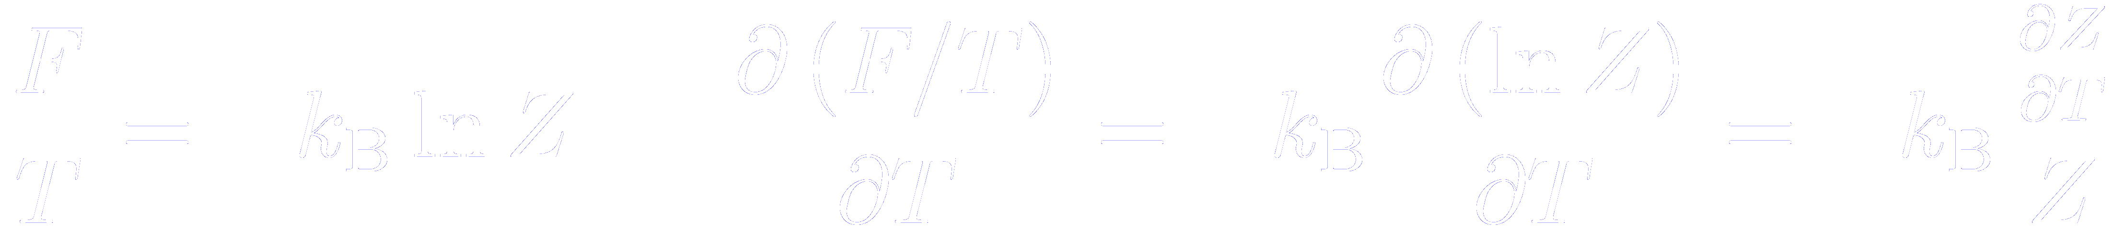
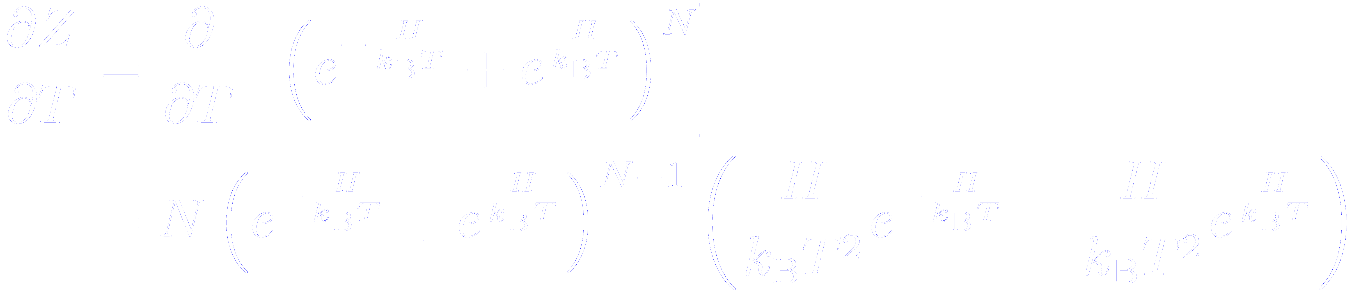
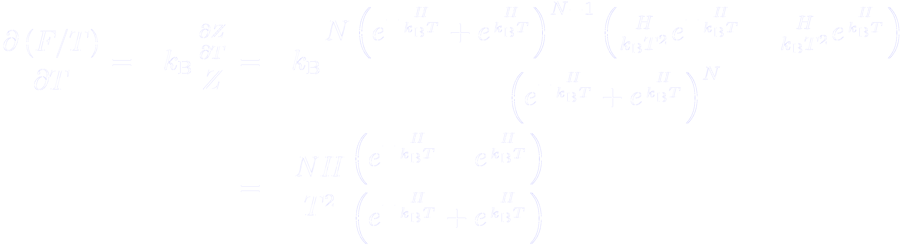
Problem: determine the temperature dependence of the internal energy of the non-interacting Ising model

Slide 19
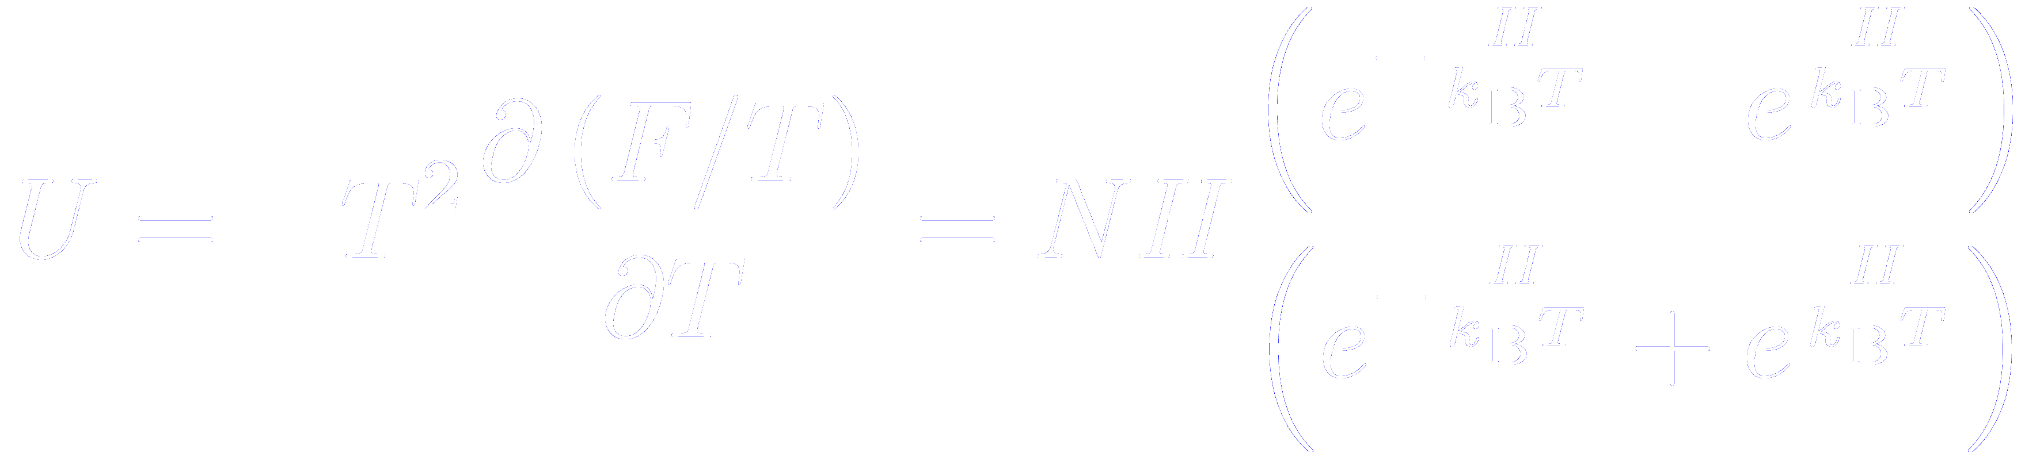

Problem: determine the temperature dependence of the internal energy of the non-interacting Ising model

Slide 20
Problem: determine the temperature dependence of the internal energy of the non-interacting Ising model

Slide 21


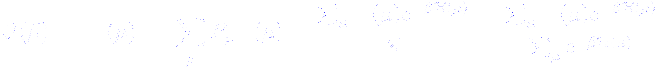
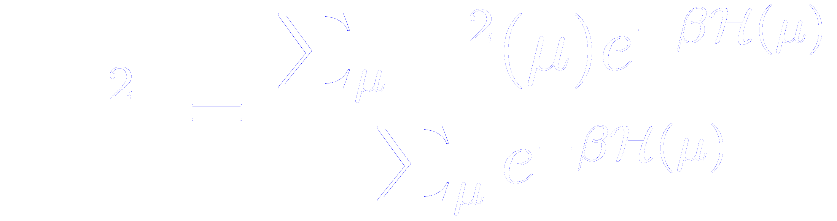
Fluctuations: how to compute probabilities of macroscopic quantities
We first form the moments, where the average energy is denoted by and is a fluctuating quantity
We note the relationship
Since , where is the specific heat, then

Slide 22
Fluctuations: the isothermal susceptibility
Similar fluctuation relations exist for many other quantities, for example, the isothermal susceptibility
that is related to fluctuations of the magnetization
Writing the Hamiltonian of the system in the presence of a magnetic field
And knowing that the average magnetization can be written as
Then
Proof in next slide

Slide 23
Fluctuations: the isothermal susceptibility
Similar fluctuation relations exist for many other quantities, for example, the isothermal susceptibility
Then

Slide 24

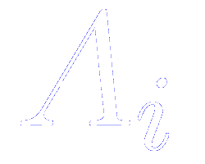
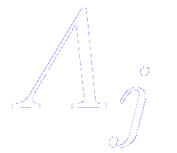
Basic notions of probability theory
Equivalent notation
From its definition
We call and “mutually exclusive” events, if and only if the occurrence of implies that does not occur and vice versa

Slide 25









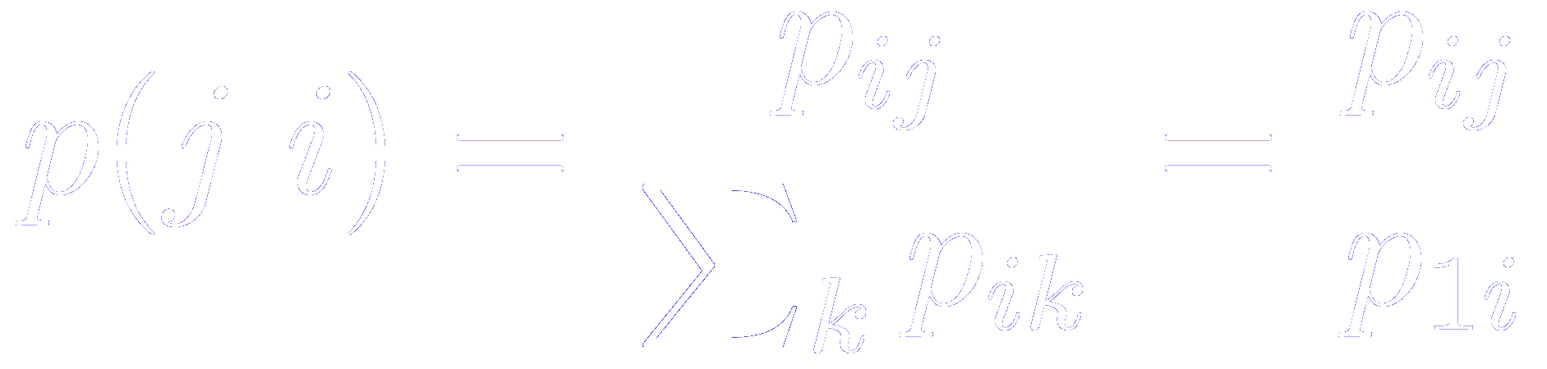
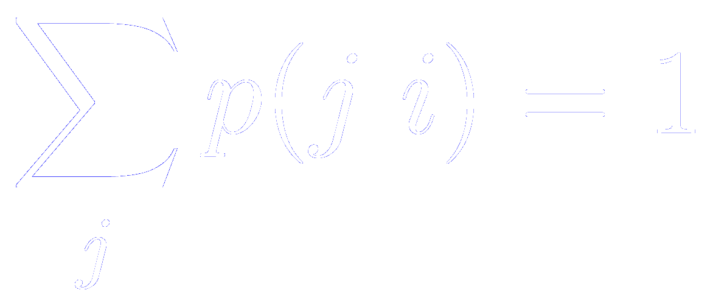
Basic notions of probability theory: conditional probability
Let us consider two events:
The first with outcomes and probabilities
The second with outcomes and probabilities
We consider now the outcome and consider the probability as a joint probability that both and occur
If the events are independents:
If they are not independent, we define the conditional probability that occurs given that occurs
Of course, we have since some must occur

Slide 26


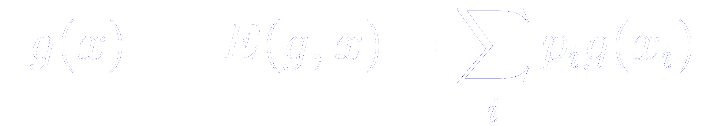

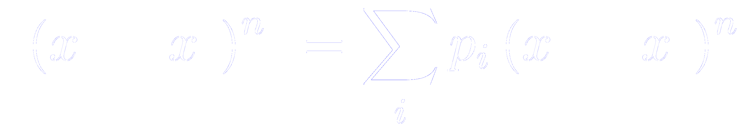

Basic notions of probability theory: some basic definitions
The outcome of such random effects might be logical variables or real numbers. These real numbers are calles random variables
We define the expectation value of the random variable as
Similarly, any real function has the expectation value
We define the nth moment as
And the cumulants
Of the greatest importance is the case , called the “variance”

Slide 27








Basic notions of probability theory: some basic definitions
Generalizing the definitions to two random variables ( and ) then the expectation value is
If and are independent, then
As a measure of the degree of independence of the two random variables, we define the covariance

Slide 28

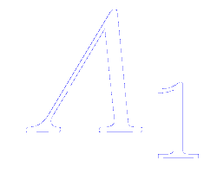

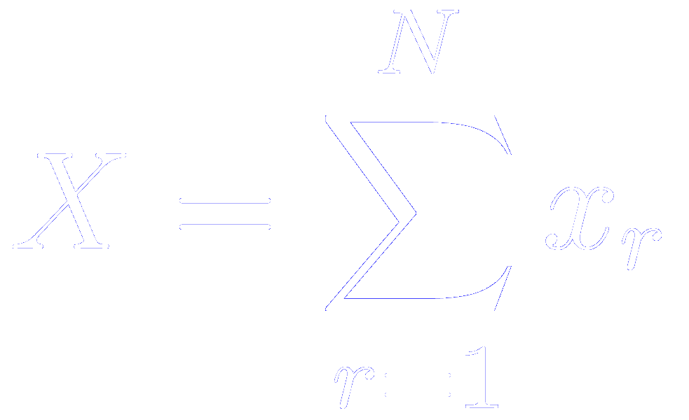




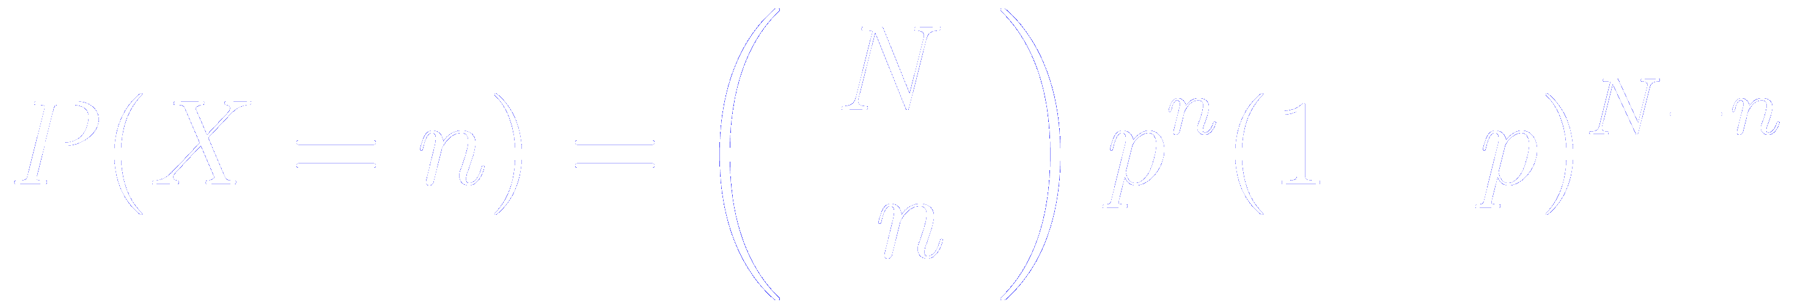

Special probability distributions and the central limit theorem
Consider two events and that are mutually exclusive and exhaustive
Suppose now that independent samples of these events occur.
Each outcome is 0 or 1.
We denote the sum of these outcomes
The probability that is the probability that of the were 1 and were 0.
Where is the binomial coefficients
This is called the binomial distribution

Slide 29
Special probability distributions: the binomial distribution
Consider two events and that are mutually exclusive and exhaustive
Suppose now that independent samples of these events occur.
Each outcome is 0 or 1.
We denote the sum of these outcomes
The probability that is the probability that of the were 1 and were 0.
Where is the binomial coefficients
This is called the binomial distribution

Slide 30

Special probability distributions: the Poisson distribution
The binomial distribution
If the probability of “success” is very small,
the binomial distribution can be approximated by the Poisson distribution

Slide 31
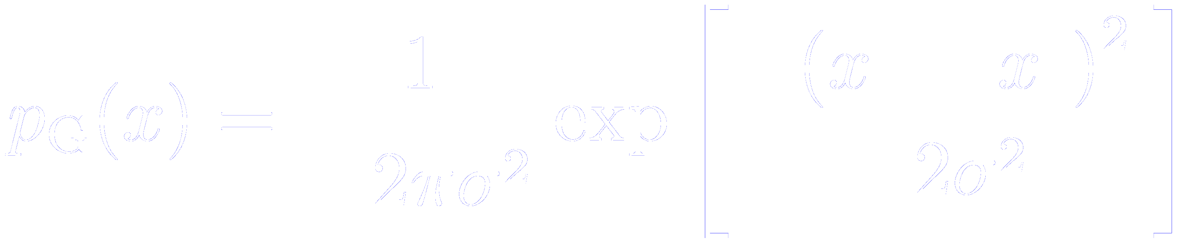

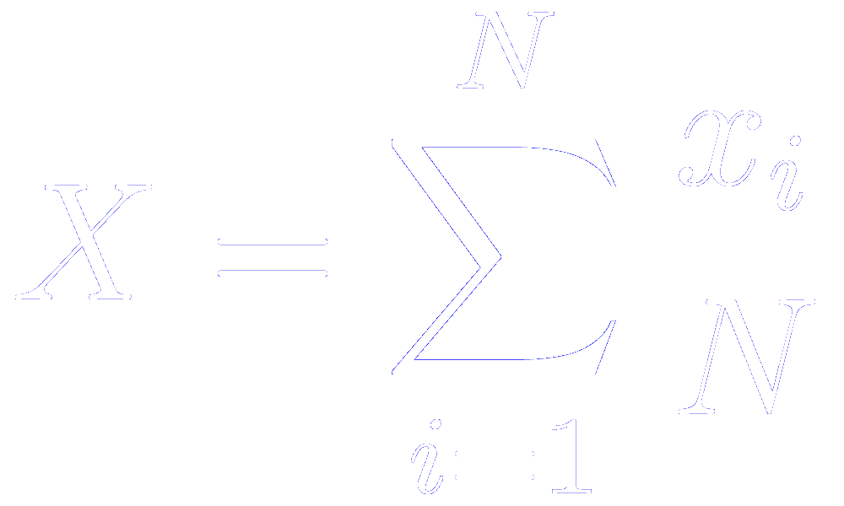




Special probability distributions: the Gaussian distribution
The most important distribution we will encounter in statistical physics
If the number of random variables are all independent of each other and drawn from the same distribution, the average value
In the limit will always be distributed according to the gaussian distribution, irrespective of the distribution from which the were drawn
This is known as the “central limit theorem”
The variance of is
and

Slide 32
Special probability distributions: the geometrical distribution
Suppose that we perform an experiment with two possible outcomes: 0 and 1
If the outcome is 0, the experiment is repeated
If the outcome is 1, we stop
Random variable of interest:
The number of experiments until we get the outcome 1
This is called the geometrical distribution

Slide 33
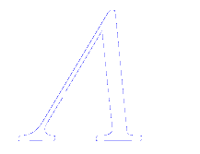
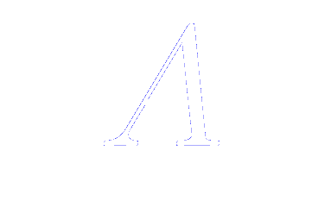



Basic notions of probability theory: Statistical errors
Suppose the quantity is distributed according to a Gaussian with mean value and width
We consider statistically independent observations of this quantity
Un unbiased estimator of the mean of this distribution is
And the standard error of this estimate
But, how to estimate the variance from the observations?

Slide 34


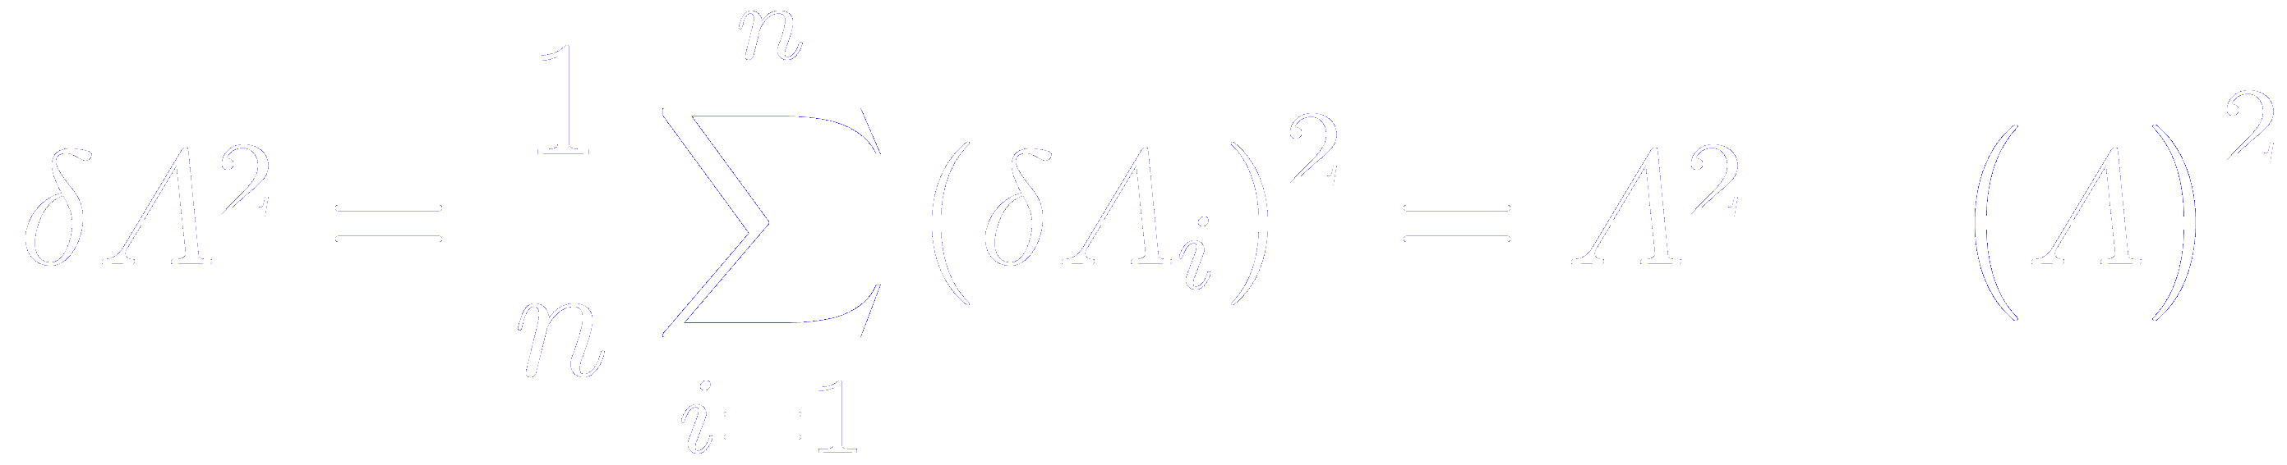

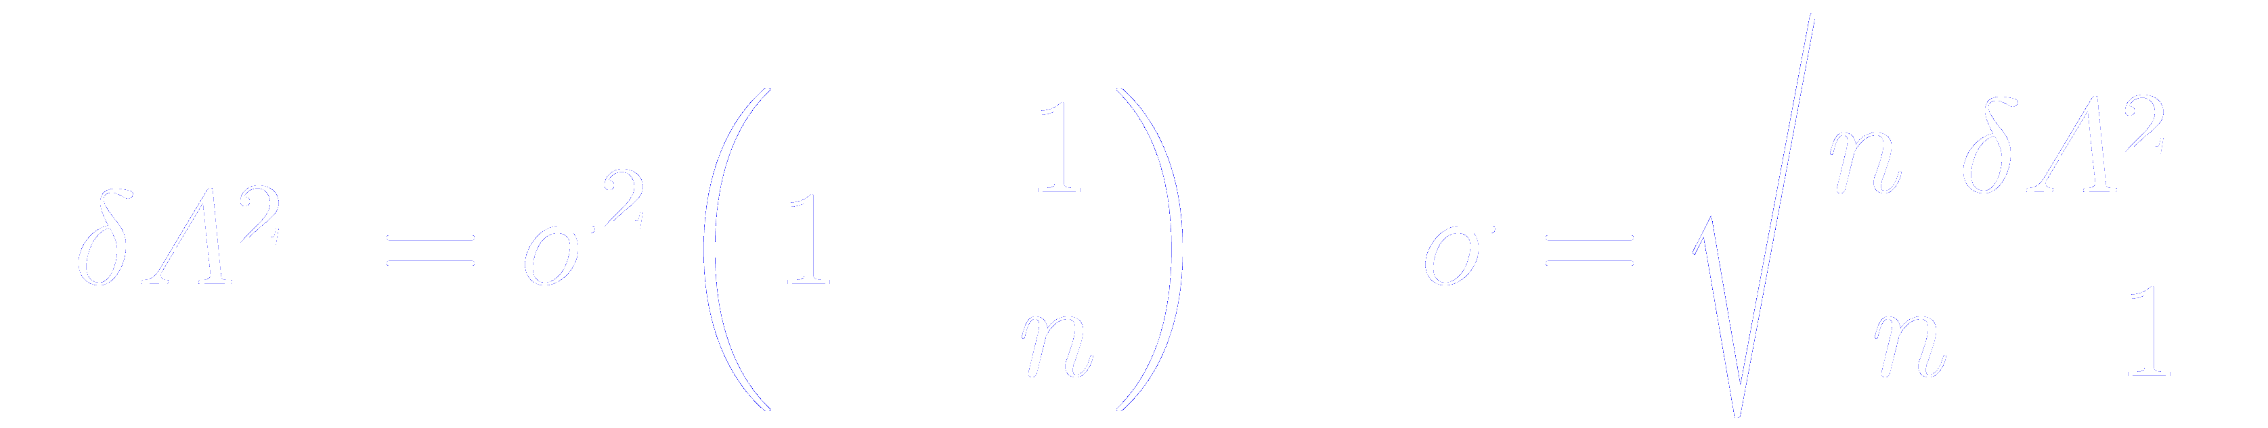
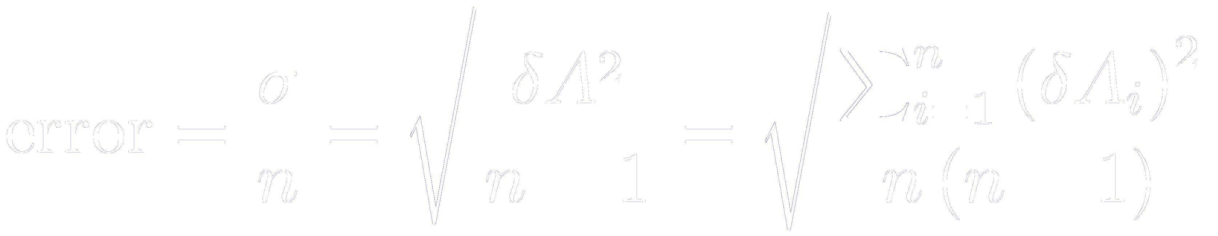
Basic notions of probability theory: Statistical errors
But, how to estimate the variance from the observations?
Consider the variations
Obviously
So we are interested in the mean square deviations
The expectation value of this quantity is easily related to
Since we arrive to the usual formula for the computation of errors of averages from uncorrelated estimates

Slide 35











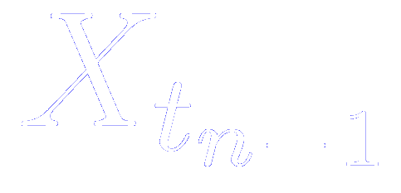

The concept of the Markov chain
We define a stochastic process at discrete times labeled consecutively
for a system with a finite set of possible states
This finite set of possible outcomes is called the state space
For instance, for a 2D Ising model
We denote by the state the system is in at time
We consider the conditional probability that given that at the preceeding time the system state was in state , etc

Slide 36



The concept of the Markov chain
We denote by the state the system is in at time
We consider the conditional probability that given that at the preceeding time the system state was in state , etc
Such a process is call a Markov process if this conditional probability is in fact independent of all states but the immediate predecessor
The corresponding sequence of states is called a Markov chain
The above conditional probability can be interpreted as the transition probability to move from state to state

Slide 37




Transition probabilities
The above conditional probability can be interpreted as the transition probability to move from state to state
As usual for transition probabilities, we require that
We may construct the total probability that at time the system is in state as

Slide 38
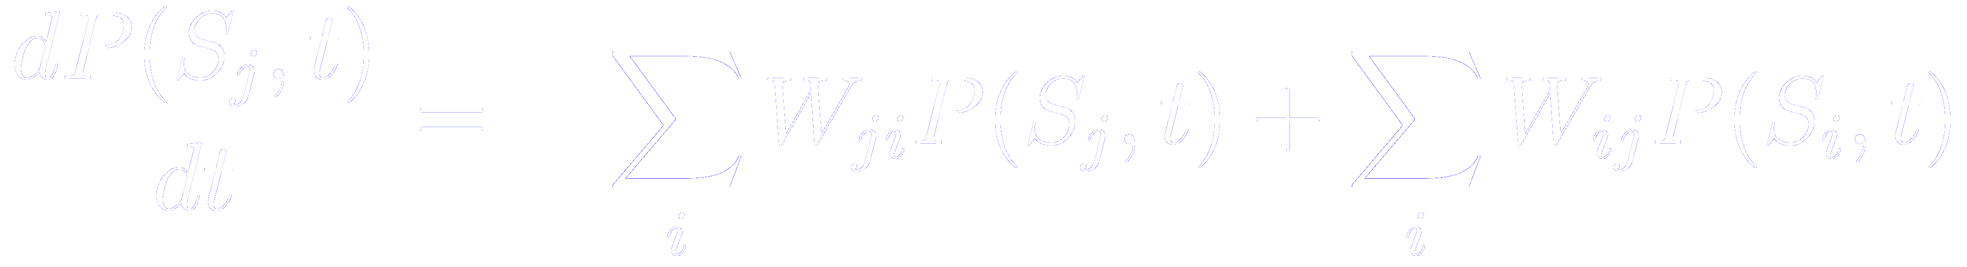

The master equation (or “continuity equation”)
The master equation considers the change of this probability with time (treating time as a continuous variable rahter than discrete variable)
Probability to move away from state to any other state
Probability to move to state coming from any other state
Knowledge of the state at time completely determines the future time evolution, there is no memory of the past (knowledge of behaviour of the systems at times earlier than is not needed)

Slide 39



The master equation at the equilibrium probability
The equilibrium probability satisfies
Since
then

