Slide 1
Importance sampling Monte Carlo
Javier Junquera

Slide 2
Bibliography
Cambridge University Press, Cambridge, 2002
ISBN 0 521 65314 2

Slide 3
The simple Ising model
Spins which are confined to the sites of a lattice and which might have only the values +1 or -1
The spins interact with the nearest neighbours on the lattice with interaction constant
Spin-spin interaction
Interaction with an external magnetic field
This model has been solved exactly in one-dimension:
No phase transition
Onsager solved exactly in two-dimension with periodic boundary conditions and no-field
Second-order phase transitions
Divergence in the specific heat, susceptibility and correlation length

Slide 4
Configurations of the 2D Ising model at zero-field
Almost at the ground state
Single large cluster of ordered spins and small clusters of oppositely oriented spins
Close to the phase transition
Broad distribution of clusters
High-temperature (no correlation between spins).
All clusters of like spins are small

Slide 5
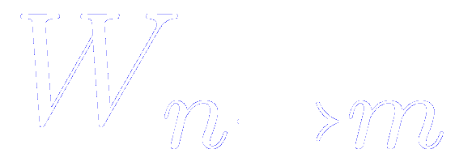
Sampling algorithm
In the classic Metropolis method configurations are generated from a previous state using a transition probability which depends on the energy difference between the initial and final states
probability of the system being in state at time
is the transition rate from to
In equilibrium
The two terms of the right hand side must be equal (“detailed balance”)

Slide 6
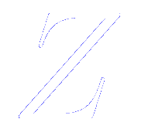
Sampling algorithm
In the classic Metropolis method configurations are generated from a previous state using a transition probability which depends on the energy difference between the initial and final states
In equilibrium
The probability of the -th state occurring in a classical system is given by
where is the partition function
This probability is usually not exactly known due to the denominator

Slide 7
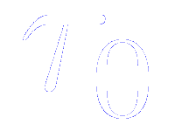
Sampling algorithm
If we generate the -th state from the -th state in a Markov chain, the relative probability is the ratio of the individual probabilities, because the denominator cancels
Only the energy difference between the two states is needed
Any transition rate that satisfied detailed balance is acceptable
where is the time required to attempt a spin-flip.
Often, this time unit is set equal to unity and suppressed from the equations

Slide 8
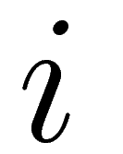
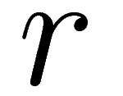
Metropolis importance sampling in Monte Carlo scheme
(1) Choose an initial state
(2) Choose a site
(3) Calculate the energy change which results if the spin at site is overturned
(4) Generate a random number such that
must be a random number chosen uniformly in
(5) If flip the spin
(6) Go to the next site and go to (3)
(7) After a set of spins have been considered, the properties of the system are determined and added to the statistical average

Slide 9
Metropolis importance sampling in Monte Carlo scheme
The standard measure of Monte Carlo time is the Monte Carlo step/size (MCS/site)
It corresponds to the consideration of every spin in the system once
Once the number of states is sufficiently large that the initial transients are negligeable, then the desired averages are computed
Note that if an attempted flip is rejected, the old state is counted again for averaging

Slide 10
Some precautions to be taken
Repeat a given run with different initial states to see if the same equilibrium distribution is reached
Repeat runs with different random numbers

Slide 11
Simplifications of the Ising model
For each spin there are only a small number of different environments which are possible
For a square lattice with nearest neighbour interactions, each spin might have
4
3
2
1
0
nearest neighbour parallel to it
There are only 5 different energy changes associated with a succesful spin flip
They can be computed for each possibility and stored in a table.
Since the exponential then need not be computed for each spin-flip trial, a tremendous saving in cpu time results

