Slide 1
Statistical mechanics
Javier Junquera

Slide 2
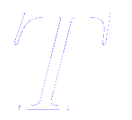
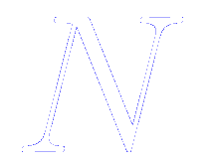
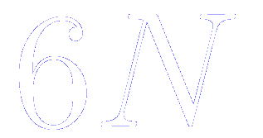
From the microscopic to the macroscopic level: the realm of statistical mechanics
Computer simulations
Thermodynamic state
Generates information at the microscopic level
Defined by a small set of macroscopic parameters
Atomic positions
Pressure
Momenta
Temperature
Number of particles
Can be thought of as coordinates of a multidimensional space of dimensions:
the phase space
Other thermodynamic properties may be derived through the knowledge of the equation of state and the fundamental equations of thermodynamics

Slide 3
Statistical sampling from ensembles
A particular point in phase space
A given property (for instance, the potential energy)
Instantaneous value of the property when the system is at point
It is reasonable to assume that the experimentally observable macroscopic property is really the time average of taken over a long time interval
The equations governing this time evolution
(Newton's equation of motion in a simple classical system)
are well known

Slide 4
Statistical sampling from ensembles
The equations governing this time evolution
(Newton's equation of motion in a simple classical system)
are well known
But we can not hope to extend the integration of the dynamical equations:
For a truly macroscopic number 10²³
To infinite time
We might be satisfied to average over:
A system of the order of thousand of atoms (length and size scale)
Over a long but finite time (time scale)
That is what we do in MD simulations:
The equations of motion is solved step by step a large number of steps

Slide 5
Practical questions regarding the validity of the method
Whether or not a sufficient region of phase space is explored by the system trajectory within a feasible amount of computer time
Whether thermodynamic consistency can be attained between simulation with identical macroscopic parameters (density, energy,…)
but different initial conditions
Such simulation runs are within the power of modern computers

Slide 6
Ergodicity
In MD we want to replace a full sampling on the appropriate statistical ensemble by a SINGLE very long trajectory.
This is OK only if system is ergodic.
Ergodic Hypothesis: a phase point for any isolated system passes in succession through every point compatible with the energy of the system before finally returning to its original position in phase space. This journey takes a Poincare cycle.
In other words, Ergodic hypothesis: each state consistent with our knowledge is equally “likely”.
Implies the average value does not depend on initial conditions.
<A>_{time}= <A>_{ensemble} , so <A_{time}> = (1/N_{MD}) = ∑_{t=1,N} A_{t} is good estimator.
Are systems in nature really ergodic? Not always!
Non-ergodic examples are glasses, folding proteins (in practice) and harmonic crystals (in principle).

Slide 7
Ergodicity
is the phase space density

Slide 8
Different aspects of ergodicity
The system relaxes on a “reasonable” time scale towards a unique equilibrium state (microcanonical state)
Trajectories wander irregularly through the energy surface eventually sampling all of accesible phase space.
Trajectories initially close together separate rapidily (Sensitivity to initial conditions).
Ergodic behavior makes possible the use of
statistical methods on MD of small system.
Small round-off errors and other mathematical
approximations should not matter.

Slide 9
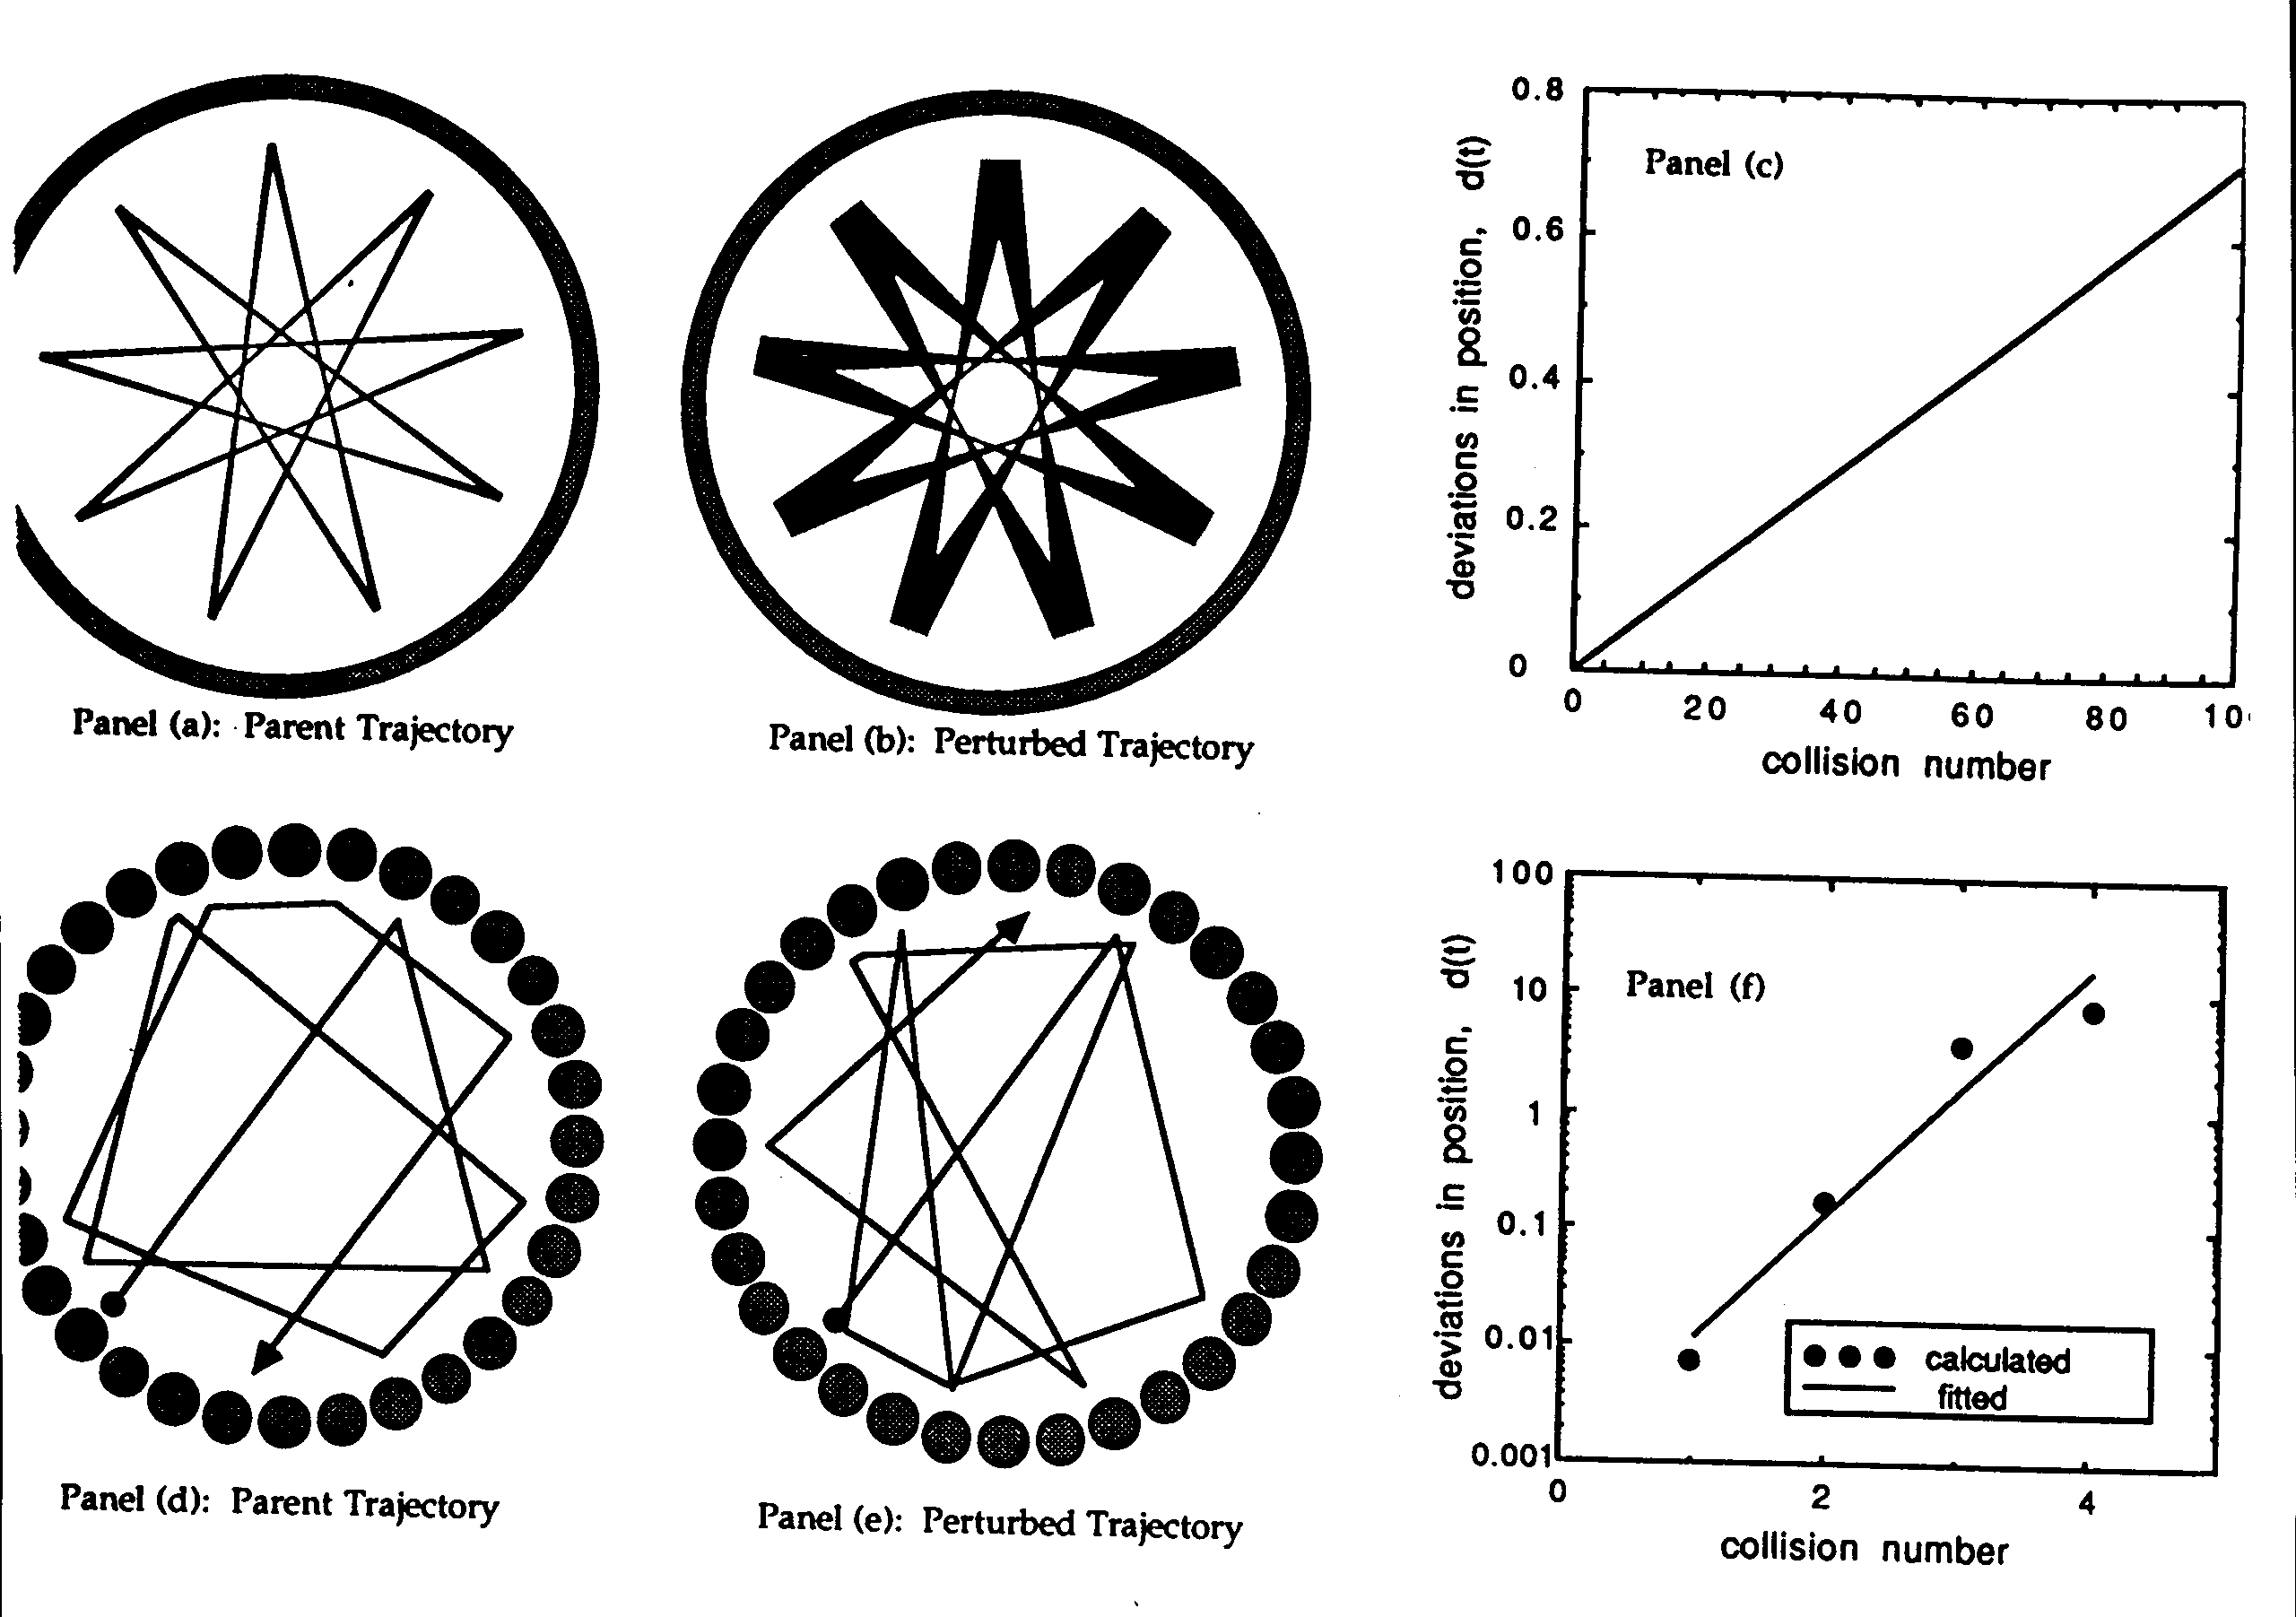
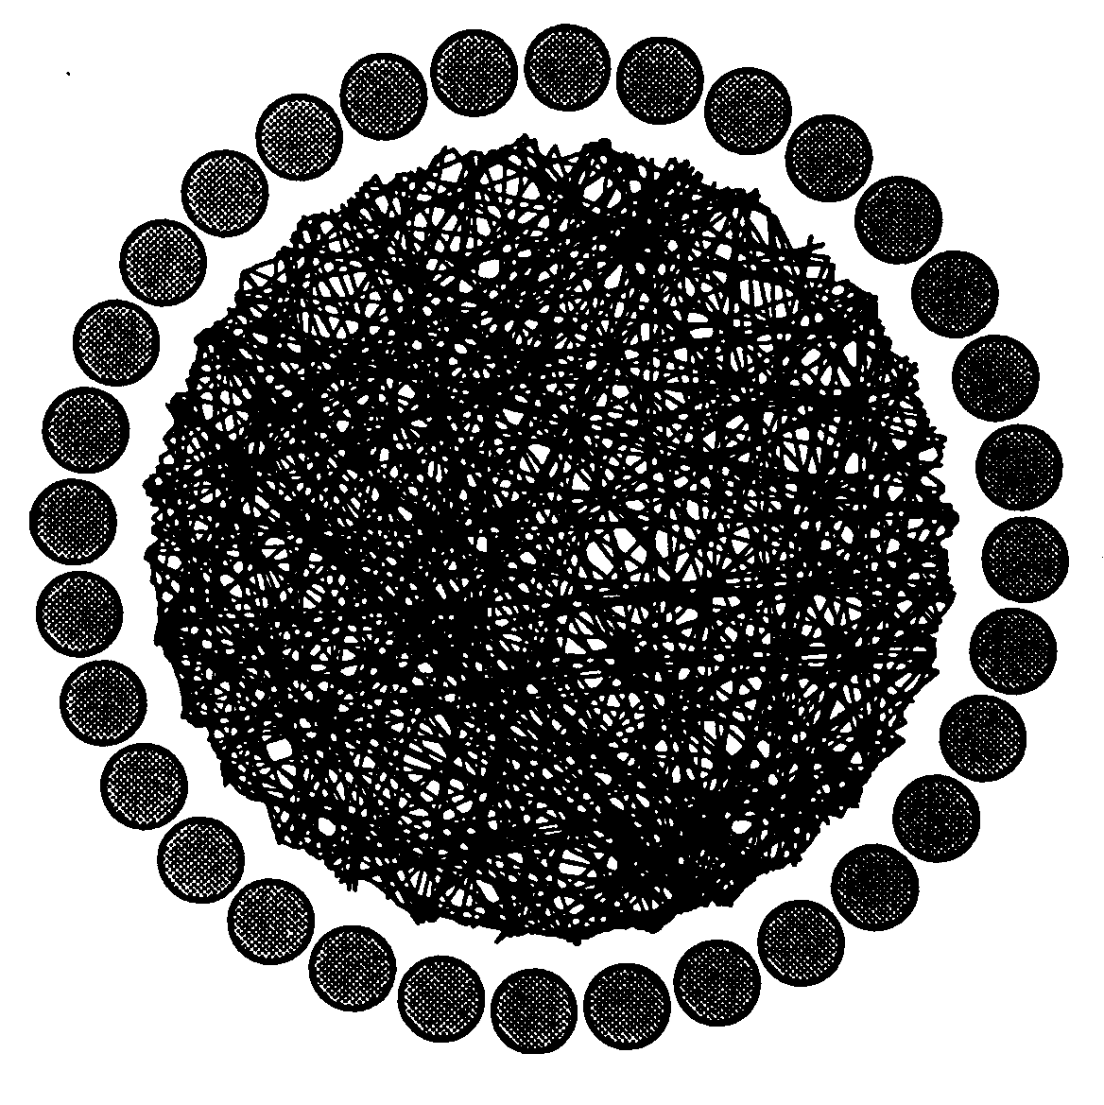
Particle in a smooth/rough circle
From J.M. Haile: MD Simulations

Slide 10
Simple thermodynamic averages: mechanical energy
The kinetic, potential, and total energies might be calculated using the phase functions already seen
Average of kinetic energy
Sum of contribution from individual particle momenta
Average of potential energy
Sum over all pairs, triplets,… depending on the complexity of the potential energy function

Slide 11
Simple thermodynamic averages: virial theorem in the form of “generalized equipartition”

Slide 12
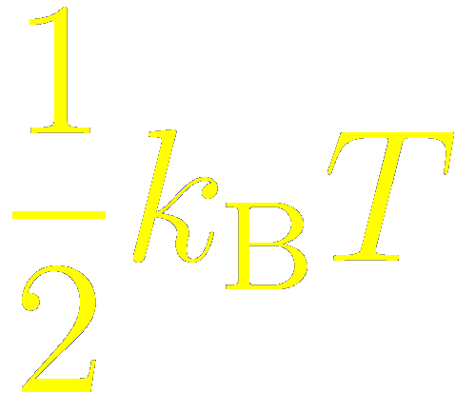
Simple thermodynamic averages: temperature
Applying the previous formula to compute the average kinetic energy in the atomic case
Familiar equipartition energy: an average energy of per degree of freedom

Slide 13
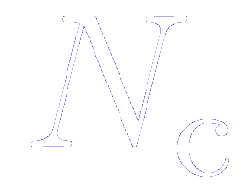
Simple thermodynamic averages: instantaneous temperature
We can define an “instantaneous kinetic energy function” from the momenta of the atoms at a given time step (not averaged)
whose average is equal to
For a system of atoms subject to internal molecular constraints, the number of degrees of freedom will be , where is the total number of independent internal constraints
In we should include the fixed bond lengths, angles, or additional global constraints (on the center of mass motion, for instance)

Slide 14
Simple thermodynamic averages: pressure
Let us assume that we are using Cartesian coordinates, and
we use the Hamilton’s equation of motion

Slide 15
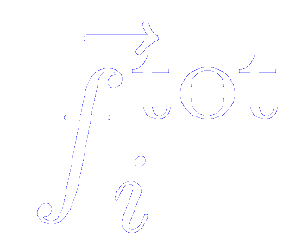
Simple thermodynamic averages: pressure
Let us assume that we are using Cartesian coordinates, and
we use the Hamilton’s equation of motion
represents the sum of internal molecular forces and external forces

Slide 16
Simple thermodynamic averages: pressure
The external forces are related to the external pressure. Considering the effect of the container walls on the system
If we define the “internal virial”, where we now restrict our attention to the intermolecular forces, then
So, finally

Slide 17
Simple thermodynamic averages: instantaneous pressure
As it happened with the temperature, we can define the instantaneous pressure function as
whose average is simply
This definition of the instantaneous pressure is not unique. For instance, for a constant temperature ensemble we can define
Both definitions of the instantaneous pressure give the same when averaged, but their fluctuations in any ensemble would be different
Although the systems simulated we use periodic boundary conditions (and therefore there are no walls), the results are the same

Slide 18
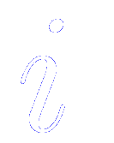
Simple thermodynamic averages: instantaneous pressure
For pairwise interaction, we can express in a form that is explicitly independent of the origin of coordinates
The indices and are equivalent
Newton’s third law is used to switch the force indices
where

Slide 19
Simple thermodynamic averages: instantaneous pressure
In a simulation that uses periodic boundary condition, it is essential to use
where the intermolecular pair virial function
Like is limited by the range of the interactions, and hence should be a well behaved, ensemble-independent function in most cases

Slide 20
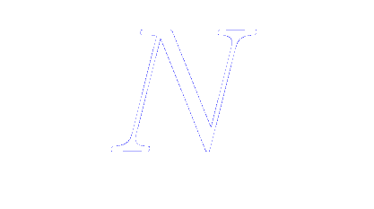
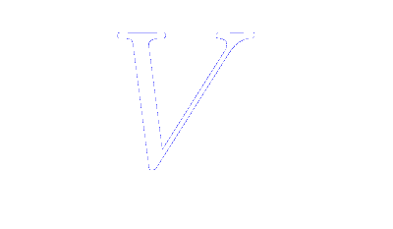
Simple thermodynamic averages: number of molecules and volume
Average number of particles
Average number of particles
Are easily evaluated in the simulation of ensembles in which these quantities vary, and derived functions such as the enthalpy are easily calculated from the above

Slide 21
Constant temperature molecular dynamics: the canonical ensemble
A physical picture of a system corresponding to the canonical ensemble
Involves weak interactions between molecules of the system and the particles of a heat bath at a specific temperature
SYSTEM
T Reservoir
Simulate an “extended system”:
- the real system
- an external (virtual) system, acting as a heat reservoir
The energy is allowed to flow dynamically from the reservoir to the system and back. The heat reservoir controls the temperature of the given system, i. e., the temperature fluctuates around a target value.
The reservoir is simply included by an extra degree of freedom, , with momentum

Slide 22
Constant temperature molecular dynamics: variables of the Nose-Hoover thermostat
SYSTEM
T Reservoir
The heat bath is considered as an integral part of the system by addition of
- an extra degree of freedom,
- an extra mometum,
- a “mass”, , [dimensions: (energy) × (times)²] . This variable controls the rate of temperature fluctuations

Slide 23
Constant temperature molecular dynamics: variables of the Nose-Hoover thermostat: the artificial variable
SYSTEM
T Reservoir
The extra degree of freedom (artificial parameter) s, plays the role of a time scaling parameter.
The time scale in the extended system, , is scaled by the factor s
Virtual time in the extended system
Real time

Slide 24
Constant temperature molecular dynamics: variables of the Nose-Hoover thermostat: the artificial momentum
SYSTEM
T Reservoir
The atomic coordinates are identical in both systems
Atomic coordinates in the extended system
Atomic coordinates in the real system
Momentum in the extended system
Momentum in the real system

Slide 25
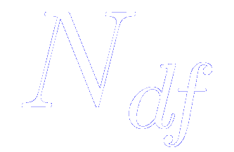
Constant temperature molecular dynamics: variables of the Nose-Hoover thermostat: the extended Lagrangian
The Lagrangian of the extended system is
Kinetic energy minus the potential energy of the real system
Kinetic energy of the thermostat
Extra potential
The extra potential is chosen to ensure that the algorithm produces a canonical ensemble
Numbers of degree of freedom:
3N
3N-3 if the total momentum is fixed
+1 because of the extra degree of freedom of the thermostat

Slide 26
Constant temperature molecular dynamics: the Lagrangian equations for the Nose-Hoover thermostat
The Lagrangian equations of motions are

Slide 27
Constant temperature molecular dynamics: the Lagrangian equations for the Nose-Hoover thermostat
The Lagrangian equations of motions are

Slide 28
Constant temperature molecular dynamics: the Lagrangian equations for the Nose-Hoover thermostat
The Lagrangian equations of motions are
The equations of motion are solved using the standard predictor-corrector method
These equations sample a microcanonical ensemble in the extended system. The extended system Hamiltonian is conserved
However, the energy of the real system is not constant. Accompanying the fluctuations of s, heat transfers occur between the system and a heat bath, which regulate the system temperature.

Slide 29
Constant temperature molecular dynamics: Choice of Q in the Nose-Hoover thermostat
Too high
Too low
Slow energy flow between the system and the reservoir
Long lived weakly damping oscillations of energy occur, resulting in poor equilibration
regain conventional Molecular Dynamics

