Slide 1


Introducción a la asignatura de Computación Avanzada
Grado en Física
Javier Junquera

Slide 2
Datos identificativos de la asignatura

Slide 3

Bibliography:
M. P. Allen and D. J. Tildesley
Computer Simulation of Liquids
Oxford Science Publications
ISBN 0 19 855645 4

Slide 4
How to reach me
Javier Junquera
Ciencias de la Tierra y Física de la Materia Condensada
Facultad de Ciencias, Despacho 3-12
E-mail: javier.junquera@unican.es
URL: http://personales.unican.es/junqueraj
In the web page, you can find:
- The program of the course
- Slides of the different lecture
- The code implementing the simulation of a liquid interacting via a Lennard-Jones potential
Office hours:
- At the end of each lecture
- At any moment, under request by e-mail

Slide 5
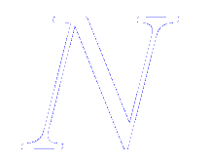


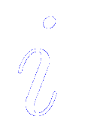
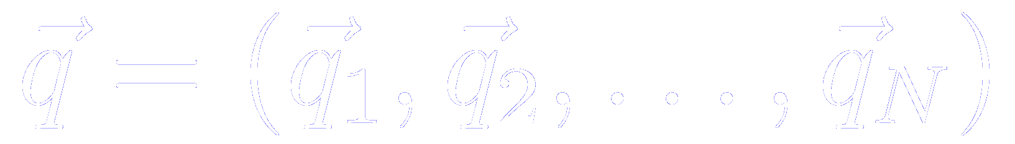

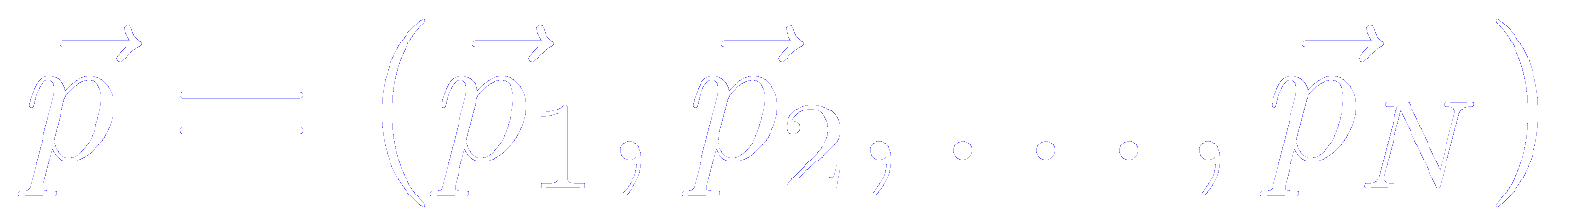


Physical problem to be solved during this course
Given a set of classical particles (atoms or molecules)
whose microscopic state may be specified in terms of:
- positions
- momenta
Note that the classical description has to be adequate. If not we can not specify at the same time the coordinates and momenta of a given molecule
and whose Hamiltonian may be written as the sum of kinetic and potential energy functions of the set of coordinates and momenta of each molecule
Solve numerically in the computer the equations of motion which governs the time evolution of the system and all its mechanical properties

Slide 6
Physical problem to be solved during this course
In particular, we will simulate numerically the evolution with time of
classical particles interacting via a two-body potential
(the Lennard-Jones potential)
Why molecular dynamics?
Why Lennard-Jones potential?
Advantages
It allows to solve time dependent problems:
- Reactions
- Collisions
- Diffusion
- Growth
- Vibrations
- Fractures
- Radiation damage
- …
It is more parallelizable than other methods, such as Monte Carlo techniques
Disadvantages
More complex (differential equations)
Less adaptable
Ergodicity problems
It require forces
Standard two-body effective pair potential
Well known parameters for many elements
Provides reasonable description of closed shells atoms (such as inert gases)

Slide 7


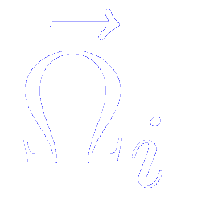

Note about the generalized coordinates
May be simply the set of cartesian coordinates of each atom or nucleus in the system
Sometimes it is more useful to treat the molecule as a rigid body.
In this case, will consist of:
- the Cartesian coordinates of the center of mass of each molecule
- together with a set of variables that specify the molecular orientation
In any case, stands for the appropriate set of conjugate momenta

Slide 8

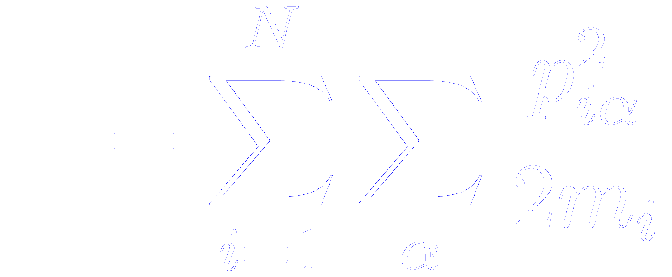
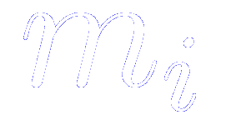

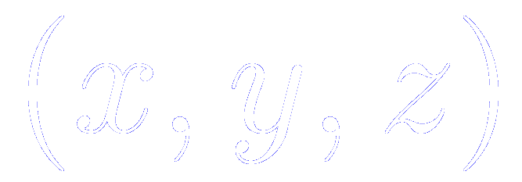

Kinetic and potential energy functions
Usually the kinetic energy takes the form
molecular mass
runs over the different
components of the momentum of the molecule
The potential energy contains the interesting information regarding intermolecular interactions

Slide 9
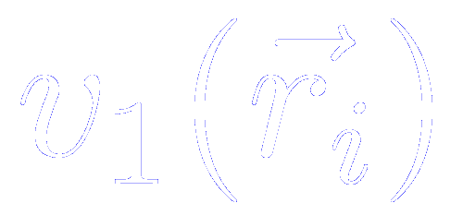
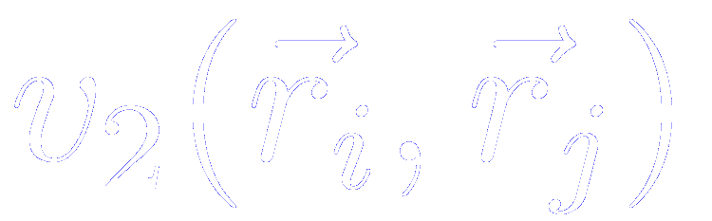
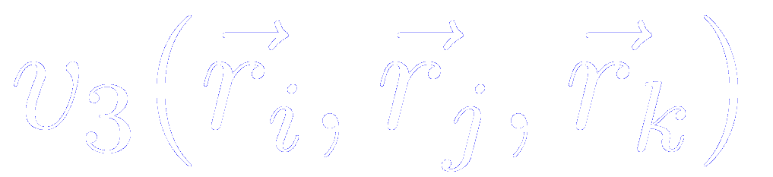
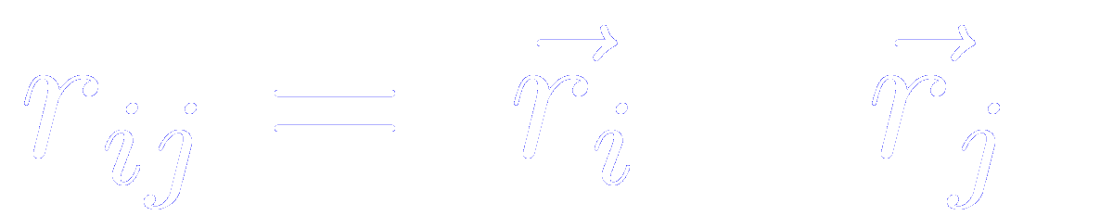
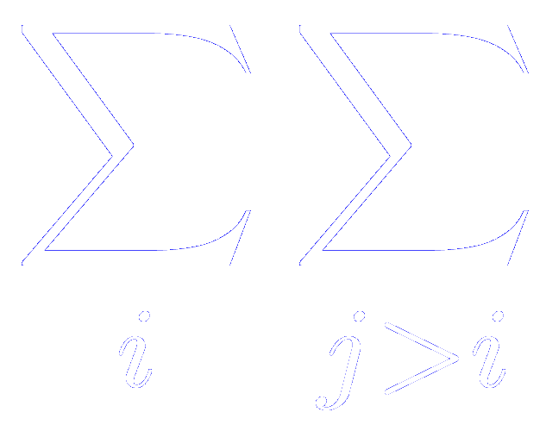
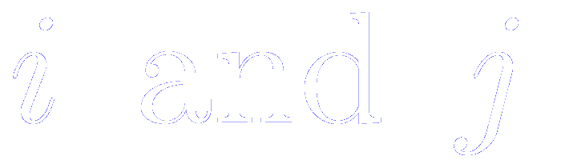
Potential energy function of an atomic system
Consider a system containing atoms.
The potential energy may be divided into terms depending on the coordinates of individual, pairs, triplets, etc.
Expected to be small
One body potential
Particle interactions
One body potential
Represents the effect of an external field (including, for example, the contained walls)
Pair potential
Depends only on the magnitude of the pair separation
Three particle potential
Significant at liquid densities.
Rarely included in computer simulations (very time consuming on a computer)
The notation indicates a summation over all
distinct pairs without containing any pair twice.
The same care must be taken for triplets, etc.

Slide 10
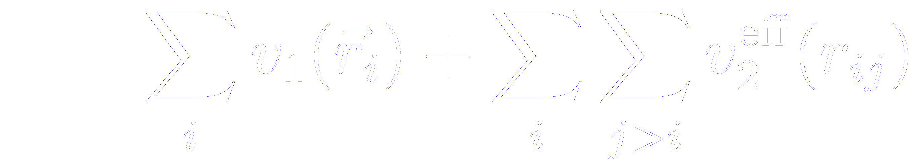
The effective pair potential
The potential energy may be divided into terms depending on the coordinates of individual, pairs, triplets, etc.
The pairwise approximation gives a remarkably good description because the average three body effects can be partially included by defining an “effective” pair potential
The pair potentials appearing in computer simulations are generally to be regarded as effective pair potentials of this kind, representing many-body effects
A consequence of this approximation is that the effective pair potential needed to reproduce experimental data may turn out to depend on the density, temperature, etc. while the true two-body potential does not.

Slide 11
Types of bonds

Slide 12
Types of simulations
What do we want regarding…?
The model:
-Realistic or more approximate
The energy:
-Prevalence of repulsion?
-Bonds are broken?
The scale:
-Atoms?
-Molecules?
-Continuum?

Slide 13
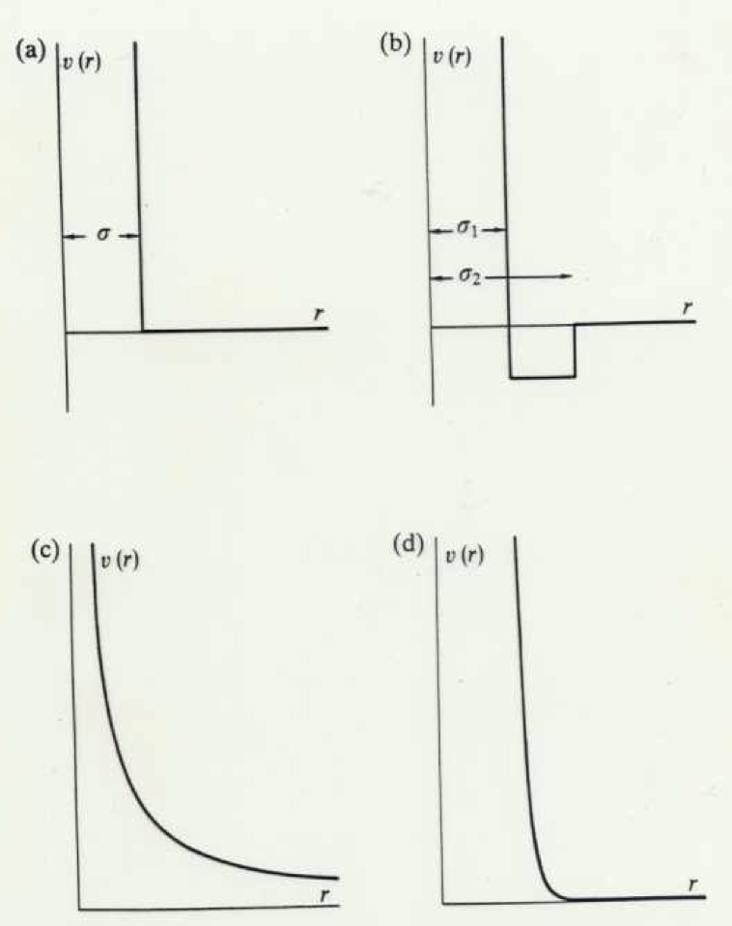
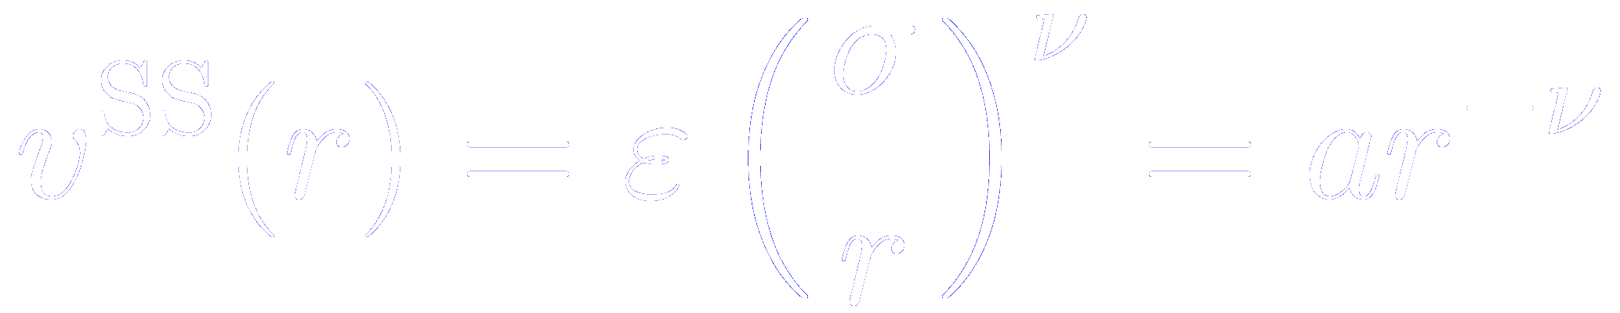
Example of ideal effective pair potentials
Hard-sphere potential
Square-well potential
Discovery of non-trivial phase transitions,
not evident just looking the equations
Soft sphere potential
(ν=1)
Soft sphere potential
(ν=12)
No attractive part
The soft-sphere potential becomes progressively harder as ν increases
No attractive part

Slide 14
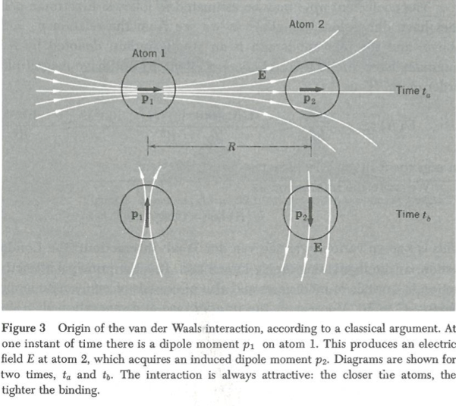
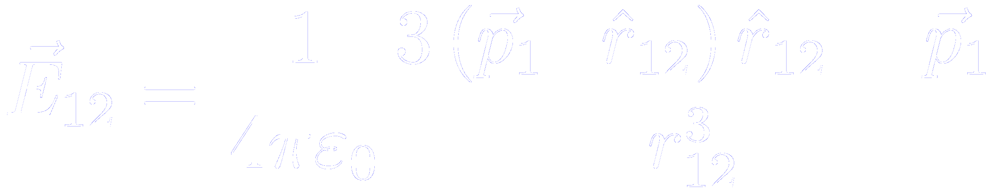
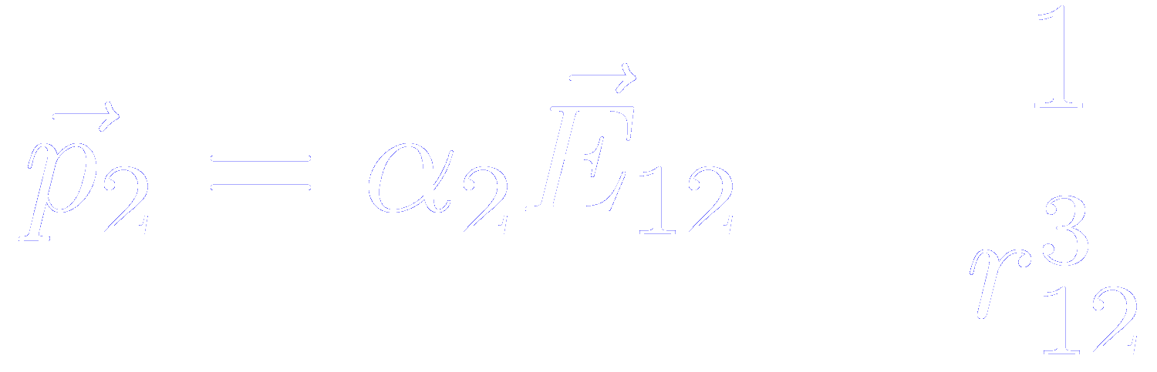
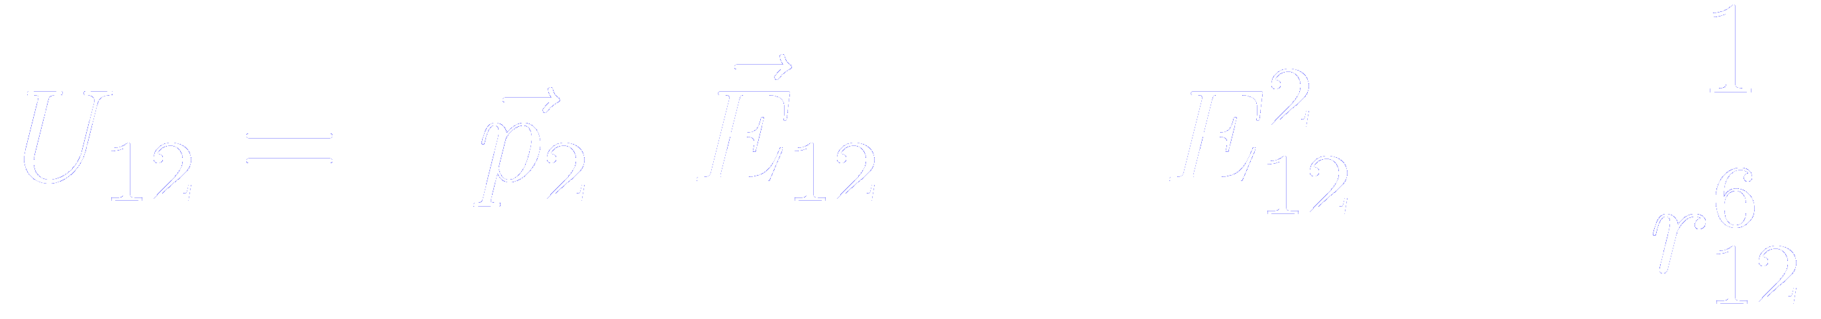
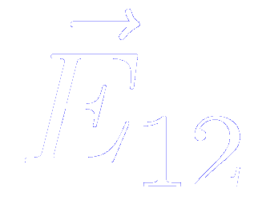
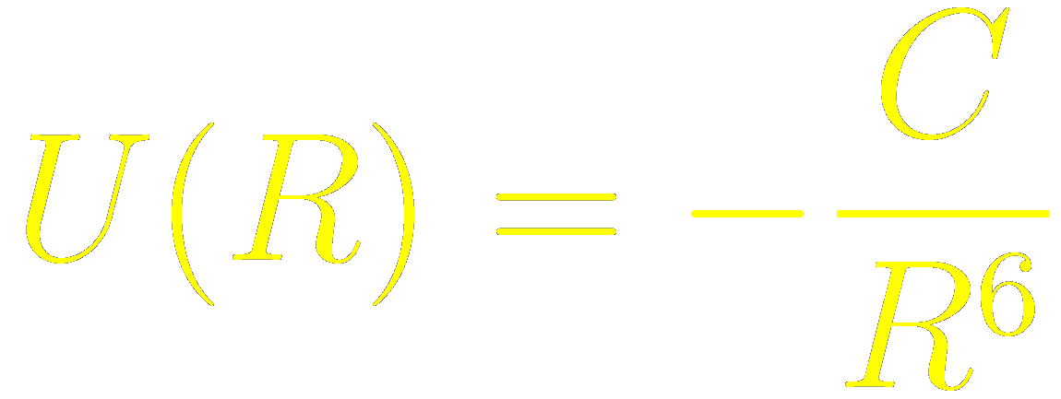
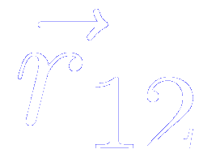

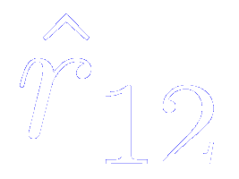
It is useful to divide realistic potentials in separate attractive and repulsive components
Attractive interaction
Van der Waals-London or fluctuating dipole interaction
Classical argument
C. Kittel
Introduction to Solid State Physics (3rd Edition)
John Wiley and sons
Electric field produced by dipole 1 on position 2
Instantaneous dipole induced by this field on 2
Potential energy of the dipole moment
Always attractive
J. D. Jackson
Classical Electrodynamics (Chapter 4)
John Wiley and Sons
Is the unit vector directed from 1 to 2

Slide 15

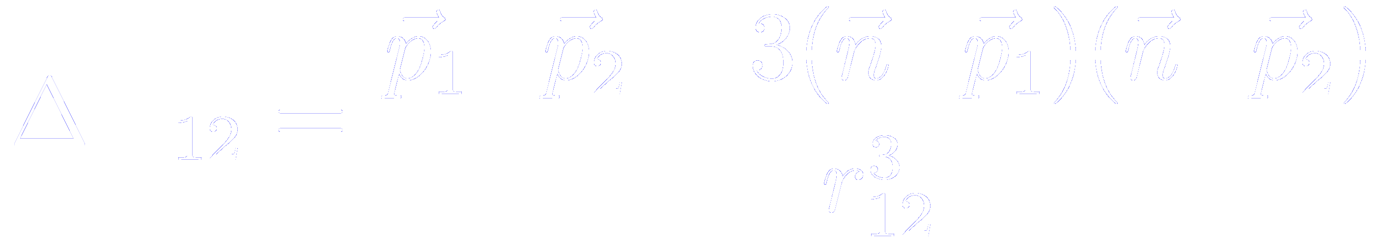

It is useful to divide realistic potentials in separate attractive and repulsive components
Attractive interaction
Van der Waals-London or fluctuating dipole interaction
Quantum argument
Hamiltonian for a system of two interacting oscillators
Where the perturbative term is the dipole-dipole interaction
From first-order perturbation theory, we can compute the change in energy
C. Kittel
Introduction to Solid State Physics (3rd Edition)
John Wiley and sons

Slide 16
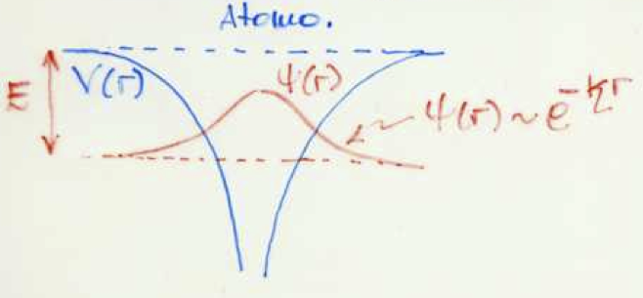
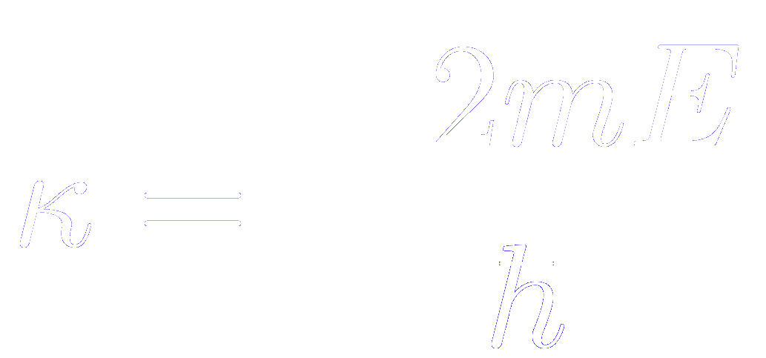
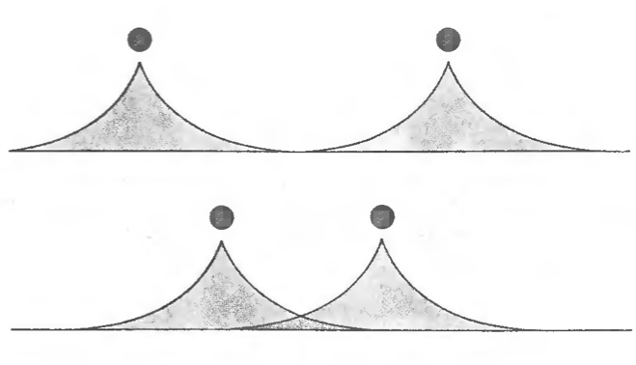
It is useful to divide realistic potentials in separate attractive and repulsive components
Repulsive interaction
As the two atoms are brought together, their charge distribution gradually overlaps, changing the energy of the system.
The overlap energy is repulsive due to the
Pauli exclusion principle:
No two electrons can have all their quantum numbers equal
When the charge of the two atoms overlap there is a tendency for electrons from atom B to occupy in part states of atom A already occupied by electrons of atom A and viceversa.
Electron distribution of atoms with closed shells can overlap only if accompanied by a partial promotion of electrons to higher unoccpied levels
Electron overlap increases the total energy of the system and gives a repulsive contribution to the interaction

Slide 17
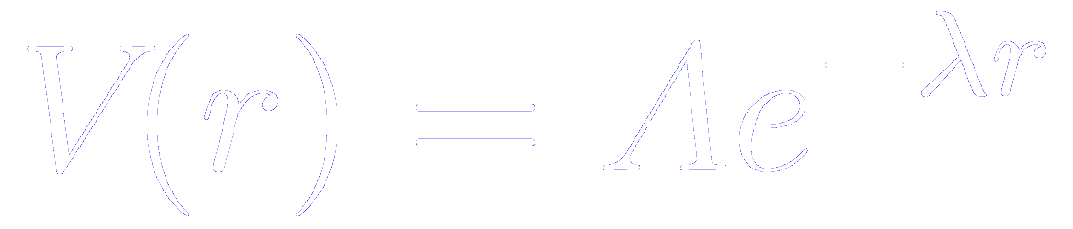
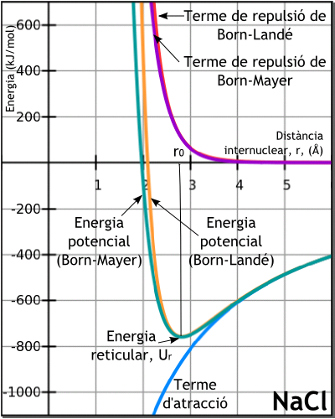
The repulsive interaction is exponential
Born-Mayer potential

Slide 18
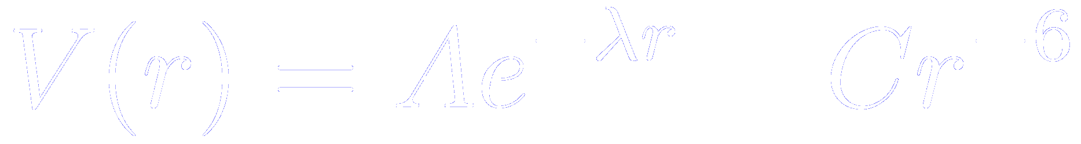
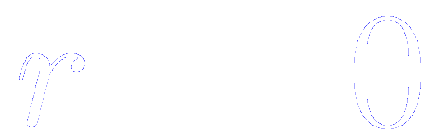
It is useful to divide realistic potentials in separate attractive and repulsive components
Buckingham potential
F. Jensen
Introduction to Computational Chemistry
John Wiley and Sons
Because the exponential term converges to a constant as , while the term diverges, the Buckingham potential “turns over” as becomes small.
This may be problematic when dealing with a structure with very short interatomic distances

Slide 19
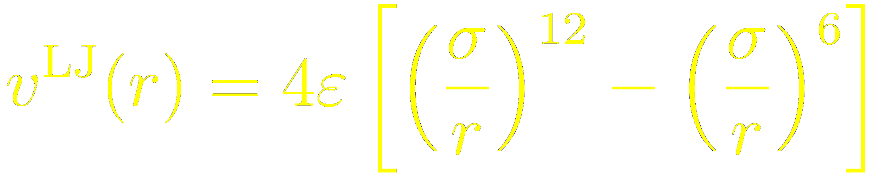
It is useful to divide realistic potentials in separate attractive and repulsive components
Lennard-Jones potential
F. Jensen
Introduction to Computational Chemistry
John Wiley and Sons
The repulsive term has no theoretical justification.
It is used because it approximates the Pauli repulsion well, and is more convenient due to the relative computational efficiency of calculating r¹² as the square of r⁶.

Slide 20
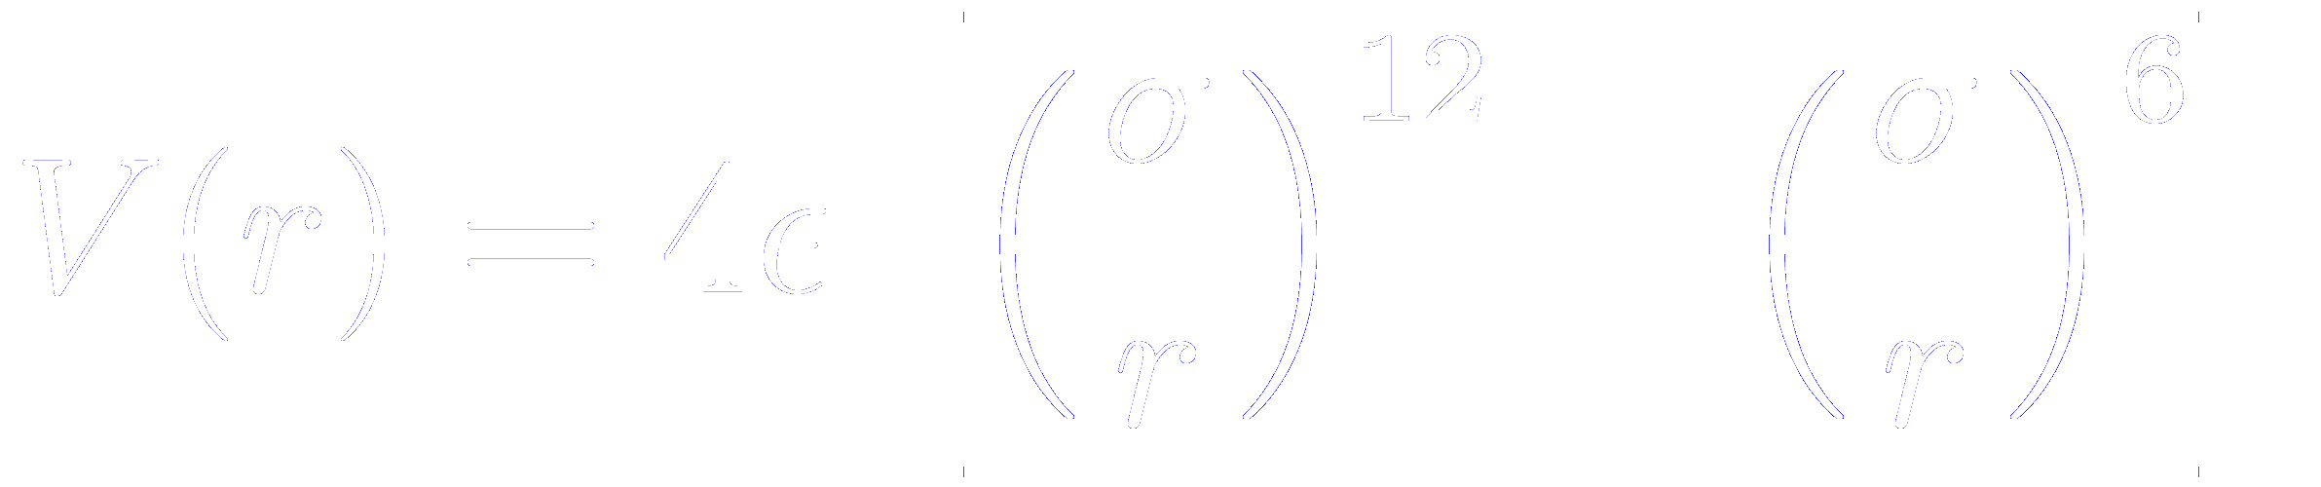
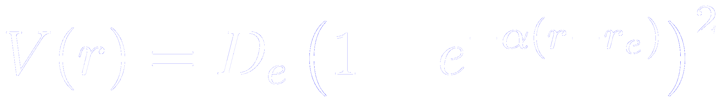
Comparison of effective two body potentials
Buckingham potential
Lennard-Jones
Morse
F. Jensen
Introduction to Computational Chemistry
John Wiley and Sons

Slide 21

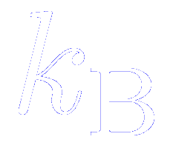
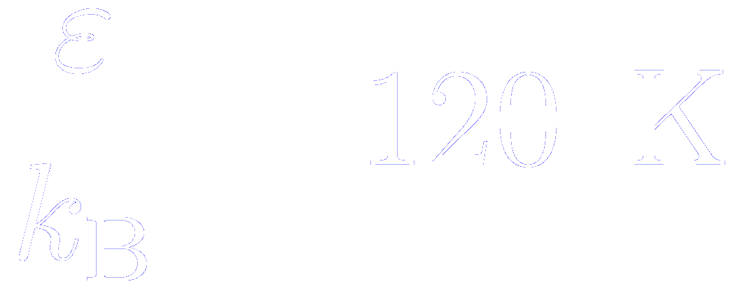
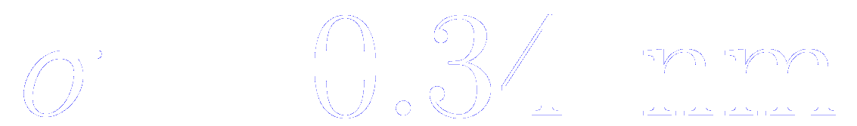
The Lennard-Jones potential
The well depth is often quoted as in units of temperature,
where is the Boltzmann’s constant
For instance, to simulate liquid Argon, reasonable values are:
We must emphasize that these are not the values which would apply to an isolated pair of argon atoms

Slide 22
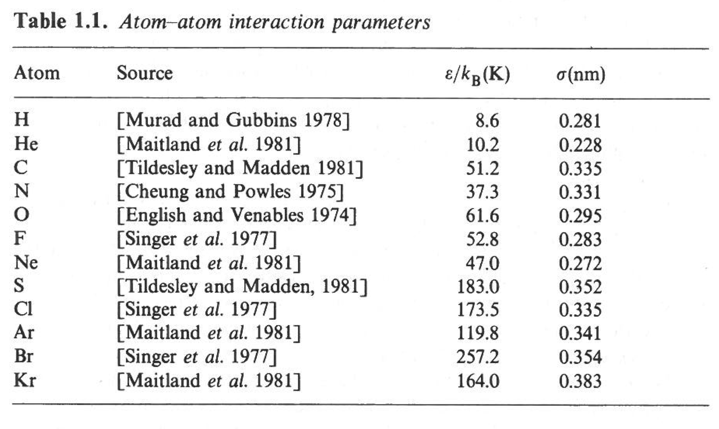
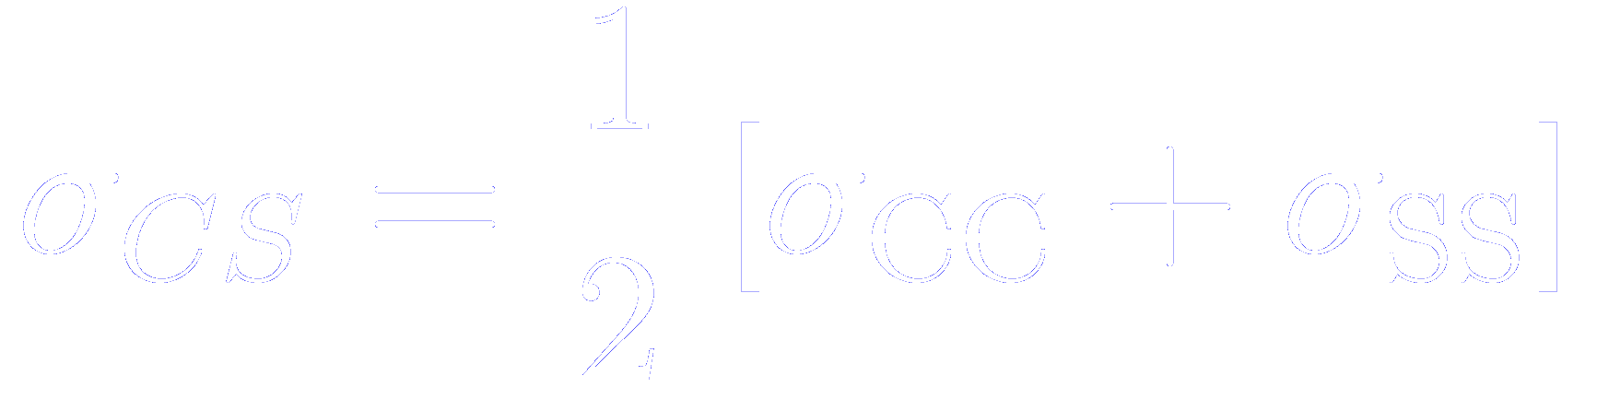

The Lennard-Jones potential
The well depth is often quoted as in units of temperature,
where is the Boltzmann’s constant
Suitable energy and length parameters for interactions between pairs of identical atoms in different molecules
WARNING:
The parameters are not designed to be transferable: the C atom parameters in CS₂ are quite different from the values appropriate to a C in graphite
Interactions between unlike atoms in different molecules can be approximated by the Lorentz-Berthelot mixing rules
(for instance, in CS₂)

Slide 23
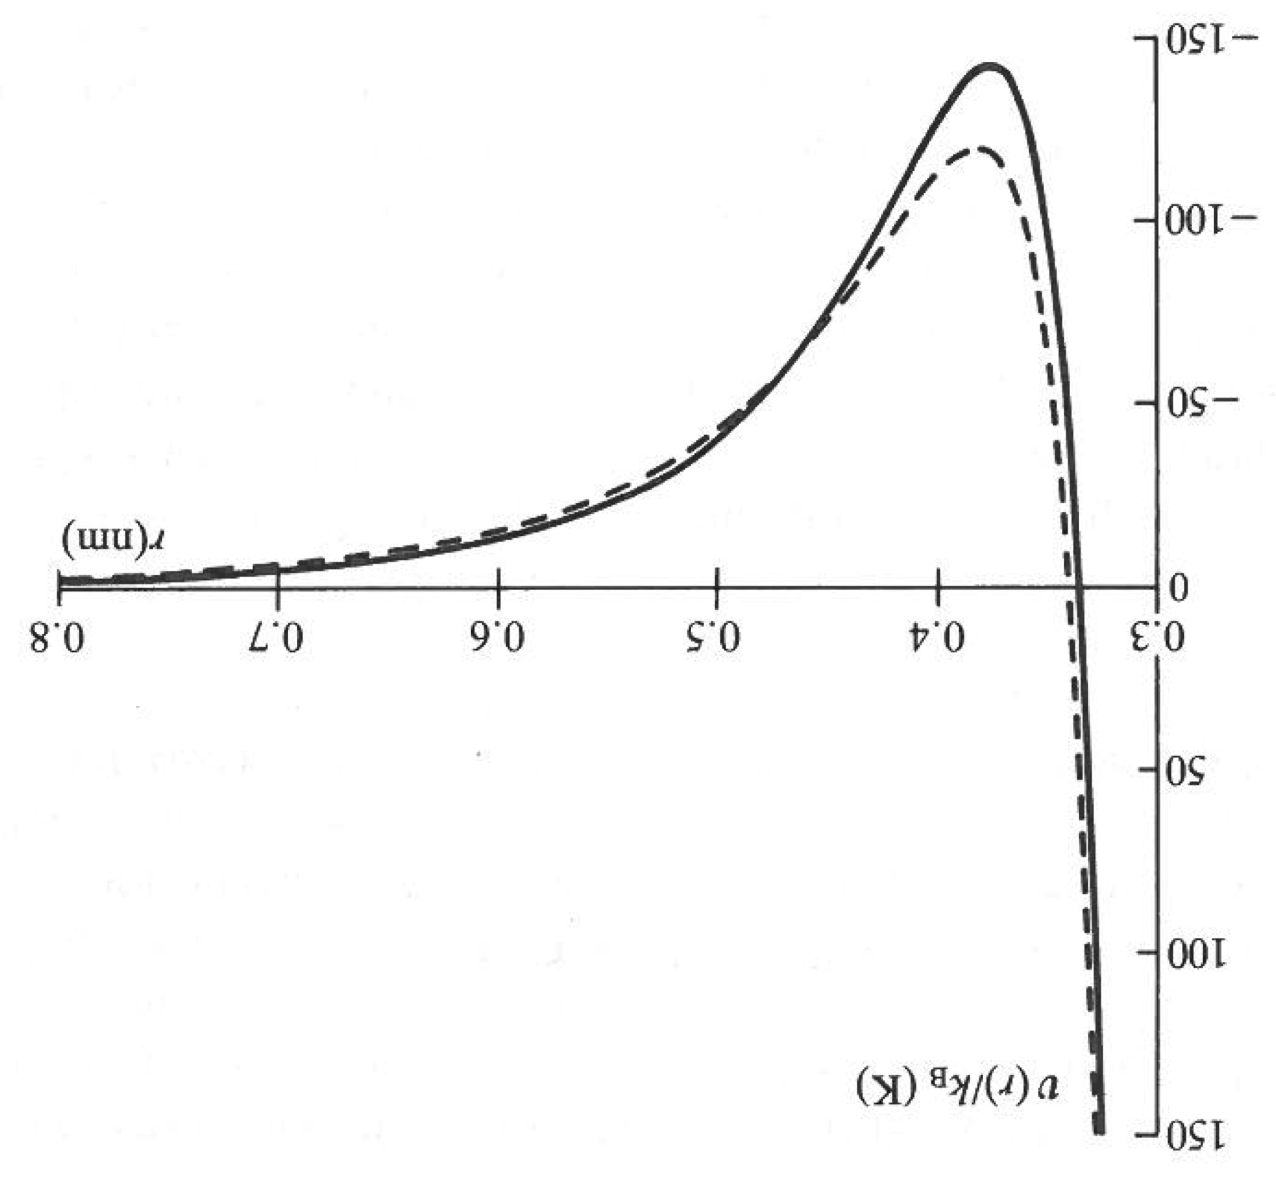
Is realistic the Lennard-Jones potential?
Dashed line: 12-6 effective Lennard-Jones potential for liquid Ar
Solid line: Bobetic-Barker-Maitland-Smith pair potential for liquid Ar (derived after considering a large quantity of experimental data)
Lennard-Jones
Attractive tail at large separations, due to correlation between electron clouds surrounding the atoms.
Responsible for cohesion in condensed phases
Steeply rising repulsive wall at short distances, due to non-bonded overlap between the electron clouds
Optimal

Slide 24
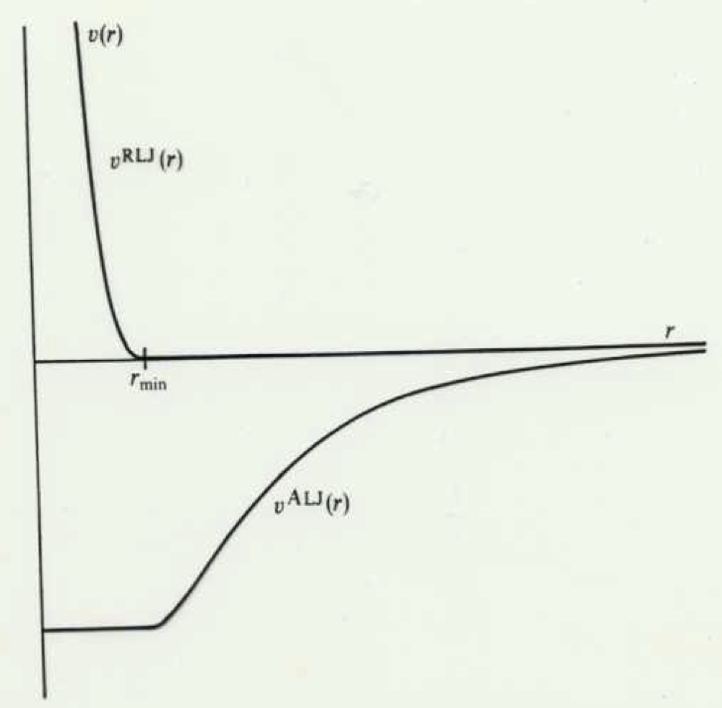
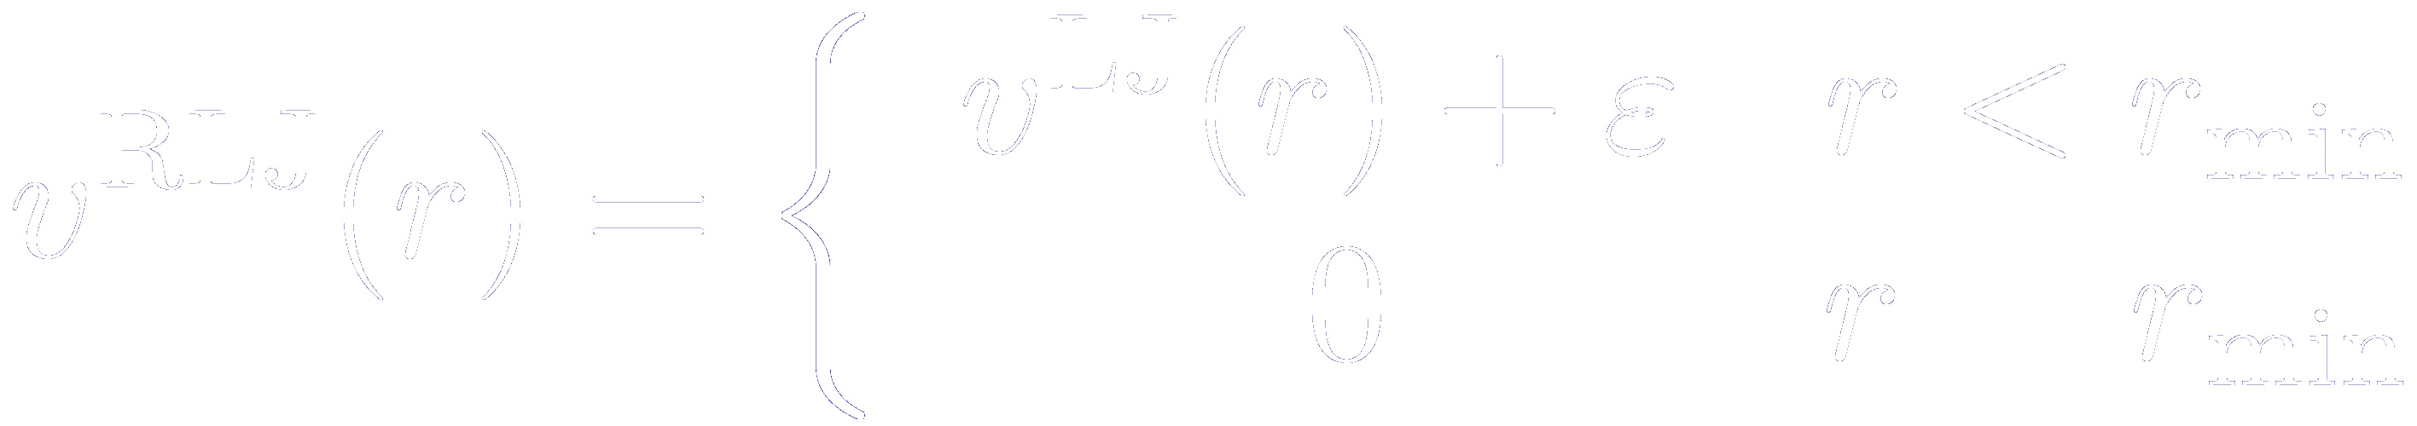
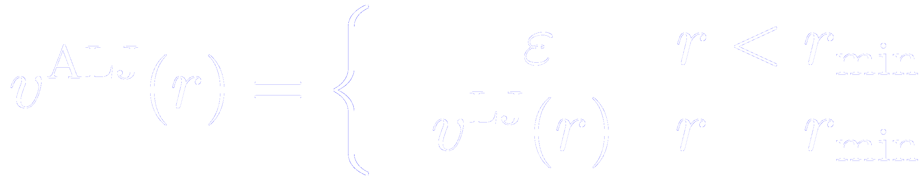
Separation of the Lennard-Jones potential into attractive and repulsive components
Attractive tail at large separations, due to correlation between electron clouds surrounding the atoms.
Responsible for cohesion in condensed phases
Steeply rising repulsive wall at short distances, due to non-bonded overlap between the electron clouds

Slide 25
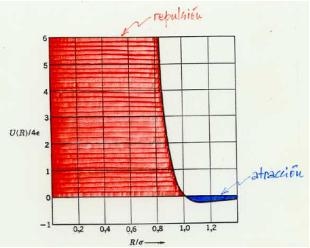
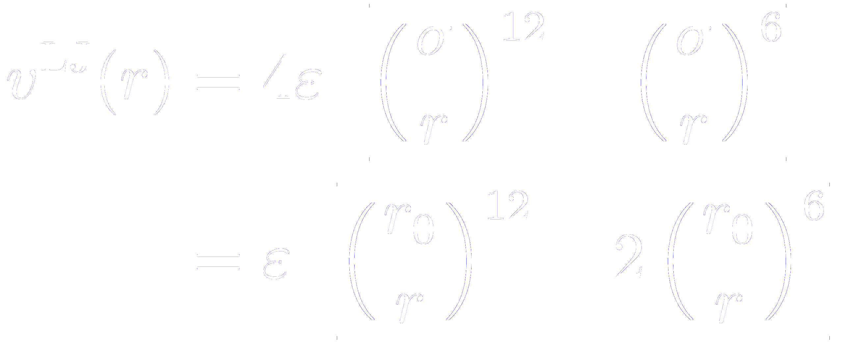
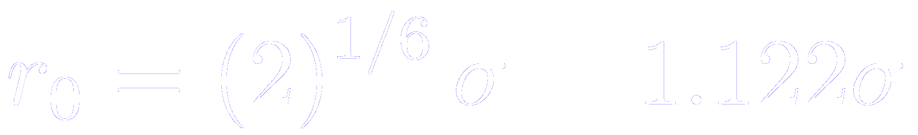
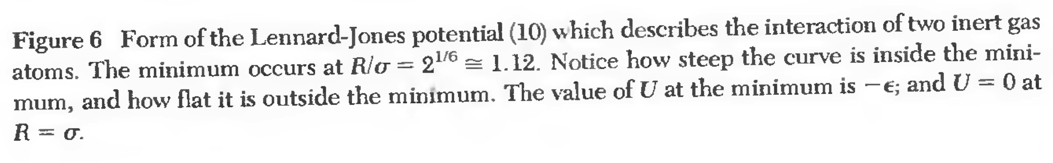
Separation of the Lennard-Jones potential into attractive and repulsive components: energy scales
repulsive
attractive

Slide 26
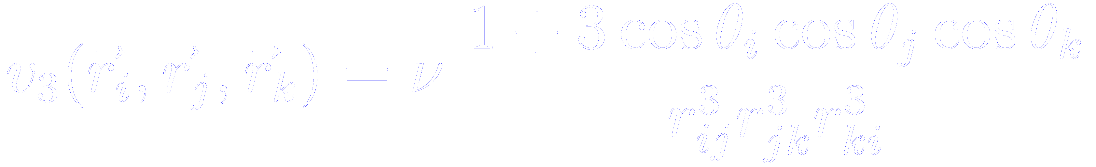
Beyond the two body potential: the Axilrod-Teller potential
Axilrod-Teller potential:
Three body potential that results from a third-order perturbation correction to the attractive Van der Waals-London dipersion interactions

Slide 27




For ions or charged particles, the long range Coulomb interaction has to be added
Where are the charges of ions and , and is the permittivity of free space

Slide 28
How to deal with molecular systems
Solution
Treat the molecule as a rigid or semi-rigid unit with fixed bond-lengths and, sometimes fixed bond and torsion angles
Justification
Bond vibrations are of very high frequency (difficult to handle in classical simulations), but of low amplitude (unimportant for many liquid properties)
A diatomic molecule with a strongly binding interatomic potential energy surface can be simulated by a dum-bell with a rigid interatomic bond

Slide 29








Interaction between nuclei and electronic charge clouds of a pair of molecules
Complicated function if relative positions and and orientations and
Interaction sites: usually centered more or less on the position of the nuclei in the real molecule
Simplified “atom-atom” or “site-site” approach
Pairwise contributions from distinct sites in molecule at position , and site in molecule at position
Nitrogen, Fluorine,… typically considered as two Lennard-Jones atoms separated by fixed bond-lengths
Pair potential acting between and

Slide 30
Incorporate pole multipole moments at the center of charge to improve molecular charge distribution
Might be equal to the known (isolated molecule) variable
or
May be “effective” values chosen to give better description of the thermodynamic properties
Alternative
Use “partial charges” distributed in a “physically reasonable way” around the molecule to reproduce the known multipole moments
Electrostatic part of the interaction between N₂ molecule might be modelled using five partial charges placed along the axis
(first non-vanishing moment: quadrupole)
For methane, a tetrahedral arrangement of partial charges is appropriate
(first non-vanishing moment: octupole)

Slide 31




For large molecules, the complexity can be reduced by fixing some internal degrees of freedom
Model for butane:
CH₃-CH₂-CH₂-CH₃
Represent the molecule as a four-center molecule with fixed bond-lengths and bond-bending angles derived from known experimental data
Whole group of atoms (CH₃ and CH₂) are condensed into spherically symmetric effective “united atoms”
Interaction between such groups may be represented by Lennard-Jones potential with empirically chosen parameters
C₁-C₂, C₂-C₃, and C₃-C₄ bond lengths fixed
Trans-conformer butane
and angles fixed (can be done by constraining the distances C₁-C₃ and C₂-C₄
Gauge conformations
Just one internal degree of freedom is left unconstrained: the rotation about C₂-C₃ (the angle)
For each molecule, an extra term in the potential energy appears in the Hamiltonian

Slide 32




Reduced units
Lennard-Jones parameters:
He:
Ar:
The functional form is the same in both cases.
Only the parameters change
If the simulation for He predicts a phase transition at
The same phase transition will occur for Ar, although at a different temperature
To know these critical points, should we perform two different simulations for essentially the same interatomic potential?

Slide 33


The use of reduced units avoids the possible embarrasement of conducting essentially duplicate simulations
The interatomic potential is completely specified by two parameters:
Take them as fundamental units for energy and length.
Units for other quantities (pressure, time, momentum,…) follow directly
The molecular dynamic simulation is carried out only once.
The transformation from reduced to other units, will be done afterwards, taking into account the real values of

Slide 34
Calculating the potential

Slide 35





Ionic systems: the Born-Mayer potential
Repulsive interaction between electronic clouds
Coulomb attraction
V
Ionic radii
Repulsive, V_{R}
Bonding energy
V(R_{o})
Total, V
Equilibrium distance
R_{o}
Two universal constants
Coulomb, V_{C}
R

Slide 36



Ionic systems: the Born-Mayer potential. Validity of the model
Model adequate only for very ionic molecules.
differs less than 10% from the experimental value for NaCl
In this model, ions are considered spherical
Improvement: consider possible deformations of their charge distributions (polarizabilities)
With these extra polarizability terms, the errors in are smaller than 3%.
+
-
R→∞
+
R
-

Slide 37
Shell model

Slide 38












Shell model: linear chain
Courtesy of Ph. Ghosez,
Troisime Cycle de la Physique en Suisse Romande
Each unit cell of lattice parameter contains two atoms:
One Cation of mass and static charge
One Anion of mass and static charge
The cation is connected to the anion through a string of force constant
The anion core and shell are connected through a spring of force constant
For the cell, the relative displacements of the cation, ion core and ion-shell are respectively
Anion:
Spherical atomic shell of negligible mass and charge coupled to an ione core of charge and mass
Charge neutrality

Slide 39


Shell model
The first force constant allows to describe vibrations around an equilibrium position
These parameters can be fitted to experiment
The second force constant, that accounts for the polarizability of the electronic cloud, acknowledges the internal structure of the atom
ABO₃ perovskite

Slide 40








Covalent model without bond breaking
Morse potential
Bond stretching
Harmonic potential
Bond bending
Bond torsion
Van der Waals
Hydrogen bridge
Electrostatic

